Slide 1
Virtual Labs for Biology
Bob Desharnais
Cal State LA
June 22, 2020
Support provided by the U.S. National Science Foundation
and the California State University Chancellor’s Office

Slide 2
Outline
Example of a virtual lab: FlyLab JS
Advantages & disadvantages of virtual labs
Case study: GE Biology

Slide 3
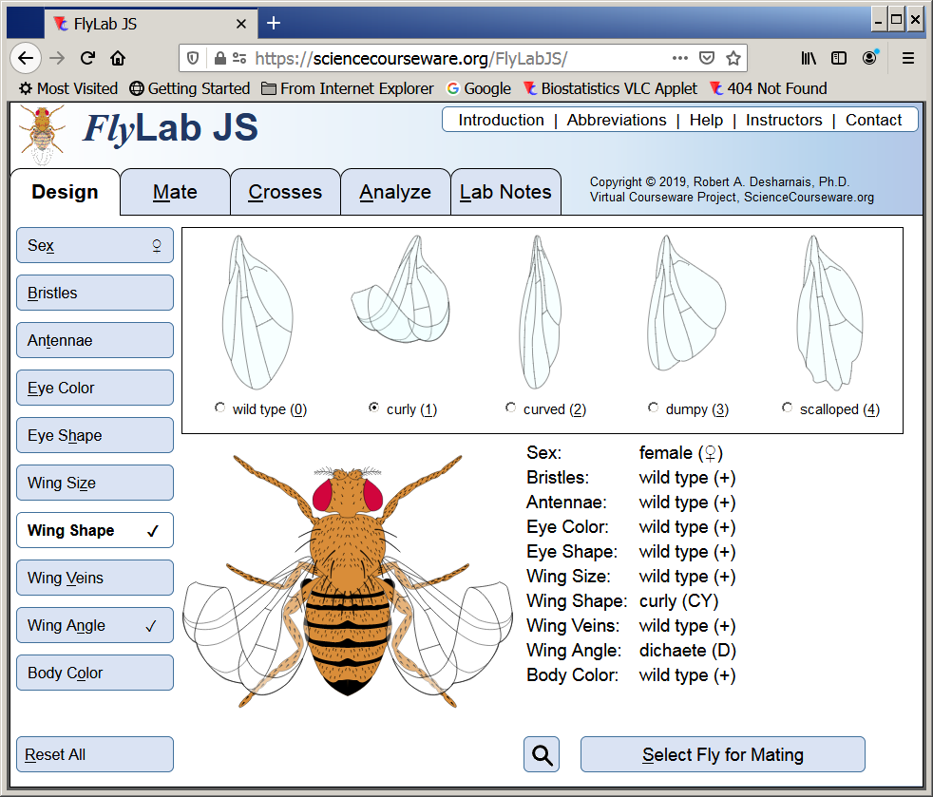
Example of a Virtual Lab: FlyLab JS
ScienceCourseware.org/FlyLabJS

Slide 4
Advantages and Disadvantages of Virtual Labs
Advantages
  Add opportunities for inquiry-based learning
  Address difficult lab topics (e.g. evolution)
  Allow students to learn from mistakes
  Better engage students
  Improved convenience (e.g. 24/7 access)
Disadvantages
  Doesn’t allow for learning lab skills (esp. majors)
  Oversimplification of reality
  Group interactions are more difficult

Slide 5
Case Study: GE Biology
BIOL 155 − Animal Biology
Three delivery models
  Traditional wet labs (8 sect)
  All online virtual labs & drop-in help (8 sect)
  Hybrid in-person/online virtual labs (16 sect)
Assessment
  Analysis of course grades
  Pre/post attitude surveys

Slide 6
Assessment: Course Grades

Slide 7
Assessment: Survey of Attitudes

Slide 8
Wet
Online
Hybrid
Son, J.Y., Narguizian, P., Beltz, D., and Desharnais, R.A. 2016. Comparing physical, virtual, and hybrid flipped labs for general education biology. Online Learning Journal 20: 228–243.

Slide 9
Questions?

