Slide 1
California State University Long Beach
Thematic Pathway for Reaffirmation of Accreditation Review
October 3, 2018
Lori Williams, PhD, Vice President & Staff Liaison
WASC Senior College & University Commission
lwilliams@wscuc.org
510-748-0371

Slide 2
Presentation Agenda
Overview of WSCUC regional accreditation
Changing Context of Higher Education
2013 WSCUC Standards and Criteria for Review
Thematic pathway for reaffirmation (TPR) of accreditation institutional review process
The TPR institutional self-study and report
Commission action
Tools and resources

Slide 3
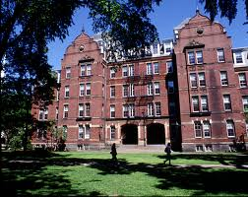
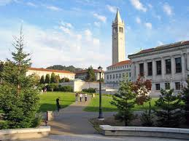
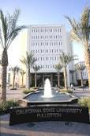
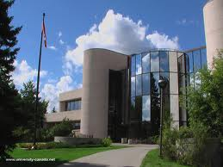
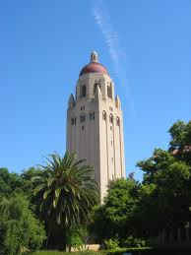
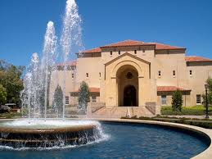

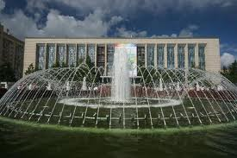
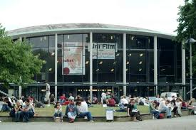
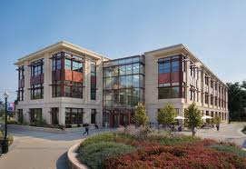

WSCUC Institutions
Public, Private
Non-profit, For profit
On ground, Online
Secular, Faith based
General, Specialized
Large, Small
Old, New

Slide 4
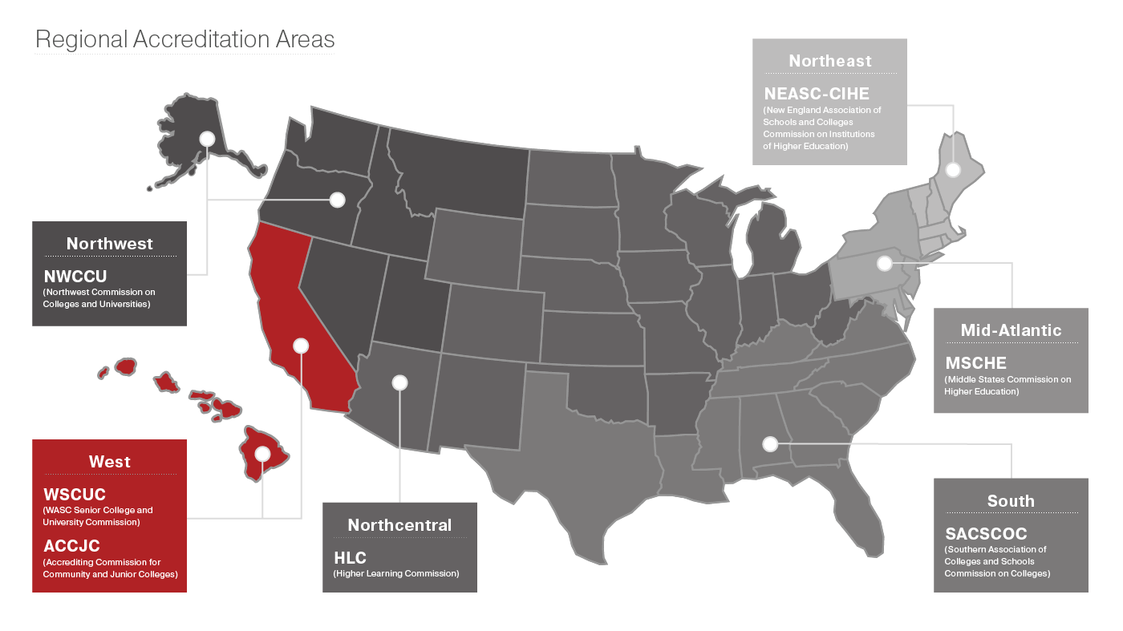
Summary of WSCUC Institutions
196 accredited institutions
~ 1,300,000 students
Variety of missions, programs and institutional types

Slide 5
WSCUC Institutions by Category
196 Accredited Institutions
27 for-profit (13.8%)
125 non-profit (63.8%)
44 public (22.4%)
11 Candidate (already had at least one Seeking Accreditation Visit)
3 for-profit (27%)
8 non-profit (73%)
21 Eligible
6 for-profit (29%)
15 non-profit (71%)
15 Applied
9 for-profit (60%)
6 non-profit (40%)
196 accredited, 11 candidate, and 21 eligible institutions = 228 total institutions
Total number of institutions including applied = 244
243 Total Institutions
  Compared to August 2010 –
  161 Accredited (1 For Profit)
  20 Eligibility and Candidacy
  181 Total Institutions

Slide 6
Characteristics of Regional Accreditation
Non-governmental
Recognition of quality
Accreditation of entire institution
Trained peer reviewers

Slide 7
Core Values of Regional Accreditation
Institutional Autonomy
Institutional Diversity
Academic Freedom
Shared Governance
Student Success

Slide 8
Strengths of Regional Accreditation
Recognized signal of quality: By using agreed-upon standards and review processes, based on quality principles, it carries great credibility
Opportunity for self-improvement: Provides both quality assurance (QA) to the public and urges continuous quality improvement (CQI) to the institution
Learning across institutions: Creation of a “learning community” among educators
Alternative to government regulation: Avoiding the political interventions and government bureaucracies of a federal agency
Transfer of credit: Ease of transferring credits between institutions

Slide 9
Presentation Agenda
Overview of WSCUC regional accreditation
Changing Context of Higher Education
2013 WSCUC Standards and Criteria for Review
Thematic pathway for reaffirmation (TPR) of accreditation institutional review process
The TPR institutional self-study and report
Commission action
Tools and resources

Slide 10
Changing Context for Accreditation
Greatly increased expectations for institutional accountability and consumer protection
Demands for improved academic standards and student performance (as measured by retention, graduation rates and post-graduation job placement)
New fiscal realities making cost-effectiveness a paramount issue for WSCUC and its constituents
Calls for risk-based assessment, for both low-risk and high-risk institutions
Notes:
Added final bullet to previous reaff version

Slide 11
Challenges for Higher Education and Accreditation
Low graduation rates
High student debt/high default rates
Difficulty in transferring credits
Dissatisfaction with quality of undergraduate education/low levels of learning
Rapid growth of online education
Practices of the for-profit industry
Increased federal regulation
Concern about the value of higher ed
Notes:
Added final bullet to previous reaff version

Slide 12
Challenges for Higher Education and Accreditation - continued
Changing demographics, including older, working, more diverse students
Swirl: majority of students attend more than one institution
Open source and Do-It-Yourselfers (DIY)
Momentum for competency-based programs
Shrinking support for public universities and trend to privatization
Strong consumer demand for degrees leading to jobs

Slide 13
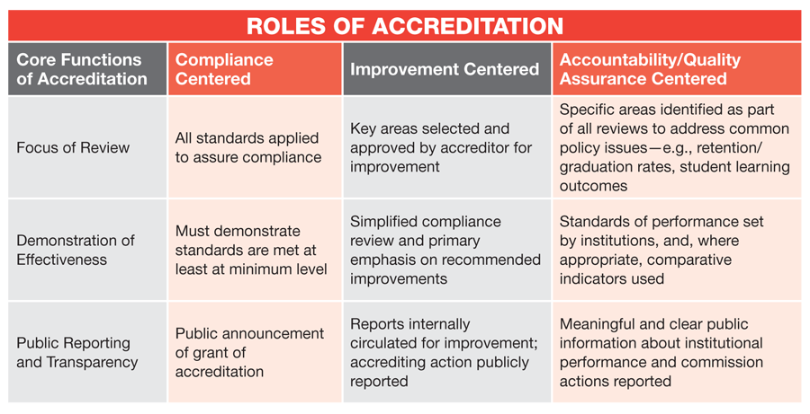
How Accreditation has Evolved

Slide 14
Presentation Agenda
Overview of WSCUC regional accreditation
Changing Context of Higher Education
2013 WSCUC Standards and Criteria for Review
Thematic pathway for reaffirmation (TPR) of accreditation institutional review process
The TPR institutional self-study and report
Commission action
Tools and resources

Slide 15
2013 Core Commitments and Standards of Accreditation
Three Core Commitments
Four Standards
  Criteria for Review (CFR)
  Guidelines

Slide 16
2013 Core Commitments
Student Learning and Success
Quality and Improvement
Institutional Integrity, Sustainability, and Accountability

Slide 17
Core Commitment:
Student Learning and Success
“Institutions have clear educational goals and student learning outcomes….Institutions support the success of all students and seek to understand and improve student success.”

Slide 18
Core Commitment:
Quality and Improvement
“Institutions are committed to high standards of quality in all of their educational activities…. Institutions demonstrate the capacity to fulfill their current commitments and future needs and opportunities.”

Slide 19
Core Commitment:
Institutional Integrity, Sustainability, and Accountability
“…Institutions engage in sound business practices, demonstrate institutional integrity, operate in a transparent manner, and adapt to changing conditions.”

Slide 20
2013 Standards of Accreditation
          Standard 1
          Standard 2
          Standard 3
          Standard 4

Slide 21
Standard 1:
Defining Institutional Purposes and Ensuring Educational Objectives
Institutional Purpose
Integrity and Transparency
Standard 2:
Achieving Educational Objectives Through Core Functions
Teaching and Learning
Scholarship and Creative Activity
Student Learning and Success

Slide 22
Standard 3:
Developing and Applying Resources and Organizational Structures to Ensure Quality and Sustainability
Faculty and Staff
Fiscal, Physical, and Information Resources
Organizational Structures and Decision-making Processes
Standard 4:
Creating an Organization Committed to Quality Assurance, Institutional Learning, and Improvement
Quality Assurance Processes
Institutional Learning and Improvement

Slide 23
Criteria for Review (CFR)
Provide statements about the meaning of the Standard
Are cited by institutions in their report, by teams in evaluating institutions, and by the Commission in making decisions

Slide 24
Guidelines
Offer examples of how an institution can address a particular CFR
Are not requirements or mandatory

Slide 25
Presentation Agenda
Overview of WSCUC regional accreditation
Changing Context of Higher Education
2013 WSCUC Standards and Criteria for Review
Thematic pathway for reaffirmation (TPR) of accreditation institutional review process
The TPR institutional self-study and report
Commission action
Tools and resources

Slide 26
Description of TPR
A review process for reaffirmation that is an alternative to the process described in the 2013 Handbook of Accreditation
Institutions provide evidence of compliance with the Standards and federal requirements and address one or more self-selected themes to demonstrate educational effectiveness

Slide 27
Eligibility for TPR
Institutions show consistent evidence of:
  Healthy fiscal condition
  Strong student achievement indicators
  Sustained quality performance
Process
  Institutions invited to apply for TPR indicate their interest
  WSCUC staff conducts eligibility review looking at 30 criteria
  Commission makes final determination of eligibility for TPR

Slide 28
Eligible Institutions for TPR
Cohort 1
  California Institute of Technology
  California State University at Long Beach
  Loma Linda University
  Naval Postgraduate School
  Pardee RAND Graduate School
  Ponoma College
  Samuel Merritt University
  Soka University of America
  University of California, San Francisco

Slide 29
Eligible Institutions for TPR
Cohort 2
  Azusa Pacific University
  California Institute of the Arts
  California State University, Northridge
  Claremont McKenna College
  Harvey Mudd College
  Occidental College
  Pepperdine University
  University of Hawaii, Manoa
  University of San Diego
  University of Southern California
  Whittier College
  California Polytechnic State University, San Luis Obispo

Slide 30
Key Elements of TPR Review
Approval of TPR in place of usual Institutional Review Process (IRP)
Identification of themes
Institutional self-study and report
  Four components (1, 2, 8, 9 of usual components)
  “Compliance with WSCUC Standards and Federal Requirements Worksheet and Forms”
  “Inventory of Educational Effectiveness Indicators”
Institutional review process
  Accreditation Visit
  Team report (posted on WSCUC website)
Commission action (posted on WSCUC website)
Notes:
Revised from previous version – CWSFRWF replaces RUTS

Slide 31
The Schedule for the CSU Long Beach Review:
Institutional report due – FALL 2020
Accreditation Visit – SPRING 2021
Notes:
Exact date TBD

Slide 32
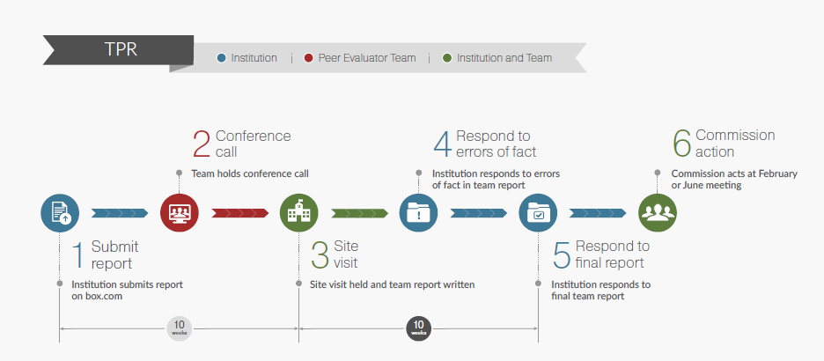
Timelines
Notes:
Here is the overall timeline from the time an institution submits its self study report.

Slide 33
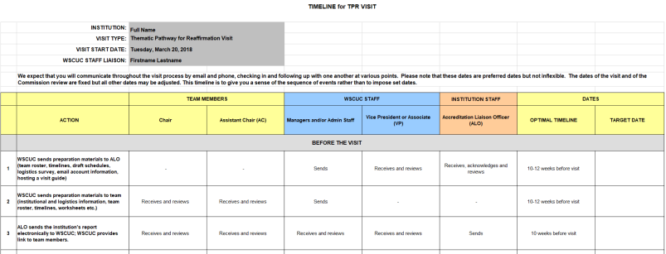
Timelines
Notes:
Please also see the longer, more detailed timeline, which will be updated for your institution. This is just a sample screen shot.

Slide 34
Themes
Can identify one or more themes
May choose multiple sub-themes
Connect to Standards and Core Commitments
Sample themes distributed in TPR Guidelines for Submission of Themes

Slide 35
Examples of Cohort 1 (Pioneer)Themes
Core Curriculum/Competencies
Academic and Co-Curricular Support Structures
Inclusive Excellence
Public Good
Intellectual Achievement
Strategic Planning
Graduate Education Excellence
Integrated and Interdisciplinary Learning Environment
Expanding Experiential Learning
Equity and Inclusion
Liberal Arts in the 21st Century
Student Success
Balancing Growth and Mission
Alumni Career Outcomes
Notes:
These are example themes from the first cohort. Not inclusive. Don’t need to choose from this list.

Slide 36
Examples of Themes
Potential Sources or Examples of Themes:
  Meaning, quality and integrity of degrees
  Assessing students’ core competencies and standards of performance at graduation
  Student success and achievement
  Quality assurance
  Use of data and evidence for decision-making
  Responding to a changing higher education environment
  Strategic planning
  Resource generation and allocation
Notes:
These are sample themes distributed in TPR Guidelines for Themes. Not inclusive. Don’t need to choose from this list. Include more from pioneer group?

Slide 37
Examples of Themes (continued)
Curriculum
  Revising general education or the core curriculum
  Incorporating experiential learning/learning by doing/service learning/capstone courses into the curriculum
  Expanding interdisciplinary learning
  Adding undergraduate research opportunities into the curriculum
  Promoting global awareness and intentional international engagement
  Enhancing writing across the curriculum
  Evaluating and strengthening the majors
Diversity, Equity, Inclusion
  Diversifying leadership, staff, faculty and board
  Closing disparities in student achievement
  Strengthening support programs
Notes:
These are sample themes distributed in TPR Guidelines for Themes. Not inclusive. Don’t need to choose from this list.

Slide 38
Examples of Themes (continued)
Faculty
  Promoting faculty engagement
  Increasing responsiveness to student learners
Institutional Culture
  Strengthening the culture of assessment
  Infusing assessment results to support strategic planning and continuous improvement
  Improving institutional effectiveness and data systems
  Integrating planning, program review and budgeting
Notes:
These are sample themes distributed in TPR Guidelines for Themes. Not inclusive. Don’t need to choose from this list.

Slide 39
The Institutional Report
Has the institution responded to previous Commission actions?
Has the institution responded to the four components?
Has it collected and analyzed data effectively?
Are its conclusions supported by evidence?
What are the strengths of the institution?
Are there problems or potential areas of noncompliance?
Does the report contain recommendations for further institutional action?

Slide 40
The TPR Visit
Exact date set 12-18 months before visit
Team comes to campus for three days
Team report and confidential recommendation sent to WSCUC Commission
Notes:
Give an example, so if the visit date is Fall 2020, the institution should expect to hear from WSCUC staff Spring 2019 to Fall 2019.

Slide 41
TPR Teams
4-6 peer evaluators on a team
Normal evaluator selection process as other review types
Peer evaluators will be trained using TPR Evaluator Guide and flipped classroom training
Notes:
For Fall 2020, no experienced TPR reviewers yet, but in future teams will be created to include experienced reviewers, including those who experienced TPR themselves in previous years.

Slide 42
Presentation Agenda
Overview of WSCUC regional accreditation
Changing Context of Higher Education
2013 WSCUC Standards and Criteria for Review
Thematic pathway for reaffirmation (TPR) of accreditation institutional review process
The TPR institutional self-study and report
Commission action
Tools and resources

Slide 43
The Institutional Report
REFLECT AND RESEARCH BEFORE YOU WRITE
(Compliance with WSCUC Standards and Federal Requirements Worksheet and Forms )

Slide 44
TPR Self-Study and Report
Institutional self-study and report
  Four components: 1, 2, 8 & 9
  Compliance with WSCUC Standards and Federal Requirements Worksheet and Forms
  Inventory of Educational Effectiveness Indicators
Institutional review process
  TPR Accreditation Visit
  Team report (posted on WSCUC website)
Commission action (posted on WSCUC website)

Slide 45
The Institutional Report
  Write the four components as outlined
  You are not expected to respond to prompts literally
  Define (discuss), measure (assess), analyze, act (plan)
  Be self-reflective

Slide 46
Institutional Report: Four Components
Introduction: Institutional context
Compliance
Meaning, Quality, Integrity of Degree
Educational Quality
Student Success
Quality Assurance
Sustainability
Institution-Specific Theme(s)
Conclusion

Slide 47
TPR Institutional Report
Introduction: Institutional context
Compliance
Institution-Specific Themes
Conclusion

Slide 48
Institutional Report Component 1: Introduction: Context, Response to Previous Commission Actions
Addresses history, mission, core constituencies, recent changes
Gives reviewers a picture of the institution’s distinctive character
Responds to issues identified in previous Commission action letters
Use the prompts as discussion-starters for the institution
Notes:
Please use the prompts as prompts and not as literal questions to be answered.

Slide 49
Institutional Report Component 1:
Previous Commission Actions for CSULB
2018 Progress Report Recommendations:
    Define student success
    Specific initiative examples that promote student success and learning
2016 Interim Report Recommendations:
    Review and improve consistency of learning outcomes assessment measures
    Reduce gap in retention and graduation rates among minority students
2012 CAL Recommendations:
    Demonstrate explicit expectations for student achievement
    Continue to prepare for future (budget)
2012 First Doctoral Degree Recommendations:
    Continue work to strengthen graduate culture

Slide 50
Institutional Report Component 2: Compliance with Standards
  “Compliance with WSCUC Standards and Federal Requirements Worksheet and Forms”
  Four Department of Education requirements:
    Credit hour and program length review
    Marketing and recruitment review
    Student complaints review
    Transfer credit review
  “Inventory of Educational Effectiveness Indicators”
  Additional areas as applicable:
    Distance education
    Off campus locations

Slide 51
Institutional Report Component 2: Compliance with Standards
Institution reviews itself with the Standards and the four federal requirements
Review worksheet is submitted by the institution in advance of the visit with links to documents
Team verifies the information
Forms for four federal requirements attached to team report
Off campus sites and distance education reviewed, as appropriate, and forms attached to team report

Slide 52
Institutional Report Component 2: Compliance: Credit Hours
Questions for the institution:
Does the institution have a policy for assigning credit hours?
How does the policy address non-standard courses (e.g., labs, studios, internships, individual directed studies)?
The team:
Reviews a sample of syllabi for non-standard courses
Examines one term’s course schedule
Completes Credit Hour form as an attachment to team report

Slide 53
Institutional Report Component 2: Compliance: Student Complaints
Questions for the institution:
Does the institution have a policy for handling student complaints?
Does the institution maintain records of student complaints?
Does the institution follow its required policies in handling complaints?
The team:
Verifies that the student complaint policy is readily accessible and adhered to
Completes Student Complaint form - attachment to report

Slide 54
Institutional Report Component 2: Compliance: Marketing and Recruitment
Questions for the institution:
Does the institution follow federal regulations on recruiting students?
Does the institution provide accurate information about time to degree and overall cost of the degree?
As applicable, does the institution provide accurate information about careers and employment?
The team:
Verifies that the institution provides accurate and truthful information in marketing and recruiting materials and in contacts with potential students
Confirms that the institution follows federal regulations
Completes Marketing & Recruitment form -attachment to report

Slide 55
Institutional Report Component 2: Compliance: Transfer Policy
Questions for the institution:
Does the institution have a policy or procedure for reviewing and receiving transfer credits?
Is the policy publicly available?
Has the institution established criteria for transfer of credits?
The team:
Verifies that the transfer policy is readily accessible, includes criteria, and is adhered to
Completes Transfer Policy form as an attachment to team report

Slide 56
Institutional Report Component 2: Compliance: Inventory of Educational Effectiveness Indicators (IEEI)
Provides an overview of the institution’s assessment processes
Requests brief narrative information for each degree program
Ensures that every degree program has in place a quality assurance system for assessing, tracking, and improving the learning of its students
Notes:
New Excel version!

Slide 57
Institutional Report Component 2: Compliance: Off-Campus Sites
(applies to 50% or more of a program; 25% of locations will be visited)
The team:
Develops plan for review
Interviews faculty, staff, students
Evaluates off site facilities
Documents findings in attachment, using form
Discusses important findings with team for inclusion in report, as appropriate
Notes:
Not pertinent to this review.

Slide 58
Institutional Report Component 2: Compliance: Distance Education
(degree programs with 50% or more of the courses online)
The team:
Develops plan for review
Interviews faculty, staff, students
Evaluates online infrastructure
Reviews courses (can be done before institutional visit)
Documents findings in attachment, using distance education form
Discusses important findings with team for inclusion in report, as appropriate
Notes:
Not pertinent to this review.

Slide 59
Institutional Report Component 8:
Institution-Specific Themes
  What has been the design and approach to investigate the theme?
  What kinds of evidence have been collected?
  How has evidence been used to support further inquiry and improvement?
  What has been accomplished? What are the conclusions?
  See TPR Guide for more details

Slide 60
Institutional Report Component 9:
Conclusion: Reflection and Plans for Improvement
What issues emerged from investigation of the theme?
What did the institution learn through the self-study process?
What are the plans for the future based on what was learned?
How will momentum be sustained?

Slide 61
Institutional Report: Attachments
“Compliance with WSCUC Standards and Federal Requirements Worksheet and Forms”
“Inventory of Educational Effectiveness Indicators”
Institution-selected documents in support of narrative

Slide 62
Institutional Report:
Format, Length, and Submission
40 – 60 pages, double spaced, 12 point font, excluding attachments
Name numbered attachments so they reference text (Not: “Attachment 1,” but “Attachment 1: Strategic Plan”)
Will be submitted via the cloud (Box.com)

Slide 63
Presentation Agenda
Overview of WSCUC regional accreditation
Changing Context of Higher Education
2013 WSCUC Standards and Criteria for Review
Thematic pathway for reaffirmation (TPR) of accreditation institutional review process
The TPR institutional self-study and report
Commission action
Tools and resources

Slide 64


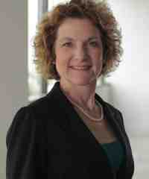


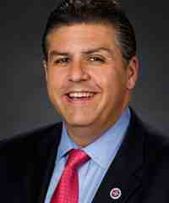


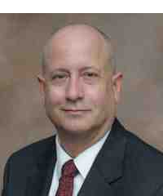

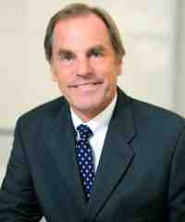







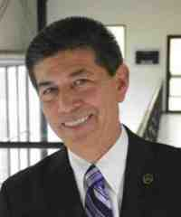
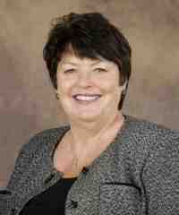
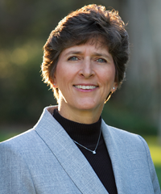
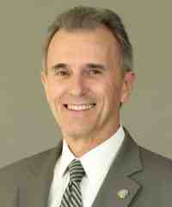

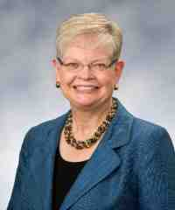


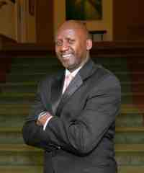


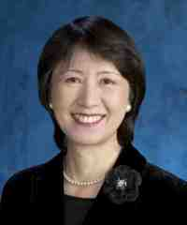
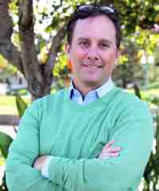
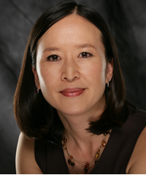

WSCUC Commissioners
Notes:
• 33 volunteer members
• Nominated and voted upon by the heads of member institutions
• Represent the region and the general public
• Meet three times a year (2 times for action and 1 retreat)

Slide 65
Commission Review:
Commission Panel reads report and documentation including institution’s written response, talks with institutional representatives at Commission meeting
Panel makes recommendation to Commission, and Commission acts
Commission communicates decision in an action letter
Letter and team report are publicly available on WSCUC website
Link provided on WSCUC website, if desired, to institution’s response to team report

Slide 66
Presentation Agenda
The changing context for accreditation
2013 WSCUC Standards and Criteria for Review
Comprehensive review for reaffirmation of accreditation
The institutional review process
The institutional self-study and report
Commission action
Tools and resources

Slide 67
TPR Resources
TPR Guide
Inventory of Educational Effectiveness Indicators
WSCUC Standards of Accreditation (on WSCUC website under Documents in 2013 Handbook)
Compliance with WSCUC Standards and Federal Requirements
Available January 2019:
TPR Peer Evaluator Training
TPR Peer Evaluator Guide

Slide 68
Tools: WSCUC Resources
Handbook of Accreditation
Materials on website (wscuc.org; Documents  Document List)
  Organizing and Uploading Institutional Reports Guide
  Materials on Box.com (for visit)
  WSCUC workshops www.wscuc.org/educational -programs
  ARC- Academic Resource Conference: April 10-12, Hyatt Regency Orange County

Slide 69
Tools: WSCUC Staff Liaison
Counselor
Coach/Trainer
Collaborator
Communicator/Interpreter
And, lastly,
Compliance Officer

Slide 70

Thank you!

