Slide 1
College of health and human services
Natalie McGlocklin – CHHS Data Coordinator
Wendy Nomura & Becky Nash – Student Success Committee

Slide 2
Goals for data fellows & CHHS
Remove barriers to timely graduation for students
To understand the synergies in our curriculum across departments and colleges so that we may be able to:
Help students navigate the many degree options
Find ways to mitigate the negative effects of major switching
Increase 4-year graduation rates
Be realistic about what we can and cannot control as a college

Slide 3
The anxiety of the 4-Year grad initiative
Admitted
Department = No Control
Readiness Varies
Pre Major
Unknown to Department
Course Choice = Wild Wild West
Declared Major
Known to Department
Controlled Curriculum
Underlying Factors: impaction, forced declaration, major readiness, clear major options, maturity, career choices, accreditation, the pre-major experience, local preference

Slide 4
Student success survey Understanding the different needs for majors vs. pre-majors
Pre-majors were more likely to report failing a course and heavy course load as barriers.
Declared majors needed more advising on graduate school, where pre-majors wanted more major course selection advising and GE advising.
Pre-majors (33.1%) were less likely than declared majors (42.7%) to plan to use summer school
Difference in the number of units taken with 46.5% of pre-majors and 32.0% of majors typically taking 15 or more units per semester
Pre-majors were more likely to feel isolated and less likely to feel supported by a network of students, that their program helped meet their career goals, that their job and family interfered with school, and that their family fully supported their academic aspiration than declared majors.

Slide 5
Who are our pre-nurses and where do they go?

Slide 6
Interview with a real student From nursing → health science
Biggest Challenges
Things That Helped
The notice for acceptance/non-acceptance for NRSG was late (between Fall and Spring semesters)
Had misconceptions about transferring to another CSU, and differing prerequisites made it impossible
Did not receive good advice on how to transfer, such as which majors lined up best
They had already taken NUTR 132 & this allowed them to declare the HSC major immediately after notification of non-acceptance to NRSG
Friends who didn’t take NUTR 132 had trouble getting into some pre-HSC courses
Did have a clear idea that they might not get into the Nursing program from the beginning

Slide 7
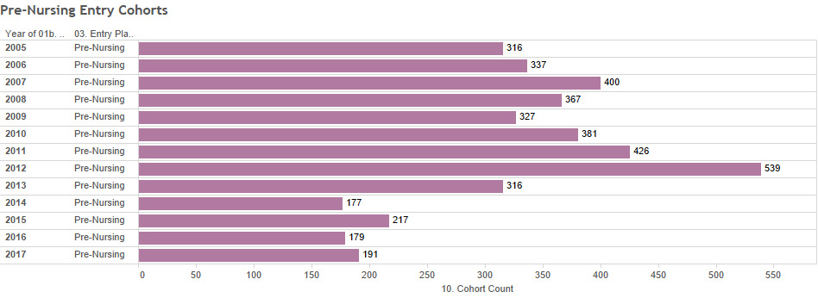
Things we can’t control
CSULB Declares Impaction

Slide 8
Being realistic
NRSG Pool
CSULB FTF
CC Transfers
400-600 Total Applications
About 70-80 students total are accepted into the Nursing undergraduate program every semester
70
Between 2005-2012, on average 15-20% of students who enter CSULB as Pre-Nursing
are accepted into the program → about 30-45 students per Fall Cohort

Slide 9
So what about the other 80%?
CSU Student Success Dashboard
More students went on to receive a degree in Health Care Administration or Health Science than were accepted and persisted in the Nursing Program

Slide 10
But we are not in the dream crushing business
So how can we help students navigate a change in direction without chastising them, while being realistic, but while being mindful of their individual needs, wants, barriers, and personal strengths?

Slide 11
Persistence and attrition Within University – Pre-NRSG vs. CHHS

Slide 12
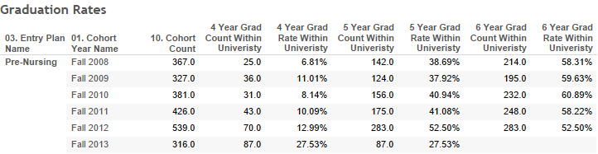
Graduation rates Within University

Slide 13
COMPARE MSDR Nursing & health Science “Alternative Pathways”
Health Science
Semester | Requirement
After First Semester | STAT 108 or 118
 | CHEM 140
 | BIOL 207
 | BIOL 208
 | HSC 210
 | NUTR 132 or RSCH 207
Nursing – Basic
Semester | Requirement
By Second Semester | STAT 108 or 118
 | CHEM 140
By Fourth Semester | BIOL 201
 | BIOL 207
 | BIOL 208
Health Care Administration
Semester | Requirement
After First Semester | STAT 108 or 118
 | BIOL 207
 | BIOL 208
 | ACCT 201
 | ECON 101 or 300
 | MATH 115

Slide 14
Time to degree
Higher 4-YR Grad Rates than overall for CHHS within University!

Slide 15
Communication 101: meet them where they “live”
Who is responsible for pre-majors?
The CHHS Advising Center currently has a 1:1000 advisor to student ratio
The School of Nursing is not permitted to advise pre-nursing students
How can we intervene effectively?
SOAR
Freshman Advising
Social Media
Brochures/flyers
Faculty Advisors
Creating a non-punitive culture or conversation around major switching

