Slide 1

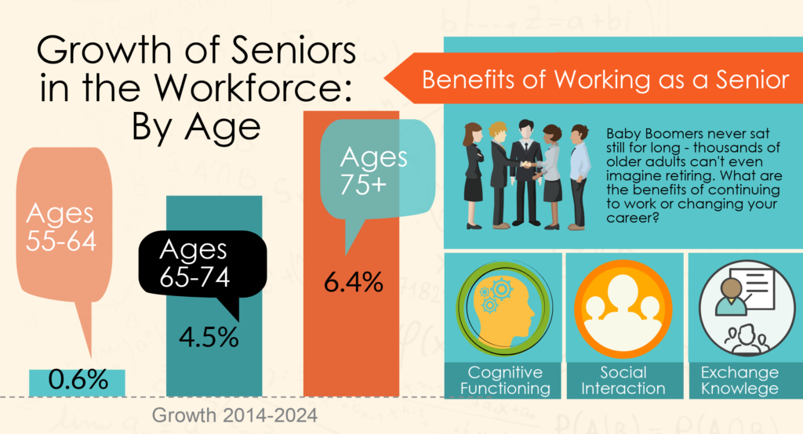
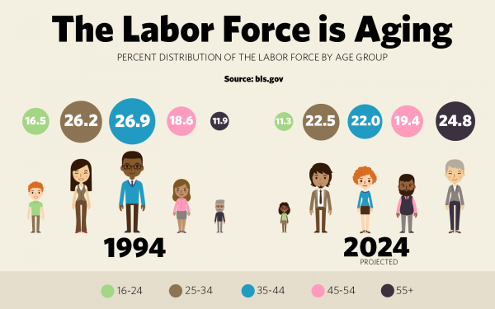
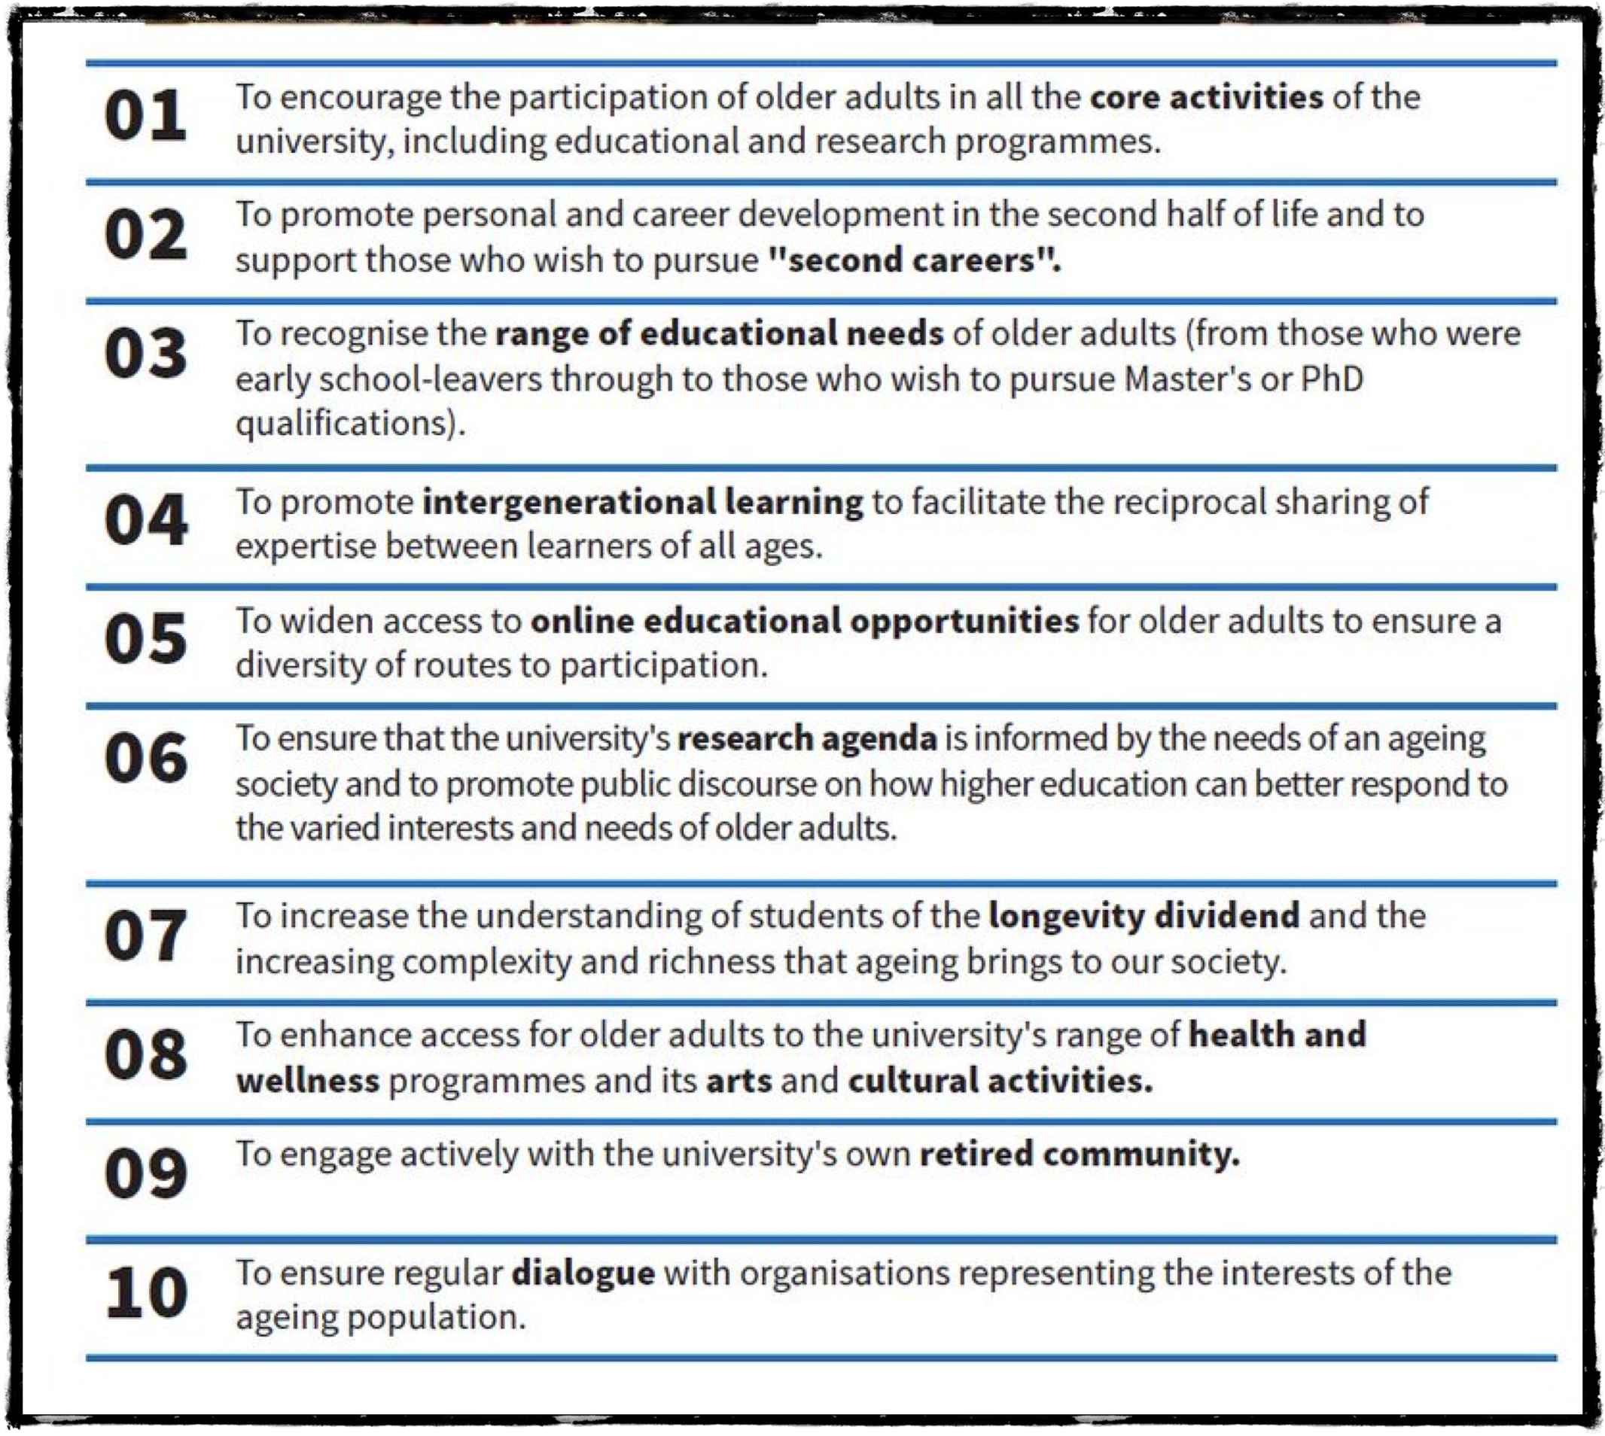


Ally Sensitivity Training For Instruction Of Older/ Non-traditional Learners
In Post Secondary Education
Nicole M. Smith, MSG
Gerontology Program
Department of Family & Consumer Sciences, California State University Long Beach
Introduction
Why Higher Education?
Increasing numbers of older learners entering college due to increase in life expectancy.
Lifelong Learning necessary to improve employment outcomes among workers facing rising demands for new and improved skills to remain in workplace.
Age Friendly Universities (AFU); a global initiative to address needs of older learners’ need to obtain higher education by encouraging inclusivity for older adults on college campuses.
Job security
Career advancement/preparation
Life long love for learning
Personal achievement/enrichment
Social engagement
Brain fitness/stimulation
Strengthen cognition
Goal achievement/knowledge validation
Family legacy
Challenges To Lifelong Learning
Computer/technological literacy
Cognitive/memory impairment
Physical/mobility limitations
Fear/lack of confidence
Outside work, family and caregiving responsibilities
Ageism, bias, social norms, and stereotypes
Financial limitations
Outdated skills necessary to be a successful student
https://www.collegeconsensus.com/resources/career/best-online-degrees-for-seniors/
Methods
Conclusion
  Methods of gathering information;
    Reviewed literature
    Conducted focus group of older learners
    Expert Panel Survey to review Older Learner Ally training material
  With increasing numbers of older learners in higher education colleges must rapidly prepare.
  Older Learner Ally (OLA) training raises awareness, helps find solutions, and starts conversations about how to meet the needs of older learners in higher education.
  Adhering to the AFU principles promotes more age inclusive learning environment.
https://blog.dol.gov/2016/11/18/why-more-people-ages-55-are-working
The Educator’s Role In Educating Older Learners
Aim
  Chart new pathways for older learners to participate in lifelong learning.
  Encourage flexibility in the classroom.
  Make appropriate accommodations for older learners.
  Start conversations to alter views about older learners in higher education.
  Apply and adhere to the AFU principles (most importantly principles 1-5)
  Review current literature and compare to research findings.
  Identify why older learners pursue post secondary education
  Identify challenges of older learners
  Identify educator’s role
  Find solutions to address challenges of older learners.
  Develop ally training based on AFU Principles to start conversations amongst faculty and staff to raise awareness and possible solutions.
For more information
Please contact Nicole M. Smith, MSG, California State University, Long Beach, at nicolesmithmsg@gmail.com
https://www.debate.org/opinions/should-adults-go-to-college

