Slide 1

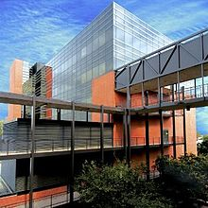
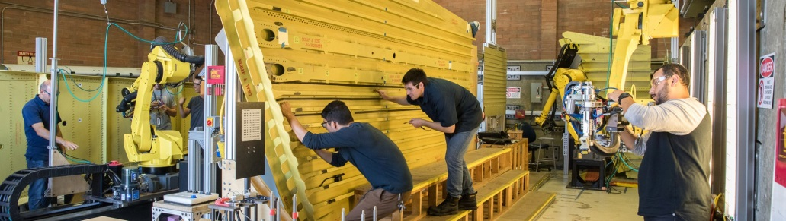
College of Engineering
EHS PRESENTATION
August 2019

Slide 2

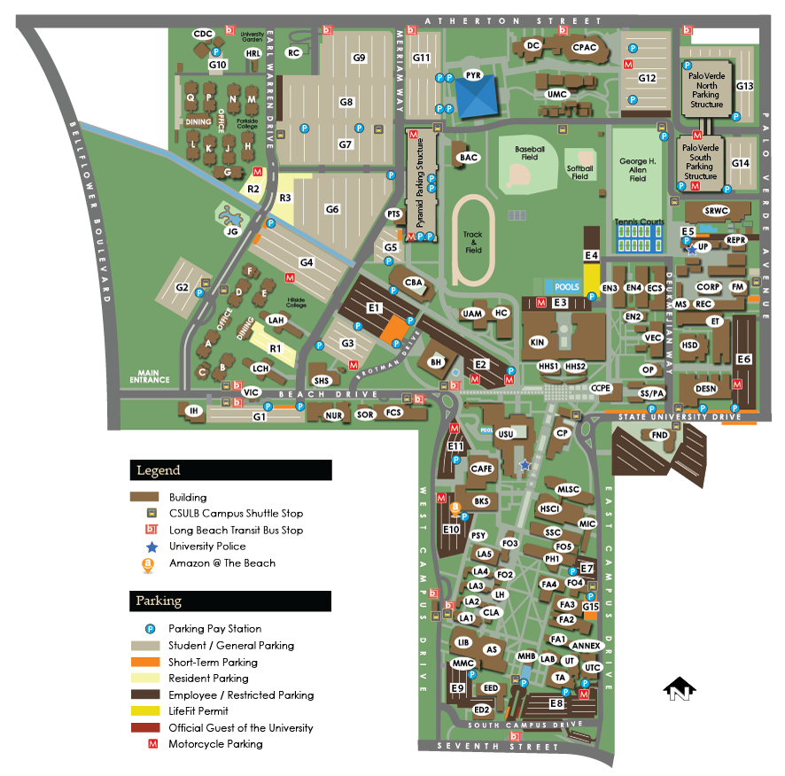
Fast Facts
Founded in 1949
Students – 37,065 (2017)
Staff and Faculty – 6,137 (2018)
323 Acres
Environmental Health & Safety
Mission
To provide and maintain a safe
and healthy work environment
for students, faculty, staff,
contractors and visitors.
To protect the local community
and environment from potential
hazards generated by University
activities.
Notes:
Started in 1949 by then Governor Earl Warren, the university was then called Los Angeles/Orange County State College. There were 160 students and 13 faculty that operated our of converted apartment buildings at the corner of Anaheim and Bellflower. Today, there are over 36,000 students and 3,600 staff and faculty over 87 buildings on a 323 acre parcel.
SWRC - $37/mo.

Slide 3

The Importance of Safety
Injuries = lost work hours, higher insurance rates, Workman’s Compensation claims, staffing shortages and possible litigation.
Regulatory fines and citations are costly, do not reflect well on the University and are the financial responsibility of the department.
Working in a safe and healthy environment allows you to focus on why CSU has hired you – to do the best work in your field you can do!
Lead by Example – Most corporations and utility districts have exceedingly high safety standards due to potential liability exposures. By emphasizing safety in your curriculum, you are creating a learning foundation and mindset for your students that they will carry into whatever career path they choose.

Slide 4

Injury and Illness Prevention Program (IIPP)
“What is it?”
The Injury and Illness Prevention Program (IIPP) is a basic written workplace safety program. Title 8 of the California Code of Regulations (T8CCR), Section 3203, requires every employer to develop and implement an effective IIPP.
IIPP Required Components
1. Responsibility
2. Compliance
Hazard Assessment
Accident/Exposure Investigation
Communication
Hazard Correction
Training
Recordkeeping

Slide 5

Injury and Illness Prevention Program (IIPP)
Employee Rights and Responsibilities
Your Responsibilities:
Implement established safe work practices at all times while performing your duties
Comply will all applicable University safety and health policies and regulations
Report all unsafe conditions, when observed without fear of reprisal, to your immediate supervisor, EH&S or University Police
  Your Rights:
  Refuse work under unsafe conditions or perform work that would create a hazard for yourself or other workers
  Access to your medical and/or personal exposure records

Slide 6
Campus OSHA 300 Reportable Injuries/Illnesses
OSHA 300 Reportables - 2014-2018
 | 2014 | 2015 | 2016 | 2017 | 2018 | Total
Campus | 67 | 53 | 37 | 41 | 45 | 243
BBS | 31 | 27 | 21 | 17 | 17 | 113
Total | 98 | 80 | 58 | 58 | 62 | 356

Slide 7
Chancellor’s Office Health and Safety Audit
Duration : April 22 – May 24, 2019
Focus
  IIPP Compliance
    Training – students/employees/faculty
    Inspections – department/campus
    Department & Campus Programs – implementation/review
  Safety Committees
  Hazardous Materials/Wastes
    Procurement
    Labeling/storage/security
    Spill response

Slide 8
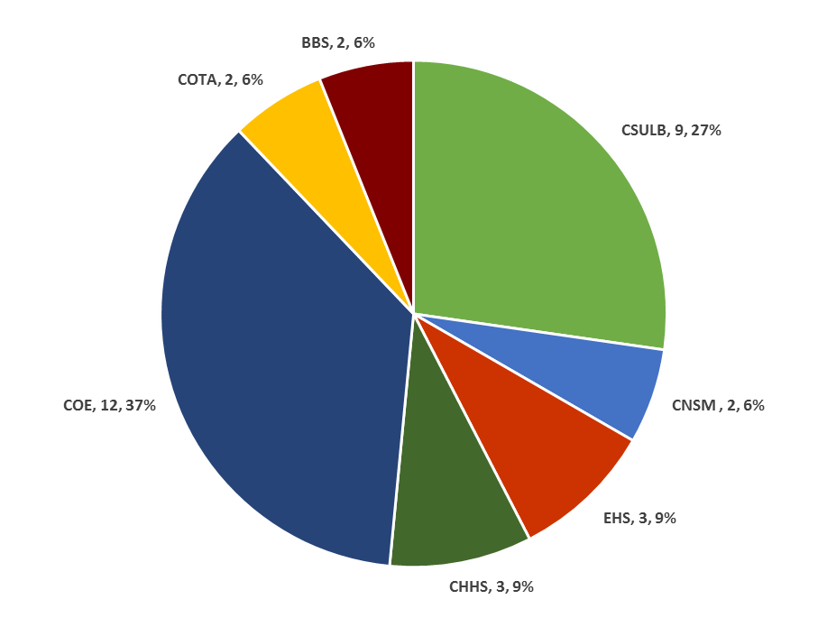
2019 Audit Findings
by Department / College

Slide 9
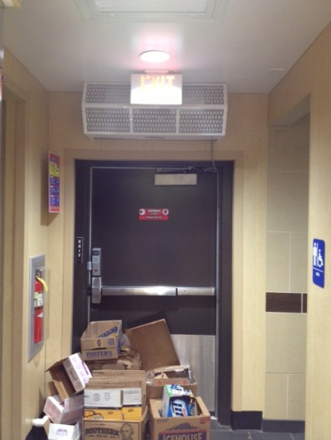
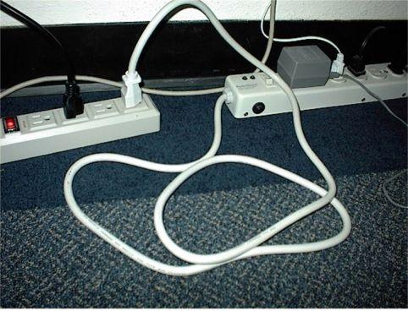
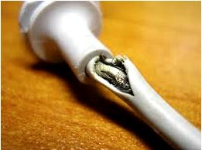
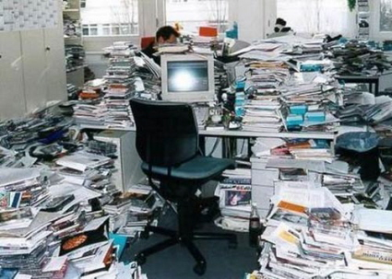
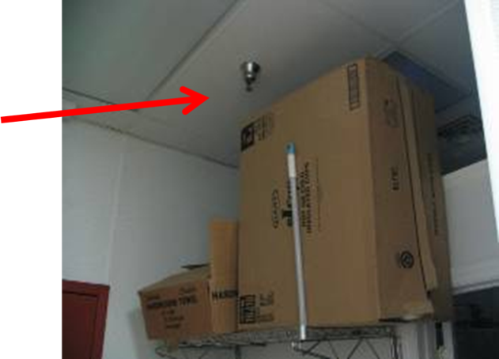
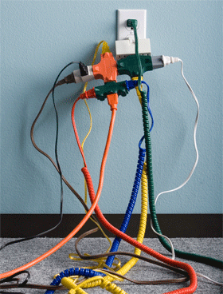
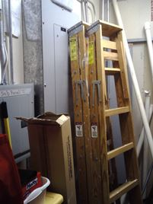

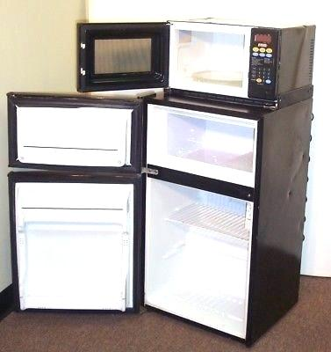
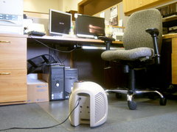
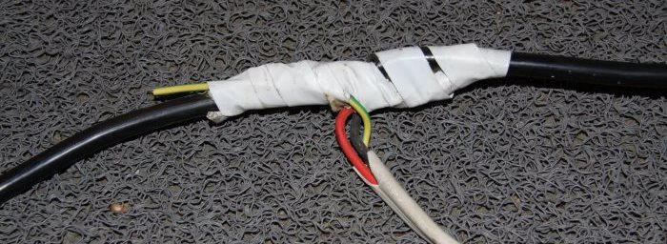
Common State Fire Code Violations

Slide 10
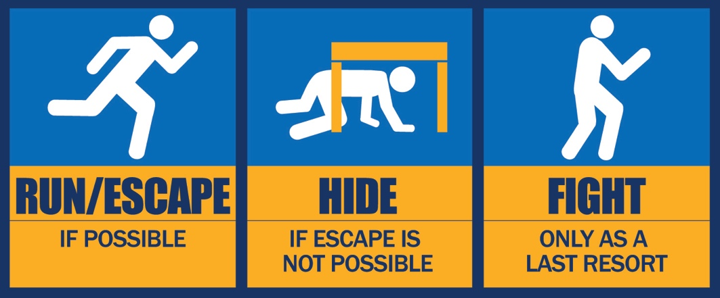

Life Safety/Emergency Preparedness
In the event
of an
ACTIVE
SHOOTER:
In the event
of an
EARTHQUAKE:

Slide 11
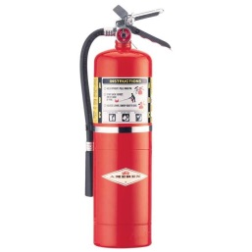
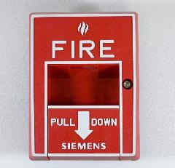

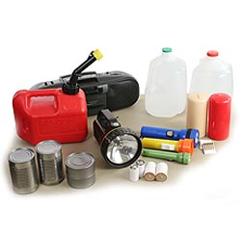
Life Safety/Emergency Preparedness
In the next 24 hours:
  Find the nearest fire extinguisher
  to your work station
  Find the nearest fire alarm pull station
  Identify your Building Marshal
  Begin to assemble a basic
  emergency kit

Slide 12
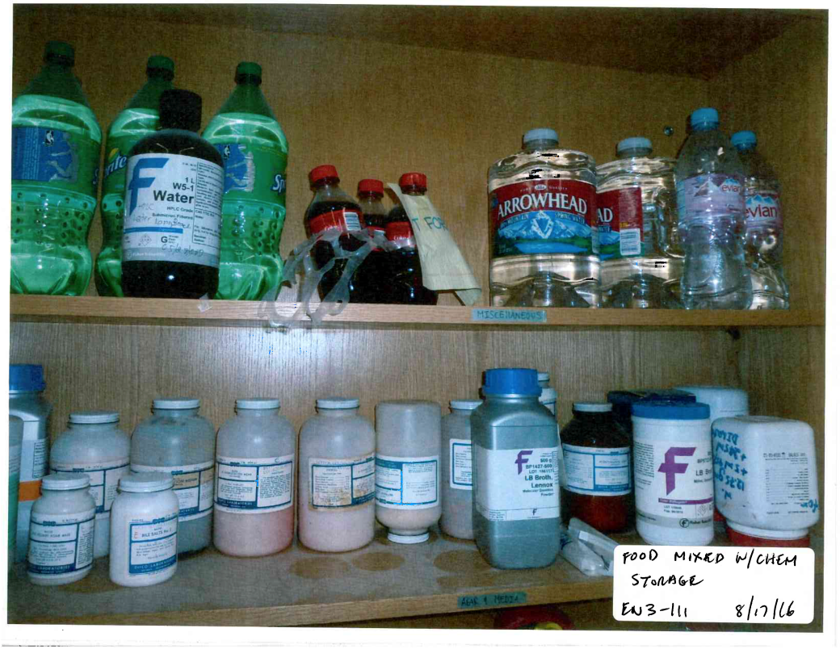
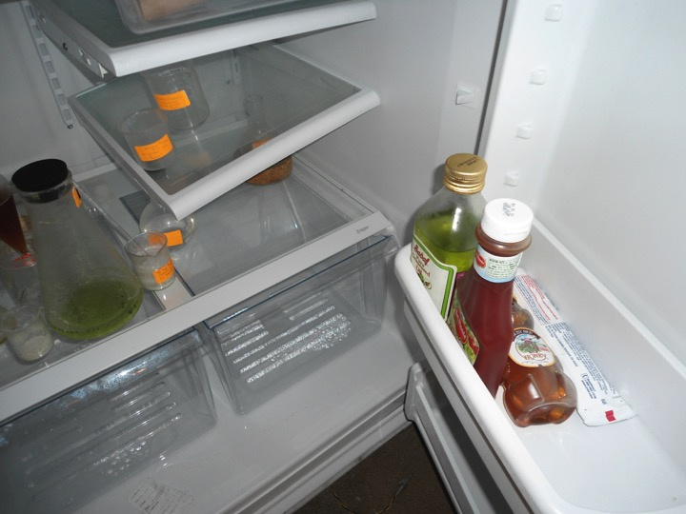

Lab Safety – Food Storage and Consumption
2019 Chancellor’s Office Audit Findings identified numerous areas in need of improvement. Random EHS audits have identified health and safety issues in non-laboratory settings as well.
Food is not to be stored in laboratories [29CFR1910.141(g)(2)]
Food and liquids should NEVER be consumed in laboratories or work areas.

Slide 13
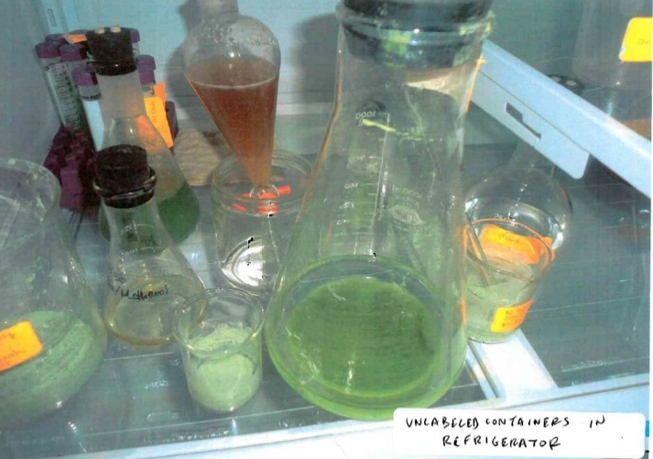
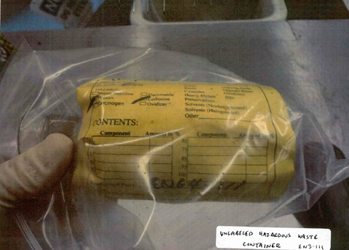
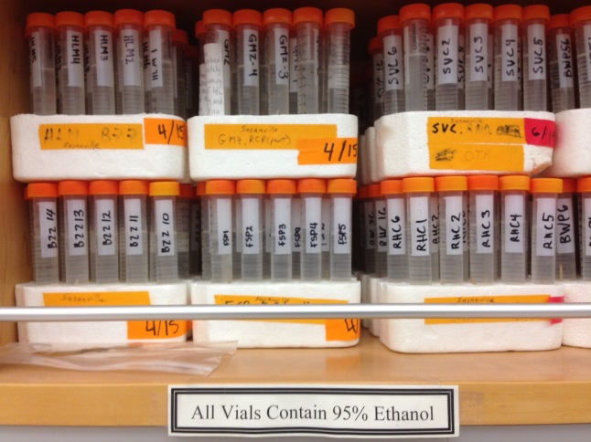

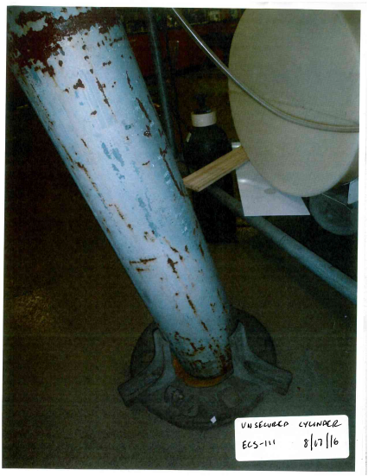
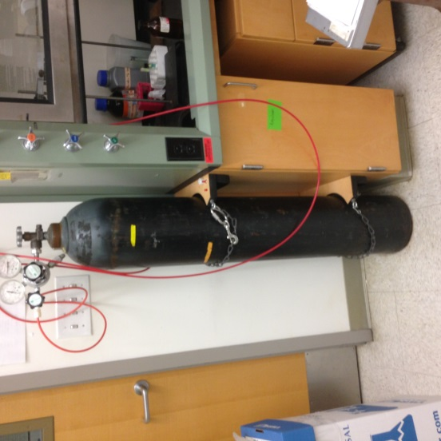
Lab Safety – Container Labeling and Cylinders Storage
All laboratory containers MUST be labelled [8 CCR 5194 (f)(6)]
Gas cylinders MUST be anchored to a fixed structure [8 CCR 4650 (e)]

Slide 14
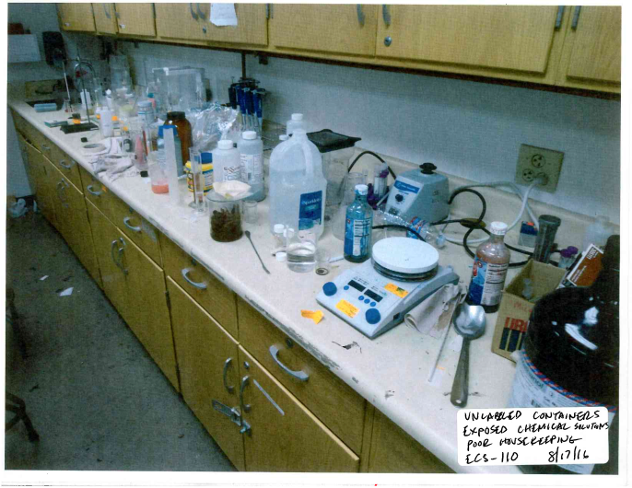
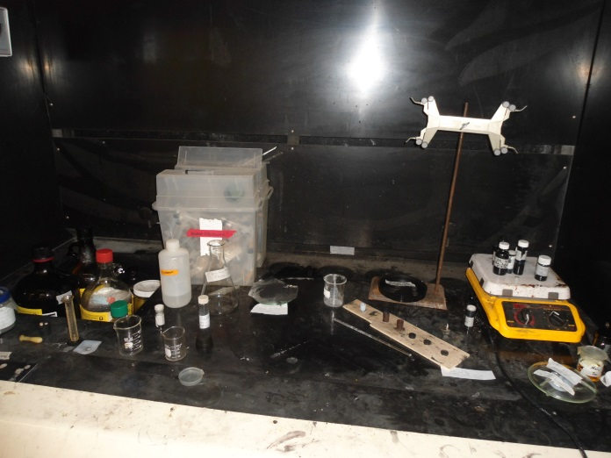
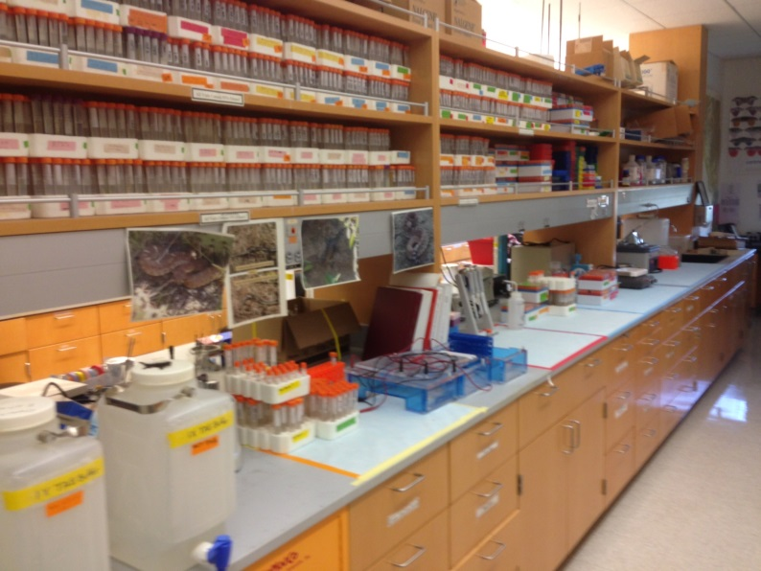
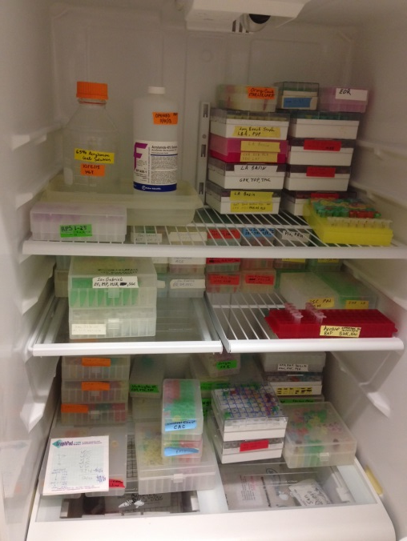
Lab Safety – General Housekeeping
Laboratory housekeeping MUST be maintained [8 CCR 5191, App A (D)(4), (E)(1)(j)]
Laboratory supplies and equipment should be returned to shelves, drawers and cabinets after use as standard practice
Countertops should be left clean and free of laboratory spills and debris

Slide 15
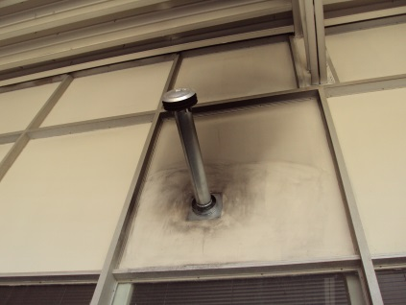
Non-Lab Safety
Any plans to alter campus buildings and building components (walls, ceilings, floors)
must be forwarded to COE Facilities Coordinator first. Unauthorized construction
or renovations (including painting) is not permitted.
Certain building construction materials within COE contain asbestos and lead.
By damaging these components, you not only put your health at risk, you are
spreading contaminated materials throughout the workplace that may impact others.

