Slide 1
Pricing decisions
Pricing and revenue

Slide 2
How will your business make money?
Why is pricing an important decision for startups?
What is the link between prices and revenue?
Every firm needs a revenue strategy.
Profits = Revenue – Costs
Need to cover your costs!

Slide 3
Pricing continuum
Competition
and other
external
factors
Consumer
Perception of
Value
Product
Costs
Price Floor
Price Ceiling
Price

Slide 4
Pricing Process
Pricing objective
Max revenue
Max market share
Max profit margin
Determine demand
Estimate Costs
Competitor analysis
Select price

Slide 5
Pricing strategies
Cost-based pricing (engineering approach)
Value-based pricing (consumer approach)

Slide 6
Pricing options
Markup Pricing or Cost plus pricing
Marginal Cost pricing
Keystone Pricing – ‘rule of thumb’ for retail pricing
Penetration pricing – capture market share quickly
Skimming pricing - capture the early adopters

Slide 7
Pricing power
What affects your ability to set price?
Type of good/service
Availability of sustitutes
Customer sensitivity
Market condition (contraction v. expansion, macro)

Slide 8
Other pricing concepts
Psychological pricing (i.e. wine)
Bundle pricing (i.e. cable TV)
Promotional pricing (i.e. new restaurant)
Premium pricing (i.e. apple watch)
Freemium model (i.e. apps)

Slide 9
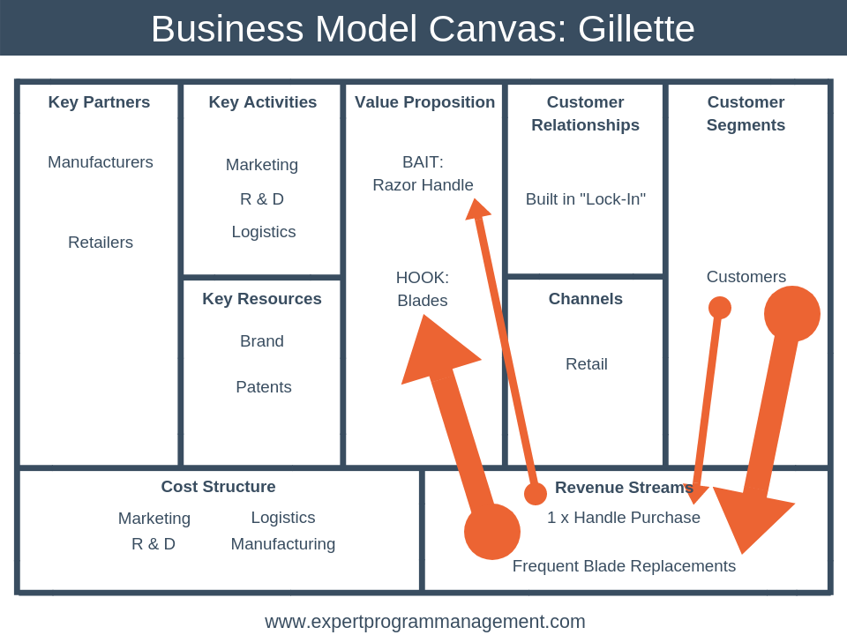

Slide 10
