Slide 1
When to Say Yes, and Other Lessons From a Life in the CSU
Legacy Lecture
May 12, 2022
Dr. Margaret Merryfield

Slide 2
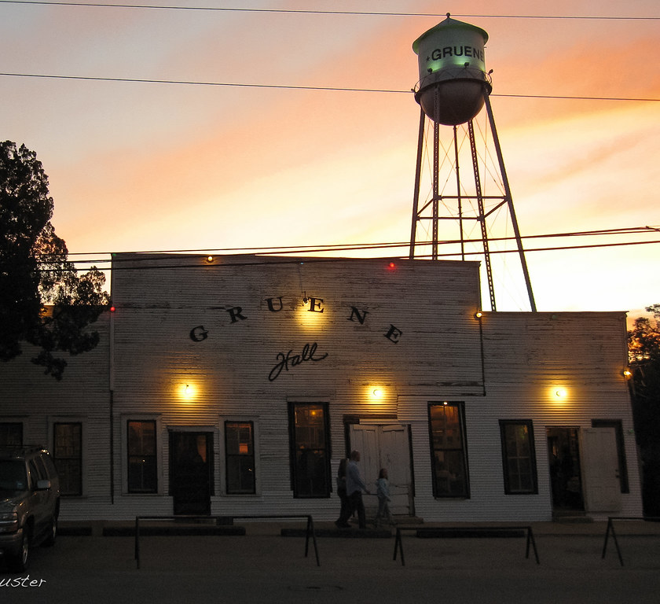
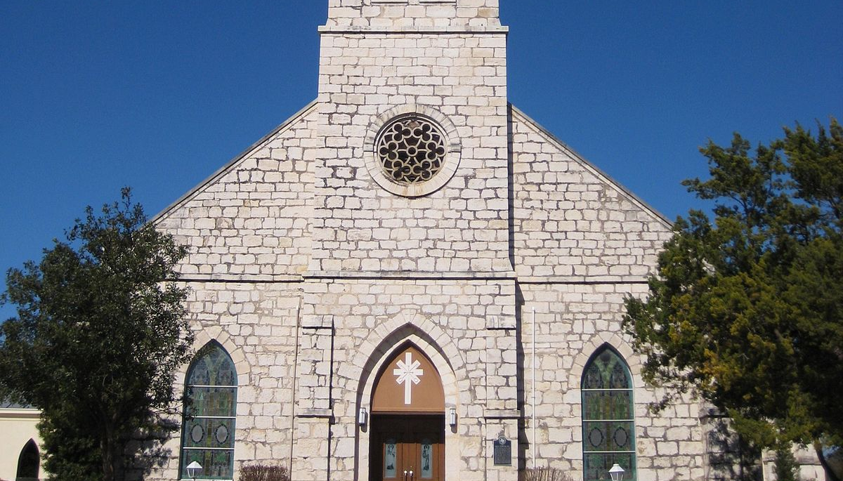
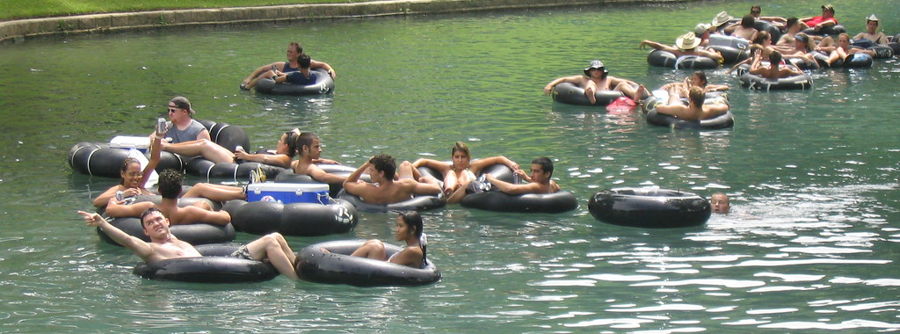

Slide 3

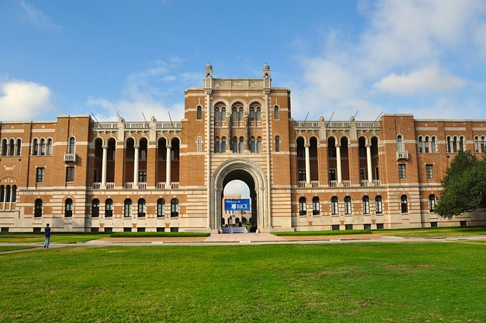



Slide 4
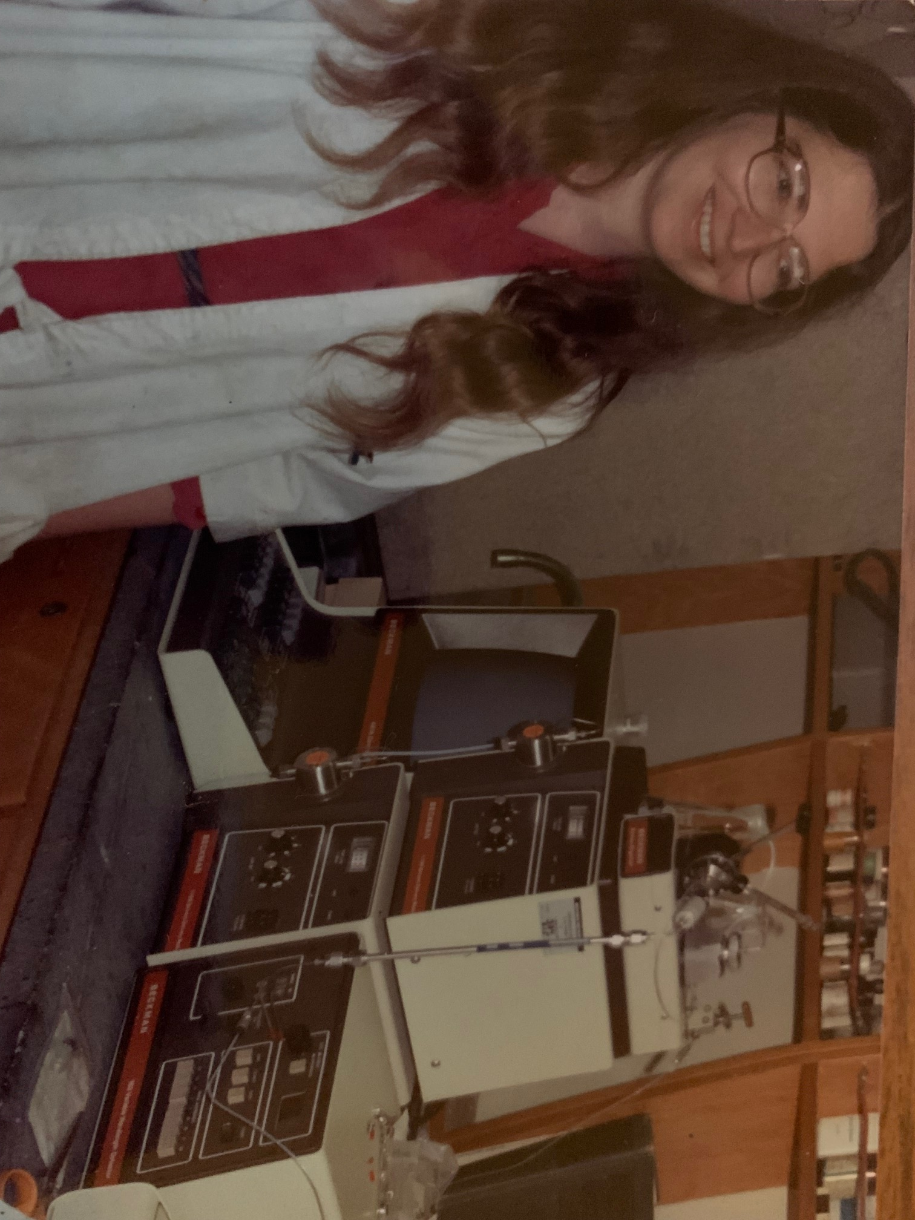
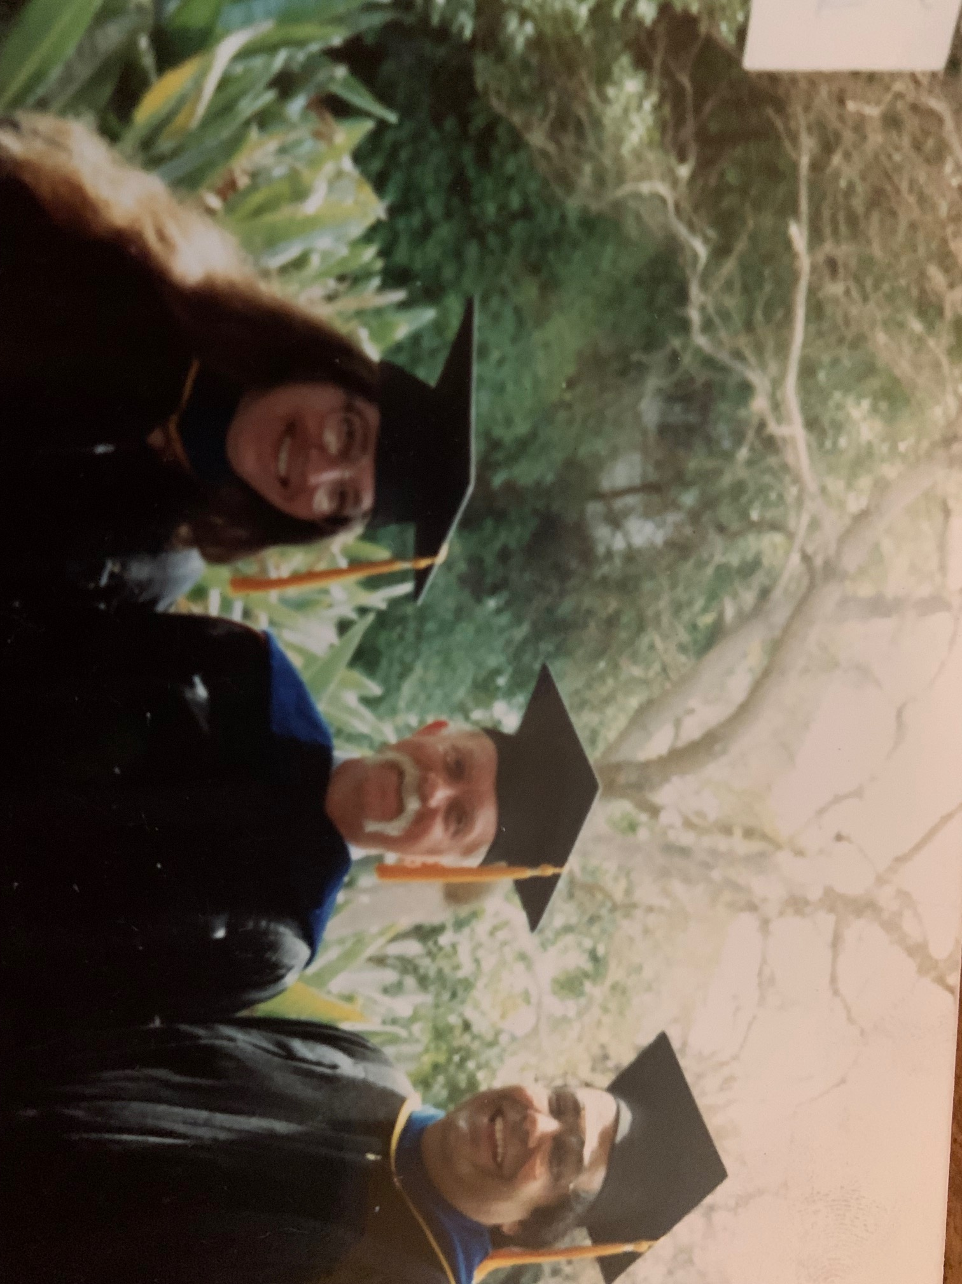

Slide 5
Lesson One: Say Yes to (the Right) Opportunities

Slide 6
Lesson Two: Get to Know, and Learn From, the Experts Around You

Slide 7
Lesson Three: Lean Into Lifelong Learning
Corollary: A Steep Learning Curve Means You’ll Never be Bored

Slide 8
Lesson Four: Education Is Never Wasted

Slide 9
Lesson Five: It Really Does Take a Village
Corollary: Cherish Your Village

Slide 10
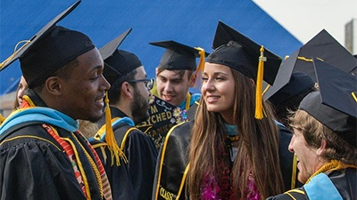
Thanks for listening!

