Slide 1
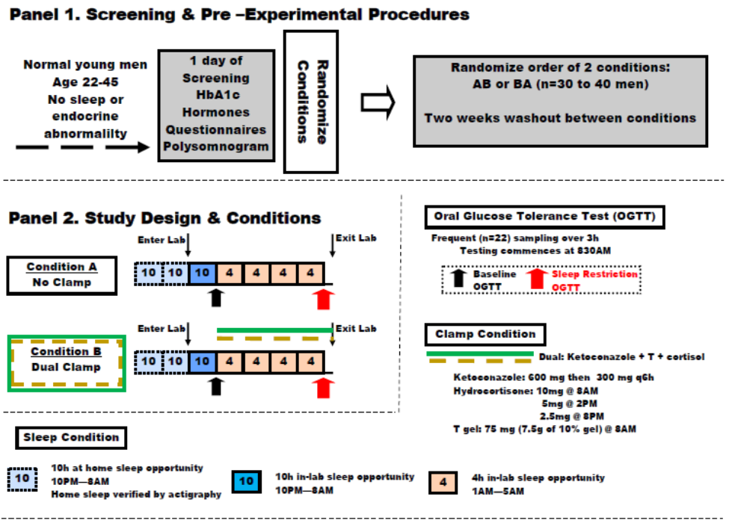
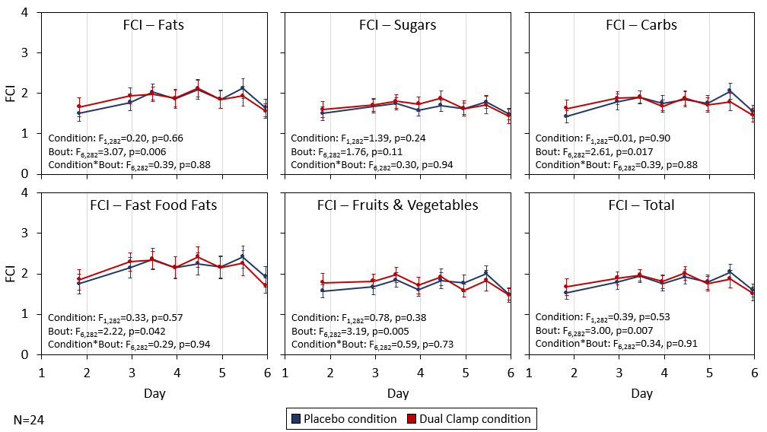
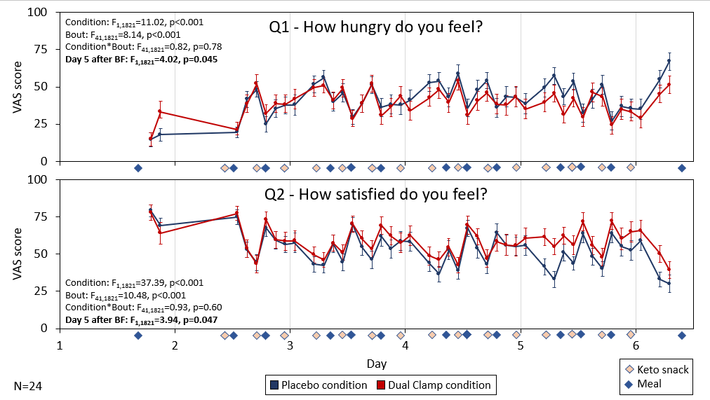
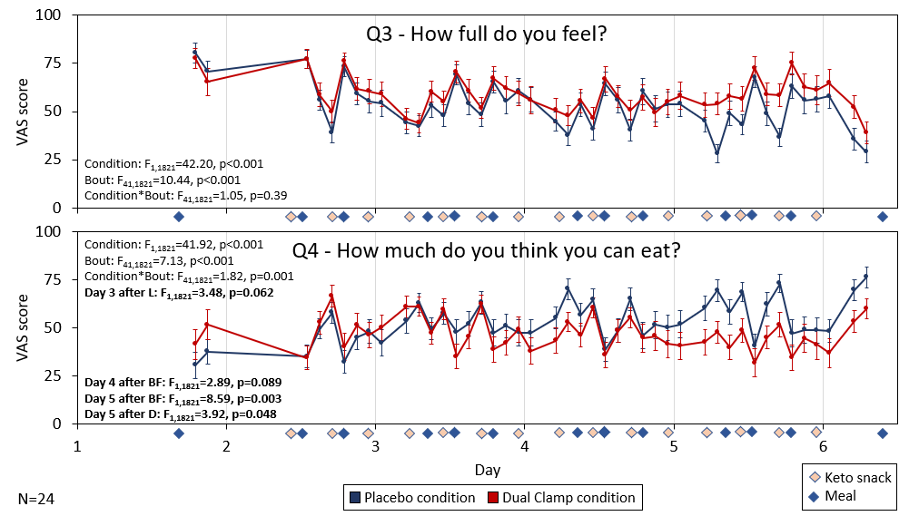
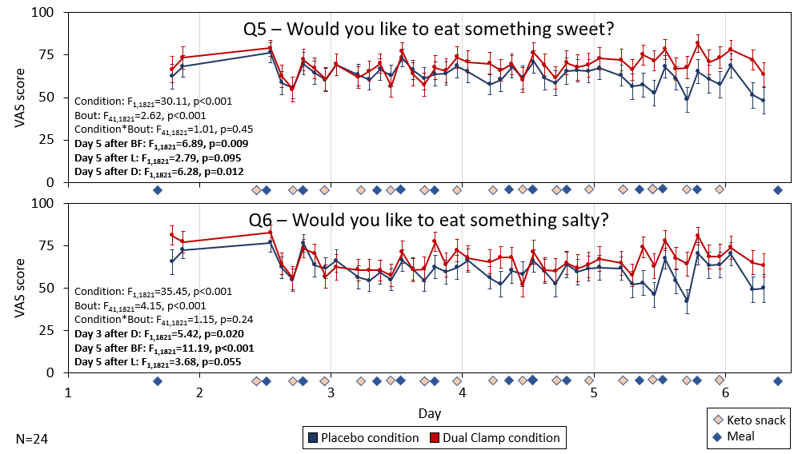
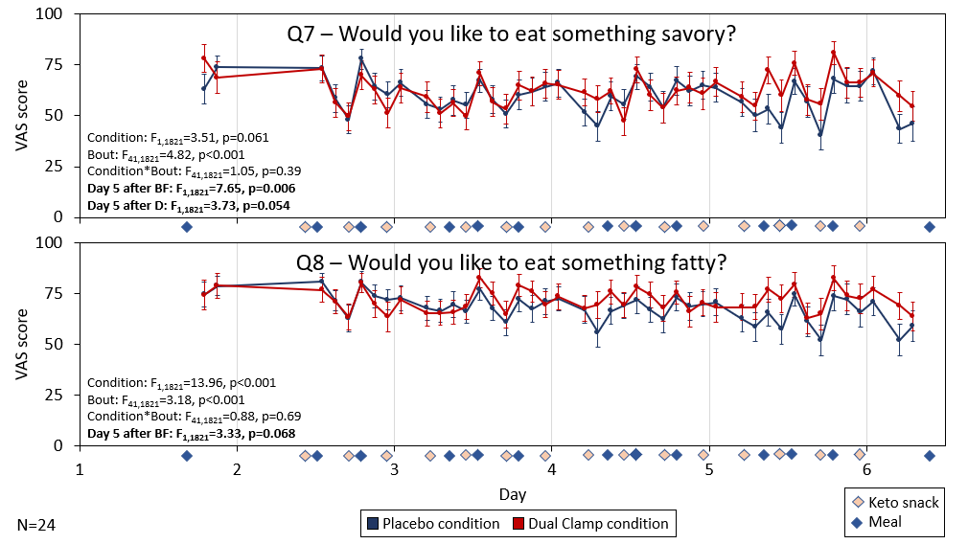
The impact of sleep restriction on subjective sensations of appetite and food cravings: a quantitative study in healthy men
Amy James, B.S., Virginia Gray, PhD, RDN, Rachelle Bross, PhD, RDN, Peter Y. Liu, MD, PhD, Selena Nguyen-Rodriguez, PhD, MPH
Department of Family & Consumer Sciences
College of Health & Human Services, California State University Long Beach
Introduction
Figure 1. Overview of study design (adapted from Peter Y. Liu).
Discussion
Sleep is a biological imperative. Modern society increasingly devalues the importance of good sleep hygiene. Studies have shown that chronic and acute sleep deficiency has known associations with major health risks such as overweight and obesity. The relationship between inadequate sleep and weight status has been established, however the exact mechanisms remain predominantly unknown.
Sleep restriction can be considered a source of physiologic stress that is associated with increased levels of cortisol and decreased levels of testosterone. Cortisol stimulates appetite and the intake of high-energy, palatable foods. Low testosterone levels are seen in individuals with increased adiposity. Further investigation is warranted regarding the interactions amongst sleep restriction, hormones, and weight status.
The current study revealed no significant difference in specific food cravings between participants in the unclamped (control) and clamped (experimental) groups, suggesting an alternative mechanism could be responsible for changes in food cravings and food behaviors after a period of sleep restriction.
FCI scores were significantly different by each administration of the FCI assessment for each group, positing a possible time of day effect.
The unclamped group scored significantly higher for prospective food consumption, suggesting that sleep restriction coupled with the perturbation of the hormones that typify the human stress response may influence actual food intake.
These findings suggest that testosterone and cortisol could be potential key hormonal players involved in the observed changes in appetite and intake after a period of altered or restricted sleep
Sleep Restriction Protocol
All participants underwent a 6-day in-laboratory study that include 4 nights of 4-hour total time in bed.
VAS and FCI Questionnaires
Participants completed visual analogue scale (VAS) questionnaires to assess subjective appetite sensations.
Analysis
VAS and FCI data were analyzed analogously using mixed-effects ANOVA with a model that incorporates the fixed effects of treatment condition and bout, and a random effect over subjects on the intercept.
Participants completed a modified food craving inventory (FCI) to assess for specific food cravings.
Figure 1. Mean food craving inventory (FCI) data across the 6-day in-laboratory study for the clamped and unclamped groups.
Purpose
The primary aim of this thesis was to evaluate if sleep restriction and its demonstrated hormonal changes is a possible mechanism by which sleep restriction influences subjective feelings of hunger and fullness.
Conclusion
Methods
These findings are clinically important and relevant for registered dietitians and other medical professionals when managing the nutrition care of patients experiencing chronic and acute sleep restriction.
There may be clinical significance in further investigating the contributions of cortisol and testosterone in the mechanism underpinning the relationship between sleep restriction and weight status.
Sample Selection
Convenience sampling was used to recruit participants that responded to public advertisement in the Los Angeles area (n = 24).
Randomization
Study participants were randomized to either the clamped or unclamped condition.
Clamped, active drug experimental group fixed both cortisol and testosterone production by blocking endogenous steroidogenesis and exogenously replacing back to diurnally appropriate physiological levels.
Unclamped, control group allowed cortisol and testosterone to change freely with conditions.
Results
Participants in the unclamped group scored significantly higher for prospective food consumption when compared to the clamped group.
Participants in the clamped group scored significantly higher for satisfaction and significantly lower for hunger when compared to the unclamped group.
There was a significant effect of bout on cravings for all 5 major subscales, except for the “sugars” subscale.
There were no significant difference in specific food cravings between participants in the unclamped (control) and clamped (experimental) groups.
Acknowledgements
I would like to thank my committee for their expertise, guidance, and ongoing support.
Figures 2-5. Mean visual analogue scale (VAS) assessment of appetite sensations across the 6-day in-laboratory study for the clamped and unclamped groups.

