Slide 1
General Education
Fall 2021 Workshop
Hosted by Danny Paskin, GE Coordinator
& Florence Newberger, GEGC Chair
with support from the Faculty Center
cc: jaubele1 - https://www.flickr.com/photos/22704986@N00

Slide 2
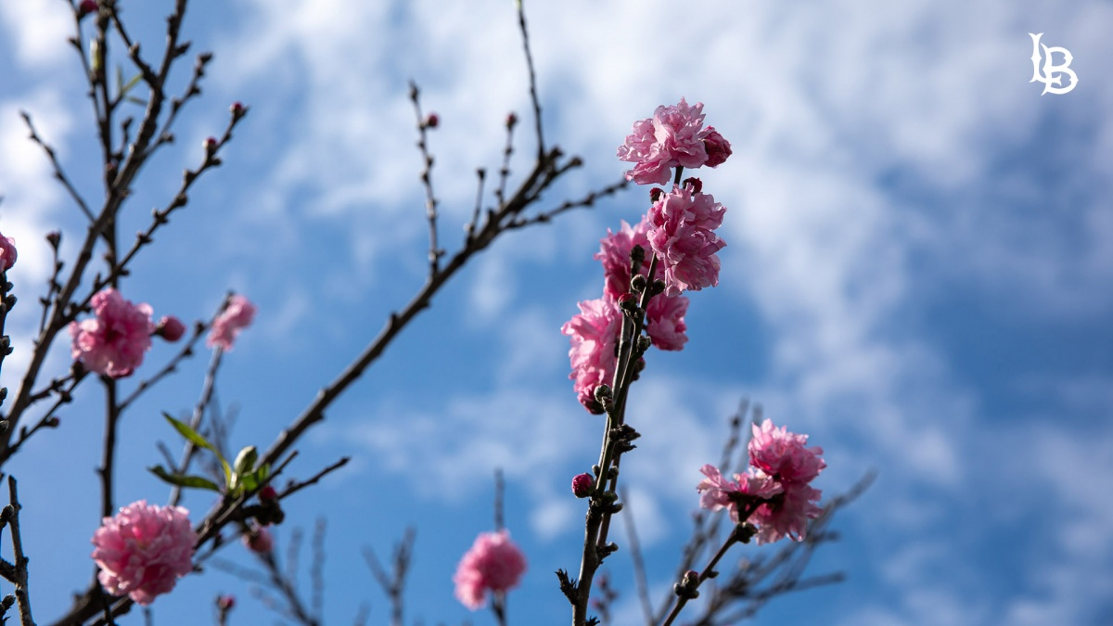
The 2021 GE Policy

Slide 3
What’s DIFFERENT
2019 Policy | Changed into | 2021 Policy
Areas A - E |  | New Area F, “Ethnic Studies”
Area D requires 9 Lower Division Units |  | Area D requires 6 Lower Division Units
US History and US Constitution must be taken at lower division |  | US History and US Constitution can be at either lower or upper div.
Upper division classes must list, as pre-reqs, 60 units, entire Foundation, one exploration course |  | Upper division classes must list, as pre-req, 60 units/Junior standing (rest not required)
WI requests reviewed by GEGC |  | WI requests reviewed by GWARC

Slide 4
What’s THE SAME
2019 Policy = 2021 Policy
Still requires 48 units of GE overall
Still requires 3 units in UD D, aside from 6 units of LD (but those can be in Social Sciences, US History or US Citizenship)
Still divided into Foundation, Explorations, Upper Division
Area-specific GE SLOs still required
Areas A-F still evaluated by GEGC (only WI goes through GWARC)
Notes:
Basics otherwise still the same

Slide 5
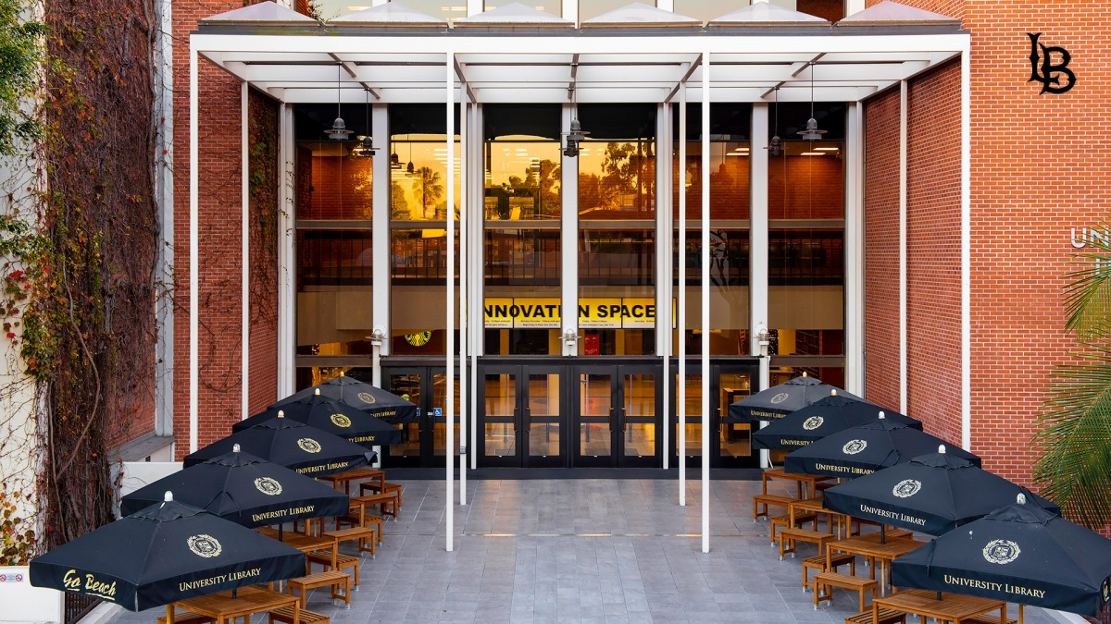
The Current GE Approval Process

Slide 6
GE Faculty Website
https://www.csulb.edu/ academic-affairs/ general-education-ge/ ge-for-faculty

Slide 7
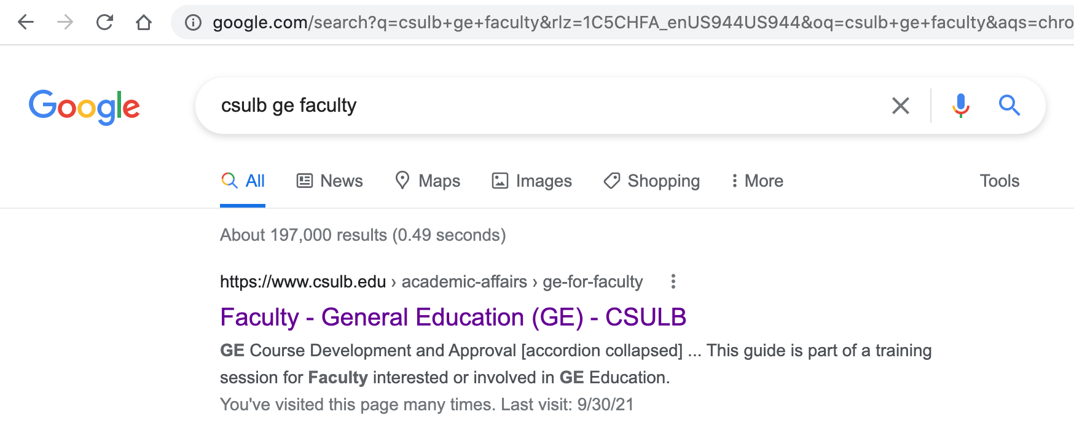
GE Faculty Website

Slide 8
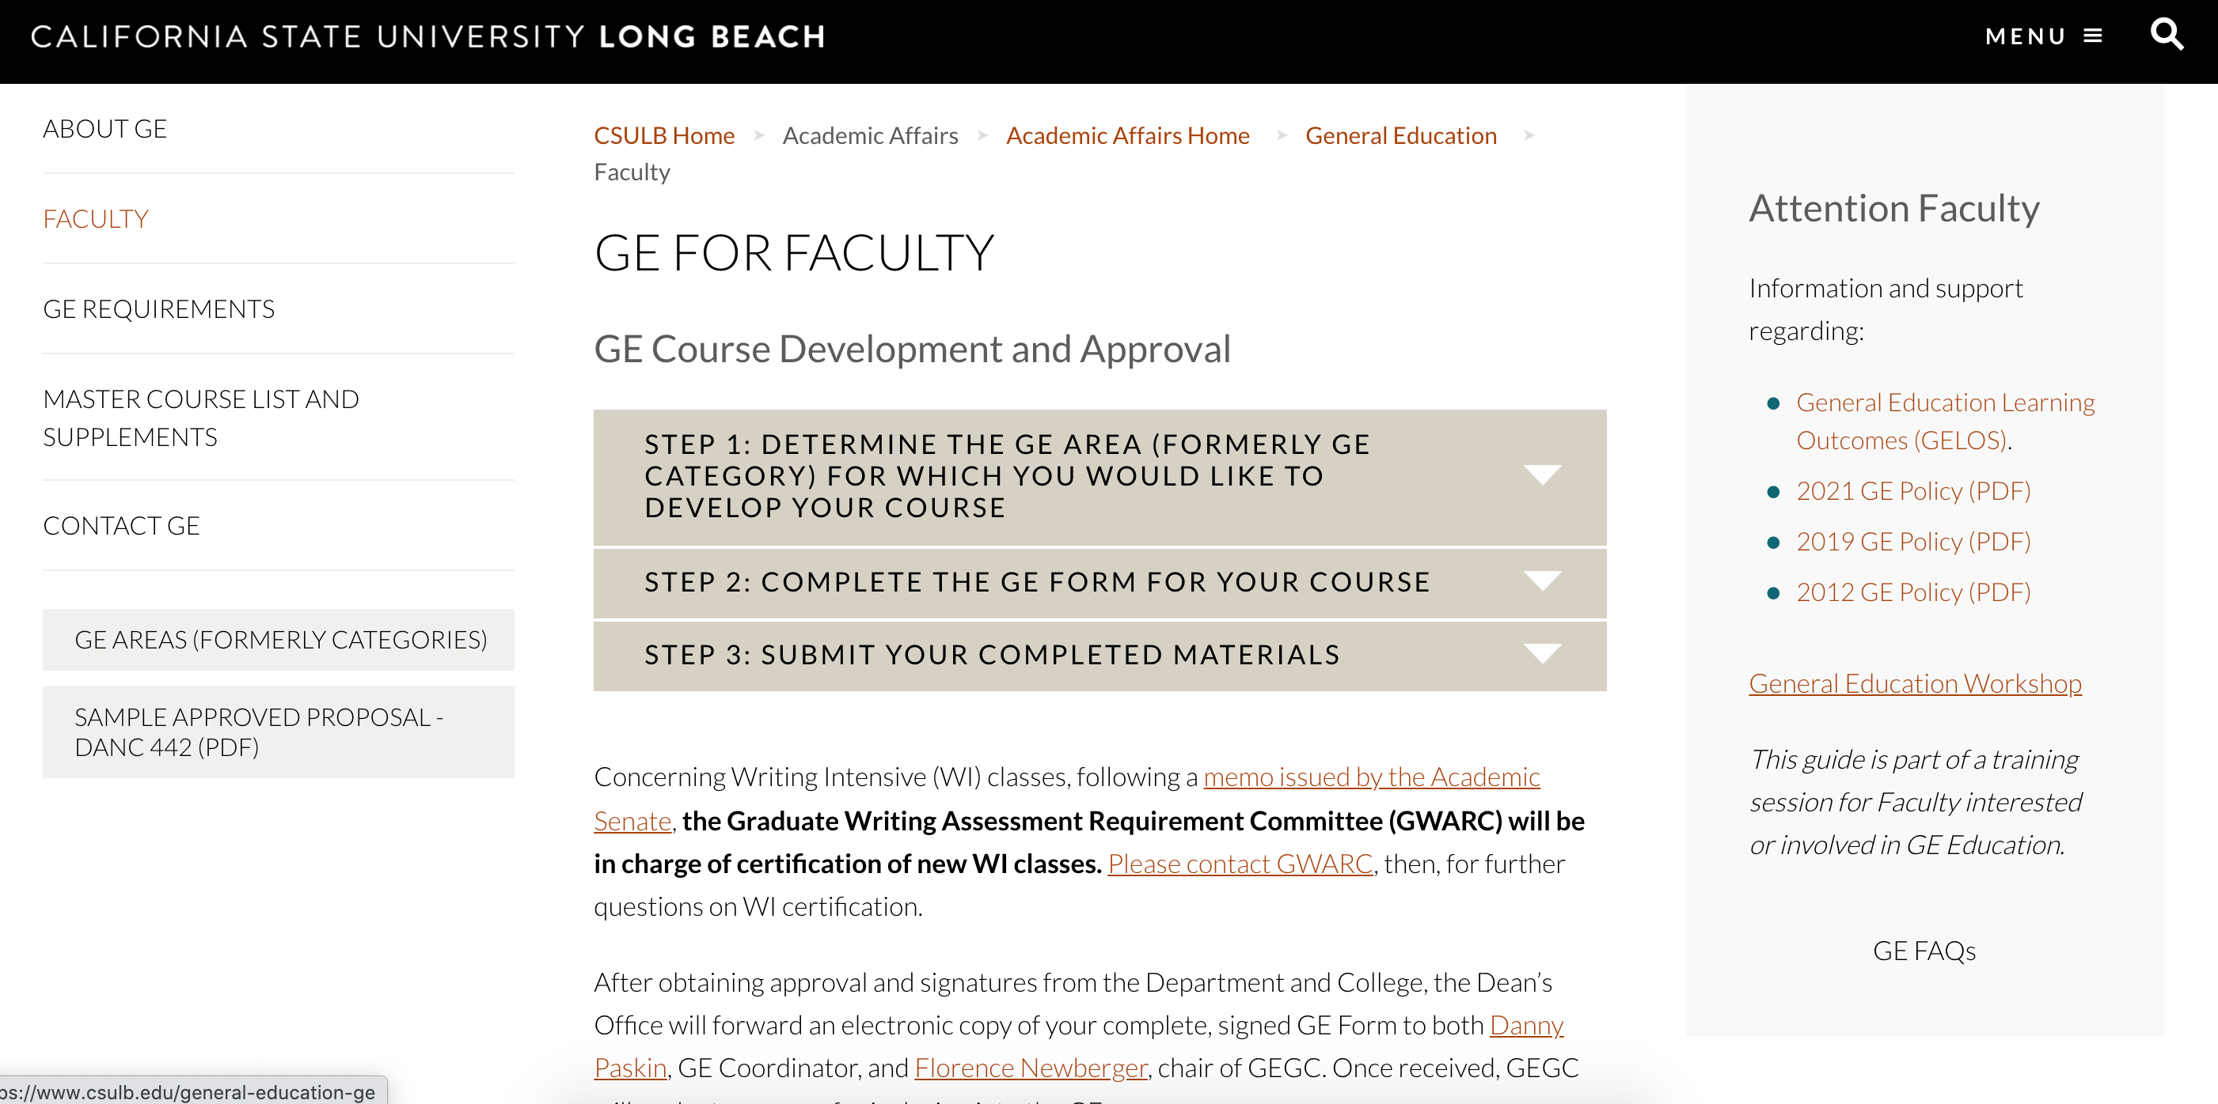
GE Faculty Website

Slide 9
GE Faculty Website
GE Submission Steps
GE Form
GELOs (GE SLOs)
FAQs
GE Policy (2021, 2019, 2012)

Slide 10
The Process Itself
Start with the GE Policy
Review the GE Website
Use the correct GE Form
Consult the FAQs
Contact GEGC if you have Questions!

Slide 11
Consult with GEGC Chair or Coordinator
From Conceptualization to Final Version

Slide 12
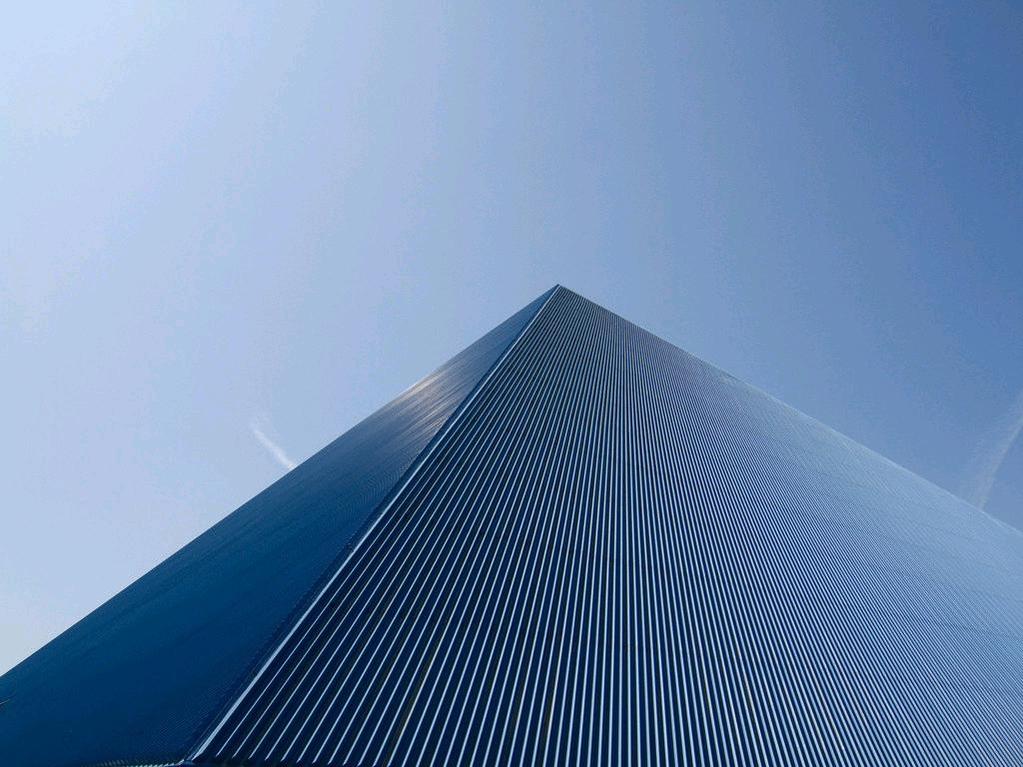
GE Form
cc: Cyrus II - https://www.flickr.com/photos/36576059@N03
Notes:
Go over the empty form and Colleens form

Slide 13
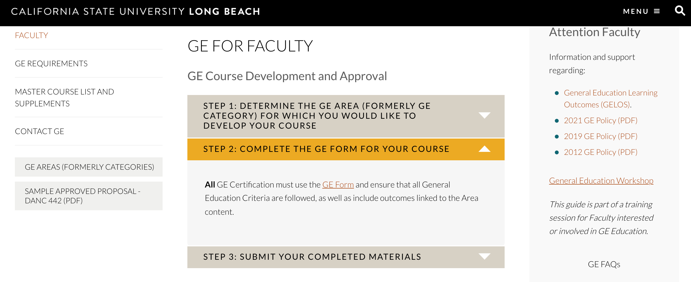
The GE Form
cc: Cyrus II - https://www.flickr.com/photos/36576059@N03
Notes:
Go over the empty form and Colleens form

Slide 14
The GE Form
https://www.csulb.edu/sites/ default/files/u66771/ ge_form_080521.docx
cc: Cyrus II - https://www.flickr.com/photos/36576059@N03
Notes:
Go over the empty form and Colleens form

Slide 15
Thanks!!
Danny Paskin, GE Coordinator – danny.paskin@csulb.edu
Florence Newberger, GEGC Chair – florence.newberger@csulb.edu
Faculty Center – fc@csulb.edu
cc: jaubele1 - https://www.flickr.com/photos/22704986@N00

