Slide 1
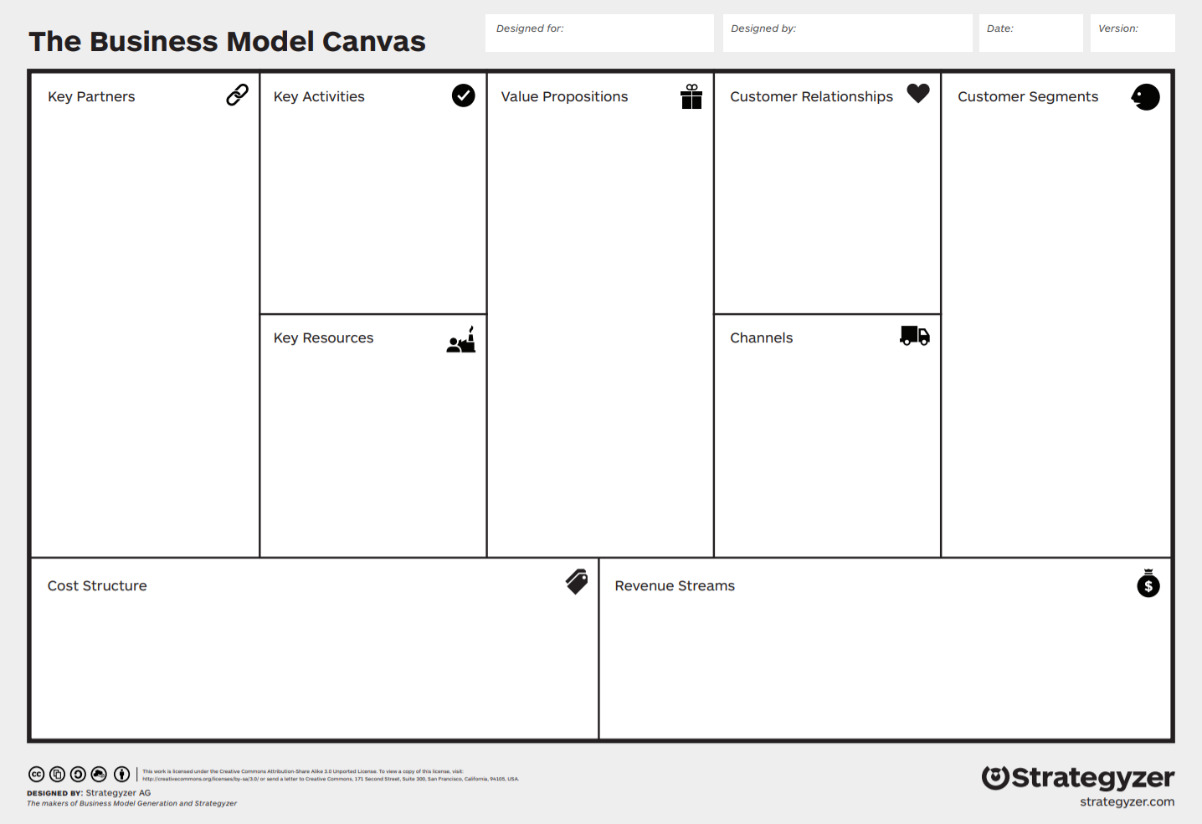
Funding your Startup
Dean Heiss & Dr. Wade Martin – Oct 19, 2021
Notes:
Funding your startup Facts, options, activity 1, information, activity 2, close w/ final comments and mention of Figma for low fidelity prototype Nov 2nd.
9:45
Late Sept Early Oct “Business Model Canvas” Physical, Intellectual, Human, and Financial Resources are all categories within the Key Resources Building block of the business model canvas.
Key Resource Financial = the money available to a business for spending in the form of cash, liquid securities, and credit lines. Sufficient financial resources are required in order to sustain operations.

Slide 2
Some Facts!
77% of small businesses rely on personal savings for startup money
One third of small businesses start with less than $5000
The average small business requires about $10K for startup capital
Only 0.05% of startups raise venture capital
The average seed round is $40m
The median company running a seed funding round is 3 years old
Of startups that raise seed rounds, 1% reach unicorn status, $1b + valuation
Startups with two co-founders rather than one raise 30% more capital
Notes:
For context:
#4: 0.05% of startups raise venture capital = One out of 2,000

Slide 3
What are the options?
Bootstrapping
Debt – you can borrow the money
Equity – you can share ownership
Activity 1: Sketch out plans to fund your startup: How much do you need (debt vs. equity)? When is it needed? Where is it coming from?
Notes:
Combination of options that suit the particular business, strategy, timing, environment.
You want to choose the funding mechanism that is right for your business strategy in the correct time and place. That typically changes over time, and can be mixed over the course of the business evolution.
Incorporate from Frank’s presentation
Add active moments – Activities – Have people report out on the activities.
Activity 1: Sketch out plans to fund your startup: What are you funding? How much do you need (debt vs. equity)? When is it needed? Where is it coming from?
Get them to write this up, then I talk through it and then they change plans accordingly.

Slide 4
Which option is right for you?
High Risk w/ uncertain return
Weak Cash flow, High Leverage, Low-to-moderate growth, Unproven management
Low Risk with ~ predictable return
Strong cash flow, low leverage, audited financials, good management, healthy balance sheet
High Return wwwwwwww
Unique business idea, high growth, niche market, proven management
Notes:
Exercise - Information to help them determine where they may fit

Slide 5
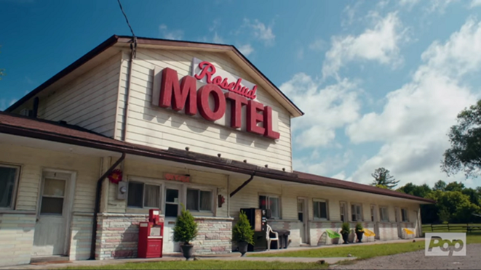
Bootstrapping
Personal savings
Cash from first sales
Notes:
Sweat equity… doing everything yourself. Bootstrapping is building a company from the ground up with nothing but personal savings, and with luck, the cash coming in from the first sales. The term is also used as a noun: A bootstrap is a business an entrepreneur with little or no outside cash or other support launches.
Personal Funds
The vast majority of founders contribute personal funds, along with sweat equity, to their ventures.
Sweat equity represents the value of the time and effort that a founder puts into a new venture.
Schitts Creek example. After Rose's business manager embezzles the family business, Rose Video, the family loses its fortune and relocates to Schitt's Creek, a small town they once purchased as a joke.^{[5]} Now living in a motel as a family, , Johnny Rose (Eugene Levy) and Moira Rose (Catherine O'Hara)—along with their adult children, David (Dan Levy) and Alexis (Annie Murphy)—must adjust to life without money and with each other
Schitts Creek example: Alexis Rose focuses on her education by obtaining her high school diploma and enrolling at a local college. She ultimately opens her own public relations company, Alexis Rose Communications, following the completion of her college degree. Runs this company out of her room in her motel, with her laptop and phone… dedicated to one client (her mom).
Also, David Rose opened his own local goods business, Rose Apothecary with the savings he had accumulated when working as a brand manager at a local clothing store.

Slide 6
Bootstrapping Methods
Buy used instead of
new equipment
Coordinate purchases
with other businesses
Lease equipment
instead of buying
Obtain payments in
advance from
customers
Minimize personal
expenses
Avoid unnecessary
expenses
Work out of your house
Share office space or
employees with other
businesses
Hire interns

Slide 7
Funding Opportunities - Debt
Founders borrowing (credit cards, 2nd mortgage, etc.)
Family & Friends
Opportunity Fund
PACE
SBA
KIVA
Long Beach Economic Development
Commercial Banks
Notes:
Schitts Creek: When they were looking to expand to a second motel, they could not get a commercial bank loan due to the lack of assets, but were able to have their friends (a new key partner) come up with the money after taking a 2nd mortgage on their house
Founders borrowing:
Friends and Family
Friends and family are the second source of funds for many new ventures.
Avoid high-interest loans at all costs. It’ll make you less competitive and less attractive to future investment. Can kill the business over time.
A second mortgage is really risky… you could lose your home!
Non-Profit and Community Lenders
Non-profit and community lenders are one option for obtaining loans. Many of these lenders are mission-driven, meaning they have community or social goals to support low-income communities, and therefore may have fewer restrictions than traditional banks when making lending decisions. Examples of community lenders include community development finance institutions (CDFIs) and some credit unions.
These loans are usually smaller or have fixed interest rates so that borrowers are less likely to default (fail to repay their loan). In addition to providing loans, many of these lenders also provide services like training or technical assistance.
All of the City of Los Angeles' BusinessSource Centers are CDFIs or have a formal relationship with a CDFI, and can be a good starting point to guide you through a few options for lending.
City Loans
City of Long Beach - http://bizport.longbeach.gov/plan/funding-types-incentives
The City of Los Angeles offers various financing programs to assist business owners. These financing and loan programs are designed to benefit low income communities, create jobs and provide goods and services in the City of Los Angeles.
The City offers a Small Business Loan Program for amounts between $50,000 – $500,000. For larger projects, the City also offers Bond Financing and Major Project Financing. You can learn more by visiting the City's Economic and Workforce Development Department website.
PACE LA - CDCs are non-profit community-based development organizations that are established to promote economic opportunities in low-wealth communities.
PACE Business Development Center - We are a non-profit 501(c)(3) community organization that promotes the growth and economic expansion of diverse Los Angeles communities through the infusion of capital and the provision of business consultation services and financial literacy training. We target low- and moderate- income residents, entrepreneurs and business owners in Los Angeles with diverse loan products as well as technical assistance focused on financial education and credit building.
SBA = Federal Loans
Fill out a short questionnaire and you can be matched with participating SBA Lenders through the LINC (Leveraging Information and Networks to access Capital) online referral tool. Submit your loan needs and LINC will connect you with lending partners and the SBA-backed financing programs to help get your business off the ground.
Banks
Bank loans are one of the most traditional ways to finance a business. Unfortunately, they’re also some of the hardest loans to get approved for due to their stricter requirements such as having an alternate source of income, stellar credit, or being able to provide significant collateral. Have a great business plan to support your case, be persistent, shop around for the lowest interest rate, and keep in mind that you can also try other avenues, such as CDFIs.
Tip/Action: Talk to a few banks to learn about their requirements and expectations before you count on bank loans as a source of financing for your business.
Schitts Creek: When they were looking to expand to a second motel, they could not get a commercial bank loan due to the lack of assets, but were able to have their friends (a new key partner) come up with the money after taking a 2nd mortgage on their house

Slide 8
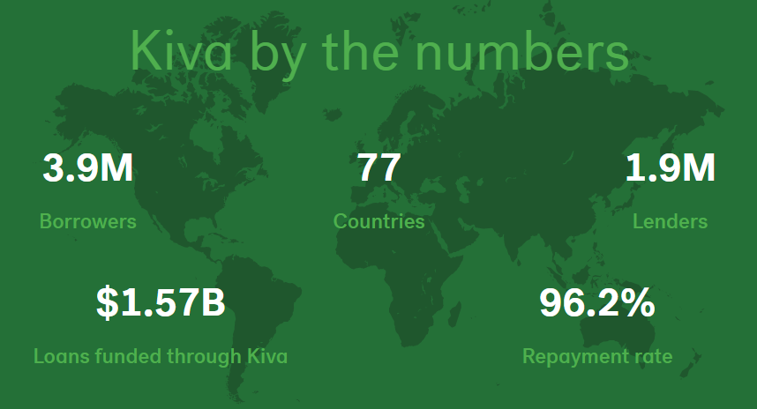
Debt - Kiva
Loan amount: $500-$10,000
Term: 6-36 months
0% interest rate!
Loans are crowdfunded on Kiva
IIE is a Kiva Trustee who identifies and vets borrowers
Kiva Long Beach
Notes:
Kiva Loan Program
The City of Long Beach has partnered with The Los Angeles Local Initiatives Support Corporation (LA LISC) to offer zero interest loans to local business owners. Through Kiva, everyday residents can loan as little as $25 to small businesses of their choice as part of a crowdfunded loan program. loans are approved through “social underwriting,” where trustworthiness is determined by friends and family lending a portion of the loan request and by a Kiva approved Trustee who will vouch for the borrower. LA LISC will match loan contributions made to borrowers who have been endorsed by a Trustee.
Loan Amount: $500-$10,000
Term: 6-36 months
Rate: 0%

Slide 9
Debt – Small Business Administration (SBA)
~50% of the 9,000 banks in the U.S. participate in the SBA Guaranteed Loan Program
Operates through private-sector lenders who provide loans that are guaranteed by the SBA
The loans are for small businesses that are not able to obtain credit elsewhere
Almost all small businesses are eligible to apply for an SBA guaranteed loan
The SBA can guarantee as much as 85% on loans up to $150,000 and 75% on loans over $150,000
An SBA guaranteed loan can be used for almost any legitimate business purpose
Although SBA guaranteed loans are utilized more heavily by existing small businesses than start-ups, they should not be dismissed as a possible source of financing
PACE Business Development Center

Slide 10
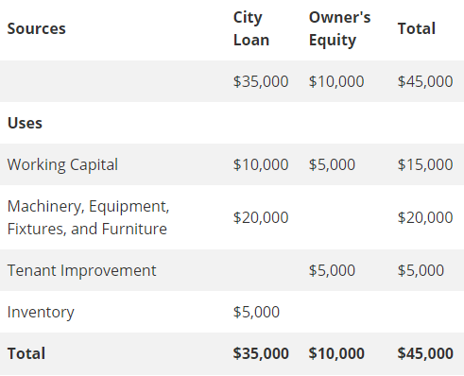
Debt – City Loans (LB Economic Dev.)
Based on quality of your business plan, resume, and personal qualifications
Credit score is considered, but not deal-breaker
Federally funded, so tax liens disqualify
Show how you intend to use funds
Notes:
The City of Long Beach has several loan programs for small businesses. City loans are based on the quality of your business plan as well as your resume and other personal qualifications. Credit score is part of the decision, but a low Credit score might not prevent you from getting a loan.
Before applying for a City loan, you should obtain a copy of your credit report to check your credit status. Once a year, you can get a free copy of your credit report
Since City loan programs are federally funded, all tax liens must be addressed/cured before submitting an loan application.

Slide 11
Debt – City Loans (LB Economic Dev.)
Microenterprise Loan Program
The Microenterprise Loan Program is designed to support Long Beach small businesses
Between $25,000 to $100,000 is available for small businesses operating in Long Beach
Interest rate: Wall Street Journal prime rate + 1.5 percent
Fees: 2 percent loan fee, if loan closes
Term: 5 to 10 years
Loan proceeds may go toward business expenses, such as personnel, rent, supplies/materials, utilities, professional services, and more (proceeds cannot be spent on construction)
Must create 1 full-time job for every $35,000 borrowed
Personal guarantee is required for all loans
Businesses must be a for-profit entity
All loans must be approved by the City's Loan Committee.
Notes:
The City of Long Beach has several loan programs for small businesses. City loans are based on the quality of your business plan as well as your resume and other personal qualifications. Credit score is part of the decision, but a low Credit score might not prevent you from getting a loan.
Before applying for a City loan, you should obtain a copy of your credit report to check your credit status. Once a year, you can get a free copy of your credit report
Since City loan programs are federally funded, all tax liens must be addressed/cured before submitting an loan application.

Slide 12
Debt – City Loans (LB Economic Dev.)
Grow Long Beach Fund
Partnership between the City of Long Beach and National Development Council Grow America Fund
Between $100,000 to $2 million is available for businesses that have been operating in Long Beach for at least two years
Interest rate: based on current Wall Street Journal prime rate
Term: 3 to 25 years
Loans underwritten by National Development Council and guaranteed by the Small Business Administration
Business must be a for-profit entity
Funds can be used for any legitimate business expense (construction, tenant improvements, equipment, working capital, etc.)
Notes:
The City of Long Beach has several loan programs for small businesses. City loans are based on the quality of your business plan as well as your resume and other personal qualifications. Credit score is part of the decision, but a low Credit score might not prevent you from getting a loan.
Before applying for a City loan, you should obtain a copy of your credit report to check your credit status. Once a year, you can get a free copy of your credit report

Slide 13
Debt – Commercial Banks
Most traditional but hardest ways to finance a business
Banks are interested in firms that have strong cash flow, low leverage, audited financials, good management, and a healthy balance sheet
Typically, stricter requirements such as having an alternate source of income, stellar credit, or being able to provide significant collateral
Have a great business plan to support your case, be persistent, shop around for the lowest interest rate, and keep in mind that you can also try other avenues, such as CDFIs
Talk to a few banks to learn about their requirements and expectations before you count on bank loans as a source of financing for your business.
Notes:
Bank loans are one of the most traditional ways to finance a business. Unfortunately, they’re also some of the hardest loans to get approved for due to their stricter requirements such as having an alternate source of income, stellar credit, or being able to provide significant collateral. Have a great business plan to support your case, be persistent, shop around for the lowest interest rate, and keep in mind that you can also try other avenues, such as CDFIs.
Tip/Action: Talk to a few banks to learn about their requirements and expectations before you count on bank loans as a source of financing for your business.
Kourosh

Slide 14
Funding Categories - Equity
Founders Savings
Friends & Family
Angel Investors
Venture Capitalist
Seed Round
Series A, B, etc.
Notes:
Investors
Your investors might be people you know such as friends, relatives, and colleagues. Or it could take the form of venture capital, which comes in the form of individuals (often called angel investors) or venture capital firms who invest in businesses that they think are promising.
Angel investors will often provide capital and mentoring in exchange for equity in the business, and may require certain conditions such as influencing how to run the company.
Tip/Action: If you receive money from friends or family, it's always a good idea to have the terms in writing to avoid future challenges or legal issues. If the money is a gift and not a loan, keep in mind that you may need to report and pay a gift tax to the IRS.
I highly Recommend using a SAFE – example at Y-Combinator.
Schitts Creek: The motel was a struggling business that fell into the hands of Stevie Budd, a clerk at the motel where the Roses reside. It was owned by the hotel clerk’s Aunt or relative (Stevie’s Aunt) and when they passed away, they left it to Stevie. She had no idea how to do it on her own, but Johnny Rose was a perfect key partner to help. He did so in exchange for equity. Later in the series, when they intended to grow the business to a major franchise, they decided to seek out Venture Capital funding that could allow them to grow from 2 properties to hundreds.

Slide 15
Funding Categories – Equity Angel Investors
Angel Investors
Individuals who invest their personal capital directly in start-ups in exchange for equity
May require certain conditions such as influencing how to run the company
Looking for companies that have the potential to grow between 30% to 40% per year and/or can return 300%
Notes:
Investors
Your investors might be people you know such as friends, relatives, and colleagues. Or it could take the form of venture capital, which comes in the form of individuals (often called angel investors) or venture capital firms who invest in businesses that they think are promising.
Angel investors will often provide capital and mentoring in exchange for equity in the business, and may require certain conditions such as influencing how to run the company.
Tip/Action: If you receive money from friends or family, it's always a good idea to have the terms in writing to avoid future challenges or legal issues. If the money is a gift and not a loan, keep in mind that you may need to report and pay a gift tax to the IRS.
I highly Recommend using a SAFE – example at Y-Combinator.
Schitts Creek: The motel was a struggling business that fell into the hands of Stevie Budd, a clerk at the motel where the Roses reside. It was owned by the hotel clerk’s Aunt or relative (Stevie’s Aunt) and when they passed away, they left it to Stevie. She had no idea how to do it on her own, but Johnny Rose was a perfect key partner to help. He did so in exchange for equity. Later in the series, when they intended to grow the business to a major franchise, they decided to seek out Venture Capital funding that could allow them to grow from 2 properties to hundreds.

Slide 16
Funding Categories – Equity, Venture Capital
Venture Capital
Money that is invested by venture capital firms in start-ups and small businesses with exceptional growth potential
There are about 1,000 venture capital firms in the U.S.
Venture capital firms fund very few entrepreneurial firms in comparison to business angels
Notes:
What Is Venture Capital?
Venture capital (VC) is a form of private equity and a type of financing that investors provide to startup companies and small businesses that are believed to have long-term growth potential. Venture capital generally comes from well-off investors, investment banks, and any other financial institutions. However, it does not always take a monetary form; it can also be provided in the form of technical or managerial expertise. Venture capital is typically allocated to small companies with exceptional growth potential, or to companies that have grown quickly and appear poised to continue to expand.

Slide 17
Other Sources
Crowdfunding (Rewards based)
Kickstarter / Indiegogo / RocketHub
Crowdfunding (Equity based)
Funders Club / Startengine.com / Crowdfunder.com
Grants (e.g., SBIR/STTR)
Competitions (e.g., PitchFest & Innovation Challenge)
Notes:
Peer-to-peer Lending / Crowdfunding
Peer-to-peer lending, also known as crowdfunding, is an alternative funding model in which individual investors provide small sums as personal loans to individuals via Internet platforms. Crowdfunding is a way for businesses to raise money not only from friends and family, but also the general public. There are a number of online crowdfunding platforms where you request a certain amount of money to start or grow your business. People often are interested in supporting small businesses and start-ups and can use crowdfunding to lend their own money to you at low- or no-interest rates. Because of the highly social nature of crowdfunding, this method of raising money is also a great way to raise awareness of your business or product.
Types of Crowdfunding Programs
Rewards-based crowdfunding allows entrepreneurs to raise money in exchange for some type of amenity or reward.
The most popular rewards-based crowdfunding sites are Kickstarter, Indiegogo, and RocketHub.
Equity based
Tip/Action: Search for crowdfunding platforms online and choose the best one for you based on fees and campaign rules so that you can maximize your fundraising.
We’ve provided some recommended resources here for both Rewards based and equity based crowdfunding
Grants
Grants are money given to you that you do not have to pay back. The money is sometimes restricted to certain uses, like repainting the front of a store or buying better equipment. Some grants are given in cash, while others pay you back (“reimburse” you) for money that you spend.
Small Business Innovation Research (SBIR)
Small Business Technology Transfer (STTR)
Competitions – PitchFest, Innovation Challenge, etc.

Slide 18
Activity 2
Revise your funding plans
Share your revised plans with another team (mentioning what changed, if anything)
Notes:
Talk about what you are doing with another team and how it changed from the start of this (activity 1).

Slide 19
Closing Comments
Bootstrapping is the first step
Delay outside funding, if practical, until risk is reduced and returns are predictable or high
Take advantage of success by funding growth with sales revenue
Structure all funding
Consider control/decision making
Formalize all funding on paper: S.A.F.E., Stock agreement, etc.
Notes:
First step is bootstrapping. You can make it happen all on your own and come out with full ownership (all the money) and full control (all the power/freedom)
Delay outside funding if practical – If you can make the small business work with your bootstrapping (self-funding and reinvesting revenue from operations), you’ll maintain complete ownership and it’ll pay off when your company is worth more and more attractive.
You’ll either get higher dividends (aka reap all the profit)
Or You’ll be more attractive to a buyer or investor (as you have no other parties to have to buy out or negotiate with) and show that the business is economically sustainable.
And you’ll get higher dollar for your shares at a later date than up front.
This maximizes your earnings per share = higher share price when you fuund
Take advantage of success by funding when doing well – Look at AMC, They found enough cash on hand to avoid bankruptcy through the pandemic, but when their stock price went to the moon, they took advantage of that by issuing more shares at that high price… This further grew their cash balances and go them multiples in more funding than if they had issued mores stock when struggling.
Also, when you take on funds, you should always use them to grow the business.. This amounts to the ROI.
Structure:
Consider control/decision making: Unless it is what you are looking for, avoid the investor who gives you money for control of the decision-making. Can take away your freedom and cause a rift in the culture. If it is what you are looking for, Consider your investor(s) as key partners if possible, as they can provide you with more than just funding. They may be able to get you some clout and shared legal resources, or operational/physical resources at a discount. This plays into your strategy.
Formalize all funding on paper: S.A.F.E., Stock agreement, etc –
More on this next week, as Rick Citron discusses sharing ownership with y’all. He will talk about the massive importance of establishing Cap Tables, and agreements amongst the equity owners.
Feb 23 – "Sharing Ownership" Featured Guest Speakers: Rick Citron

Slide 20
Backup

Slide 21
Small Business
Personal Finance/Bootstrapping
Equity Finance
Debt Finance
Venture Capital (VC)
Angel Investment
CDFI
CDC
Grants/Loans
Federal Government
City of Long Beach
Small Business Innovation Research (SBIR)
Small Business Technology Transfer (STTR)
SBA Grants
KIVA
Microenterprise
GROW Long Beach
CDC Small Business Finance
PACE LA
Opportunity Fund
LA LISC
Crowdlending
Grants.gov
Donor Crowdlending
Crowdfunding
Debt Crowdfunding
Equity Crowdfunding
Rewards-based Crowdfunding
Donor Crowdfunding
Notes:
Various paths of funding are shown here and broken out on the following slides.
Bank loans are one of the most traditional ways to finance a business. Unfortunately, they’re also some of the hardest loans to get approved for due to their stricter requirements such as having an alternate source of income, stellar credit, or being able to provide significant collateral. Have a great business plan to support your case, be persistent, shop around for the lowest interest rate, and keep in mind that you can also try other avenues, such as CDFIs.
Commercial Banks are an obvious source of Debt Financing

Slide 22
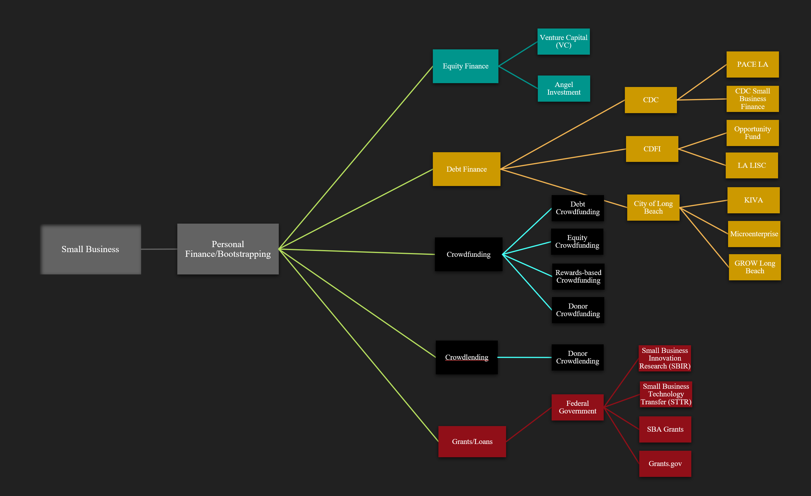
Small Business
Personal Finance/Bootstrapping
Crowdlending
Crowdfunding
Donor Crowdlending
Debt Crowdfunding
Equity Crowdfunding
Rewards-based Crowdfunding
Donor Crowdfunding
Notes:
Crowd Lending is in exchange for interest. Crowd Funding is in exchange for equity.
Crowdfunding (Rewards based)
Kickstarter
Indiegogo
RocketHub
Crowdfunding (Equity based)
Funders Club
Startengine.com
Crowdfunder.com

Slide 23
Small Business
Personal Finance/Bootstrapping
Equity Finance
Venture Capital (VC)
Angel Investment
Notes:
Only 0.05% of startups raise venture capital. 0.05% of startups raise venture capital = One out of 2,000

Slide 24
Small Business
Personal Finance/Bootstrapping
Debt Finance
CDFI
CDC
City of Long Beach
KIVA
Microenterprise
CDC Small Business Finance
PACE LA
Opportunity Fund
LA LISC
GROW Long Beach
Notes:
Community Development Corporations (CDCs) and Community Development Financial Institutions (CDFIs) are certified community based non-profits that help low wealth communities through economic opportunities. CDCs are non-profit community-based development organizations that are established to promote economic opportunities in low-wealth communities. CDFIs are non-profit community-based financial institutions that are established to provide responsible and affordable financial products and services that will promote economic growth in under-served neighborhoods and communities.
Note: Commercial Banks are an obvious source of Debt Financing

Slide 25
Small Business
Personal Finance/Bootstrapping
Grants
Federal Government
Small Business Innovation Research (SBIR)
Small Business Technology Transfer (STTR)
SBA Grants
Grants.gov
Notes:
No interest gift of money!

