Slide 1
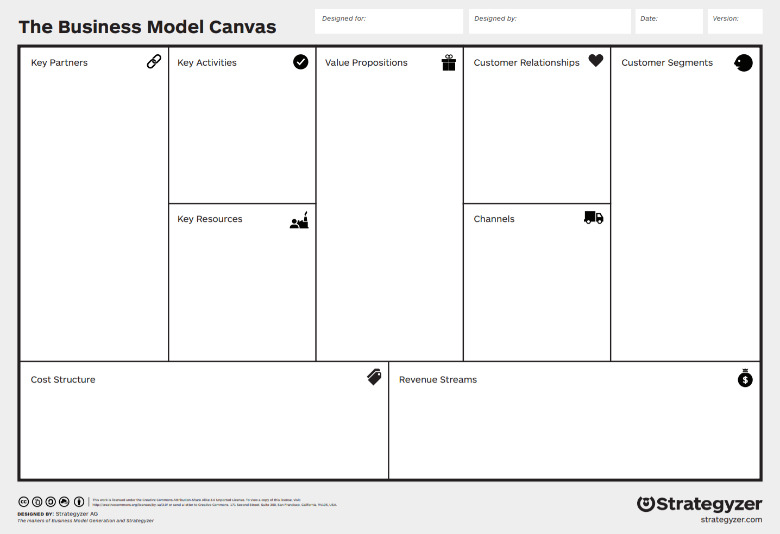
Funding your Startup
Apostle Incubator – February 16, 2021
Notes:
Late Sept Early Oct “Business Model Canvas” Physical, Intellectual, Human, and Financial Resources are all categories within the Key Resources Building block of the business model canvas.
Key Resource Financial = the money available to a business for spending in the form of cash, liquid securities, and credit lines. Sufficient financial resources are required in order to sustain operations.

Slide 2
Some Facts!
77% of small businesses rely on personal savings for startup money
One third of small businesses start with less than $5000
The average small business requires about $10K for startup capital
Only 0.05% of startups raise venture capital
The average seed round is $40m
The median company running a seed funding round is 3 years old
Of startups that raise seed rounds, 1% reach unicorn status, $1b + valuation
Startups with two co-founders rather than one raise 30% more capital
Notes:
For context:
#4: 0.05% of startups raise venture capital = One out of 2,000

Slide 3
What are the options?
Bootstrapping
Debt – you can borrow the money
Equity – you can share ownership
Notes:
Combination of options that suit the particular business, strategy, timing, environment.
You want to choose the funding mechanism that is right for your business strategy in the correct time and place. That typically changes over time, and can be mixed over the course of the business evolution.

Slide 4
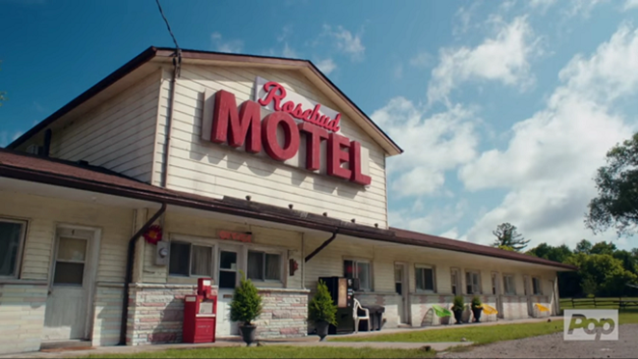
Bootstrapping
Personal savings
Cash from first sales
Lease equipment
Work out of your house
Etc.
Notes:
Sweat equity… doing everything yourself. Bootstrapping is building a company from the ground up with nothing but personal savings, and with luck, the cash coming in from the first sales. The term is also used as a noun: A bootstrap is a business an entrepreneur with little or no outside cash or other support launches.
Schitts Creek example. After Rose's business manager embezzles the family business, Rose Video, the family loses its fortune and relocates to Schitt's Creek, a small town they once purchased as a joke.^{[5]} Now living in a motel as a family, , Johnny Rose (Eugene Levy) and Moira Rose (Catherine O'Hara)—along with their adult children, David (Dan Levy) and Alexis (Annie Murphy)—must adjust to life without money and with each other
Schitts Creek example: Alexis Rose focuses on her education by obtaining her high school diploma and enrolling at a local college. She ultimately opens her own public relations company, Alexis Rose Communications, following the completion of her college degree. Runs this company out of her room in her motel, with her laptop and phone… dedicated to one client (her mom).
Also, David Rose opened his own local goods business, Rose Apothecary with the savings he had accumulated when working as a brand manager at a local clothing store.

Slide 5
Funding Opportunities - Debt
Founders borrowing (credit cards, 2nd mortgage, etc.)
Family & Friends
KIVA
Opportunity Fund
PACE
SBA
Long Beach Economic Development
Commercial Banks
Notes:
Founders borrowing:
Avoid high-interest loans at all costs. It’ll make you less competitive and less attractive to future investment. Can kill the business over time.
A second mortgage is really risky… you could lose your home!
Non-Profit and Community Lenders
Non-profit and community lenders are one option for obtaining loans. Many of these lenders are mission-driven, meaning they have community or social goals to support low-income communities, and therefore may have fewer restrictions than traditional banks when making lending decisions. Examples of community lenders include community development finance institutions (CDFIs) and some credit unions.
These loans are usually smaller or have fixed interest rates so that borrowers are less likely to default (fail to repay their loan). In addition to providing loans, many of these lenders also provide services like training or technical assistance.
All of the City of Los Angeles' BusinessSource Centers are CDFIs or have a formal relationship with a CDFI, and can be a good starting point to guide you through a few options for lending.
City Loans
The City of Los Angeles offers various financing programs to assist business owners. These financing and loan programs are designed to benefit low income communities, create jobs and provide goods and services in the City of Los Angeles.
The City offers a Small Business Loan Program for amounts between $50,000 – $500,000. For larger projects, the City also offers Bond Financing and Major Project Financing. You can learn more by visiting the City's Economic and Workforce Development Department website.
PACE LA - CDCs are non-profit community-based development organizations that are established to promote economic opportunities in low-wealth communities.
Banks
Bank loans are one of the most traditional ways to finance a business. Unfortunately, they’re also some of the hardest loans to get approved for due to their stricter requirements such as having an alternate source of income, stellar credit, or being able to provide significant collateral. Have a great business plan to support your case, be persistent, shop around for the lowest interest rate, and keep in mind that you can also try other avenues, such as CDFIs.
Tip/Action: Talk to a few banks to learn about their requirements and expectations before you count on bank loans as a source of financing for your business.
Schitts Creek: When they were looking to expand to a second motel, they could not get a commercial bank loan due to the lack of assets, but were able to have their friends (a new key partner) come up with the money after taking a 2nd mortgage on their house

Slide 6
Funding Categories - Equity
Founders Savings
Friends & Family
Angel Investors
Venture Capitalist
Seed Round
Series A, B, etc.
Notes:
Investors
Your investors might be people you know such as friends, relatives, and colleagues. Or it could take the form of venture capital, which comes in the form of individuals (often called angel investors) or venture capital firms who invest in businesses that they think are promising. Angel investors will often provide capital and mentoring in exchange for equity in the business, and may require certain conditions such as influencing how to run the company.
Tip/Action: If you receive money from friends or family, it's always a good idea to have the terms in writing to avoid future challenges or legal issues. If the money is a gift and not a loan, keep in mind that you may need to report and pay a gift tax to the IRS.
I highly Recommend using a SAFE – example at Y-Combinator.
Schitts Creek: The motel was a struggling business that fell into the hands of Stevie Budd, a clerk at the motel where the Roses reside. It was owned by the hotel clerk’s Aunt or relative (Stevie’s Aunt) and when they passed away, they left it to Stevie. She had no idea how to do it on her own, but Johnny Rose was a perfect key partner to help. He did so in exchange for equity. Later in the series, when they intended to grow the business to a major franchise, they decided to seek out Venture Capital funding that could allow them to grow from 2 properties to hundreds.

Slide 7
Other Sources
Crowdfunding (Rewards based)
Kickstarter
Indiegogo
RocketHub
Crowdfunding (Equity based)
Funders Club
Startengine.com
Crowdfunder.com
SBIR/STTR
Notes:
Peer-to-peer Lending / Crowdfunding
Peer-to-peer lending, also known as crowdfunding, is an alternative funding model in which individual investors provide small sums as personal loans to individuals via Internet platforms. Crowdfunding is a way for businesses to raise money not only from friends and family, but also the general public. There are a number of online crowdfunding platforms where you request a certain amount of money to start or grow your business. People often are interested in supporting small businesses and start-ups and can use crowdfunding to lend their own money to you at low- or no-interest rates. Because of the highly social nature of crowdfunding, this method of raising money is also a great way to raise awareness of your business or product.
Tip/Action: Search for crowdfunding platforms online and choose the best one for you based on fees and campaign rules so that you can maximize your fundraising.
We’ve provided some recommended resources here for both Rewards based and equity based crowdfunding

Slide 8
Small Business
Personal Finance/Bootstrapping
Equity Finance
Debt Finance
Venture Capital (VC)
Angel Investment
CDFI
CDC
Grants/Loans
Federal Government
City of Long Beach
Small Business Innovation Research (SBIR)
Small Business Technology Transfer (STTR)
SBA Grants
KIVA
Microenterprise
GROW Long Beach
CDC Small Business Finance
PACE LA
Opportunity Fund
LA LISC
Crowdlending
Grants.gov
Donor Crowdlending
Crowdfunding
Debt Crowdfunding
Equity Crowdfunding
Rewards-based Crowdfunding
Donor Crowdfunding
Notes:
Various paths of funding are shown here and broken out on the following slides.
Bank loans are one of the most traditional ways to finance a business. Unfortunately, they’re also some of the hardest loans to get approved for due to their stricter requirements such as having an alternate source of income, stellar credit, or being able to provide significant collateral. Have a great business plan to support your case, be persistent, shop around for the lowest interest rate, and keep in mind that you can also try other avenues, such as CDFIs.

Slide 9
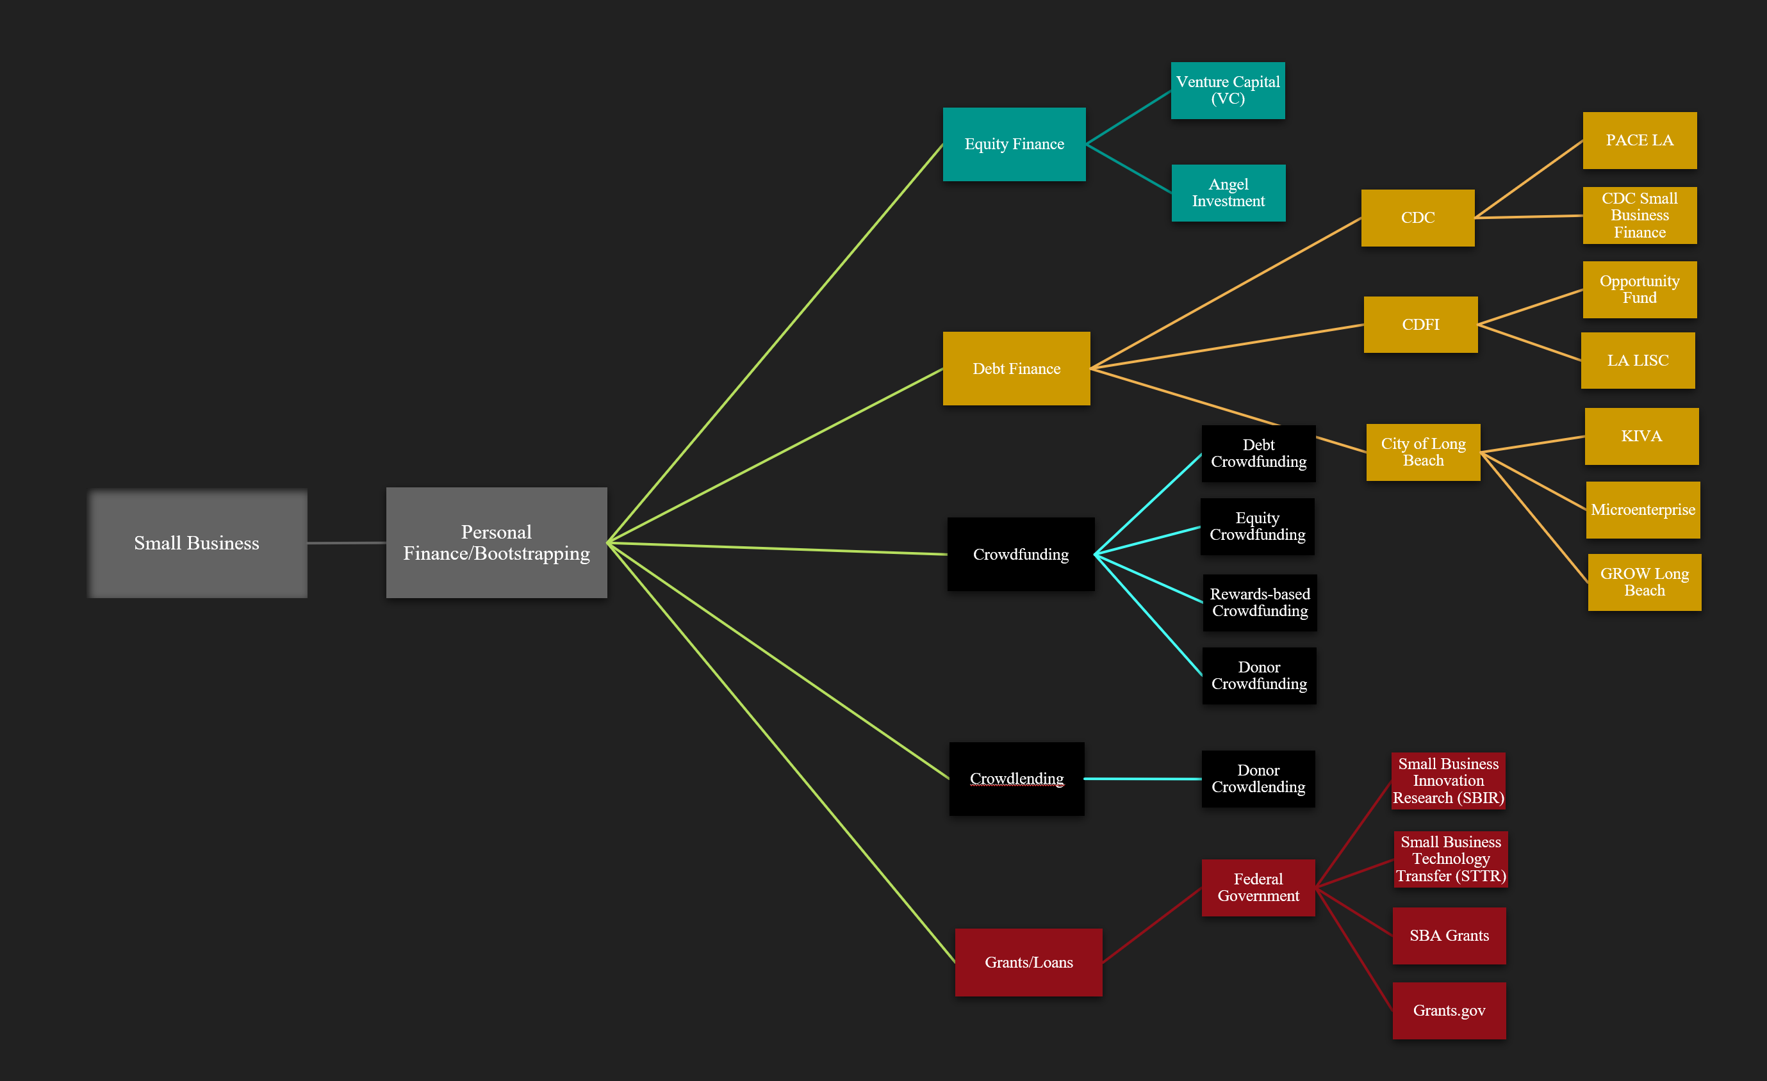
Small Business
Personal Finance/Bootstrapping
Crowdlending
Crowdfunding
Donor Crowdlending
Debt Crowdfunding
Equity Crowdfunding
Rewards-based Crowdfunding
Donor Crowdfunding
Notes:
Crowd Lending is in exchange for interest. Crowd Funding is in exchange for equity.
Crowdfunding (Rewards based)
Kickstarter
Indiegogo
RocketHub
Crowdfunding (Equity based)
Funders Club
Startengine.com
Crowdfunder.com

Slide 10
Small Business
Personal Finance/Bootstrapping
Equity Finance
Venture Capital (VC)
Angel Investment
Notes:
Only 0.05% of startups raise venture capital. 0.05% of startups raise venture capital = One out of 2,000

Slide 11
Small Business
Personal Finance/Bootstrapping
Debt Finance
CDFI
CDC
City of Long Beach
KIVA
Microenterprise
CDC Small Business Finance
PACE LA
Opportunity Fund
LA LISC
GROW Long Beach
Notes:
Community Development Corporations (CDCs) and Community Development Financial Institutions (CDFIs) are certified community based non-profits that help low wealth communities through economic opportunities. CDCs are non-profit community-based development organizations that are established to promote economic opportunities in low-wealth communities. CDFIs are non-profit community-based financial institutions that are established to provide responsible and affordable financial products and services that will promote economic growth in under-served neighborhoods and communities.

Slide 12
Small Business
Personal Finance/Bootstrapping
Grants
Federal Government
Small Business Innovation Research (SBIR)
Small Business Technology Transfer (STTR)
SBA Grants
Grants.gov
Notes:
No interest gift of money!

Slide 13
Closing Comments
Bootstrapping is the first step
Delay outside funding, if practical
Take advantage of success by funding to grow
Structure all funding
Consider control/decision making
Formalize all funding on paper: S.A.F.E., Stock agreement, etc.
Notes:
First step is bootstrapping. You can make it happen all on your own and come out with full ownership (all the money) and full control (all the power/freedom)
Delay outside funding if practical – If you can make the small business work with your bootstrapping (self-funding and reinvesting revenue from operations), you’ll maintain complete ownership and it’ll pay off when your company is worth more and more attractive.
You’ll either get higher dividends (aka reap all the profit)
Or You’ll be more attractive to a buyer or investor (as you have no other parties to have to buy out or negotiate with) and show that the business is economically sustainable.
And you’ll get higher dollar for your shares at a later date than up front.
This maximizes your earnings per share = higher share price when you fuund
Take advantage of success by funding when doing well – Look at AMC, They found enough cash on hand to avoid bankruptcy through the pandemic, but when their stock price went to the moon, they took advantage of that by issuing more shares at that high price… This further grew their cash balances and go them multiples in more funding than if they had issued mores stock when struggling.
Also, when you take on funds, you should always use them to grow the business.. This amounts to the ROI.
Structure:
Consider control/decision making: Unless it is what you are looking for, avoid the investor who gives you money for control of the decision-making. Can take away your freedom and cause a rift in the culture. If it is what you are looking for, Consider your investor(s) as key partners if possible, as they can provide you with more than just funding. They may be able to get you some clout and shared legal resources, or operational/physical resources at a discount. This plays into your strategy.
Formalize all funding on paper: S.A.F.E., Stock agreement, etc –
More on this next week, as Rick Citron discusses sharing ownership with y’all. He will talk about the massive importance of establishing Cap Tables, and agreements amongst the equity owners.
Feb 23 – "Sharing Ownership" Featured Guest Speakers: Rick Citron

