Slide 1
BIG Picture BIG Data
CSULB Opportunities and Challenges for Diversifying the Faculty

Slide 2
The BIG Data Quick Quiz
True or False: The number of PhD’s granted in the U.S. has been on the rise since 2009?
How many doctoral degrees (PhD, EdD, JD, MD, DDS) were granted in the U.S. in 2013?
How many PhD’s were granted in the U.S. in 2013?
What state produces the most PhD's?
What university awarded the most PhD’s in 2013?
What academic area experienced the most growth in PhDs in 2013?

Slide 3
BIG DATA: Doctoral/Equivalent 2013
Total | White | Black | Hispanic | A/PI | AI/AKN |  | 2+ Races | NR-A
175,038 | 110,775 | 12,084 | 10,107 | 18,408 | 900 |  | 2,438 | 20,326
Males | Females
62,730 | 89,934
Total PhDs | Asian/Am | AF/AM | HIS/Latino
52,560 | 25.5% | 5.03% | 5.8%
PhD’s reporting jobs at graduation: 62.7%

Slide 4
Diversifying the faculty requires a diverse pipeline…
Hiring a diverse faculty is important, but so is developing a robust “pipeline” AND retaining and promoting the diverse faculty we hire.
Undergraduate
Masters
Ph.D.
Assistant
Professor
Associate Professor
Full
Professor
Department Hiring

Slide 5
CSULB – Opportunities for Diversifying the Faculty
Strong Pipeline Opportunities
  Top 10 in Bachelor’s Degrees to Minority Students
  100 Best Values in Public Colleges
  Among Nation’s Top 10 in Bachelor and Masters Degrees to Hispanics
  Designated a ‘Military Friendly School’
  Ranked No. 4 (Top Regional University) in the West by U.S.News & World Report
  63 academic departments and programs, 24 centers, four institutes and four clinics.

Slide 6
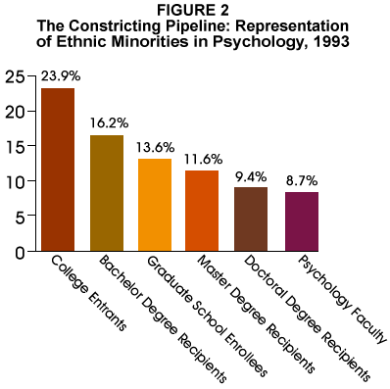
Pipeline Case Study: Psychology

Slide 7
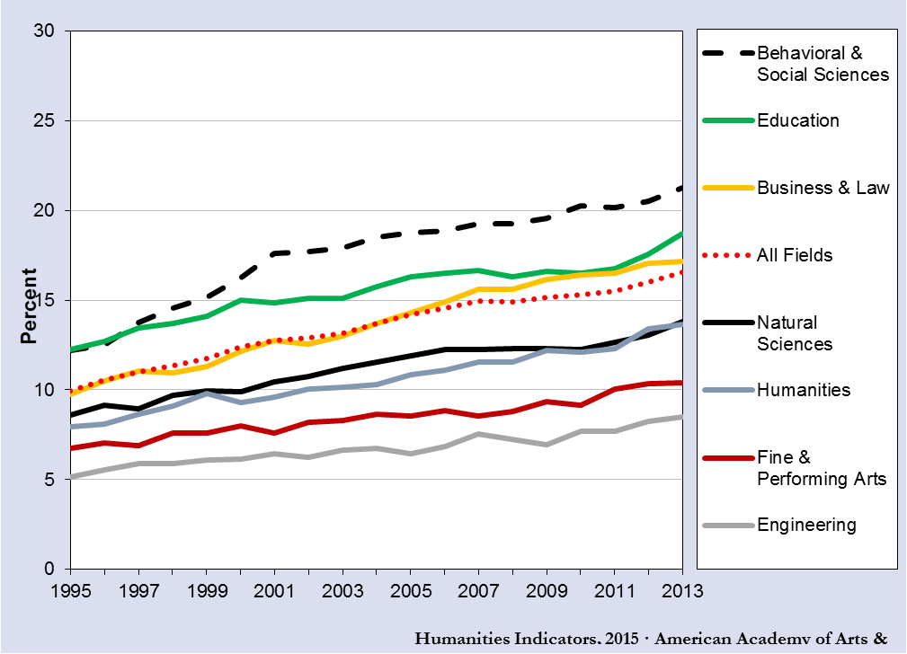
Percentage of Master’s and Professional-Practice Degrees Awarded to Traditionally Underrepresented Racial/Ethnic Groups, by Field, 1995–2013

Slide 8
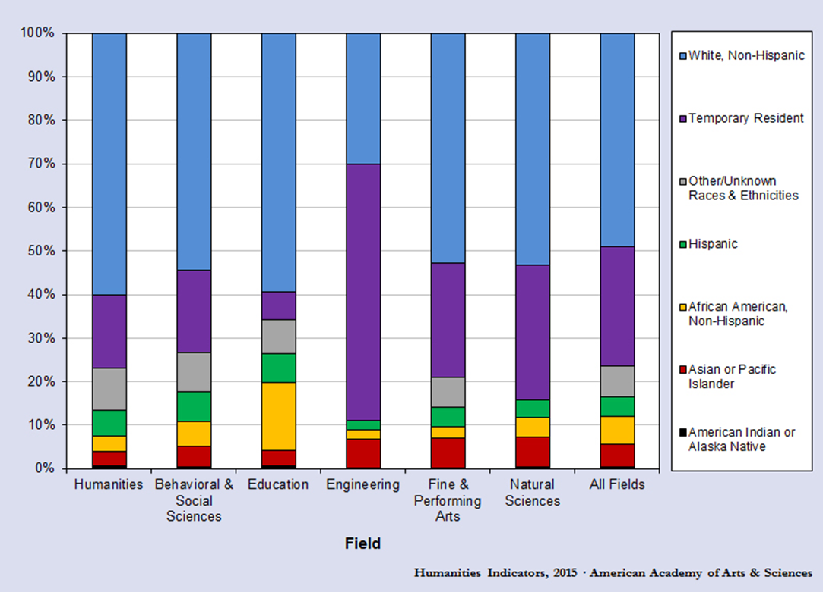
Racial/Ethnic Distribution of 2013 Doctoral Degree Recipients, Selected Academic Fields

Slide 9
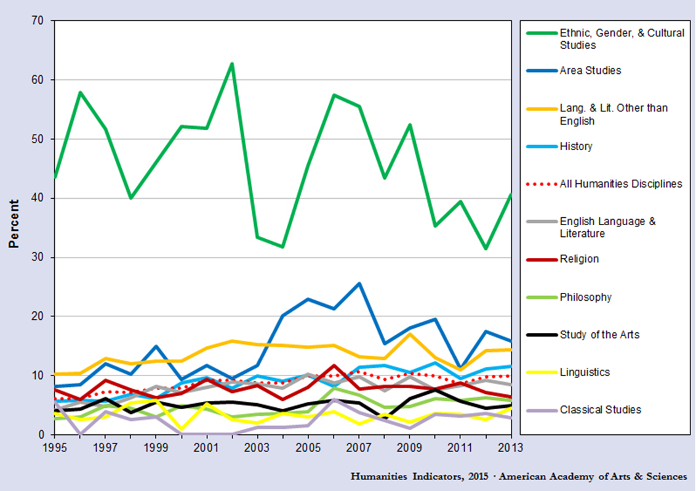
Percentage of Doctoral Degrees Awarded to Members of Traditionally Underrepresented Racial/Ethnic Groups,* Selected Humanities Disciplines, 1995–2013

Slide 10
Diversifying the faculty requires a diverse pipeline…
Hiring a diverse faculty is important, but so is developing a robust “pipeline” AND retaining and promoting the diverse faculty we hire.
Undergraduate
Masters
Ph.D.
Assistant
Professor
Associate Professor
Full
Professor
Department Hiring

Slide 11
Challenges: Department Strategic Planning for Pipeline Support
A Tale of Two Colleges
CLA BA’s Granted/MA Seeking
CHHS BA’s Granted/MA Seeking
BA’s Granted 7,668
MA Seeking 523
TOP 5 BA Enrollment
  Communication Studies
  Psychology
  Sociology
  Management
  Accountancy
BA/S Granted 6,659
MA Seeking 1,719

Slide 12
Challenges: Retaining and Promoting
No differences based on faculty race and workplace satisfaction.
Mentoring Diverse Faculty (see COACHE, 2008)
  “The Similarity Thesis”
Professional Assistance (see COACHE, 2008)
  Improve teaching skills
  Childcare
  Financial assistance with housing
  Stop-the-tenure clock
  Personal leaves during probationary period

Slide 13
Diversifying the faculty requires a diverse pipeline…
Hiring a diverse faculty is important, but so is developing a robust “pipeline” AND retaining and promoting the diverse faculty we hire.
Undergraduate
Masters
Ph.D.
Assistant
Professor
Associate Professor
Full
Professor
Department Hiring

Slide 14
Challenges: Department Strategic Planning for Hiring for the FUTURE
Move beyond “replacement” thinking
Ask and Answer Questions: What do we want our department to be in the next 3, 5, 10 years?
What are our opportunities for growth?
What are our opportunities for change?
What are our unmet demands?
Who are our students and what is their future?

