Slide 1
Efficient & Effective Teaching
By: Terre H. Allen, PhD
Professor/Senior Director
Faculty Center for Professional Development
CSULB

Slide 2
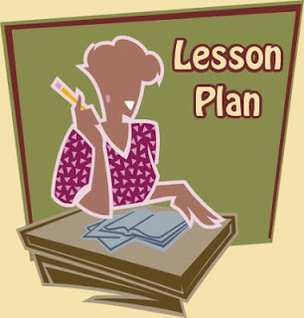
How much is enough?
Have you ever wondered …
  How much time should I spend preparing for class?
  How much time should I spend grading?
  How much time should I spend on research/creative activities?
  What does it take to achieve a healthy teaching/research balance?
  Will I have time for a personal life?

Slide 3
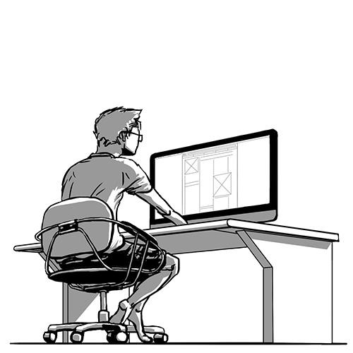
One size doesn’t fit all…
Bob Boice studied the habits of new faculty who were successful at achieving tenure and promotion and the habits of those who were not successful.
Boice makes several recommendations for engaging in behaviors that lead to faculty success….

Slide 4
Boice’s Research
Common behaviors of the new faculty members:
  spent far less time on scholarly writing (proposals and papers) than was needed to meet promotion and tenure criteria for their institutions.
  admitted to going to class over-prepared (with more material than they could reasonably cover in the allotted time) and rushing to complete everything, often at the expense of active student participation. (nearly 30 hours per week on class preparation)
  taught defensively, doing whatever they could to avoid student complaints (primarily concerned that students would complain about content errors).

Slide 5
Boice’s Research
received student evaluations that fell well below their expectations and blamed the results on external factors (invalid rating systems, poor students, unfavorable class times and sizes).
experienced a sense of loneliness and lack of collegial acceptance, and had difficulty establishing productive contacts with colleagues who could provide guidance and support.

Slide 6

Boice’s Advice
Limit classroom preparation to a maximum of two hours per hour of lecture.
Spend 30-60 minutes a day on scholarly writing.
Spend at least 2 hours a week on discussions with colleagues focused on teaching and research.
Keep daily records of work time expenditure.
Integrate research interests into lectures.
Engage students in active learning.

Slide 7
Tips for Teaching Effectively& Efficiently
You’ll be a star!

Slide 8
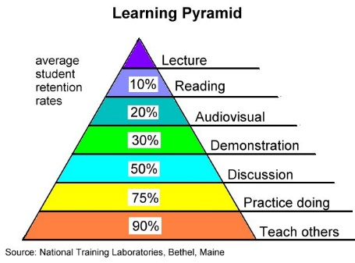

Slide 9

Preparation, Assignment, Exams
What do experts say?
  Handout Review
What do you say?
  What is your best Tip to Share?

Slide 10

Grading & Student Feedback
What do experts say?
  Handout Review
What do you say?
  What is your best Tip to Share?

Slide 11
Communicating with Students: Inside and Outside the Classroom
What do experts say?
  Handout Review
What do you say?
  What is your best Tip to Share?

Slide 12
The 15 Minute Planner (75 min)
0 – 15 Minutes: The Warm-Up & Opening
15 to 30: Content Preview & Content Coverage 1
30 to 45: Active Learning 1/Wrap/Transition
45 to 60: Content Coverage 2
60 to 75: Active Learning 2/Wrap/Closing

