Slide 1
Classroom Emergency Procedures
California State University Long Beach

Slide 2
Emergency Contact Information
University Police (562) 985-4101 – full service police agency, operating on campus 24 hours a day, 365 days a year
9-1-1 from campus phone will connect to University Police
9-1-1 from standard phone (cell) will connect to general dispatch
http://emergency.csulb.edu

Slide 3
Emergency Notification System
In the case of a campus emergency, the University can send updates and critical information to you via text, voicemail and e-mail. It’s therefore critical that your contact information is current.
Visit the “Student Center” at MyCSULB to update your information.

Slide 4
Evacuation
Will be initiated whenever horns and strobes are activated
In case of fire
As directed by University Personnel in case of emergency
Take a moment to identify the available exits in this space

Slide 5
Evacuation Procedures
Take personal belongings
DO NOT use elevators – use nearest stairs
Follow directions given by designated evacuator / instructor
Assist persons with disabilities
Go to designated evacuation point and do not return until directed to do so
Every person MUST evacuate the building

Slide 6
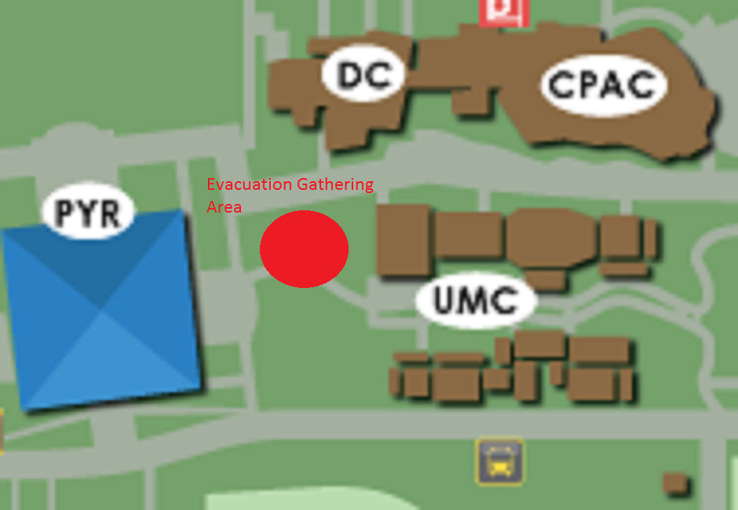
Evacuation Point / Staging Area
Once you have evacuated safely, DO NOT leave the area until you have been released by your instructor or the Building Marshal. It is critical for emergency response that we have an accurate count of all individuals, to ascertain who may have remained in the facility.

Slide 7
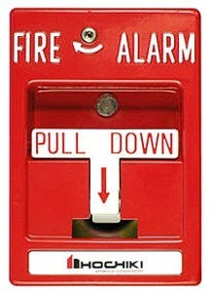
Fire
In case of fire, activate nearest alarm
Evacuate building.
Dial 911 or 985-4101
Do not re-enter building until instructed to do so.

Slide 8
Earthquake
DROP-COVER-HOLD (under a table or against an interior wall
Try to remain calm and stay in place until shaking stops
Evacuation is not automatic – do so only when directed
If you are outdoors, find a spot away from buildings, trees, street lights and power lines
DO NOT leave the area until you are accounted for with your instructor

