Slide 1
After Abandoning the California Master Plan, Where Do We Go From Here?
Benjamin P. Bowser
Emeritus Professor of Sociology and Social Services
Former Interim Dean of College Arts, Letter & Social Sciences
California State University East Bay

Slide 2
The Abandoned Mission in Public Higher Education:
Based on Benjamin Bowser
The Case of the California State University (New York: Routledge, 2017)

Slide 3
Chapter 2: The California Master Plan (1959)
Increase access to high quality public higher education on three tiers
Guaranteed admission for top 12% and 33% of state high school graduates.
Regardless of financial status.
High quality faculty instruction.
Competitive faculty pay and benefits.
Liberal transfer between sectors.
Remediation at Cal. Community Colleges.
California State University Bachelor Degrees
California Community Colleges/ Associates Degrees
University of California
Graduate Degrees
The California Master Plan updates: 1972, 1987 & 2002

Slide 4
Abandonment Specifics by 2019
Original Plan (1959)
Current Practices (2019)
Guaranteed admission top 1/3
Financial barrier eliminated
High quality faculty instruction
Competitive pay & benefits
Liberal transfer between tiers
Remedial in CCC
Admissions not guaranteed
Inc. tuition, loans & debt
Decline in faculty / inc enrollments
Declining pay & benefits
Declining transfers between tiers
Remediation at all three tiers

Slide 5
Budgetary Abandonment: California General Funds Expenditures by Function, 1967-2002

Slide 6
California Higher Education Proportion of State
General Funds By Year and Administration
Who is Responsible for Cuts?

Slide 7
California Higher Education Hierarchy & Decision-Making
California Governor
State Assembly
H.E. Committee
UC Chancellor & Trustees
CSU Chancellor & Trustees
State Senate H.E. Committee
CCC Chancellor & Trustees
Campus Administrations
Campus Administrations
Campus Administrations
Decision-Making

Slide 8
Direct Effects of Budget Cuts
Tuition increases.
Not enough courses for the number of students enrolled.
Pressure to cut major requirements.
Increasing class sizes and online courses.
More out of state and foreign students.
Not enough faculty.
Erosion of academic affairs.
What is the real goal of budget cuts?

Slide 9
Endgame of Budget Cuts
Public higher education is largest source of state revenue after health care still state managed ($7 billion/year in California alone).
Eventual goal of budget cuts: Eliminate tenure and for institutions to welcome privatization.
Privatization of public H.E. is a well articulated goal of some Republican Governors, legislators as well as the following foundations:
  The Bill and Melinda Gates
  Walton
  Kresge
  Lumina

Slide 10
Budget cuts have followed the current cohort of college students since their first grade
Reasons for cuts
Findings
Unsustained budget growth
Boom/bust state budget
Loss of “public confidence”
H.E. is discretionary funding
Fault of admin & faculty
Poorly prepared students
Composition of students
Diversity of students
Budget decline as % of Gen. Fund
Not an issue: pre-2002 recessions
Not an issue prior to 2002
Has always been discretionary
Unchanged
Has been a problem since 1959
Became an issue after 1987
Became most evident after 2002
What is it about the new students?

Slide 11
California High School Graduates by Ethnicity, Statewide 1993, 2014

Slide 12
Where Do We Go From Here?
Governor & Legislators
Renew state higher education master planning.
Return funding of higher education to 16% of State General Funds.
Make Higher Education funding a mandatory budget line item as is primary and secondary education.
Reinstate California Commission for Higher Education to coordinate relations between tiers, gather data, and evaluate outcomes.
There is a need for greater transparency in budget formulation and decision-making.
Independent audits of systems office and individual campuses.

Slide 13
Chancellors and Trustees
(Do we need system-wide offices and trustees?)
The chancellor should report to Presidents as trustees.
Chancellor and Presidents should have ongoing means to learn the effects of decision-making from faculty and students.
Reaffirm liberal arts as core of bachelor degrees in arts, science, education, business and technologies.
Recalibrate per student costs.
Campuses should know their budgets prior to the next fiscal years and receive funding promptly.

Slide 14
Campus Administration and Faculties (Keys to Great Universities)
Administrations build their culture around serving faculty and students.
The bottom line is the quality of what happens in the classroom (interactions between students & faculty).
There is no substitute in a quality education for in-person interactions between student and faculty (low faculty-student ratio).
Faculty driven curriculum and academic affairs.
Chief administrators are selected from faculty with proven records of excellence in teaching and research, not career administrators.

Slide 15
Beach 2030
What is the meaning of no messages from Deans of College of the Arts and College of Liberal Arts?
Messages make no reference to CSULB as part of a larger state system of H.E. with a Master Plan.
Dean of College of Education is the only one to mention that CSULB is Hispanic, Asian and Native-American serving.
Dean of Business Admin: Faculty & Admin. should work together, yet he questions concept of tenure?
There is a distinct sense that a corporation could buy one of CSULB technical colleges?

Slide 16
Beach 2030

Slide 17
Beach 2030

Slide 18
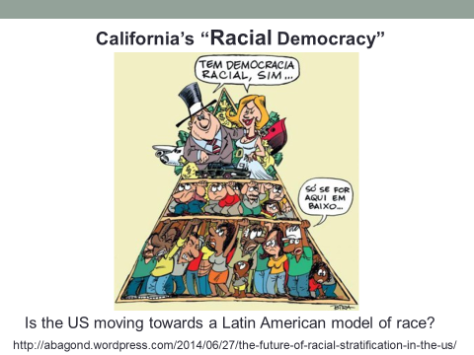

Slide 19
Beach 2030
We must help create an informed public that recognizes its need for high quality low-cost public education.

