Slide 1
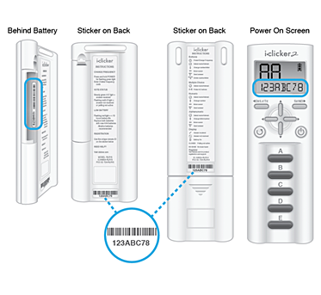
Register Your iClicker Remote
Go to your course on BeachBoard to register your iClicker remote:
Navigate to your course.
Click the “Register your iClicker remote” link.
Enter the 8-character code from your remote.

Slide 2
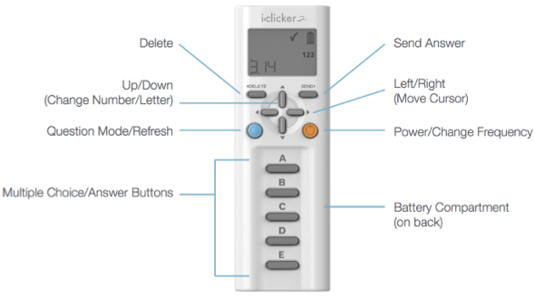
Get to Know Your iClicker Remote

Slide 3
Get to Know Your iClicker Remote
Remote Displays
CLOSED – Displays when poll is closed
NO BASE – Displays if remote is unable to communicate with base check with your instructor to make sure that remote is set to the correct frequency and base is connected
123 – Displays when the remote is in Numeric mode
abc 123 – Displays when the remote is in Alphanumeric mode
✓ – Displays when the frequency is changed successfully or an answer is received
⦸ – Displays when the frequency is not changed successfully or an answer is not received
To turn on the remote, press the Power button
To change frequency, press and hold Power/Change Frequency for 2 seconds then use the A-E buttons to enter the 2-letter frequency code provided by your instructor
Check batteries as your first troubleshooting step if your clicker isn’t powering on

Slide 4
Service and Support
Live Technical and Product Support 9AM-11PM Monday - Thursday 9AM – 9PM Friday Via Phone: 866-209-5698 Via Email: support@iclicker.com Visit iclicker.com/studentsupport at any time.
Support is available for any registration questions as well as inquiries regarding your iClicker remotes.

