Slide 1
Black Boys and Special Education
Alexander Shrewsberry, M.S.
Ed.D Candidate 2021
alexshrewsberry@gmail.com or 562-449-8453

Slide 2
This workshop will explore the intersection of culturally relevant and ability inclusive practices for K-12 students. The topics of culturally relevant pedagogy and inclusive special education are rarely explored together. However, the disproportionate numbers of Black boys recieving special education services creates the need for these two topics to be discussed simultaneously. Not doing so provides a disservice to our students, teachers, and school communities. Through discussion of previous research, preliminary dissertation findings and other student experiences, participants will be connected to existing or needed pedagogical practices and policies that are both Anti-Racist and inclusive. Issues that have been exacerbated by COVID, shutdowns, and distance learning will also be explored. This will help participants impact equitable education in their specific roles by addressing the issues that exist regarding the overrepresentation of Black boys in special education. By the end of the workshop each participant will have developed a local, institutional and state-wide action plan to create immediate impact in their community regarding equitable education practices.
Notes:
Select a word or phrase that is most relevant to you or that you are looking forward to

Slide 3
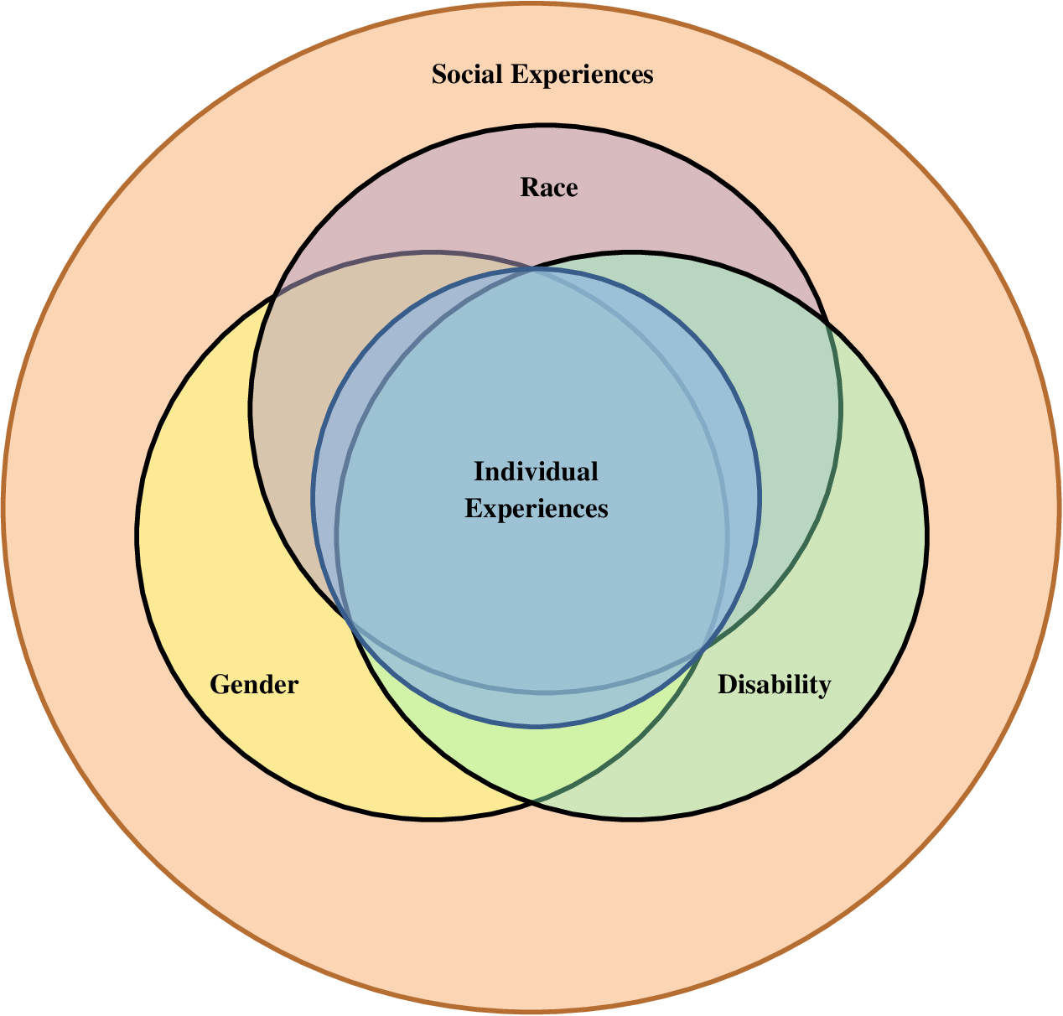
Notes:
Discussion of intersectionality

Slide 4
Workshop Goals
Participants will have a deeper understanding of anti-racist and inclusive education practices.
Participants will be informed of student experiences regarding their teacher interactions, interventions and services provided

Slide 5
Learning Outcomes
By the end of the workshop each participant will have developed a local, institutional and state-wide action plan to create immediate impact in their community regarding equitable education practices.

Slide 6
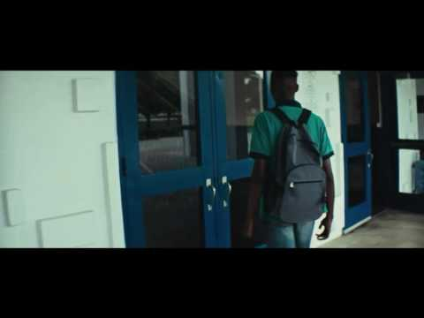
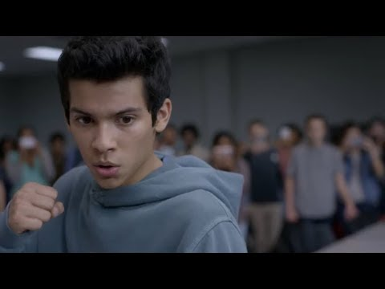
The Way We Treat Behavior

Slide 7
Discussion
What thoughts or connections do you have regarding the previous videos?

Slide 8
Why Perceptions Matter
Study of preservice teachers
Participants identified as White (N = 32), Black (N = 2), multi-racial (N = 5) or Asian American (N = 1).
Participants were shown a video of a student interaction
Misbehaviors were perceived as more hostile for Black than White boys.
Although stronger toward Black males, anger bias exists toward Black females as well.
Leads to more referrals and severe punishment
(Halberstadt et al., 2015)

Slide 9
Why Perceptions Matter
Out of 98 preservice teachers
the majority were women (n = 76) and identified as European American or White (n = 90)
Teachers were read a vignette about a student with “culturally common names for White or Black students”
Student was not working and not responding to teacher directions
If teacher assumed the student was black, they thought they were disrespectful/defiant and needed disciplinary action
Identified permanent reason for behavior
If teacher assumed the student was white, they mentioned they may need to be taught “new skills” and were having a “bad day”
Kunesh and Noltemeyer, 2018

Slide 10
About Me
Bachelor’s Degree in Special Education
Master’s Degree in Psychology
Ed.D Candidate 2021
5 years in youth development
Boys and Girls Clubs of America
4 years as a Special Education teacher
2 years at Locke High School
2 years in Long Beach Unified as a Self-Contained Emotional Disturbance Teacher
Conference Presentation Topics
Intersection of Race, Disability and Gender
Youth Mental Health
Trauma Responsive Classrooms
Inclusive Special Education Practices
PBIS

Slide 11
White
White
Male
Male
Multiple Mental Health Diagnoses
Multiple Mental Health Diagnoses

Slide 12
Theoretical Framework: DisCrit
DisCrit focuses on ways that the forces of racism and ableism circulate interdependently, often in neutralized and invisible ways, to uphold notions of normality.
DisCrit values multidimensional identities and troubles singular notions of identity such as race or dis/ability or class or gender or sexuality, and so on.
DisCrit emphasizes the social constructions of race and ability and yet recognizes the material and psychological impacts of being labeled as raced or dis/abled, which sets one outside of the western cultural norms.
DisCrit privileges voices of marginalized populations, traditionally not acknowledged within research.
DisCrit considers legal and historical aspects of dis/ability and race and how both have been used separately and together to deny the rights of some citizens.
DisCrit recognizes Whiteness and Ability as Property and that gains for people labeled with dis/abilities have largely been made as the result of interest convergence of White, middle-class citizens.
DisCrit requires activism and supports all forms of resistance. (Annamma, Connor, & Ferri, 2013)

Slide 13
Definitions
Disability
A physical or mental condition that limits a person's movements, senses, or activities
Additionally defined by the experiences one has because of their ability levels and label
Inclusive
All students regardless of ability level have access to grade level curriculum and above, in their neighborhood, with the appropriate supports based on their abilities and needs
Culturally Responsive Teaching
Utilizing relationships and social emotional connections with students, as well as cultural knowledge of students to make learning meaningful (Hammond, 2015).

Slide 14
Definitions Continued
Racism
Supporting a racist policy/action through actions or inactions, or expressing a racist idea (Kendi, 2019)
Prejudice and discrimination that includes institutional support of those ideas
Anti-Racism
Counteracting racism through intentional actions to dismantle structures in place that benefit White people

Slide 15
Special Education Eligibilities
13 Total Eligibilities
ED: Emotional disturbance
Inability to learn, build relationships, inappropriate behaviors, pervasive mood of unhappiness
OHI: Other Health Impairment
Limited alertness
IDEA Sec 300.306 C I
(i) Draw upon information from a variety of sources, including aptitude and achievement tests, parent input, and teacher recommendations, as well as information about the child’s physical condition, social or cultural background, and adaptive behavior; and

Slide 16
Problem of Practice
Unequitable discipline, teacher stereotypes (Racism, and Ableism), and other community factors
3 - 4 times more likely to be identified as having an Emotional Disturbance than other students (U.S. Commission on Civil Rights, 2019).
Black boys are 17 % of the school age population but 33 % of the students receiving special education services (U.S. Commission on Civil Rights, 2019).
ED students are 18% more likely to be in separate schools or environments (Dematthews, 2018).
More likely than their peers to receive school discipline, including detentions, suspensions, and expulsions (U.S. Commission on Civil Rights, 2019).
Academic, social, and personal outcomes are lessened such as issues with substance abuse, incarceration, graduation, and higher degree attainment (Annamma, et al., 2013).

Slide 17
Existing Research
Motherly support and students seek to make them proud
Supportive, caring, high expectations from teachers
Racist educational practices
Educator implicit bias
Interventions without fidelity
Misunderstanding of special education services from teachers and parents
Students with Resistant Capital
Families with Navigational Capital

Slide 18
Previous Experiences with Students
Not provided Least Restrictive Environment
Students HAVE to be advocates of their own educational rights
Effective interventions in general education settings are more effective than seclusive special education settings
Demeaning language used regarding special education
Students with behavioral disabilities are placed in self contained classroom as punishment
No supports related to their needs provided
Interventions provided for much longer periods for White students
Out of 40 students over two years in self-contained class for ED or OHI
37 boys
30 of the boys were black
38 students primarily from Low-income neighborhoods in Long Beach
Majority of the students placed in SPED after disciplinary issue

Slide 19
Dissertation
Central Research Question: What are the experiences of Black Boys in middle and high school in South LA identified as having an Emotional Disturbance or behaviorally related Other Health Impairment?
Qualitative Interviews of 10 - 15 students
Currently finishing last interviews and coding process

Slide 20
Preliminary Dissertation Findings
Student Capital
Strong support from mothers and warm demanding teachers has been helpful
Students maintain positive outlook to education and life despite inequities
Manage and navigate multiple roles at home
Positive attitude and resilience
Self Advocacy and Self Awareness
Educational Experiences
Students feeling “targeted” by teachers for discipline
Even across multiple years
In special education because they are a “bad kid” or “doing too much”
Students charged with crimes at highest level
Special Education done to them, not for or with them
Need a bond with teachers to learn from them

Slide 21
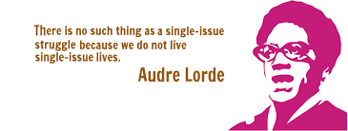

Slide 22
Culturally Responsive Teaching
Makes meaningful connections between what students learn in school and their cultures, languages, and life experiences
Raises expectations and supports all students
Includes
Rigorous curriculum
Development of high level cognitive processes
Relevance of academic content to real life
(Ladson Billings, 1994; Hammond, 2015)

Slide 23
Anti-Racist Educational Practices
Remaking social structures one action at a time
Reject false notions of human differences
Acknowledging and engaging lived experiences that vary along racial lines
Learn from diversity in human experience
Equip ourselves and others to challenge racial inequalities of opportunity and outcome
Book: Everyday Antiracism edited by Mica Pollock

Slide 24
Inclusive Education Practices
Universal Design for Learning
Resources based on individual student needs
All staff given PD on students with disabilities
Go beyond compliance
Appropriate learning environments
Instruction for multiple learning styles
Use 504 plans
True Less Restrictive Environments
Acknowledge “visible and invisible” disabilities

Slide 25
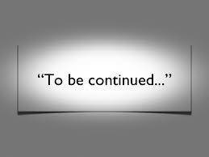
Other Relevant Topics Not Mentioned in Depth
School to Prison Pipeline
Healthcare Inequities
Mental Health Stigma in Communities of Color
Teacher Credentialing
Trauma
History of these Issues

Slide 26
Develop Action Plans
Local: Policies or practices for the participants specific job or role in education
Institutional: Policies or practices for the participants educational organization or institution they are within
https://docs.google.com/document/d/1SK4UPiI9V50qthOFlsWZie-CjiazHstNzDUe6S6dVS4/edit?usp=sharing

Slide 27
alexshrewsberry@gmail.com

