Slide 1
Business Model Canvas

Slide 2
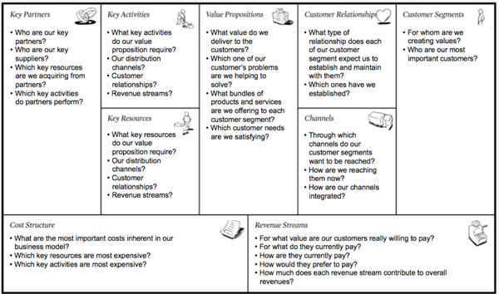
Notes:
THE RIGHT SIDE LEADS TO REVENUE AT THE BOTTOM
THE LEFT SIDE LEADS TO COSTS AT THE BOTTOM
THE DIFFERENCE IS THE PROFIT/LOSS

Slide 3
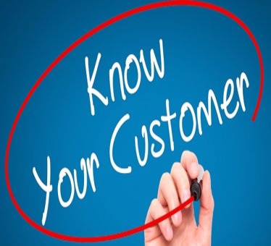
Customer Segments

Slide 4
Who would be your ideal customer?
Not all consumers are the same!
Notes:
Customer groups represent separate segments if:
Their needs require and justify a distinct offer
They are reached through different communication channels and messaging
They are reached through different distribution channels
They require different types of relationships
They have substantially different profitability
They are willing to pay for different versions of the product

Slide 5
Different types of markets
Mass markets – utilities, Coca-Cola
Niche markets – pet food, dating apps
Mass Customization – Nike’s NikeiD Brand
Diversified markets – Tesla builds the S, 3, X, Y
Notes:
Mass Markets: business models that focus on Mass Markets don’t distinguish between different customer segments, value propositions, and distribution channels. They relate to their customers in the same way because it is one large group with the same basic needs and problems. COCA COLA is a mass market product because of the way it is marketed – same message, distribution channels, value proposition, etc.
Niche Markets: Specialized customer segments and each segment has its own value proposition, distribution channels, and type of customer relationship tailored to the specific requirements of that target segment.
Mass customization: Mass customization is a marketing and manufacturing technique that combines the flexibility and personalization of custom-made products with the low unit costs associated with mass production. Other names for mass customization include made-to-order or built-to-order. (https://simplicable.com/new/mass-customization-examples).
Segmented Markets: they distinguish between customer segments based on different needs and problems. There can be some overlap in needs and problems between these markets but there are enough differences that they need to have their own business strategy – value proposition, distribution channels, customer relationships, revenue streams.
Diversified Markets: an organization that serves two unrelated Customer Segments with very different needs and problems resulting in different value propositions, distribution/communication channels. For example, an auto company may diversify by adding a new car model or by expanding into a related market like trucks.

Slide 6
Exercise 1 – The Persona:
(Focus on the customer not the types of market)
Describe the ideal customer that you want to buy your product or service:

Slide 7
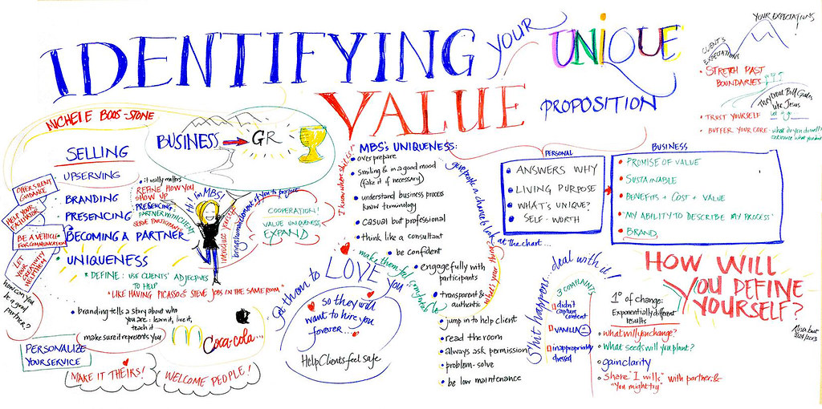
Value Proposition
Notes:
Your Value Proposition is based on a bundle of products and services that create value for a customer segment. If you have multiple customer segments then you would have multiple Value Propositions.
A value proposition is a statement that answers the 'why' someone should do business with you. It should convince a potential customer why your service or product will be of more value to them than similar offerings from your competition. ... So, having a clear, concise value proposition is more important than ever.
AKA: Unique Selling Proposition

Slide 8
Value Propositions can focus on:
New set of needs – Tesla
Performance - INTEL INSIDE
Customization – Dell Build Your Own PC
Convenience/Usability - STARBUCKS
Brand/Status – Louis Vuitton, Rolex
Price – Southwest Airlines
Cost Reduction – Wal-Mart
Risk Reduction - Carvana
Design - iPad Pro
Notes:
Newness as a value proposition: focus is on a new set of needs that customers previously didn’t perceive because there was no similar offering. For example, ethical investment funds, cell phones created a whole new industry around mobile telecommunications AND DISRUPTED THE CAMERA MARKET. Tesla set the standard for electric cars.
n 2012, Kodak filed for chapter 11 bankruptcy. Kodak emerged from bankruptcy in September 2013 as a much leaner company, mostly focused on high-speed digital printing technology and flexible packaging for consumer goods.
Performance as a value proposition: improving product/service performance is a great way to create value. For example, faster PCs, more storage, better graphics, etc.
Customization as a value proposition: tailoring your products/services to the specific needs of individual customers or customer segments. Co-creation is a common way of creating mass-customization.
Convenience/usability as a value proposition: making your product/service more convenient or easier to use can create a lot of value. For example, Apple did that with iPods and iTunes.
Design as a value proposition: a product can stand out based on its superior design. For example, Apple products
Brand/Status as a value proposition: customers find value in the act of using and displaying a specific brand such as wearing a Rolex watch means you are wealthy. OR skateboarders wear the latest in “underground” brands to show that they are “in”.
Price as a value proposition: provide value for price-sensitive customers segments. For example, Southwest airlines is a ‘no-frill’ airline that allows people to fly at a lower cost other airlines.
Cost Reduction as a value proposition: helping customers to reduce costs is a great way to create value. For example, Salesforce.com provides a ‘hosted CRM” application and buyers don’t have to buy, install and manage CRM software themselves.
Risk Reduction as a value proposition: reducing the risk when you buy some such as having a 1-year warranty on a used car.

Slide 9
Value proposition
WHAT VALUE ARE YOU DELIVERING TO YOUR CUSTOMERS??
UBER: The smartest way to get around!
Apple iPhone: The experience IS the product!
Slack: Be more productive at work with less!
Intuit: “simplifying the business of life.” (Turbo Tax, QuickBooks, and more)
DogVacay: “Find a Loving Dog Sitter.”
Notes:
Your value proposition should spell out what the value is for each of these – this is just a shortened version of a unique value proposition that immediately tells your customers and your team the benefits of the brand:
UBER: The smartest way to get around!
Apple iPhone: The experience IS the product!
Slack: Be more productive at work with less!
Intuit: “simplifying the business of life.” (Turbo Tax, QuickBooks, and more)
DogVacay: “Find a Loving Dog Sitter.”

Slide 10
Exercise 2:
What do you think your ideal customer wants (needs) from your product or service?
Why would that customer buy your product?
What value can you give them?

Slide 11
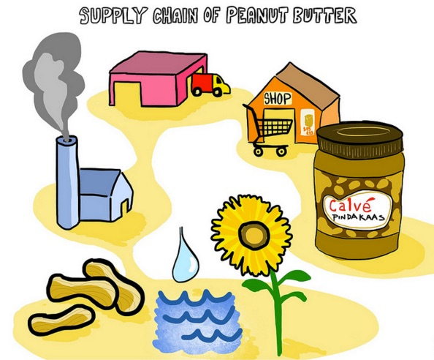
What are your ideal channels?
Notes:
Who are potential suppliers?
How do you get your product to your customers?
Which customer segments use which channels?
UPSTREAM AND DOWNSTREAM CONSIDERATIONS

Slide 12
Channels of Distribution
Notes:
How do your products get to your customers?
B2B – B2C - DTC
Channels have different functions:
Raise awareness among customers about your product and services (brand name)
Help customers evaluate a company's Value Proposition
Allow customers to buy specific products and services
Deliver your Value Proposition to your customers
Provide post-purchase customer support

Slide 13
What would be the ideal Channels of Communication
Dollar Shave Club became popular
due to this amazing video.
Notes:
Awareness – how do you raise awareness about your business?
Evaluation – how do we help our customers evaluate our organization's Value Proposition
Purchase – how do we allow customers to purchase our products and services?
Delivery – how do we deliver our Value Proposition to our customers?
After Sales – How do we provide post-purchase customer support?
REMEMBER IT IS A PROCESS – ONE COMMUNICATION CAN NOT DO EVERYTHING!!

Slide 14
Exercise 3
What would be the best way to communicate with your ideal customer?
What channels would you use?
Would you expect your ideal customer to use those channels to learn about products?

Slide 15
Customer Relationships
Notes:
What type of relationship does/do your target segment(s) look for when choosing your product or service?
How much does it cost to develop and maintain these relationships? (https://www.linkdex.com/en-us/inked/10-exceptional-examples-of-brand-communities/
How are the chosen customer relationships integrated into your business model?

Slide 16
Customer Relationships
Customer Acquisition: What type of relationship do each of your customers segments expect to establish/grow?
Customer Retention: Which ones do we work to keep and how much does it cost us?
Boosting sales (upselling): How are the customers integrated into the rest of your business?
Notes:
Personal assistance: customers can communicate with a human cust relationship but with advances in AI customer relationship is becoming more ‘human-like”.
Dedicated personal assistance: dedicating a customer rep to an individual customer. Creates an intimate/close relationship between the company and the customer. For example, Nordstrom provides PERSONAL STYLISTS FOR FREE!
Self service: a company can provide all the means that a customer needs to help themselves. For example: Carvana
Automated Services: mixes customer self-service with automated processes. For example, personal online profiles give customers access to customized services. Automated services can recognize individual customers and their needs, and offer information related to orders/transactions.
Communities: (brand communities) helps companies develop a closer relationship with user groups and to facilitate connections/sharing of knowledge between community members.
Co-creation: companies that are going beyond the traditional seller-buyer relationship to co-create value with customers. For example, Amazon invites customers to write reviews and create value for other customers. YouTube solicit customers to create content for public consumption.
WHEN DO YOU LET A CUSTOMER GO???
IS IT CHEAPER TO KEEP A CUSTOMER OR TO ATTRACT NEW CUSTOMERS

Slide 17
Exercise 4:
What would you keep your ideal customer coming back?
How would you get new customers?
What should you do to find out if your customers are happy with your products/services?
Are all customers good customers?

Slide 18
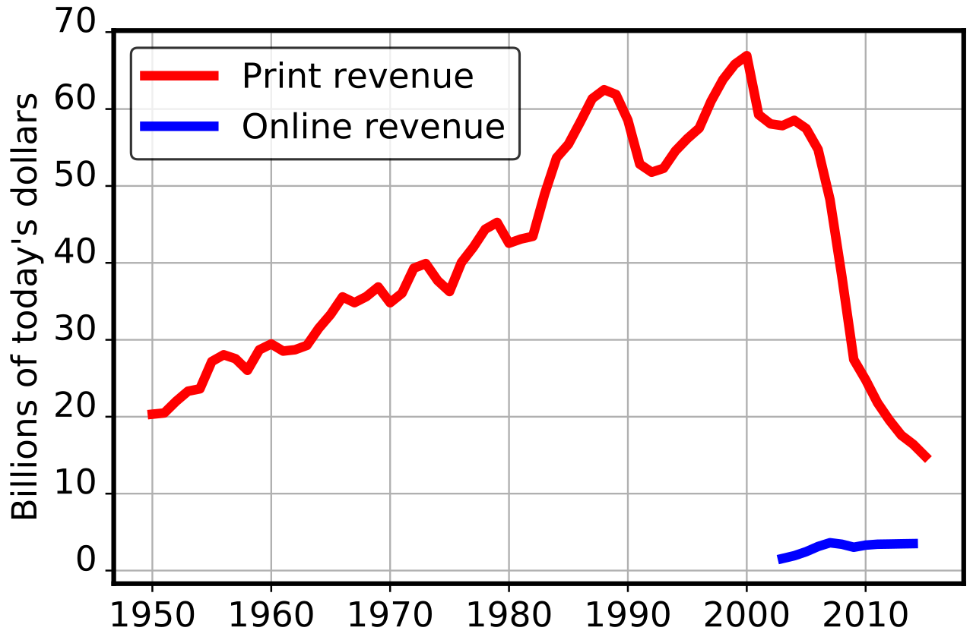
Revenue Streams
Notes:
WHAT IS THE CONTEXT HERE? WHAT IS THE STORY?

Slide 19
Revenue Streams
How much are our customers really willing to pay?
What do they currently pay?
How are they currently paying for that product?
How much does each Revenue Stream contribute to your overall revenue?
Notes:
There are two different types of revenues streams:
Transaction revenues resulting from one-time customer payments
2. Recurring revenues resulting from ongoing payment to either deliver a value proposition or provide post-purchase customer support.

Slide 20
Exercise 5:
How do you get revenue from your customers?
How do you get revenues from the way that you do business?
For example: subscription fees, licensing, renting/leasing, usage fee (delivery fees), etc.
Notes:
Asset sales: Selling ownership rights to a physical product. Amazon.com sells books, and everything else in the world. They are selling their assets.
Usage fees: generated by the use of a service. The more service is used the more the customer pays. A hotel charges customers for rooms, a delivery service charges for delivering food, etc.
Subscriptions fees: selling access to a service such as Spotify, Amazon Prime, etc.
Lending/renting/leasing: temporarily granting someone the exclusive right to use an asset.
Licensing fees: giving customers permission to use protected intellectual property in exchange for licensing fees (technology companies will allow other companies the right to use their patented technology in for a fee.

Slide 21
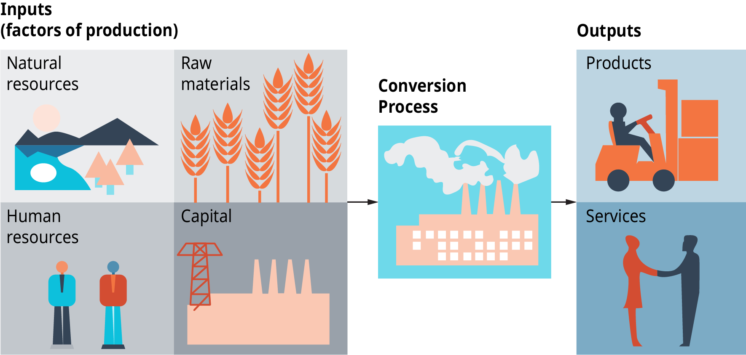
Key Resources

Slide 22
Key Resources
Key resources can be:
physical (building/office),
financial (lines of credit, cash in bank, stock options),
intellectual (brands, patents, copyrights, proprietary knowledge), or
human (skilled workforce, employees).
They can be owned or leased by a business.
Link your Key Resources to VP, Dist Channels, CR, Rev Streams.
Notes:
Physical resources, such as raw material, buildings, vehicles, transportation, storage facility, machines and factory.
Human resources, or staff, such as a talented engineer or marketing experts. ...
Intellectual resources, such as your brand, patents, copyrights, partnerships, and customer databases.
What key resources does your value proposition(s) require? Distribution channels? Customer relationships? Revenue Streams?

Slide 23
Exercise 6:
What are examples of key resources that your business has?
Or what type of key resources would you need to start your business?

Slide 24
Key Activities

Slide 25
Key Activities
Critical actions a business needs to operate successfully.
What are the key activities required to create and offer:
YOUR Value proposition,
Reach your target customers,
Maintain relationships with your customers, and
earn $$
Notes:
The Key activities of a business represent what the company must do to make the business model work. ... For example, if your business focuses on production of a product,
your activities may include learning more about the customers and new production techniques to improve the product.
What are Key Activities in Marketing
Adding value by marketing products and services. ...
Sales. Selling a product. ...
Design. Designing things. ...
Operations. The production of products and delivery of services. ...
Distribution. The process of reaching the customer to sell to them and deliver your obligations. ...
Customer Experience.
What are key activities for a Restaurant:
Prep food
customer service,
cleaning,
purchasing raw materials,
accounting,
reporting,
etc.

Slide 26
Exercise 7:
What do you produce?
What do you sell that can solve a customer’s problems?
Do you or would you like to sell on a platform such as eBay or a SHOPIFY website?

Slide 27
Key Partnerships

Slide 28
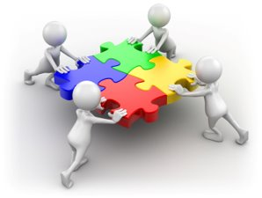
Key Partnerships
Why do we have partnerships:
Reduces the risk
Acquire resources
Make your business stronger
Notes:
Partnerships the network of suppliers and partners that make your business function.
Four different types of partnerships:
1) strategic partnerships between non-competitors
2). Coopetition: strategic partnerships between competitors
Joint ventures to develop a new business
Buyer-seller relationships to assure reliable supplies.

Slide 29
Exercise 8:
Who are or would be your key partners that can help you survive and grow as a business?

Slide 30
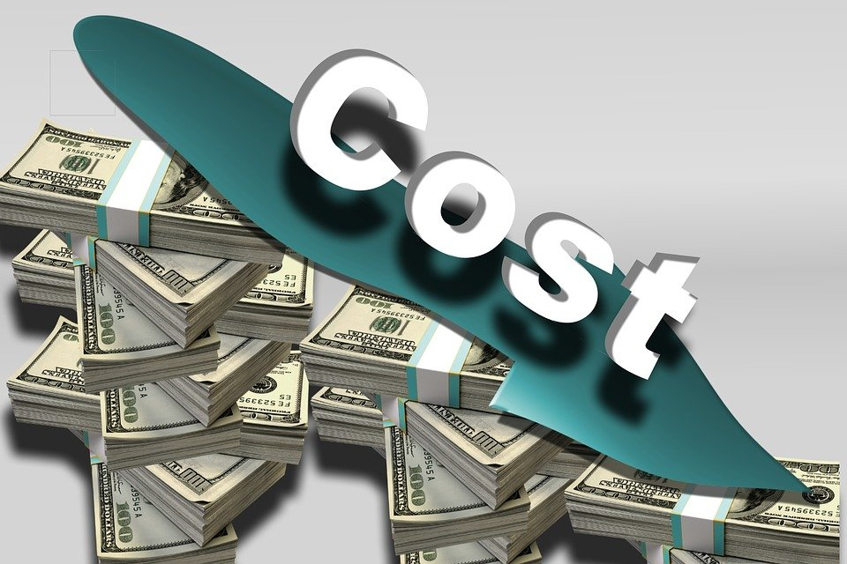
Cost Structure
Notes:
A cost structure means the types and relative proportions of fixed and variable costs incurred by the business.

Slide 31
Cost Structure
Notes:
Cost-driven – focus on keeping costs down
Value-driven – less concerned about costs and more focused on value creation
Fixed Costs – costs remain the same despite the volume of goods/services produced/sold
Variables Costs – costs vary based on the volume of goods/services produced/sold
Economies of Scale – cost advantages that a business enjoys as its output expands – benefit from lower bulk purchase rates
Economies of Scope – cost advantages that a business enjoys due to a larger scope of operations – marketing activities and distribution can support multiple products so the costs of your distribution and marketing goes down per unit.

Slide 32
Exercise 9:
What are the most important costs that you incur or would incur in your business?

Slide 33
Putting it all together

Slide 35
Take all this and then put together your business plan!

Slide 36
Business Plan
Describe the Opportunity
Present your Idea
Analyze the business environment
Introduce your management team
Highlight the qualifications
Present the team as a unit
Go-to-market Strategy
Operations plan
Marketing plan
Project Financial Risk and Reward
Prepare your financial plan
Anticipate readers’ concerns

Slide 37
Marketing Plan
Target market – describe your ideal customer (persona)
The Four P’s
Product
Price
Promotion
Place
Positioning

