Slide 1
Tutti: Music & Physical Activity Curriculum for Older Adults
Kelsey Uyeda, B.A., M.S.G.
Department of Gerontology
Department of Family and Consumer Sciences
California State University, Long Beach

Slide 2
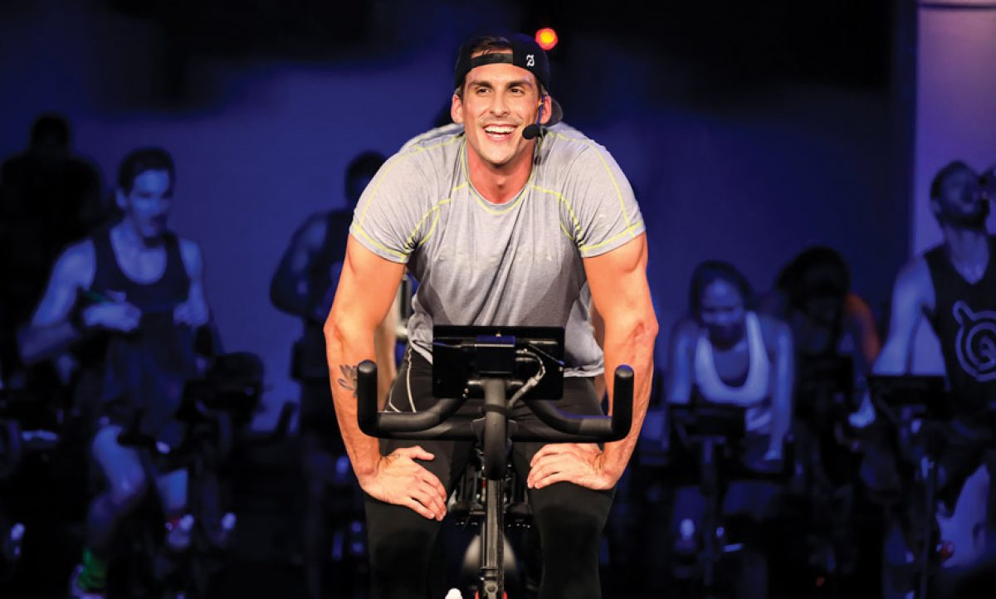
Inspiration
Peloton
Synthesis of exercise, music & comradery
Intervals & climbs pair with musical structure (excludes Tabata & HIIT classes)
e.g. push cadence (RPM: 100—120) during chorus (20 seconds); recover during verse (30 seconds)
Research concludes the effectiveness of group exercise
Healthy competition
Solidify your bond
Greater accountability
Improved communication
Boost your endorphins
JAMA Internal Medicine (The Influence of Partner’s Behavior on Health Behavior Change: The English Longitudinal Study of Ageing by Sarah E. Jackson, Andrew Steptoe & Jane Wardle; March 2015)
Peloton photo

Slide 3
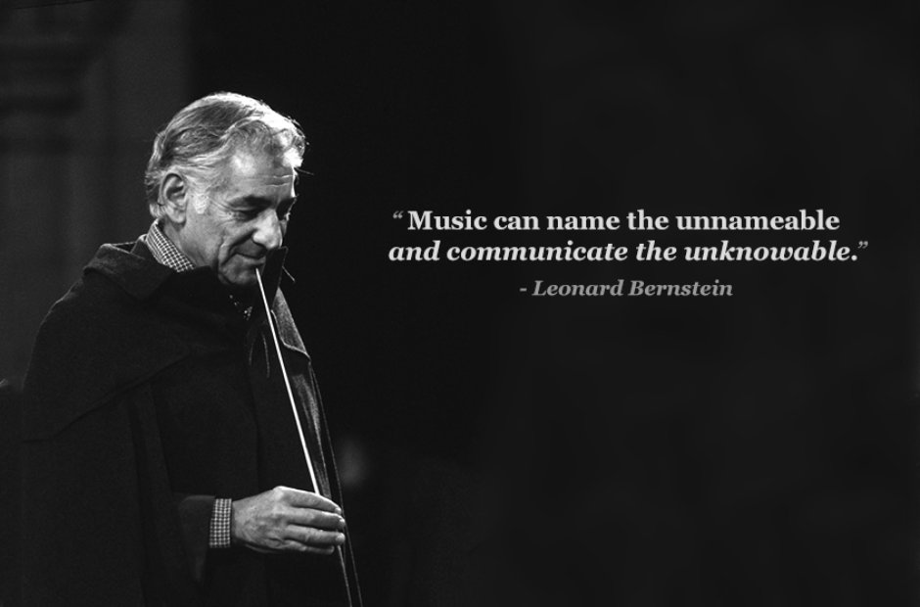
Chapter 1: Introduction
Yale Daily News Classic fM radio

Slide 4
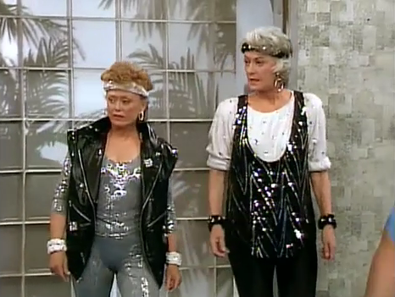
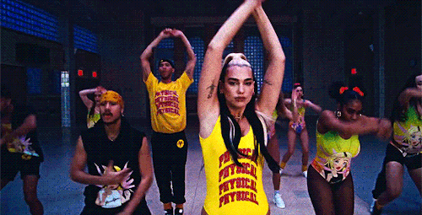
Chapter 1: Statement of the Problem
Limited literature on music + physical activity for older adults
Literature on physical activity for older adults
Literature on music for older adults
Golden Girls gif
Older Adult DJ
Dua Lipa “Physical” music video gif

Slide 5
Chapter 1: Purpose Statement
The purpose of this project was to create a music and physical activity curriculum for older adults (age 65 years and older) to participate in a group setting at an adult day care (social model), residential care facility for the elderly (assisted living and board and care), memory care unit, or an individual setting in an aging-in-place environment. The physical activity intensity is low to moderate and requires older adults to follow basic movement patterns with rhythm sticks to follow the musical structure (e.g., verse, chorus, verse, chorus, bridge) and elements (e.g., tempo) of the songs led by a facilitator (activities coordinator, family member, caregiver, virtual instructor). The music ranges in genres (e.g., pop, hip hop/rap, EDM, R&B/soul, rock, country) but will exclude classical, opera and jazz genres due to the inconsistent musical structure and elements.

Slide 6
Chapter 1: Objectives
Objective 1: Review peer-reviewed literature pertaining to older adults’ physical health, cognitive health, social benefits, psychology of music and music and physical activity.
Objective 2: Review popular media sources pertaining to physical activity, psychology of music and music and older adults.
Objective 3: Create music paired physical activity curriculum for family members, caregivers and facility staff to conduct in a facility or aging-in-place environment.
Objective 4: Present the music-physical activity program to a panel of experts for feedback.

Slide 7
Chapter 1: Delimitations
Universally appropriate for older adults who attend a group setting at an adult day care, a residential care facility, or memory care unit (with or without a formal caregiver) or an individual setting (living with a family member or alone)
Setting: in-person group, online group via Zoom/Skype/Google Hangouts, individual e-book
No to moderate cognitive impairment (Alzheimer’s disease and other dementia): diagnosed by a neurologist
May not have vision and hearing deficits, no mobility limitations in shoulders, arms, wrists, hands; verified by a medical professional
Not appropriate for older adults with physical limitations and/or diagnosed with severe mental health

Slide 8
Chapter 1: Assumptions
Determine song’s tempo (a tempo, half-beat, double beat)
Use popular music platforms to create music playlist (Apple Music & Spotify)
Pair or connect sound system via auxiliary cable or Bluetooth to a smartphone, tablet or laptop
Older adults capable of mirroring all movement patterns and tempos with rhythm sticks
Apple music logo
Spotify logo

Slide 9
Chapter 2: Review of Literature
Older Adult Physical Well-being
Benefit of Physical Activity on Physical Well-being
Benefit of Music on Physical Well-being
Benefit of Physical Activity and Music for Physical Well-being
Older Adult Cognitive and Social Well-being
Benefit of Physical Activity on Cognition and Social Well-being
Benefit of Music on Cognitive and Social Well-being
Benefit of Group Physical Activity to Cognitive and Social Well-being
gif from tenor.com

Slide 10
Chapter 3: Methods/Social Context
Facilitator is determined by environment setting (e.g. activities coordinator at residential care facility)
Encourage participation from residents & residents’ family members, neighbors, friends
Conducted in an indoor environment (e.g., activity room): does not disturb others but is visually and auditorily within range of non-participants to encourage participation
Utilize social media to promote activity (e.g., Instagram)
Post colorful flyers in common social areas (e.g., dining room)
gif from tenor.com

Slide 11
Chapter 3: Curriculum Development
Original curriculum; never developed, acquired, modified; no evaluation on success rate
6 priorities:
Priority 1: founded in contemporary research to justify the benefits of physical activity for older adults’ physical and social wellbeing, the psychology of music and the significance of combining music and physical activity
Priority 2: develop physical activity component of curriculum consisting of 10 subsections
Priority 3: develop music component of curriculum consisting of 6 subsections
Priority 4: develop index section consisting of 2 subsections
Priority 5: present curriculum to panel of experts in gerontology and activities coordinators
Priority 6: develop final version to be distributed to adult day care, residential care facilities, memory care units and family members

Slide 12
Chapter 3: Curriculum Structure
Provides stepping blocks to create the activity from beginning to end
Physical Activity section: 10 subsections
Music section: 6 subsections
Index section: 2 subsections
Facilitator encouraged to interact with participants during the activity, explore unfamiliar music genres & artists, avoid redundancy with movement patterns and music playlists
Photo via Lakeshore Learning

Slide 13
Chapter 3: Role of the Project Developer
UCLA ’14 / Herb Alpert School of Music & Graduate School of Education
Bachelor of Arts Music (tenor trombone)
Single Subject Teaching Credential K—12: Music
CSULB ‘20 / Department of Family & Consumer Sciences
Masters of Science Gerontology
Pacific Symphony
Musical Carnival Coordinator
Youth Orchestra & Youth Quartet Manager
Irvine Unified School District
Grades 4—6 (strings & winds)
Grades 9—12 (concert orchestra, string orchestra, wind ensemble, symphonic band, marching band, jazz band)
Performance Venues:
Carnegie Hall (New York, NY)
Rose Bowl Stadium (Pasadena, CA)
Royce Hall (Los Angeles, CA)
Freud Playhouse (Los Angeles, CA)
Renee & Henry Segerstrom Concert Hall (Costa Mesa, CA)
Disneyland (Anaheim, CA)

Slide 14
Chapter 4: Curriculum
Divided into three main sections with several subsections
Includes acknowledgements, an introduction and information about the developer
Section One: physical activity component of the activity with ten subsections to guide the facilitator on how to administer the physical activity component of the activity
Section Two: music component of the activity with six subsections to guide the facilitator on how to combine and structure the music with the physical activity
Section Three: index with two subsections to provide additional information and guidance for the facilitator
For more information about “Tutti: Music and Physical Activity Curriculum for Older Adults,” contact the developer directly at kauyeda.msg@gmail.com

Slide 15
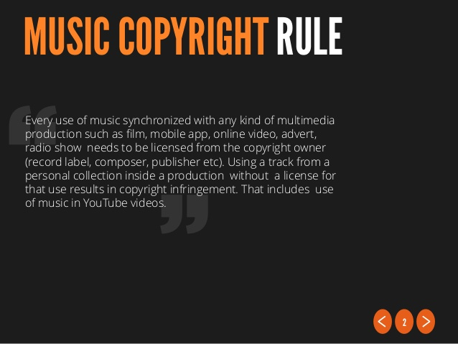
Chapter 4: Expert Panel Feedback Results and Revisions
1 gerontologist & 2 program specialists from residential care facilities
No music trained background
Likert Scale (scale 1 to 10; 1 = 10% & 10 = 100%) for each subsection (clarity of information, clarity of directions, photo clarity, presentation, organization)
Closed ended questions: Yes or No
Open ended questions: follow up to closed ended questions
1 panelist provided comments & suggestions per Likert Scale rating
Overall: agreed to recommend curriculum; 1 panelist stated confusion with music subsections
Revisions based on panelists’ comments & suggestions
Using Music in Online Videos & Media: Music Copyright Law Basics

Slide 16
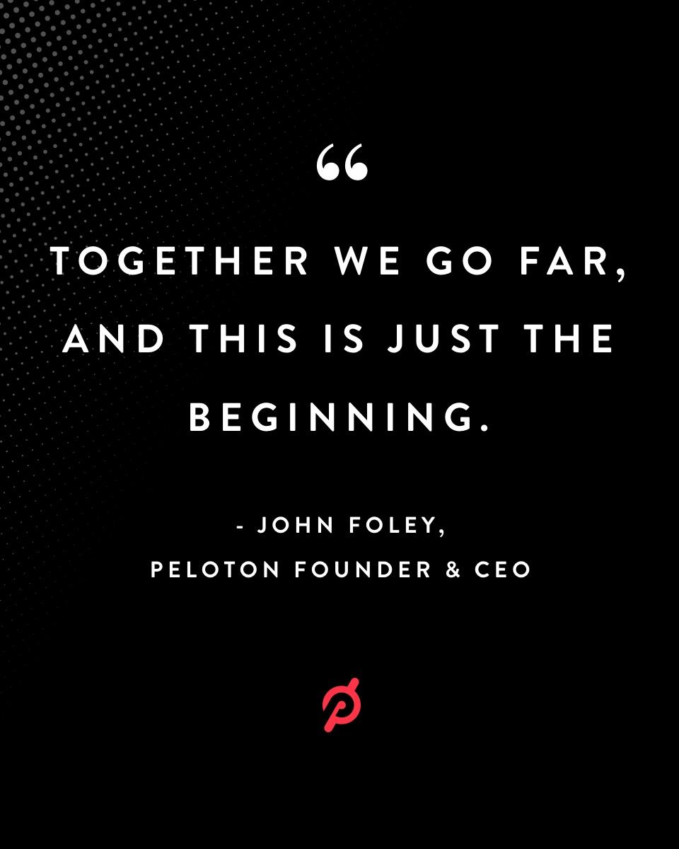
Chapter 5: Evaluation of Project
Curriculum addresses the following:
Benefits of physical activity on physical well-being for older adults
Benefits of music on physical well-being
Benefits of physical activity and music on cognition and social well-being
Curriculum is adaptable to multiple environments
Group or individual settings
Residential care facility, adult day care, memory care units, aging in place, virtual
Encourages multigenerational setting: older adults + older adults’ family members, neighbors and friends
Founded in contemporary research
Photo via Twitter

Slide 17
Chapter 5: Recommendations
Previously informally conducted by project developer at an adult day center
No formal evaluation; face validity only
Future research
Formally evaluate the curriculum in adult day care or residential care facility
Test retest reliability & construct validity
Pre- & post-test of Terrible Delightful Scale
Create virtual version for Zoom, Skype or Google Hangouts during COVID-19
Write grant proposal to receive grant money to pay music licensing fees to legally record & upload online

Slide 18
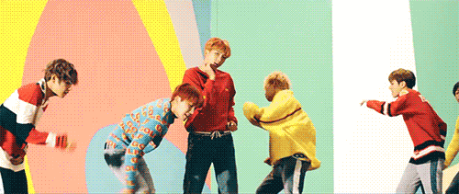
Thank you! ☺
Special thank you to my committee members: Dr. Maria Claver, Miriam Henan & John Fay. Special thank you to my expert panel. Extra special thank you to my fire family for always inspiring me to slay the game!
gif from Pinterest

