Slide 1
Closing the Graduation Gap
Academic Senate Retreat 2014

Slide 2
Agenda
Welcome
President Conoley
Setting the Context
Table Time
Reception

Slide 3
Closing the Graduation Gap
Academic Senate Retreat 2014

Slide 4
Recognition
Executive Committee
Guests:
Brandon Gamble
Jeff Klaus
Angela Locks
Lynn Mahoney
José Moreno
Anna Ortiz
Manuel Pérez
Maggie Pérez-Muñoz
Brett Waterfield
Teri Yamada

Slide 5
Setting the Context
The Graduation Gap
National Picture
CSULB
What We Do Matters
As an Institution
In the Classroom
Outside of the Classroom
Table Time

Slide 6
Our Task
Theme: Closing the Graduation Gap
Two Trends
Graduation rates
The Graduation Gap
Our Task
How do we best serve all of our students to provide them the opportunity to succeed?

Slide 7
Graduation Matters
Lifetime Earnings
Other financial “benefits”
Citizenship/Voting
Volunteer
Better Physical and Mental Health
Sense of self
Impact on the Community
Notes:
Impact on siblings and communities.

Slide 8
The National Picture

Slide 9
Percent of U.S. Adults with a Bachelor’s Degree (2012)
33%
EdTrust, 2014.

Slide 10
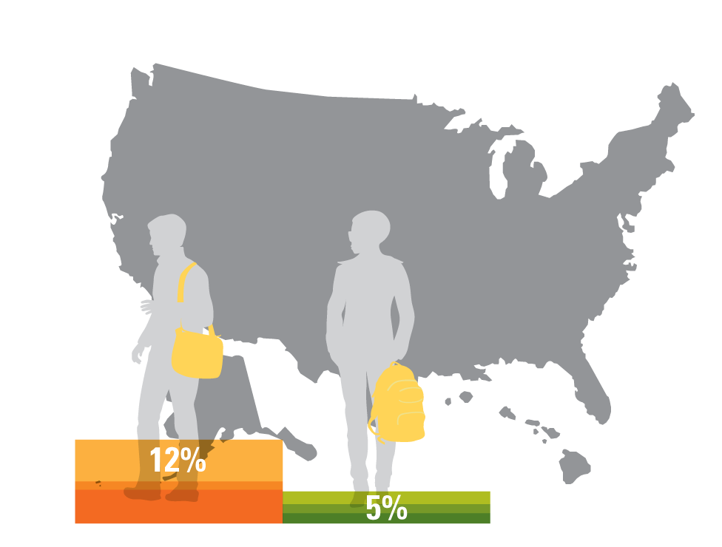
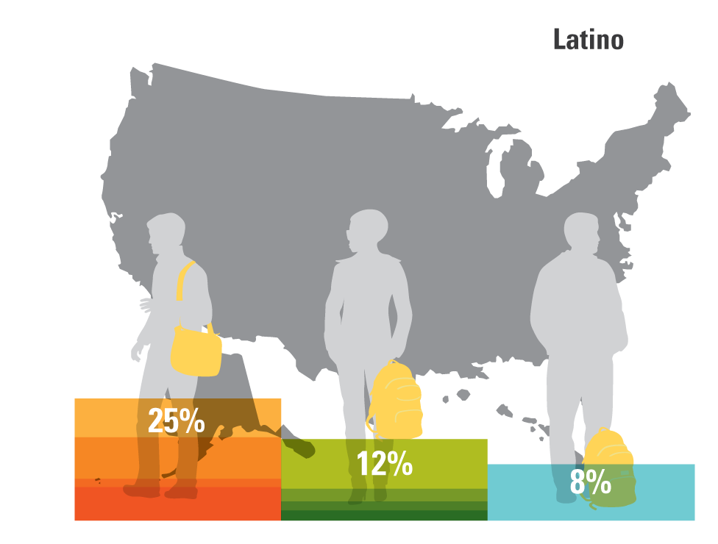
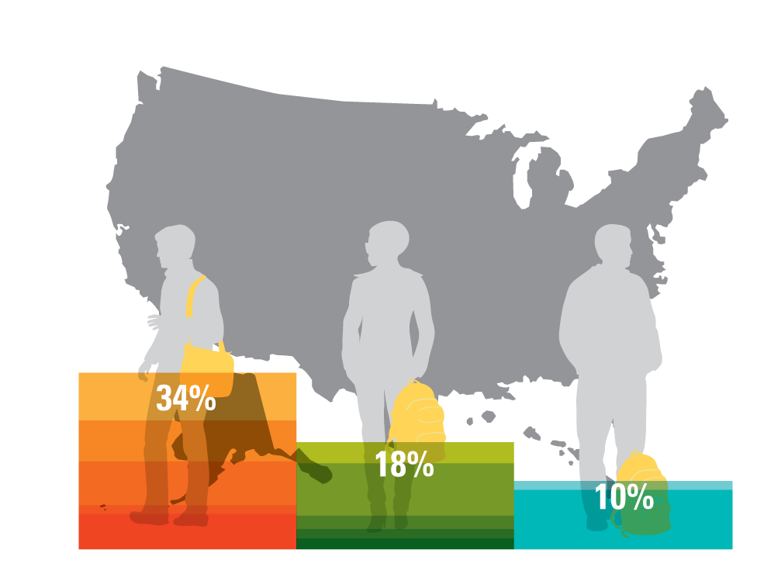
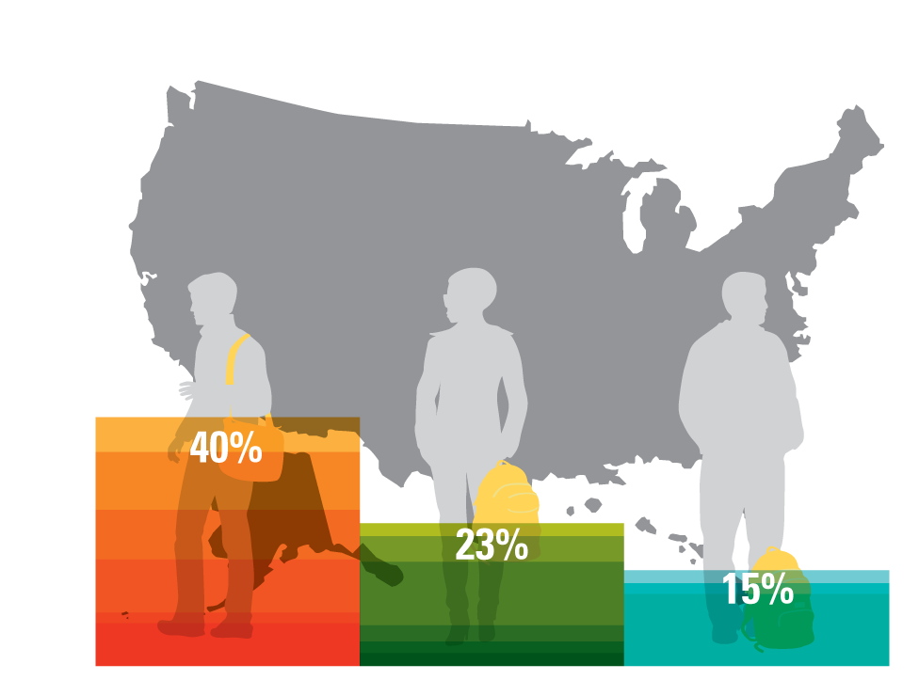
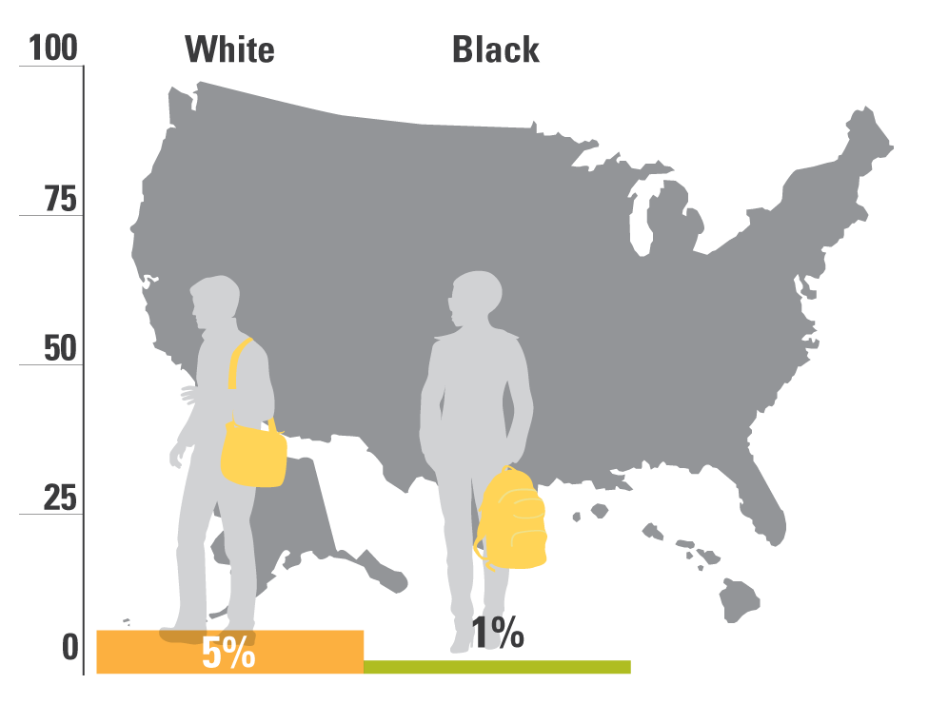
Percent of U.S. Adults with a Bachelor’s Degree 2012
EdTrust, 2014.

Slide 11
Graduation Rates: National
Fewer than 4 in 10 (38%) entering full-time freshmen obtain a Bachelor’s degree from the same institution within 4 years.
Within six years of entry, that proportion rises to just under 6 in 10 (59%).
National 6-Year graduation rates from ANY institution are at approximately 67%.
Source: NCES (December 2013). Enrollment in Postsecondary Institutions, Fall 2012; Financial Statistics, Fiscal Year 2012; and Graduation Rates, Selected Cohorts, 2004-2009, First Look (Provisional Data) Table 4, via EdTrust.
Notes:
Explain how IPEDS data reports graduation for Freshman cohorts that persist at the same university. Transfers are not included (in or out).
Comment on the myth that they leave one institution and graduate at another.

Slide 12
National 6 Year Grad Rates: 2006 Cohort
Source: NCES (December 2013). Enrollment in Postsecondary Institutions, Fall 2012; Financial Statistics, Fiscal Year 2012; and Graduation Rates, Selected Cohorts, 2004-2009, First Look (Provisional Data) Table 3, via EdTrust.
Notes:
Once we get young adults to college, what are the chances that they will graduate in six years?
Explain why we use 6 year graduation rates. For accountability purposes…
Explain the problem of using “Asian” as a descriptor; it may hide as much as it reveals. Immigration status.
URMs vs. NURMs: CSU thing.

Slide 13
CSULB

Slide 14
6 Year Grad Rates: CSULB vs. Other CSUs
CSU Chancellor’s Office Analytic Studies
http://www.asd.calstate.edu/csrde/index.shtml#ftf
Notes:
CSULB is the 3rd highest of the 23 campus CSU system.

Slide 15
6 Year Grad Rates by Ethnicity
CSULB, Office of Institutional Research and Assessment, Dashboard
Notes:
Volatility of the AFAM and NATAM numbers is due to low numbers.

Slide 16
Closing the Graduation Gap
What does the phrase “Graduation Gap” mean?
National and CSU data is categorized into two groups:
Under Represented Minorities: African-American, Latino/a, Native American
Non Under Represented Minorities: Caucasian, Asian/Pacific Islander

Slide 17
CA Graduation Gap in National Perspective
2008-2010 Three-Year American Community Survey (ACS) data from NCHEMS Information Center, via EdTrust.
Notes:
National Average is 11.7%; California’s is 18%.

Slide 18
CSULB Graduation Gap

Slide 19
Retention is Key
The first two years are critical towards a student’s success.
Notes:
On the next few slides, the absolute numbers are not important; focus on the trends. Beginning in their third years, are student remaining in the major?

Slide 20
Why is there a Graduation Gap?
The Usual Suspects
College Readiness
State Funding of Education

Slide 21
It is a fundamental assumption of this Retreat that what institutions do to help their students succeed matters.
A lot.
Let’s focus on what we are doing well at CSULB, and what we can improve.

Slide 22
Mission/Access
Beyond graduation rates
Mission of access

Slide 23
Best Practices

Slide 24
Closing the Graduation Gap: National Best Practices
Student success is a campus-wide priority.
Data-based decision making is a norm.
Advising is a top priority with clear, structured pathways to success.
Course redesign is supported, especially for Introductory and Developmental Classes.

Slide 25
Closing the Graduation Gap: National Best Practices
The most effective instructors are assigned to lower division courses.
Professional development of faculty and staff is supported.
The Campus recruits and retains diverse faculty and staff.
Outreach is made to students who leave prior to graduation.

Slide 26
Closing the Graduation Gap: Best Practices – In the Classroom
Faculty establish a sense of community in the classroom.
Faculty establish a sense of belonging in the class, major, discipline.
Students receive consistent support and validation from instructors, even when students struggle.

Slide 27
Closing the Graduation Gap: Best Practices – In the Classroom
Faculty intentionally apply and connect coursework to their students’ lives.
Assignments emphasize experiential and project-based learning.
The administration and faculty support and mentor student research.

Slide 28
Closing the Graduation Gap: Best Practices – Outside of the Classroom
The campus strives to create a sense of community for all students.
Under Represented students are given access to frequent, high-quality interactions with faculty outside of the classroom.
Notes:
Talk about Multiple identities.

Slide 29
Closing the Graduation Gap: Best Practices – Outside of the Classroom
Student services and organizations provide activities and experiences designed to strengthen ethnic identities.
The campus provides spaces and multi-cultural programming that encourage student interaction.
The campus makes available jobs on campus for students who must work.

Slide 30
The Good News
and The Work

Slide 31
Table Time

Slide 32
Best Practices
In your experience as [student/faculty/staff/administrator], what are some major factors that contribute to student success (however defined):
In the Classroom
Outside of the Classroom

Slide 33
Best Practices
In your experience as [student/faculty/staff/administrator], what are some major factors that constitute obstacles/barriers to student success:
In the Classroom
Outside of the Classroom

Slide 34
Areas for Improvement
3. What can we do as an institution?
4. What can we do as individuals?

Slide 35
Thoughts? Ideas? Responses?
Aracely.Montes@csulb.edu

