Slide 1
Prototyping
Birgit Penzenstadler
Alvaro Monge
Wade Martin
CC Attribution-NonCommercial-ShareAlike
unless specified otherwise on the slides.
Photo by Megan Thomas on Unsplash

Slide 2
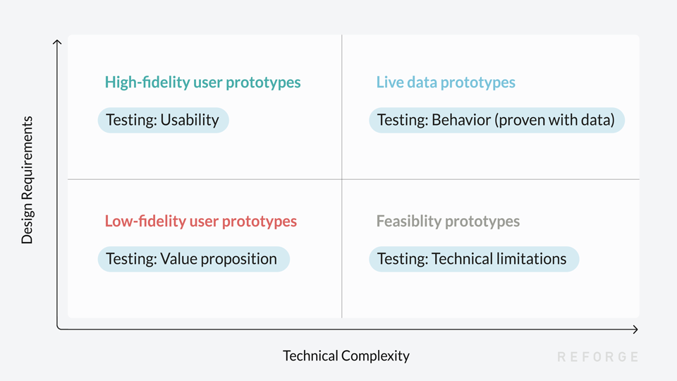
Source: Marty Cagan, Partner Silicon Valley Product Group

Slide 3
HIGH-FIDELITY USER PROTOTYPES
Realistic, working simulation
Communicating a product
Defensive user testing
LOW-FIDELITY USER PROTOTYPES
Interactive wireframe
Test the workflow
Simulate processes
LIVE-DATA PROTOTYPES
Prove it works
Access to real data
Not yet ‘productized’
FESIBILITY PROTOTYPES
Prototyping new tech
Write just enough code
To understand tech risk
Source: Marty Cagan, Partner, Silicon Valley Product Group

Slide 4
Rapid Prototyping
Engineering: rapid prototyping is … the process of creating prototypes quickly to visually and functionally evaluate an engineering product design.
Design: an analogy for proof of concept — it’s a process of quickly creating the future state of a product, be it a website or an app, and validating it with a group of users, stakeholders, developers, and other designers.

Slide 5
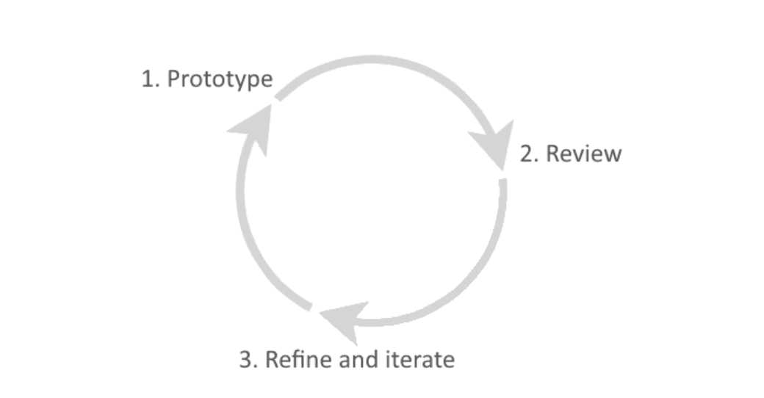

Slide 6
Low-Fidelity Prototypes
Low-fidelity prototypes are generally limited function, limited interaction prototyping efforts.
They are constructed to depict concepts, design alternatives, and screen layouts…
These prototypes are created to communicate, educate, and inform.
https://dl.acm.org/citation.cfm?id=223514

Slide 7
Why Now?
Design thinking advocates for “thinking with your hands” as a way to build empathetic solutions.
Lean startup relies on early validation and the development of a minimum viable product to iterate on.
User-centered design calls for a collaborative design process where users deliver continual feedback based on their reactions to a product’s prototype.
https://www.smashingmagazine.com/2014/10/the-skeptics-guide-to-low-fidelity-prototyping/
Notes:
Though low-fidelity prototyping has existed for centuries, it has recently become popular with the spread of agile design methodologies, inspired by several movements

Slide 8
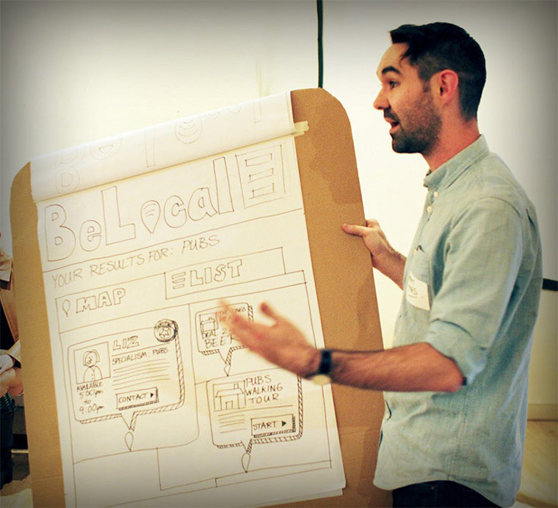
Examples
UX designer Matt Tyas presents a prototype concept.
https://www.smashingmagazine.com/2014/10/the-skeptics-guide-to-low-fidelity-prototyping/

Slide 9
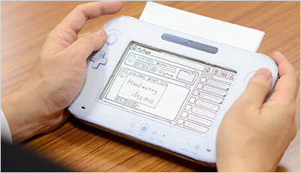
Examples
Designers in companies such as Nintendo use low-fidelity prototyping. Designer Kazuyuki Motoyama explains that the only way to actually know what a Miiverse would feel like was to hold it. That’s when he built this prototype out of cardboard. (Image credit: Nintendo)
https://www.smashingmagazine.com/2014/10/the-skeptics-guide-to-low-fidelity-prototyping/

Slide 10
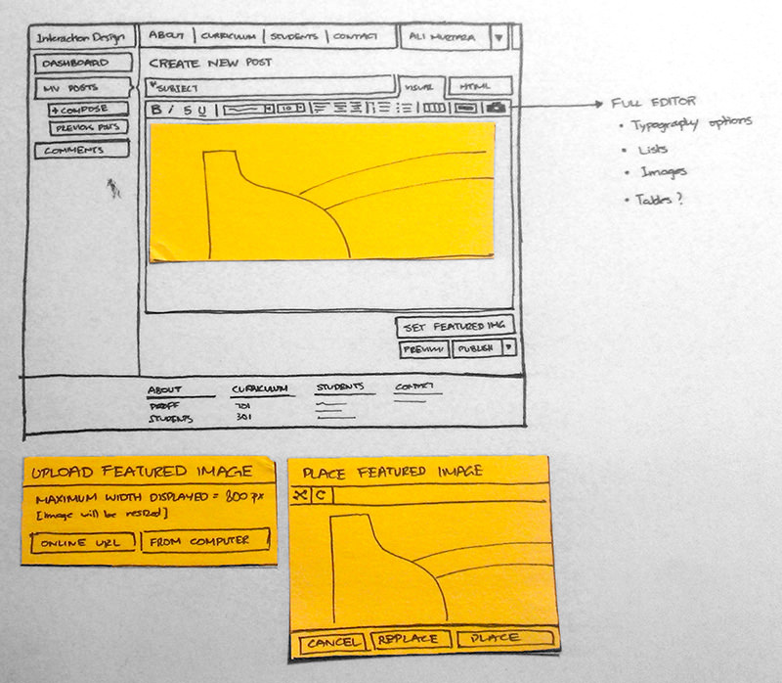
Examples
This low-fidelity prototype of a new web design for SCAD’s Interaction Design department shows the initial concepts for improving reading and posting interactions.
https://www.smashingmagazine.com/2014/10/the-skeptics-guide-to-low-fidelity-prototyping/

Slide 11
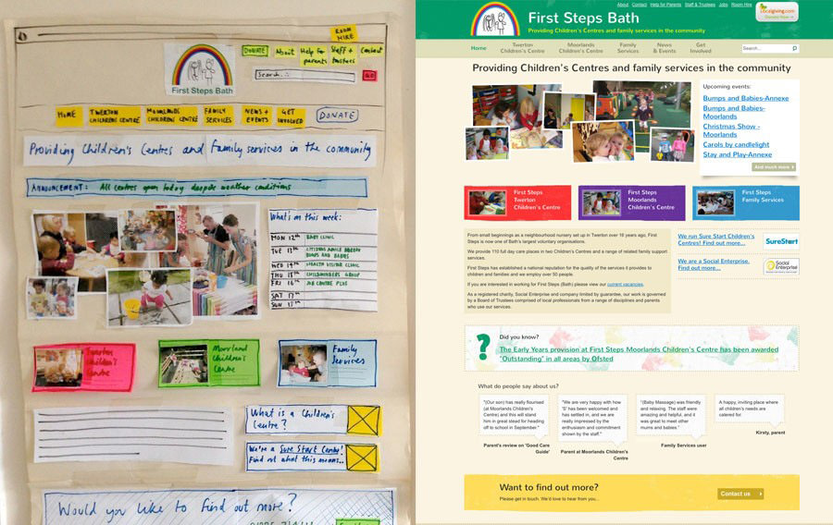
Examples
The team at Flow New Media Design shows how it starts with paper-based prototypes to “strip things back to the bare bones [and] concentrate on the important things.”
https://www.smashingmagazine.com/2014/10/the-skeptics-guide-to-low-fidelity-prototyping/

Slide 12
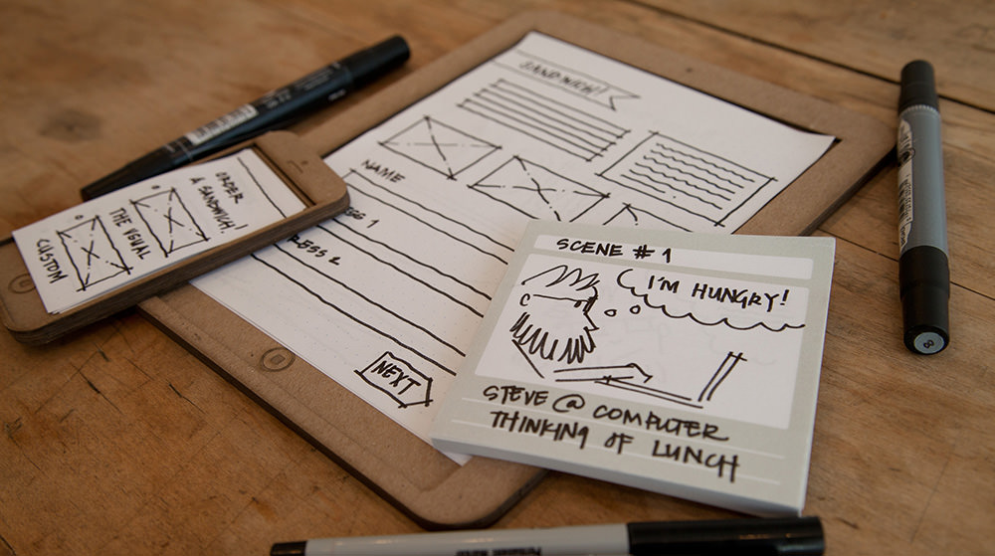
Examples
https://stickyjots.bigcartel.com
Two interaction design students launched a company named Sticky Jots, which offers kits to help anyone get started with low-fidelity paper-based prototypes, such as storyboards.
https://www.smashingmagazine.com/2014/10/the-skeptics-guide-to-low-fidelity-prototyping/

Slide 13
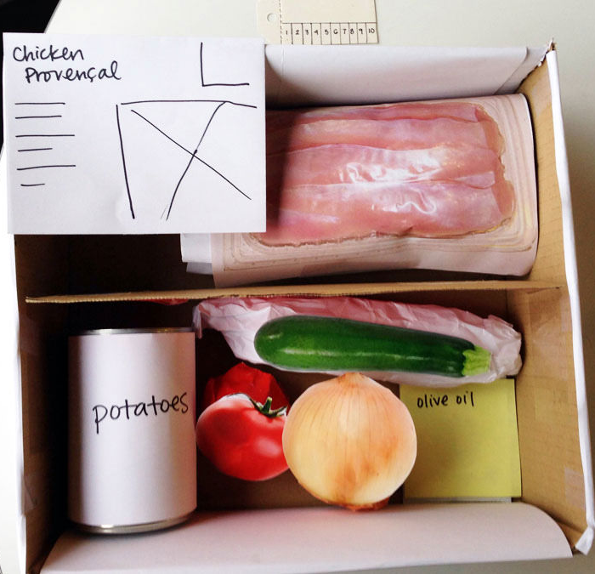
Examples
3D prototypes add a level of interaction that 2D prototypes do not achieve. Takes slightly longer, a 3D prototype encourages manipulation and could draw a higher level of engagement.
https://www.smashingmagazine.com/2014/10/the-skeptics-guide-to-low-fidelity-prototyping/

Slide 14
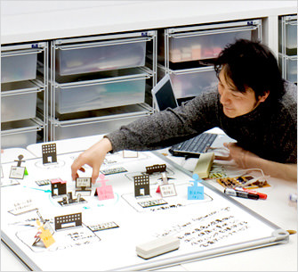
Business origami is a paper prototyping method developed by Hitachi to facilitate the design of services and systems.
3D prototypes add a level of interaction that 2D prototypes do not achieve. Takes slightly longer, a 3D prototype encourages manipulation and could draw a higher level of engagement.
https://www.smashingmagazine.com/2014/10/the-skeptics-guide-to-low-fidelity-prototyping/

Slide 15
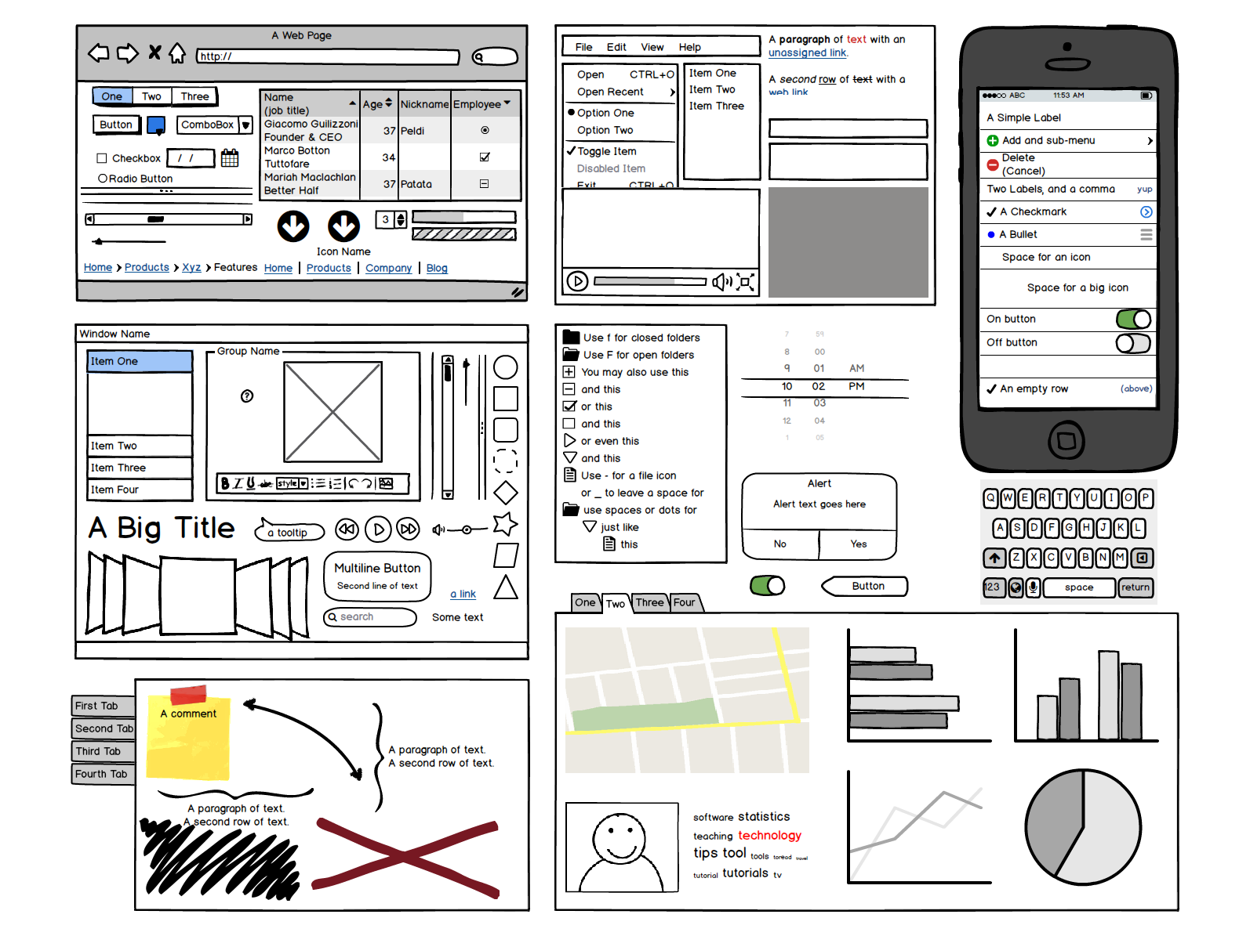
Balsamiq
Balsamiq

Slide 16
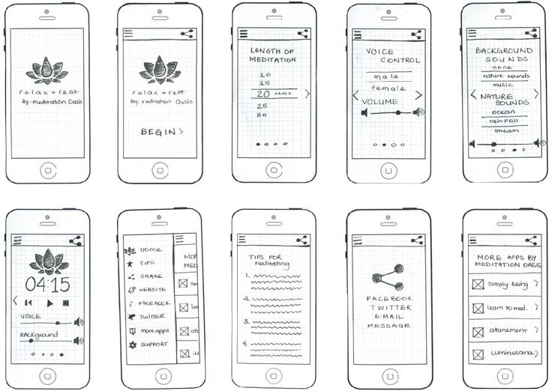

Slide 17
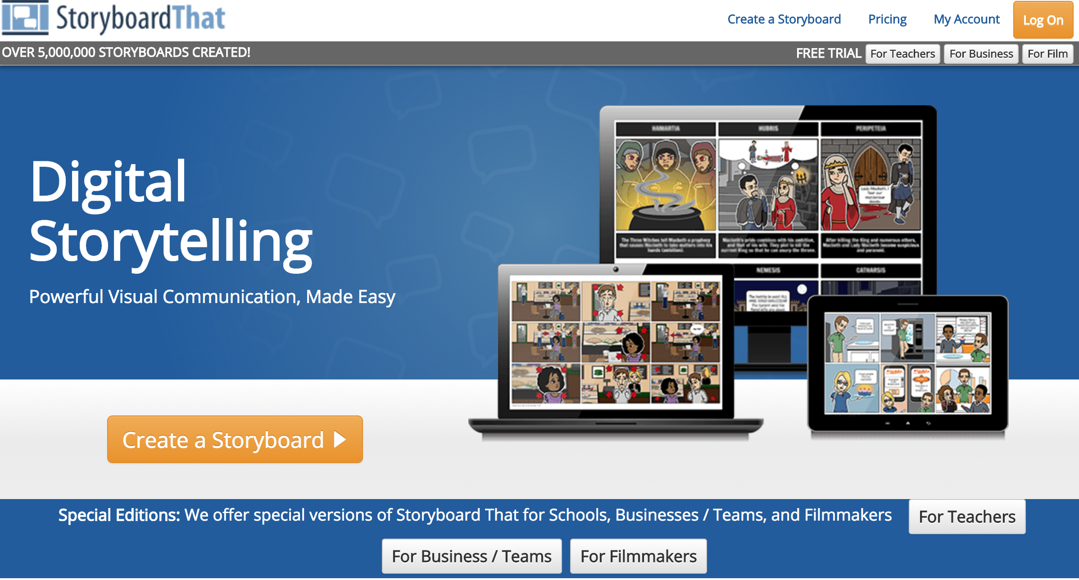
Storyboard that

Slide 18
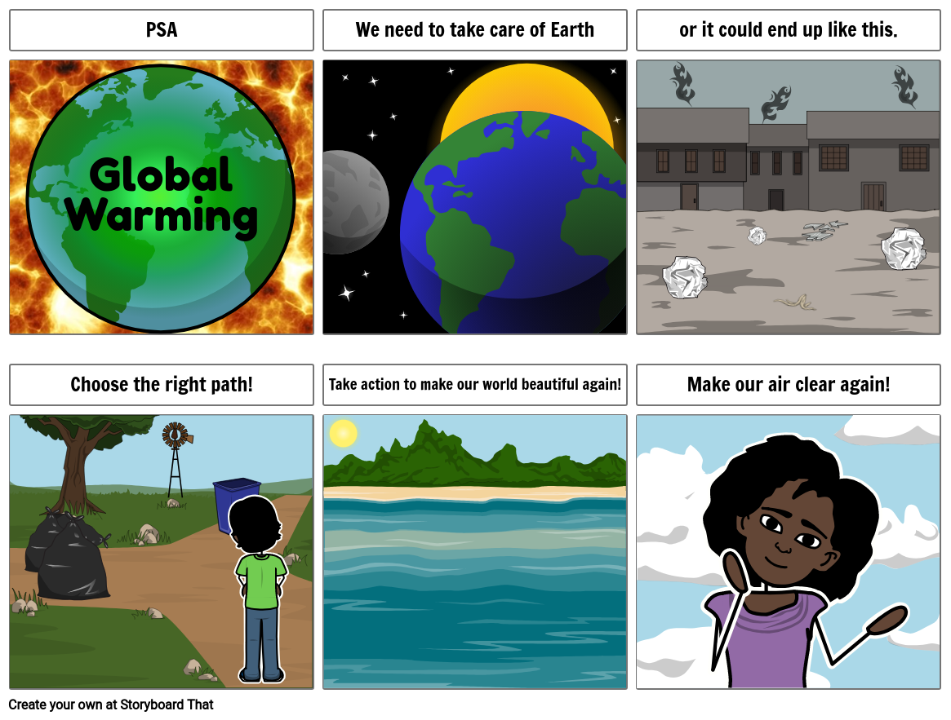
https://www.storyboardthat.com/storyboards/examples/public-service-announcement---global-warming

Slide 19
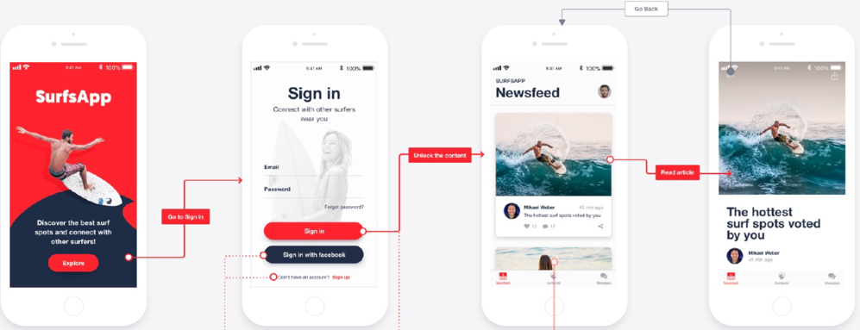
Proto.io
Suggested by a student at Climathon 2019
The software I would use!

Slide 20
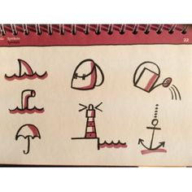
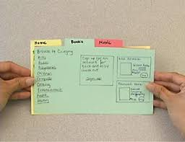
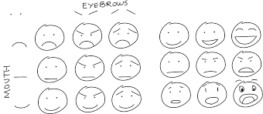
Simplicity is key

Slide 21
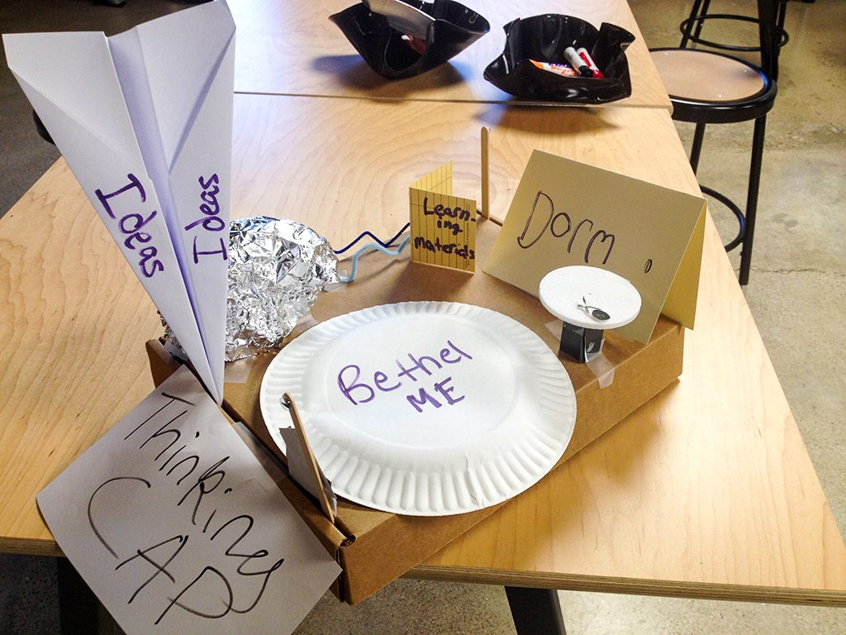
Design thinking prototypes

Slide 22
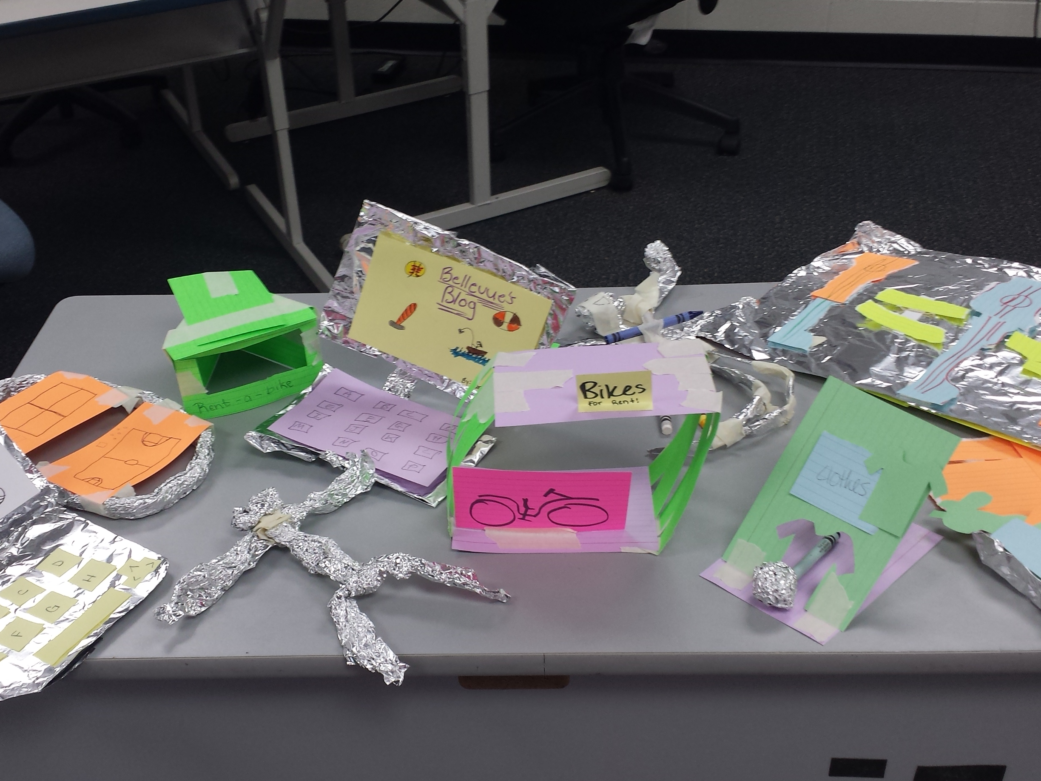
Design thinking prototypes

Slide 23
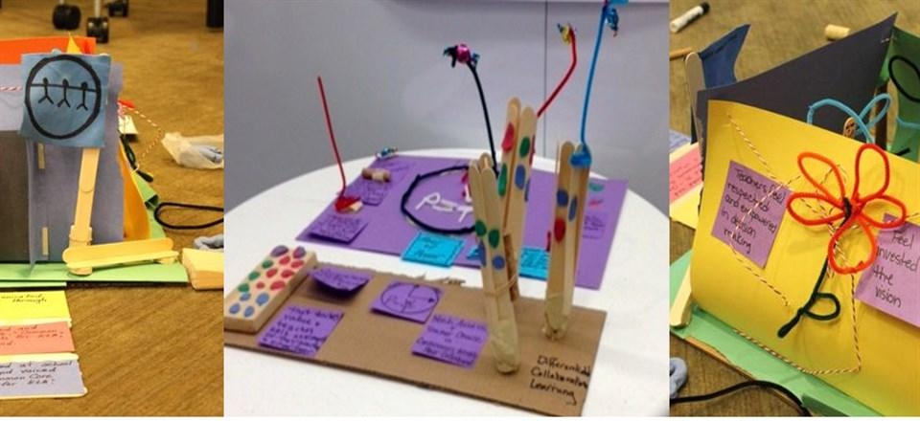
Design thinking prototypes

Slide 24
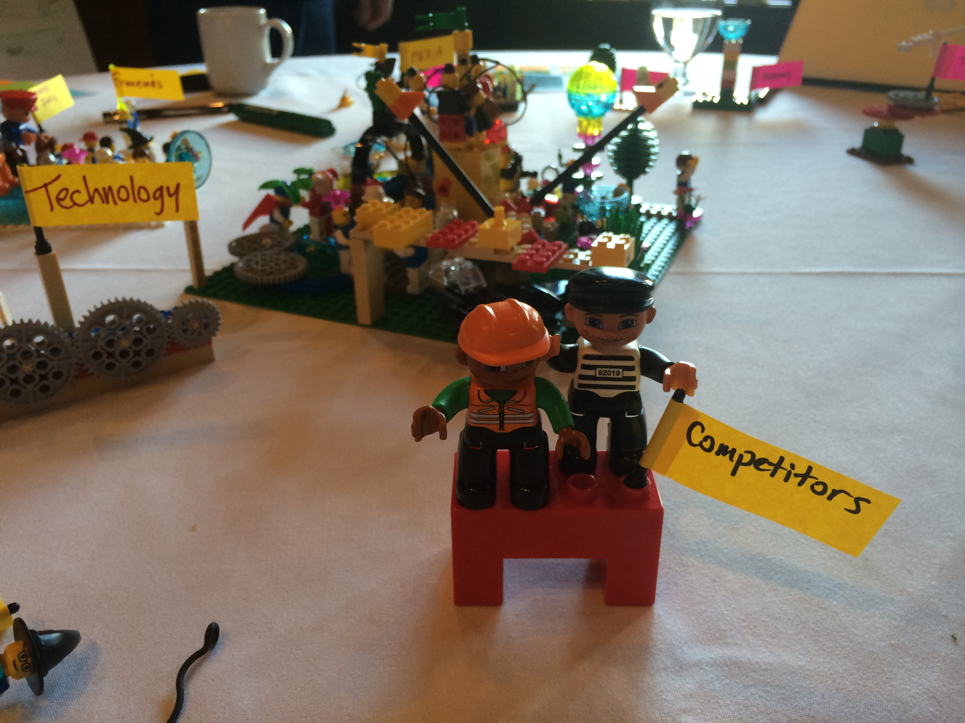
Let go my Lego!

Slide 25
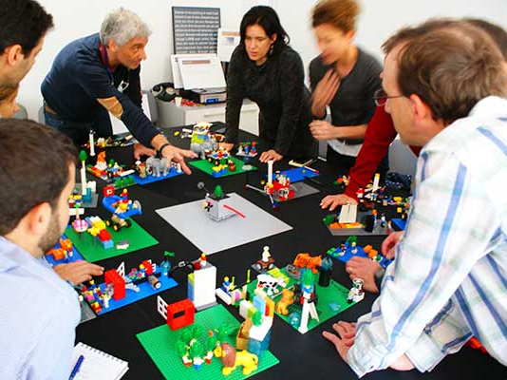
Lego power!

Slide 26
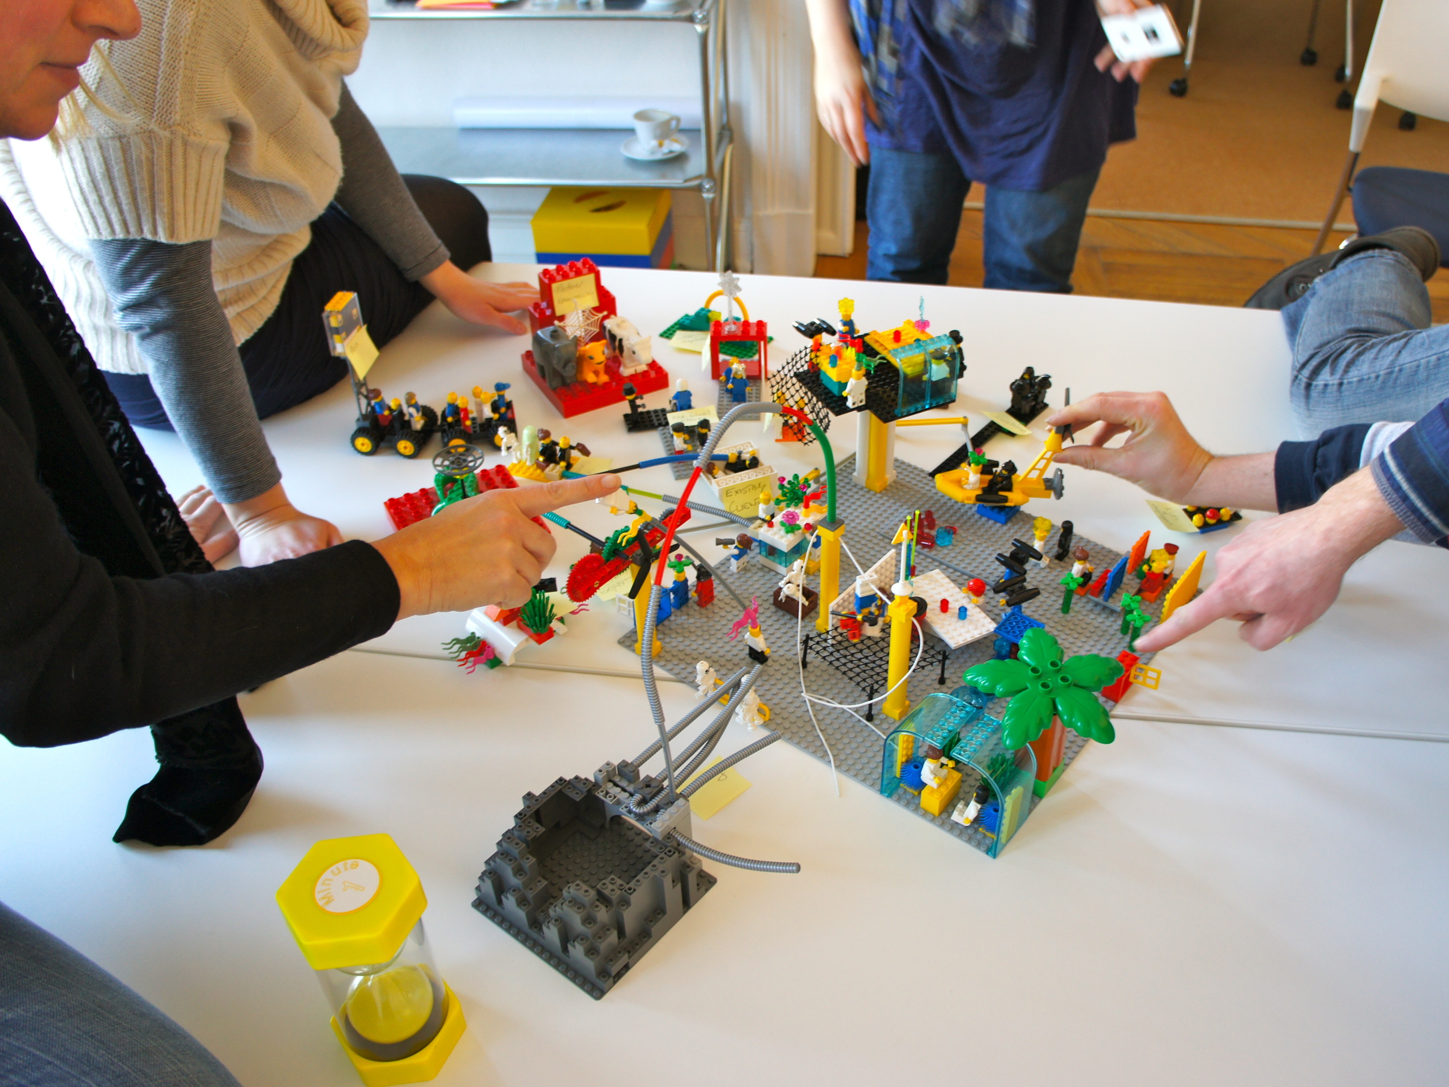
Luke…. use the Legos!

Slide 27
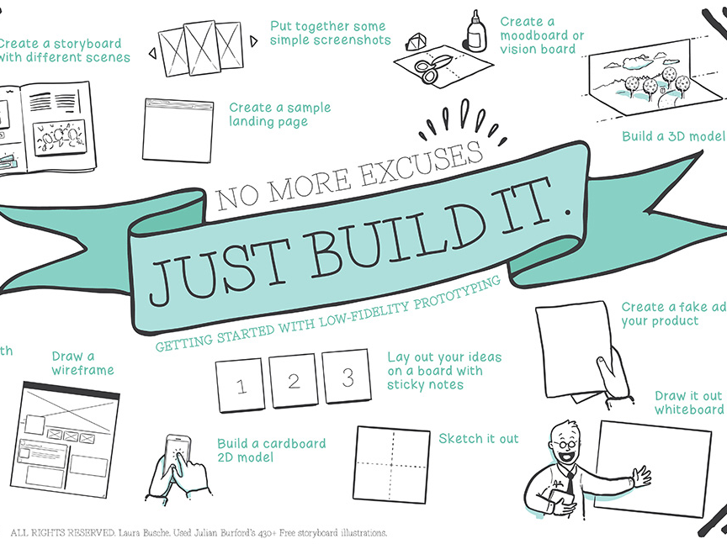

Slide 28
References
Rudd et al. “Low vs. high-fidelity prototyping debate” 1996 https://dl.acm.org/citation.cfm?id=223514
https://www.smashingmagazine.com/2014/10/the-skeptics-guide-to-low-fidelity-prototyping/
https://www.invisionapp.com/inside-design/the-designers-guide-to-building-a-brand-story/
www.unsplash.com
https://www.linkedin.com/learning/design-thinking-prototyping/

