Slide 1

UNIVERSITY WRITING CENTER at CSULB
Appointment scheduling guide

Slide 2
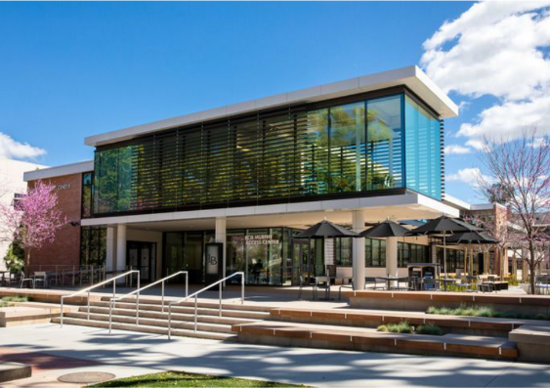
CENTER INFORMATION
Location: Shakarian Student Success Center (SSSC), Room 245
Printable Map
Phone: (562) 985 – 5162
Home page: csulb.edu/uwc
General Inquiries: UWC@csulb.edu
Zoom Room (open during business hours)
Please check our website for link
Hours of Operation : Monday – Friday
Please Check our website for updated hours.
Follow us on social media - check our linktree

Slide 3

Important Reminders
You can only schedule an appointment up to two weeks in advance.
You are limited to 2 appointments per week
If you cannot keep an appointment, you must cancel or reschedule the appointment at least 1 hour in advance.
If you have 2 or more no-shows, the system will prevent you from making another appointment.

Slide 4

Log-In to Single-Sign On (SSO)
Log in using Single Sign-On https://sso.csulb.edu
1
Use your student ID number and Beach password
(same number used for MyCSULB/Canvas).
2
Click on the “BeachConnect” button from the list of apps.
3

Slide 5
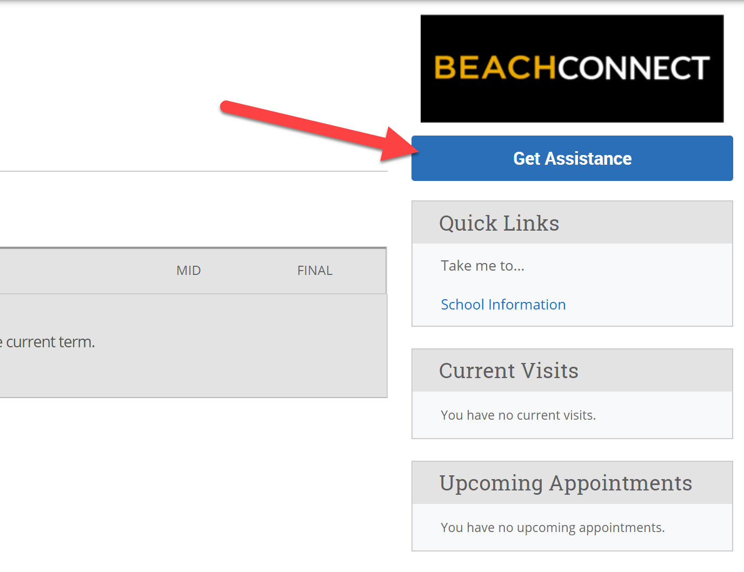
Get Assistance
On the far right, top of the page, click the “Get Assistance” button to make a writing tutoring appointment.

Slide 6
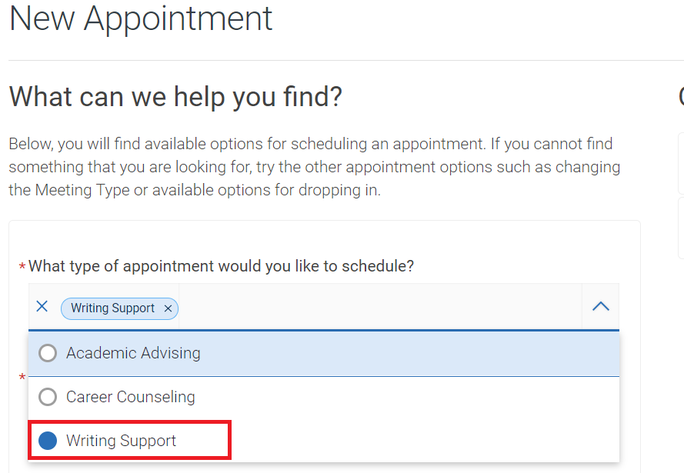
Choose: Writing Support
From the drop-down menu choose the type of appointment you need.
To schedule a writing appointment, select “Writing Support”

Slide 7
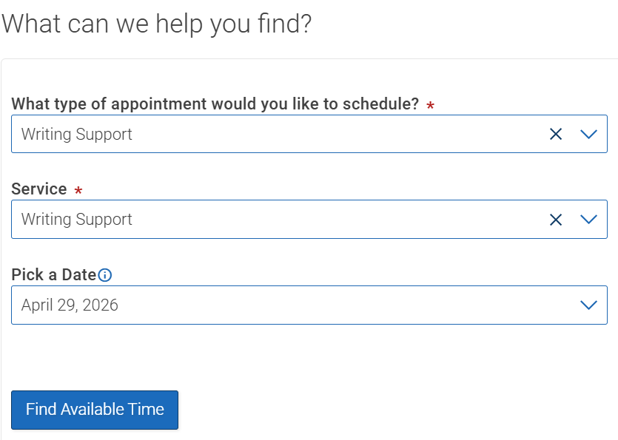
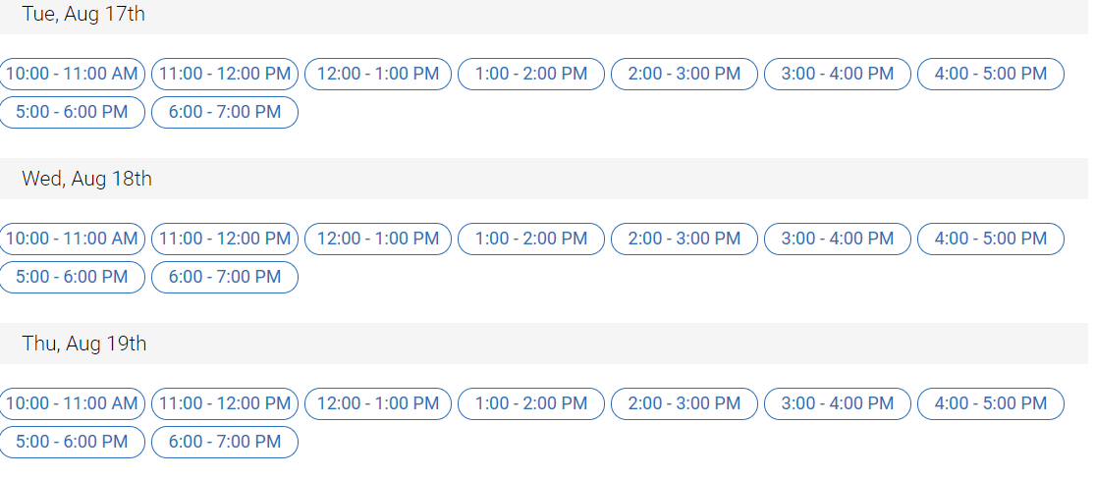
Choose: Date & Time
Choose the day and time that fits with your schedule.

Slide 8
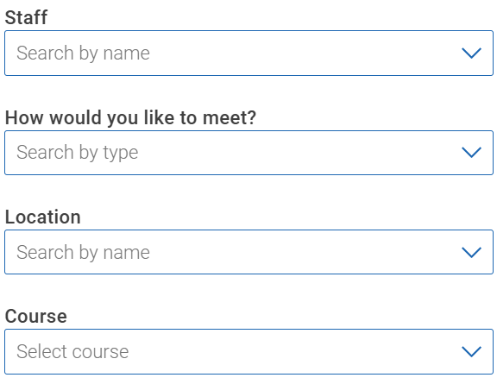
Filtering: Other Options
At the bottom left of the screen, you can filter through other options:
Staff: will let you search through a specific tutor’s schedule.
Meet: will let you choose between an
in-person or online appointment.
Location: select University Writing Center
Course: will remain blank

Slide 9
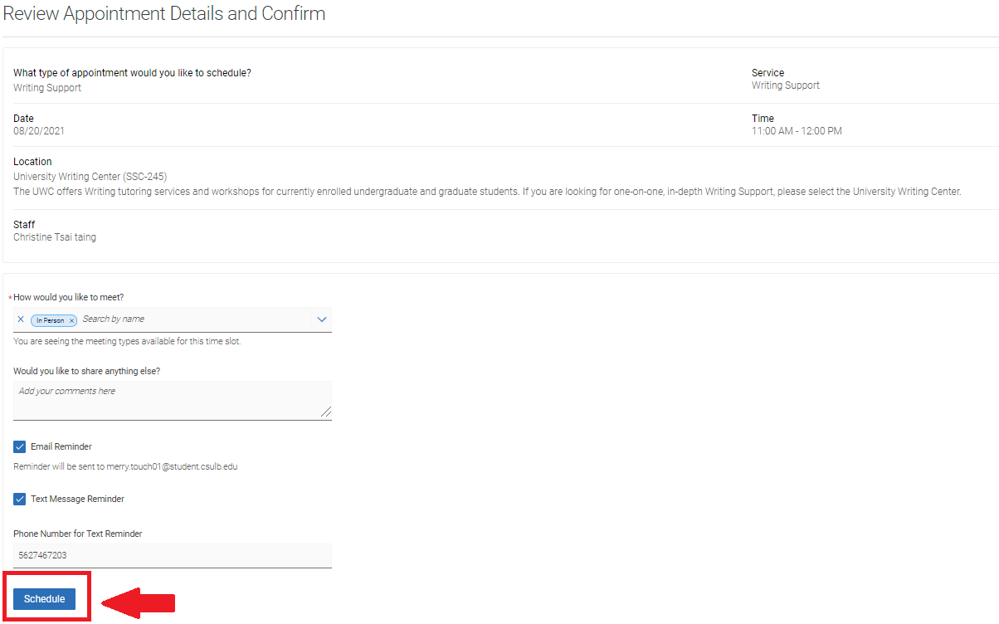
Confirm
Review the Appointment Details and select which method you wish to receive your reminder: email or text. Please put a few brief notes about the class and assignment you will be working on in the comment box.
IMPORTANT: Click on “Schedule” to confirm the appointment.
What you currently see is a preview. If you do not select “Schedule,” your appointment will not be made.

Slide 10
Cancel Appointment
If you need to cancel, please try do so at least 1 hour before your scheduled appointment time by doing the following:
Log into Single Sign On.
Click on “BeachConnect” chiclet.
Locate the appointment under “Calendar” or “Appointments.”
Click on the appointment you want to cancel.
Click on “Cancel Appointment.”

Slide 11
More Tips
For more information about our services, please visit our website
You can review information about: Our Team, Appointment Policies, Workshops, Resources, and more!
For more information about appointments and policies, please visit our “appointment” section in our homepage. Here you can review about the following:
Preparing for your Zoom appointment with links to “how-to” videos
What to bring to your appointment
Policies regarding cancellations and no-shows
And more…

