Slide 1
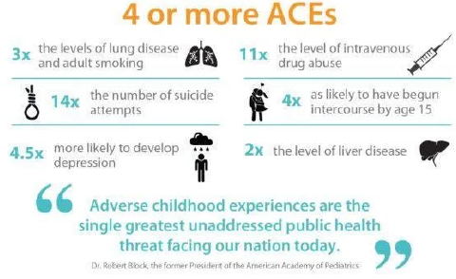
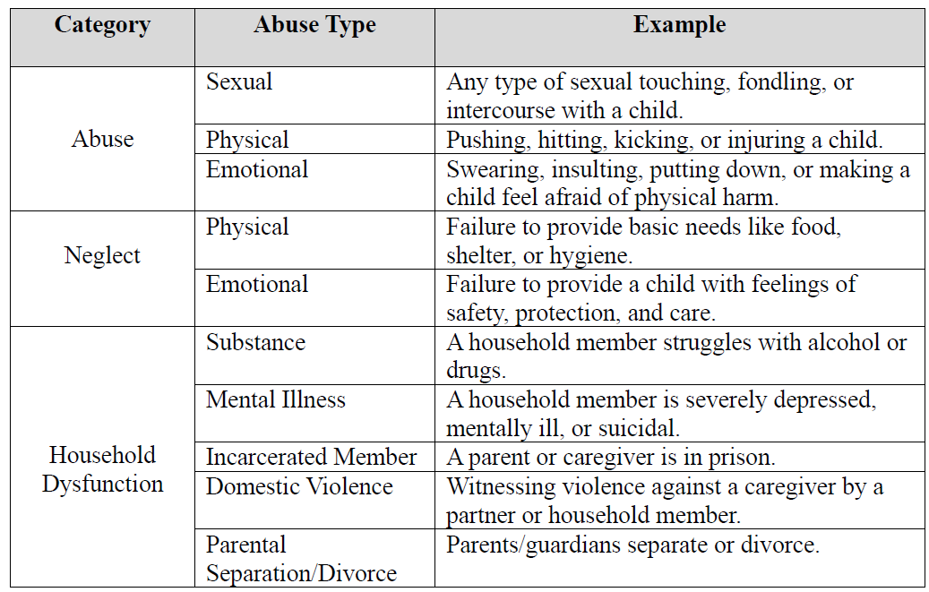
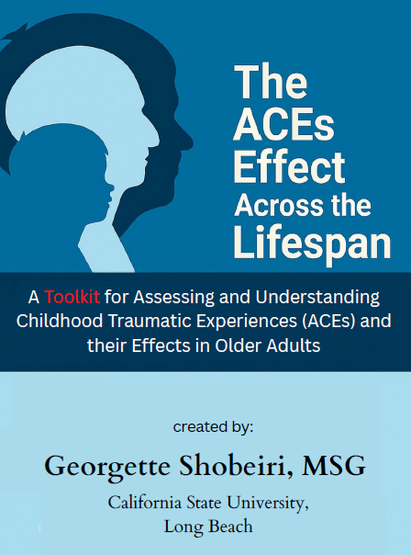
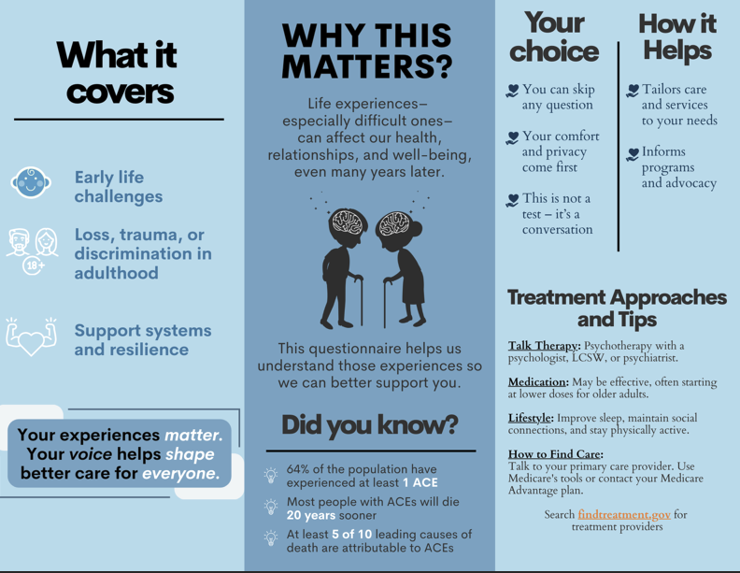

Assessing the effects of childhood trauma in older adults
Georgette Shobeiri, Maria Carpiac, Vanessa Dixon, Nakia Thierry
Department of Family & Consumer Sciences
College of Health & Human Services, California State University Long Beach
Introduction
Results
Discussion
Assessing the effects of childhood trauma in older adulthood: The ACEs effect across the lifespan toolkit
ACEs = Adverse Childhood Experiences
These are traumatic experiences that occur before age 18, and can be categorized into three categories: abuse, neglect, and household dysfunction.
Recent research is exploring the intersectionality of these childhood events and their linkages to mental, physical, and financial outcomes later in life.
Expert panel feedback:
9 people who are gerontological professionals, family members, or older persons.
Overall positive responses and most reviewers gave detailed feedback on what portions worked and where more clarity was needed.
Project Revisions:
Restructured layout.
Created additional hyperlinking to improve ease of exploring sections.
Created roadmap so users will understand the steps from education to application to follow-up.
Provided insights to who should be involved in creating the network to support older adults.
The project developed a toolkit to inform both patients and their care providers (whether medical, social, or caregivers) about ACEs and their longtime effects on an individual’s health along with a guide on how to administer, score, and interpret assessment results.
This toolkit can be deployed to medical offices, social care offices, or residential facilities.
Reasons this toolkit is needed:
ACEs are linked to multimorbidity, accelerated biological aging, subjective cognitive decline, and socioeconomic vulnerability.
Higher ACEs scores indicate increased risks for chronic conditions, cognitive impairment, diminished quality of life, and premature mortality,
Research shows early life adversity is linked to biological outcomes such as chronic inflammation, stress dysregulation, accelerated epigenetic aging, and greater likelihood of developing cognitive dysfunction in late life.
Life course theory shows that experiences such as where and when a person was born, relationships with family and others, illnesses and life traumas influence one’s outcomes in life, meaning that one’s health is not solely influenced by their personal choices.
Gap identified in this country’s current system: most professionals and support providers do not routinely collect ACEs histories, or when they do, the information is rarely used to develop plan of care.
Implementing ACEs screenings in the same manner as depression or fall-risk would standardize implementation of wraparound services that would improve overall health gains.
Gains would be improved chronic health management and reduced financial burdens on healthcare and social systems.
Current clinical practices are disease-specific and individual-focused, and operate reactively instead of proactively – at odds with public health strategies, which seek to take a proactive approach to improve the health of a society overall.
Figure 1.
Examples
of types of
Adverse
Childhood
Experiences.
Conclusion
ACEs screening should become part of our standard of care – at all ages, as the statistics show that the ACEs effect is cross-generational.
Our current model of specialists treating only one aspect of a person’s health is failing us and adding to the costs of our healthcare system as this ignores the intersectionality of many influences on a person’s health.
The ACEs effect on our rapidly aging population should not be ignored, as they are helping to create a public health crisis.
If we want to improve public health, we must shift our medical and social care models to be proactive rather than reactive.
Figure 2. Toolkit
Cover.
Methods
Selected group of interested parties including gerontologists, family members, and other experts in the field of aging reviewed the toolkit that provides resources to medical and social care providers through three components:
ACEs Assessment
Facilitator/Provider Manual
Patient Information Guide
The currently used ACEs Assessment revised to include additional questions and reworded to be more relatable for older generations.
A pictorial version of the ACEs Assessment developed for those with mild to moderate cognitive impairment.
Developer spent extensive time developing a manual to educate healthcare and social workers and caregivers on why having knowledge of ACEs exposure is important and gives some examples of how to mitigate the effects of ACEs in older people.
Patient Information Guide developed to explain to patients and caregivers importance of why they are being asked to take the assessment.
Feedback form with open- and closed-ended questions completed after review of guidebook and informational guide.
Responses collected from expert panel were incorporated to improve clarity and design.
Acknowledgements
Without the many individuals who make up my tribe, I could not have completed this project while also battling breast cancer. They were my strength and pillars of support and encouragement, pushing me to the finish line. Although I can never say it enough, I would like to thank: my wife, my cohort (you know who you are), Professors Maria Carpiac, Mary Marshall, and Vanessa Dixon.
For the little girl who was told by her teachers that she would never amount to anything – you are amazing and you have proved them wrong!!!
For more information
Please contact geoshob@gmail.com. More information on this and related projects can be obtained from maria.carpiac@csulb.edu.
Figure 3. Patient Information Guide.

