Slide 1

24-Month STEM OPT Extension
Presented by
International Students & Scholars Office
Center for International Education
California State University, Long Beach

Slide 2
This tutorial will help you:
Understand the Eligibility Requirements.​
Understand the application deadlines & process.​
Understand the key elements of Form I-983.​
Learn What is necessary to Maintain F-1 status including the Mandatory Reporting requirements.​
Review Frequently asked questions.​
Recognize key Resources.

Slide 3

What is the 24-Month STEM OPT extension?
The 24-Month STEM OPT extension allows students with STEM designated degrees the opportunity to extend their current employment authorization for an additional 24-Months.

Slide 4


24-Month STEM OPT Eligibility

Slide 5
Eligibility is determined
by 4 components
Having a qualifying degree
Currently in Post-Completion OPT
Have a STEM OPT qualifying employer
Have a STEM OPT qualifying job

Slide 6
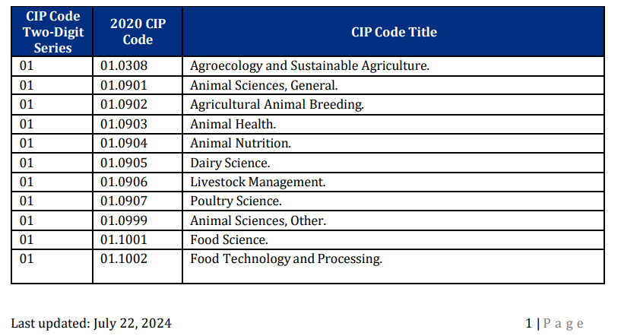
Qualifying Degree
Degree program must be at one of the following educational levels: Bachelor's; Master's; or Doctoral.​
​
The major field of study of the degree program must have a CIP code that appears on the DHS STEM OPT Designated Programs List.​
​
The STEM OPT extension may be based either on the current degree or a STEM Designated degree conferred no more than 10 years prior
STEM Designated Degree Program List

Slide 7
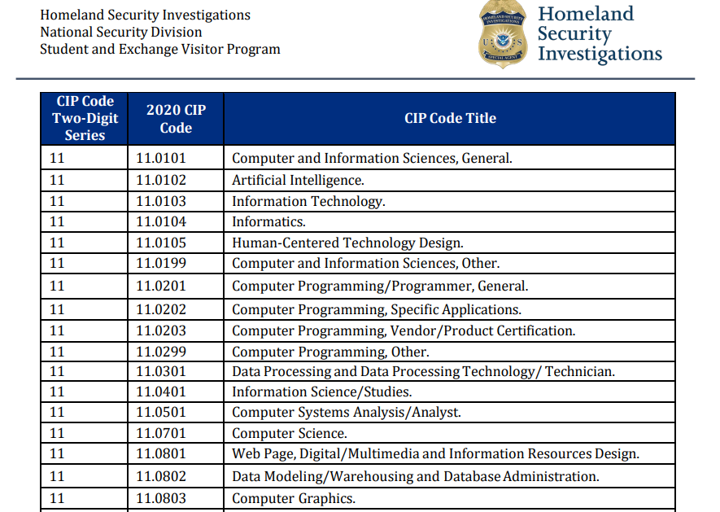
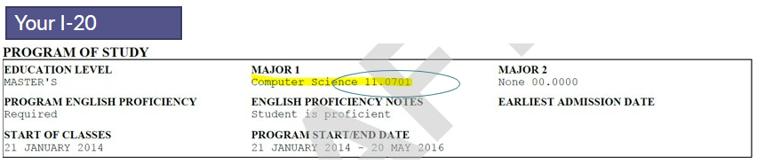
STEM Designated Degree Program List
Your I20

Slide 8

Qualifying Employer
The regulations require any job undertaken during a 24-month STEM OPT extension to be with an employer who meets the following conditions:​
The employer is enrolled in E-Verify​
The employer has an IRS Employer Identification Number (EIN)​
The employer has sufficient resources and personnel available to provide the training specified in the Form I-983​
The employer signs the Form I-983 Training Plan, agreeing to the wage, working conditions, supervision, site visit, and reporting obligations set forth on the form and in the regulations-​
Employer will provide compensation to the STEM OPT student commensurate to that provided to similarly situated U.S. workers​

Slide 9

Qualifying Job
•The job must be directly related to the degree that qualifies the student for the STEM OPT extension.
•The job must be a paid job therefore volunteer or unpaid positions do not qualify.
•The job's compensation and working conditions must be "commensurate with terms and conditions applicable to the employer's similarly situated U.S. workers in the area of employment."
•The student on a STEM OPT extension cannot replace a full-or part-time, temporary or permanent U.S. worker
•Any job undertaken must be for at least 20 hours per week.
•The job must comply with "all applicable Federal and State requirements relating to employment."

Slide 10

The job must be in the context of a bona-fide employer-employee relationship.
▫Self-employment does not constitute a qualifying job for purposes of a 24-month STEM OPT extension
▫F-1 students seeking STEM OPT extensions may be employed by new “start-up” businesses so long as all regulatory requirements are met.
•According to DHS, the following do not constitute a bona-fide employer-employee relationship and are therefore not “apt” for the STEM OPT extension:
▫"multiple employer arrangements"
▫"sole proprietorships"
▫"employment through “temp” agencies"
▫"employment through consulting firm arrangements that provide labor for hire, and"
▫"other relationships that do not constitute a bona fide employer-employee relationship"
Qualifying Job (cont.)

Slide 11

Application Process

Slide 12


General Application Deadline
STUDENTS in OPT
Apply as early as 90 days before the end of your post-completion OPT authorization. You cannot apply during the 60 days grace period following the end of post-completion OPT
File application within 60 days from the day the DSO request the extension and before OPT EAD expires.

Slide 14
General process to apply for the 24-Month STEM OPT extension
1
Determine if you are eligible for the 24-month STEM OPT Extension
2
Student and employer complete and sign Form I 983 (Training Plan for STEM OPT Student) and all other application forms.
3
Submit the evidence of eligibility to the DSO by online submission @ Optional Practical Training | California State University Long Beach
4
DSO recommends the STEM extension and provides new I 20 to student.
5
Student prepares the application using the Cover Sheet provide by the DSO, File the complete Application for Work Authorization and all supporting documents to USCIS in a timely manner.
6
USCIS reviews the application and makes a decision within 90 100 days.

Slide 15

Prepare STEM OPT
Application forms
Find the application forms for STEM OPT at STEM OPT | CSULB
→Click on: Application Instructions

Slide 16

Submit Evidence of Eligibility
DSO will review the following documents to issue the STEM OPT I-20
STEM OPT I-20 Request Form Form I-983Training Plan Most recent I-94 record Copy of your qualifying STEM OPT degree only if it was issued by a school other than CSULB.
Visit the USCIS website to confirm current applicable fees for form I-765. USCIS's OPT (I-765) application fee is $470 for online filings Prepare a copy of your official transcripts while you wait for your I-20.

Slide 17
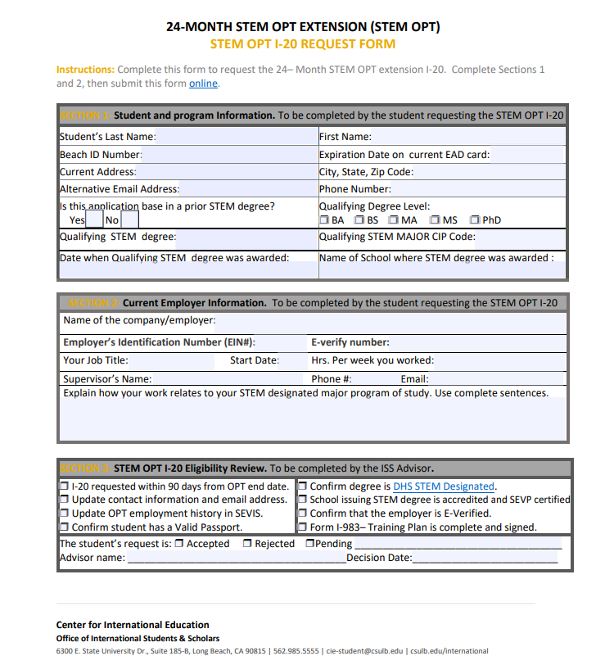
STEM OPT I-20 Request form

Slide 18
Form I-983 (Training Plan)
Also called the Training Plan for STEM OPT Students
Student and Employers Sign on it then DSO reviews it!
A complete Form I-983 is required before a DSO makes the recommendation for the 24-Month STEM OPT extension, complete pages 1-4.
Pg. 5 is due for submission ONLY when evaluation on student progress is due.
Form I-983 stays with the DSO (it will not be mailed to USCIS).
Material changes on Form I-983 must be reported in a timely manner.

Slide 19
I-983 Form – Brief Overview

Slide 20

Signatures on Form I-983
Students and employers may continue to physically sign the Form I-983 or input their own electronic signature.
Valid electronic signatures:
electronic signatures produced with software programs or applications
digitally reproduced copies of a signature example: a scanned image of a physical signature.

Slide 21

When is a new Form I-983 Due?
When 24-Month STEM OPT is requested
•When there are any material changes to the original training plan
When the Student stops working for an employer
When Student changes employer

Slide 22
DSO reviews Evidence & issues an New I-20
All students requesting the 24-Month STEM OPT will receive the following from the DSO:
Cover Sheet
I-20
The Cover Sheet will include information about:
How to file your application to USCIS online
Reminders to maintain F-1 status
What to expect after the application is filed

Slide 23
Track the application review progress
You can use your USCIS account to track the progress of your application review.
At any time, you may use the online tools to submit inquiries to USCIS about your application and review you rcase status.
It is critical that you keep your mailing address always updated!

Slide 24
Once your STEM OPT is approved you will receive your new EAD by mail.
Review your EAD to ensure your name is spelled accurately and your approval dates are no more than 24 months in length.

Slide 25

Maintaining F1 Status
Reporting Requirements
Unemployment Time
Travel

Slide 26
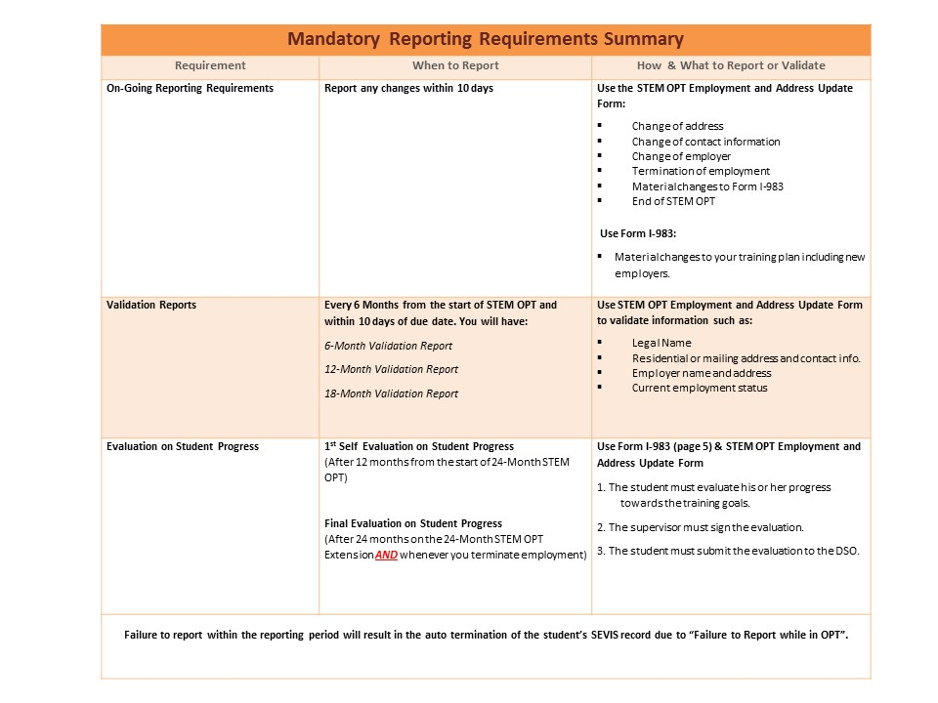
Mandatory Reporting Requirements

Slide 27
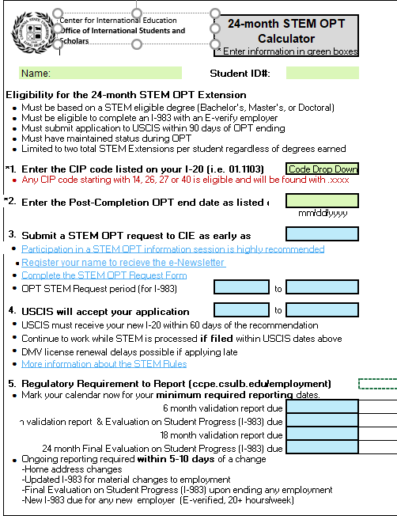
The STEM OPT calculator will help you determine the due dates for your mandatory reports.
Use your SEVP Portal to review a summary of due dates & ensure your information is accurate. You can access it at https://sevp.ice.gov/opt

Slide 28
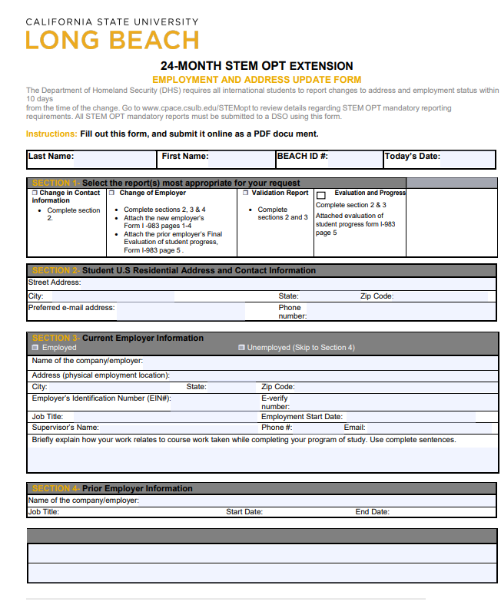
How to Report
Form and submission instructions available here:
https://www.csulb.edu/inte rnational/current-students/request-documents-or-signatures

Slide 29

Unemployment Time
If you received… | You may be unemployed for… | For a total of…
Post Completion OPT only | Up to 90 day | 90 days
24 month extension | An additional 60 days | 150 days
• The SEVIS System will automatically terminate students who exceed the unemployment time!
• Unemployment time begins with the start date in the EAD card.
• Unemployment days could be accrued at any time throughout the 24 months of STEM OPT if you are not employed.

Slide 30

Travel Outside the U.S.
Travel is NEVER recommended when your application is pending and your Post-Completion OPT EAD has expired.
Travel may be ok before your OPT EAD expires but always ask an International Student Advisor first!
How to Re-Enter Safely
Valid Passport (valid for at least 6 months)
Valid F-1 Visa Stamp
Freshly Signed OPT I-20 (No more than 6 months old)
Unexpired EAD Card
Letter from your Employer
Contact information for the designated school official (DSO) at your school
Ensure you have not exceeded unemployment time.

Slide 31

Frequently Asked Questions

Slide 32

Can you work while your application is still pending?
USCIS may take up to 90 days to process your application. If you file your OPT STEM extension application in a timely manner, you will receive an extension of employment authorization while your application is pending for up to 180 days, or the date of the decision over your request, whichever date is earlier.
You will not receive any special confirmation for this extension but your STEM OPT I-20 will show the authorization for employment continues after the end of your current EAD.

Slide 33
What are Material Changes?
Any change of the employer’s Employer Identification Number, (i.e., the company’s Federal Tax ID number) resulting from a change in the employer’s ownership or structure.
Any reduction in student compensation that is not tied to a reduction in hours worked.
Any significant decrease in hours per week that a student engages in a STEM training opportunity.
Changes to the employer’s commitments or student’s learning objectives as documented on the Form I-983.

Slide 34

Can I take class's while on STEM OPT?
So far only vocational and recreational classes
are allowed in part time basis (up to 6 units per
semester).
Classes cannot lead to a certificate or degree.
You must get authorization from a DSO prior to
registration.

Slide 35

What happens after STEM OPT?
You have a 60-day grace period at the end of your STEM OPT extension, assuming you have been maintaining F1 status.
During this time you can depart the U.S., start a new academic program or change visa status.

Slide 36
Resources
Support Services from ISS
STEM OPT/OPT e-Newsletter-Emailed twice per year
Meet with an Advisor or email your questions about the 24-Month STEM extension to an International Student Advisor in CIE-student@csulb.edu
Letter to the employer-Request a letter from ISS to better explain STEM OPT to your employer.
F-1 Student Information sesions-participate in a LIVE Webinars

Slide 37
Other Resources
Review STEM OPT FAQs
Browse SEVP's Study in the States STEM OPT
Help Hub that contains resources to help
students, schools, and employers.
Visit U.S. Citizenship and Immigration Services
(USCIS) page on STEM OPT

Slide 38
InternationalStudents andScholars
Location Foundation 185B
Contact cie-student@csulb.edu
Web www.csulb.edu/international
www.facebook.com/csulbiss
www.instagram.com/csulb_iss
Hours Mondays –Thursdays
9:00 am -12:00 pm
1:00 pm -4:00 pm
Fridays
9:00 am -12:00 pm then 1:00 pm -3:00 pm

