Slide 1


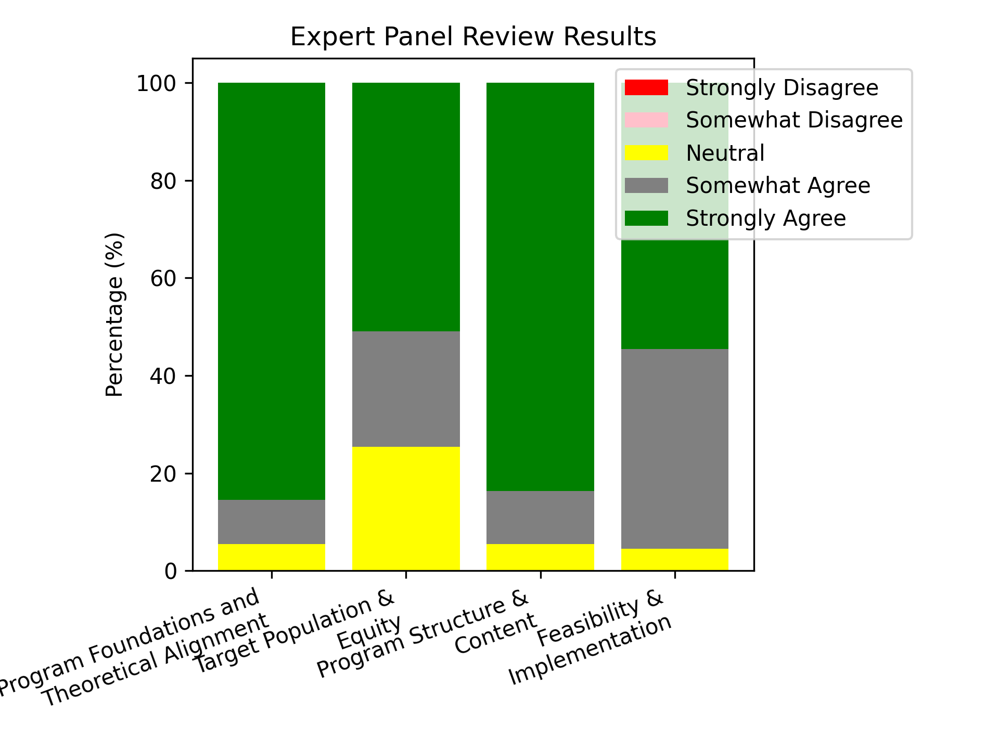

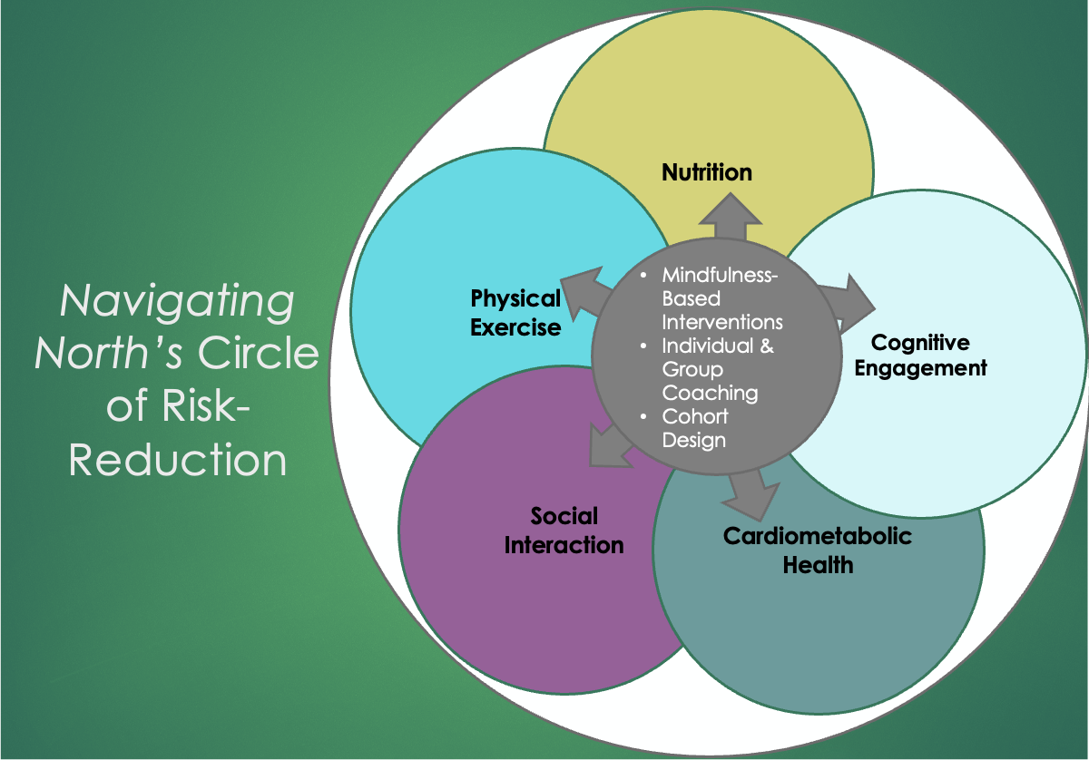
Navigating North: A Brain Health & Vitality Program for Adults Age 60 and Over
Natasha Alexsa Garcia
California State University Long Beach
Department of Family & Consumer Sciences, Gerontology Program
Introduction
.
Results
Conclusions
Growing dementia crisis; 7.2M U.S. adults over 65.
No effective pharmaceutical prevention or cure once the disease has taken hold.
Multifactorial disease involves complex interactions of lifestyle, genetic, and environmental factors.
Addressing lifestyle could potentially decrease risk by 40%.
Evidence from FINGER and U.S. POINTER studies supports multidomain lifestyle intervention for risk reduction.
There is a gap in community-based programs.
Developed full curriculum & facilitator guide
Strong expert support for feasibility.
Aligned with scientific evidence
Refined for improved inclusivity and clarity
Navigating North has the potential to reduce the risk of cognitive decline in older adults.
Potential to lower healthcare and care partner burden.
Scalable across community settings
Support a prevention-focused policy.
Future pilot testing needed.
Purpose
Methods
To develop the Navigating North program for adults 60+ to address the current gap in structured, community-based, multidomain interventions for brain health in older adults.
Translate FINGER and U.S. POINTER research into a real-world program.
Target sedentary, community-dwelling adults without clinical levels of cognitive decline.
Address modifiable risk factors with increased physical exercise, healthy diet, social connection, structured cognitive engagement, stress reduction, and sleep improvement.
Promote adherence with mindfulness-based techniques, coaching, and peer accountability and support.
Improve brain health and independence.
        1. Extensive literature review with the following themes emerging:
          Addressing modifiable risk factors for improved brain health.
            Mindfulness-based interventions for habit change, stress reduction, and overall program adherence.
            Financial and human impact of dementia in society.
            The relationship between sleep and cognitive decline.
            The role of polypharmacy in brain health.
            2. Expert Consultations
            FINGER Brain Health Institute Team
            U.S. POINTER Team
3. Content Development: Facilitator guide, 12-week curriculum, program materials.
4. Expert panel review (N=11).
Discussion
Acknowledgments
Bridges research-to-practice gap
Multidomain approach vs. single domain approach
Adherence & cultural relevance
Facilitator training
Scalable community delivery
Next steps
My wonderful thesis committee: Maria Carpiac, Miriam Watts, Joy Miller
Expert panelists for your time and thoughtful feedback.
FINGER Brain Health Team
U.S. POINTER Team
Debra Bein, for your unwavering support throughout this process.
My family for encouraging me to carry on through tough times along this journey.
For More Information
Contact: Natasha Alexsa Garcia
navigatingnorthpnw@gmail.com

