Slide 1
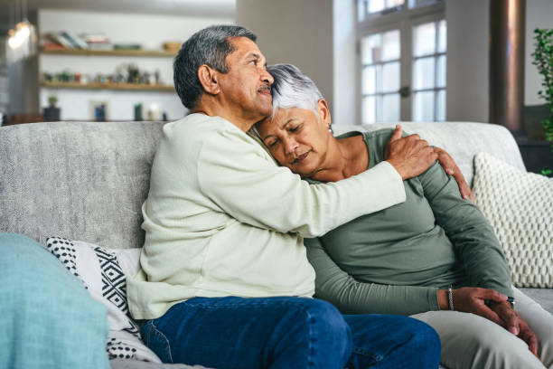
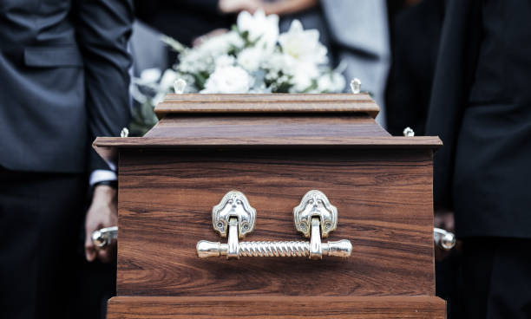
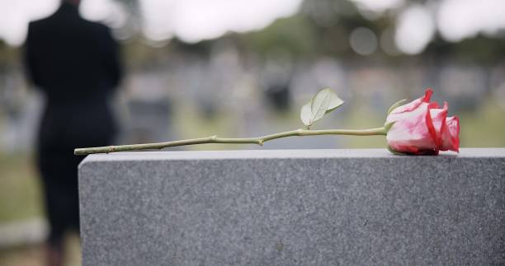

Why Grieving Among Older Male Latinos and Hispanics Matters
Lizette Hernandez-Soto
California State University Long Beach
Department of Family & Consumer Sciences, Gerontology Program
Introduction
Methods
Discussion
Acknowledgements
The loss of a loved one can have significant negative effects
Hispanic people may struggle more because they may encounter barriers such as limited English proficiency, discrimination, and limited access to resources (Boen et al., 2019)
Cultural beliefs may also play an important role for older Latinos and Hispanics during grief
Keeping their feelings of grief inside can put Latino men at higher risk of developing worse health outcomes (Sobralske, 2006)
Information about the study was shared with colleagues that work with older adults through word of mouth
Thematic analysis (Braun & Clarke, 2006) involved identifying, organizing, and providing clarity into understanding patterns across the data
Themes were developed by reading through the transcripts for every participant
Descriptive statistics were used to describe the characteristics of the sample
Researcher identified any patterns that appeared in the results of the study
Participants relied on family members and friends to move forward with the loss
Challenges of grief included lack of advice from the relative that passed away and lacking energy to continue activities
Participants coped with loss by living in the moment or occupying themselves
Similarities from past studies included lower risk of depression if partner is supportive
Maria Carpiac, Marine Aghekyan, and Mary Marshall
For more information
Lizette.HernandezSoto@student.csulb.edu
lizettehernandez331@gmail.com
Results
Aim
Participants had a variety of ways they felt about death which included relief, natural, unpredictable, and sudden
Fourteen participants did not consider grief counseling but six were open to it if necessary
Only two participants had issues with the medical setting, which included not providing enough support for Hispanic/Latino immigrants or offering tools of support after the loss of a loved one
Six participants claimed that religion helped them cope with the loss
Most respondents reported that their community has been supportive and encouraged them to move forward
To explore the experiences of grief among older Latino and Hispanic males
Participants were Hispanic and Latino males above 50 years old who have experienced a loss within the past 5 years
Methods
Conclusions
Qualitative design with individual interviews and a demographic survey
Convenience and snowball sampling was used
Informational flyers were delivered to senior centers
Population included English and Spanish speaking Latino and Hispanic males
20 participants were interviewed and 18 participated in the survey
Almost all participants reported that losing a family member such as a parent, sibling, or child intensified feelings of grief
Future research could include a larger Hispanic/Latino population to improve generalization
Further research should be done on grieving experiences of older Hispanic/Latino immigrants

