Slide 1


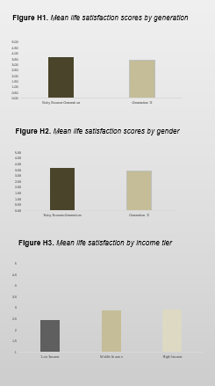
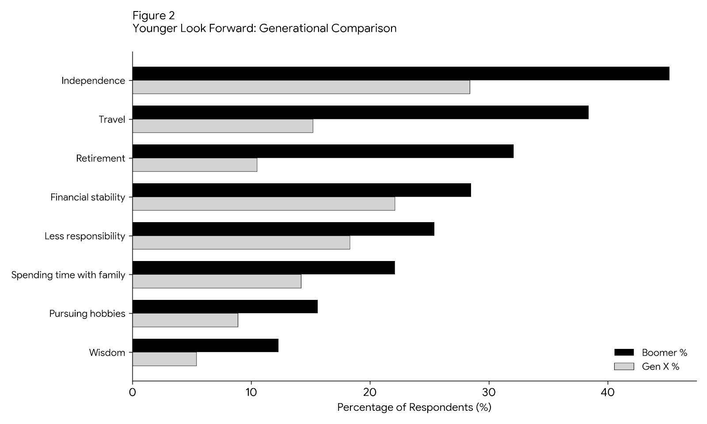
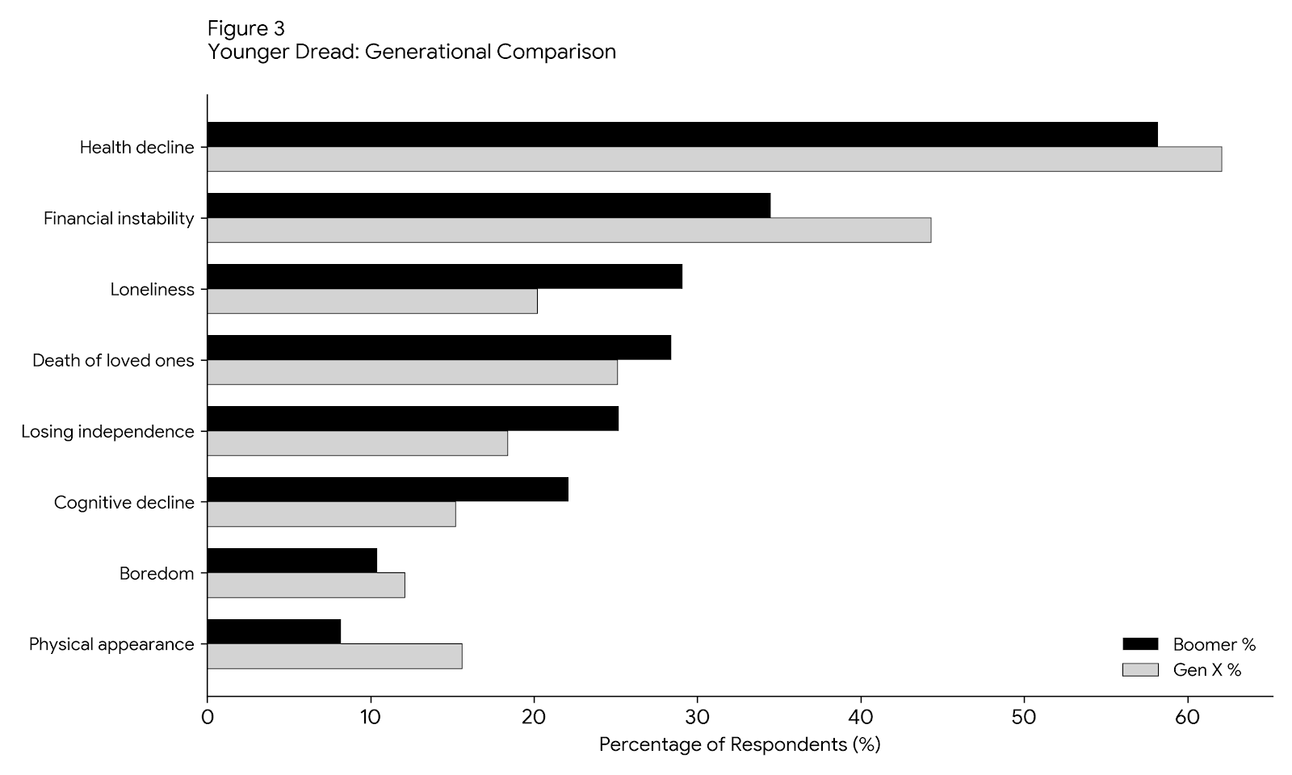

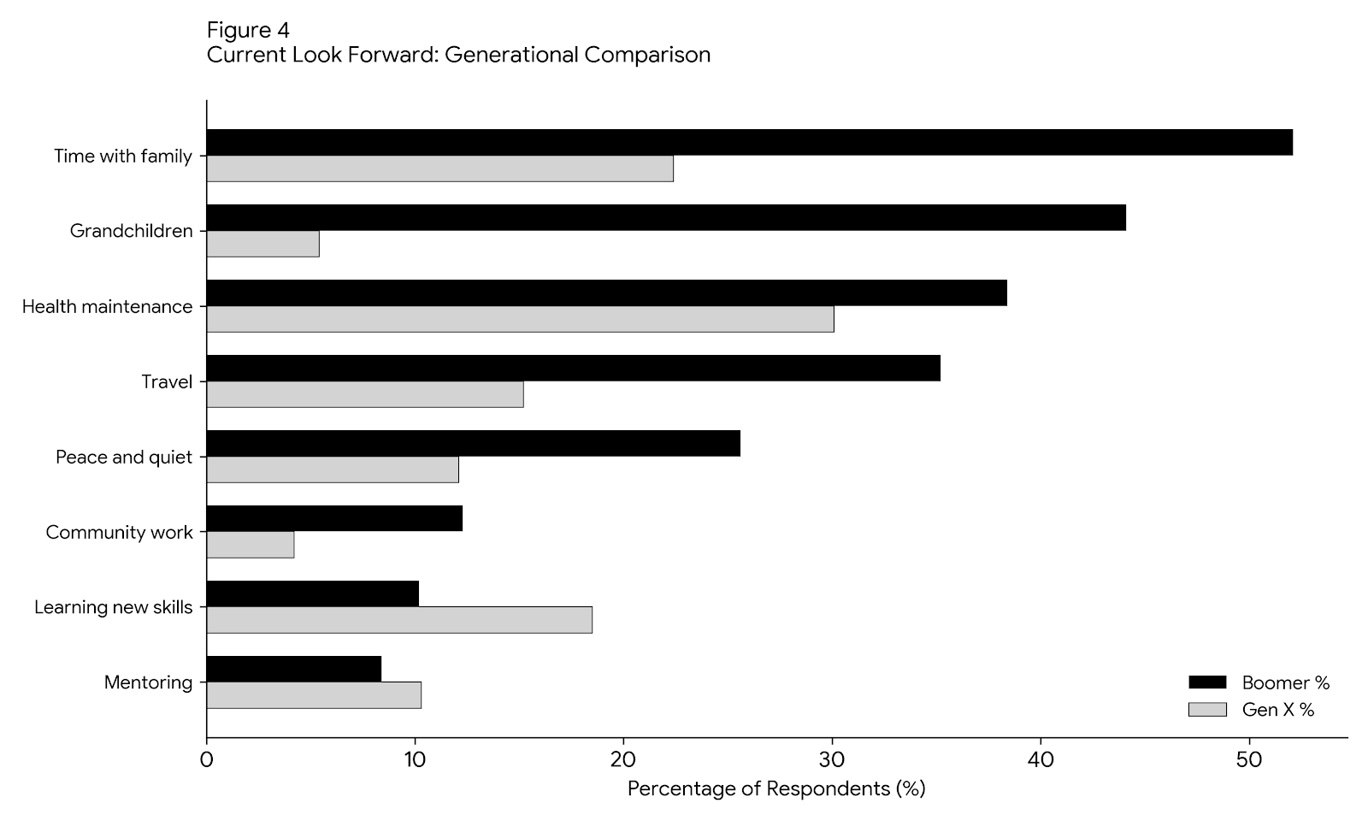
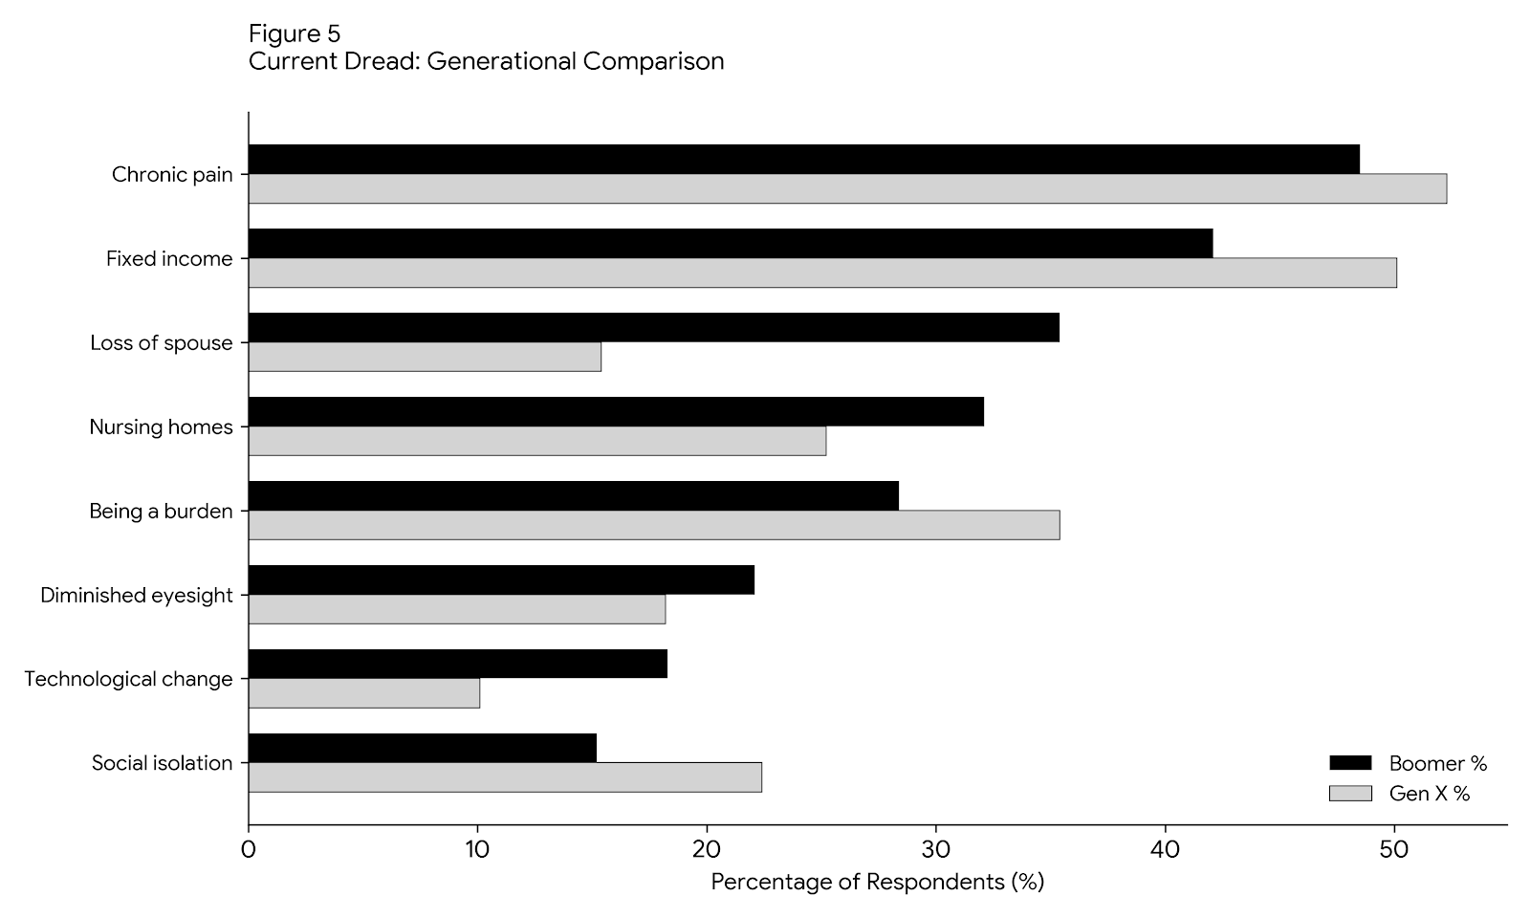



A Tale of Two Generations:
Factors of Life Satisfaction in Older Adults
Tangerine K. Hill, MSG Candidate
Department of Family and Consumer Services
College of Health and Human Services California State University Long Beach
Introduction
Results
Discussion
Conclusion
Approximately 61 million adults 65+ live in the U.S.
A good life, well lived goes beyond essential needs and healthcare
How do older adults in the U.S. define life satisfaction?
This study sought to understand the factors for higher life satisfaction in older adults, particularly the Boomers and Generation X in the US.
H1: There is a significant difference in life satisfaction between the generations, t(320) = 3.42, p = .016. *Note: The Baby Boomers have higher life satisfaction than Generation X.
H2: There is no significant difference in life satisfaction between the genders, t(171) = 1.60, p = .112. *Note: Women scored just slightly higher than men.
H3: Household income has a significant effect on life satisfaction between the generations, F(2, 152) = 3.08, p = .049, η² = .039. The most noticeable increase in life satisfaction was from the low to middle income. This points to a threshold of security and stability being attained.
Secondary results: Independence/autonomy, and financial security/stability were the most important factors for life satisfaction for these cohorts.
Understanding the factors of life satisfaction: The cohorts of Boomers and Gen X (n = 322), ultimately pointed to independence/autonomy, and financial stability as their strongest factors for life satisfaction. In this study, the Boomers scored higher in life satisfaction than Gen X.
Addressing the "Gen X Anxiety": A likely cause is the added anxiety of Gen X being a “Sandwich generation,” taking care of their own households and future, and the and the health and well-being of their parents.
The Financial Buffer: For these cohorts, financial stability acts as a safety net. A solid financial compass allows older adults to maintain the independence they value so highly.
Future Implications: Future aging services should move away from "one size fits all" and instead focus on these specific psychological and financial anchors.
Baby Boomers and Generation X demonstrated that life satisfaction in older adulthood is fundamentally driven by independence/autonomy and financial security. Baby Boomers showed higher life satisfaction than Generation X. Most likely, this is because “Gen X” is the “Sandwich generation,” which increases anxiety, reducing life satisfaction.
Additional analysis concluded that gender did not play a substantial role in life satisfaction. Within Income levels, higher life satisfaction occurred from low income to middle income. This suggests that there is a threshold for financial security that effects the human need for essential fulfillment.
Methods
Qualitative study: A cross-sectional, mixed methods survey via online throughout mainland U.S.
Data: Satisfaction in Life public data set from SeniorLiving.org. Boomers and Gen X were selected to meet the age criteria of 45-78 years. *The original data set surveyed five generations in the U.S.
Analysis: Primary analysis for three hypotheses: 1. Compare life satisfaction between the generations, 2. Compare life satisfaction between genders, and 3. Compare life satisfaction by household income. *Note: Secondary analyses assessed what the respondents looked forward to, or dreaded, about getting older. The secondary analyses is expressed through line-item percentages.
Data Analysis Software: IBM SPSS, Microsoft Excel, and Google Sheets
Tests: Frequencies, descriptive statistics, Independent Samples T-test, and 2-way Anova with a Tukey HSD.
Acknowledgements
I would like to thank my advisor, Dr. Maria Carpiac, for her invaluable guidance, as well as Michael Hill, Ph.D. and Lauren Gelgur-Yoon, M.S. for their encouragement and support.
Figures 2 & 3: When the cohorts were younger, these are the things they looked forward to and what they would dread.
For more information
Gerontology Program
California State University Long Beach
1250 Bellflower Blvd, Long Beach, CA 90840
csulb.edu/gerontology
SeniorLiving.org
https://www.seniorliving.org
Figures 4 & 5: The cohorts contemplate what they looked forward to and what they would dread at their current age.

