Slide 1

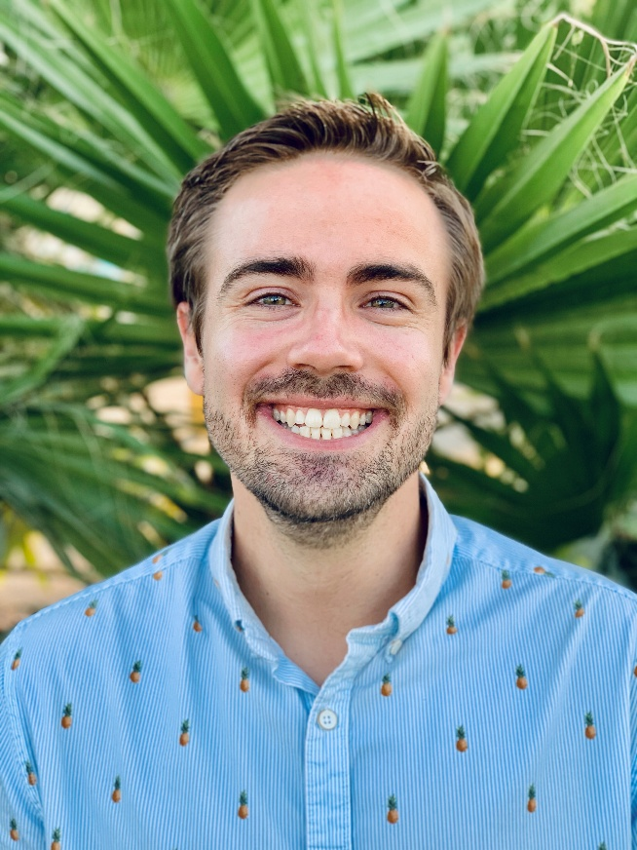

Blended Track (BS-to-MS) Information Session
Mr. James Childers MS, RD

Slide 2
ABOUT THE GP@CSULB

Slide 3




WHAT’S A GP?
ACEND accredited “Graduate Program/GP” - a new option in place of the “Dietetic Internship/DI”
Results in a M.S. in Applied Nutrition and Dietetics and readiness to take the RDN exam
More integrated approach to training RDNs

Slide 4
GP vs DI+MS Differences
No DPD Verification Statement required
Set pre-reqs required for all applicants (DPD or not)
Graduate coursework integrated with supervised learning hours
Competency-based training
Accelerated pace
No one is an “intern” – all are “graduate students”

Slide 5
GP vs DI+MS Similarities
Complete at least 1,000+ supervised hours across clinical, community, food service, and other nutrition settings
Grads must achieve competency across various practice areas
Grads receive a Master’s degree and readiness for RDN exam

Slide 6
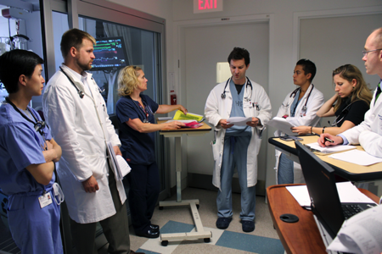
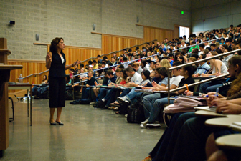
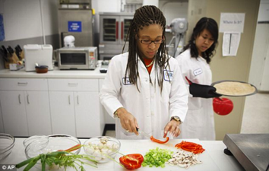

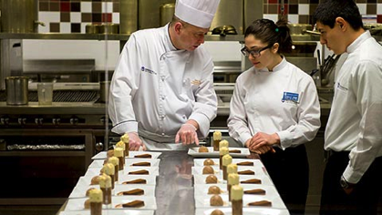
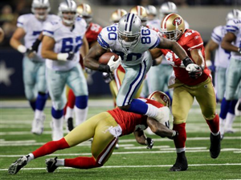
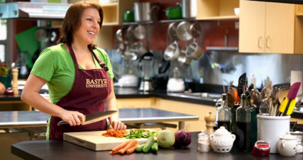
Careers
Notes:
RD or RDN (Registered Dietitian Nutritionist)
Food and nutrition expert who has met registration certification criteria
The RD credential is a legally protected title that can only be used by practitioners who are authorized by CDR
Dietitians are often referred to as “nutritionists,” but RDs have more education and training than nutritionists and have greater job responsibilities.

Slide 7
GP@CSULB Mission
To train graduates for evidence-based practice as registered dietitian nutritionists equipped to solve problems, serve diverse populations with cultural humility, and advocate for good in their workplaces and communities.

Slide 8
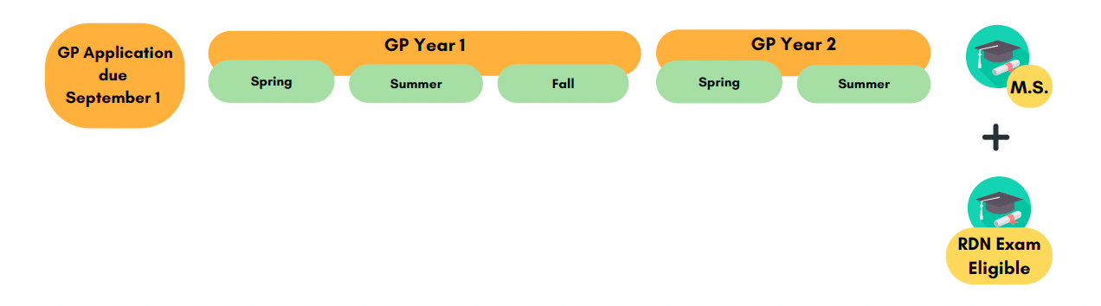
Curriculum Summary
Full-time, 19-months
Start in January, ends in August of Year 2
Course work completed
Supervised Experiential Learning

Slide 9
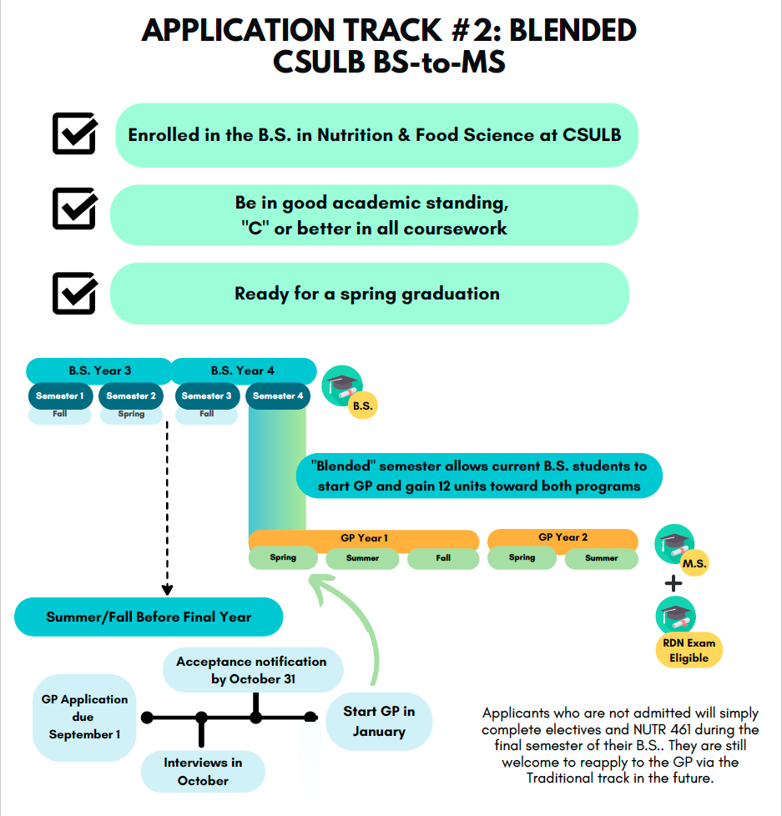
Admissions

Slide 10
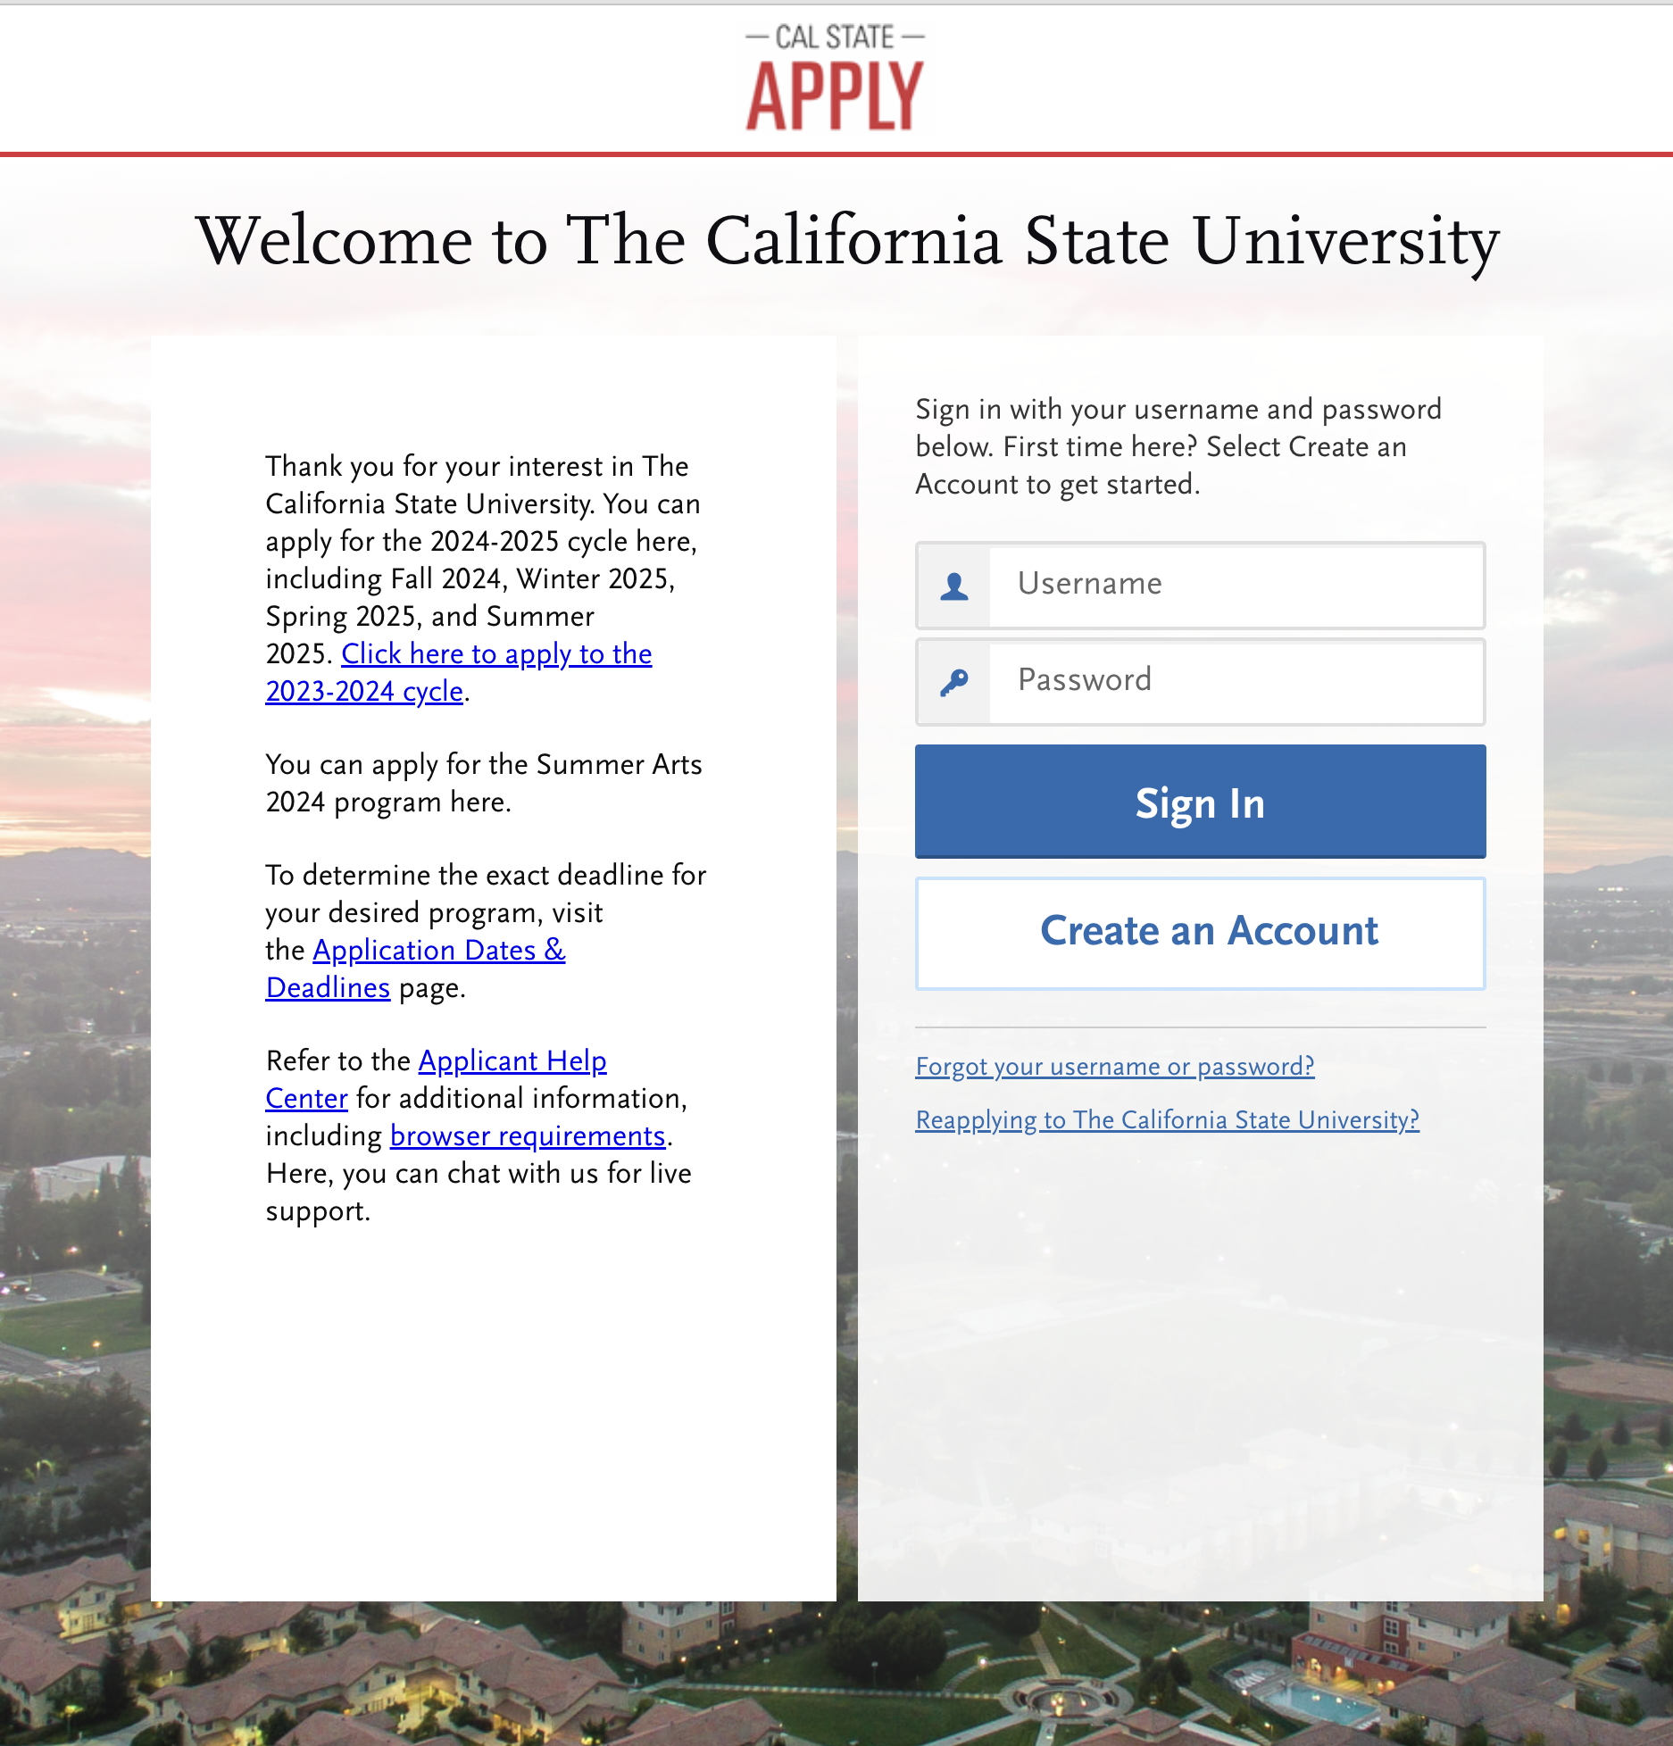
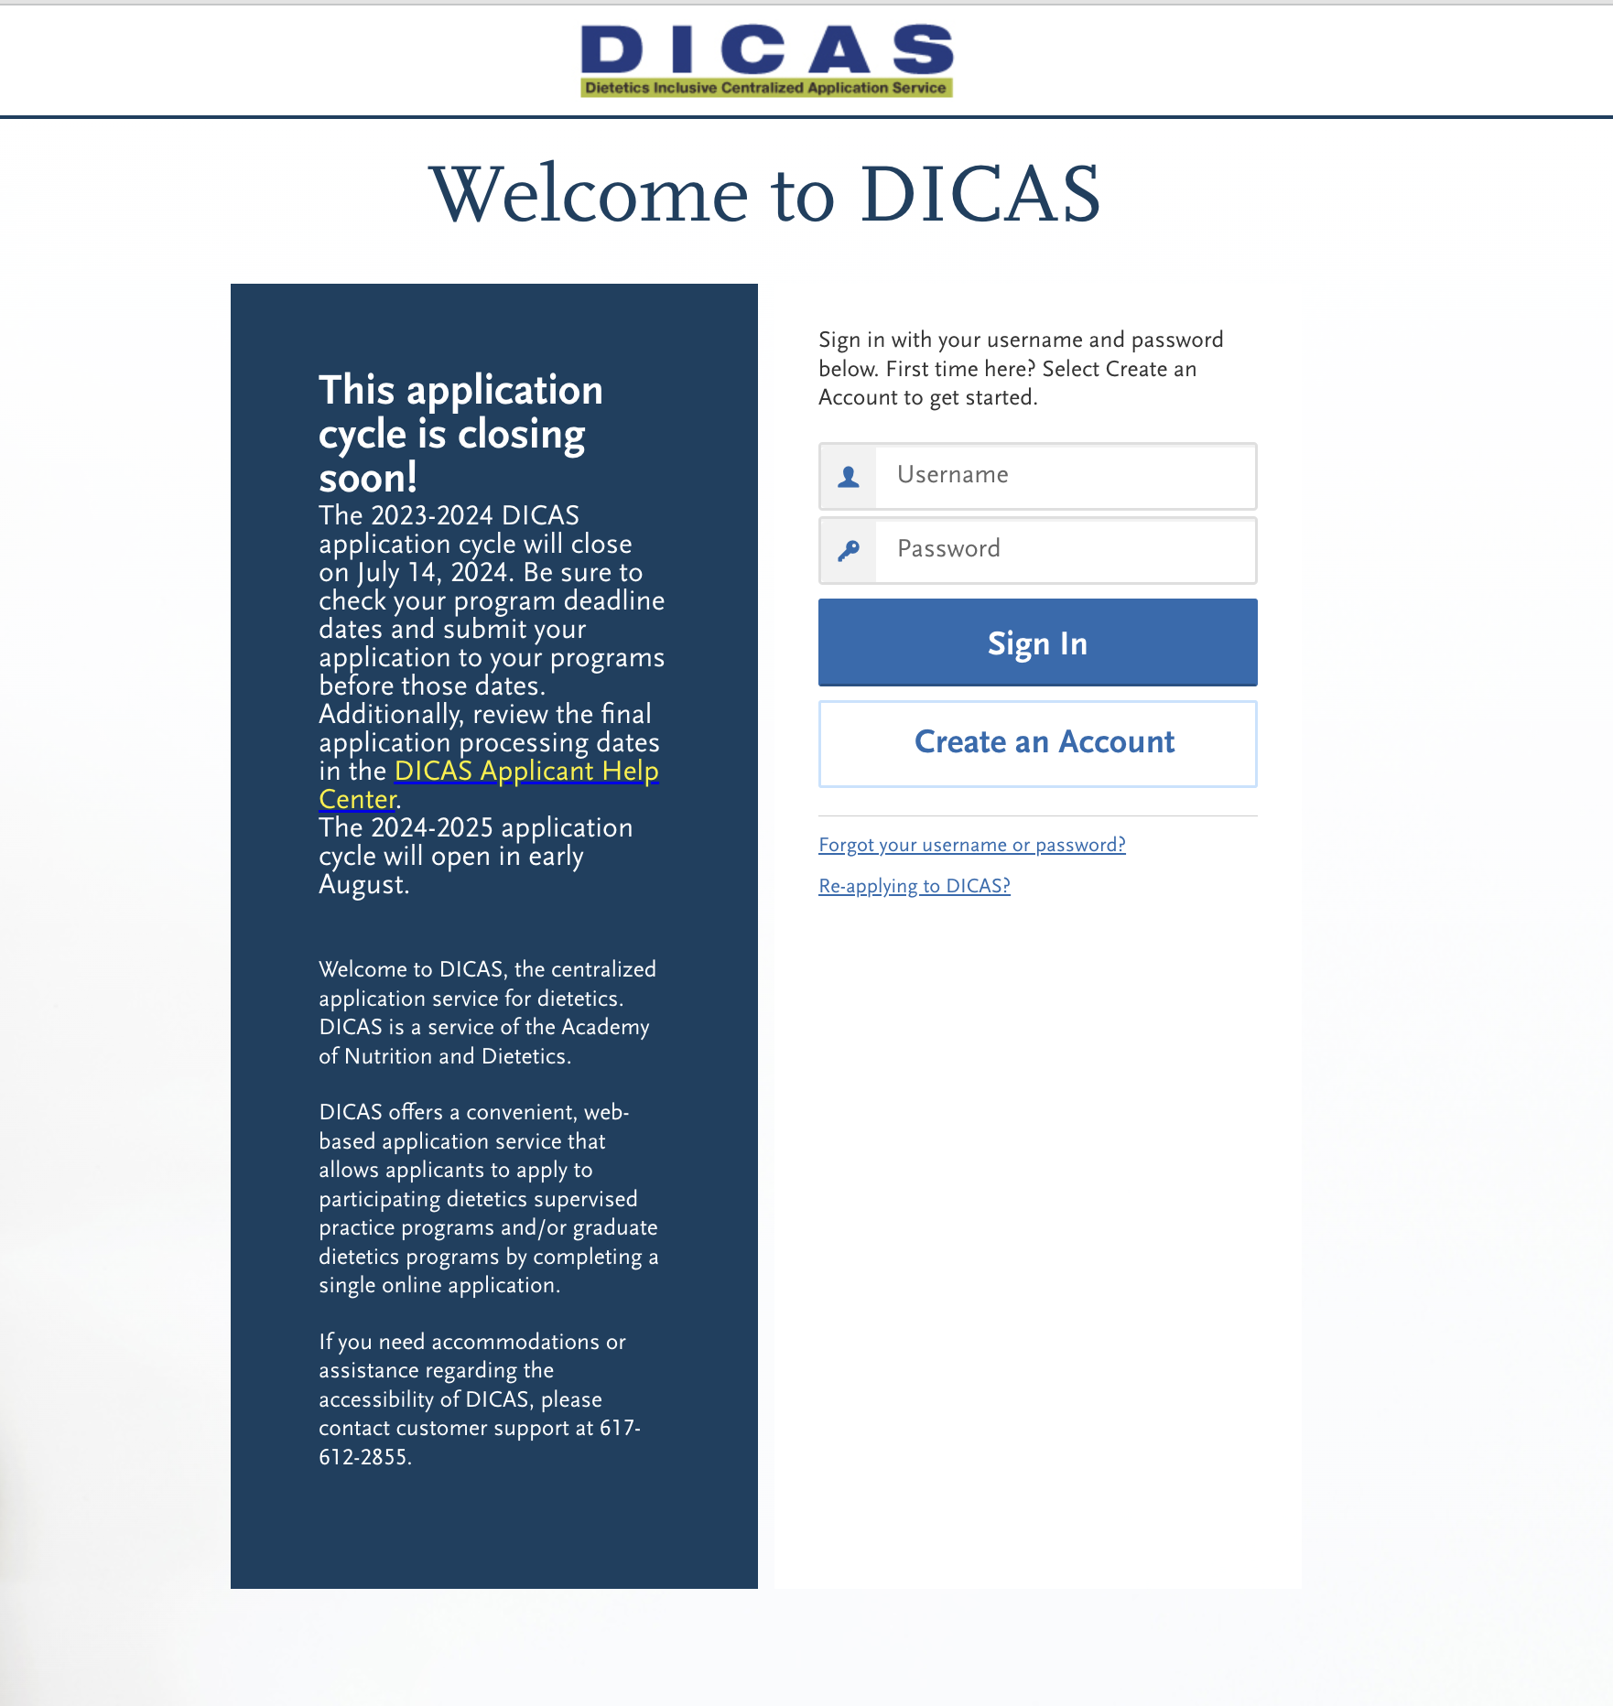
Blended Application
Not
required!!

Slide 11
Applying
DICAS portal opens on August 2026
Applications due September 2026
Refer to GP website for details!

Slide 12
Timeline
Application Deadline for Cal State Apply and DICAS Applications reviewed by CSULB Admissions
September 1st
GP Admissions Committee reviews the final pool of applicants, and Zoom interviews will occur
Month of October
Applicants are notified of their admission status
October 31
Applicants must accept/decline the admissions offer
November 15
January 11-13, 2027
Required on-campus orientation activities for GP students
First day of classes
January 21, 2027

Slide 14
A DAY IN THE LIFE OF A GP STUDENT

Slide 15
Sample Schedule
Year 1
Year 2
Spring:
Summer:
Fall:
Spring:
Summer
Classes only
2-3 full days/week in person
Classes only
2-3 full days/week in person
Mondays: Class all day/into evening
Wednesday: Night class possible
Tues-Fri: 32 hours/week supervised learning
Monday: Online classes all day
Wednesday: Online night class
Tues-Fri: 32 hours/week supervised learning
32 hours/week supervised learning

Slide 16
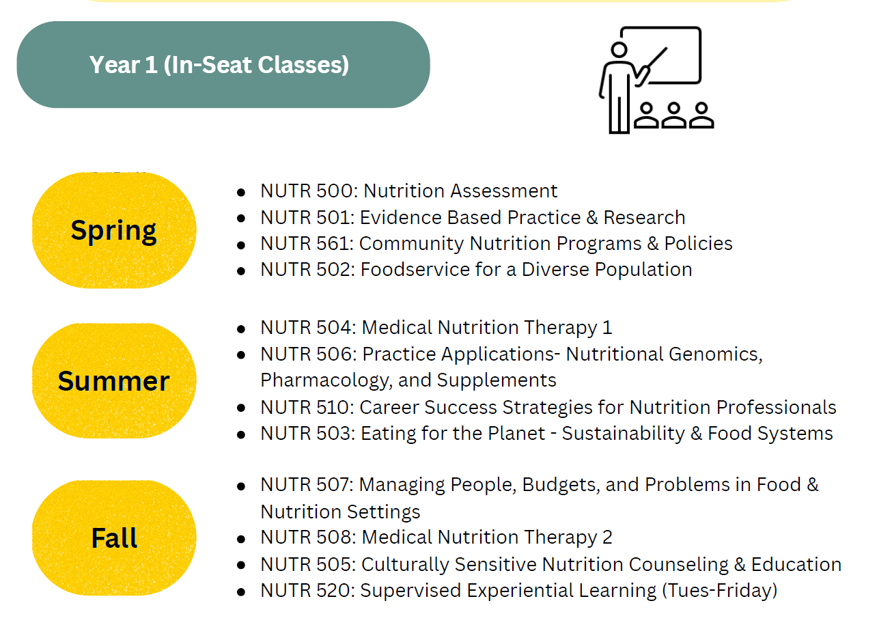

Slide 17
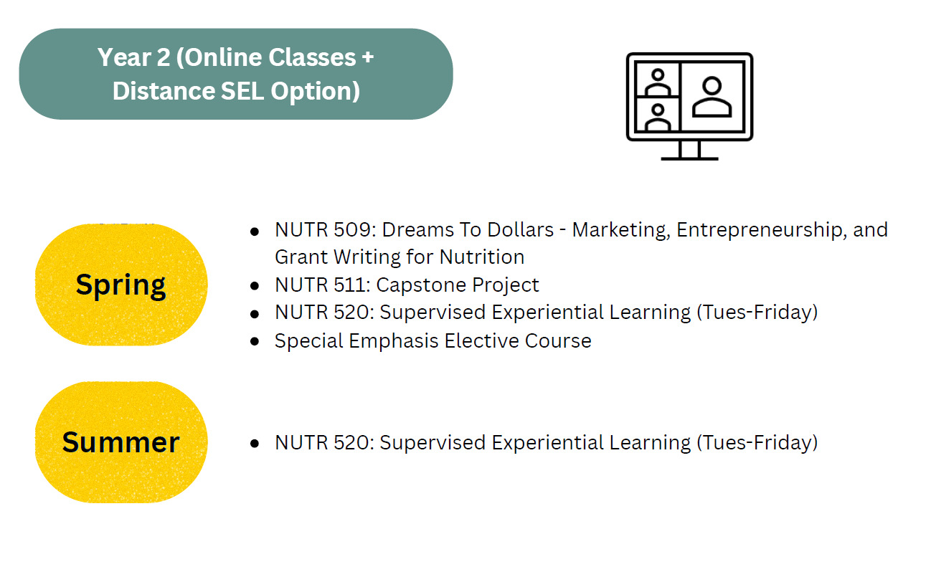

Slide 18

Costs
Rough estimate of total tuition/fees for a California resident: $18,558 (entire program)
Other expenses (see web for breakdown)
Housing/food
Books/supplies
Transportation (must have a working car)
Drug testing/liability insurance/background checks
Membership in AND

Slide 19
Program Specifics
Supervised practice (SEL)
What it is like
Types of sites
Distance option in Year 2
Self Select option

Slide 20
Program Specifics
Special emphases
Sports
Community
Media & Communications
Dictates your elective choice as well as your specialty rotation choice

Slide 21
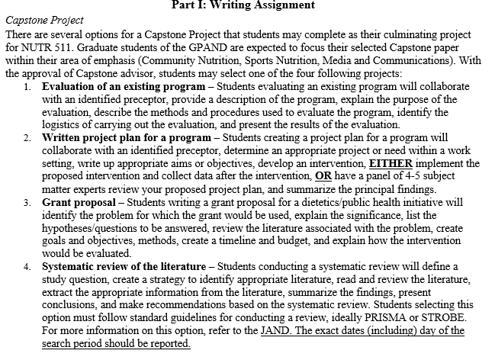
Program Specifics
Capstone project

Slide 22
DICAS APPLICATION TIPS

Slide 23
Application Checklist
$50 Application Fee
Form from CHHS Advising (indicating you are ready to apply)
Complete the DICAS application (enter coursework, experience, and answer questions)
Answer 6 short-answer questions
Send all official transcripts from any university you’ve ever been to
Contact info for 3 references
One (1) reference from a professor or faculty member
One (1) reference from a supervisor
One (1) reference letter of applicant's choice
Personal statement
Resume/CV
Demonstration of Writing Proficiency (GRE or writing sample – see website)
Notes:
Option 1: Submit a writing sample demonstrating your analytical writing and critical thinking abilities. This can be a short essay for a nutrition or health-related course, a thesis project, a laboratory assignment, or anything that is at least 1,000 words and is completed entirely by you (no group work). Ideal writing samples should show critical thinking, such as an opinion piece or an essay about a topic that requires you to provide research sources. If you do not have a writing sample from a prior course that meets these criteria, you may prepare one related to a selected current controversy in nutrition. Writing samples must:
Be at least 1000 words
Double-spaced and 12-point font
Include a cover page that indicates 1) the context (course name/number if applies), 2) the date of the writing sample, 3) a statement that you attest that the writing sample was not created with assistance from artificial intelligence (AI) or any other collaborators and that you understand it will be reviewed for plagiarism or AI usage.
Option 2: Submit a GRE analytical writing score of 4.0 or above. If you choose this option, upload an unofficial copy of your GRE scores to CalState Apply and send GRE scores using the CSULB institution code, 4389.

Slide 24
DICAS ESSENTIALS
https://dicas.liaisoncas.com/
Each program has its own references, materials, and submission requirements
References must be added to each program
Applicant is responsible for tracking status of all documents/references

Slide 25
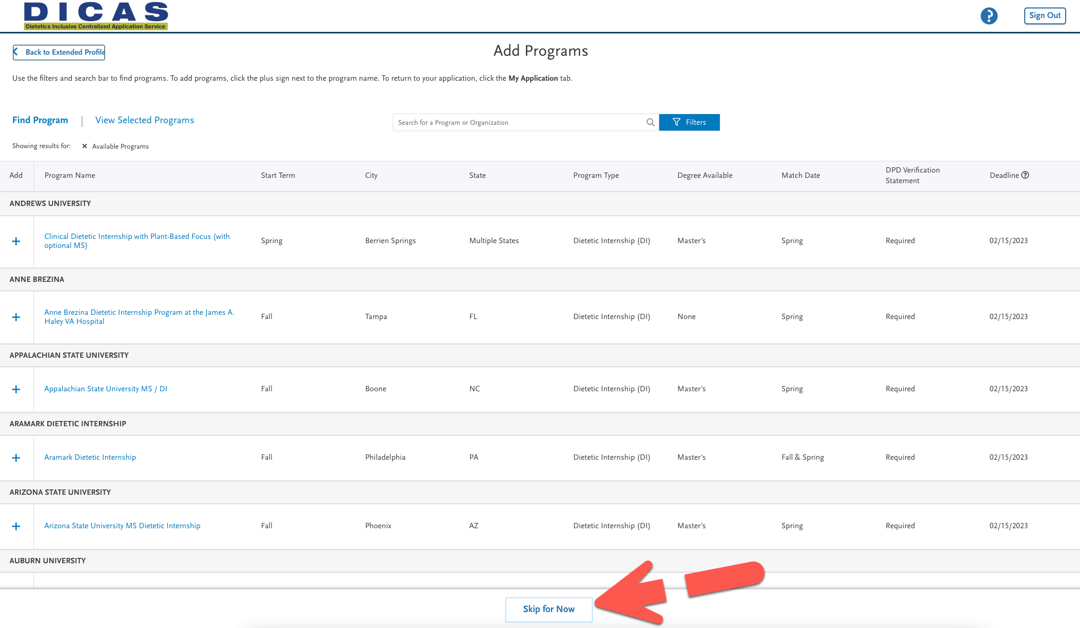
The GP@CSULB will not be visible in DICAS until it “refreshes” and opens in August 2026.
You can still add general things to it now and copy it then!

Slide 26
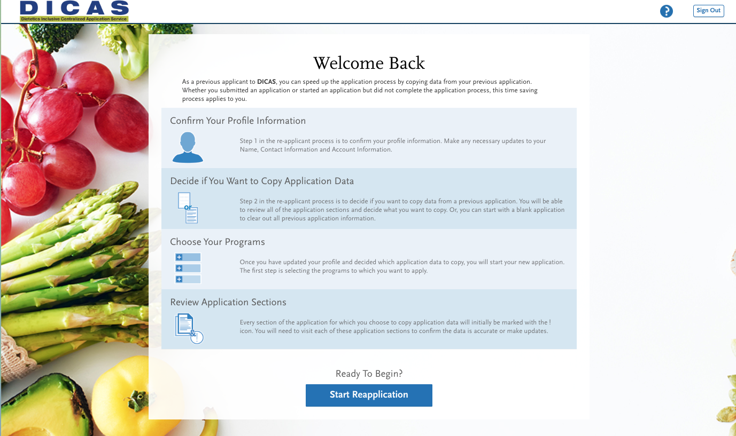
REUSE Past Application info

Slide 27
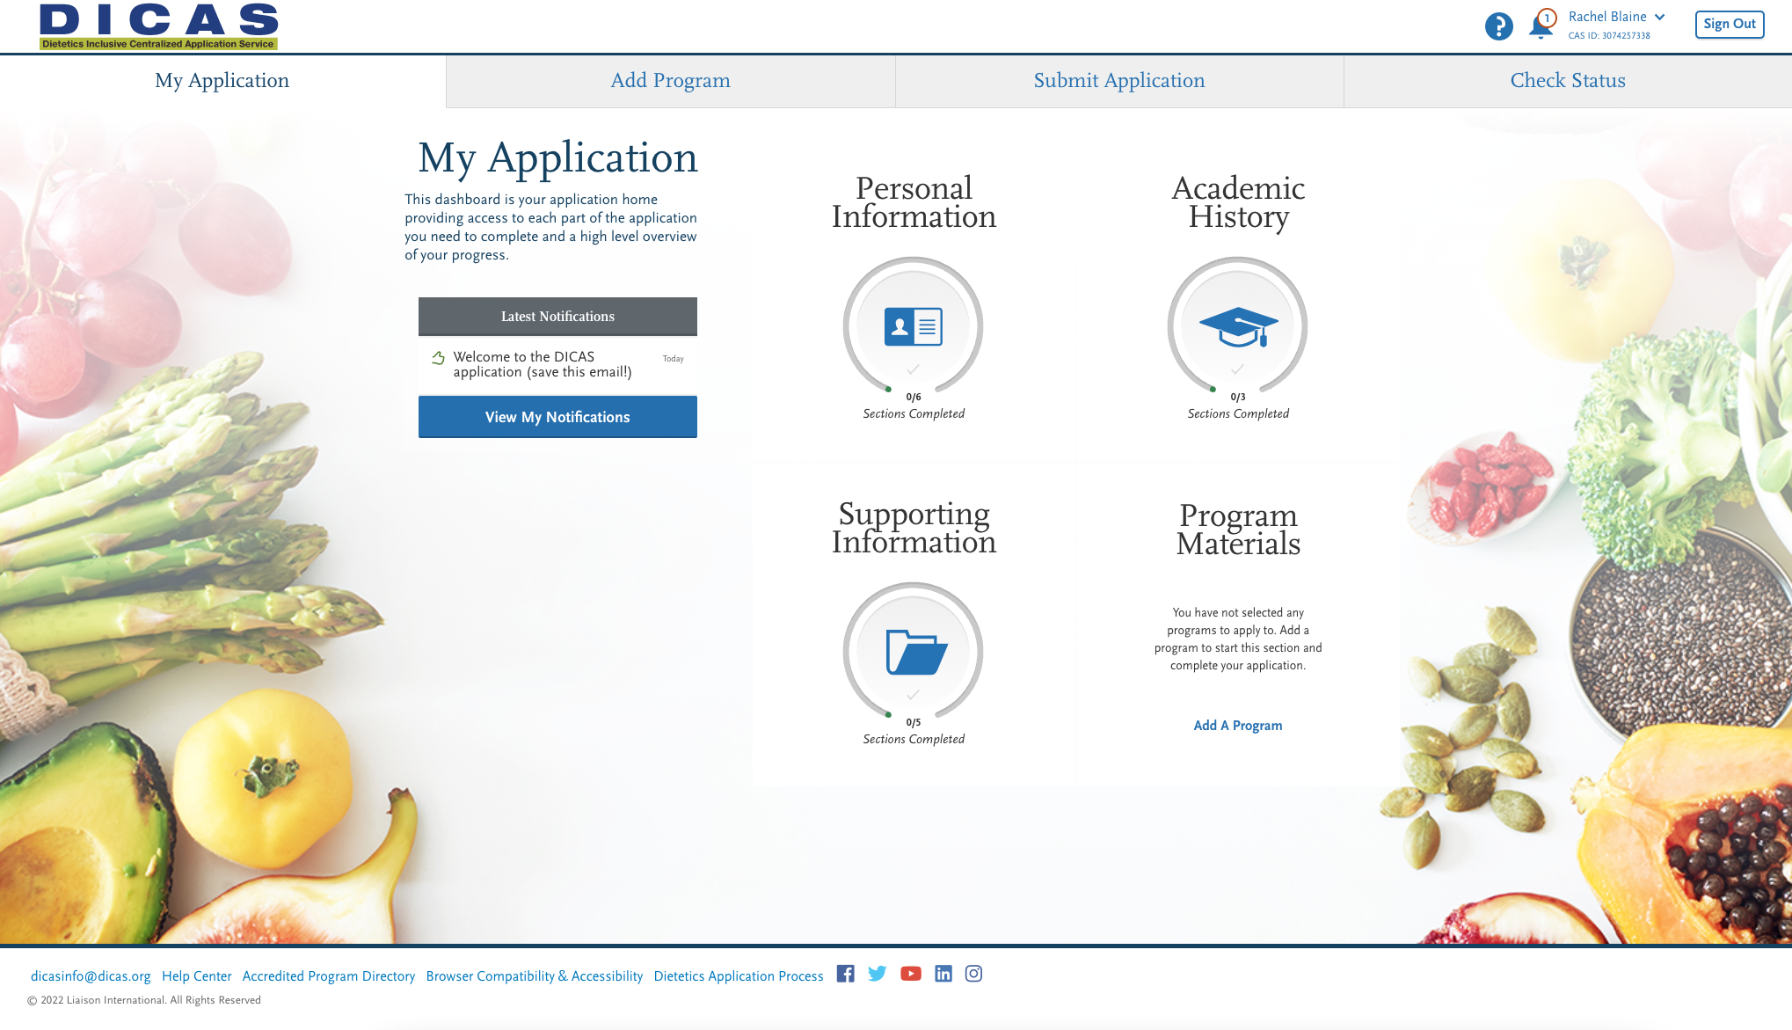
Notes:
4 Main Sections, 4 main tabs
Personal information is very straightforward, so I won’t walk through it

Slide 28
Suggested Timeline
Things to work on anytime
Writing sample/GRE
Personal statement
Entering your coursework
Resume
Entering your experiences
June/July
Identify your references
Let them know your deadline (end of August)
August 5
Immediately order transcripts and add your reference contact info
Until Sep 1
Complete the rest of the DICAS application

Slide 29
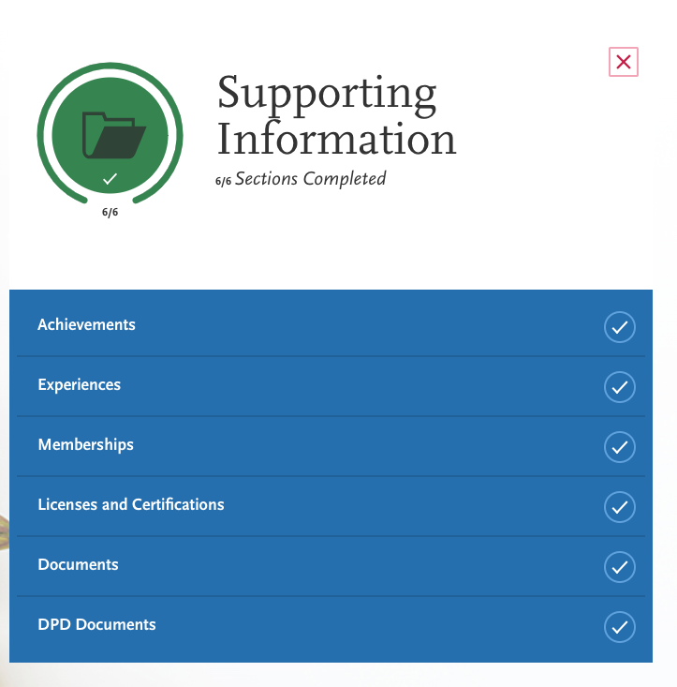
Supporting Information
Submissions here appear the same to ALL programs
Enter and describe relevant experiences post-high school or in past 10 years

Slide 30
COURSEWORK ENTRY (Enter your own transcript)
Must use your transcripts to manually enter every course you’ve taken at all College Attended
Include future/in progress courses and pre-reqs
Time consuming, but not hard

Slide 31
GETTING QUESTIONS ANSWERED
DICAS (excellent customer service)
Chat support
dicasinfo@dicas.org
617–612–2855 (6am-2pm PST)
Best time to call is ~12pm PST

Slide 32
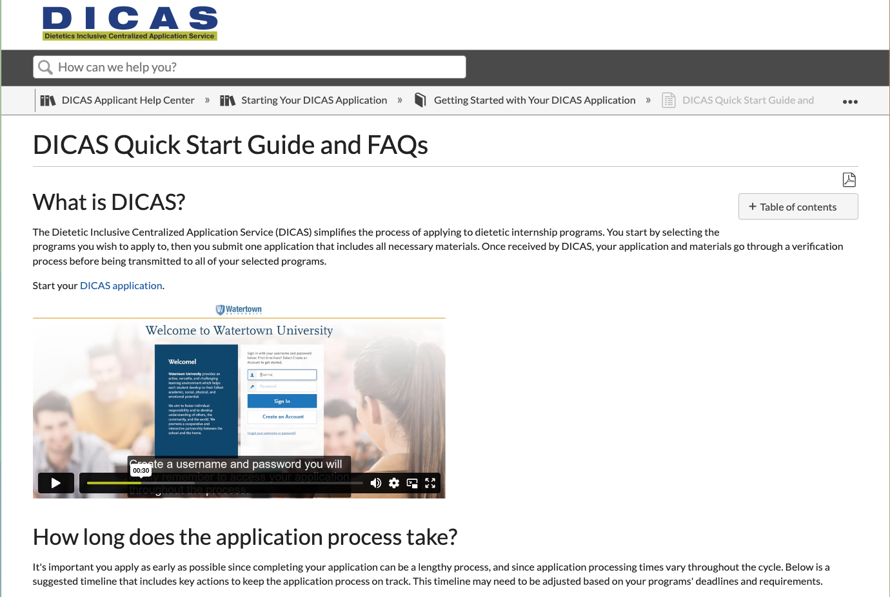
DICAS Applicant HELP CENTER

