Slide 1
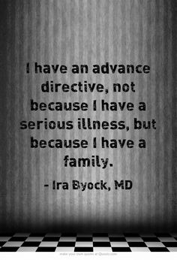
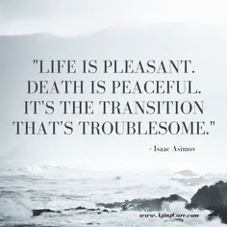
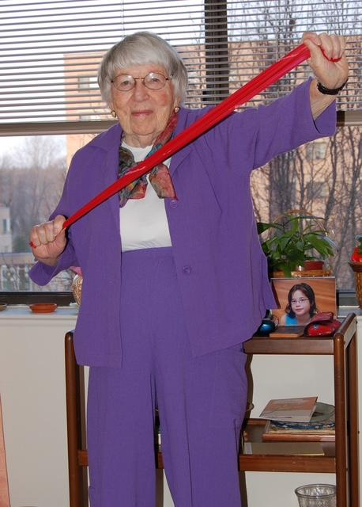
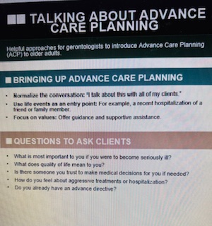
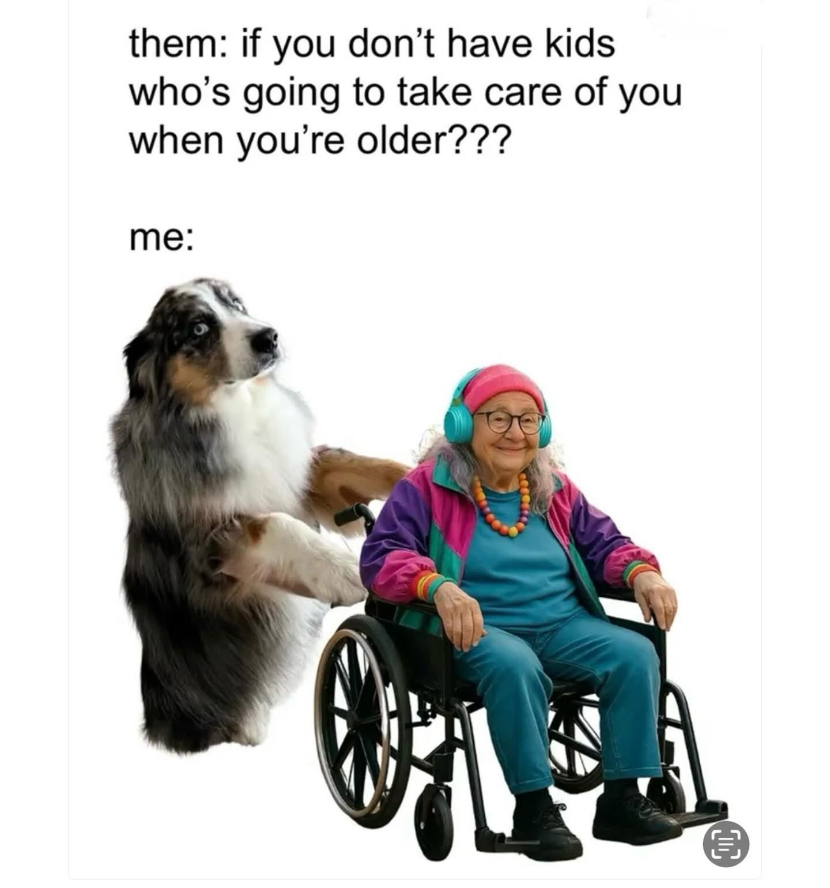

Advance Care Planning Should Be For Everyone
Debra Bein, Maria Carpiac, Aleta Ostlund, Sofia Hodjat
Department of Family & Consumer Sciences
College of Health & Human Services, California State University Long Beach
Introduction
Results
Discussion
Advance Care Planning (ACP): Helps older adults plan for medical treatment & end-of-life wishes should they become incapacitated.
Marginalized groups not as likely to have ACP (Solo Agers, LGBTQ+ and Persons with Dementia) and have more barriers, due to being part of non-traditional groups
African Americans & Hispanics rely more on emotional support & religion, than science
End-of-life care often not discussed, even in majority groups
Expert Panel Feedback:
Comprised of 6 gerontological professionals
Overall, very positive responses and everyone learned that “unique groups present with potential ACP issues since part of a marginalized group”
Reviewers wanted to learn about “starting campaigns & educating people on ACP” using presenter’s Tipsheets
Revisions to project:
Not as much info on each slide and pre-record talk for live presentation would help with this request
Interactive Q & A helps tell stories and demystify end-of-life/death
Advance Care Planning (ACP) should be for everyone regardless of net worth, culture or part of a marginalized group
Medicare pays for a doctor visit to discuss ACP and only 1% of people actually complete it through annual visits with their doctor
Many clinicians claim they don’t know about ACP or understand LGBTQ+ people since they don’t understand “queer gerontology”
Solo Agers may feel more isolated/disconnected from others and don’t think ACP is important for them, since there’s no family around
African Americans often leave medical decisions to God & use informal networks to disseminate any info
Role of family (if older adults have one) is a reason ACP is more likely to be completed if there is a lot of love and positive family dynamics
Thoughtful discussions with all stakeholders are more likely to produce ACP, even if not family
Hispanics need emotional support; and more support leads to fewer instances of DNRs. More emotions than science and superfluous care without a DNR
Persons with dementia can also participate in ACP, with MCI, with the assistance of stakeholders but conversations can be had with this group. The earlier the better.
Conclusion
Advance Care Planning Should be For Everyone can work despite barriers and cultural concerns.The project offers tips to help with discussions and sources for ACP, such as Five Wishes for ease of explanation about end of life, medical care/wishes, which is more spiritual/holistic in nature
Future adaptations of this project would include live learning or pre-recorded sessions for those who can’t attend in person
Clinicians, families and gerontologists should all be informed about ACP then educate people wherever possible.
ACP is available for everyone, but it is the stakeholder’s responsibility to try to educate the older adult get their end-of-life and medical treatment wishes on legal documents so they can be honored.
My Nana at 100 years old, was doing well physically/mentally but still needed the support and love of her family. This is why she had ACP too!
Methods
Figure 3. Information for future 3 ce included here.
Target population reviewed the educational toolkit about Advance Care Planning (ACP) including gerontologists, family members, and other experts in the field of aging.
Key sections of the project include marginalized groups of LGBTQ+, Solo Agers, Persons w/ Dementia, African Americans and Hispanics
PowerPoint presentation of ACP sent to expert panelists
Discusses legal documents, options, and end-of-life wishes/values
Project Developer performed extensive review about marginalized groups and why ACP is often not completed, using salient/current literature
Tip Sheets about LGBTQ+ and Solo Agers provided to make conversations easier for gerontologists, clinicians, family members
Feedback Form with open/closed ended questions completed after expert panelists watched entire presentation
Responses by reviewers will help to bolster information about end-of-life care to others and understand this topic better themselves.
Acknowledgements
__________________________________________
Affiliation / Expertise Area: _________________________________
Date: _______________________
SECTION 2 — Presentation Content (ACP Focus)
Rating Scale: 1 = Strongly Disagree | 5 = Strongly Agree
[ ] 1 [ ] 2 [ ] 3 [ ] 4 [ ] 5 — The slideshow on the topic of ACP was relevant to gerontological practice.
[ ] 1 [ ] 2 [ ] 3 [ ] 4 [ ] 5 — The objectives of the presentation were clearly stated.
[ ] 1 [ ] 2 [ ] 3 [ ] 4 [ ] 5 — The content demonstrates depth in its coverage of principles, policies, and practices.
[ ] 1 [ ] 2 [ ] 3 [ ] 4 [ ] 5 — The information presented reflected current evidence and ethical considerations related to ACP.
[ ] 1 [ ] 2 [ ] 3 [ ] 4 [ ] 5 — The conclusions were logical and supported by the findings or literature.
SECTION 3 — Presentation Delivery
Rating Scale: 1 = Strongly Disagree | 5 = Strongly Agree
[ ] 1 [ ] 2 [ ] 3 [ ] 4 [ ] 5 — The presenter communicate ideas clearly and effectively.
[ ] 1 [ ] 2 [ ] 3 [ ] 4 [ ] 5 — The PowerPoint slides presented the content clearly and supported understanding.
[ ] 1 [ ] 2 [ ] 3 [ ] 4 [ ] 5 — The pacing and organization of the presentation were appropriate.
[ ] 1 [ ] 2 [ ] 3 [ ] 4 [ ] 5 — The presenter was confident and professional.
SECTION 4 — Impact and Application
Rating Scale: 1 = Strongly Disagree | 5 = Strongly Agree
Big thanks to Dr.Carpiac for always believing in me, and my parents, my partner, and friends for cheering me on all the time, as my ancestors have always done. Of course, my ancestors were wonderful and loved me so much that I eventually realized I wanted to have a career in the field of gerontology. I am so glad that I switched my career to working with older adults and my heart is full.
For more information
Please contact Debra Bein at debrabein@gmail.com about my Directed Project.
Example of Feedback Form- Page 1

