Slide 1
Post-Completion
OPTIONAL PRACTICAL TRAINING (OPT)
Presented by:
International Student Services
Center for International Education, CSULB

Slide 2
Workshop Objectives
Am I eligible for Post-completion OPT?
Application Process​
Application Deadlines​
Online Filing Instructions​
USCIS approval process
Maintaining F-1 Status during OPT​
Travel during OPT​
Health Insurance during OPT​
OPT is ending, now what?​
Resources
Q&A​

Slide 3
International Student Employment
1. On-Campus​
2. Practical Training:​
Curricular Practical Training(CPT)​
Optional Practical Training (OPT)​
24-Month STEM OPT Extension​
Cap Gap Extension​
​
3. Off-Campus:​
Severe unforeseen financial hardship
Internship with a qualifying International Organization
ALERT: Violation to employment regulations will lead to the termination of the student’s SEVIS record!

Slide 4
What is Post-Completion OPT?
Employment benefit for F-1 Visa Students
Work permit for up to 12 months
Gain practical experience in your field
Training takes place after academic program end date
OPT Allows:
Part-Time/Full-Time Work
Related to your major field of study.
Anywhere in the US.
Variety of Types of Employment

Slide 5
OPT Process Overview
Confirm Eligibility by reviewing our website www.csulb.edu/international/current-students/optional-practical-training
→ OPT
Follow the application Deadline to Obtain an OPT I-20
File your complete application Online with USCIS
Track your application Online
Receive your EAD & Maintain Valid F-Status
The estimated time to receive EAD is
90- 100 days

Slide 6
Eligibility
Must be in lawful F-1 Status
Have been enrolled in a full course of study for at least one academic year
Be in good academic standing
Have completed, or be in the process of completing all degree-required coursework
Must apply during the application period & comply with deadlines
Have not already been granted OPT at your current degree level, or exceeded 12 months of Full-Time CPT

Slide 7
Application Deadline
Apply no earlier than 90 days before program completion, and no later than 60 days after program completion
IF APPLYING FOR THE FOLLOWING TERM: | PROGRAM END DATE/ GRADUATION DATE | SUBMIT APPLICATION TO CIE BETWEEN: | AVAILABLE OPT START DATES: | USCIS MUST RECEIVE YOUR APPLICATION BETWEEN (90/60)
Spring 2025 | 05/23/2025 | 02/12/2025 - 07/10/2025 | 05/24/2025 - 07/22/2025 | 02/22/2025 - 7/22/2025
Summer 2025 | 0815/2025 | 05/07/2025 - 10/04/2025 | 08/16/2025 - 10/14/2025 | 05/17/2025 - 10/14/2025
Fall 2025 | 12/24/2025 | 09/15/2025 - 02/12/2026 | 12/25/2025 - 02/22/2026 | 09/25/2025 - 02/22/2026
Winter 2026 | 01/16/2025 | 10/08/2025 - 03/07/2026 | 01/17/2026 - 03/17/2026 | 10/18/2025 - 03/17/2026
Students cannot work on-campus or be eligible for CPT
after the program
end date

Slide 8
Alternative Application Deadlines for some Graduate students
Graduate students can apply for Post-completion OPT:
The semester they complete all required coursework OR
The semester they complete all required course work & their culminating experience (thesis/dissertation or comprehensive exam).
Your I-20 will be shortened to the official end of the semester in which you submit the OPT application.

Slide 9
OPT I-20 REQUEST PROCESS

Slide 10
Request an OPT I-20
Confirm Eligibility for OPT and application deadline for your graduation term.
Review OPT eligibility to ensure you qualify for Post-Completion OPT at Optional Practical Training | California State University Long Beach (csulb.edu)
1
Follow Application Instructions to Request an OPT I-20
File to Graduate
Complete the OPT I-20 Request Form
Have your most recent I-94 record ready
2
Submit the OPT I-20 service request
An Advisor reviews your request, confirms eligibility & issues the OPT I-20.
The OPT I-20 and a Coversheet will be delivered via email.
3

Slide 11
Apply to Graduate
We will verify that you applied for graduation.
If you have not applied for graduation your OPT request will be denied!
Graduate Students
Apply to Graduate (Graduate Students) | California State University Long Beach (csulb.edu)
Undergraduate Students
Apply to Graduate (Undergraduate) | California State University Long Beach (csulb.edu)

Slide 12
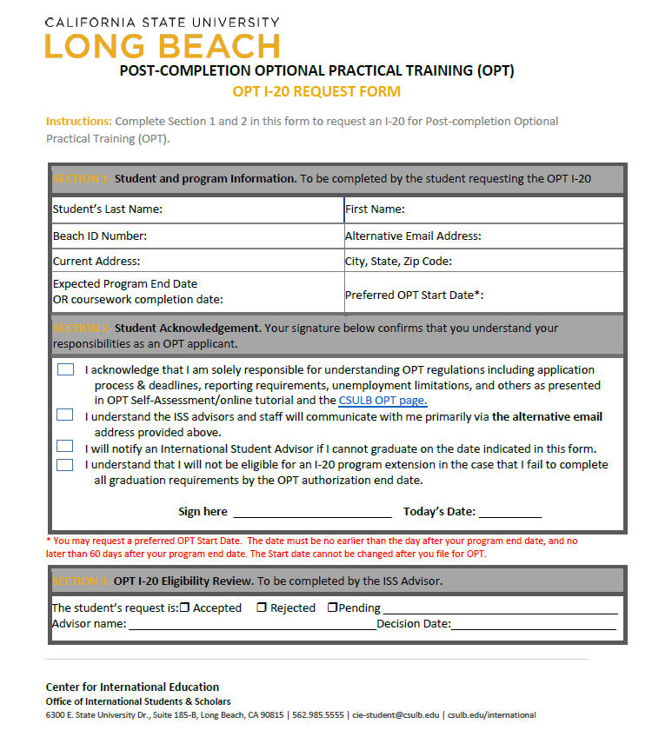
I-20 Request Form
Sections 1 & 2
Student’s section
Section 3
Advisor Approval

Slide 13
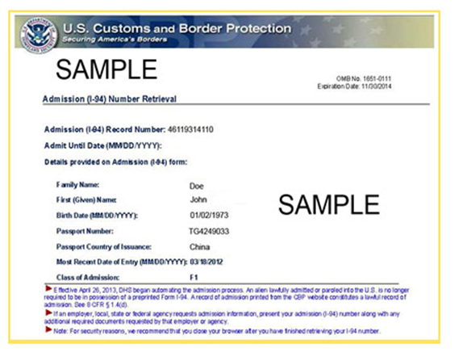
I-94 Form
Access your I-94 record at www.cbp.gov/I94
Review your most recent i-94 record, and ensure your most recent entry details are accurate including,
Class of Admission: F-1

Slide 14
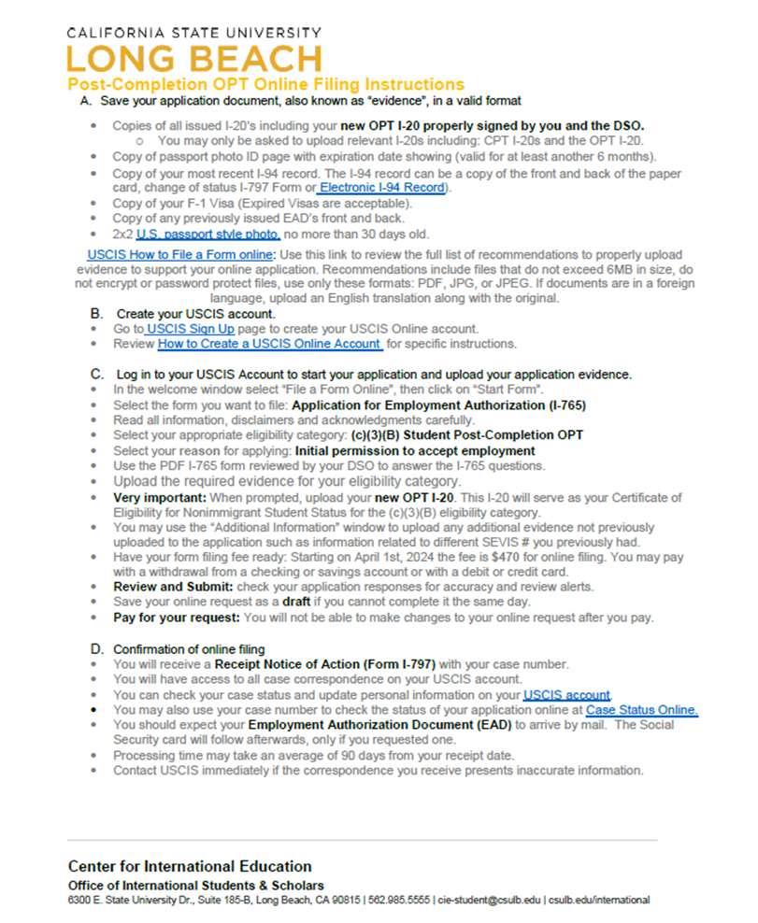
Coversheet & OPT I-20
You will receive your OPT I-20, and your Coversheet from the ISS Advisor
Follow the instruction on your Coversheet to Create a USCIS Account and file your OPT application online.

Slide 15
Filing Deadline
You must file your OPT I-20 with form i-765 within 30 days from the original OPT request date indicated in SEVIS.
This date usually coincides with the date OPT I-20 was signed by the DSO.
Reminder: You can file Form I-765 90 days before your program end date, but no later than 60 days after.

Slide 16
File form I-765 to USCIS (ONLINE FILING)

Slide 17
Preparing to file Form I-765
Create USCIS Account
3
1
Gather Form I-765 Supporting Documents
2
Complete the Online filing and payment for Post-completion OPT.
Prepare Form I-765 Filing Fee
Prepare Valid passport Pictures
Track your application progress.

Slide 18
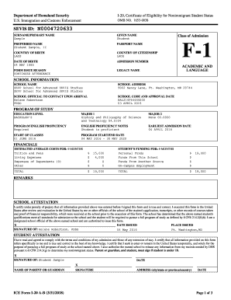
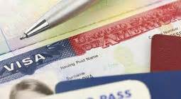
Form I-765 Supporting Documents
Copy of Passport (must be valid for 6 months in the future)
Copy F-1 Visa (it is ok if expired)
Copy of I-94 Card or I-94 record- go to www.cbp.gov/I94 to print you most recent record
Copy of relevant CPT I-20s, prior OPT I-20 & any EADs you received.

Slide 19
Form I-765 Fees https://www.uscis.gov/i-765
Fee for form I-765 is $470 dollars (as of July 2024).
You will be prompted to complete the fee payment online prior to submitting the Form I-765 in your MyUSCIS account.
Payment can be completed by electronic bank transfer or with a credit or debit card.
Filing fees are final and non-refundable, regardless of any action USCIS takes on your application, petition, or request, or if you withdraw your request.

Slide 20
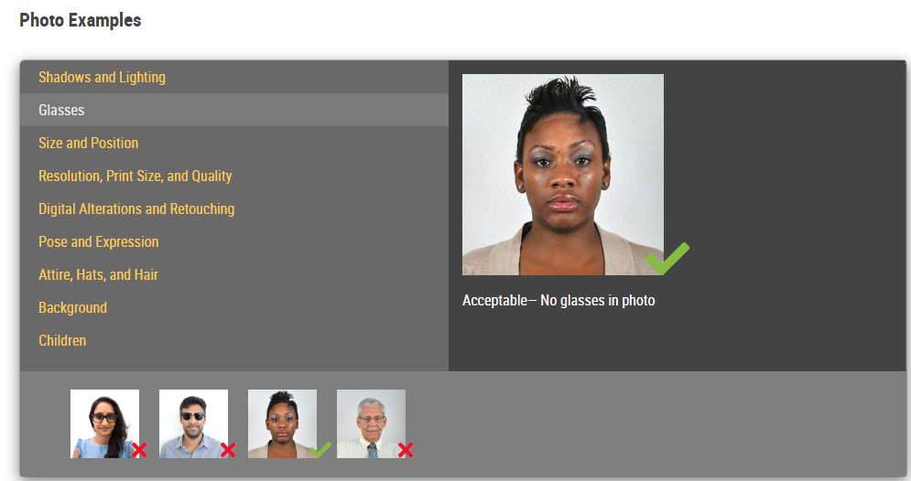
Picture Requirements https://travel.state.gov/content/travel/en/passports/how-apply/photos.html
You will need passport style pictures taken within the last 30 days. DO NOT DIGITALLY ALTER YOUR APPEARANCE
Find photo examples and guidelines in the link provided above.
Valid Passport Picture

Slide 21
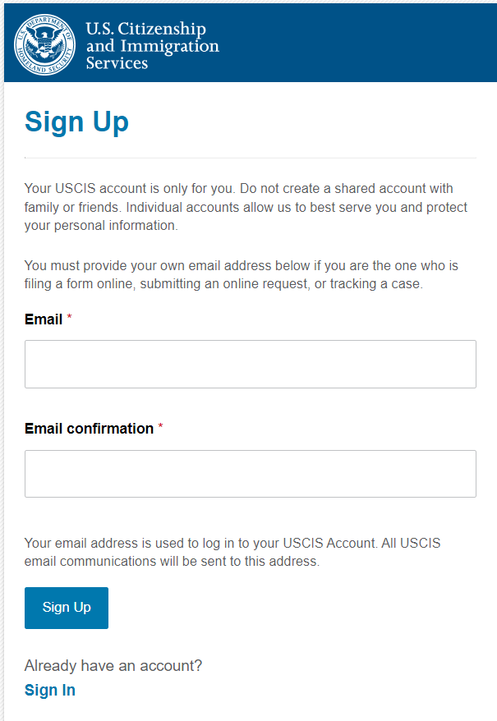
USCIS Account
Create your USCIS account.
Go to USCIS Sign Up page to create your USCIS Online account.
Review How to Create a USCIS Online Account for specific instructions

Slide 22
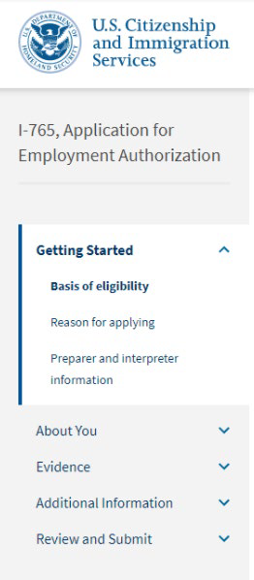
GETTING STARTED
Basis of Eligibility
• What is your eligibility category?
Select “Post-completion OPT, (c)(3)(B)”
Reason for Applying
• What is your reason for applying?
Select Initial permission to accept employment
• Have you previously filed Form I-765?
Select No if you have not previously applied for work authorization with an I-765
Select Yes if you have previously filed an I-765 (provide proof in the “Evidence” section)
Preparer and Interpreter Information
• Is someone assisting you with completing this application?
Select No

Slide 23
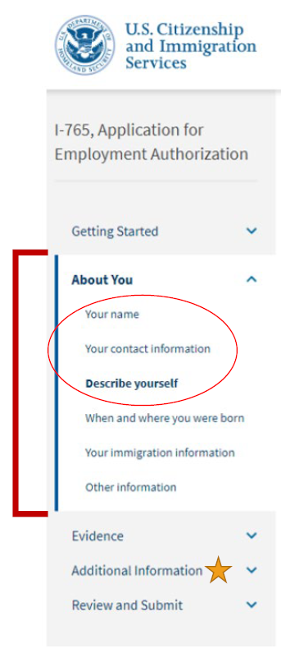
ABOUT YOU
Your Name
• What is your current legal name?
Enter your full name as it appears on your passport. If your full name does not fit in the spaces provided, use the Additional Information section to list your full name.
• Have you used any other names since birth:
You can use this section if you have ever changed your name OR if your name appears differently on different legal documents.
If this does not apply to you, select “No”.

Slide 24
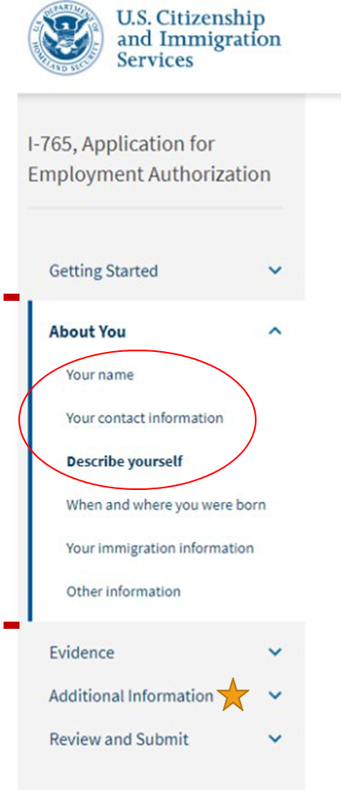
ABOUT YOU (continued)
Your Contact Information
How may we contact you?
Daytime telephone number
Email address (do not use a “u.rochester.edu” email address; it is invalid in the online form)
What is your current U.S. mailing address? (see next page)
Is your current mailing address the same as your physical address? (see next page)
Describe Yourself
What is your gender?
Mark the box that best describes you.
What is your marital status?
Mark the box that best describes you.

Slide 25
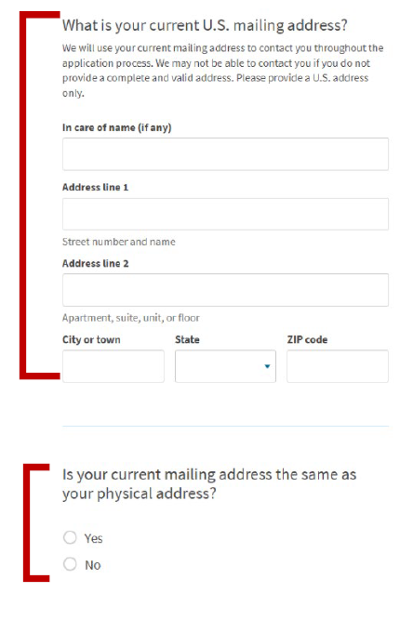
US Mailing Address:
The address you enter here is where your EAD card and any other notices from USCIS will be mailed. This should be an address where you can securely receive mail for the next 6 months.
If the mailing address you are using is different from where you live, select “No”.
You will be prompted to list your current residential address.
If the mailing address you are using is the same as your physical address, select “Yes”.

Slide 26
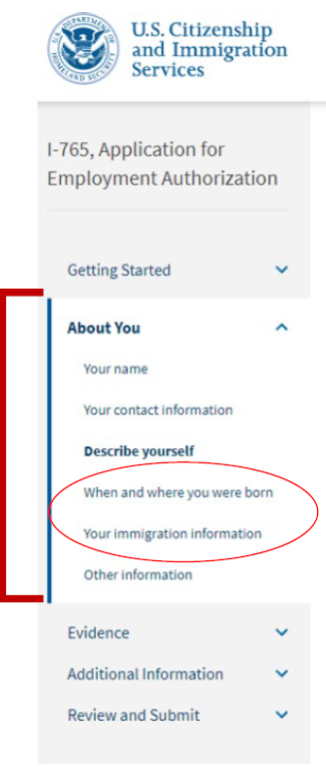
ABOUT YOU (Continued)
When and Where You Were Born
What is your city/town/village, state/province, and country of birth?
What is your date of birth? Enter your date of birth in MONTH/DAY/YEAR format.
Your Immigration Information
What is your country of citizenship or nationality?
If you are a citizen or national of more than one country, select + Add Country to add all the countries where you hold citizenship.
What is your Form I-94 Arrival-Departure Record Number?
You can find this on your I-94 record, when you select Get Most Recent I-94.

Slide 27
Your Immigration Information (cont)
When did you last arrive in the United States?
Date of Arrival: You can find this on your I-94 record.
Place of arrival (Port of Entry): Click on the Travel History button on your I94 record to access this information.
Status at last arrival: Select F-1 Student
What is the passport number of your most recently issued passport?
What is your travel document number (if any)? You can leave this blank unless you have a travel document other than a passport.
What is the expiration date of your passport or travel document?
What country issued your passport or travel document?
What is your current immigration status or category?
Select F-1 Student
What is your Student and Exchange Visitor Information System (SEVIS) Number?
You can find your SEVIS ID number on your I-20.

Slide 28
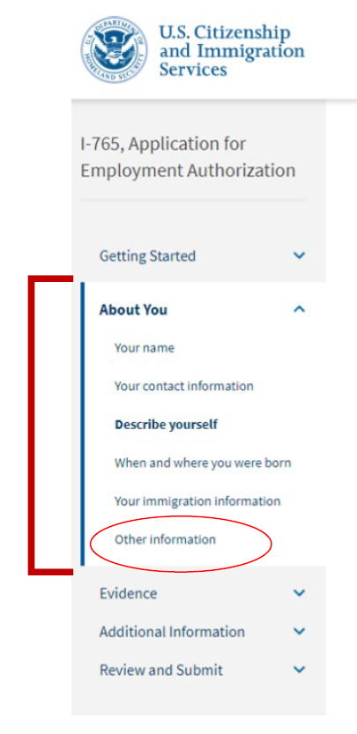
ABOUT YOU
Other Information
• What is your A-number?
If you have previously applied for OPT, you can enter the 9 -digit “USCIS #” on your current EAD card as your “A - Number”.
Otherwise, select “I do not have or know my A-Number.”
What is your USCIS Online Account Number?
Select “I do not have or know my USCIS Online Account Number” if applicable.
Has the Social Security Administration (SSA) ever officially issued a Social Security Card to you
Select Yes or No.

Slide 29
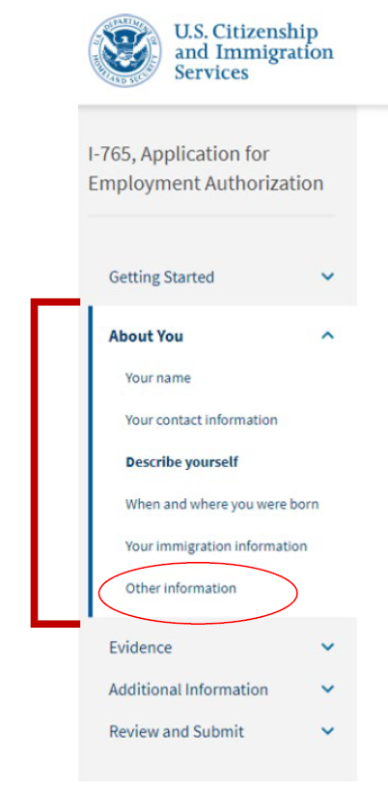
ABOUT YOU (Cont.)
• Do you want the SSA to issue you a Social Security card?
Select No IF you already have an SSN card.
Select Yes IF you do not have an SSN or have lost your card. You will be prompted to complete additional information so SSA can issue you a social security card.***
***The Social Security Administration (SSA) has given indication that they will no longer issue Social Security Cards automatically with employment authorization applications such as OPT. We can anticipate that the new change will require that OPT applicants will have to visit the Social Security Administration office in person to request the Social Security Card.

Slide 30
SOCIAL SECURTIY NUMBER (cont.)
OPT applicants will be eligible to apply for the SS card on the approved OPT EAD start date.
Complete the Online Social Security Number Application. Begin at Request a Social Security number | SSA
Schedule an appointment to visit the SSA in person at Make or change an appointment | SSA.
Bring supporting documents to your in-person appointment at the SSA: EAD, OPT I-20, I-94, Visa, passport.
SS Card will be delivered by mail within 14 days.
Sign up for Informed Delivery - Mail & Package Notifications | USPS to avoid missing the delivery of important mail such as the SS Card.
REMINDER FROM THE SOCIAL SECURITY ADMINISTRATION:
You are not required to have an SSN before you start work. However, the Internal Revenue Service (IRS) requires employers to report wages using an SSN. While you wait for your SSN, your employer can use a letter from us stating that you applied for a number.
Your employer may use your immigration documents as proof of your authorization to work in the United States.
Employers can find more information on the Internet at www.ssa.gov/employer/hiring.htm

Slide 31
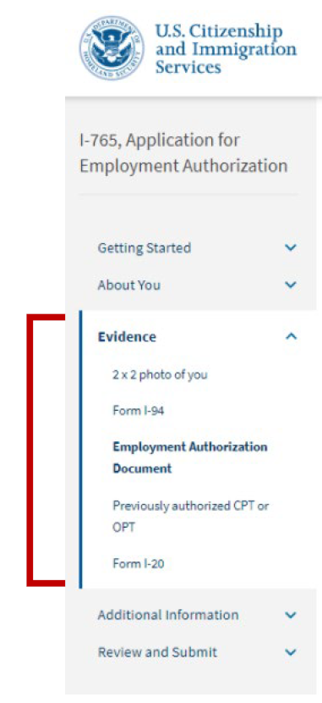
Evidence
2x2 Photo of you:
Upload a passport photo that meets USCIS specifications. Local convenience stores (such as CVS) may provide digital passport photos. Use the photo tool to upload your photo and ensure it meets the photo requirements.
Form I-94:
Upload a COPY of your I-94 record. You can look up your most recent I-94 online.
Employment Authorization Document:
Upload a COPY of your Passport ID page
Upload a front-and-back COPY of any previous/current EAD(s) (if applicable)

Slide 32
Evidence (Cont.)
Previously authorized CPT or OPT:
Upload a COPY of previous I-20s with CPT or OPT information (if applicable)
Form I-20:
Upload a COPY of your OPT Recommendation(after you have printed and signed/dated the I-20 in blue ink)
Tips for Uploading Evidence
•Make sure each image is clear and that all text is readable.
•You can upload multiple files in each section, if needed.
•Files must not be larger than 6MB.
•Files must be in one of these formats: PDF, JPG, or JPEG. For some forms, USCIS also accepts files in TIF or TIFF format.
•Do not encrypt or password protect your files.

Slide 33
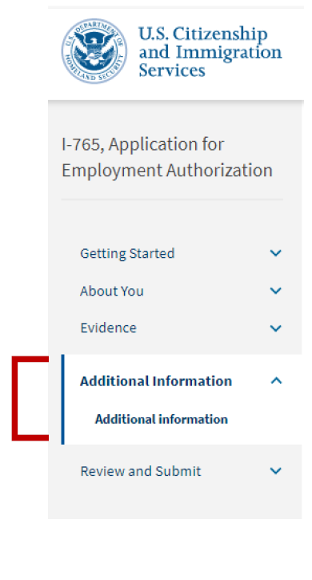
Additional Information
(as applicable to your situation)
USE THIS SECTION IF:
Your full name could not fit in the About You section.
Example: Complete legal name: Last name:____, First name: _____, Middle Name: _____
Your I-94 record does not list your most recent entry.
Example explanation: Public I-94 record system was not updated after most recent travel to Canada. The I-94 record uploaded in the “Evidence” section does not reflect my most recent entry to the United States referenced in the “About You-Your Immigration Information” section.

Slide 34
Additional Information (Cont)
(as applicable to your situation)
You've had any previous SEVIS ID Numbers:
Section: About You, Page: Your Immigration Information
Additional Information: List your previous SEVIS ID number and the degree level (High School, Bachelor’s Master’s, etc.) associated with that SEVIS ID.
You've had previously authorized CPT or OPT and do not have former I-20's with these details.
Section Evidence Page: Previously authorized CPT or OPT Additional Information: List the type of previously authorized practical training (CPT, OPT, etc.), the dates of previously authorized practical training, the degree Level (Bachelor’s, Master’s, PhD, etc.), the application status (approved, denied, or withdrawn), and the Receipt or Card Number (if applicable and known).

Slide 35
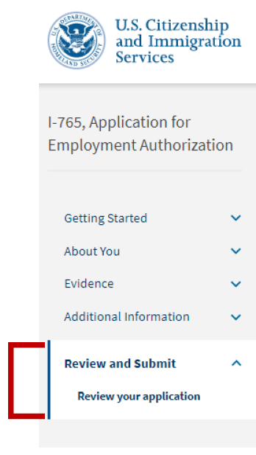
Review & Submit
Review your application: CIE recommends that you review your application before submitting to USCIS.
Read and agree to the “Applicant’s Statement”.
Digitally sign
Pay the application fee: The system will direct you to Pay.gov, a US government payment site, to pay the required I-765 application fee. You will be able to pay using a US credit / debit card or through an ACH transfer (direct withdrawal) from your US checking account.

Slide 36
Review & Submit (Cont)
Submit your application! After submission, your application will automatically be assigned a USCIS receipt number. You can print out an electronic receipt from your myUSCIS account portal. A paper receipt notice will follow in the mail a few weeks later.
IMPORTANT: Once you submit your payment information and the payment is successfully received, USCIS considers your application OFFICIALLY SUBMITTED. You cannot change or edit your I-765 application responses after payment has been submitted

Slide 37
Common Mistakes to Avoid
Application is not submitted within the timeframe.
Application is incomplete/missing the OPT I-20.
Payment issues: i.e. money not available, wrong fee amount, etc.
Pictures do not follow requirements. Review the picture requirement here or on our website.
Failure to respond to the an RFE by the given deadline.
What is a Request for further Evidence (RFE)?
An RFE is a formal notice sent by the immigration adjudicator reviewing your OPT application for: missing documents, better pictures, clarification of information
Must respond within 60 days

Slide 38
Application Progress & Status Updates
You will have the receipt notice (Form I-797) immediately after completing the online filing.
Use the case number to check the status of your application online and case correspondence. at https://egov.uscis.gov/casestatus/landing.do​
Use the online tools to submit inquiries to USCIS about your application​.
You should expect your Employment Authorization Document (EAD) to arrive by mail. The Social Security card will follow afterwards, only if you requested one.
Notify USCIS immediately if you notice mistakes in form I-797.​
USCIS Contact Center
Dial 800-375-5283

Slide 39
INFORMED DELIVERY BY USPS
Monitor your incoming USCIS mail by signing up for Informed Delivery by USPS.
• Informed Delivery provides a digital preview of your mail and allows you to manage and track your packages scheduled to arrive soon.
• Sign up online at Informed Delivery by USPS: https://informeddelivery.usps.com/box/pages/intro/start.action

Slide 40
Maintain F-1 Status while Completing Post-Completion OPT

Slide 41
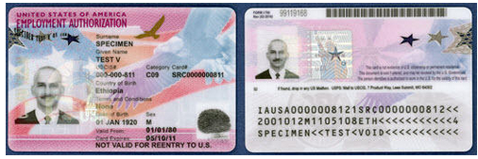
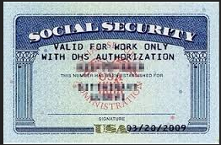
Employment
Begin Training
Verify the Information in your EAD is correct
You can start your employment on the Valid Date printed on the EAD.
You will receive your Social Security Card in the mail shortly after your OPT approval, for questions go to www.ssa.gov

Slide 42
Employment
Train within your field of study
All training opportunities must be related to your major​. For assistance with this requirement, use these resources:
https://bigfuture.collegeboard.org/majors-careers
https://www.onetonline.org
https://nces.ed.gov/ipeds/cipcode/Oefault.aspx?y=55
You begin your employment only on the EAD start date & end employment on the EAD expiration date.
You must train a minimum of 20 hours per week.​
You must not be unemployed more than 90 days​ for the duration of your OPT approved period.
Your SEVIS record will automatically terminate when you accumulate 90 cumulative unemployment days.

Slide 43
Valid Employment Categories
Regular paid employment
Single full-time, or multiple part-time jobs
Multiple, short-term employers
Work for hire / independent contractor
Self-employed business owner
Employment through an agency
Volunteer / Unpaid internship
(where Labor Regulations are not in violation)

Slide 44
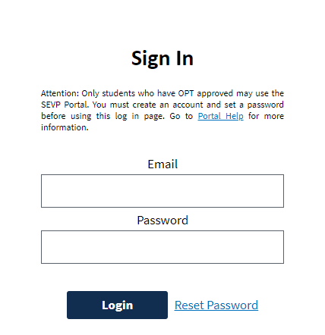
Report
Report updates within 10 days from the change
Your SEVP Portal will help you update your record accordingly.
The SEVP Portal will be accessible to you only after OPT is approved.
You will receive an email to set up your individual SEVP Portal from
do-not-reply.sevp@ice.dhs.gov on day 1 of your approved OPT period.
Use the SEVP Portal to report the following information except email:
* Physical home address.
* Mailing address.
* Telephone numbers.
* Employment information, including unemployment periods.
After you set up your SEVP Portal you can access it at https://sevp.ice.gov/opt
For help with the SEVP Portal visit SEVP PORTAL HELP or contact an International Student Advisor/DSO.
You are encouraged to use Request Documents or Signatures | California State University Long Beach (csulb.edu) to summit changes to your preferred email address or a request to reset your SEVP portal

Slide 45
Is your job related to your major? Sample Descriptions for the SEVP Portal
Bachelor's degree in Electrical Engineering: I work full time as an Electrical Engineer at ABC Corp., a government contractor. In my job, I analyze client requirements for electrical systems and provide them with cost estimates of such systems. My work requires understanding of electrical circuit theory, which I studied in-depth at the University of ABC.
Bachelor's degree in Business: I work full time as a Loan Officer at a mortgage company, Happy Homes, where I meet with clients and evaluate, authorize and recommend approval of loan applications. On a daily basis, I use the knowledge I gained in my credit analysis, sales and marketing classes that I took as part of my major program of study.
Master's degree in Music: I am working at a hospital playing the harp in patient rooms. I also conduct hands-on harp beginner workshops for long-term patients. On average, I work at the hospital 35 hours a week. My duties directly utilize the skills and knowledge I acquired from my coursework and degree in music therapy.

Slide 46
Travel & Insurance requirements

Slide 47
TRAVEL
Travel may be ok before program end date under certain circumstances but always ask an International Student Advisor first!
Travel is NEVER recommended when your application is pending AFTER your academic program already ended.
How to Re-Enter Safely
Valid Passport
Valid F-1 Visa Stamp
Freshly Signed OPT I-20
Request a travel signature online Request Documents or Signatures | California State University Long Beach (csulb.edu)
EAD Card
Letter from your Employer
Contact information for the designated school official (DSO) at your school

Slide 48
Purchasing Health Insurance is not required but ABSOLUTELY recommended!
INSURANCE
OPT Students may enroll in the JCB Plan on a voluntary basis.
OPT students may purchase a maximum of 12 consecutive months of coverage from the OPT effective date.
OPT extension coverage beyond 12 months is not allowed.
Enrollment must be completed within 30 days of the expiration of prior coverage on the schools’ student health insurance plan. A gap in coverage is not allowed.
A copy of a valid EAD or OPT application or receipt (I-765 or I-797c) is required to enroll.
Inquired with ISS Advisor about alternative insurance providers for OPT students.
https://jcbins.com/

Slide 49
Ending Post-Completion OPT

Slide 50
End of OPT
You have a 60 Day Grace Period but only if you have been maintaining F1 status through OPT. Below are your options.
1. Depart the U.S.
2. Complete a transfer to another college/university to study full-time again
3. Complete a change of program level here at CSULB (i.e. B.A., M.A.)
4. Seek a Change of Status to a different visa type

Slide 51
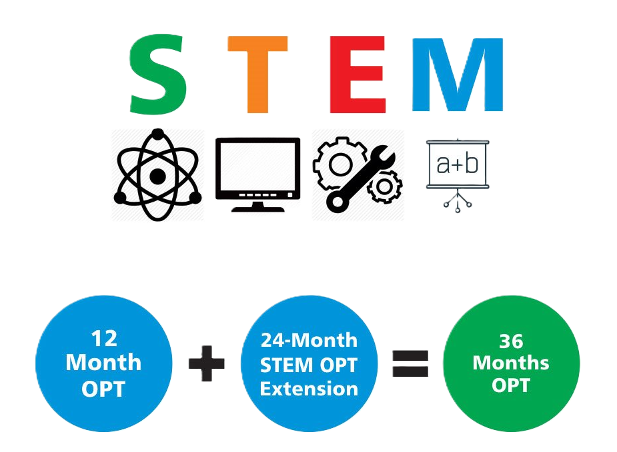
Cap Gap
24 Month STEM OPT Extension
Students who are eligible MUST apply 90 days before OPT expires.
Students who are eligible for a Cap-Gap extension of post-completion OPT employment and F1-status may request an updated I-20 from a DSO.

Slide 52
Helpful Resources

Slide 53
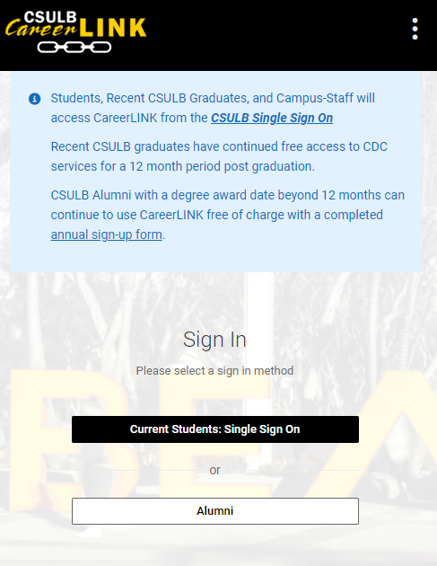
Career Development Center (CDC) Resources
College Job and Internship feeds
College of Business Job & Internship Feed
College of Education Job & Internship Feed
College of Engineering Job & Internship Feed
College of Health & Human Services Job & Internship Feed
College of Liberal Arts Job & Internship Feed
College of Natural Sciences & Mathematics Job & Internship Feed
College of The Arts Job & Internship Feed
Job Search Club | Virtual
Every Tuesday, 12:00 P.M. - 1:00 P.M. , July 16 - August 6
If you are an alumnus and need some motivation in your job search, join this weekly virtual meeting of fellow CSULB job seekers. Share your struggles and successes with others who know what you're going through; you don’t have to go through the job search process alone!
RSVP Here
Visit Careerlink here for more events.
Beach Nexus
Beach Nexus is CSULB’s exclusive online mentoring and professional network that connects alumni, students and community.
GoinGlobal
International students can find employers who have sponsored in the past (H1B visas).
www.csulb.edu/career-development-center

Slide 54
Beach Connect- Advising
Online: sso.csulb.edu
Meet with your immigration advisors
Access university resources

Slide 55
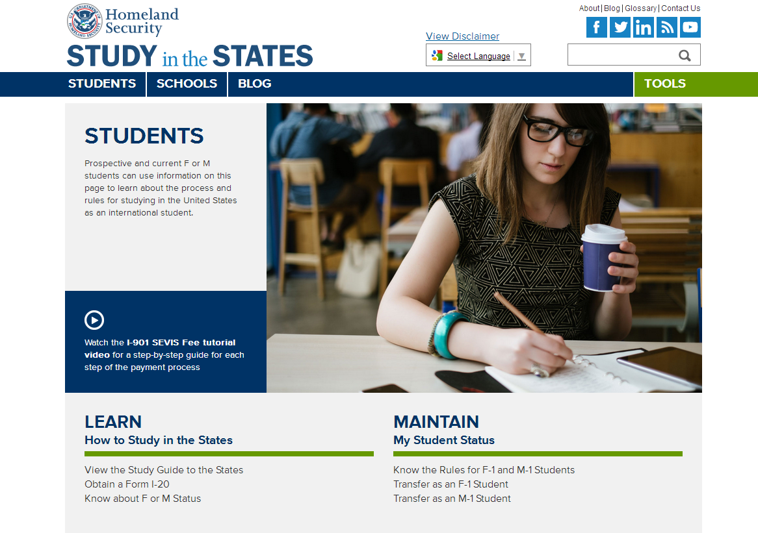
Visit studyinthestates.dhs.gov/students

Slide 56
Center for International Education International Student Services
Office Hours:
Monday – Thursday: 9:00 am – 12:00 pm, 1:00 pm to 4:00 pm
Friday, 9:00 am – 3:00 pm
Closed everyday 12:00 pm – 1:00 pm
Location: FND 185B
Email:
cie-student@csulb.edu
Website and social media:
International Students and Scholars | California State University Long Beach (csulb.edu)
Facebook: CSULB International Student Services
Instagram: CSULB_ISS

