Slide 1
Time Management
Strategies to Stay Organized, Reduce Stress, and Achieve More
Start Here

Slide 2

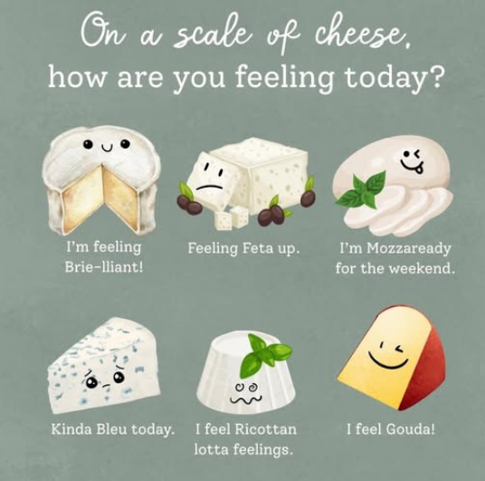
Notes:
Type your answers in the chat!

Slide 3
Why Does Time Management Matter?
Improves academic performance
Reduces stress and anxiety
Helps create school-life balance
Builds life-long habits that will foster success
Think of a time when you had to cram for an assignment or test. How did that feel? Now imagine you could start preparing two weeks earlier. What would have been different?

Slide 4
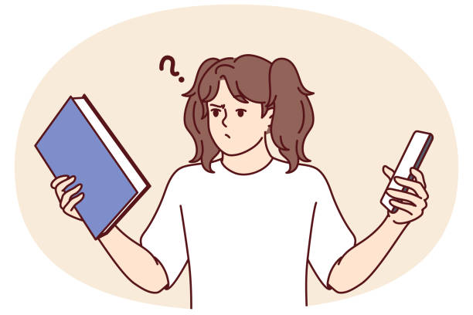
Common Challenges
Distractions
  Social media
  Phone
  Environment (e.g., noise, presence of others)
Procrastination
Overcommitment
Poor planning
Lack of focus/burnout

Slide 5
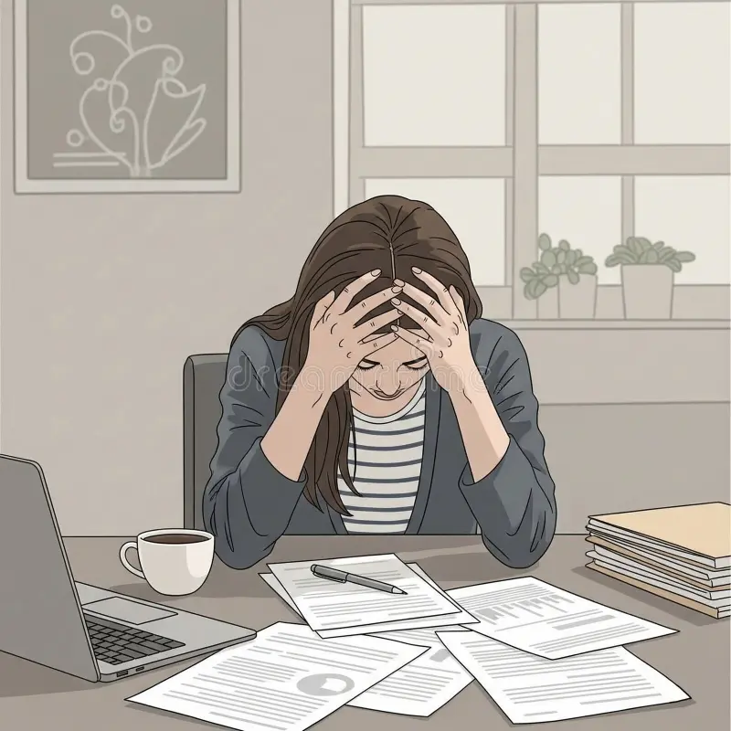
Time Management Myths
Myth: “Multitasking saves time”
Fact: Even brief mental blocks from shifting between tasks can reduce productivity by up to 40%
Myth: “I work best under pressure”
Fact: There is no evidence that we work better under pressure. In fact, the stress can slowly erode at our mental health and well-being
Myth: “Time management = being busy”
Fact: Good time management is about being effective and efficient
Myth: “Schedules kill flexibility”
Fact: Schedules can create flexibility by helping you plan ahead, make time for fun, and reduce last-minute conflicts

Slide 6
Core Principles of Time Management
Prioritize
Focus on what truly matters
Plan
Use calendars, planners, or apps
Organize
Keep materials and deadlines in order
Discipline
Stick to your system
Balance
Build in opportunities for rest and fun too

Slide 7
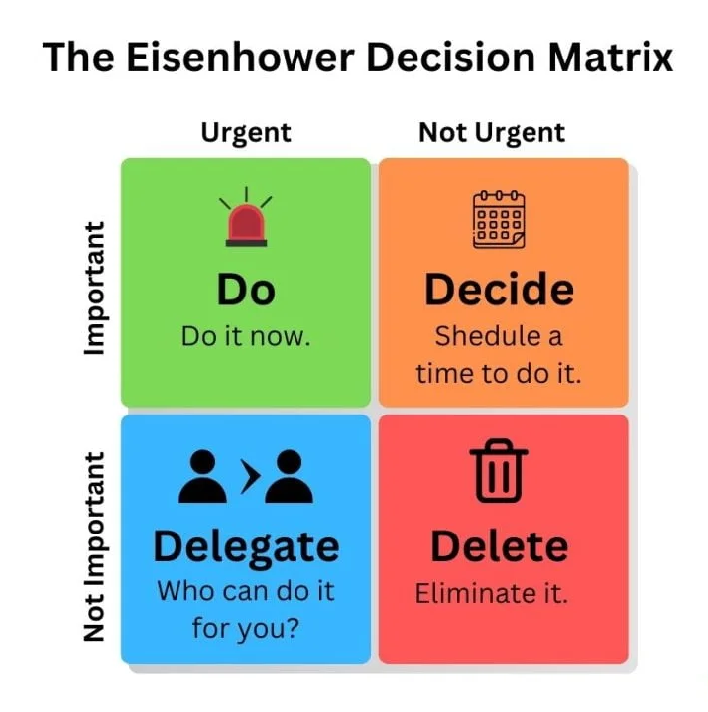
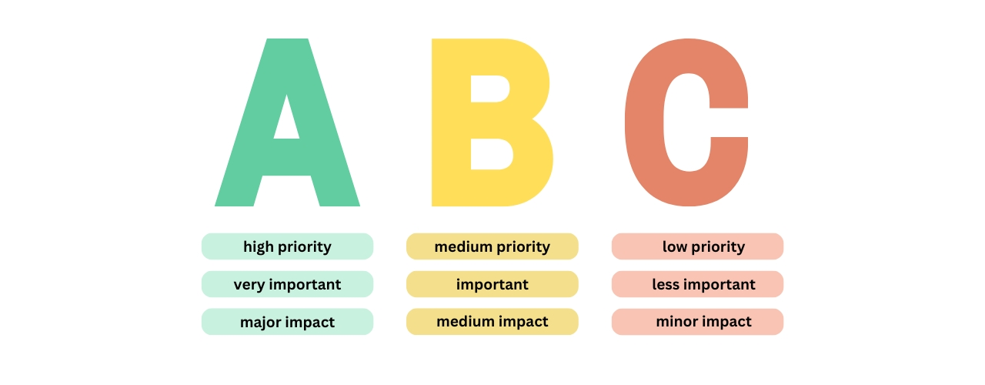
Prioritization Frameworks

Slide 8
Weekly Study Schedule
Break large tasks into smaller, specific goals. You can also schedule recurring study blocks, including buffer time for any unexpected events.
Monday | Tuesday | Wednesday | Thursday | Friday
10-12:45 PM - Class | 9-11 AM - Project mtg | Math problem set | 9-11 AM - Project mtg | 8-10:30 AM - Class
Eat lunch + commute | Tutoring session @ 2 PM | Attend Office Hours | 2-4 PM - Class | Work on paper 12-3 pm
3-5 PM - Read chapter 6 and take notes | Go to gym | Get dinner w/ family | Go to gym
Dinner | 7-9:45 PM - Class | Pack for trip | Do discussion board | Go out with friends

Slide 9
Tools & Techniques
Planners/Calendars
Checklists
Use your syllabus calendar to see class times, due dates, and exams. Work backwards from deadlines to plan when to start assignments. This helps prevent double-booking.
Writing tasks down creates a sense of accountability. It can also give you a sense of accomplishment as you check things off. Lists can be daily (e.g., “Read Ch. 3”) or weekly (e.g., Finish project draft”)
Time Blocking
Pomodoro Technique
Set aside intentional time to study or attend to assignments. This reduces decision fatigue and ensures you dedicate real time for tasks. You can also schedule downtime so you don’t overwork.
Helps fight procrastination and burnout. Work for 25 minutes, then take a 5-minute break. After 4 rounds of that, take a longer, 15-30 minute break. You can also do longer sessions (50/10)

Slide 10
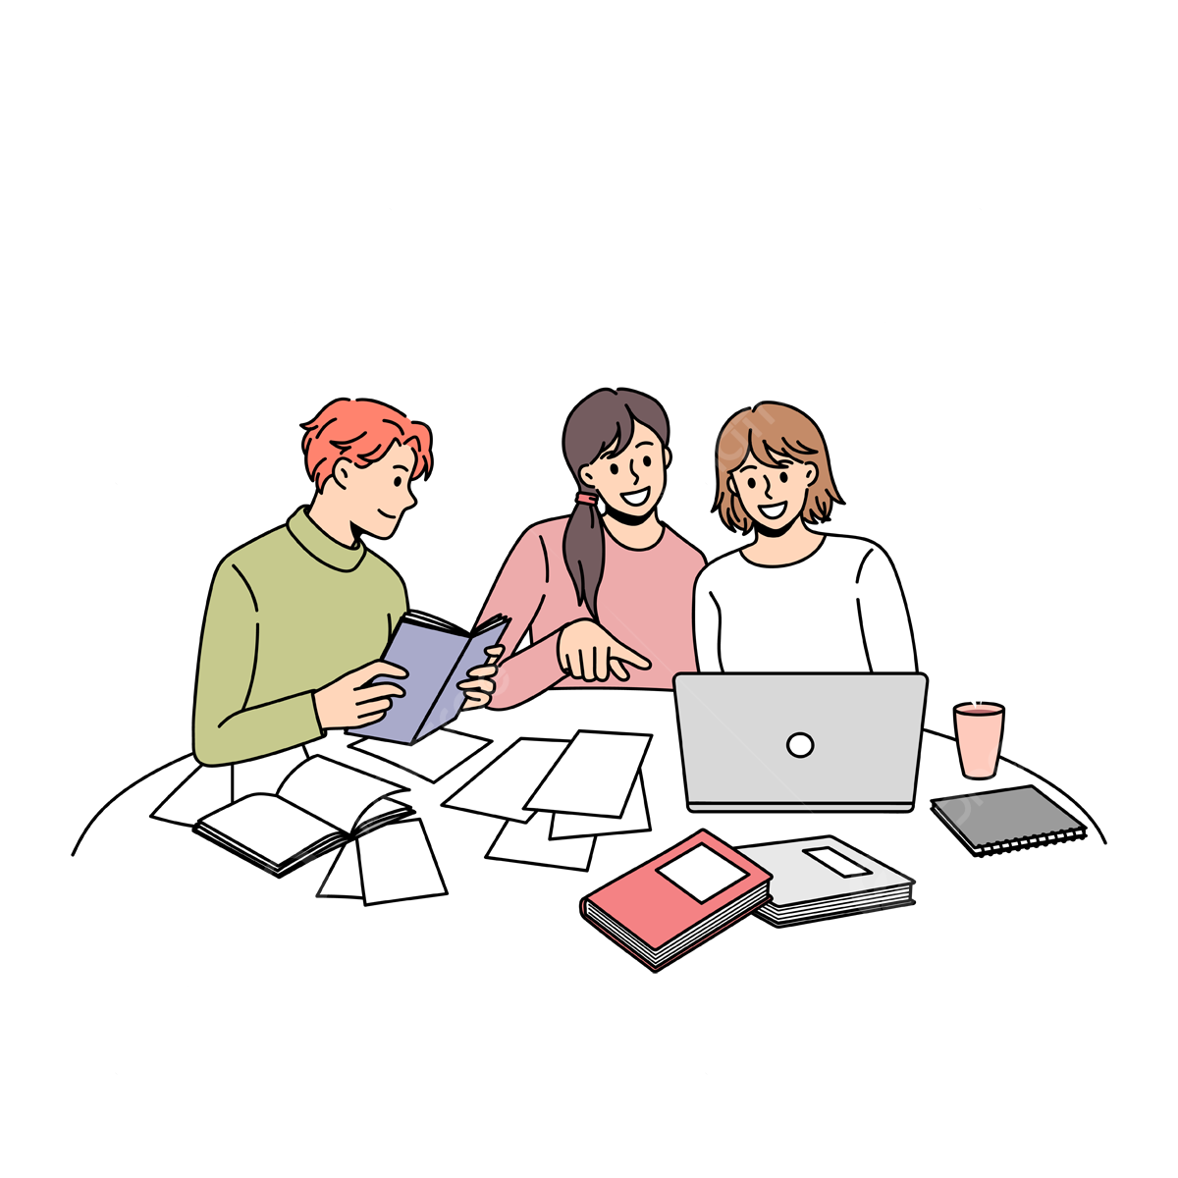
Beating Procrastination
Start with a 5-minute rule
  Try to work for at least 5 minutes on the specific task you set to do - nothing else. Often, momentum will build, and you won’t feel a desire to stop
Remove distractions
  Put your phone on silent and place it in another room
  If you need, install website blockers so you don’t get distracted
Reward yourself after completing tasks
Take advantage of partners and study groups
Cognitively reframe tasks:
  Instead of “I have to study”, try “I get to study”

Slide 11

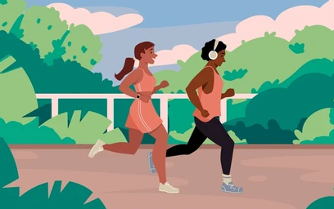
Balance is Key
Don’t overschedule
  Learn to say no without feeling guilty
Prioritize your health: sleep, meals, movement
  You can’t work successfully when running on empty
Schedule downtime for hobbies and socializing
Only do harder tasks when you’re alert, so you can ensure your quality of work during that time is higher
Be flexible and adjust your schedule when needed (staying ahead of tasks can help with this)

Slide 12
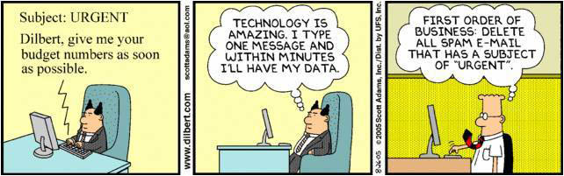
Practical Tips for Success
Plan the night before
Batch similar tasks together and block off time to do it (ex: answer emails at once)
If a task can be done within two minutes, complete it immediately to get it out of the way
Review your goals on a weekly basis to gauge for progress
Stack your habits
  Tie new habits to your existing routines “After [Old Habit], I will do [New Habit]”

Slide 13

Key Takeaways.
Time management = work smarter, not harder
Use prioritization and planning tools
Beat procrastination with small steps and accountability
Balance school + life → success + less stress

Slide 14
Thank You!
Remember…lost time is never found again

