Slide 1
Addressing Severe
Economic Hardship
and Options for F1 Students
Presented by:
The Center for International Education
International Students & Scholars

Slide 2
SESSION OBJECTIVES:​
By the end of the session, you will recognize the following options to help you address economic hardship:​
Off-campus work permit due to Unforeseen and Severe Economic Hardship (SEH)​
Special Student Relief (SSR)​
Undergraduate, Non-resident Fee Waiver (NRT)​
Educational Leave of Absence​
Other Possible Options to Relieve Stress During Hardship

Slide 3
When is off-campus employment available ?​
An F-1 student must show an ability to afford the costs of school and living expenses before entering the United States and should not plan to work off-campus. ​
However, U.S. Citizenship and Immigration Services (USCIS) will authorize off-campus employment as follows:​
only in cases of severe economic hardship occurring after a student's enrollment in an academic program and​
after the student has been in F-1 status for at least one full academic year, or ​
in emergent circumstances as defined by the Department of Homeland Security (DHS).​

Slide 4
What situations will qualify a student for assistance from USCIS?​
Emergent Circumstances are world events that affect a specific group of F-1 students and which causes them to suffer severe economic hardship, including, but not limited to:​
​natural disasters, ​
wars and military conflicts,​
national or international financial crises.​
A situation of severe economic hardship include:​
Loss of financial aid or on-campus employment (if the student is not at fault)​
Large increases in tuition or living costs​
Substantial decrease in the relative value of currency the student depends upon to pay expenses​
Unexpected changes in the financial conditions for a student's sources of financial support​
Unexpectedly large medical bills not covered by insurance​
Other substantial, unexpected expenses​

Slide 5
EMPLOYMENT BASED ON
SEVERE ECONOMIC HARDSHIP (SEH)​
Who Qualifies?
F-1 visa students who have encountered financial difficulties due to unforeseen circumstances may be eligible to apply for a part-time, off-campus work permit.​
The work permit allows employment off campus for up to a year.​
Work does not have to be related to your major.​

Slide 6
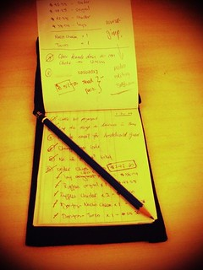
ELIGIBILITY
Must be in lawful f-1 Status
Have been enrolled in a full course of study for at least one academic year​
Be in good academic standing​
Must be able to provide evidence of financial hardship​ that was unforeseen and out of your control.​
Limited to part time employment during the Spring and Fall terms.​

Slide 7
SEH Application Process
1
Meet with a DSO to discuss your current situation and determine if you meet eligibility
2
Explore all available options to ameliorate your current economic hardship.​
3
Complete the SHE Request Form and submit it to the Office of Internationals Students and Scholars along with all supporting documents.​
4
5
6
Allow 7-10 business for the review of your request and for the DSO to issue you an SEH I-20​
Mail your application packet, with supporting documents and Fee to USCIS. Allow 90 days for processing and approval.​
Receive your Employment Authorization Document (EAD) by mail.
7
Apply for a Social Security number with the Social Security Administration if necessary.​
You may renew your EAD every year, if the SEH continues​.

Slide 8
SPECIAL STUDENT RELIEF (SSR)
Who Qualifies
F-1 visa students from a particular region of the world who are directly affected by geo-political events that cause detrimental hardship. ​
These events are described by the U.S. Department of Homeland Security (DHS) as Emergent circumstances.​
natural disasters, ​
wars and military conflicts,​
national or international financial crises. ​

Slide 9
Current Special Student Relief Program Designations​ ​
Country​ | Effective dates​ | Federal Register notice​
Burma/Myanmar​ | May 26, 2021 –November 25, 2025​ | 89 FR 20675 (March 25, 2024)​
Cameroon​ | June 7, 2022 - June 7, 2025​ | 88 FR 69939 (October 10, 2023)​
Ethiopia​ | December 12, 2022 - December 12, 2025​ | 89 FR 26161 (April 15, 2024)​
Haiti​ | August 4, 2024 – February 3, 2026​ | 89 FR 54477 (July 1, 2024)​
Lebanon​ | July 26, 2024 – January 25, 2026 and November 27, 2024 – May 27, 2026​ | 89 FR 83897 (October 18, 2024) 89 FR 93634 (November 27, 2024)
Palestinian Territories​ | April 15, 2024 – August 13, 2025​ | 89 FR 26156 (April 15, 2024)​
Somalia​ | September 18, 2024 - March 17, 2026​ | 89 FR 59129 (July 19, 2024)​
Sudan​ | April 19, 2022 - April 19, 2025​ | 88 FR 56857 (August 21, 2023)​
South Sudan​ | March 3, 2022 -May 3, 2025​ | 88 FR 60965 (September 6, 2023)​
Syria​ | April 1, 2024 – September 30, 2025​ | 89 FR 5557 (January 29, 2024)​
Venezuela​ | April 22, 2021 – September 10, 2025​ | 89 FR 17500 (March 11, 2024)​
Yemen​ | September 4, 2021- March 3, 2026 | 89 FR 56759 (July 10, 2024)​
Ukraine​ | April 19, 2022 - April 19, 2025​ | 88 FR 56851 (August 21, 2023)​
Afghanistan​ | May 20, 2022 through May 20, 2025​ | 88 FR 65721 (September 25, 2023)​
Under an "emergent circumstances" determination, regulatory requirements that may be suspended or altered for an F-1 student include:​
​
full course of study allowing student to enroll in no less than 6 units per semester (generally)​
and on-campus or off- campus employment, allowing student to work more than 20 hours per week under the on-campus employment regulations, practical training option known as CPT or through F-1 Severe Economic Hardship (SEH) Work Permit.​

Slide 10
ELIGIBILITY (SSR)
Must be in lawful F-1 Status.
Must be in good academic standing.
Must have citizenship in the affected country or​ region, as per the FR notice and have been ​ lawfully present in the United States for the dates​ indicated in FR notice.​
Must meet minimum course requirements for the duration of authorized employment.​
Must demonstrate that employment is needed to alleviate severe economic hardship caused by the​ emergent circumstances.​

Slide 11
SPECIAL STUDENT RELIEF (SSR) Application Process
1
Meet with a DSO to discuss your current situation and determine if you meet eligibility
2
Explore all available options to ameliorate your current economic hardship.​
3
4
5
Allow 7-10 business for the review of your request and for the DSO to issue you an updated I-20 for SSR.
Mail your application packet, with supporting documentation and fees to USCIS. Allow approximately 90 days for processing and approval.​
Complete the SSR Request Form and provide any supporting documentation including employment authorization (EAD) if applicable.​

Slide 12
Under exceptional circumstances, California State University, Long Beach, may grant a non-resident tuition waiver to eligible international students (holders of​ F-1 or J-1 visas) on the basis of economic hardship.​
Hardship must be the result of changes that arose recently, were unforeseen, and beyond your control.​
Waivers are only granted in the event of a catastrophic and sudden change in a student's financial situation, such as a death in the family or severe illness.​
Ordinary economic factors, such as fluctuations in currency exchange rates or business profitability, do not merit the granting of an NRT Waiver.​
The waiver will only waive out of state​
tuition fees for two terms.​
Undergraduate,
Non-resident
Fee Waiver (NRT)​
Please be aware that economic hardship NRT waivers are rarely granted. Waiver is not available to graduate students!​

Slide 13
ELIGIBILITY (NRT)
1
Must be in lawful F-1 student status.
2
Have only two terms left (Spring/Fall) before graduation. Average of 30 units or less.​
3
4
5
Must be able to provide evidence of financial hardship​ that was catastrophic.​
The waiver will only waive out of state tuition fees for two terms, summer & winter terms are not included.​​
Be in good academic standing & 3.0 GPA.​

Slide 14
NRT APPLICATION PROCESS
1
Meet with a DSO to discuss your current situation and determine if you meet eligibility.​
2
Explore all available options to ameliorate your current economic hardship
3
Complete the NRT Request Form and submit it to the Office of International Students and Scholars along with all supporting documents.​
4
Allow 7-10 business for the review and approval of your request.​
5
If approved, your non-resident fees will be waived only for your last two terms (Fall/spring for an average of 30 units.). Summer & winter terms are not included.​

Slide 15
EDUCATIONAL LEAVE
Matriculated undergraduate or graduate students, in good standing, who have completed at least one semester and have earned units at CSULB may apply for an Educational Leave for a minimum of 1 semester or a maximum of 4 semesters (depending on approval).​
Applications for Educational Leave must be submitted to Enrollment Services by the last day of the previous Fall or Spring semester.​
International student must meet with an International Student Advisor as soon as educational leave is considered an option.​
​
http://www.csulb.edu/registration-and-records/educational-leave​

Slide 16
Ed Leave…Things to consider
Keep your spot in the​
university​
You must re-enter the U.S. with new SEVIS # & initial I-20 (Unless you Transfer to another U.S. institution).​
You will re-start your F-1 status upon return.​
You will need to wait 1 academic year upon return to qualify for CPT, OPT or SEH​

Slide 17
Other Possible Options to Relief Stress During Economic Hardship
On-Campus Employment (CIE Guidance)
49er Shops
Associated Students Inc.
Career Development Center
University Library
Office of Research & Economic Development
Speak with your department or programs for assistantship opportunities.
Basic Needs Program
Serves students who have been displaced, experiencing homelessness, food insecurity, an emergency, and/or a crisis.
Payment Plans
Beach Pantry

Slide 18
The Career Development Center Location: BH 250 Online: Career Development Center | California State University Long Beach Learn about: Resume Writing Internships Job Search

Slide 19
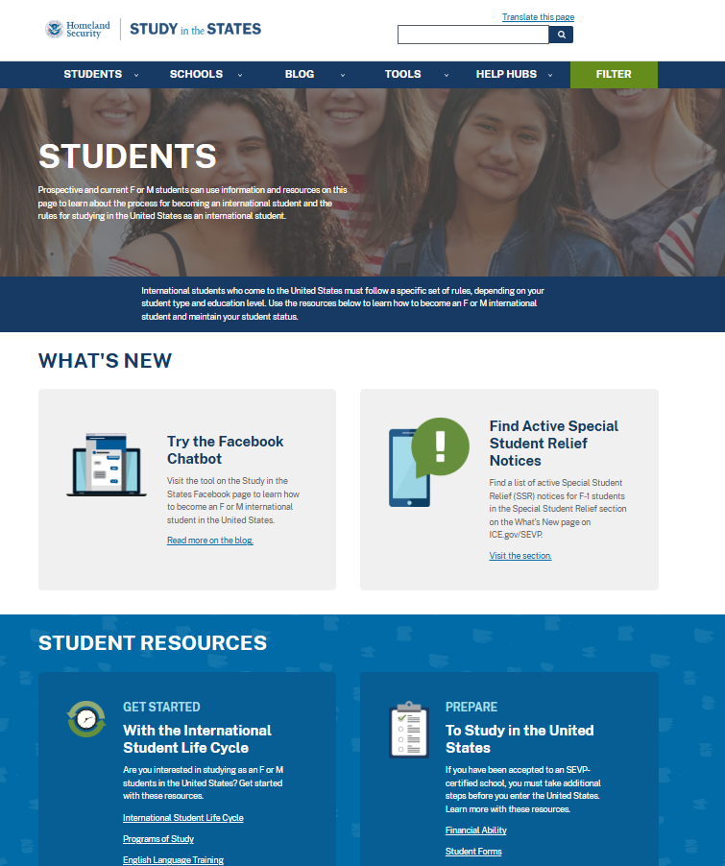
Visit
https://studyinthe states.dhs.gov
The form I-20
Maintaining Status
Paying the I-901 Fee
Training Opportunities in the U.S.
Applying for a Visa

Slide 20
Center for International Education International Student Services
Office Hours:
Monday – Thursday: 9:00 am – 12:00 pm, 1:00 pm to 4:00 pm
Friday, 9:00 am – 3:00 pm
Closed everyday 12:00 pm – 1:00 pm
Location: FND 185B
Email:
cie-student@csulb.edu
Website and social media:
International Students and Scholars | California State University Long Beach (csulb.edu)
Facebook: CSULB International Student Services
Instagram: CSULB_ISS

