Slide 1
Academic Senate Retreat
Shared Governance Over the Last 75 Years:
A Decade-by-Decade Look
October 31, 2024

Slide 2
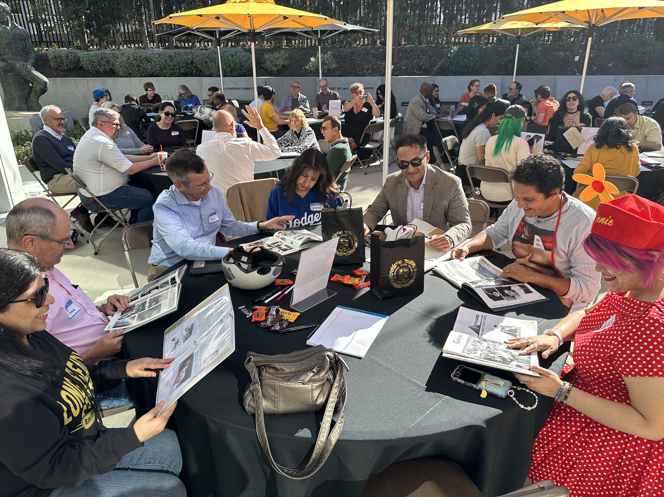
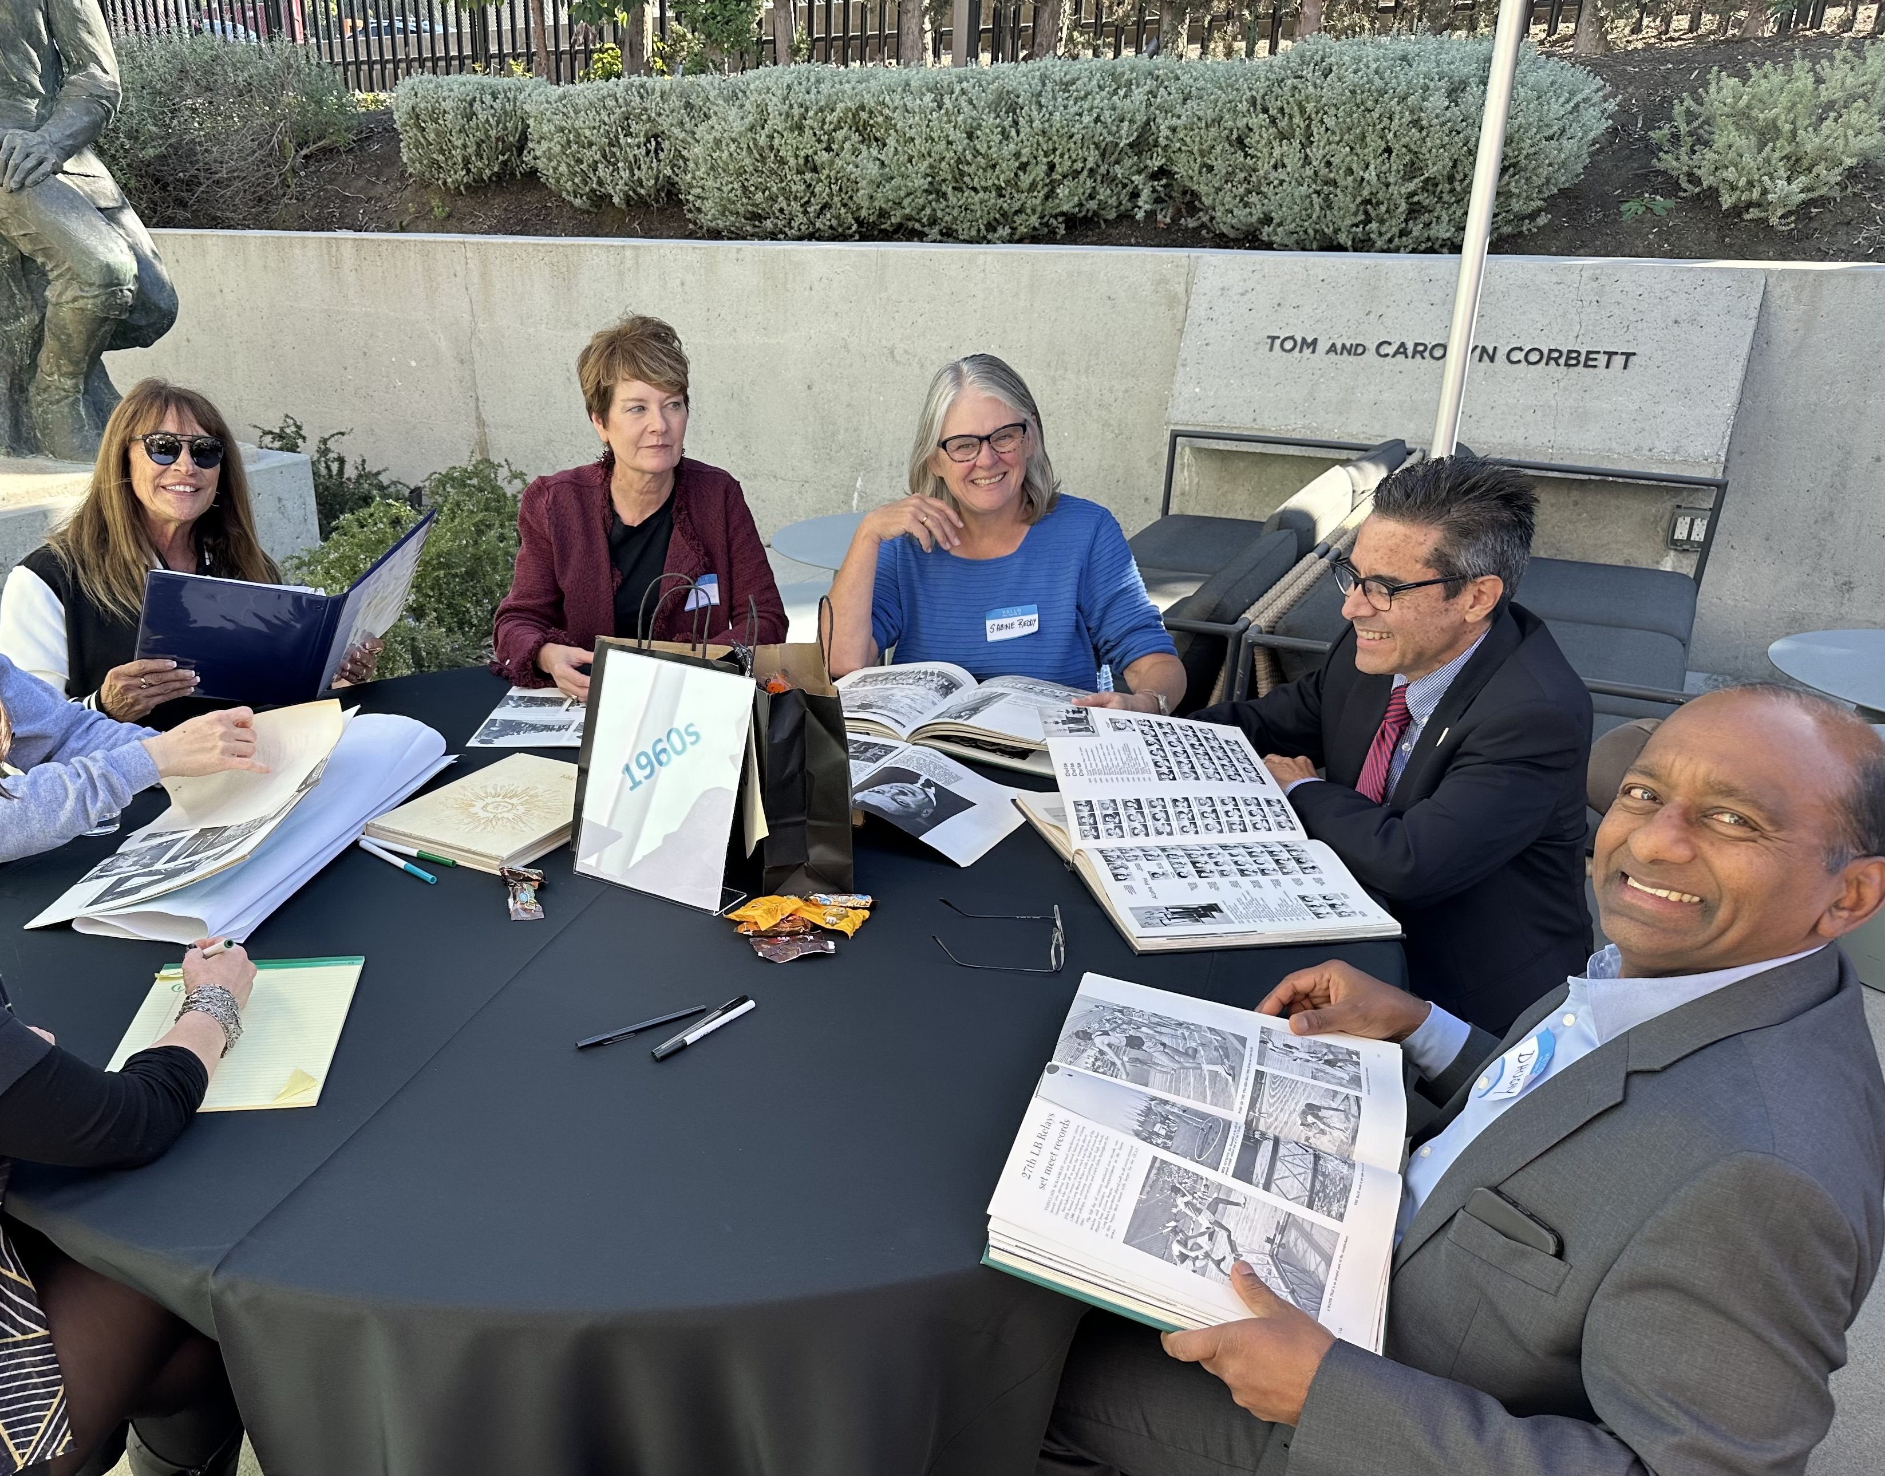
Members of the campus community came together at the Anna W. Ngai Alumni Center to explore 75 years of history at CSULB

Slide 3
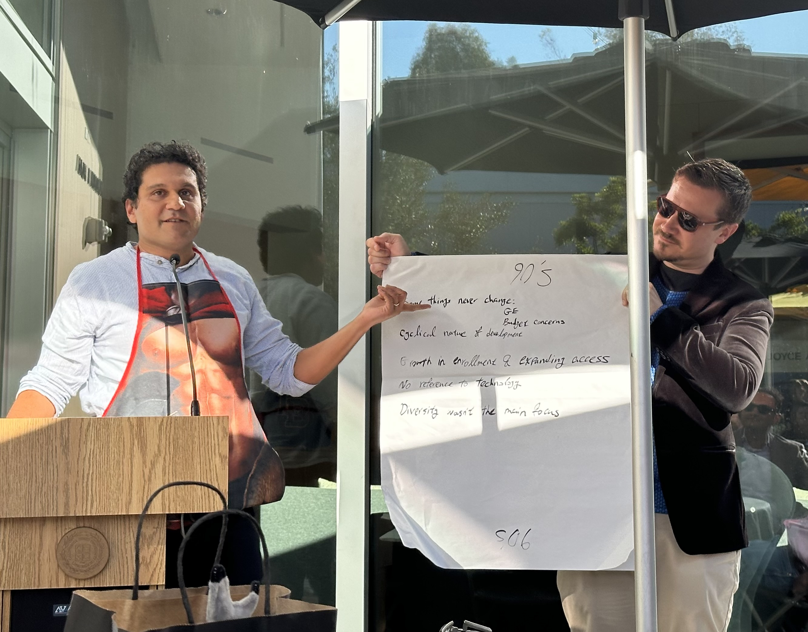
THEMES of the RETREAT
Shared Governance
Campus Leadership: Academic Senate & Administrators
Faculty Focus
Campus Culture & Growth
Diversity

Slide 4
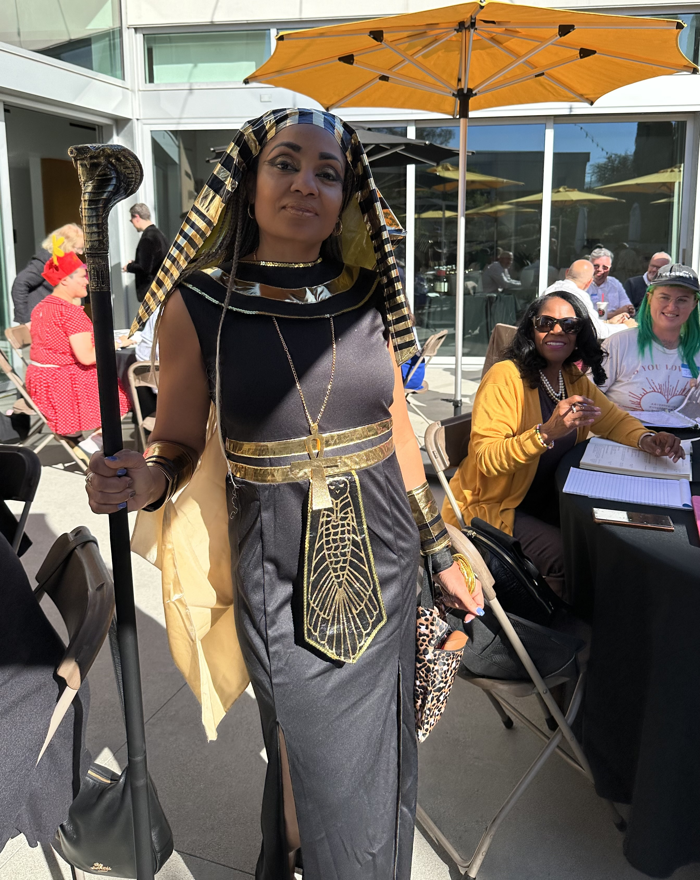
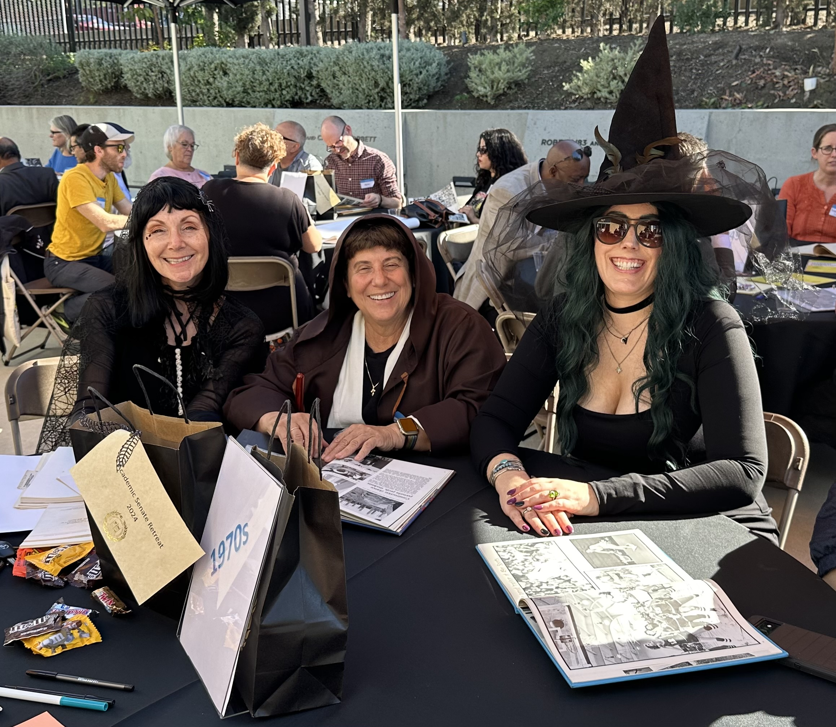
THEMES of the RETREAT
Halloween Style

Slide 5
A STEADY TIDE Commitment to Shared Governance
1950s
“Expectation of Shared Governance” – Faculty Manual
1960s
Meaning of shared governance will grow
1970s
Continued commitment to shared governance
Has the power to protect & amplify the voices of those who comprise the campus

Slide 6
A STEADY TIDE Commitment to Shared Governance
1980s
Shared governance continues to become normalized
1990s
Need to build strong, healthy relationships across campus
2000s
Recognizing the value of healthy shared governance

Slide 7
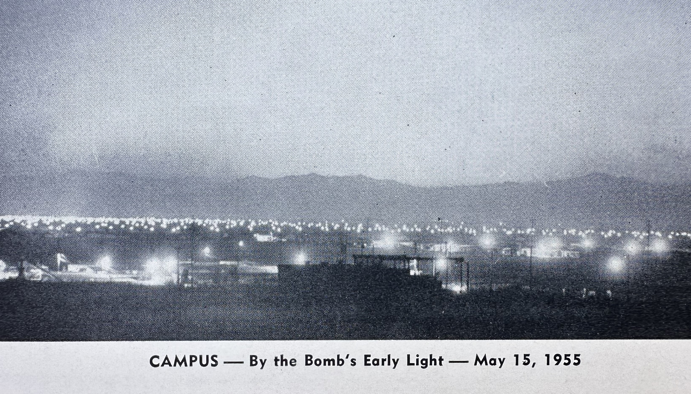
EBBS & FLOWS Campus Leadership: Academic Senate & Administrators
Bi-weekly communications to faculty with campus updates
Annual “Faculty Manual” published
Rules considered for administrators who “do not enjoy the confidence of the faculty”
Questionnaire to faculty about what the future of higher education should look like

Slide 8
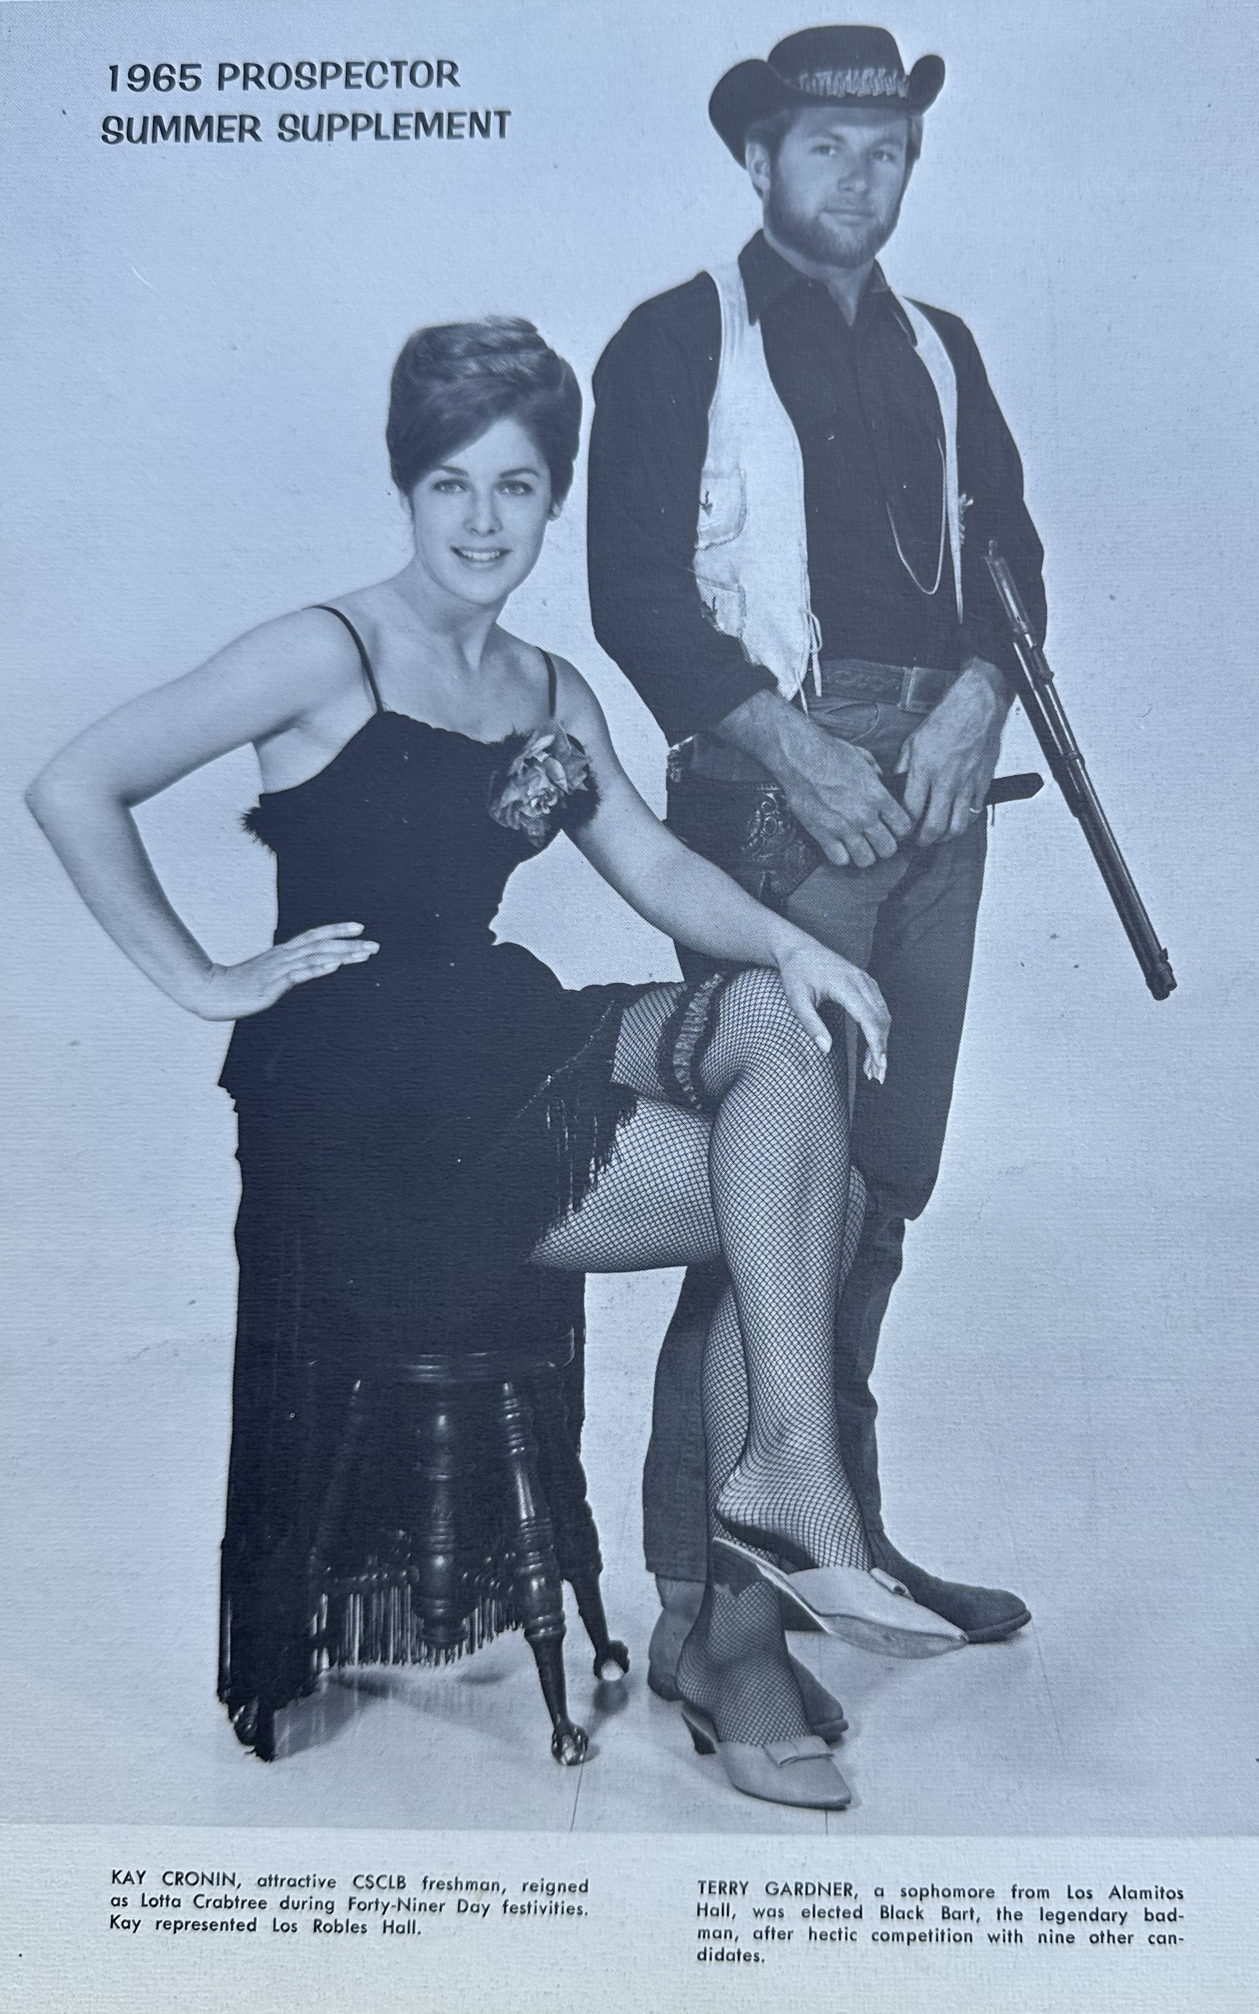
EBBS & FLOWS Campus Leadership: Academic Senate & Administrators
Academic Senate passed 16 policies in one year
Call for less bureaucracy and more flexibility
Administrators were becoming upset

Slide 9
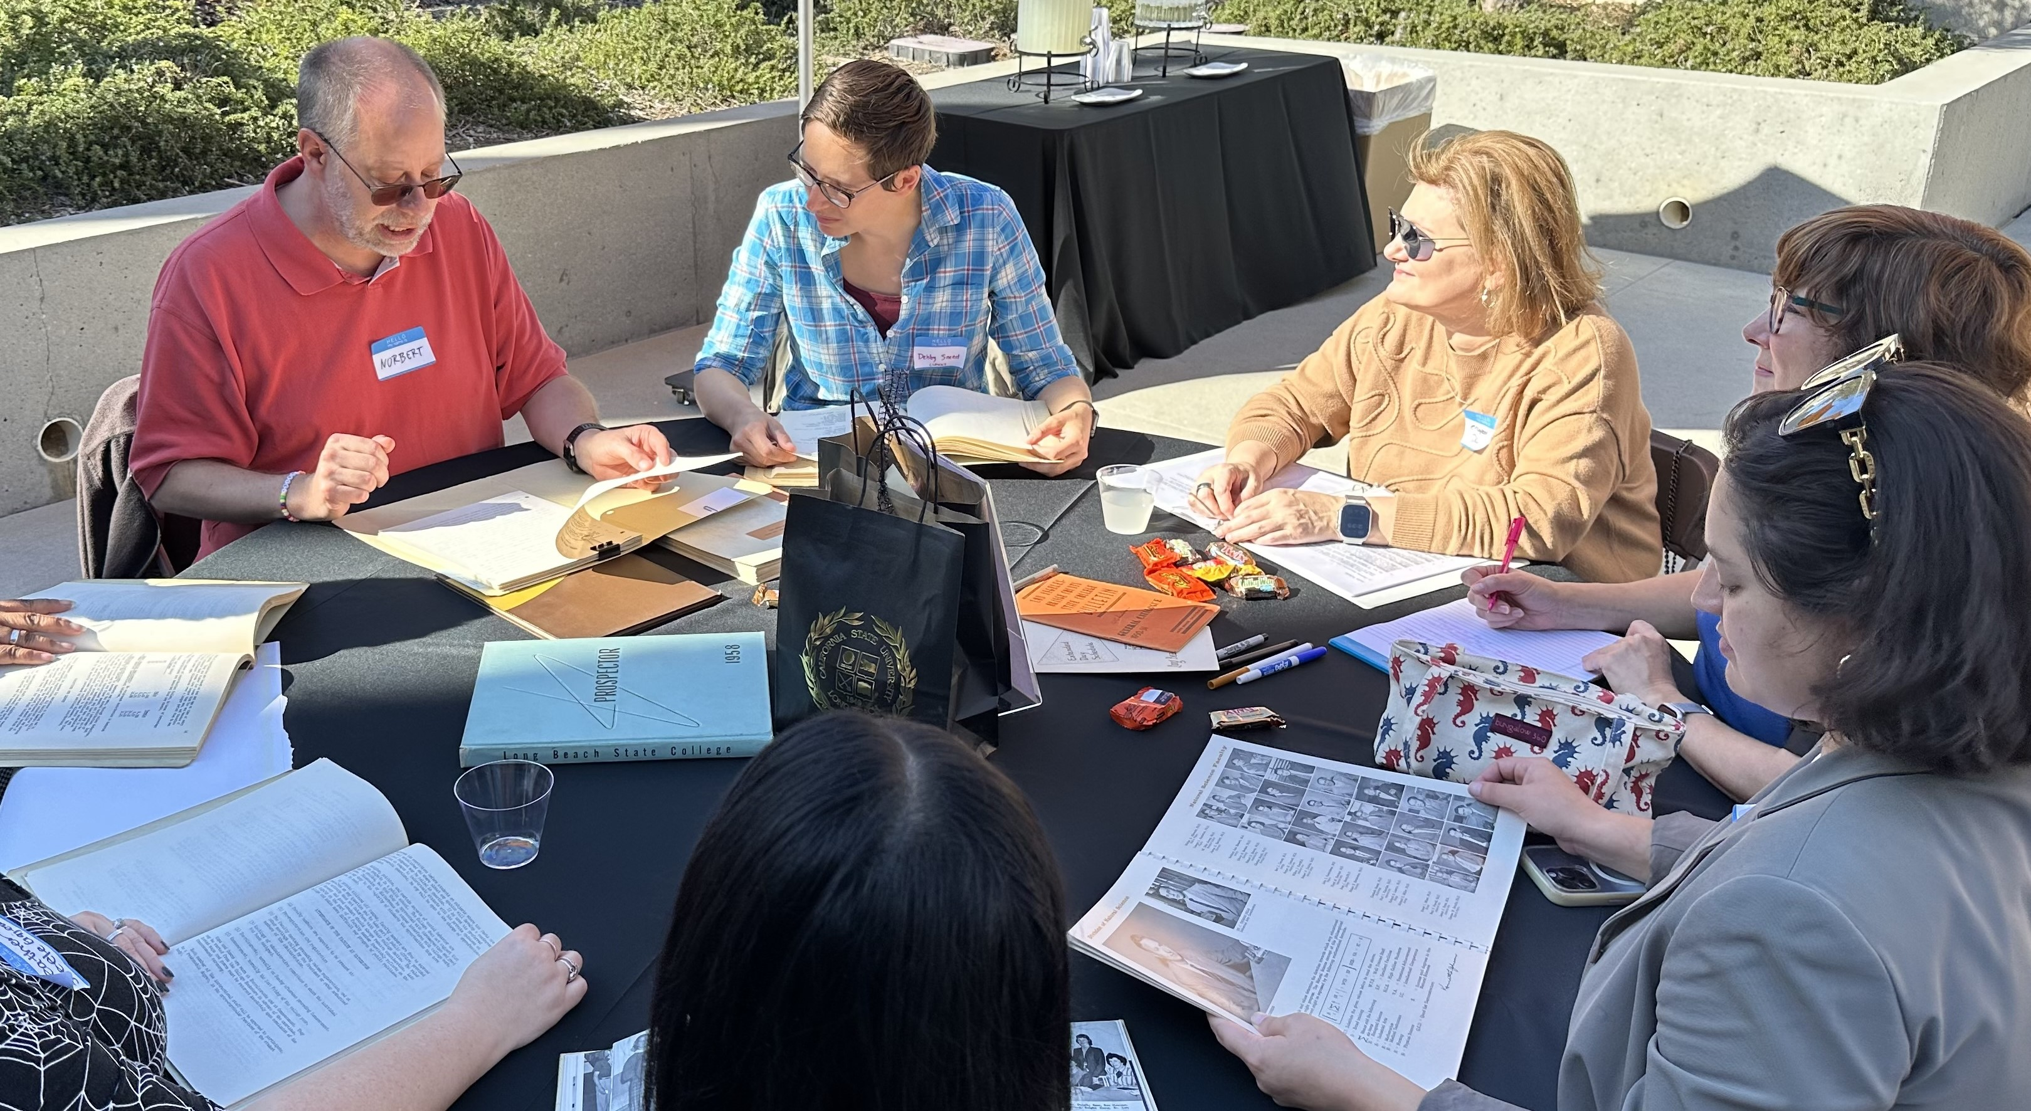
EBBS & FLOWS Campus Leadership: Academic Senate & Administrators
Minutes of the Academic Senate note a call for the removal of “unnecessary denotations of gender” from CSULB documents
Academic Senate adds student senators
Agendas & minutes distributed via mail
Policies/structures encouraged to ensure the interests of the campus population are met and not directed by those in leadership positions
Call for President Horn to spend more time on campus, and less time in D.C.

Slide 10
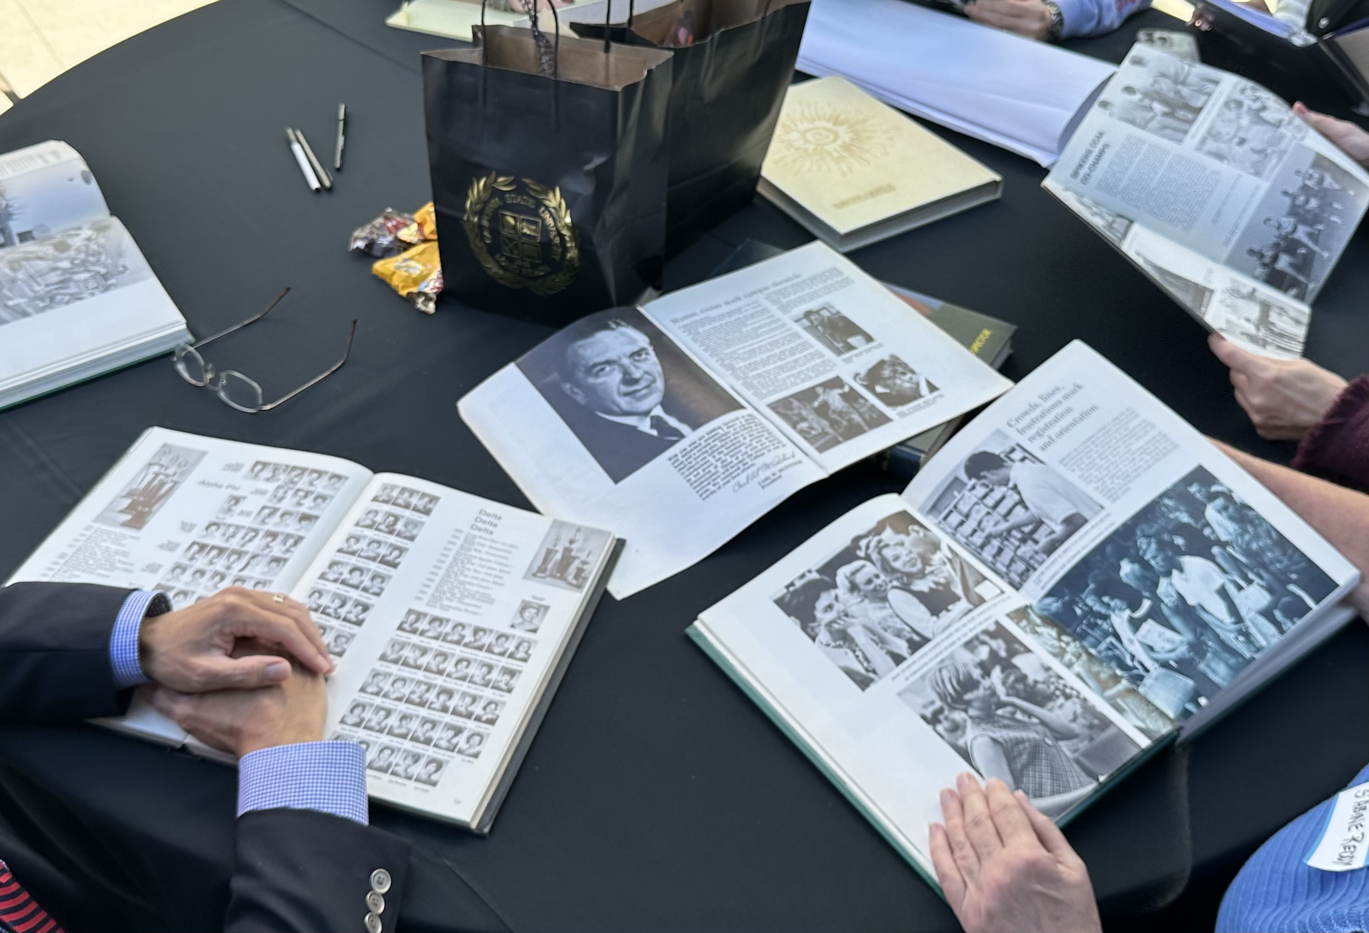
EBBS & FLOWS Campus Leadership: Academic Senate & Administrators
Four Staff representatives added to Academic Senate
Established Staff Council
General Education and Budget Concerns

Slide 11
EBBS & FLOWS Campus Leadership: Academic Senate & Administrators
Efforts made for faculty and administrative leadership to better reflect our student population
Downward trend in trust and cooperation with management

Slide 12
RISING TIDE Faculty Focus
1950s
One paragraph RTP submissions
Tenure automatic after three years, but demotion was a possibility
Emphasis on “good teaching” and “training teachers”
Academic freedom promoted
1970s
More faculty protections put into place
1960s
Academic freedom promoted, but needed to be fought for
Late 1960s, less academic freedom for faculty
1980s
Mandatory retirement at age 70

Slide 13
TSUNAMI Campus Culture & Growth
1950s
President McIntosh stressed necessity of realizing the ‘potentialities’ of the rapidly expanding institution
120 units required for degree in major
1951: Tuition & Fees = $14 for Full-time enrollment
1959: 10,000 students
Commencement speaker, Ralph Bunche (African American Nobel Prize Winner) spoke about “negotiating to end the Palestine War”
Balls, dances, and festivals a common campus occurrence
Campus support for veterans

Slide 14
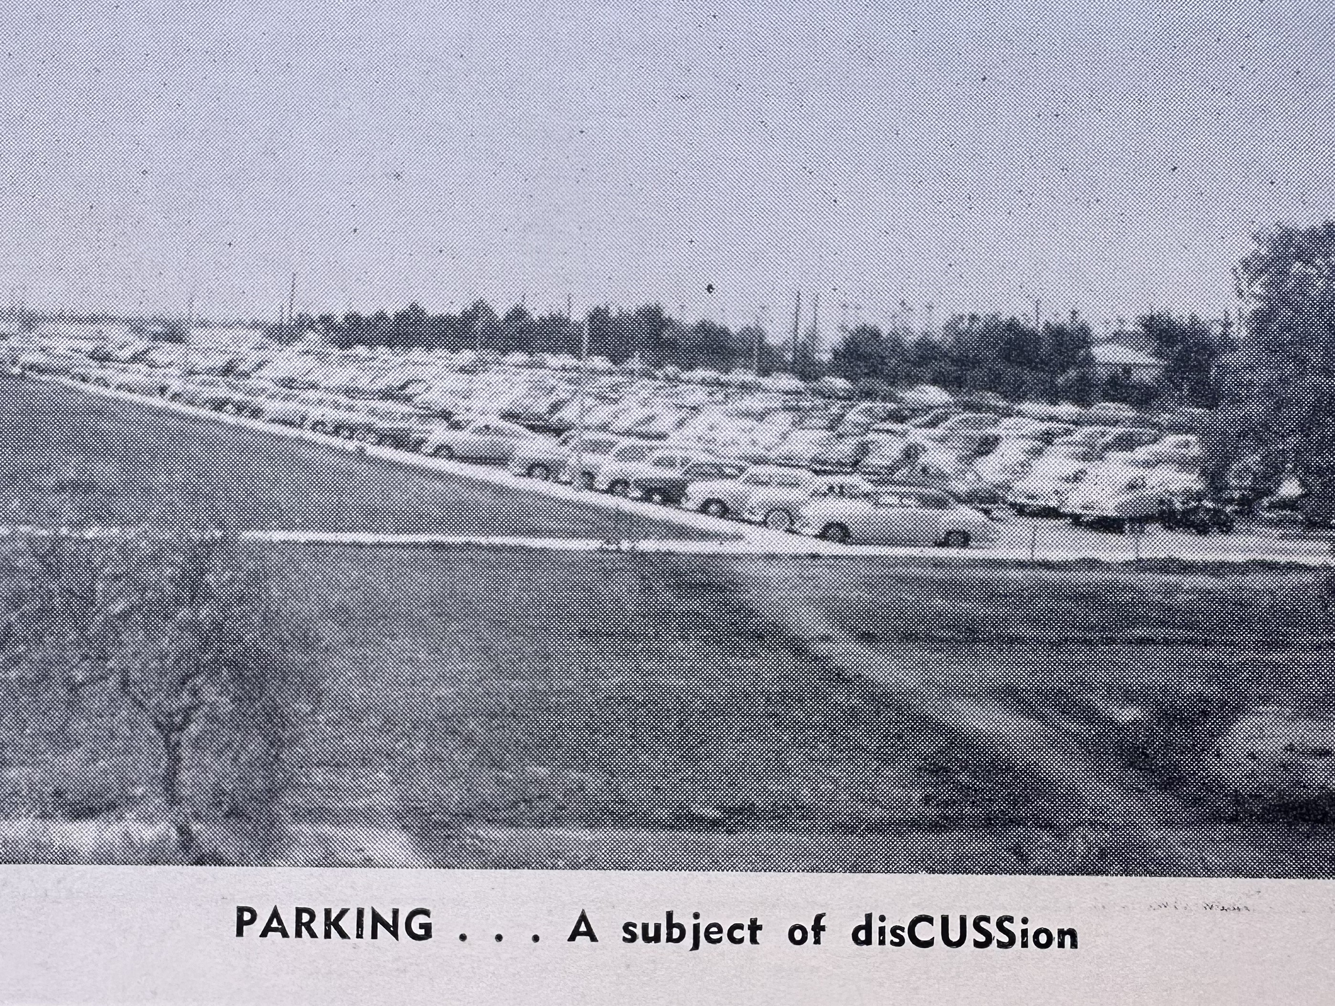
TSUNAMI Campus Culture & Growth
1960s
1968: 22,000 students (largest campus in California State College system)
Masters degrees emerged
Parking was a problem (Cost - $12 per semester)
Large campus events & celebrations continued
Recognition of Native American / Indian Culture
Leaders protested 49ers Days
Political forums & riots on campus (Vietnam, religion)
More students rights
Large focus on athletics & football program

Slide 15
TSUNAMI Campus Culture & Growth
1970s
Campus Construction slows
Beer, ping pong, and pinball became common campus activities
Protests against Prospector Pete mascot

Slide 16
SHARE THE WAVES Diversity
1950s
GENDER
Women celebrated, but more often about the “Female Form”
Gender stereotypes were prevalent --- STEM faculty were male; Education faculty were female
“Wives’ Club” formed for establishing friendships
Beauty pageants held on campus
Very little gender diversity on campus
Campus had an acting “Dean of Women” (Dean of Sororities)
RACE, ETHNICITY, & ORIGIN
Primarily White students on campus
Few BIPOC students on campus, but the 1955 Class President was Black
In 1958, one club promoted activities for international students

Slide 17
SHARE THE WAVES Diversity
1960s
GENDER
Still mostly male students
RACE, ETHNICITY, & ORIGIN
Still lacking diversity, but program in Black Studies was created
Chairperson of Black Studies, Dr. Karenga created African American Holiday (Kwanzaa in 1966)
Steps toward equity --- In 1967, special admissions procedure for minority populations (up to 75 students)
Students ask for more classes focusing on diversity

Slide 18
SHARE THE WAVES Diversity
1970s
GENDER
Push for Equal Rights for Women
RACE, ETHNICITY, & ORIGIN
Diversity data collected on students for first time
First adult learning and disability program on the West Coast established

Slide 19
SHARE THE WAVES Diversity
1980s & 1990s
Early 1980s
Diversity was already a focus, but not in the right way or places
More diversity in students, but less in faculty & staff
Late 1980s
Diversity flourishes
Lesbian/Gay Club established
Black Law Society, Lebanese Society, and multiple Affinity Groups established
1990s
Less focus on diversity

Slide 20
SHARE THE WAVES Diversity
2000s
Recognition that diversity is global
Exponential Latino/Hispanic population growth

