Slide 1
Legacy Lecture:
My Path in Research and Teaching
Jeff Cohlberg
Chemistry and Biochemistry
April 13, 2023

Slide 2
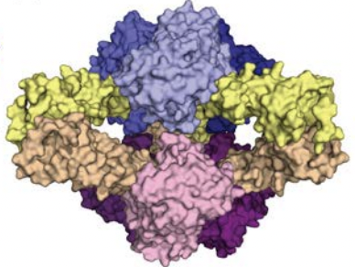
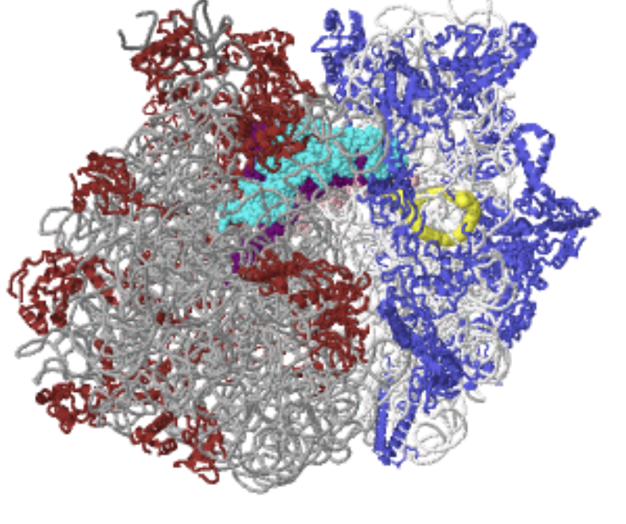
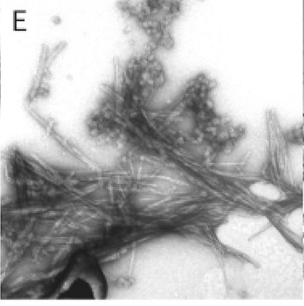
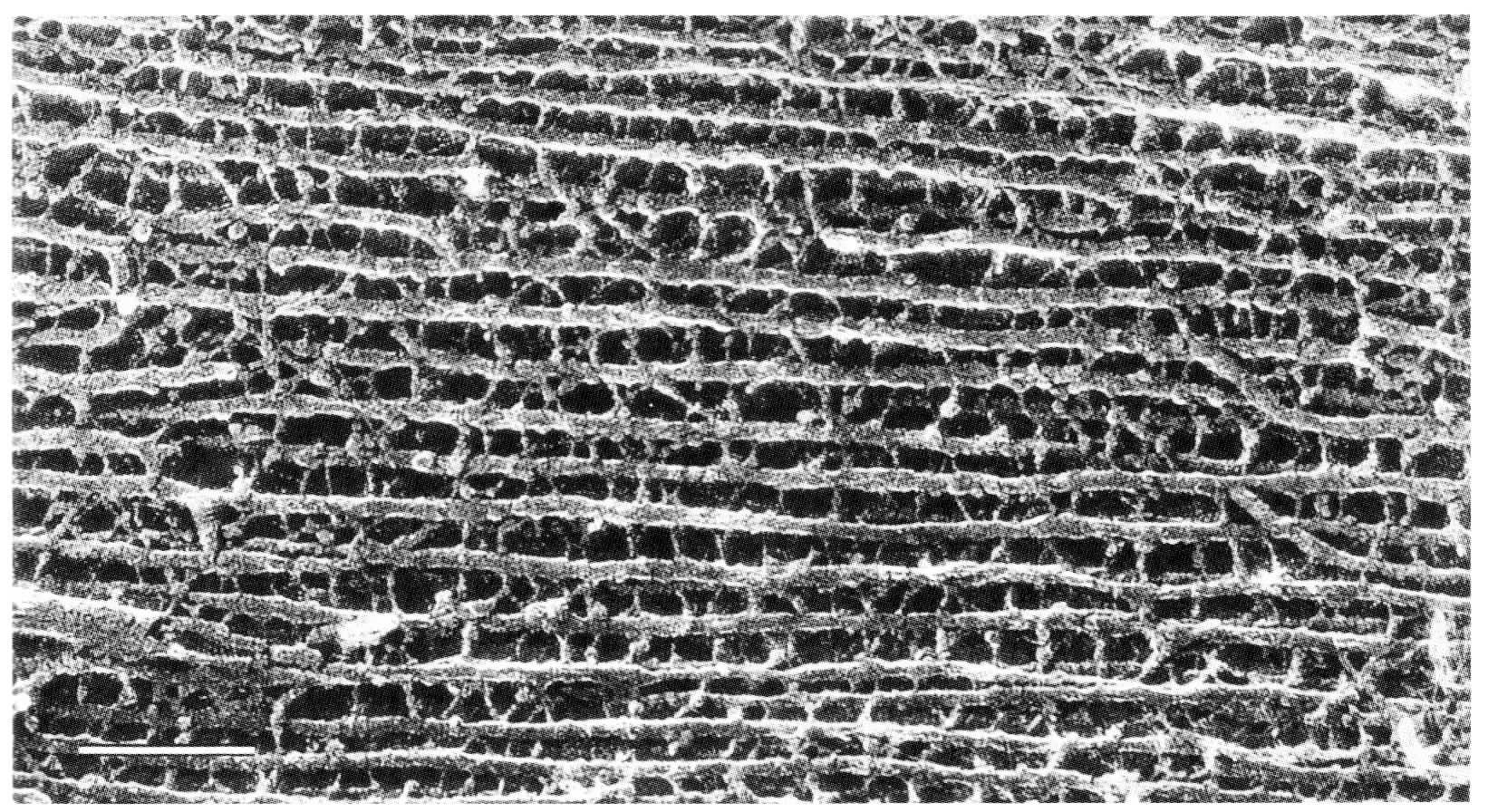
Bacterial ribosome
Aspartate transcarbamoylase
Region of an axon rich in neurofilaments
Amyloid fibrils from superoxide dismutase

Slide 3
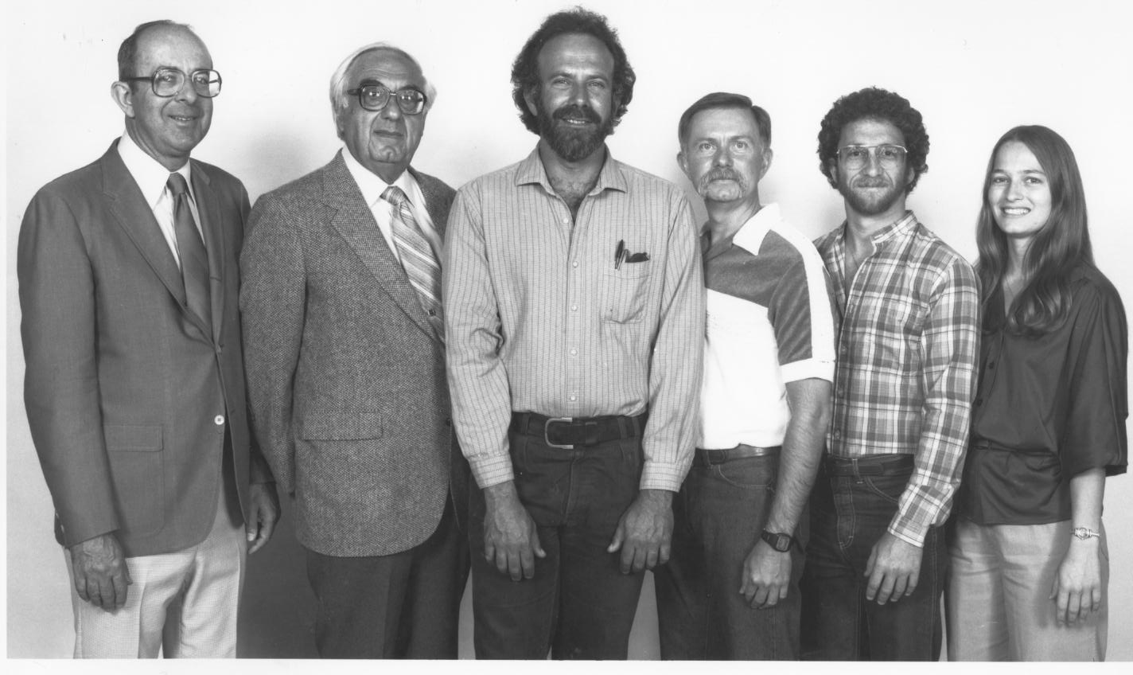
Biochemists, around 1979

Slide 4
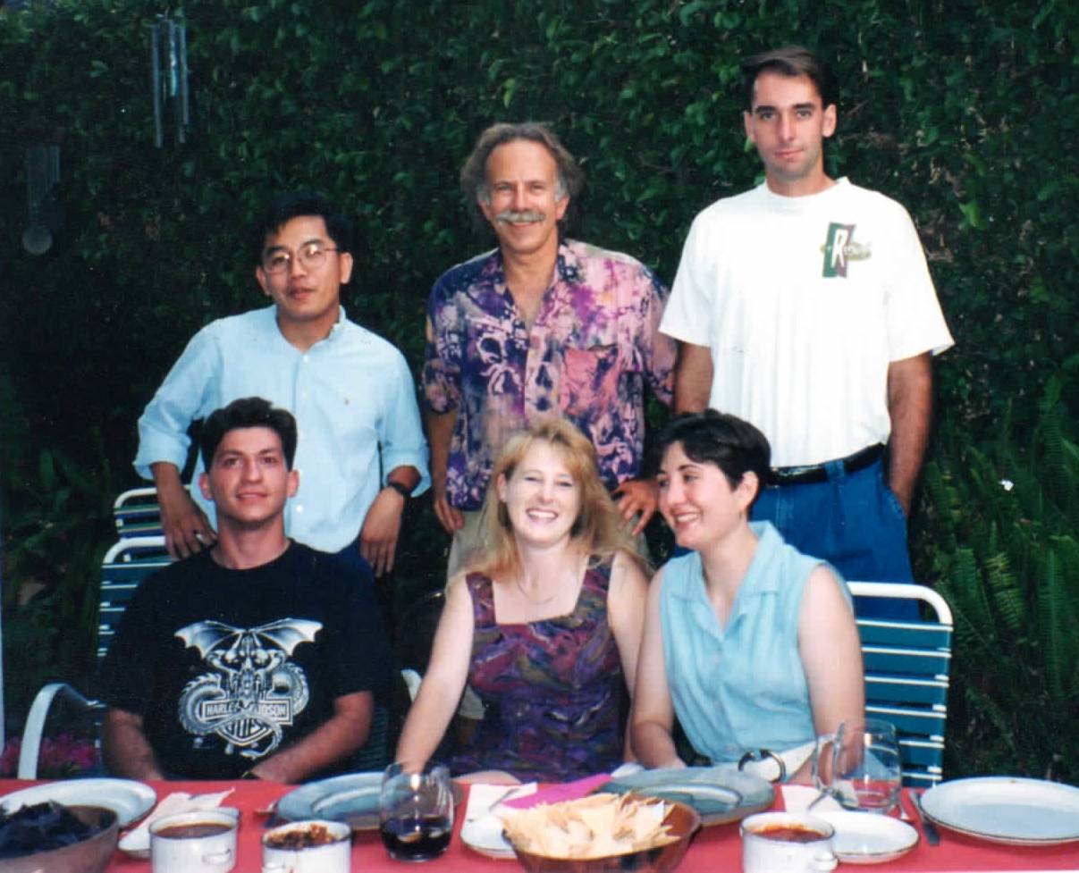
Lab group mid-1990’s

Slide 5
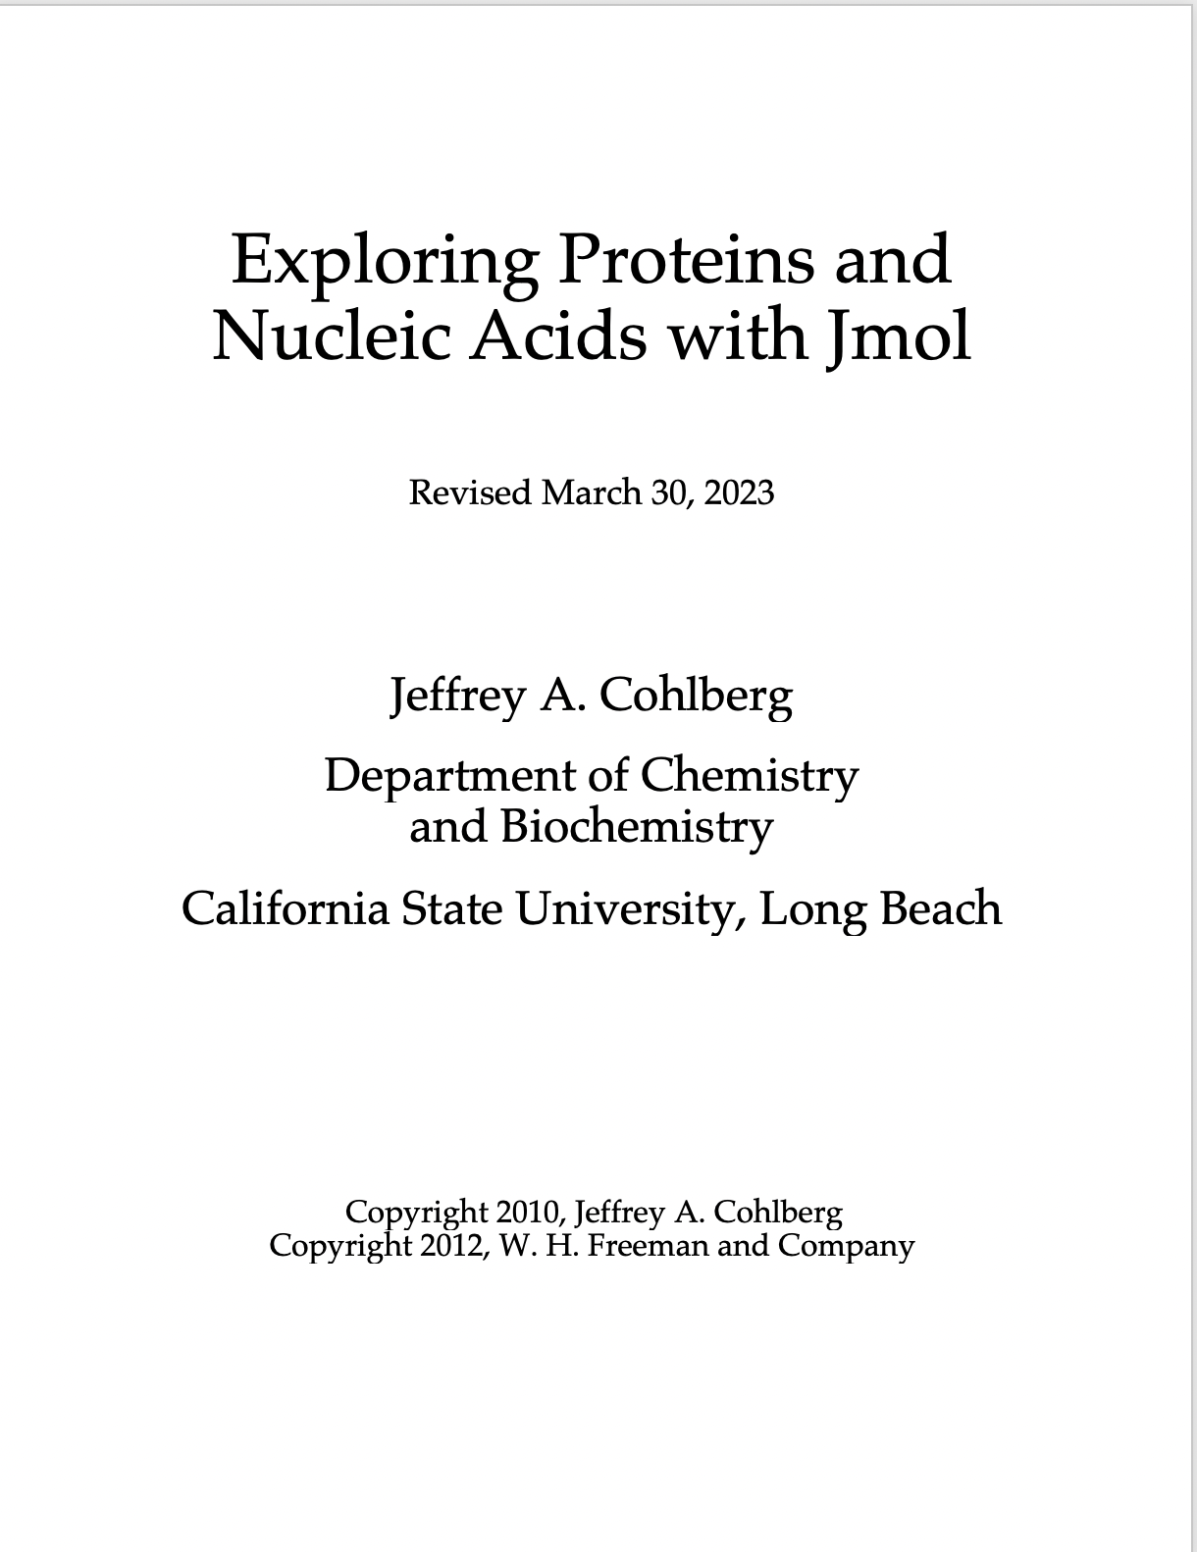
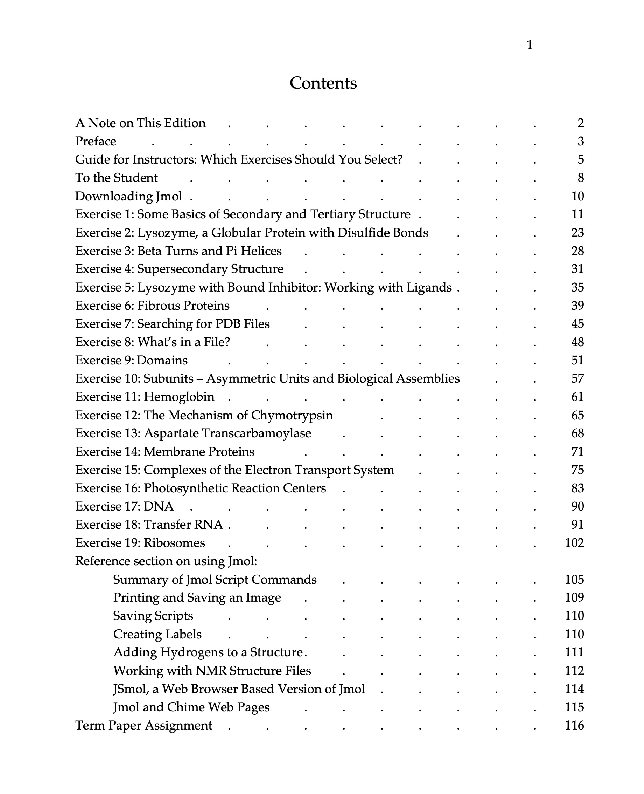

Slide 6
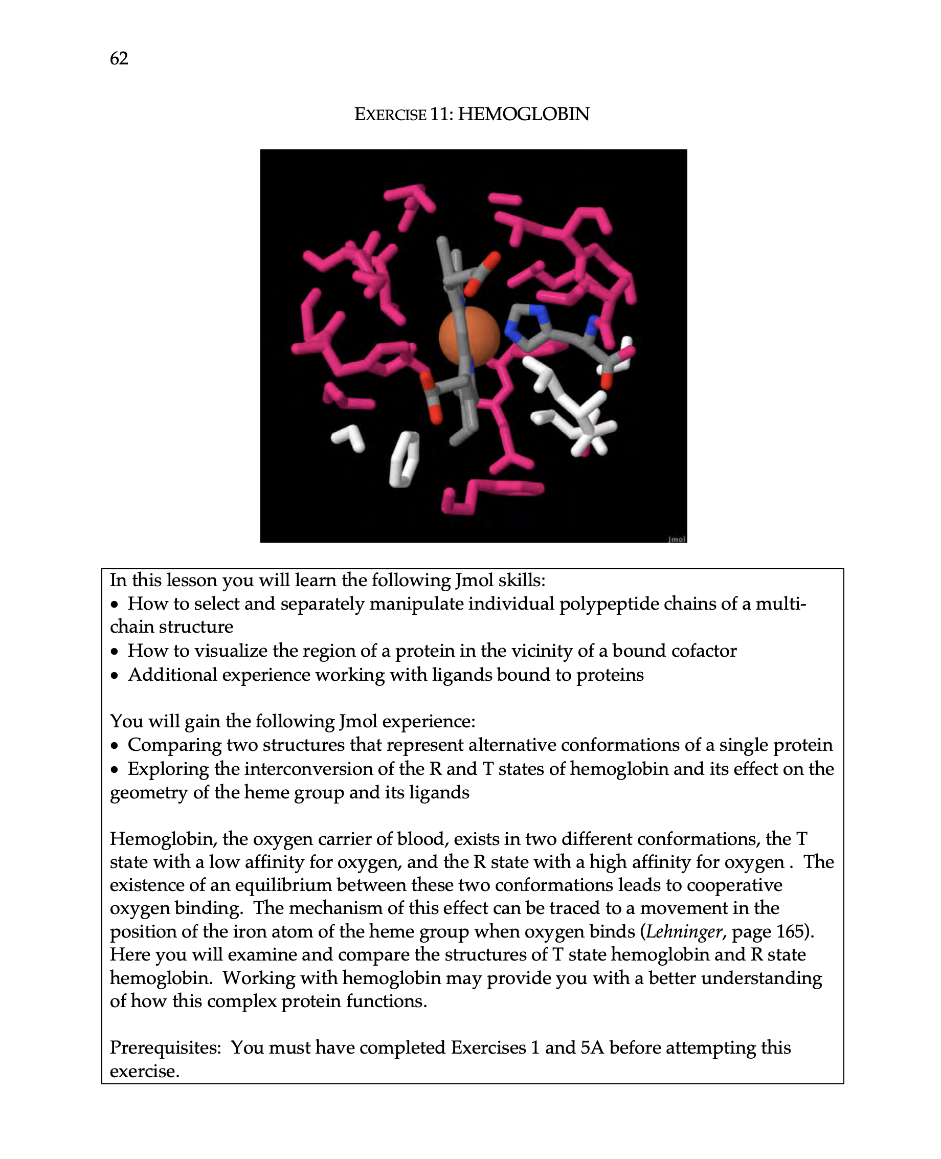
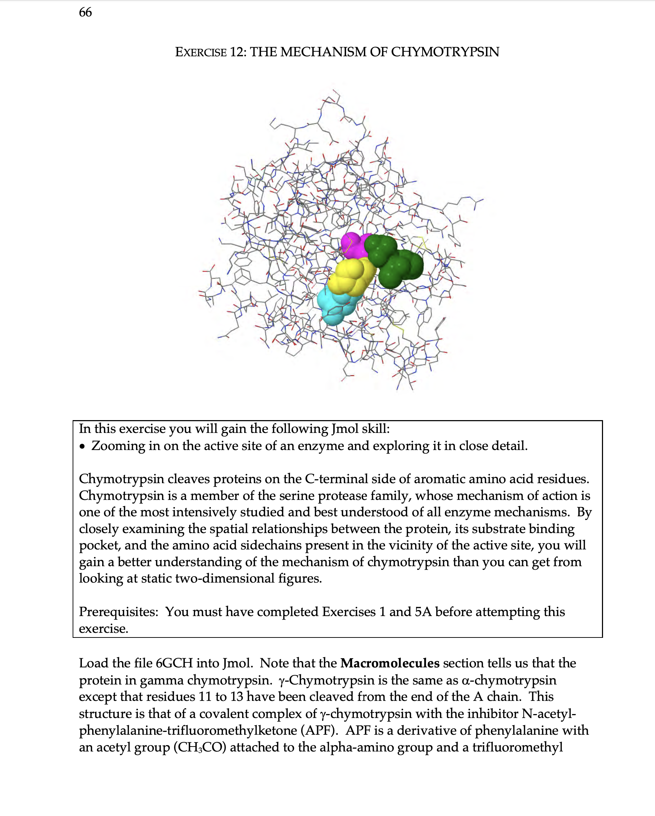

Slide 7
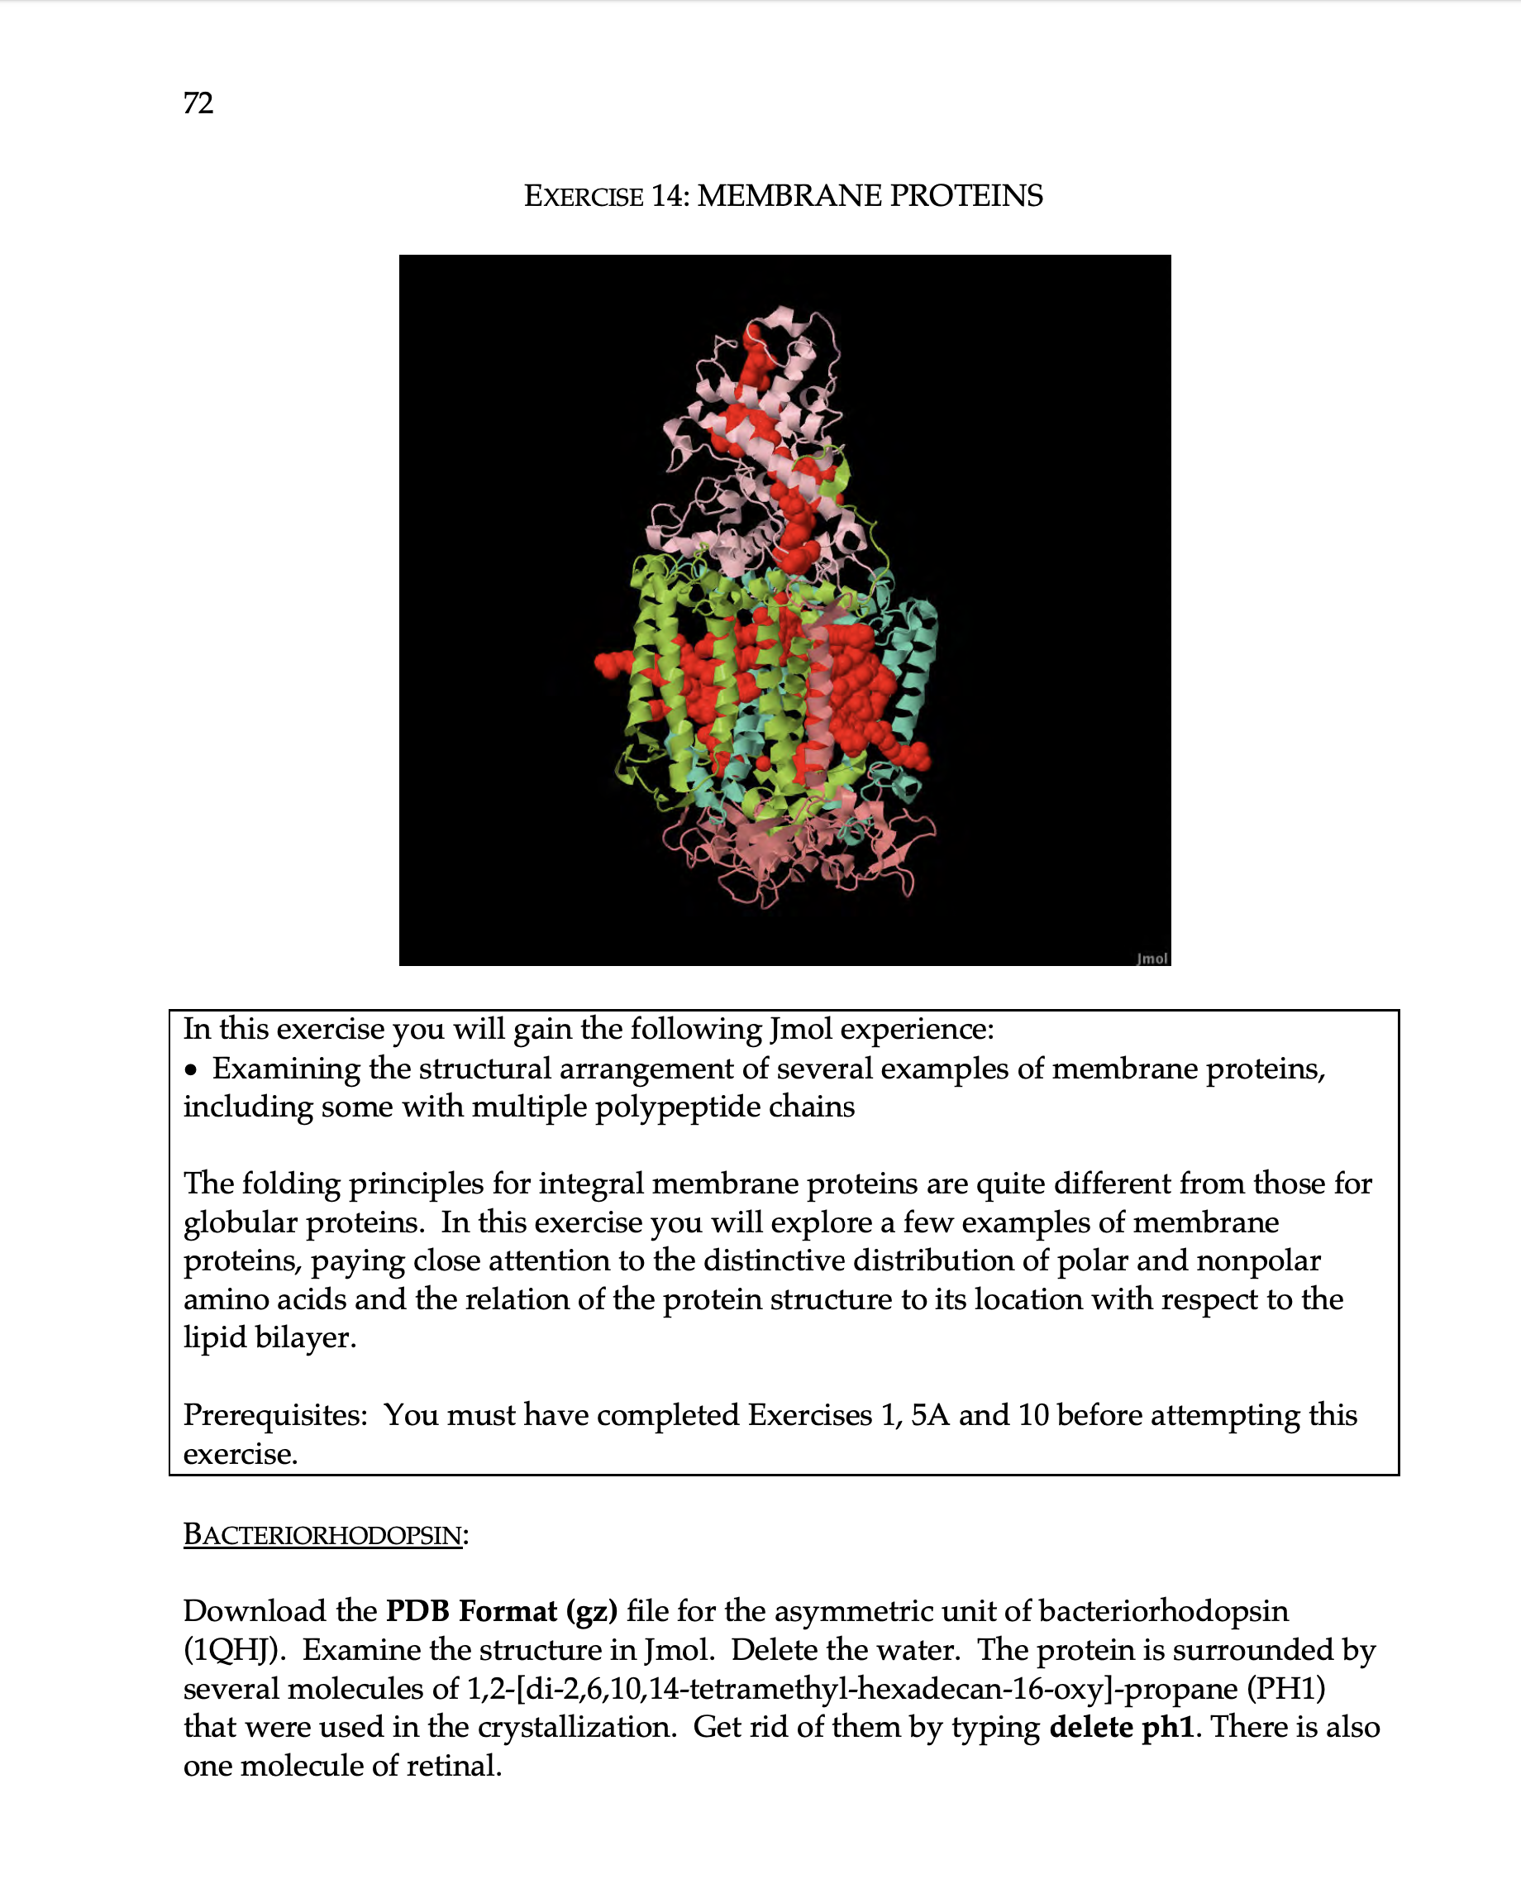
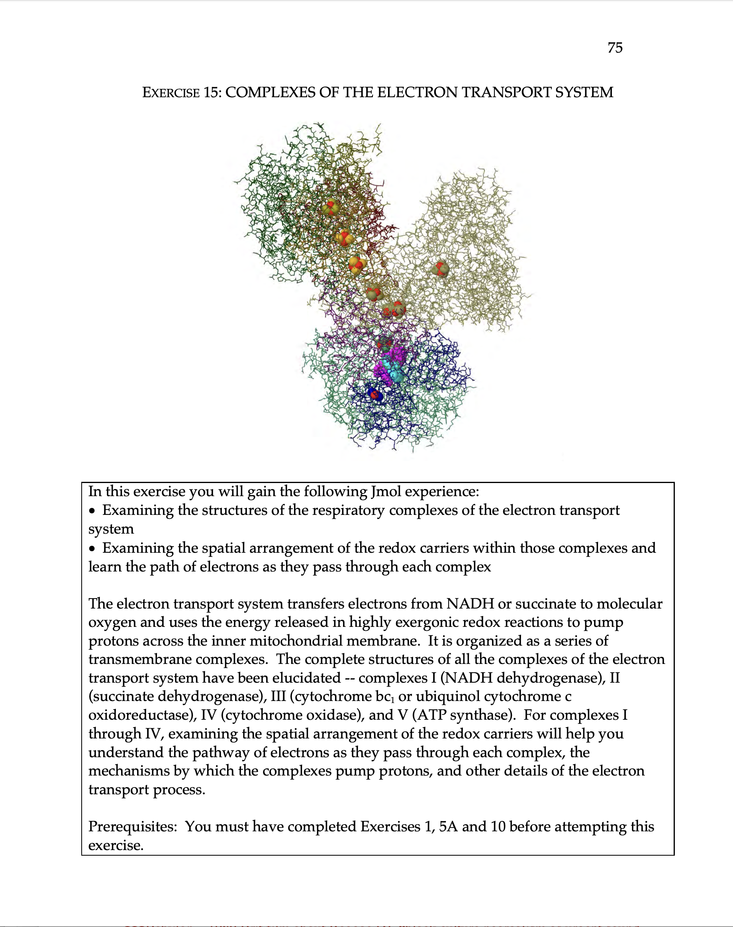

Slide 8
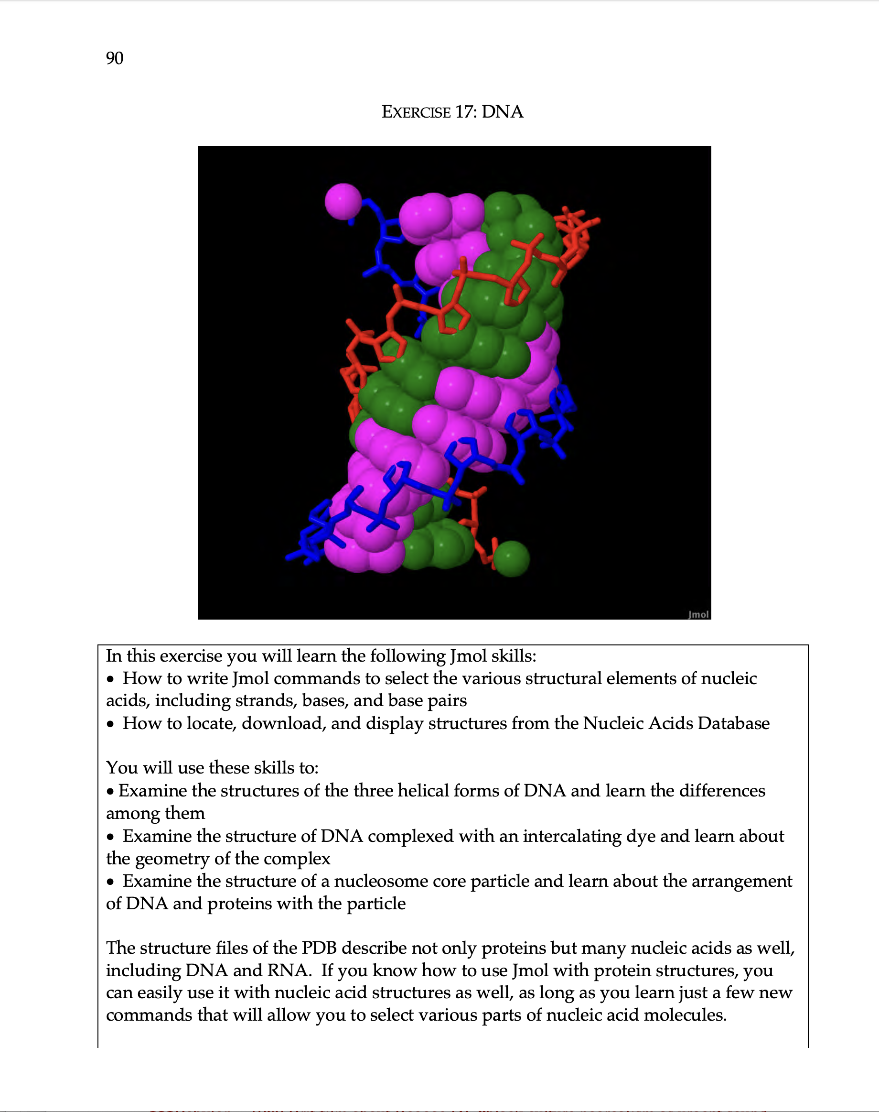
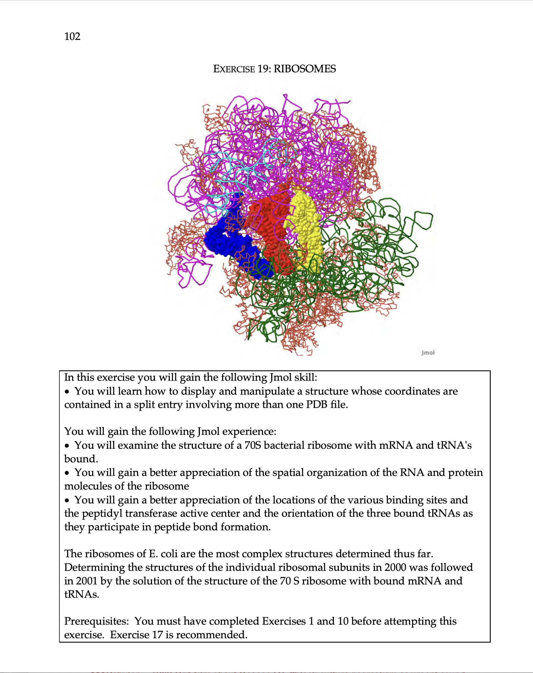

Slide 9
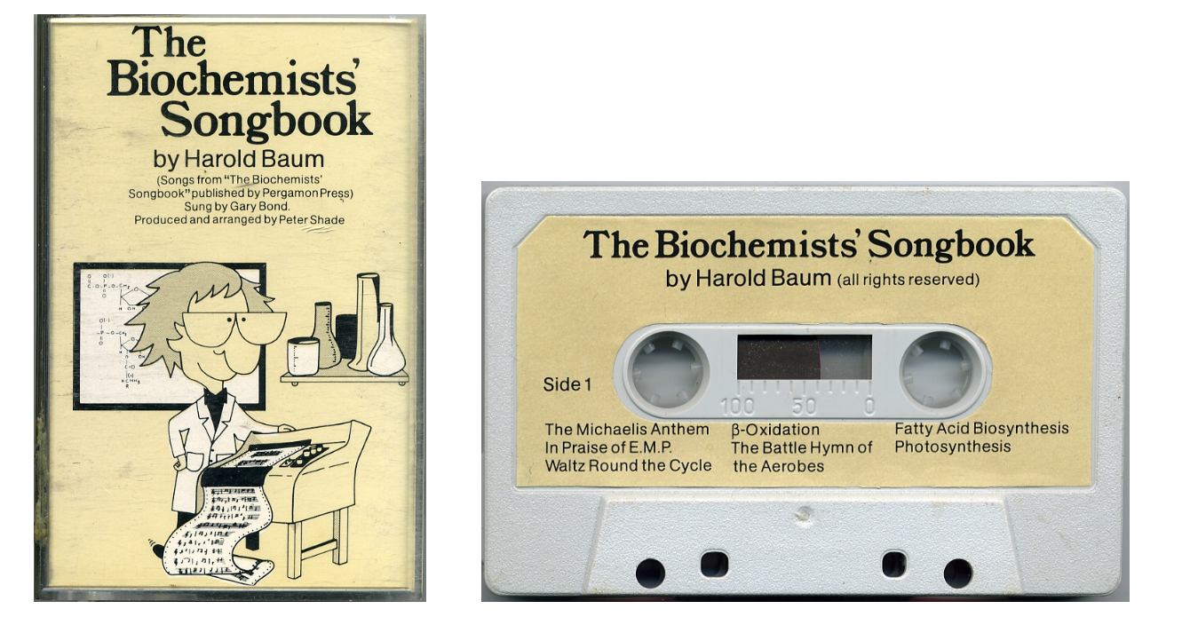

Slide 10
Ketone Bodies is the Game to Play
(Tune: "A Policeman's Lot is Not a Happy One")
When your exercising's gotten rather furious (rather furious)
And glucose is depleted from your blood (from your blood)
Then with sugar stores you'd best not be penurious (be penurious)
Or soon you'll be collapsing with a thud. (with a thud)
But when your liver glycogen's dissolving ('gen's dissolving)
And the energy demand seems there to stay, (there to stay)
Then I think it's time you'd better be resolving (be resolving)
That Ketone Bodies is the game to play. OH!
When oxaloacetate has gone away, gone away,
Then Ketone Bodies is the game to play, game to play.
When gluconeogenesis is speeded, ('sis is speeded)
PEP carboxykinase activated, (activated)
Then oxaloacetate becomes depleted, ('comes depleted)
Citrate synthetase velocity deflated. ('ty deflated)
If you go through pyruvate to acetyl CoA, (acetyl CoA)
Pyruvate carboxylase can save the day. (save the day)
But when burning fatty acids there is no way (there is no way)
And Ketone Bodies is the game to play. OH!
When oxaloacetate has gone away, gone away,
Then Ketone Bodies is the game to play, game to play.

Slide 11
If you bring two acetyl CoA's together, ('A's together)
Acetoacetyl CoA is what you get. (what you get)
A third acetyl CoA we now can tether, (now can tether)
And you'll get HMG CoA, I bet. ('A, I bet)
Then HMG CoA is split asunder (split asunder)
To acetoacetate and acetyl CoA. ('tyl CoA)
Now, think a minute, is it any wonder (any wonder)
That Ketone Bodies is the game to play? OH!
When oxaloacetate has gone away, gone away,
Then Ketone Bodies is the game to play, game to play.
Acetoacetate you may be reducing (be reducing)
With NADH from β-oxidation, (oxidation)
And hydroxybutyrate you'll be producing, (be producing)
Destined for the blood by membrane translocation. (translocation)
Now sometimes a CO₂ you will be losing (will be losing)
And acetone is made, but don't dismay, (don't dismay)
For the other ketone bodies you'll be using, (you'll be using)
And Ketone Bodies is the game to play. OH!
When oxaloacetate has gone away, gone away,
Then Ketone Bodies is the game to play, game to play.

Slide 12
Now the bloodstream flows just like a mighty torrent. (mighty torrent)
Ketone bodies go to muscle and to brain. (and to brain)
And wasted ketone bodies certainly aren't. (certainly aren't)
For liver's loss is other tissues gain. (tissues gain)
For the brain, while thinking glucose so nutritious, (so nutritious)
Won't take fatty acids up, it's sad to say, (sad to say)
But it finds ketone bodies quite delicious, (quite delicious)
So Ketone Bodies is the game to play. OH!
When oxaloacetate has gone away, gone away,
Then Ketone Bodies is the game to play, game to play.
Hydroxybutyrate combines with NAD, now, (NAD, now)
Forms acetoacetate; it does not fester. (does not fester)
Then a succinyl CoA, I hope you'll see, now, (hope you'll see, now)
Gives energy for AcAc CoA ester. (CoA ester)
Thiolase two acetyl CoA's now produces, (now produces)
And ATP will soon be on its way. (on its way)
Well, I hope it's clear by now just what their use is. (what their use is)
Yes, Ketone Bodies is the game to play. OH!
When oxaloacetate has gone away, gone away,
Then Ketone Bodies is the game to play, game to play.

