Slide 1
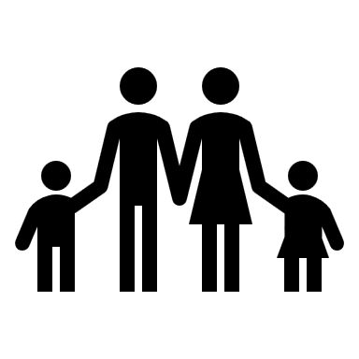
Prevalence of Trauma
Intimate Partner Violence
Childhood Trauma
Sexual Assault
Stalking
61% of adults > Adverse Childhood Experience (CDC, 2016)
1 in 3 women, 1 in 4 men (CDC, 2010)
1 in 4 women, 1 in 7 men (CDC, 2010)
1 in 3 women, 1 in 6 men (CDC, 2010)
CSULB = 38,273 students
23,346
3,923 men
7,527 women
2,241 men
5,645 women
2,614 men
7,527 women

Slide 2
Disclosure to Friends & Family
Nearly half of all women & a quarter of all men will experience sexual assault, physical violence, or stalking in their lifetime

Slide 3
Disclosure to Friends & Family
Nearly half of all women & a quarter of all men will experience sexual assault, physical violence, or stalking in their lifetime

Slide 4
Disclosure to Friends & Family
Nearly half of all women & a quarter of all men will experience sexual assault, physical violence, or stalking in their lifetime
Each survivor of sexual & relationship trauma tells an average of 3 people, primarily friends and family

Slide 5
Social Reactions
Helpful social reactions
Emotional support
Tangible aid
Unhelpful social reactions
Blame and doubt
Control
Distraction
Minimization
Treat Differently

Slide 6
Impact of Social Reactions
Negative Social Reactions
Positive Social Reactions
More important to avoid negative reactions

Slide 7
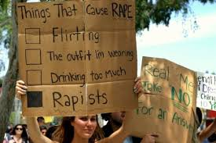
Victim Blame
Victim Blame
Society tends to focus on the victim rather than the perpetrator
There is nothing about someone’s vulnerability that causes other people to hurt them

Slide 8
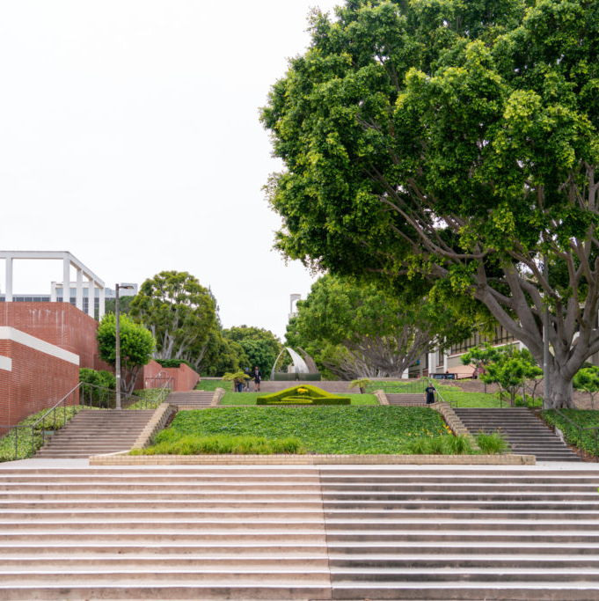
Imagine…

Slide 9
Right to Say No at Any Time for Any Reason

Slide 10
Activity
Pair up with another participant
One person reads the line of the survivor
The other person reads the line of the support provider
How did it feel as a survivor hearing this?
How did if feel as a support provider saying this?
What else can you do to support survivors?

