Slide 1
CSULB ACADEMIC SENATE
2022-23
New Senator Orientation
Pei-Fang Hung, Ph.D., CCC-SLP
Academic Senator Chair (AY 22-23)
August 25, 2022

Slide 2
Land Acknowledgment
CSULB is located on the sacred site of Puvungna. We
acknowledge that we are on the land of the Tongva
Gabrieleño and the Acjachemen/Juaneño Nations who
have lived and continue to live here. We recognize
the Tongva and Acjachemen Nations and their spiritual
connection as the first stewards and the traditional
caretakers of this land. We thank them for their
strength, perseverance, and resistance. We pay our
respects to the Ancestors, Elders, and our relatives, past,
present and emerging.

Slide 3
New Senator Orientation Agenda
Welcome and Introductions
Senate Structure and Roster
Typical Agenda and Flow of Meeting
Parliamentary Procedure
Your Responsibilities as a Senator
Preview: Policies Coming your Way

Slide 4
Welcome and Introductions
Senate Executive Committee
  Pei-Fang Hung, CHHS, Chair
  Norbert Schürer, CLA, Vice Chair
  Ryan Fischer, CHHS, Secretary
  Mehrdad Aliasgari, COE, at-large
  Alan Colburn, CNSM, at-large
  Nancy Meyer-Adams, CHHS, at-large
  Aparna Nayak, CLA, at-large

Slide 5
Introductions: New & Returning Senators
Tell us your name, unit, and department
Tell us what brought you to the Senate

Slide 6
Senate Structure & Roster
61 Faculty, including Librarians and Counseling and Psychological Services (CAPS) Psychologists
5 Staff Members: Including the Chair of Staff Council
5 Students: Elected by Associated Students, Inc. (ASI), plus the ASI president
1 Emeritus Faculty
2 Voting Deans
5 Voting Administrators: Provost, AVPs
Nonvoting Members: Deans and Administrators, and 3 Statewide Senators

Slide 7
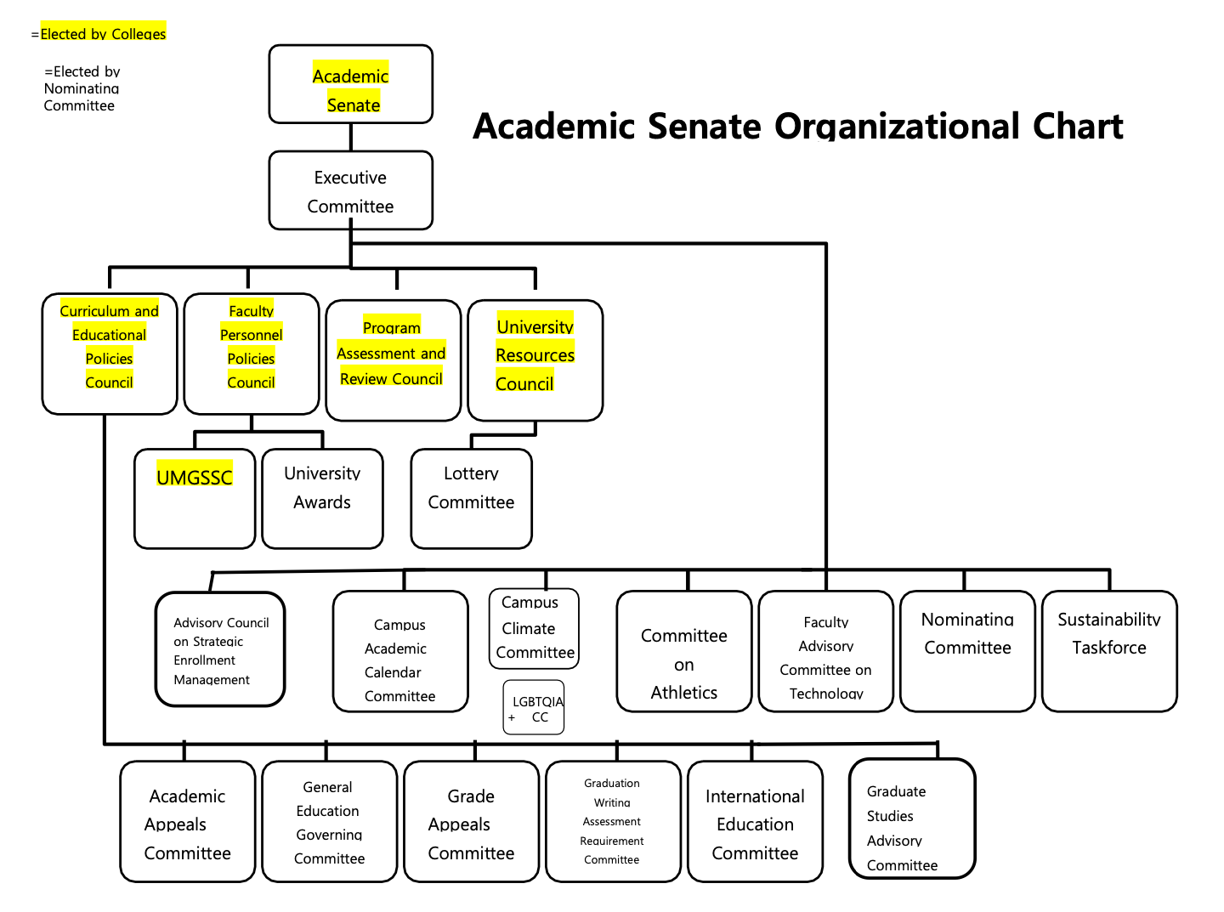

Slide 8
How it Works--- Scenario #1
Creating a New Academic Program
New Program Proposals
  Must be approved by Departments, Colleges, and the Vice Provost of Academic Programs
Forward to the AS Councils for Review
  Review by the Curriculum and Educational Policies Council (CEPC)
  Review by the University Resources Council (URC)
Forward to the Academic Senate for Review and Approval
  The proposed program must be reviewed and approved by the entire senate.
Notes:
Pei-Fang

Slide 9
How it Works--- Scenario #2
Making Changes to a Policy
Request to Open a Policy (by administrators, faculty, staff)
  The request will be reviewed by Academic Senate Executive Committee
Forward the Request to the Senate Councils for Review
  For example, Faculty Personnel Policies Council (FPPC) reviews and makes recommendation on policies related to academic personnel matters
Forward to the Academic Senate for Review and Approval
  All amended policies and regulations must be reviewed and approved by the entire senate.
Notes:
Pei-Fang

Slide 10
The role of the executive committee
Works as a consultative body
Helps the flow of information and presentation of policy issues
  By discussing issues as they come up before they are referred to the Academic Senate
Serves as the agenda-making body of the Academic Senate
Organizes annual retreat and spring lectures
Organizes officer elections

Slide 11
Where to find Meeting Materials
Ann keeps the Academic Senate (AS) Agenda updated on the AS Website
As dictated by the AS Rules and Regulations, we need to circulate the agenda at least five days before the meeting.
  We do our best to circulate it one week in advance.

Slide 12
AS Parliamentary Procedure
We follow Robert’s Rules of Order, Newly Revised, as stipulated by AS Rules and Regulations.
a. Motions: need a second and a majority vote
  We start our meetings by moving the agenda and approving the agenda.
  After this, we move and approve the minutes from our last meeting.
b. Amendments: need a second and a majority vote
This is important when we are revising policy, but we will also amend the agenda and minutes at as needed.

Slide 13
More Parliamentary procedure!
These can be helpful when things get complicated:
c. Point of Order: You can say this at any time if you want to understand if procedure is being followed appropriately.
d. Point of Clarification: Ensure the understanding of what the speaker has said is correct, reducing misunderstanding
e. Call the Question: Vote on the motion; if no objection, we just proceed to vote; if there is objection needs 2/3 majority

Slide 14
ENOUGH WITH THE PARLIAMENTARY PROCEDURE!
It will most likely seem overly formal and and a little overwhelming at first, but all of us are still learning.
  We have a parliamentarian to help us when needed.
Don’t worry about being confused
  Feel free to ask us questions before or after the meeting.

Slide 15
Your Responsibilities as a Senator
Read the agenda
Read minutes, supporting documents, and policies
Work with your other college/unit senators
  Inform your unit’s members about items of interest beforehand and bring their comments to the senate
    Example: Faculty Council Chair (if you’re a faculty member)
  This is why we have first and second readings!
Make amendments to online policy drafts before the meetings
Listen, debate, and contribute ideas collegially
Report back on policies passed, etc. after meetings

Slide 16
Preview of coming attractions
Consent Calendar
  Nothing at this point. Stay tuned!
Special Orders
  Reports from CSULB President, CFA Co-President, ASCSU Senators
Curriculum
  Proposal for a Bachelor of Science in Dance Science
Policies
  Proposed revision of PS 10-12, Policy on Program Review
  Proposed revision of PARC charge

Slide 17



Follow us:
http://www.csulb.edu/academic-senate
CSULB Academic Senate
csulb_academicsenate
@CSULB_senate

Slide 18

QUESTIONS?
Pei-Fang:
Pei-Fang.Hung@csulb.edu
Norbert:
Norbert.Schurer@csulb.edu
Ann:
Ann.Kinsey@csulb.edu

