Slide 1
EE 444
Wireless Transceiver
nRF24L01+
Roy Benmoshe

Slide 2
Overview
The goal of this presentation is to educate you on the NRF24l01+ transceiver. I will walk you through the steps that I went through in order to determine whether or not it is possible to accurately calculate the position of the robot in the maze.
You will learn about
Types of distance measuring sensors
The different types of transceivers I used
The pros and cons
How I tested the transceivers
Where I failed and succeeded
Other applications that it can be used for

Slide 3
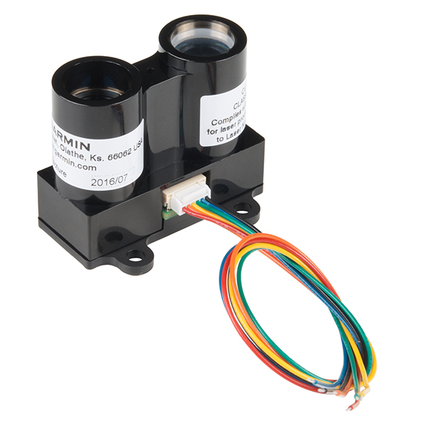
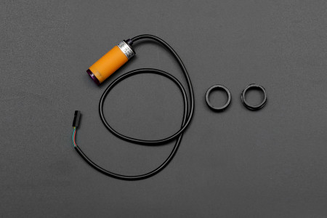
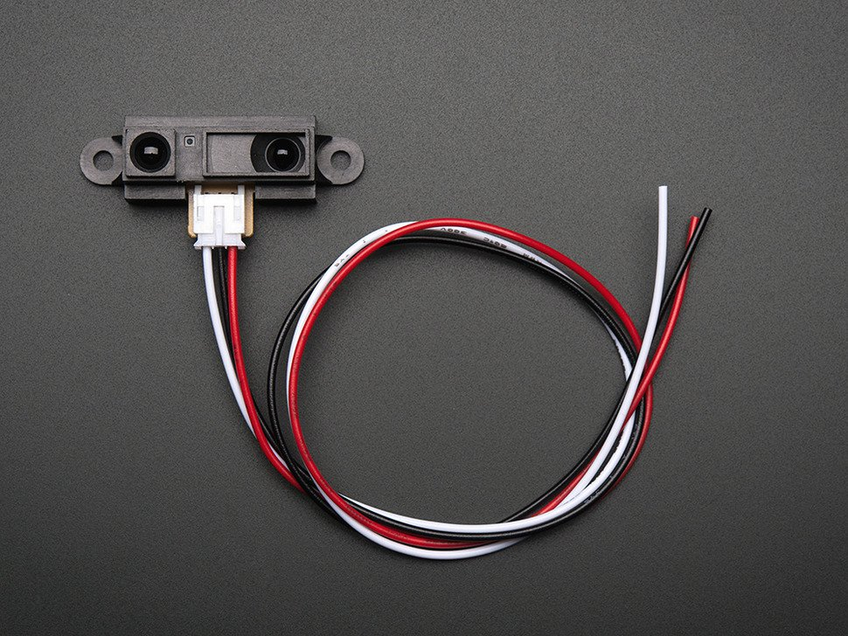
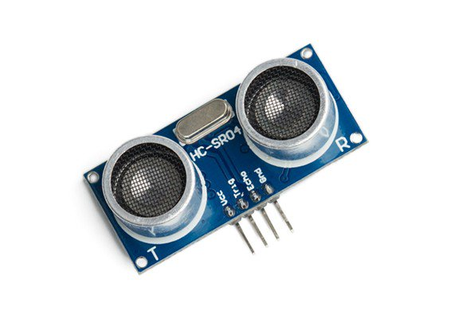
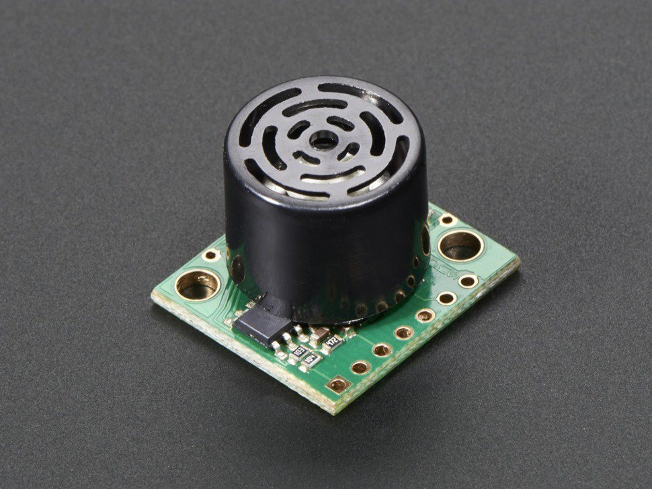
Distance Sensors
LIDAR
IR distance sensor
LIDAR, which stands for Light Detection and Ranging, is a remote sensing method that uses light in the form of a pulsed laser to measure ranges (variable distances)
A proximity sensor often emits an electromagnetic field or a beam of electromagnetic radiation (infrared, for instance), and looks for changes in the field or return signal. The object being sensed is often referred to as the proximity sensor's target.
Ultrasonic Distance Sensor
The Ultrasonic Sensor sends out a high-frequency sound pulse and then times how long it takes for the echo of the sound to reflect back. The sensor has 2 openings on its front. One opening transmits ultrasonic waves, (like a tiny speaker), the other receives them, (like a tiny microphone).
https://en.wikipedia.org/wiki/Proximity_sensor
Sparkfun - LIDAR-LITE V3
https://oceanservice.noaa.gov/facts/lidar.html
http://arduino-info.wikispaces.com/Ultrasonic+Distance+Sensor

Slide 4
Wireless Transceiver
A transceiver is a device that contains a transmitter and a receiver which are both combined and share common circuitry. Transceivers combine a significant amount of the transmitter and receiver handling circuitry.
The term applies to wireless communications devices such as cellular telephones, cordless telephone sets, handheld two-way radios, and mobile two-way radios.
http://www.futureelectronics.com/en/wireless-rf-radio-frequency/transceiver-ics.aspx
http://searchnetworking.techtarget.com/definition/transceiver

Slide 5
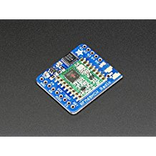
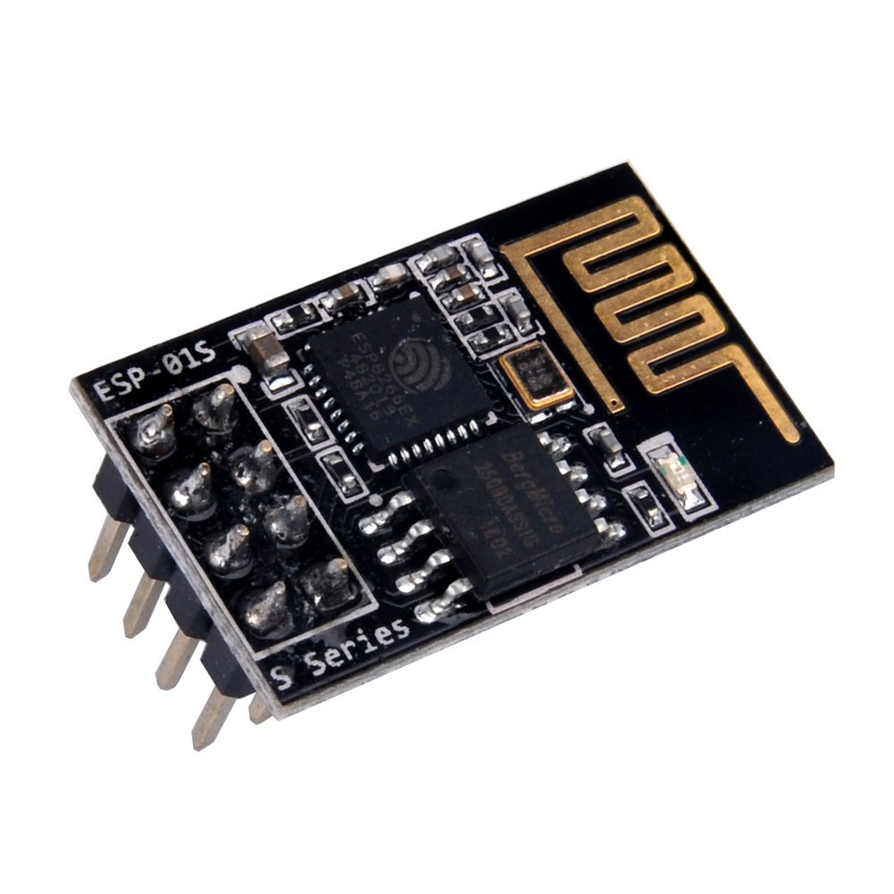
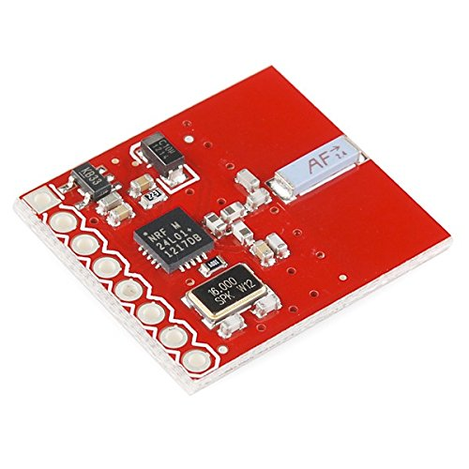
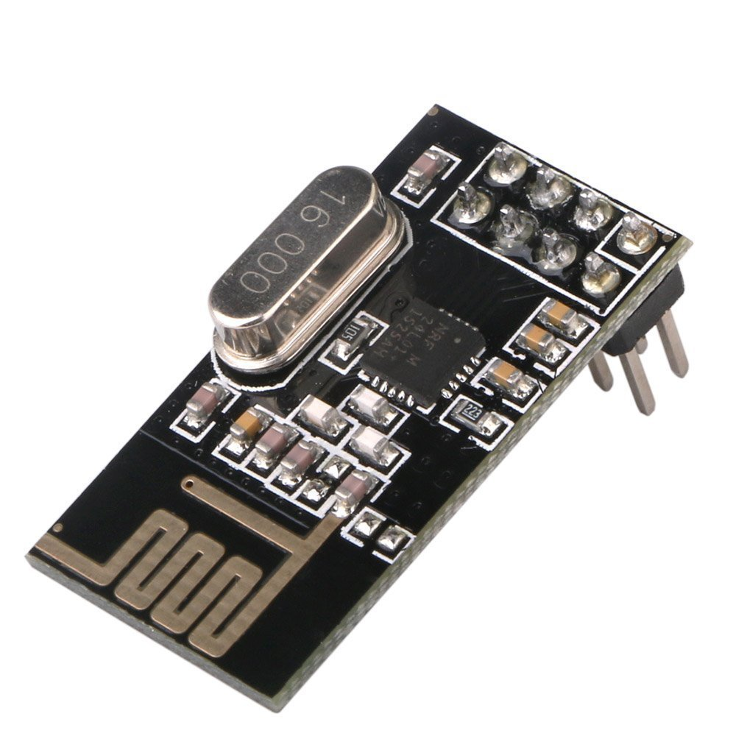
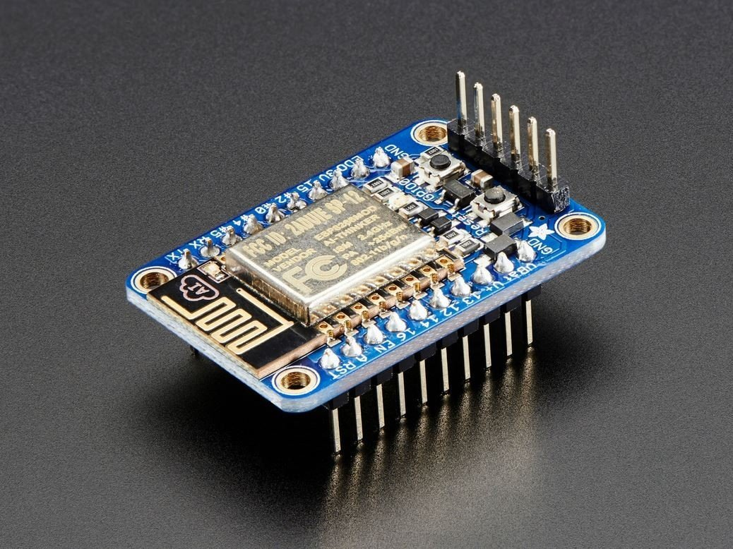
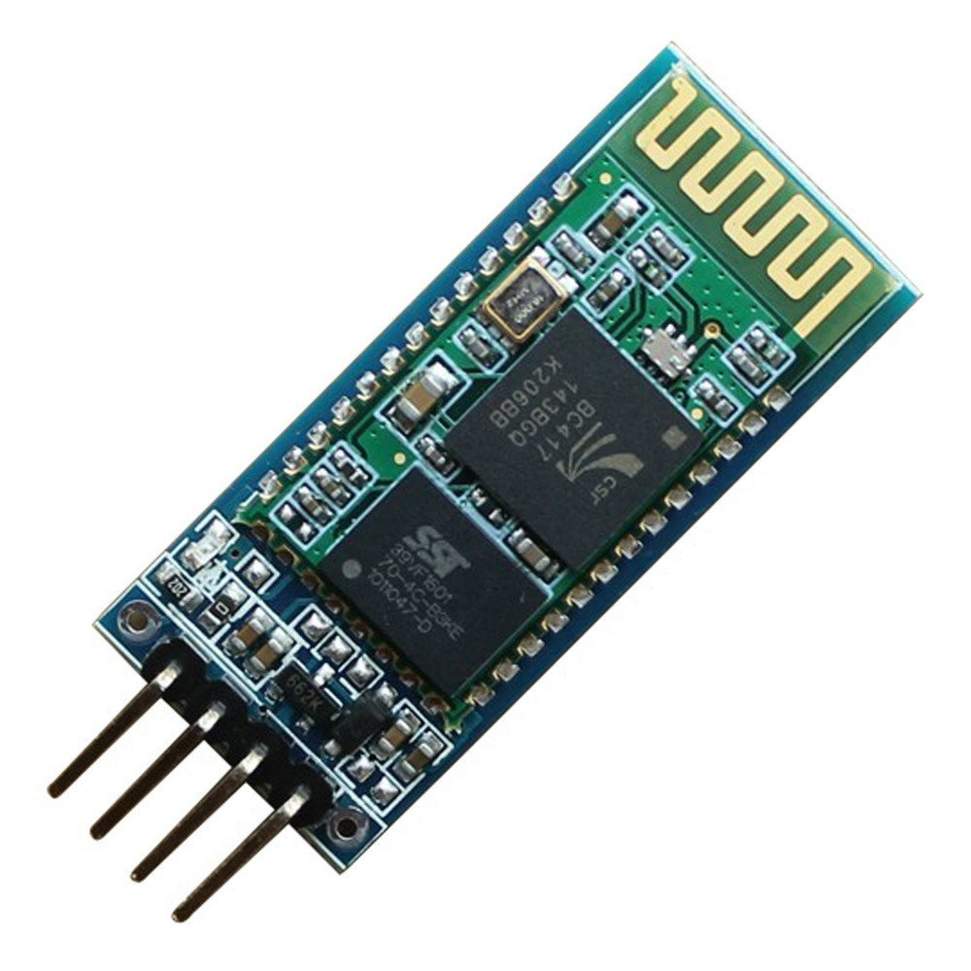
Based on sx1231 transceiver
Based on nrf24lo1+ transceiver
Based on ESP8266 WiFi chip
Adafruit (PID 3071) RFM69HCW Transceiver Radio Breakout - 433 MHz
SparkFun Transceiver Breakout - nRF24L01+
ESP8266 ESP-01S WiFi Serial Transceiver Module
433Mhz Rf Transmitter and Receiver Module Link Kit
Wireless Module NRF24L01+PA+LNA
ESP8266 microcontroller NodeMCU Lua V3 WIFI with CH340G
HUZZAH ESP8266 Breakout
HC-06 Bluetooth
NRF24L01+ 2.4GHz Antenna Wireless Transceiver

Slide 6
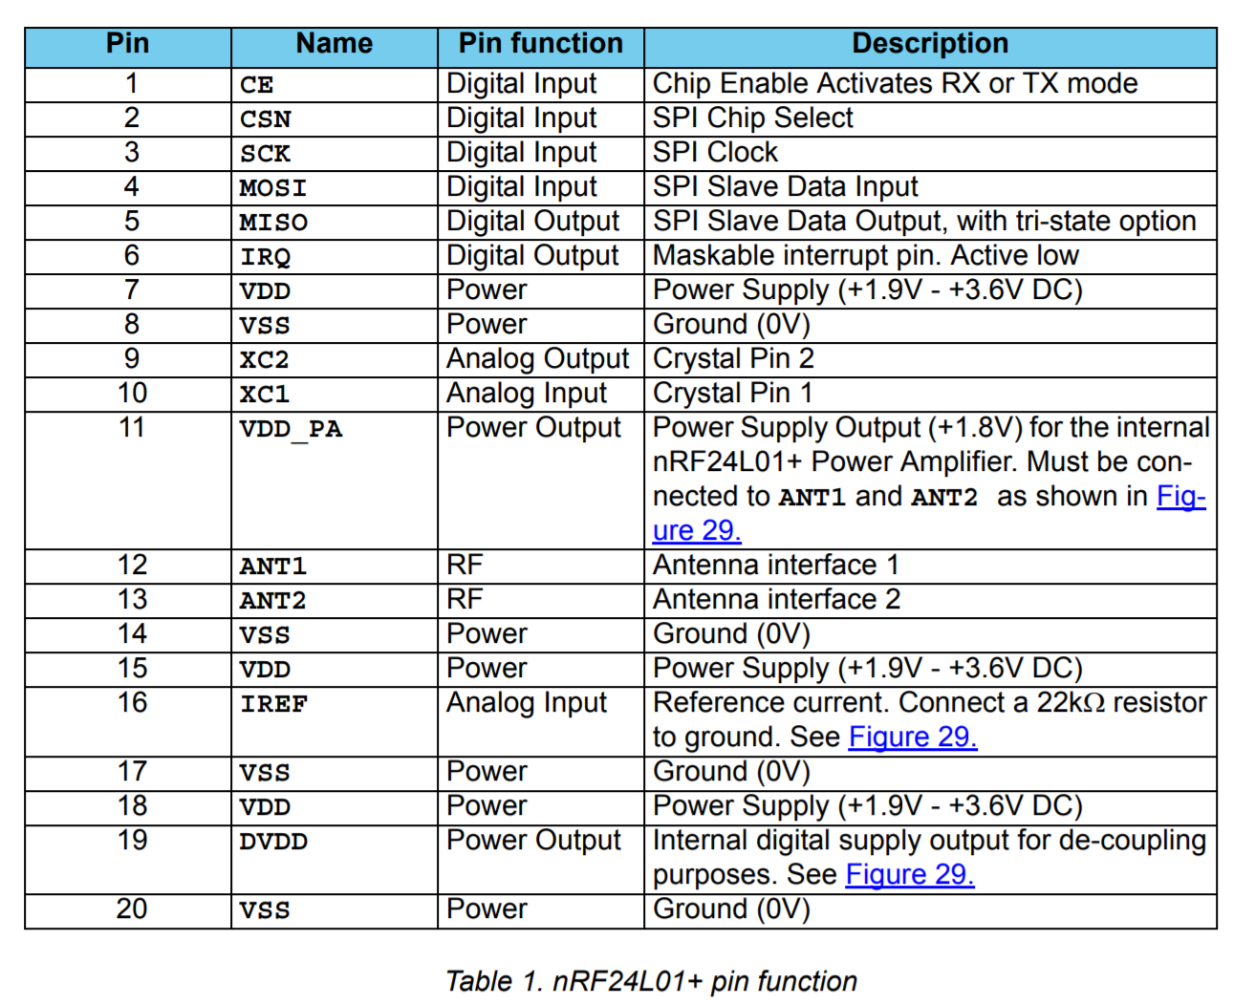
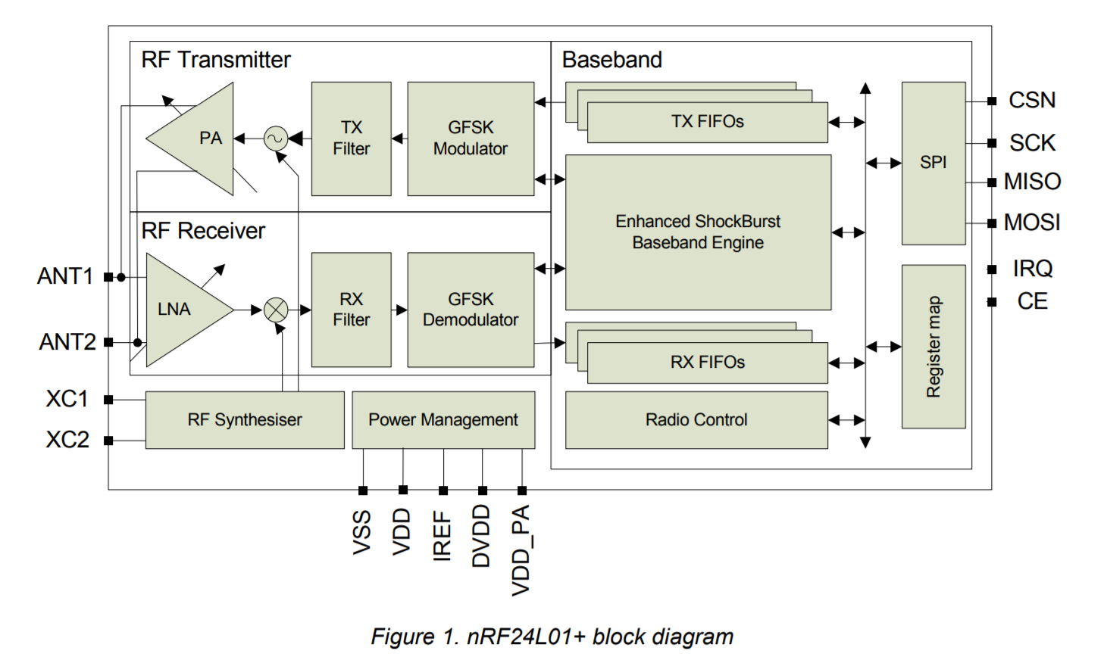
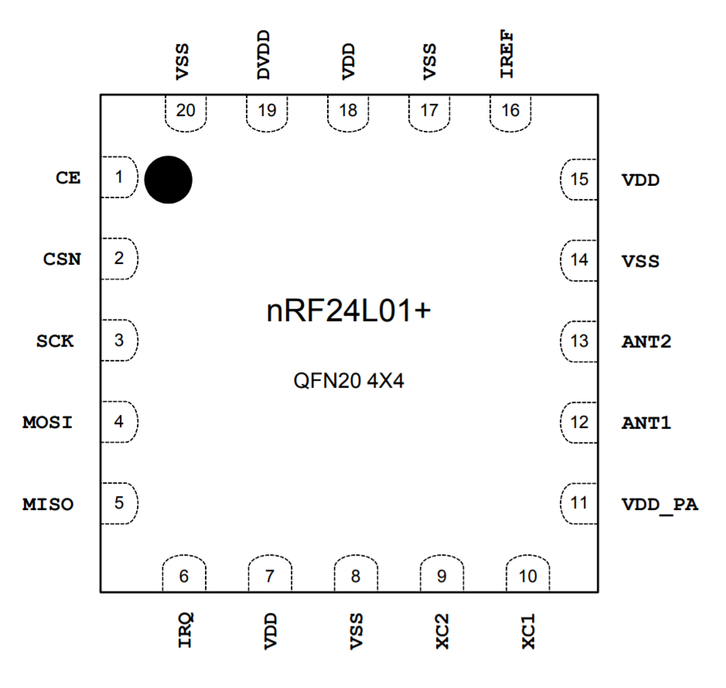
nRF24L01+ Transceiver IC
The Nordic nRF24L01+ is a highly integrated, ultra low power (ULP) 2Mbps RF transceiver IC for the 2.4GHz ISM (Industrial, Scientific and Medical) band.
With peak RX/TX currents lower than 14mA, a sub μA power down mode, advanced power management, and a 1.9 to 3.6V supply range, the nRF24L01+ provides a true ULP solution enabling months to years of battery life from coin cell or AA/AAA batteries.
The Enhanced ShockBurst™ hardware protocol accelerator offloads time critical protocol functions from the application microcontroller enabling the implementation of advanced and robust wireless connectivity with low cost 3rd-party microcontrollers.
Features
Low cost, single-chip 2.4GHz GFSK RF transceiver IC
Worldwide license-free 2.4GHz ISM band operation
250kbps, 1Mbps and 2Mbps on-air data-rate options
Ultra low power consumption – months to years of battery lifetime
https://www.nordicsemi.com/eng/Products/2.4GHz-RF/nRF24L01P

Slide 7
Wireless Transceiver Breakout
The goal:
Find the best transceiver to transmit data CONSISTANTLY
Determine distance using ping
Determine positioning using trilateration
NRF24L01+
NRF24L01+PA+LNA
SparkFun Transceiver

Slide 8
2.4GHz
When considering if 2.4Gz wireless is suitable for your projects, some of the considerations you would look at include cost, ease of use, availability, range and bandwidth.
One of the most common wireless modules around today is the nRF24L01. It is not only cheap, but relatively easy to use and can be used for short or long range communications.
Your router, your cordless phone, your Bluetooth earpiece, your baby monitor and your garage opener, car alarm, microwave, video devices, wireless mics, etc... Generally use 2.4 GHz transmission
A 2.4-GHz system will have a longer range (if unobstructed) and generally requires a smaller antenna, which keeps the phone's size in check.
The range is 2.400 to 2.525 Ghz which is 2400 to 2525 MHz. The nRF24L01 channel spacing is 1 Mhz which gives 125 possible channels numbered 0 .. 124.
There are five different bands used for Wi-Fi transmissions: 2.4GHz, 3.6GHz, 4.9GHz, 5GHz, and 5.9GHz. How the bands are used varies from one country to another. The most widely used is the 2.4GHz..
https://www.allaboutcircuits.com/technical-articles/wi-fi-antennas-part-1-fundamentals/
https://www.wired.com/2010/09/wireless-explainer/

Slide 9
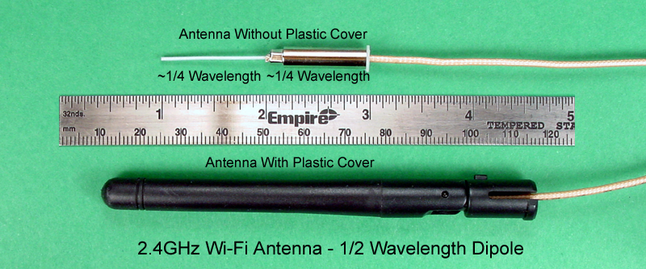
2.4GHz Antenna
The antenna is a dipole. One half of the dipole is the white wire that protrudes to the left, and the other half of the dipole is the metal cylinder. Each half is electrically insulated from the other, and is approximately ¼ wavelength long.
The wavelength of a 2.45GHz signal is 122.45 mm.
A dipole at 2.45GHz is 61.22 mm from end to end, and each of the two halves is 30.61 mm.
Working in inches, a dipole at 2.45GHz is 2.41” from end to end, and each of the two halves is 1.205”.
The elements are quite small in the 2.4GHz band, and even smaller in the other four bands.
https://www.allaboutcircuits.com/technical-articles/wi-fi-antennas-part-1-fundamentals/

Slide 10
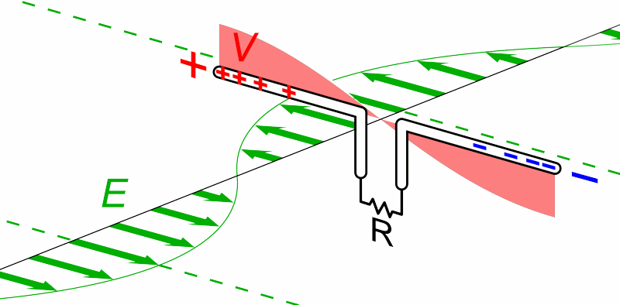
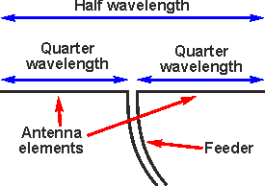
2.4GHz Antenna
Resonance will occur at whole number fractions (1/2, 1/3, 1/4, etc.) of the fundamental frequency, shorter antennas can be used to send and recover the signal.
A half-wave dipole antenna has a length that is one-half of the fundamental wavelength It is broken into two quarter-wave lengths called elements. The elements are set at 180 degrees from each other and fed from the middle. This type of antenna is called a center-fed half-wave dipole and shortens the antenna length by half.
https://upload.wikimedia.org/wikipedia/commons/d/dd/Dipole_receiving_antenna_animation_6_800x394x150ms.gif

Slide 11
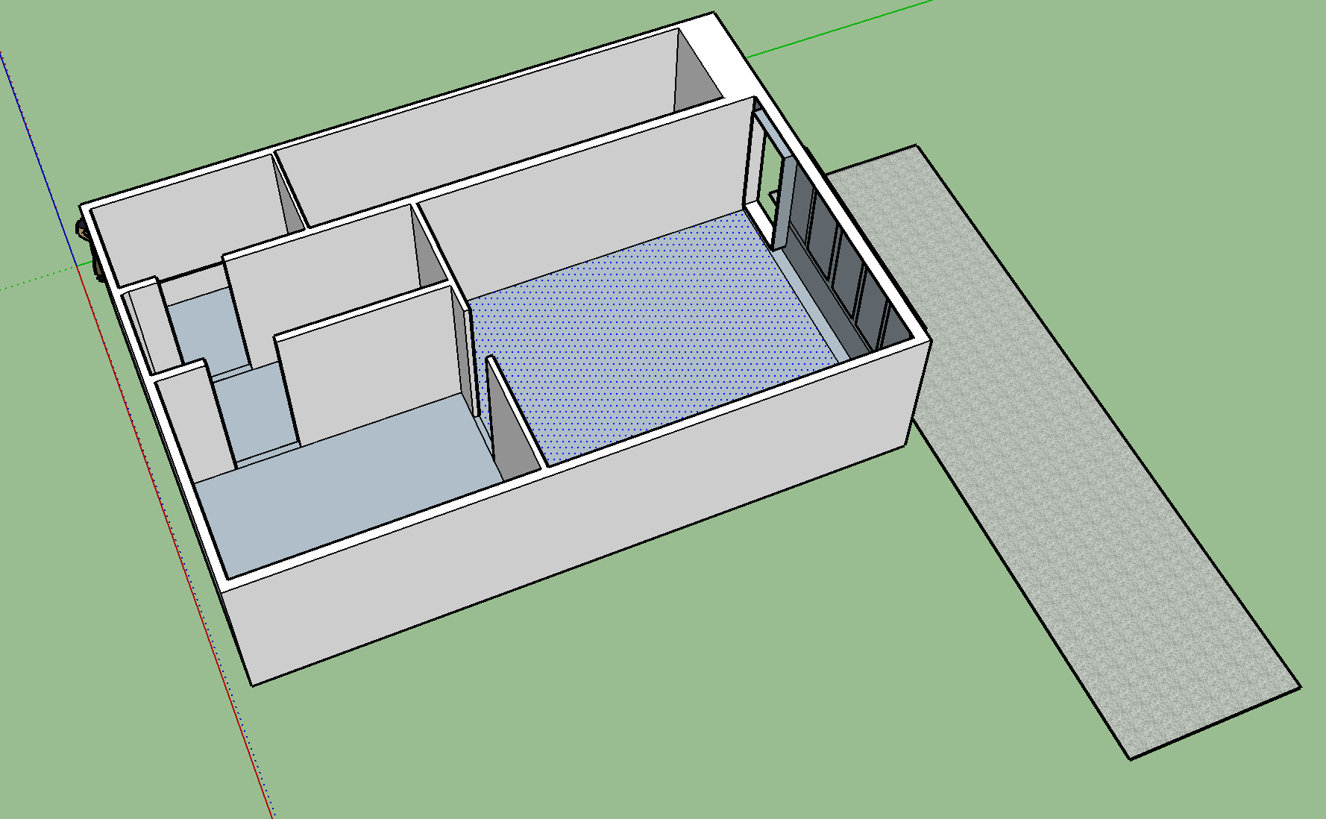
2.4GHz PCB Trace Antenna
8 ft
Designed on Sketchup
https://www.sketchup.com/products/sketchup-pro/new-in-2017

Slide 12
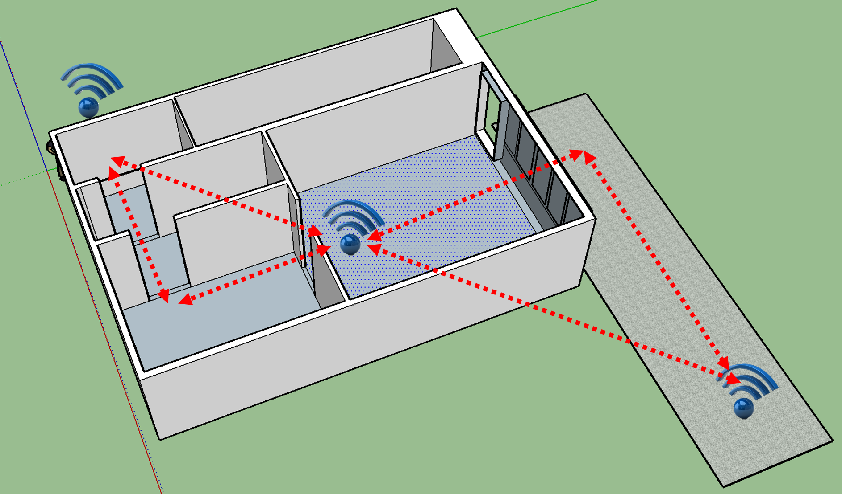
2.4GHz Sparkfun Board With Ceramic Antenna
30 ft
Designed on Sketchup
https://www.sketchup.com/products/sketchup-pro/new-in-2017

Slide 13
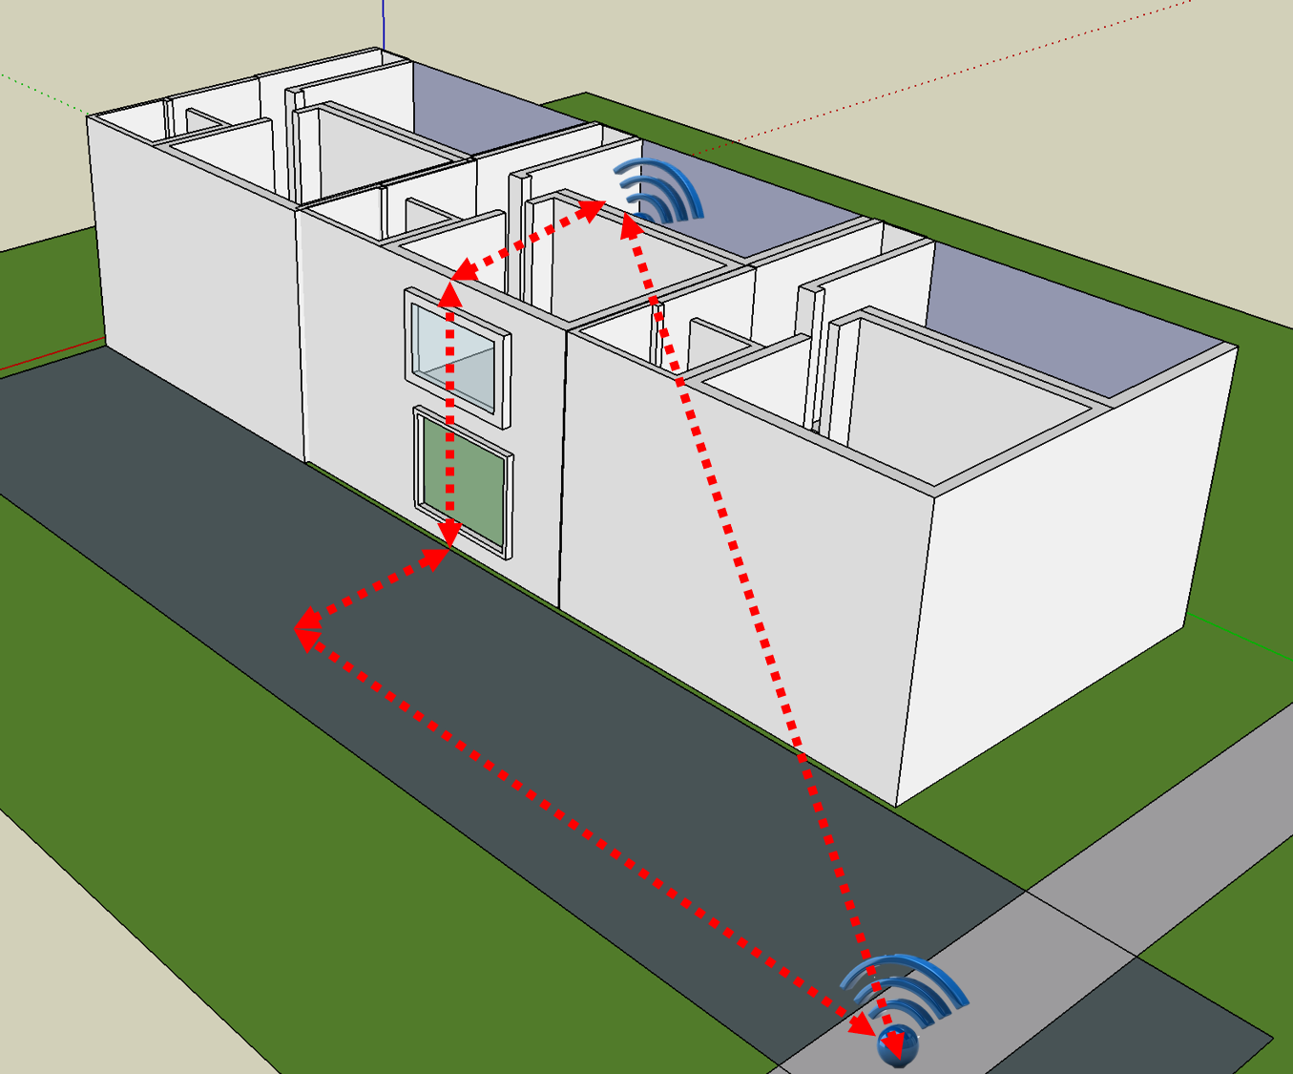
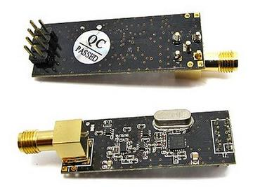
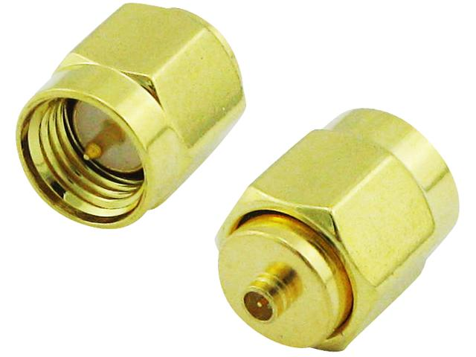
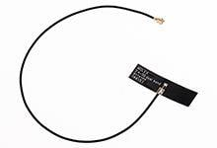
Breakout with SMA-> u.fl adapter -> PCB Antenna
100 ft
Designed on Sketchup
https://www.sketchup.com/products/sketchup-pro/new-in-2017

Slide 14
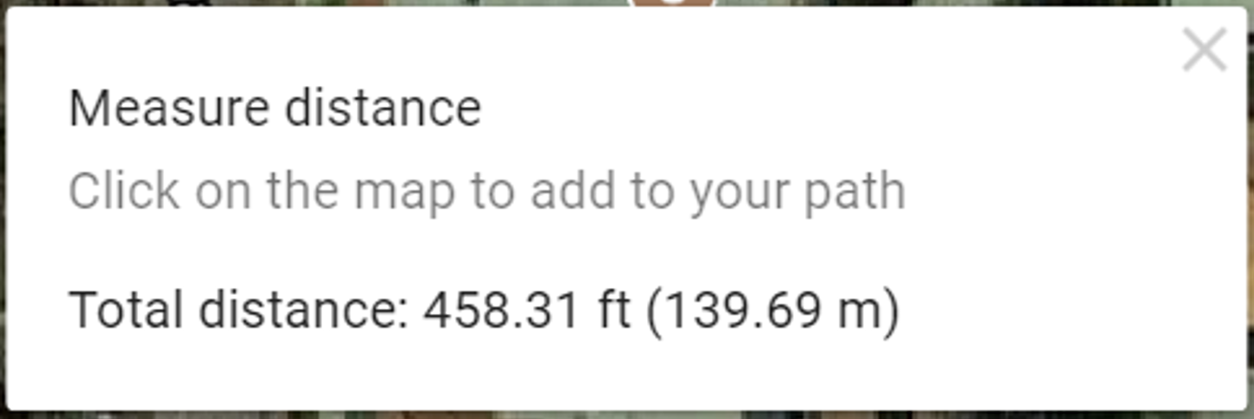
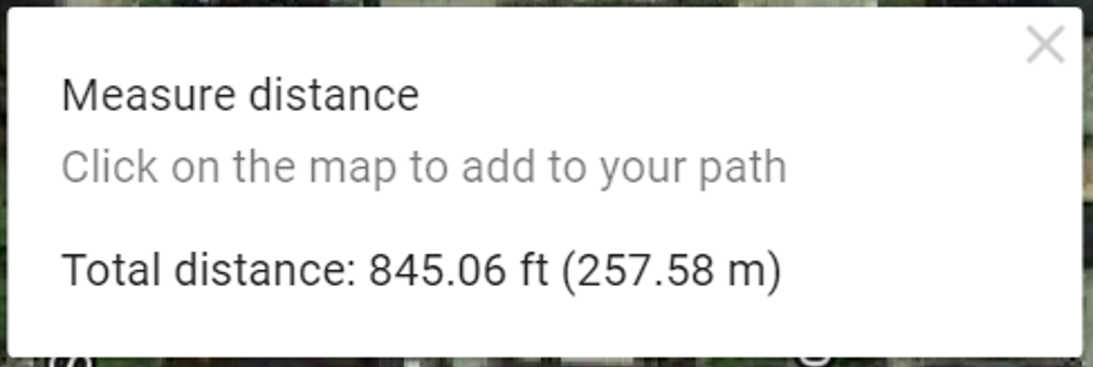
Breakout Rubber Duck Antenna
Origin

Slide 15
Final Results
Low Power
6 ft directional
Medium Power
100 ft
High Power
850 ft line of sight

Slide 16
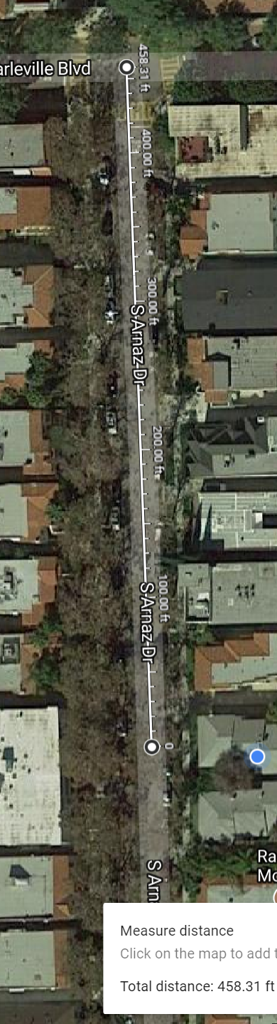
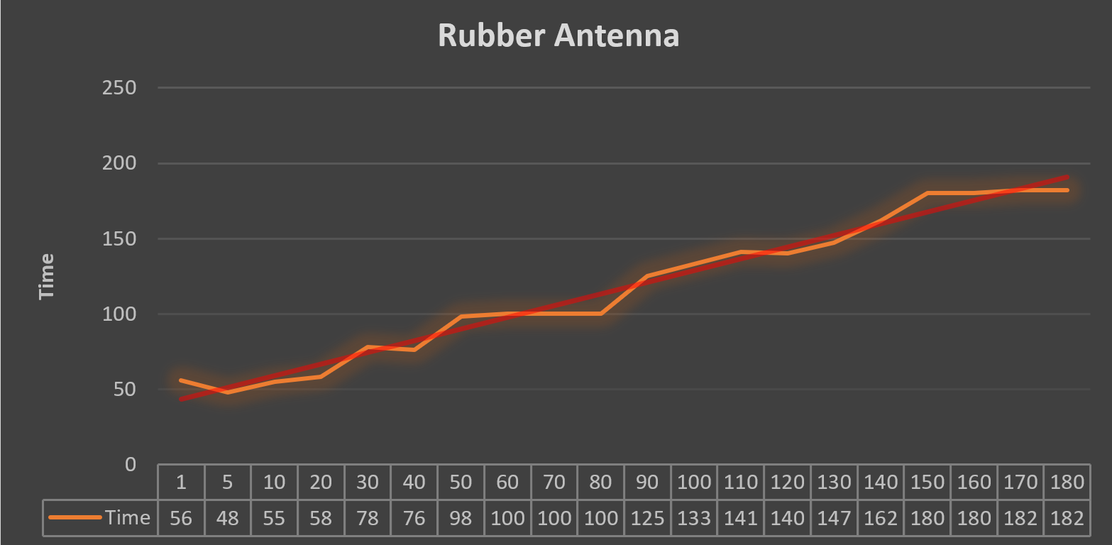
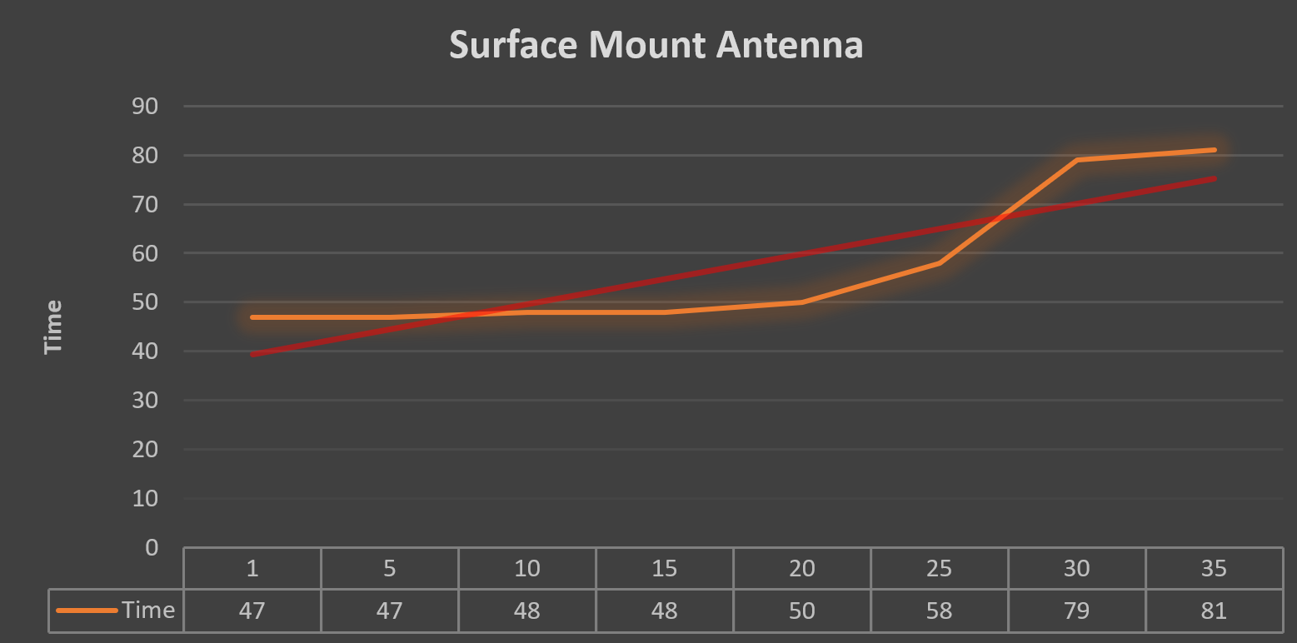

Slide 17
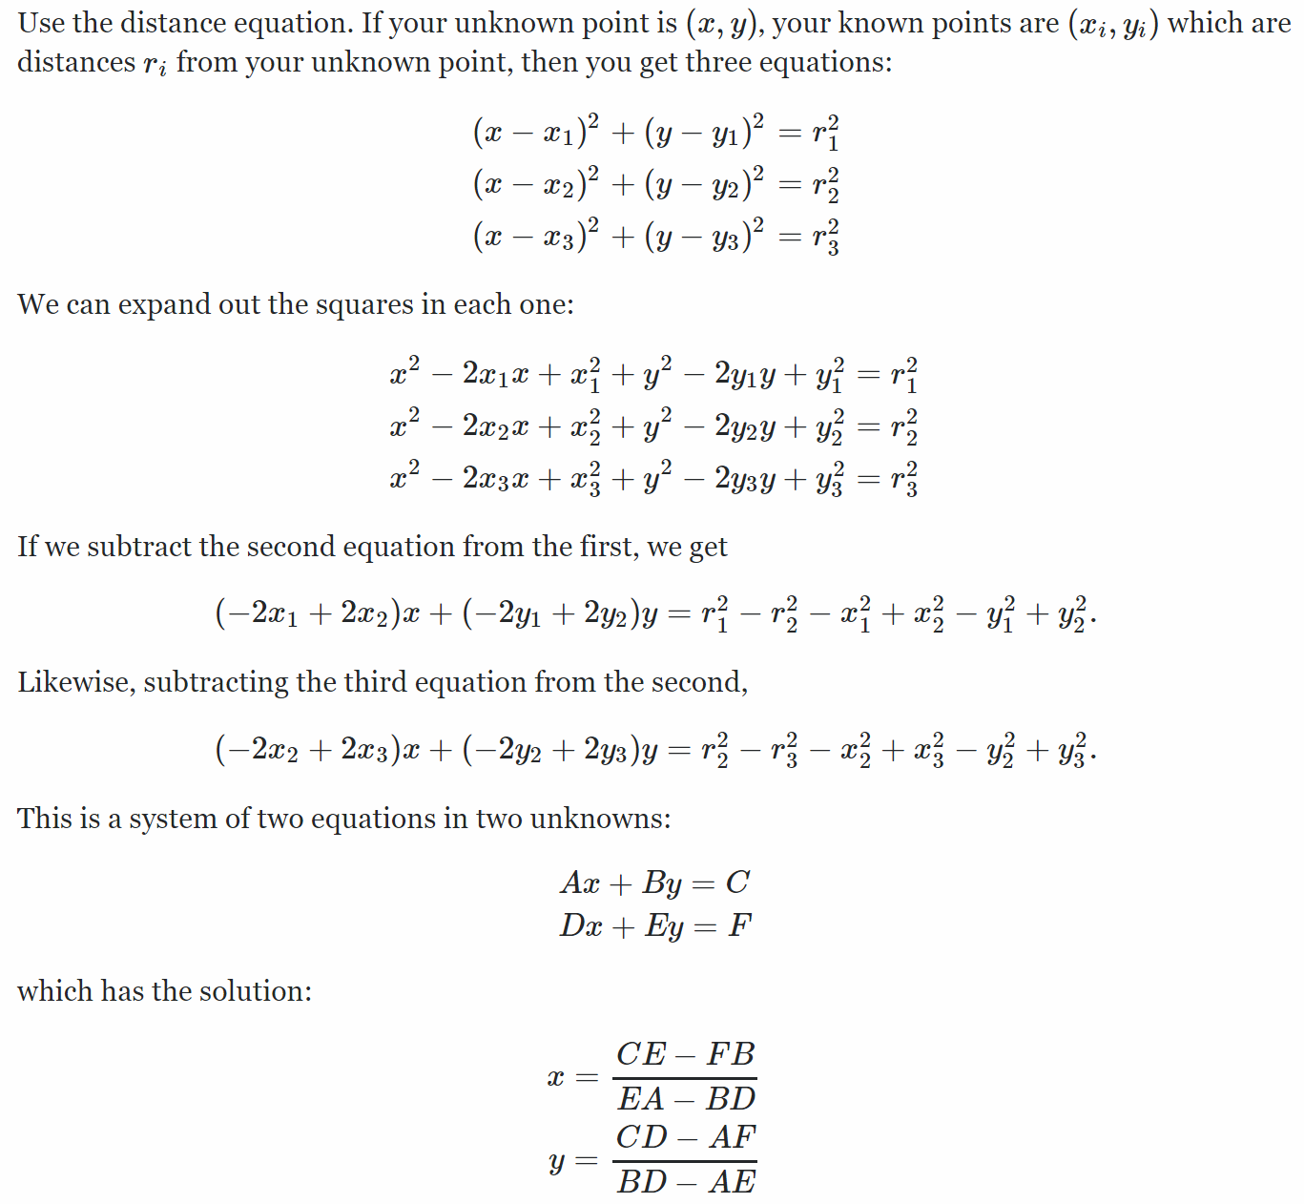
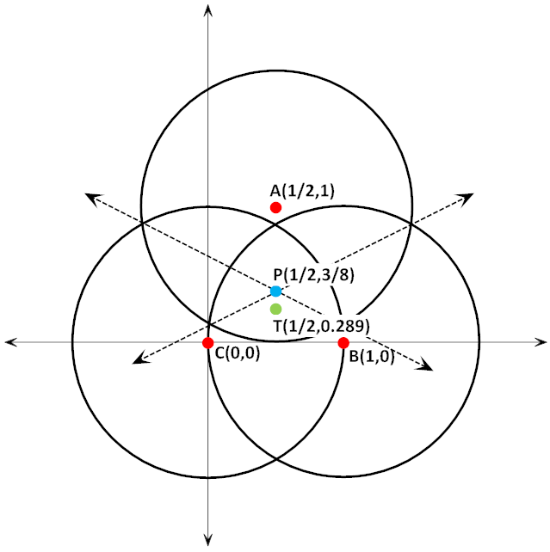
Trilateration
The process of determining absolute or relative locations of points by measurement of distances, using the geometry of circles, spheres or triangles.
wavelength (in meters) = 300 / frequency (in MHz)

Slide 18
Basic Operation
Connections nRF24s uses SPI to communicate with the Arduino.
They must use Arduino pins 13, 12 and 11 (SCK, MISO and MOSI)
CSN and CE can be connected to any digital pin of the Arduino board and they are used for setting the module in standby or active mode, as well as for switching between transmit or command mode.
IRQ is an interrupt pin which doesn’t have to be used.
Power The nRF24 modules require a 3.3v power supply.
Broadcasting
nRF24L01+ modules broadcast on the 2.4GHz band.
The precise frequency is determined by the channel that is selected.
Both TX and RX must use the same channel.
The default channel for the RF24 library is 76.
When the TX sends a message every RX listening on the same channel will receive the message. The TX includes an "address" in the message and the RX will ignore messages that do not have its address.
Data Packets The nRF24L01+ modules can transmit a maximum of 32 bytes in a single message.
The nRF24s automatically include sophisticated systems to identify whether the data received matches the data that was sent. If the data is not received correctly the RX will not show data available() and will not send an acknowledgment.

Slide 19
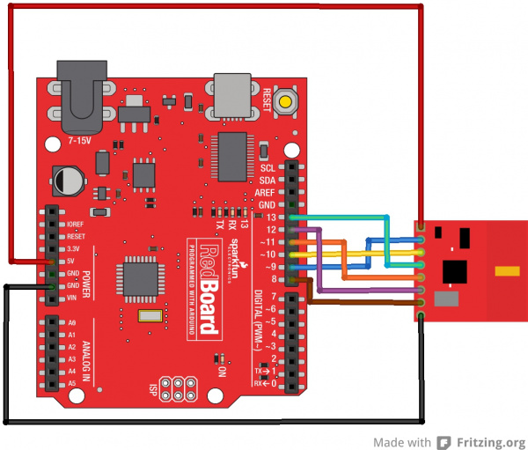
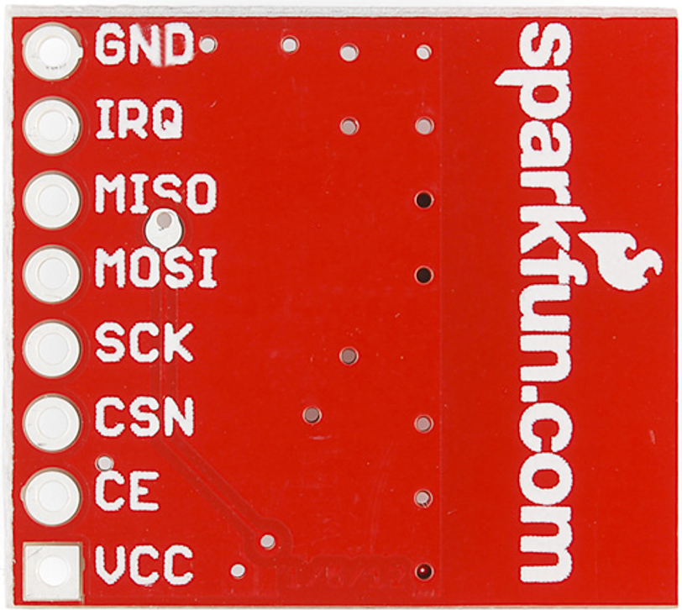
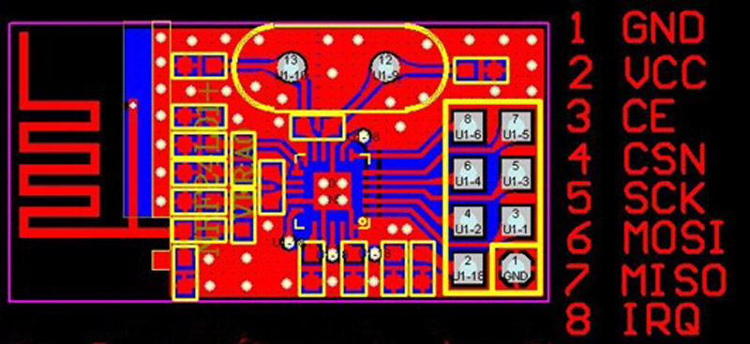
Connections
Referencing Sparkfun Board
GND - Ground
IRQ - Interrupt pin. This pin is active LOW.
MISO - 3.3V-5V tolerant SPI slave output.
MOSI - 3.3V-5V tolerant SPI slave input.
SCK - 3.3V-5V tolerant SPI clock.
CSN - 3.3V-5V tolerant SPI chip select.
CE - 3.3V-5V tolerant chip enable. This pin toggles the nRF24L01+ IC between transmit (TX), receive (RX), standby, and power-down mode.
VCC - This is VRAW and is regulated on-board down to 3.3V for the proper functionality of the nRF24L01+. Voltage range on this pin is 3.3V-7V.
https://learn.sparkfun.com/tutorials/nrf24l01-transceiver-hookup-guide
http://howtomechatronics.com/tutorials/arduino/arduino-wireless-communication-nrf24l01-tutorial/

Slide 20
Wireless Transceiver Breakout
Benefits
Ability to connect multiple Arduinos via wireless transmission
Can be use for sensors such as distance, pressure, temperature, I/O, voltages, etc..
Control robots
Monitor rooms in homes, schools, MAZE’s, etc…
NRF24L01+
NRF24L01+PA+LNA
SparkFun Transceiver

Slide 21
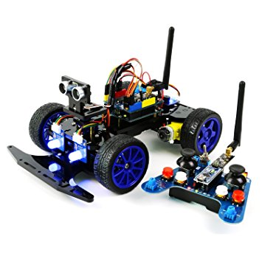
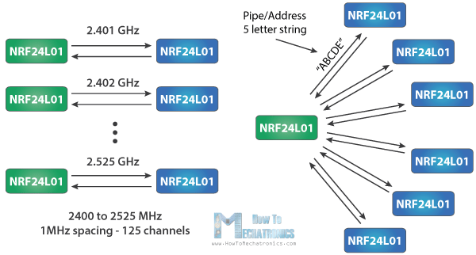
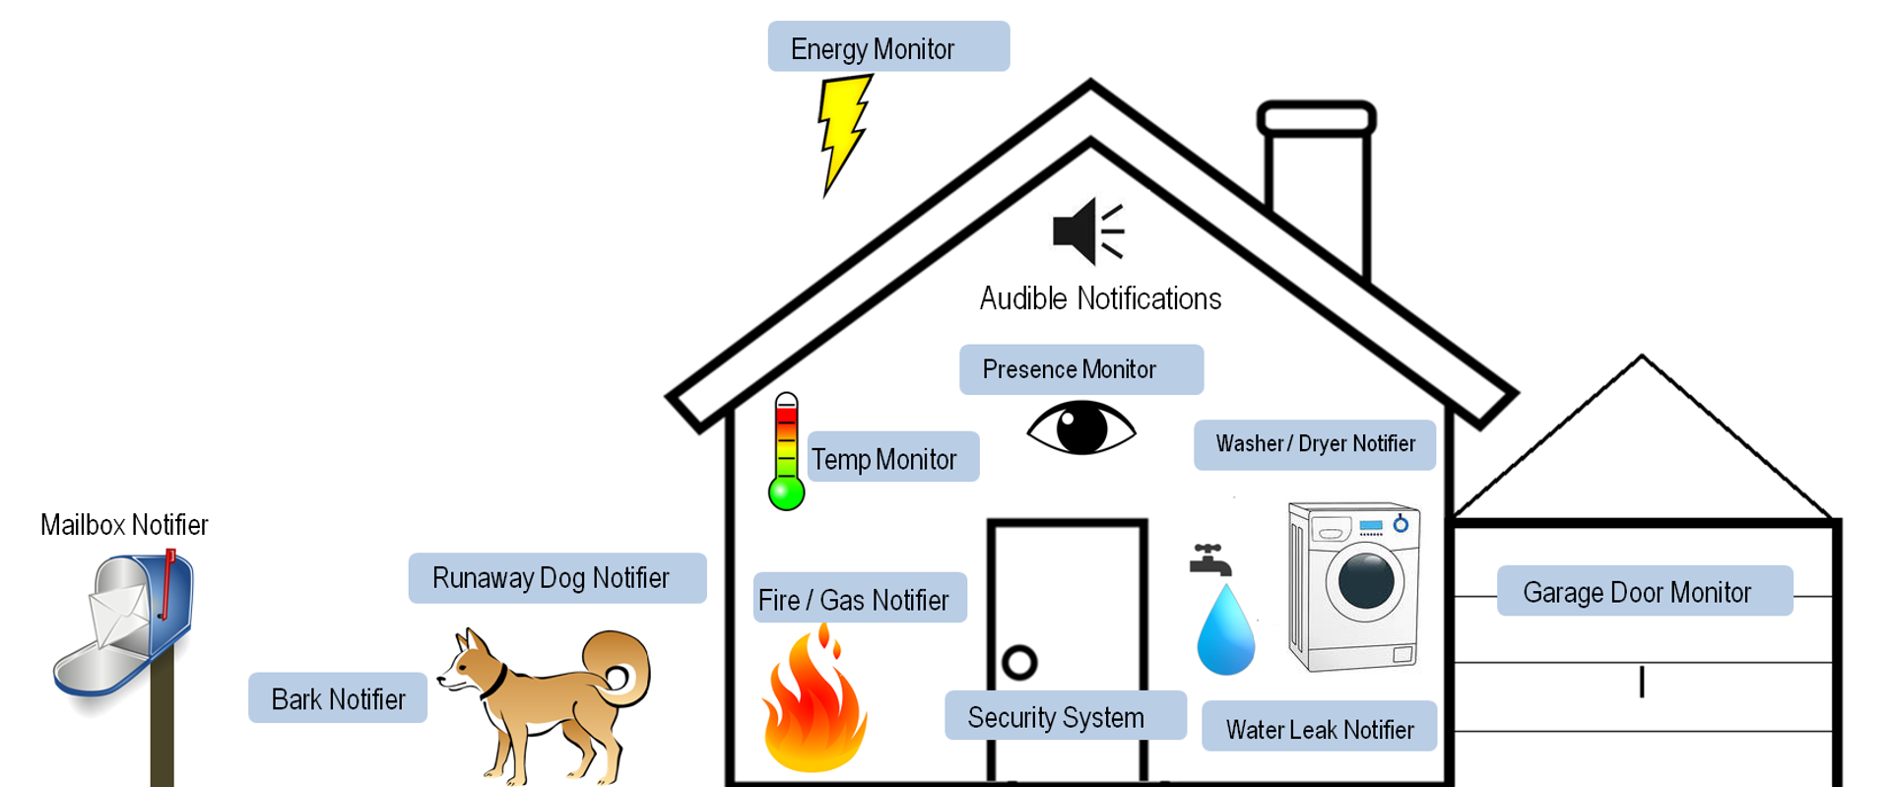
What Else?
http://howtomechatronics.com/tutorials/arduino/arduino-wireless-communication-nrf24l01-tutorial/
www.google.com images

Slide 22
The End

Slide 23
Extra
Example to understand antenna wave lengths
Think of a "sine wave" 12 cm long. Draw it on graph paper if you like. The first half goes positive, the second half goes negative
When catching an RF signal, "negative is just a phase change - you can divide the signal in half (6cm) and say it starts and ends at zero.
Dividing AGAIN for quarter wave (3cm): looking at your graph, the sine wave goes from zero to maximum. At the pointy end of your dipole, no current flows (open circuit) so, applying the sine wave, the other end with a connector has maximum signal current.
Good tutorial and how to video
http://howtomechatronics.com/tutorials/arduino/arduino-wireless-communication-nrf24l01-tutorial/
Great site for learning why and getting started
https://learn.sparkfun.com/tutorials/nrf24l01-transceiver-hookup-guide
Great site to start with
https://arduino-info.wikispaces.com/Nrf24L01-2.4GHz-HowTo
https://www.instructables.com/answers/How-do-you-determine-the-length-of-an-antenna-and-/

Slide 24
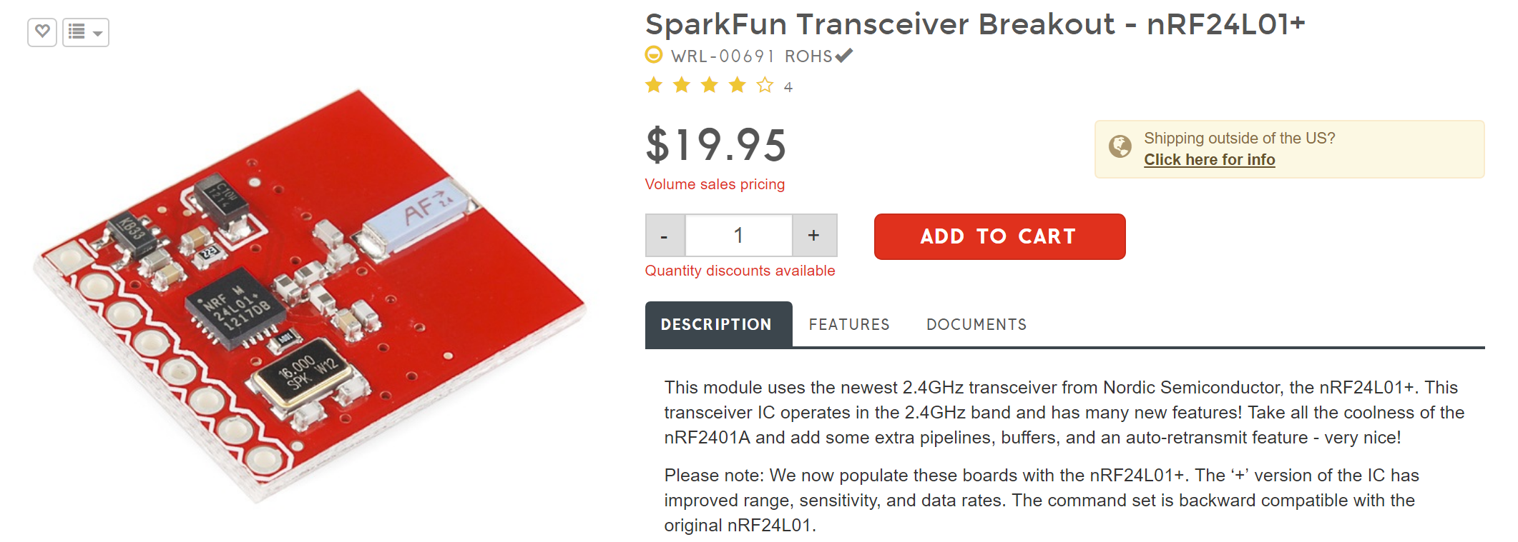
Extra

Slide 25
