Slide 1
LiDAR
James Donahue EE 444 Fall 2017 11-13-17

Slide 2
What is LiDAR?
LIDAR stands for Light Detection and Ranging or Laser Imaging and Ranging
LiDAR originated in the 1960’s after the invention of the laser
First space LiDAR system was used in 1971 on Apollo 15 as an altimeter
Lidar uses ultraviolet, visible, or near infrared light to image objects
Measures time delay, phase shift between transmitted and reflected signals
Wavelengths vary to suit the target: from about 10 micrometers to the UV (approximately 250 nm)

Slide 3
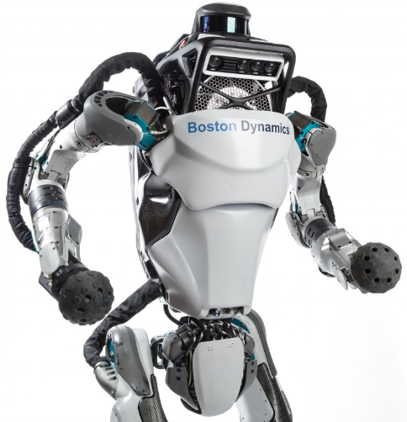
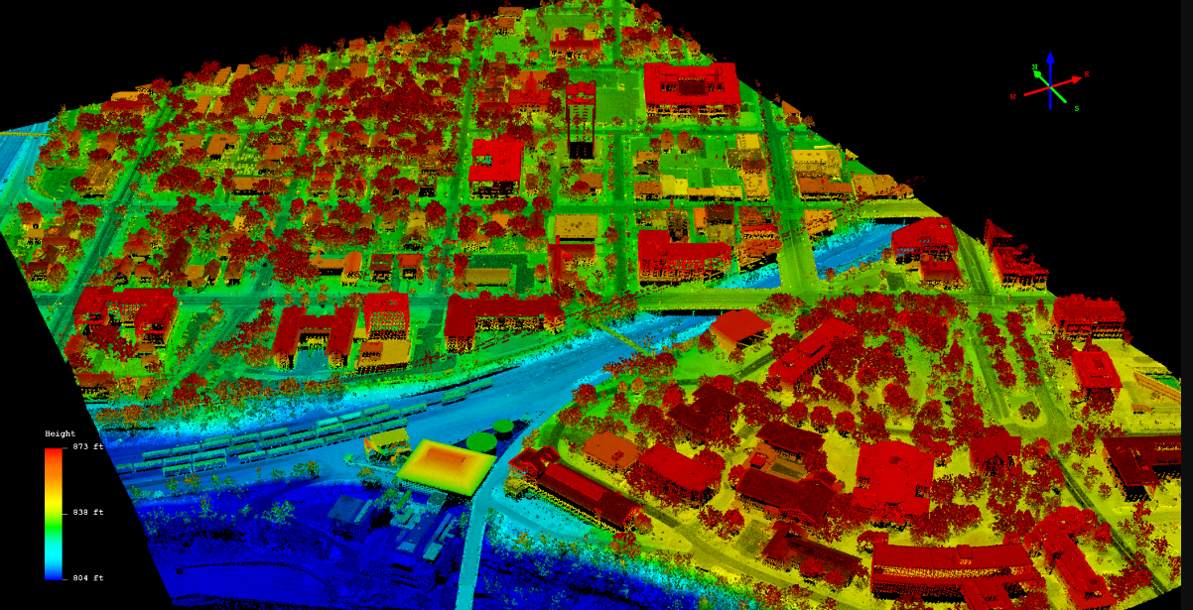
LiDAR Applications
Generating point cloud and 3d images for robotics
Distance measurements for drones and autonomous vehicles
Creating topographical maps for surveying and forestry
Measuring Aerosols and cloud structure in the atmosphere

Slide 4
LiDAR Laser Wavelengths
Wavelength | 532nM | 600-1000nM | 1550nM
 | Used for Bathymetric under water depth scanning LiDAR systems Wavelength attenuates less in water. | Most commonly used for non scientific applications Lasers in the wavelength are abundant This frequency range is absorbed by the eye, so the max power is limited to make them eye safe | Much safer at higher power levels since the wavelength isn’t as easily absorbed by the eye. Technology is less advanced for detectors in this frequency range Used for longer range and lower resolution because of this

Slide 5
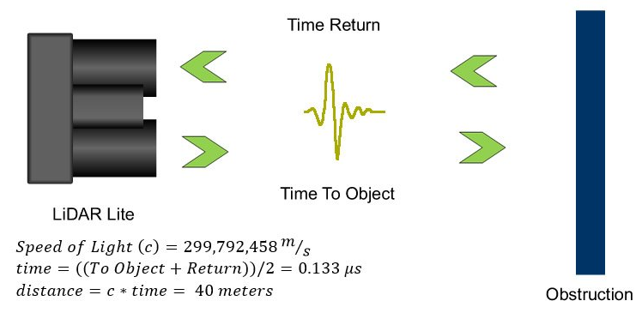
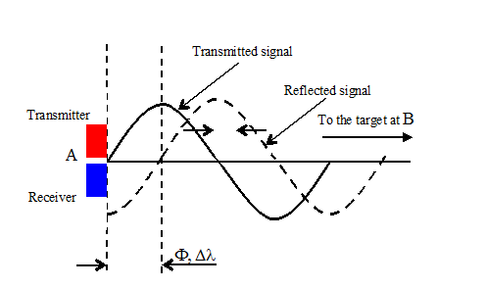
LiDAR Detection Schemes
Coherent Detection
Direct Energy Detection (Incoherent)
Uses phase difference between transmitted and received signal to determine distance. Used in phase sensitive applications like Aerosol scattering lidar systems.
Receiver measures the intensity of the returning signal and uses time of flight to determine the distance

Slide 6
High Energy v. Pulse LiDAR
High Energy LiDAR
Micro Pulse LiDAR
Not eye safe and requires more power.
More suitable for LiDAR scanning applications
Use pulsed lasers to reduce the energy usage of the systems
Usually classified as eye safe
Relatively new technology, requires fast computing and sensing
NASA operates a network of these systems to measure aerosols and cloud structure

Slide 7
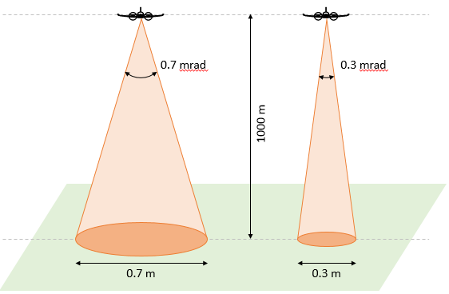
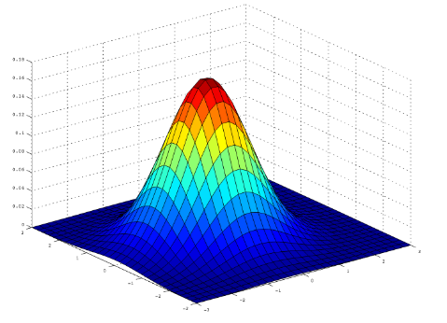
Beam Divergence
Signal disperses the further away from the emitter
The rate at which the beam is spread is defined through the system-specific beam divergence angle
As a result sensors with a larger beam divergence will spread the pulse energy over a larger area which leads to a lower signal to noise ratio
Point spacing should be equal to the footprint diameter

Slide 8
Scanning and LiDAR Footprint
Larger footprints can be beneficial if we want to be sure to detect small or thin objects like for example power lines. A larger illuminated area will also help to ensure that some part of the signal penetrates the forest canopy.
Small LiDAR footprint will result in a more distinctive return. With a smaller illuminated area the signal is also more likely to be returned from a single homogeneous surface and as a result multiple returns will be less likely.
Pulse Spacing Equal To footprint | Pulse Spacing smaller than footprint diameter | Pulse Spacing greater than footprint diameter

Slide 9
Laser Scanning – Azimuth and Elevation
Very commonly used in terrestrial lidar systems, i.e. Surveying
Not a quick method for laser scanning
Usually combined with GPS to generate geospatially referenced data.

Slide 10
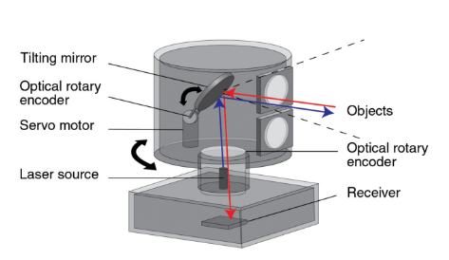
Laser Scanning - Nodding (tilt) Mirror Systems
Commonly used scanning method in fast refresh LiDAR systems
Usually rotates at a high rate of speed, above 1000 RPM to increase resolution of 3D images
Panoramic data acquisition
Require rotary encoders for a position feedback control loop.
Usually capable of scanning in a 360° fov

Slide 11
Other LASER Scanning Techniques
Dual Oscillating Plane Mirrors
Polygonal Mirror Scanning

Slide 12
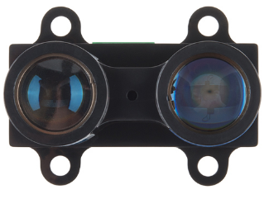
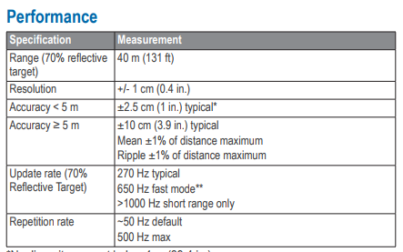
LIDAR LITE Module

Slide 13
LIDAR v. PINGDAR v. IR Ranging
 | LIDAR LITE V3 | SHARP GP2Y0A710YK0F | Parallax PING Ultrasonic
Emitter Wavelength Nominal | 905 nm | 850 nm | .00858 m (40 khZ c=343.2 m/sec)
Distance Range | 5 cm to 40 m (70% reflectance target) | 100cm to 5.5m (90% reflectance target) | 2 cm to 3 m (no info)
Interface | I2c or PWM | Analog Output | Bidirectional TTL pulse interface on a single I/O pin
Current Consumption | 105 – 135 mA | 30mA | 30 – 35mA

Slide 14
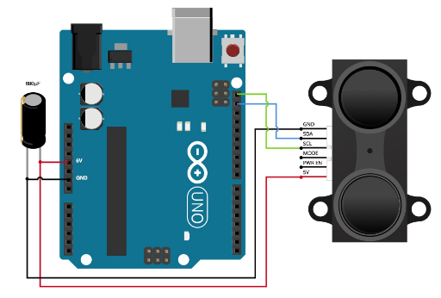
Interfacing with LIDAR LITE in Arduino
There are 3 versions of the LiDAR lite sensor, each version interfaces with Arduino differently.

Slide 16
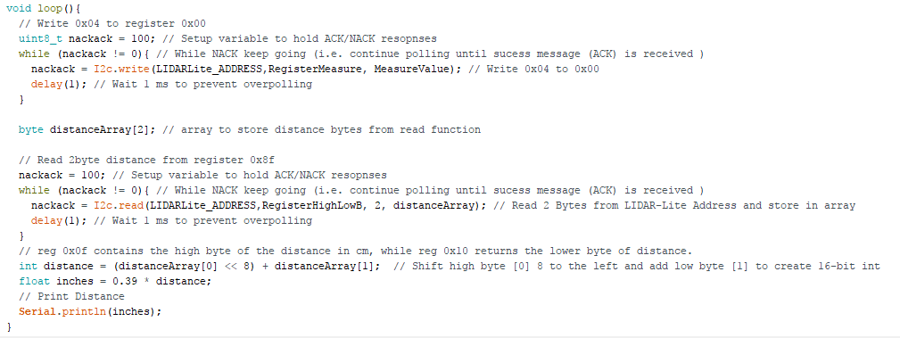

Slide 17
Questions?
A smaller LiDAR footprint is more desirable to detect smaller objects like power lines? (T/F)
Which detection scheme is used in aerosol scattering and atmospheric LiDAR?
Coherent Detection, Incoherent Detection, High Energy LiDAR, Pulsed LiDAR
Directed energy detection schemes measure which of the following? Returning Signal : Amplitude, Phase, Frequency
Which LiDAR scanning method can provide a 360° degree fov? Tilt Mirror, Dual Oscillating Plane Mirror , Polygonal Mirror
A larger beam divergence is desireable for long range LiDAR systems? (T/F)

Slide 18
Sources Used
https://en.wikipedia.org/wiki/Lidar - General info on LIDAR
http://static.garmin.com/pumac/LIDAR_Lite_v3_Operation_Manual_and_Technical_Specifications.pdf - Product Datasheet, wiring guide, and programming guide
https://www.fs.fed.us/pnw/pubs/pnw_gtr768.pdf – Information on LIDAR terminology
http://felix.rohrba.ch/en/2015/lidar-footprint-diameter/ - Information about Beam Divergence with LIDAR
https://buy.garmin.com/en-US/US/p/557294#specs - LIDAR LITE Datasheet
https://acroname.com/sites/default/files/assets/sharp_gp2y0a710yk0f_datasheet.pdf - SHARP Sensor
https://www.parallax.com/sites/default/files/downloads/28015-PING-Sensor-Product-Guide-v2.0.pdf - PING sensor
http://www.lidar-uk.com/how-lidar-works/
http://www.hamamatsu.com/us/en/community/optical_sensors/articles/measuring_distance_with_light/index.html
http://www.sdrobots.com/tech-thursday-012-pulsedlight-lidar-lite/
https://mplnet.gsfc.nasa.gov

