Slide 1
Data Backup with EEEPROM
By Ricardo Alcaraz

Slide 2
EEPROM and what can we use it for?
Stands for Electrically Erasable Programmable Read-Only Memory
Non-volatile memory
Separate from the rest of the memory
Can be used to hold data between power cycles
EEPROM data gets cleared between programming cycles

Slide 3
EEPROM in the Atmega32u4
The Atmega 32u4 contains 1024 bytes of EEPROM organized in a separate dataspace
Endurance of 100,000 write cycles
Accessible within the I/O space of our chip
Programmable by using the EEPROM Address Registers, EEPROM data registers and the EEPROM control Registers
Specific Read and Write procedures must be taken before we can do anything
When the EEPROM is read the CPU is halted for 4 clock cycles
When written, the CPU is halted for 2 clock cycles before the next instruction is executed

Slide 4
The EEPROM Address register
Before we can read or write, must point to an Address
Address controlled by two registers, EEARH(EEPROM Address High) and EEARL(EEPROM Address Low)
Initial value is undefined
Anything beyond the EEPROM End will not work
Note: the address registers can point up to address 0xFFF while we only need up to 0x400

Slide 5
EEPROM Data Register
If writing, contains the data to be written to the EEPROM at the value pointed by EEAR
If reading, it contains the data that is read from the value pointed by the EEAR

Slide 6
EEPROM Control Register
Bits 7 & 6 - reserved bits, always read as 0
Bits 5 & 4 - EEPROM Programming Mode Bits
Bit 3 - EEPROM Ready Interrupt Enable
Bit 2 - EEPROM Master Programming Enable
Bit 1 - EEPROM Programming Enable
Bit 0 - EEPROM Read Enable

Slide 7
Bits 5 & 4 - EEPROM Programming Mode
These bits define whether you will write or erase to the EEPROM
Set to 0b00 by default for the atomic operation however takes longer period of time
Since it takes a predefined amount of time, you have to account for this in your design
Any changes to this while writing to the EEPROM will be ignored until next access time
Typical writing access time is determined by calibrated RC Oscillator Cycles which is usually 26,368(for the atomic writing operation)

Slide 8
Bit 3 - EEPROM Ready Interrupt Enable
Bit 2 - EEPROM Master Programming Enable
Setting this to 1 enables Interrupts
Works in tandem with EEPE. If set to 1, and EEPE is set to 1 within 4 clock cycles, then the EEPROM write takes place
If set to 0 then setting EEPE has no effect and effectively disables writes
Bit is cleared after every write operation

Slide 9
Bit 1 - EEPROM Programming Enable
The actual write signal to the EEPROM. Must be set to 1 within 4 clock cycles of the EEMPE bit being set to 1.
Steps that should be taken before a write takes place
Wait until EEPE becomes -
Wait until SELFPRGEN in SPMCSR becomes zero.
Write new EEPROM address to EEAR
Write new EEPROM data to EEDR
Write a 1 to the EEMPE and a 0 to EEPE in the EECR
Set EEPE to 1 within 4 clock cycles of doing the above
Since we are not using flash, we can omit step 2
Note: Disable interrupts while you are programming the control registers since it will time out if not done fast enough
After the write access time has elapsed(3.4ms or 1.8ms) the EEPE bit will be cleared by hardware

Slide 10
Bit 0 - EEPROM Read Enable
After the correct address is set in the EEAR, setting this bit to 1 will trigger the EEPROM read.
CPU is halted for 4 clock cycles before the data is read
Data will be made available in the EEDR
If EEPE is still set then No read access can occur

Slide 11
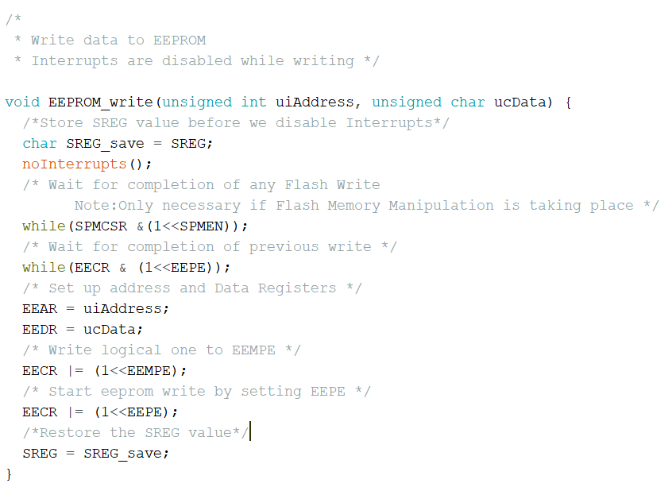
Writing data to the EEPROM in C++
Special care has to be taken to that EEPROM writing is not interrupted.
We disable interrupts, poll the flash memory to ensure no access is taking place, and poll the EEPROM control register to ensure no access is taking place before we do anything

Slide 12
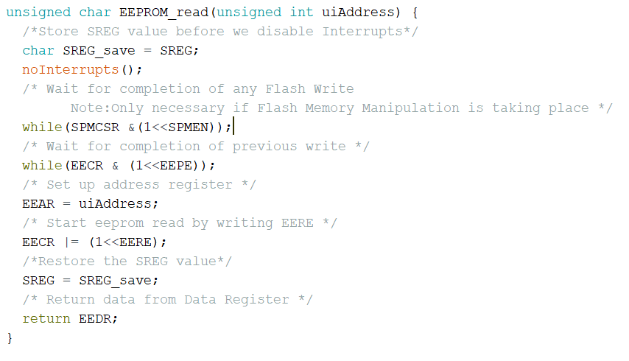
Reading from EEPROM in C++
Same precautions as writing must be taken when reading to ensure data does not get corrupted.

Slide 13
Proof of Concept: State Saver
Simple LED Arduino Circuit to showcase how EEPROM can save data over power cycles

Slide 14
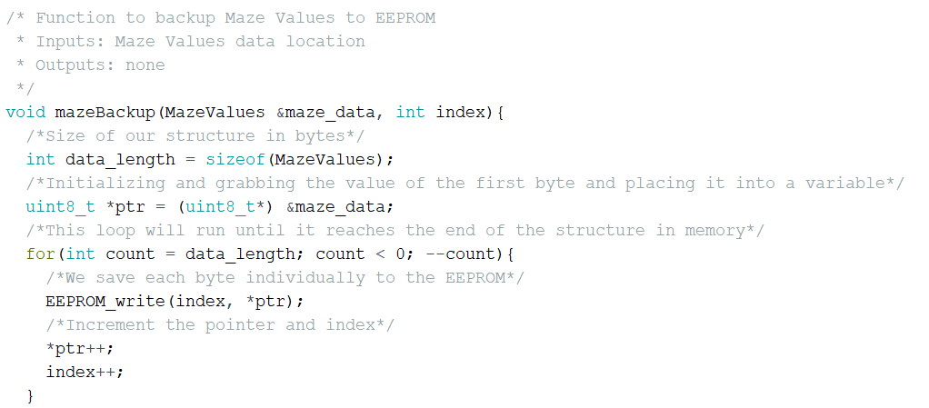
Saving our Maze Data in C++
Useful function to backup our volatile data into the EEPROM in case of power shutdown
The function grabs the bytes from the original structure and saves them to EEPROM

Slide 15
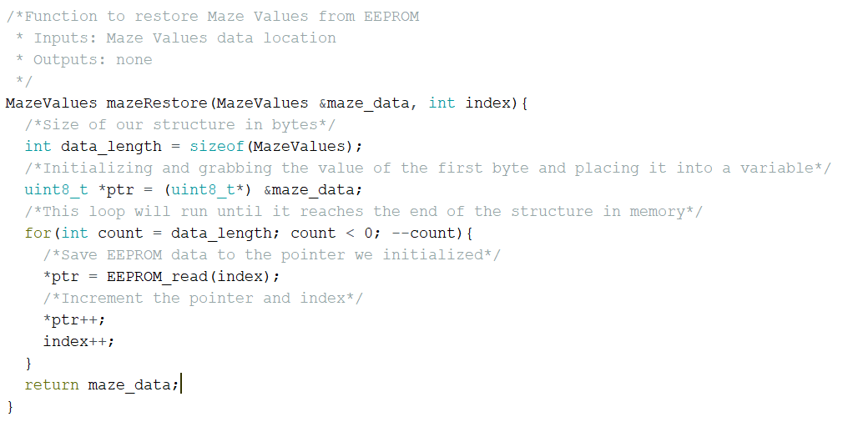
Restoring our data from EEPROM in C++
Useful Function to restore the data from the EEPROM
Grabs the data from the EEPROM and overwrites the original structure

Slide 16
Detecting a Low Voltage Condition
By using the internal ADC and the internal Bandgap reference, we can detect a low voltage condition with no additional circuitry!
If we use VCC as the reference and compare it to a known value, we can find what Vcc actually is fairly accurately.

Slide 17
Bandgap Reference
Internal Reference Voltage that gets activated when: the ADC is on, Brownout Detection is enabled, and when used as the input for the analog comparator
Provides a 1.1V stable reference voltage regardless of Vcc conditions, temperature conditions or circuit loading
It provides what we need to detect low voltage conditions

Slide 18
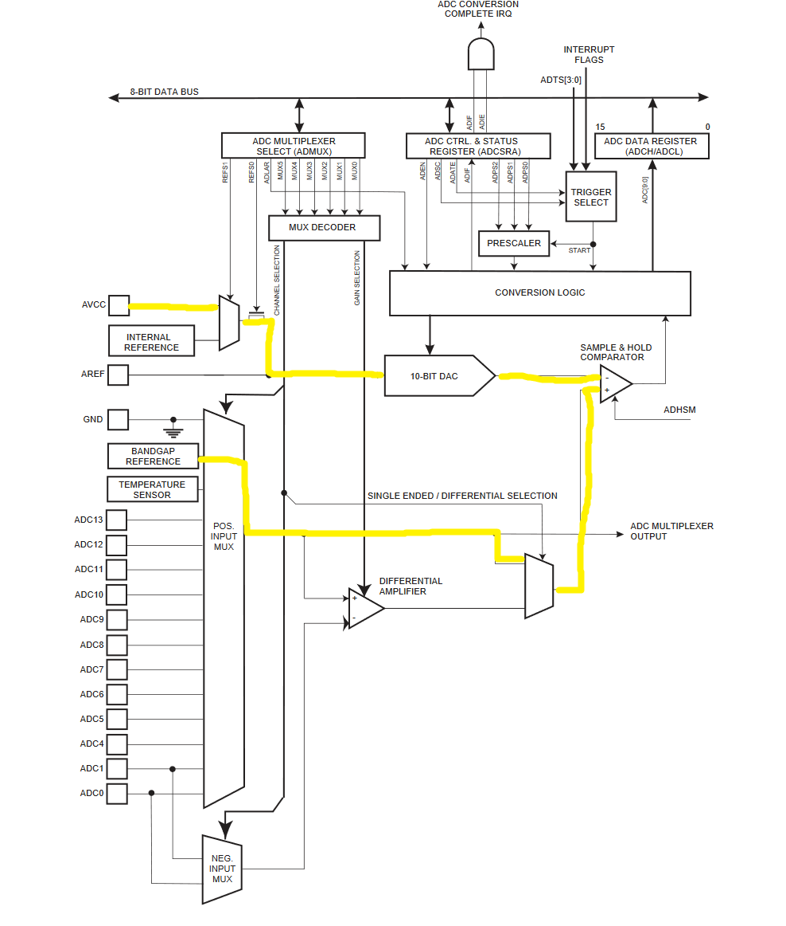
ADC Block Diagram
The ADC Input MUX allows us to select the bandgap reference as an input to the ADC
From here finding the input voltage is easy:
ADC = (Vin*1024)/Vref
Vin = 1.1V
Vcc = (1.1V*1024)/ADC

Slide 19
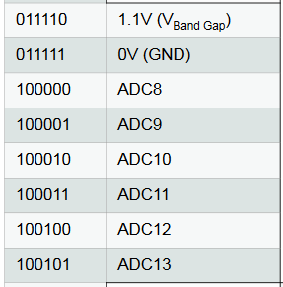
ADC Multiplexer Selection Register - ADMUX
Bits 7 & 6 allows us to select the voltage reference
We want AVcc (1 0)
Bits 5 - Select right adjust or left adjust
Bits 4-0 : Mux Select
NOTE: Mux bit 5 is in the ADCSRB Register
To select Bandgap we want B011110

Slide 20
ADC Control Register A
Bit 7 - Enable
Bit 6 - Start Conversion
Bit 5 - Interrupt Flag
Bit 4 - Interrupt Enable
Bit 3-0 - Prescaler select

Slide 21
ADC Control Register B
Bit 7 - ADC High Speed mode; allows faster conversion at expense of more power use
Bit 6 - Analog Comparator Mux Enable;(not relevant to ADC operation)
Bit 5 - MUX5
Bits 3:0 - ADC Auto Trigger, determines which source will trigger an ADC conversion

Slide 22
Data Register with ADLAR = 0 (Right Adjust)

Slide 23
Data Register with ADLAR = 1 (Left Adjust)

Slide 24
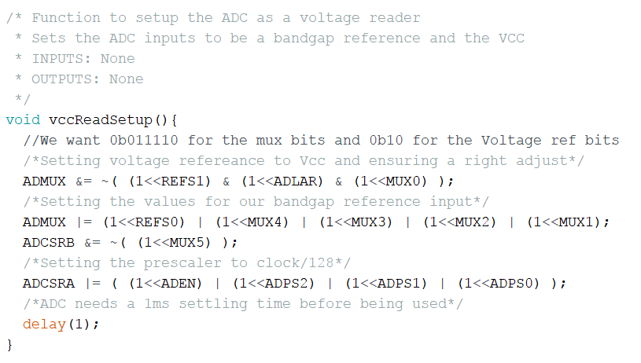
Setting up the ADC as a voltage reader in C++

Slide 25
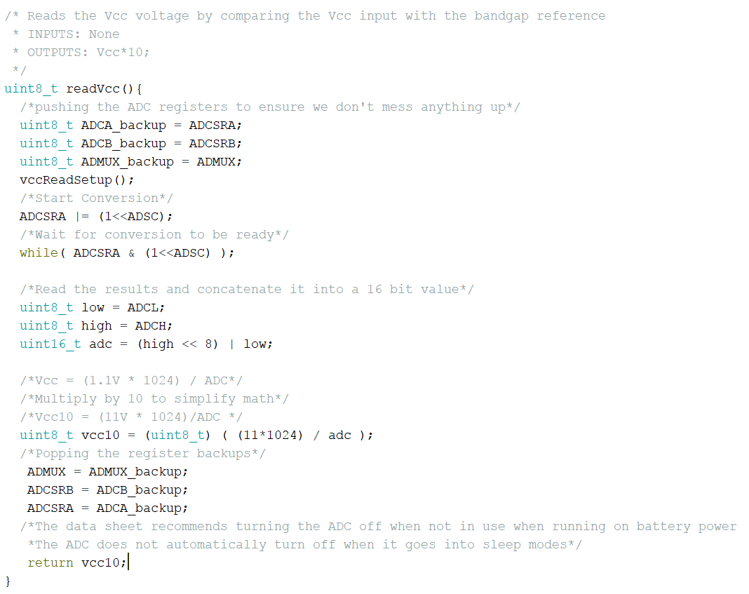
Reading Vcc Voltage
From here it’s a matter of deciding what your threshold for the backup and reset will be

Slide 26
Restoring from a Low Power Backup
To restore from a low power shutdown, we want to write a unique signature into the EEPROM.
In this case it’ll be a byte of memory in the beginning reading 0b01011010
When the Atmega starts up it’ll read the EEPROM and if it sees this byte at the beginning, it’ll know that a low power shutdown occurred
The next block of data will be the actual object
The last piece of data will be the not of the CRC value

Slide 27
Data Validation with CRC
CRC stands for cyclic redundancy check.
Commonly used simple algorithm to check whether data is correct
Derived by taking the exclusive OR of a byte of data with a CRC code and then exclusive ORing that with the next piece of data
Algorithms are designed for minimal contact
I’m using an open source FastCRC checking

Slide 28
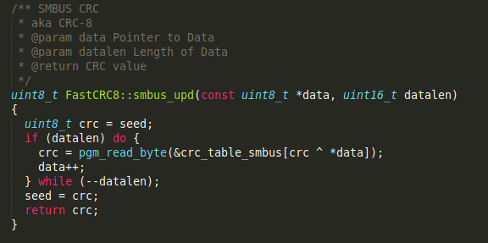
FastCRC8
A table is included with the files
What happens here is an initial crc value is taken and XOR’ed with a byte of data. This is then taken and used as an index for the next crc value to XOR.
This is done until the final byte of data then the last indexed value is returned.

Slide 29
Free Source for Code
I created a class for Data Backup in my github
github.com/ricardoalcaraz/DataBackupCRC

Slide 30
References
Atmega 32u4 data sheet

