Slide 1
Buck/boost converter model with motor load: results
EE444
Professor Hill
12-10-17
Tai Nguyen
Miki Kelley

Slide 2
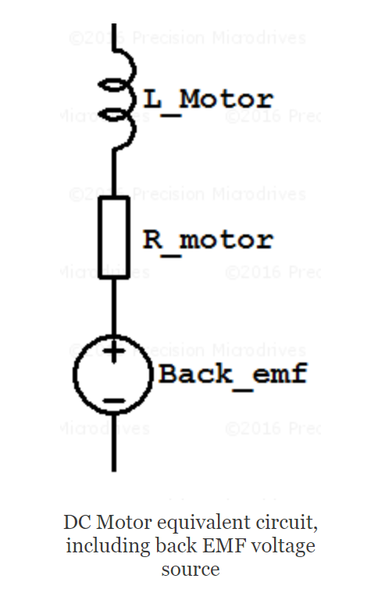
Measuring motor characteristics
Resistance measurement:
Motor is off
Do continuity check to ensure that the leads are connected
Measure resistance using multimeter and account for wire resistance
Inductance measurement:
Use AC signal and half deflection method for impedance
Use device!
Back emf measurement

Slide 3
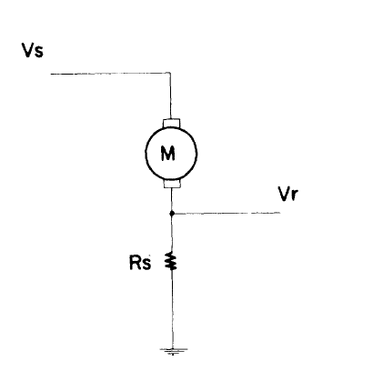
Back emf measurement method
The voltage drop from the back emf cannot be measured directly.
Rs = sense resistor
Vs = DC power supply voltage
Vr = voltage drop across sense resistor
Rm = motor resistance
K = Rs/(Rs+Rm)
Vb = Vs – Vr/K
Either measure the current or Vr (we tried both).
Finally, measure the motor speed (rad/s)

Slide 4
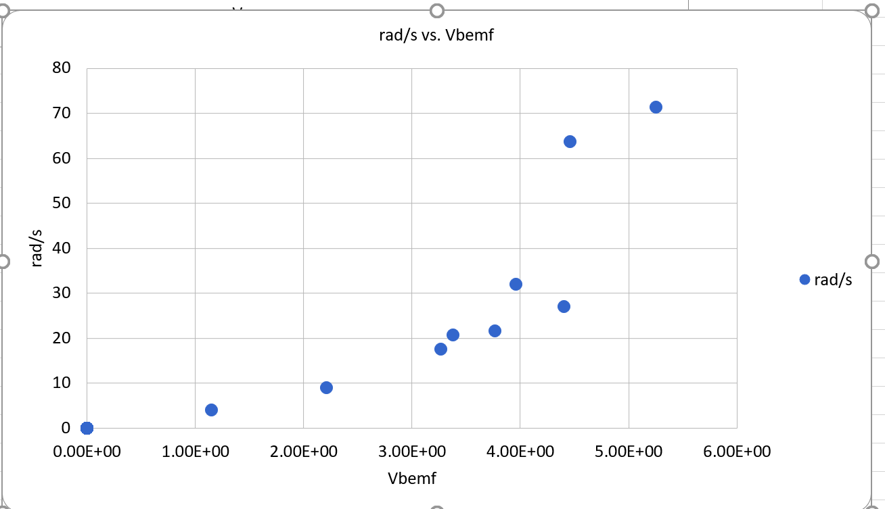
Results (measure current)

Slide 5
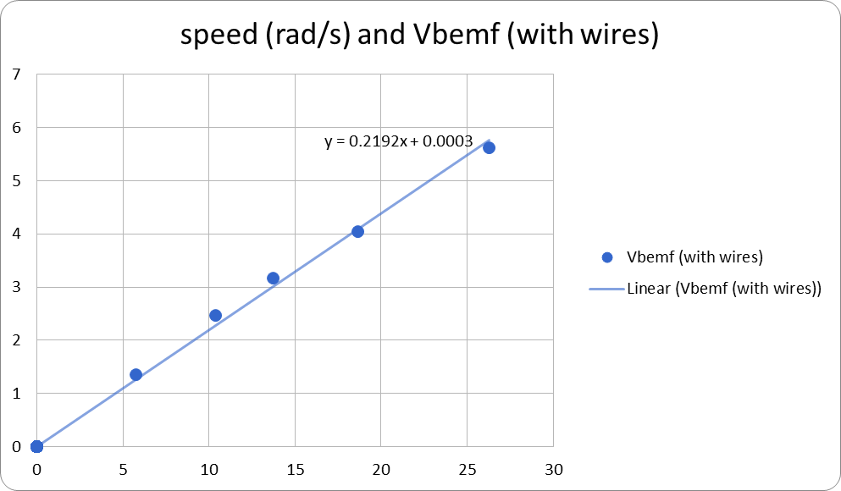
Results (measure Vr)
(Excel curve fitting)
Had to account for wire resistances since working at low resistance values (resistance of wires was about 2 Ohms)

Slide 6
Results (measure Vr)
Google spreadsheet…

Slide 7
Combined results

Slide 8
Comparing with datasheet torque constant
1 Force-gram centimeter (gmcm) = 9.81x10^-5 Nm
Kt1 = 0.293 Nm/A
Kt2 = 0.265 Nm/A

Slide 9
LTSpice models: simple check
How do RL circuits respond to square wave inputs?
Let’s get a good idea about how voltage and current behave for the inductors vs. the resistors

Slide 10
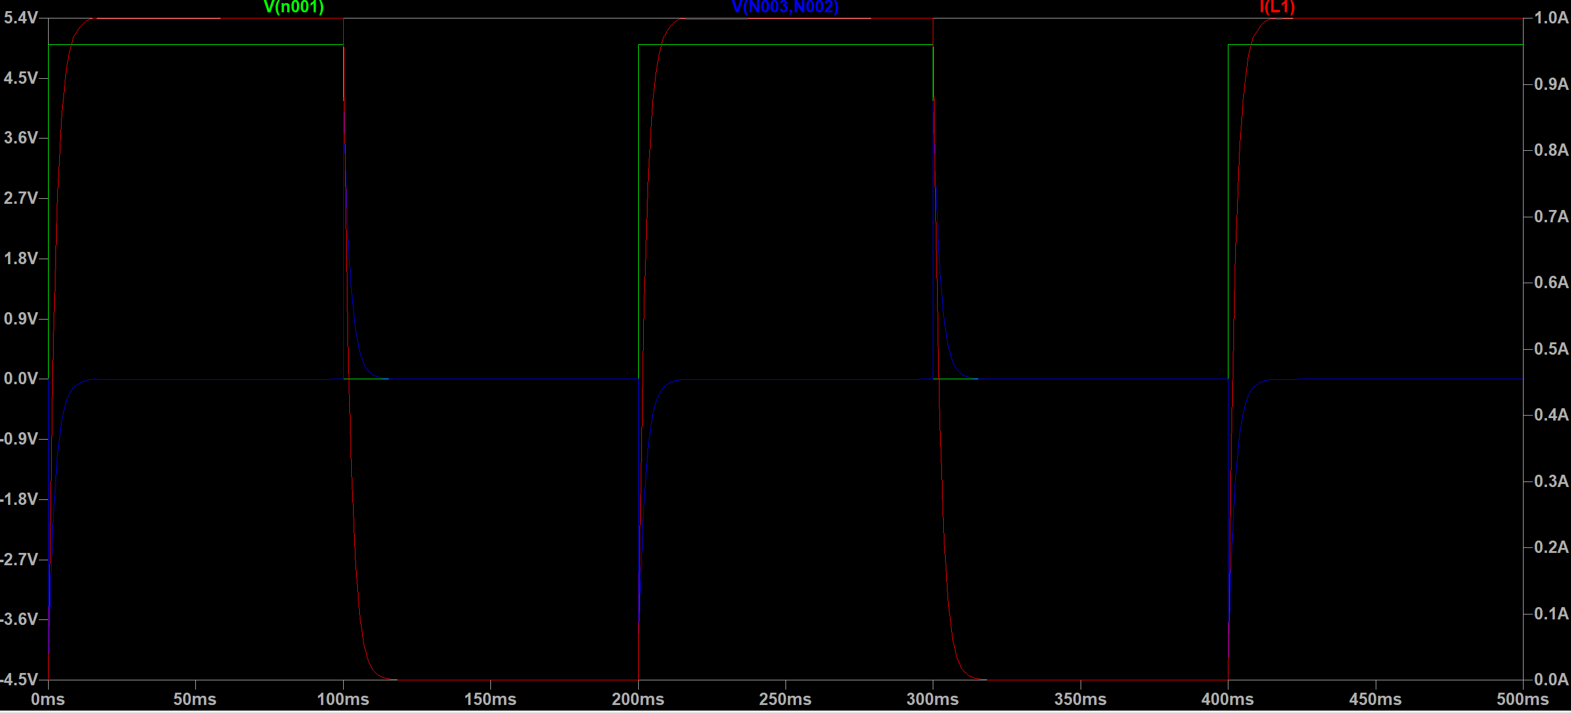
Inductor behavior
Inductor1
L1 = 2mH
Key point: to find the voltage vs. current relationship for the inductors, measure the voltage drop across the inductor, not the voltage drop from inductor to ground.
Inductor2
L2 = 10mH

Slide 11
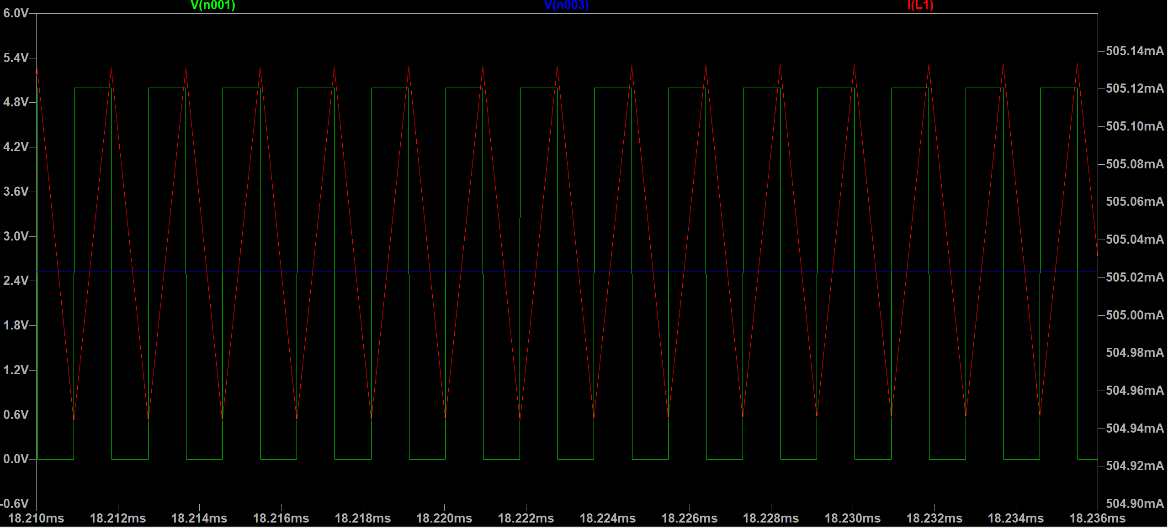
Inductor behavior vs. frequency
Arduino Fast PWM defaults to 250Hz
Boost converter designs range from 550kHz – 1250kHz
3DoT boost converter is between 1250-1650kHz
Simple inductor circuit with square wave behaves like boost converter! Ripple current with constant Vout
Frequency in simulation is at 550kHz (same as boost converter model used in simulation)
(Makes sense, the inductors are a low-pass filter for the resistive load)

Slide 12
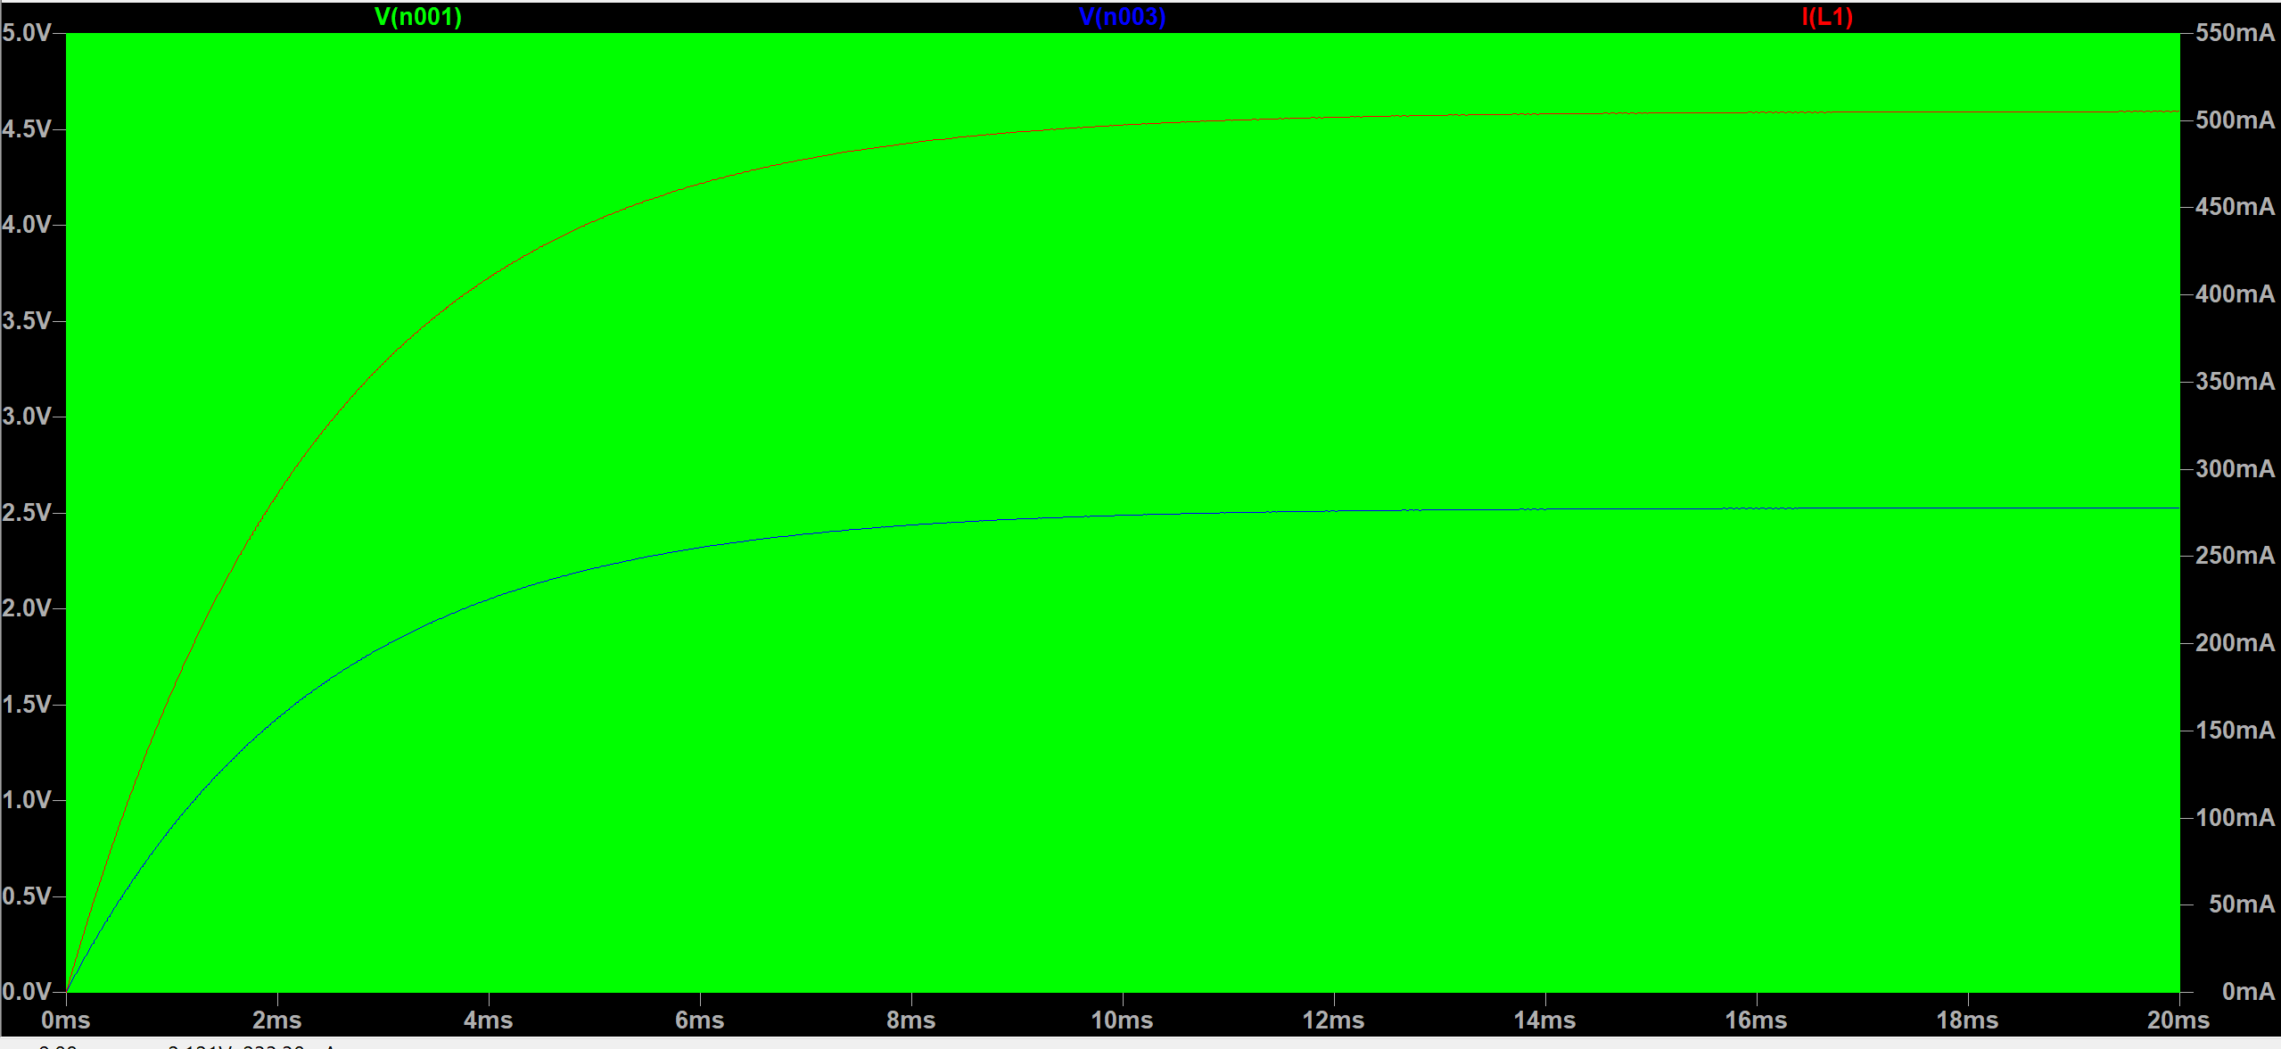
Steady state behavior (resistor)
Like a buck converter!

Slide 13
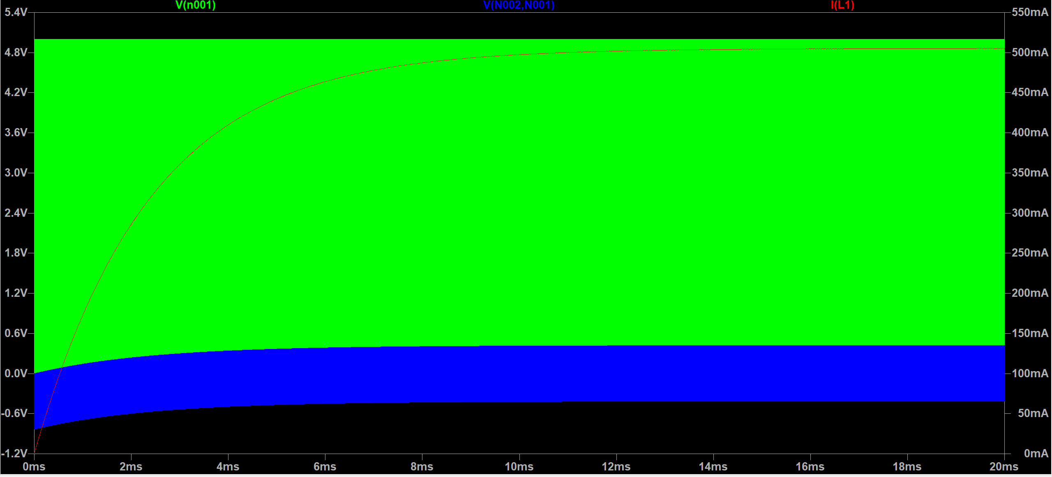
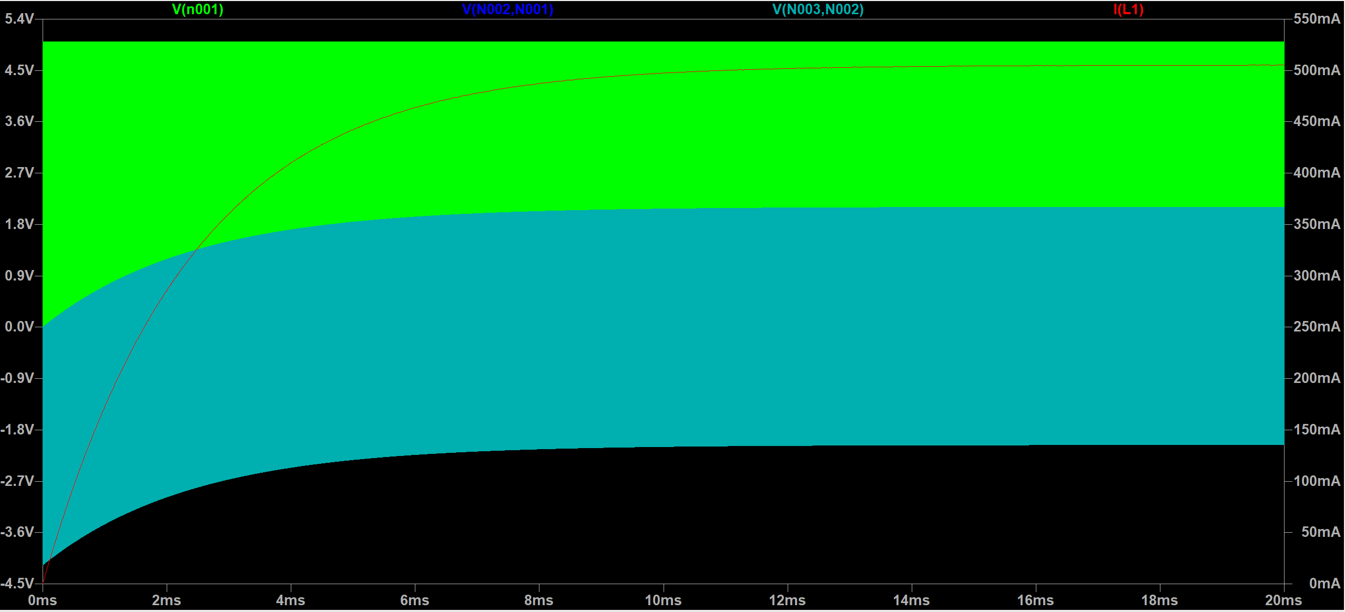
Steady state behavior – L1 vs. L2
Larger inductance produces larger ripple voltage across the inductor (not at output)
L1
L2

Slide 14
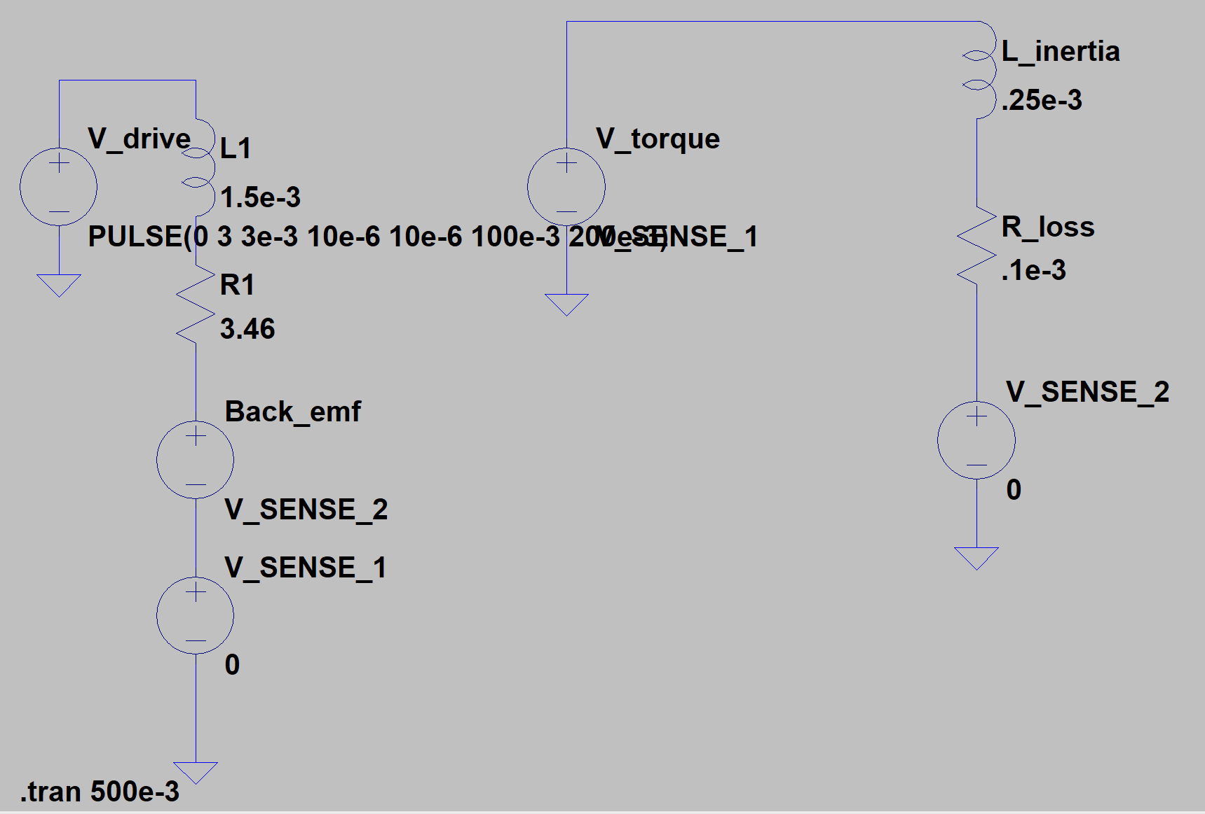
DC motor model check

Slide 15
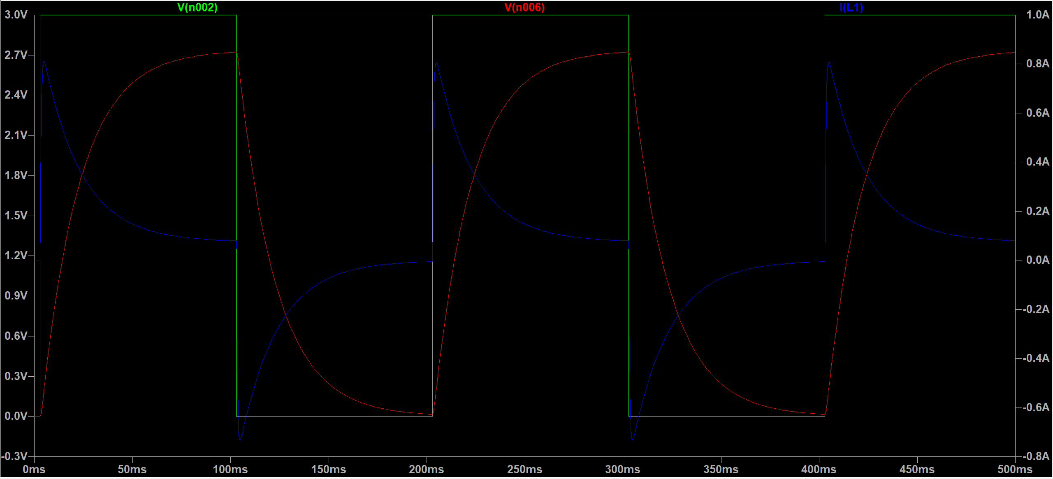
DC motor model check
Green: 5Hz square wave input
Blue: current through inductor (and load)
Red: Back emf
Turqoise

Slide 16
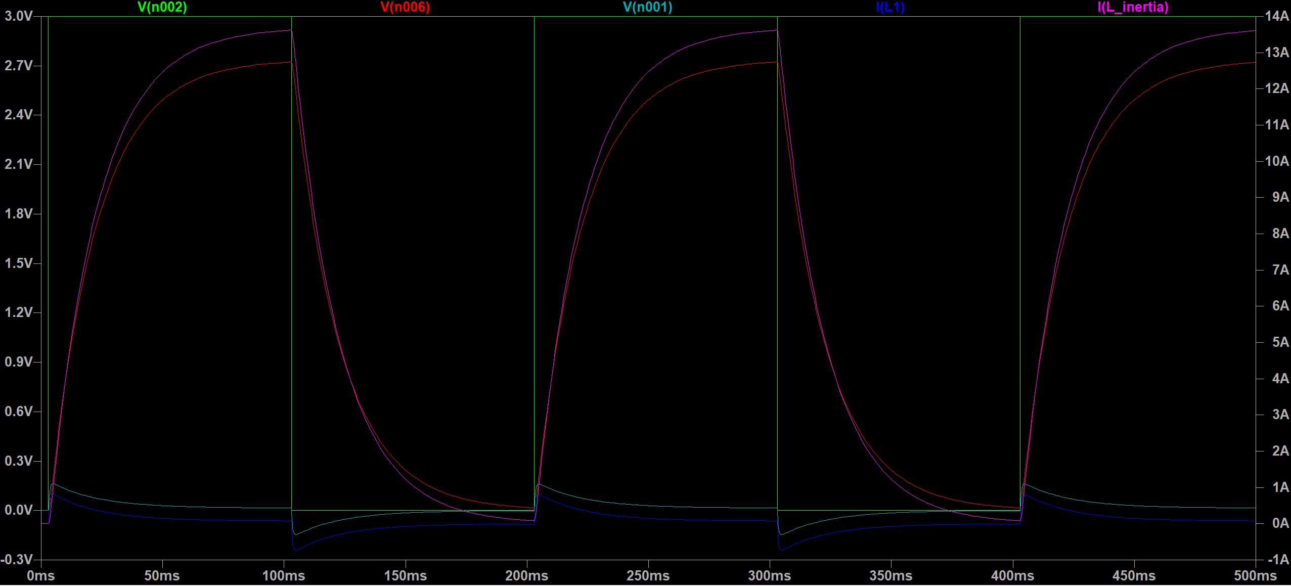
DC motor model check
Green: 5Hz square wave input
Blue: current through inductor (and load)
Red: Back emf
Turqoise: torque
Magenta: Back emf

Slide 17
Boost converter with resistive load

Slide 18
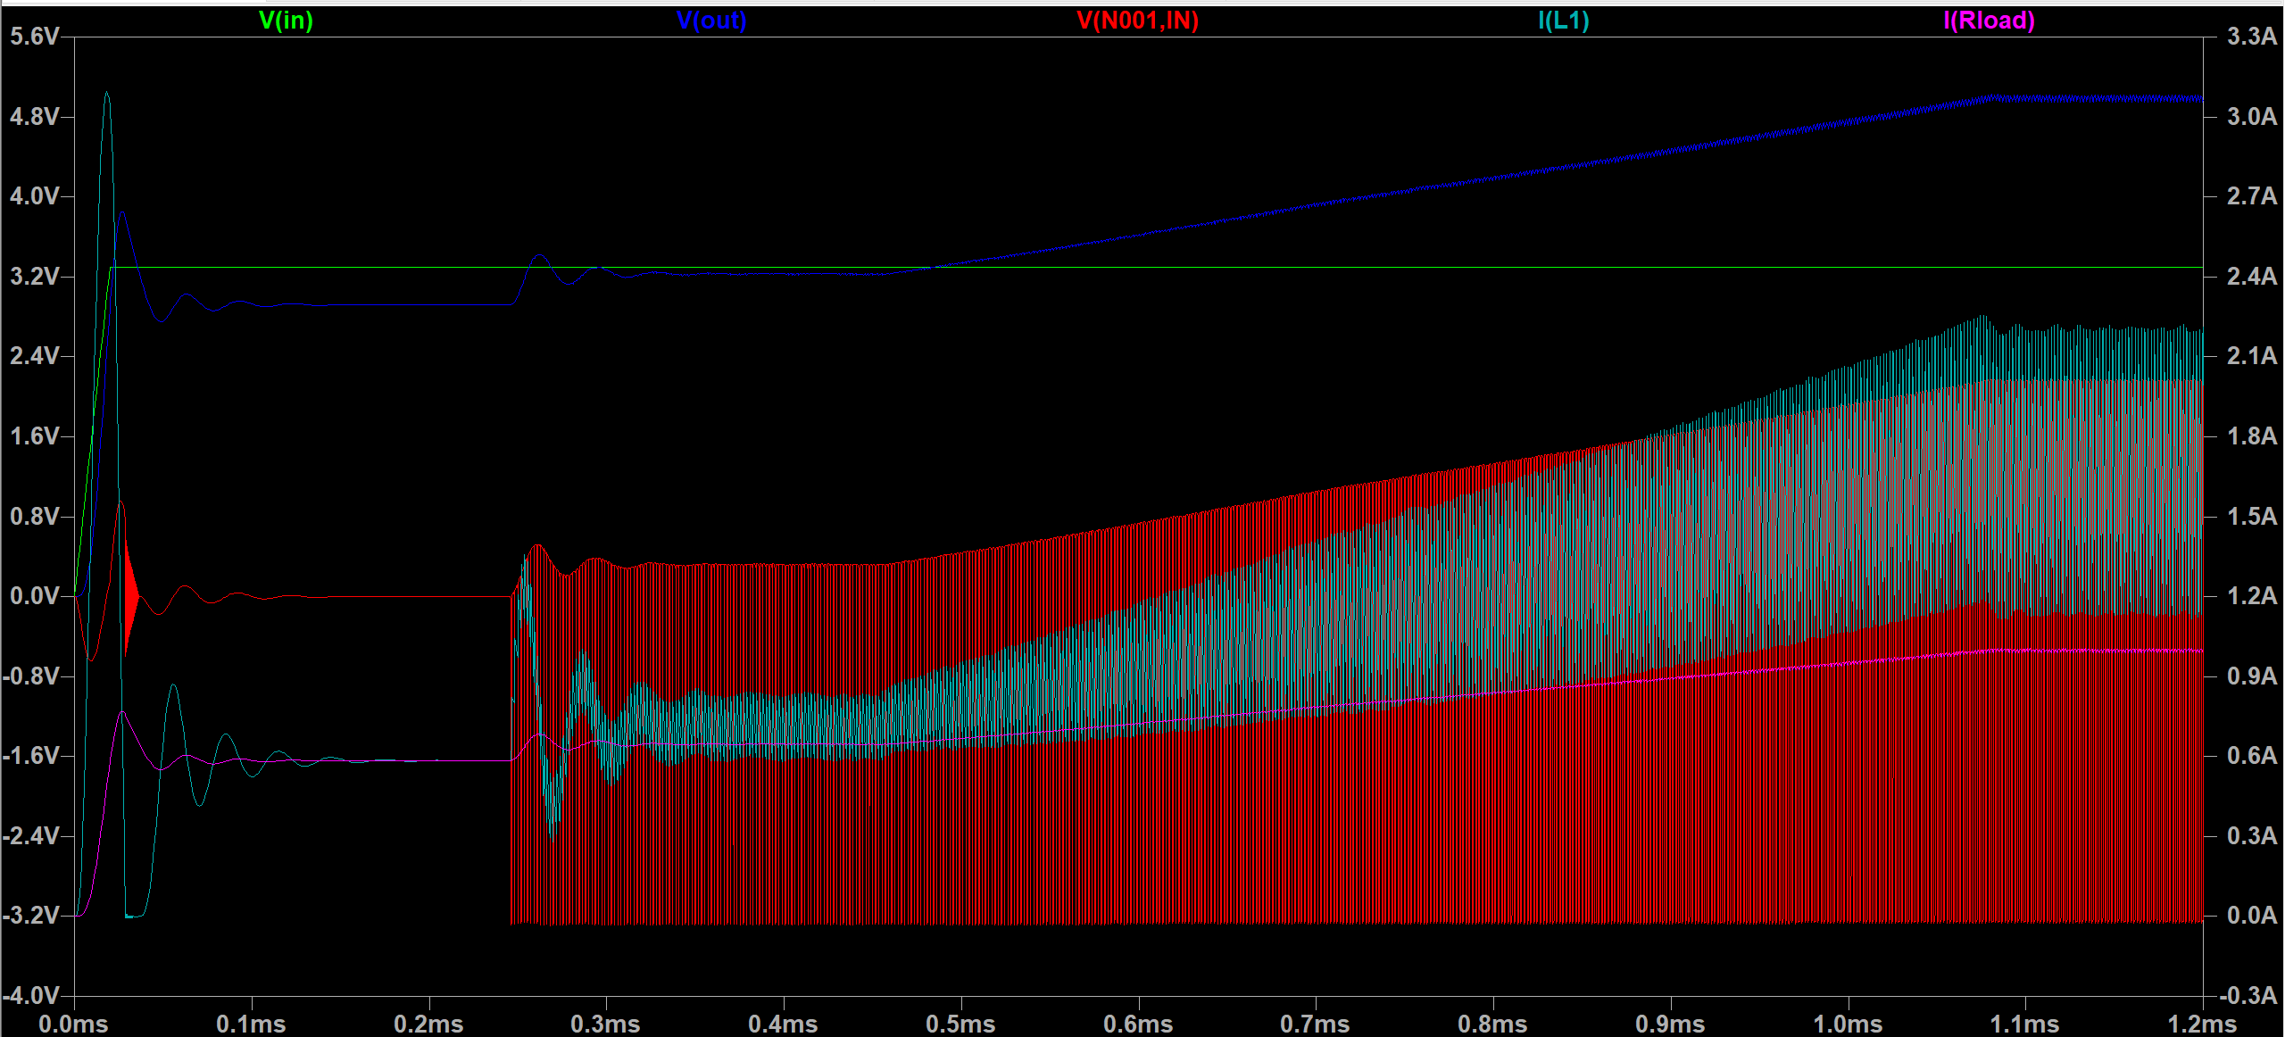
Transient response and reaching steady state
Green: Vin
Blue: Vout
Red: ∆V_{L}
Turqoise: ∆I_{L}
Magenta: Iout

Slide 19
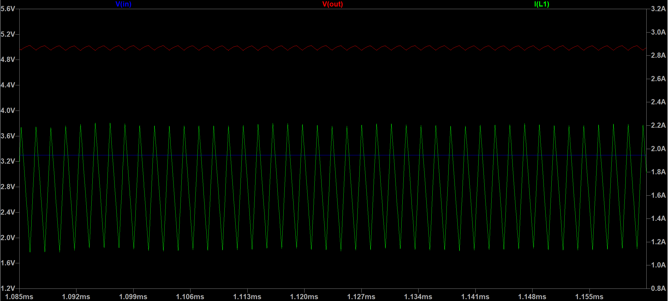
Steady state

Slide 20
Boost converter with motor load

Slide 21
Transient response (reaching steady state)

Slide 22
Steady state

Slide 23
Analysis
 | Resistive load | Motor load (L = 1.5mH) | Motor load (L = 1.5µH)
Ripple, Vout | 73.2mV | 100.4mV | 103.3mV
Ripple current, inductor | 1.077A | 1.087A | 1.083A
Ripple current, load | 14.5mA | 0A (not measurable) | 13.3mA
Average current, load | 1.00A | 1.36A | 1.36A
The ripple voltage is 37% higher with a motor load
Ripple current through the inductor does not change by much from resistive to motor load
Ripple current through load decreases with higher motor load inductance (from higher time constant)
Average current through load increases with motor load, but is not affected by inductance

