Slide 1
Bluetooth Antenna Design
Part 2
Matt Shellhammer | December 11th, 2017 | Mattshellhammer90@gmail.com

Slide 2
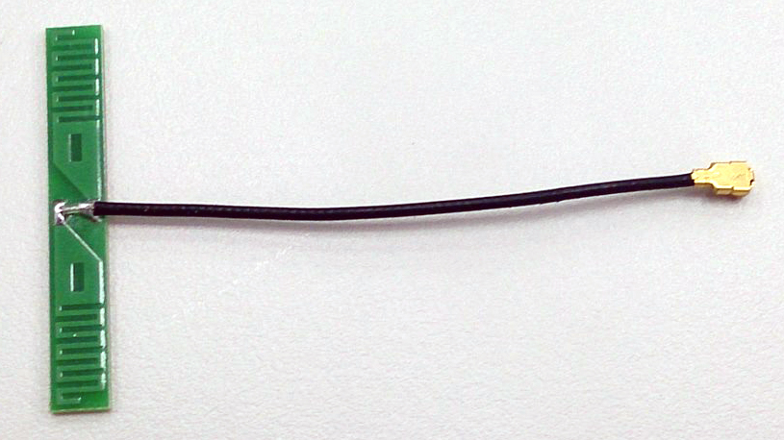
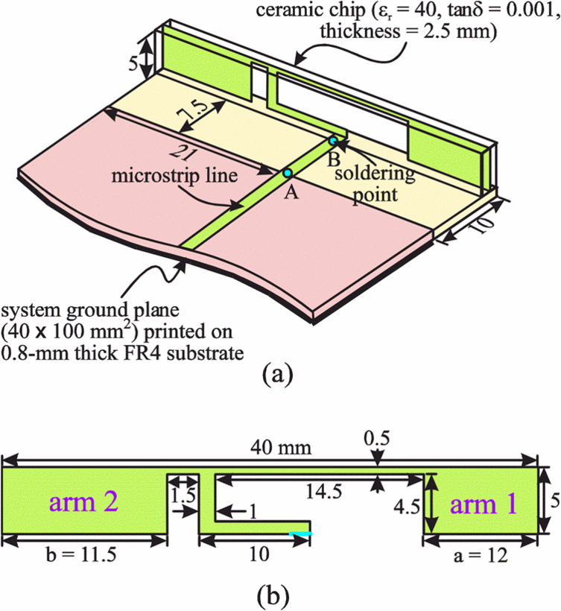
What is a Bluetooth antenna
Devices that are resonant at 2.45 GHz with a bandwidth of more than 100 MHz and an efficiency greater than 50% can be considered a Bluetooth antenna.
Due to these broad specifications there is many different forms of antennas for Bluetooth.
  Wire Monopole – This is a wire that is soldered at one end and fed along a plane and is trimmed to resonate at 2.45 GHz. This type of antenna has high efficiency however protrudes from the PCB.
  Ceramic — Smallest antennas available. Printed on a ceramic slab.
http://www.nienyi.com/e_channel.asp?id=44
https://electronics.stackexchange.com/questions/243341/how-does-a-chip-antenna-work

Slide 3
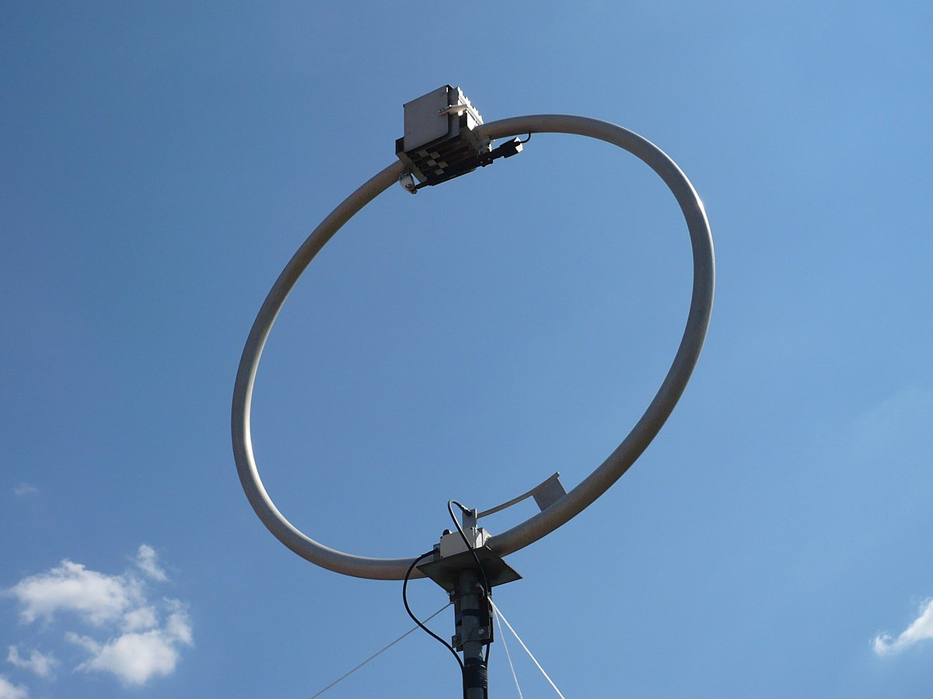
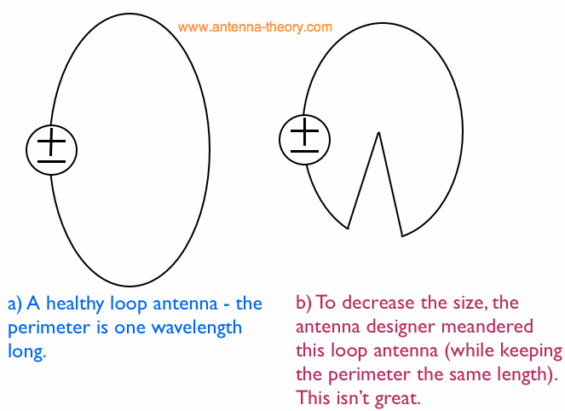
Antenna Types
Wire Antennas
  Loop antennas
The larger the loop antenna, the better the antenna.
Loop antennas do not have to be a perfect circle. As long as the perimeter is equal to one wavelength it will still function.
Can degrade the efficiency and bandwidth of the antenna
http://www.antenna-theory.com/antennas/loopantenna.gif
https://upload.wikimedia.org/wikipedia/commons/thumb/0/01/Loop_antenna.jpg/1200px-Loop_antenna.jpg
Notes:
As loop antennas get larger, they become better antennas. A loop antenna will be resonant (with a purely real impedance) as the perimeter of the loop approaches one wavelength in size. Hence, a 300 MHz loop antenna should have a perimeter of 1 meter or larger; a 2.4 GHz loop antenna will only need to be about 12 centimeters in perimeter.
It turns out the loop antenna does not need to be a perfect circle (as in Figure 1), or a tight rectangle as in the folded dipole case. The main parameter of interest is the perimeter length, which should be about a wavelength. Therefore, the enclosed loop area is not as important a parameter as the perimeter length. One note: it is not a great idea to meander the loop to increase the length. This causes the current to somewhat cancel and introduces capacitance to the loop, which degrades the efficiency and bandwidth of the antenna. A loop antenna designer may try to shrink the size of the loop antenna by meandering

Slide 4
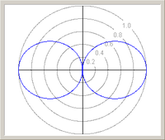

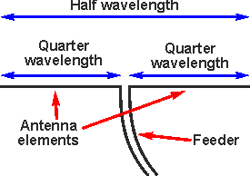
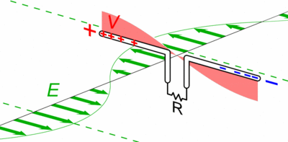
Antenna Types
Wire Antennas
  Dipole antenna (Special case: Half-wave dipole antenna)
Simplest and most widely used class of antenna.
The most common form of dipole antenna is the half-wave dipole, in which each pole is approximately a quarter wavelength long.
Also used in coaxial antennas (often known as a coaxial dipole) a particular form of a half-wave dipole antenna.
http://www.radio-electronics.com/images/half-wave-dipole.gif
https://upload.wikimedia.org/wikipedia/commons/thumb/d/dd/Dipole_receiving_antenna_animation_6_800x394x150ms.gif/400px-Dipole_receiving_antenna_animation_6_800x394x150ms.gif

Slide 5
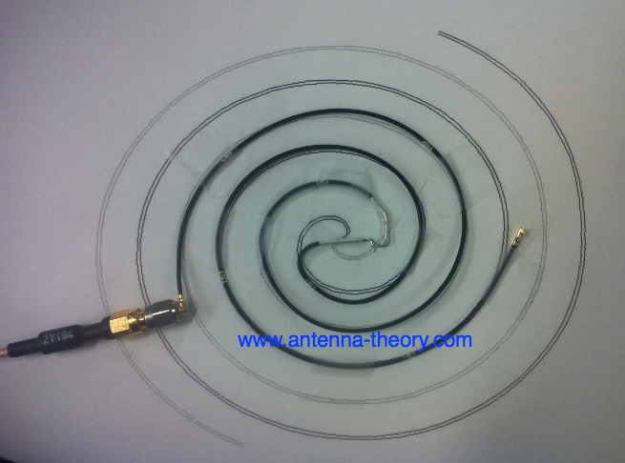
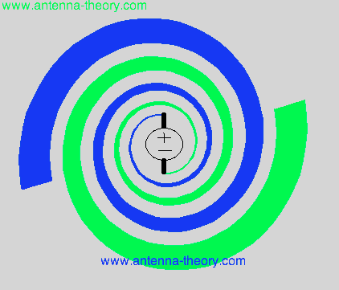

Antenna Types
Travelling Wave Antennas
  Spiral antennas
Frequency independent antennas
Having very large bandwidth with a fractional Bandwidth as high as 30:1
Spiral antennas are widely used when a wideband antenna that doesn’t take up too much space is needed
The outer radius of the antenna determines the lowest frequency of operation. And the highest frequency of operation is when innermost radius of the spiral is equal to a quarter of the wavelength. Often approximated to:
$f_{low}=\frac{c}{2πR_{spiral}}$ $f_{high}=\frac{c}{λ_{high}}=\frac{c}{4R_{0}}$
http://www.antenna-theory.com/antennas/travelling/logSpiral.gif
http://www.antenna-theory.com/antennas/travelling/spiralAntenna.gif
Notes:
The fractional Bandwidth can be as high as 30:1 meaning that if the lower frequency is 1 GHz, the antenna would still be efficient at 30 GHz, and every frequency in between.

Slide 6
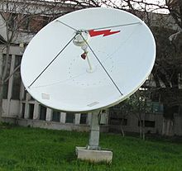
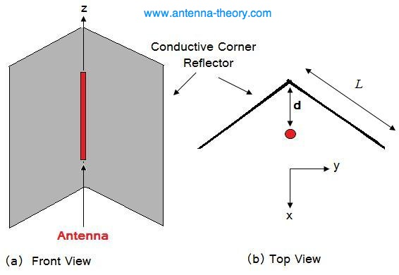
Antenna Types
Reflector Antennas
Reflectors can be used to increase the directivity of an antenna.
Reflectors can be used with various antennas to direct radiation in the forward direction.
They can also be used to redirect electromagnetic energy towards an antenna.
https://upload.wikimedia.org/wikipedia/commons/thumb/7/7b/Satellite_dish_1_C-Band.jpg/220px-Satellite_dish_1_C-Band.jpg
http://www.antenna-theory.com/antennas/reflectors/corner.jpg

Slide 7
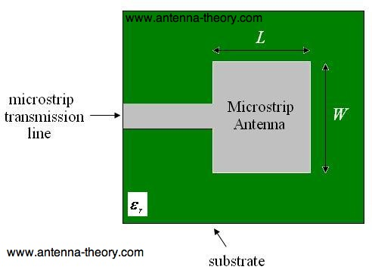
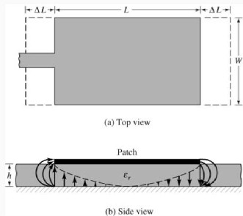
Antenna Types
Microstrip Antennas
  Rectangular Microstrip (Patch) Antenna
Patch antennas are low cost, have a low profile and are easily fabricated.
The length and the the permittivity of the antenna patch determines its resonant frequency.
Fringing fields around the antenna make the patch seem longer and cause a shift in the antennas resonant frequency.
When designing a patch antenna it is typically trimmed by 2-4% to achieve resonance at the desired frequency.
http://www.antenna-theory.com/antennas/patches/patch.jpg
https://www.ijser.org/paper/A-Review-on-Wearable-Textile-Patch-Antenna/Image_012.jpg
Notes:
Fringing fields have a great effect on the performance of a microstrip antenna. In microstrip antennas the electric filed in the center of the patch is zero. The radiation is due to the fringing field between the periphery of the patch and the ground plane. For the rectangular patch shown in the figure 2, there is no field variation along the width and thickness. The amount of the fringing field is a function of the dimensions of the patch and the height of the substrate. Higher the substrate, the greater is the fringing field. Due to the effect of fringing, a microstrip patch antenna would look electrically wider compared to its physical dimensions. As shown in Figure 2, waves travel both in substrate and in the air. Thus an effective dielectric constant εreff is to be introduced. The effective dielectric constant εreff takes in account both the fringing and the wave propagation in the line.

Slide 8
Dielectric Constant (Ceramic Antennas)
The small size of ceramic antennas is attributed to their high dielectric constant (high-κ) which concentrates its electric field and therefore maintains a high resonant frequency.
The dielectric constant of an antenna is often referred to as the relative permittivity (its permittivity expressed as a ratio relative to the permittivity of vacuum) of a material.
Permittivity is a material property that affects the Coulomb force between two charges in the material.

Slide 9
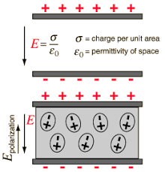

Permittivity
Permittivity is the amount of charge needed to generate one unit of electric flux in a particular medium (material). It is the measure of a material's ability to resist an electric field.
A charge will yield more electric flux in a medium with low permittivity than in a medium with high permittivity.
Size of dielectric resonator antenna: $\frac{λ_{0}}{\sqrt{ε_{r}}}$
  $λ_{0}$: free-space wavelength
  $ε_{r}$: Dielectric constant
https://encrypted-tbn0.gstatic.com/images?q=tbn:ANd9GcR9F9xEX8wRhC-o0PXbdIenaMmsq7TxZUb7nTcdudxtochNbM_R

Slide 10

Permittivity
The permittivity of a medium affects the speed of propagation of a wave through a medium and also its wavelength.
The speed of wave propagation for an antenna with a higher relative permittivity will be smaller than that of its speed in free space.
Therefore the wavelength of a plane wave decreases, yet the frequency remains constant.
$$λ=\frac{c}{f}=\frac{c_{0}}{f\sqrt{ε_{r}}}=\frac{λ_{0}}{\sqrt{ε_{r}}}$$

Slide 11
References
www.ti.com/lit/an/snoa519b/snoa519b.pdf
http://www.antenna-theory.com/antennas/main.php
https://en.wikipedia.org/wiki/Dipole_antenna
https://en.wikipedia.org/wiki/Dielectric_resonator_antenna
https://en.wikipedia.org/wiki/Permittivity
https://en.wikipedia.org/wiki/Relative_permittivity

Slide 12
Bluetooth Loss-of-Signal (LoS) Experiment
Part 2

Slide 13
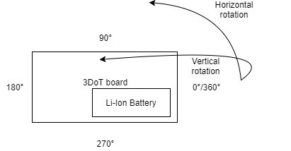
Experiment Layout
Captured Bluetooth signal power levels using the “BLE Scanner” app from the google play store.
Rotated around the board at various radii and recorded the power level at each point in space.
Set “BLE Scanner” app to scan for 6 seconds.
Experiment performed with 3DoT board (v4.54) and 3DoT chassis (with and without motors running).
Notes:
Experiment done with 3DoT v4.54 with no 3DoT chassis

Slide 14
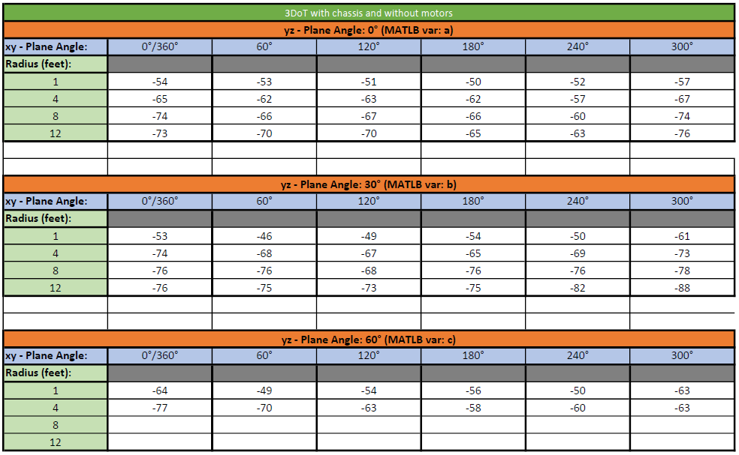
Experiment Data
Notes:
Didn’t do the last two columns because the phone would have had to be 6.9 & 10.4 feet in the air and that wasn’t feasible.

Slide 15
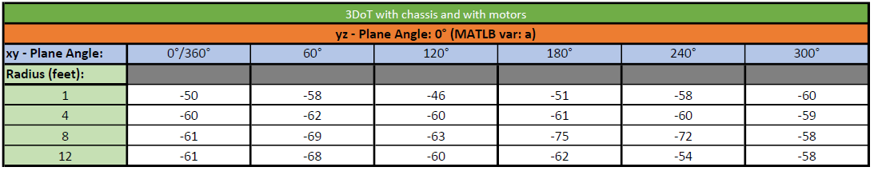
Experiment Data
Notes:
Only ran experiments

Slide 16
Full 2D space of experiment

Slide 17
Full 3D space of experiment (3DoT & Chassis)

Slide 18
Thanks For Listening

