Slide 1
Bluetooth Antenna Design
Matt Shellhammer | October 16th, 2017 | Mattshellhammer90@gmail.com

Slide 2
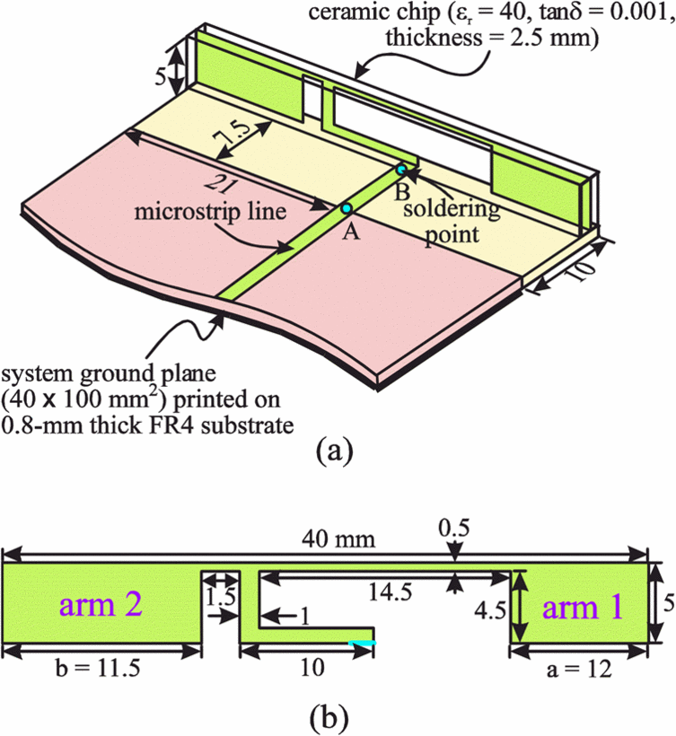
What is a Bluetooth antenna
Devices that are resonant at 2.45 GHz with a bandwidth of more than 100 MHz and an efficiency greater than 50% can be considered a Bluetooth antenna.
Due to these broad specifications there is many different forms of antennas for Bluetooth.
Wire Monopole – This is a wire that is soldered at one end and fed along a plane and is trimmed to resonate at 2.45 GHz. This type of antenna has high efficiency however protrudes from the PCB.
Ceramic — Smallest antennas available. Printed on a ceramic slab.
http://www.nienyi.com/e_channel.asp?id=44
https://electronics.stackexchange.com/questions/243341/how-does-a-chip-antenna-work

Slide 3
Other Various Antenna Types
Wire Antennas
Loop antenna
Dipole antenna (Special case: Half-wave dipole antenna)
Travelling Wave Antennas
Reflector Antennas
Microstrip Antennas
Rectangular Microstrip (Patch) Antenna
Log-Periodic Antennas
Aperture Antennas
Slot antenna
Other
Wearable antenna

Slide 4
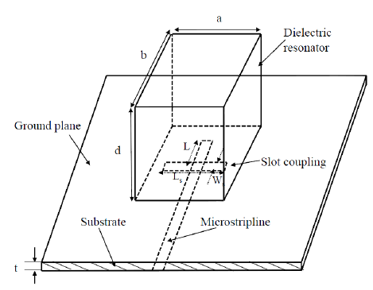
Ceramic antennas
The big advantage of ceramic antennas are that they are small.
There small size is attributed to their high dielectric constant (high-κ) which concentrates its electric field and therefore maintain a high resonant frequency.
Size of ceramic antenna: $\frac{λ_{0}}{\sqrt{ε_{r}}}$
$λ_{0}$: free-space wavelength
$ε_{r}$: Dielectric constant
https://www.researchgate.net/figure/237054209_fig1_Figure-1-A-rectangular-Dielectric-resonator-antenna-geometry
Notes:
- Metal parts become lossy at high frequencies and dissipate energy.
Chosing a high dielectric constant will allow for a relatively small device.
Dipole antennas are most commonly referring to half-wavelength. Therefore the size of a dipole antenna is $λ/2$ so for Bluetooth at 2.45 GHz a dipole antenna would be 61.2 mm

Slide 5
Additional benefits of Dielectric resonator (ceramic) antennas
Dielectric resonator (ceramic) antennas (DRA) lack metal parts. Because of this, they can have higher efficiency than metal antennas at higher frequencies.
The Bandwidth of a DRA can be easily varied from a fraction of a percent to approximately 20%.
Notes:
“The operating bandwidth of a DRA can be varied over a wide range by suitably choosing resonator parameters. For example, the bandwidth of the lower order modes of a DRA can be easily varied from a fraction of a percent to about 20% or more by the suitable choice of the dielectric constant of the material and/or by strategic shaping of the DRA element.”

Slide 6
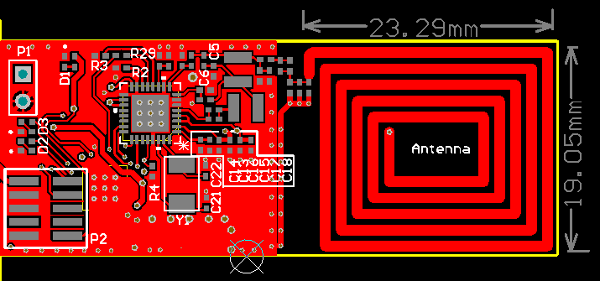
PCB (Microstrip) Antennas
PCB antennas are traced into the PCB which can reduce the manufacturing costs since it’s included in the PCB assembly process.
PCB antennas are thin, simple and generally have fairly large bandwidth.
Small changes or tolerance variations within PCB manufacturing process can result in an offset center frequency which can cause frequency shifting.
https://e2e.ti.com/support/wireless_connectivity/nfc_rfid/f/667/t/496205
Notes:
Though the PCB manufacturing process is fairly reliable these very minuscule variations can have a large effect on the antenna due to the inherit nature of antennas being sensitive devices.

Slide 7
Ceramic vs PCB
Ceramic antennas have less significant detuning issues when placed in close proximity to other component.
Ceramic antennas are effected less by environmental factors (obstructions) than PCB antennas.
PCB antennas are limited on tuning options, ceramic antennas can simply use a matching circuit.
PCB antennas take up space on the PCB that could be used for other components.

Slide 8
Antenna Radiation
Free space path loss, $FSPL= {\left(\frac{4 π d}{λ}\right)}^{2}$, will be consistent for all Bluetooth antennas since they’re all operating at the same frequency.
However, each antenna will have its own radiation pattern.
What is most desired for our applications is an omnidirectional antenna radiation pattern.
Radiation pattern should be taken into account when thinking about what applications the antenna will be used for.
Notes:
The reason for the frequency dependence is that the equation contains two effects:
The first results from the spreading out of the energy as the sphere over which the energy is spread increases in area. This is described by the inverse square law.
The second effect results from the antenna aperture change. This affects the way in which any antenna can pick up signals and this term is frequency dependent.

Slide 9
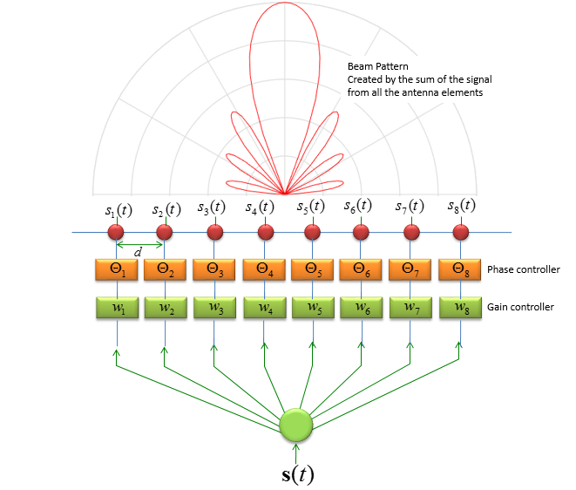
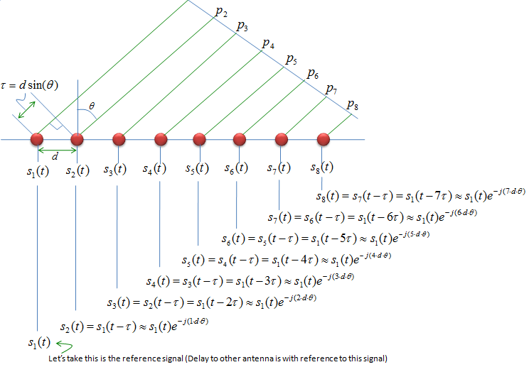
Beamforming
Directional beamforming is the process of focusing a signal in a specific direction to improve the signal strength in the path of the beam.
Applications: wireless communications, radar, sonar, etc.
This technique can all be used to implement spatial filtering
For our applications beamforming is not desired.
http://www.sharetechnote.com/html/Handbook_LTE_BeamForming.html
Notes:
This is possible due to constructive and destructive interference.

Slide 10
References
www.ti.com/lit/an/snoa519b/snoa519b.pdf
http://www.antenna-theory.com/antennas/main.php
https://en.wikipedia.org/wiki/Dielectric_resonator_antenna
https://www.researchgate.net/figure/237054209_fig1_Figure-1-A-rectangular-Dielectric-resonator-antenna-geometry
https://www.digikey.jp/Web%20Export/Supplier%20Content/Pulse_553/PDF/pulse_ceramic-chip-antennas-vs-pcb-trace-antennas.pdf

Slide 11
Bluetooth Loss-of-Signal (LoS) Experiment

Slide 12
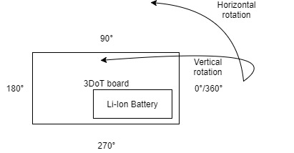
Experiment Layout
Captured Bluetooth signal power levels using the “BLE Scanner” app from the google play store.
Rotated around the board at various radii and recorded the power level at each point in space.
Set “BLE Scanner” app to scan for 8 seconds.

Slide 13
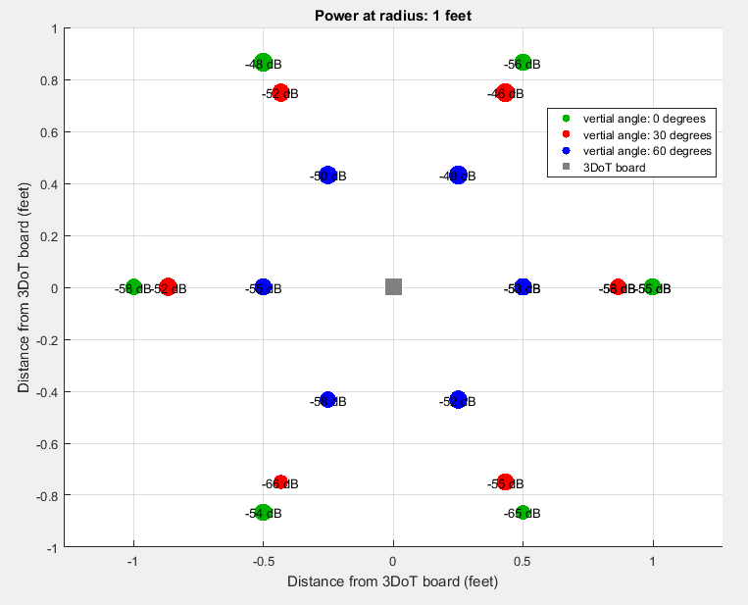
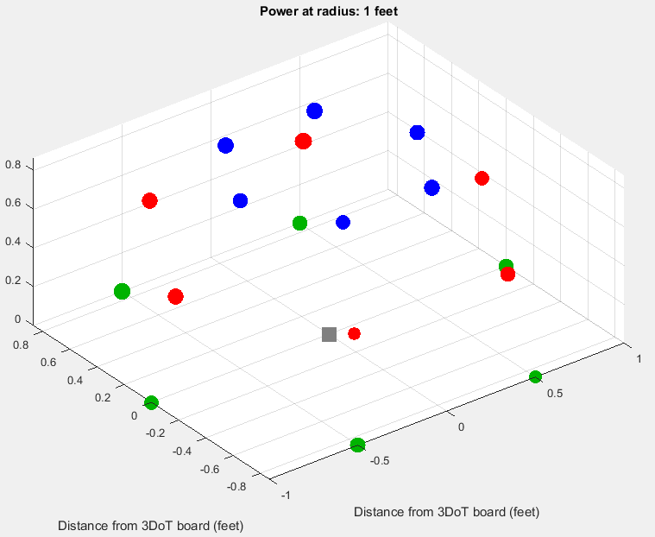
Results at radius: 1 foot

Slide 14
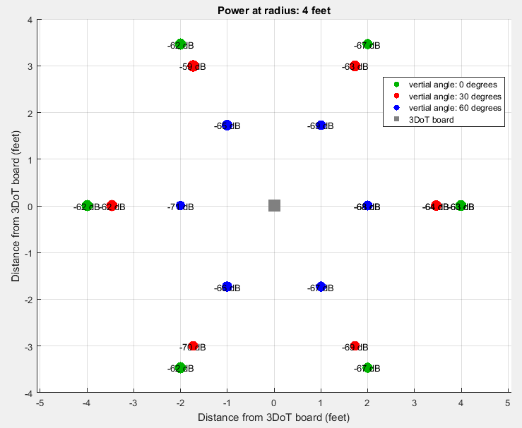
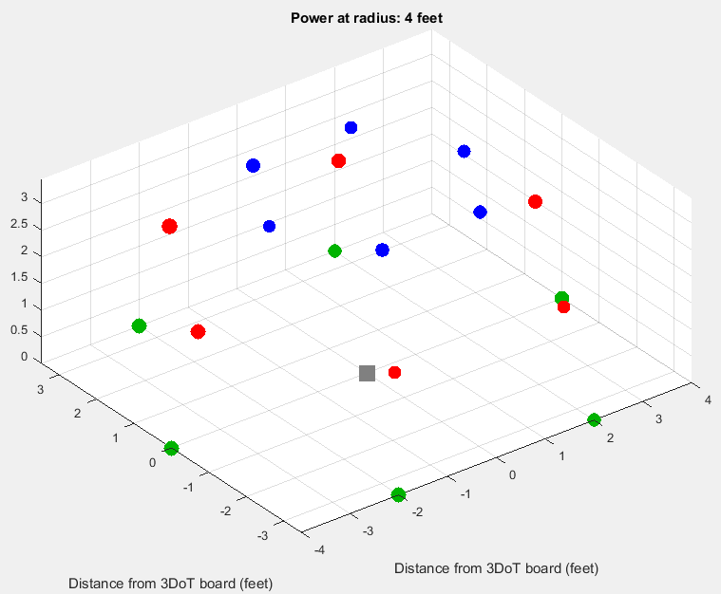
Results at radius: 4 feet

Slide 15
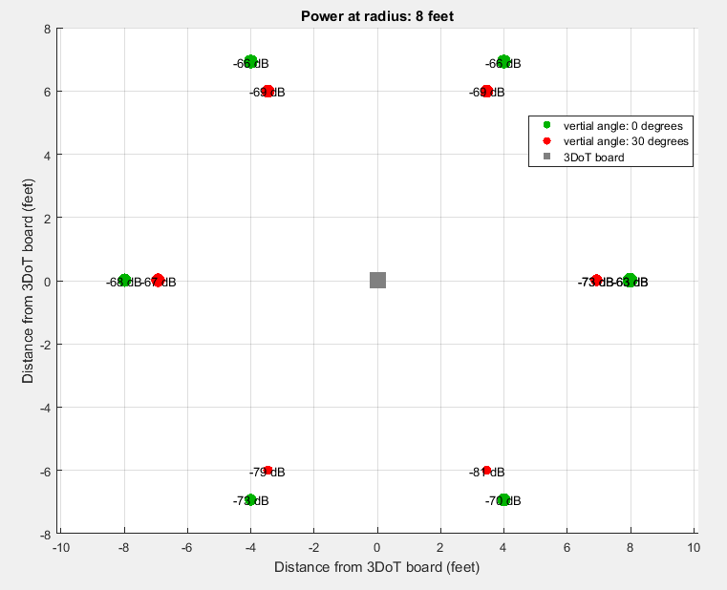
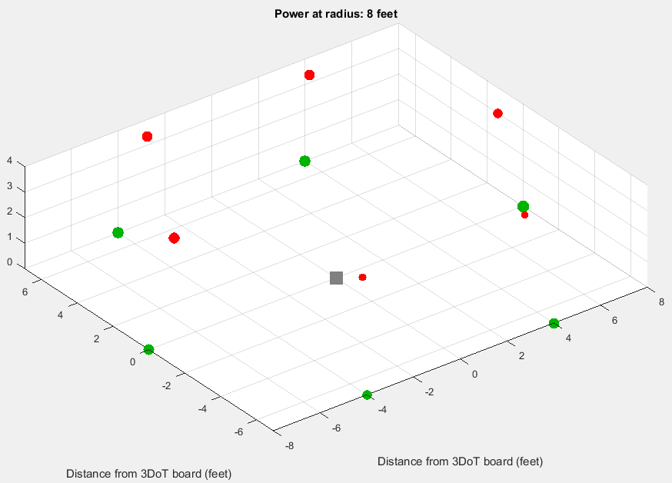
Results at radius: 8 feet

Slide 16
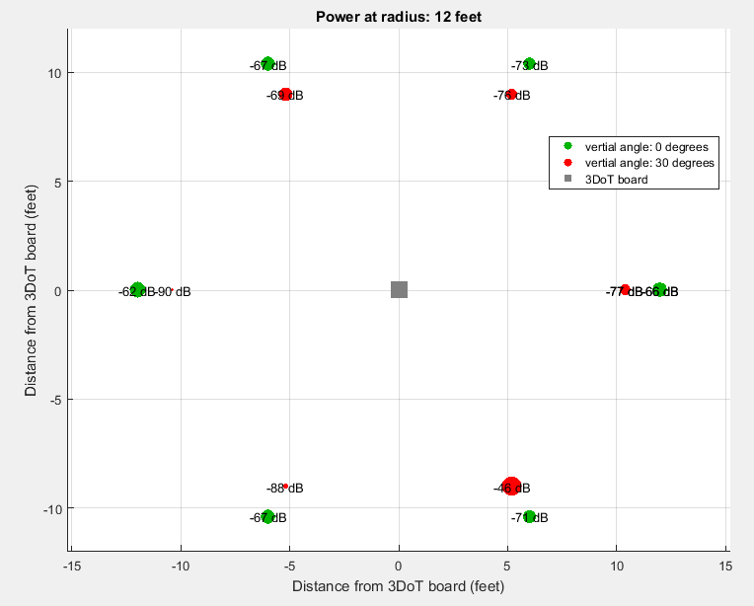
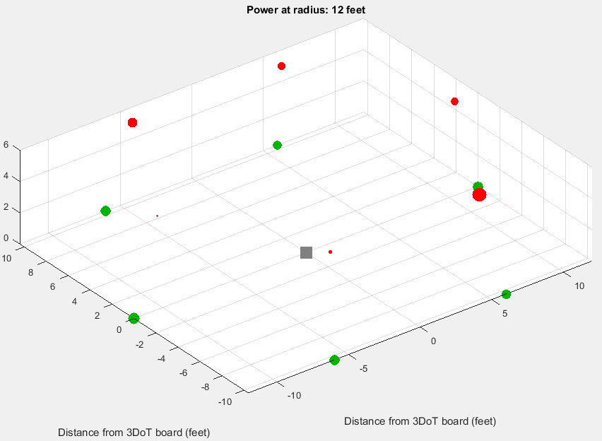
Results at radius: 12 feet

Slide 17
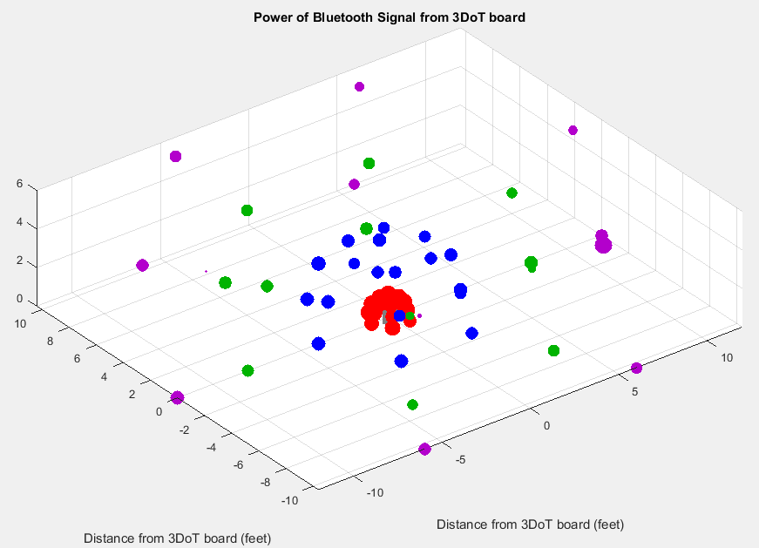
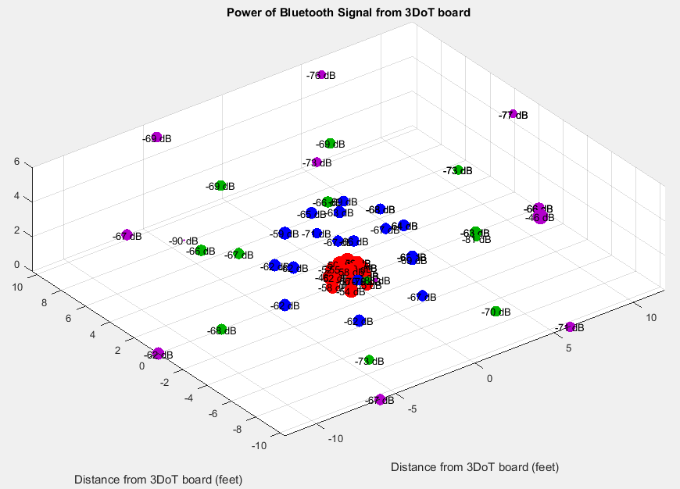
Full 3D space of experiment
Notes:
Red: radius = 1 foot
Blue: radius = 4 feet
Green: radius = 8 feet
Purple: radius = 12 feet

Slide 18
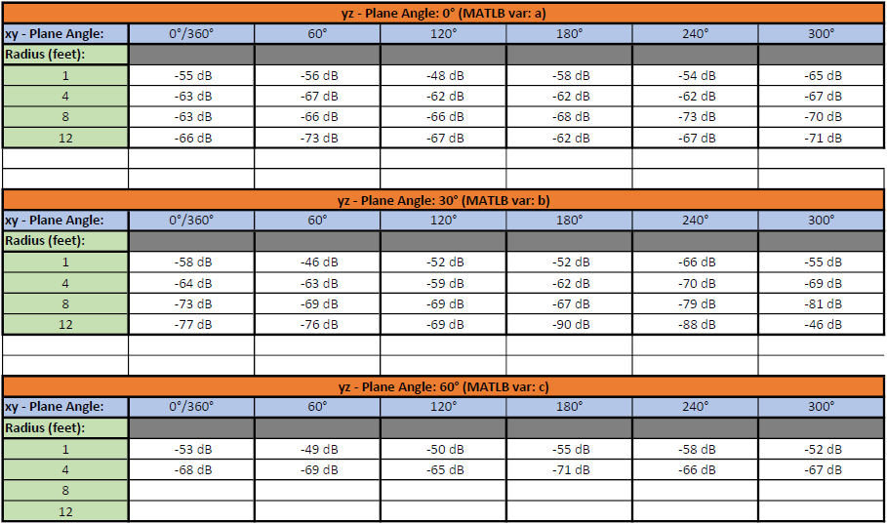
Experiment Data
Notes:
Didn’t do the last two columns because the phone would have had to be 6.9 & 10.4 feet in the air and that wasn’t feasible.

Slide 19
Thanks For Listening

Slide 20
Questions

Slide 21
Questions 1-6
What is the resonant frequency of a Bluetooth antenna?
5 GHz
2.45 GHz
3.45 GHz
950 MHz
What is the minimum bandwidth for a device to be considered a Bluetooth device?
100 kHz
500 kHz
150 MHz
100 MHz
Which type of the following antennas is the smallest antenna available?
Loop antenna
Microstrip (patch) antenna
Dipole antenna
Dielectric resonator (ceramic) antenna
What is a benefit of a PCB antenna?
Reduced manufacturing costs
Objects don’t interfere with signal
Easy tuning process to improve antenna performance.
They have an efficiency of 95%
Which antenna allows for more components to be used on the PCB?
Ceramic antenna
PCB antenna
Which frequency will have the greatest Free Space Path Loss (FSPL)?
1 GHz
2.45 GHz
10 GHz
200 MHz

Slide 22
Questions 1-6 Answers
What is the resonant frequency of a Bluetooth antenna?
5 GHz
2.45 GHz
3.45 GHz
950 MHz
What is the minimum bandwidth for a device to be considered a Bluetooth device?
100 kHz
500 kHz
150 MHz
100 MHz
Which type of the following antennas is the smallest antenna available?
Loop antenna
Microstrip (patch) antenna
Dipole antenna
Dielectric resonator (ceramic) antenna
What is a benefit of a PCB antenna?
Reduced manufacturing costs
Objects don’t interfere with signal
Easy tuning process to improve antenna performance.
They have an efficiency of 95%
Which antenna allows for more components to be used on the PCB?
Ceramic antenna
PCB antenna
Which frequency will have the greatest Free Space Path Loss (FSPL)?
1 GHz
2.45 GHz
10 GHz
200 MHz

Slide 23
Questions 7-10
All antennas have the same radiation pattern.
True
False
Omnidirectional antennas are useful for spatial filtering.
True
False
Which is not an application of beamforming?
Wireless communications
Radar
Microcontroller robots
Sonar
Generally what is the length of a dipole antenna?
4λ
2λ
λ/2
λ

Slide 24
Questions 7-10 Answers
All antennas have the same radiation pattern.
True
False
Omnidirectional antennas are useful for spatial filtering.
True
False
Which is not an application of beamforming?
Wireless communications
Radar
Microcontroller robots
Sonar
Generally what is the length of a dipole antenna?
4λ
2λ
λ/2
λ

