Slide 1
PID Controllers
Jordan smallwood

Slide 2
Overview
Definition – Proportional Integral Derivative Controller is a control feedback compensation system used in a wide variety of industry applications.
Continuous modulation and calculation of error, e(t), as the difference between present value and set point.
It’s not about the destination, it’s about how you get there.
I.E overshoot, delay, stability.

Slide 3
PID Theory
Proportional: Corrects the current value
Integral: Examines the past
Derivative: Forecasted events
Various compensators have different desirable/undesirable characteristics, such as PI, PD, and PID. We will look at these on the next few slides.

Slide 4
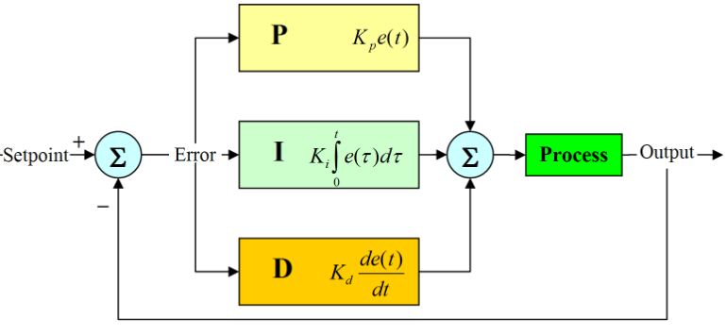

Slide 5
PI Compensator
Improves steady state accuracy by increasing the system type number, which is adding a pole to the forward path of closed loop transfer function
Increases instability or the transient response, typically has a higher overshoot.
Transfer function of proportional-plus-integral compensator:

Slide 6
PD Compensator
System type number decreases by one because of the open-loop zero added, which in turn improves stability.
Primarily used to improve the relative stability of a system.
Can have effect on steady-state error however.

Slide 7
PID: Have your cake, and eat it too.
PID Compensator combines the steady state accuracy of the PI compensator with the improvement in stability of a PD compensator. This is also nice in terms of design, you can design the PD compensator and PI compensator individually (determine gain such that stability is optimized) and superimpose one on the other.
PD controller will reduce the overshoot and settling time but increases steady state error and has effect on rise time
PI controller will eliminate steady state error, reduce rise time, and increase the overshoot. Respective gains are adjusted to optimize.

Slide 8
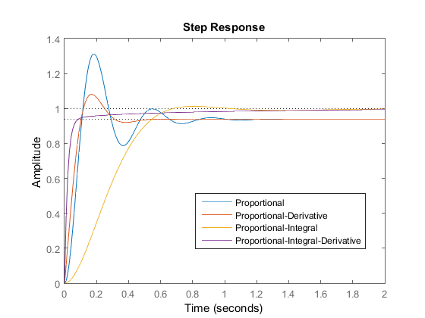

Slide 9
Continuous to Discrete (Differentiation)
These mathematical models are very nice but don’t really help when it comes to discrete values.
Remember the definition of the derivative:
After some manipulation we arrive at the difference equation:

Slide 10
Continuous to Discrete (Integration)
The definition of the integral is known as the area under a curve:
For our situation, we will be able to evaluate discrete integrals by the time step and the present value.

Slide 11
Why we need this
Our robot will be travelling through a maze and needs to know where the walls are.
Line following robots are everywhere, they use IR sensors to determine where the line is and since most motors do not operate flawlessly, we need to adjust the left and right motor speeds to keep the robot on track.
We can also use this concept for a wall following robot that will keep the robot within the walls of the maze.
Our PID controller will accept the current position as the input, compensate using a PID controller and output left and right motor speeds to adjust the position such that the robot displays the desired response.

