Slide 1
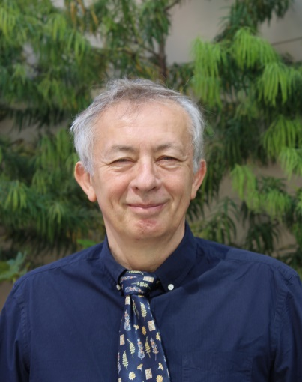
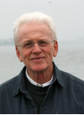
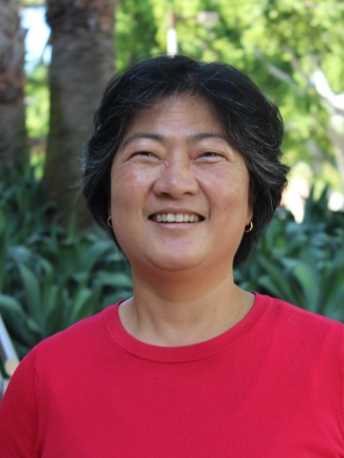
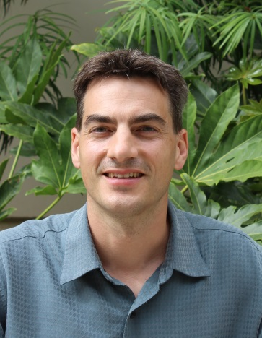
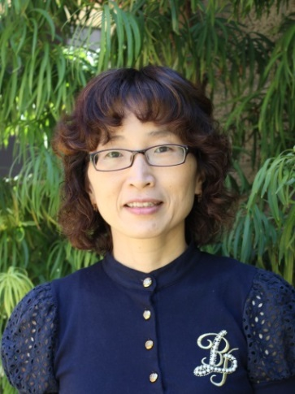
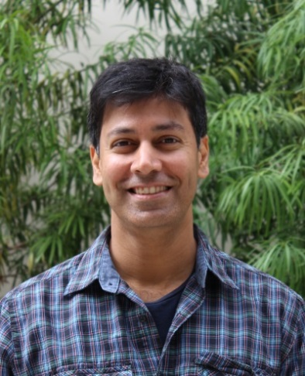
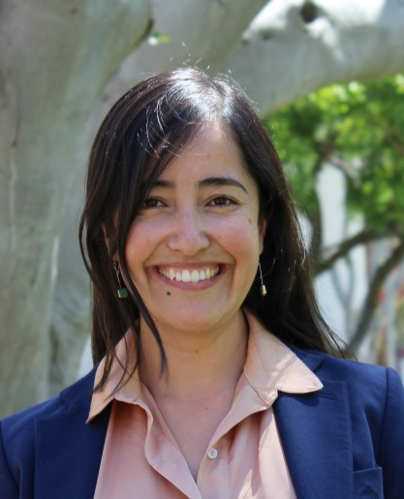
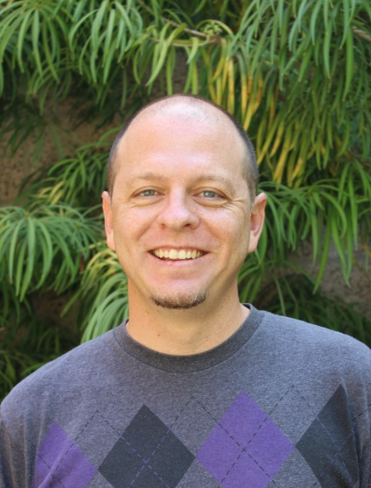
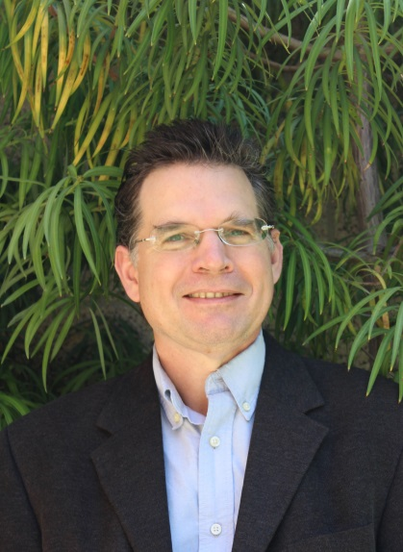
California State University Long Beach
PhysTEC Impact at CSU Long Beach
Galen T. Pickett, Chuhee Kwon, Laura Henriques
Z. Papp, P. Kenealy, C. Kwon,
J. Gu , T. Gredig, P. Jaikumar,
C. Ojeda-Aristizábal, M. Peterson
Galen.Pickett@csulb.edu
www.physics.csulb.edu

Slide 2
California State University Long Beach
Undergaduate Program
Galen T. Pickett
J. Gu, C. Kwon, P. Kenealy,
T. Gredig, P. Jaikumar, M. Peterson,
C. Ojeda-Aristizabál, Z. Papp, A. Bill
Galen.Pickett@csulb.edu
www.csulb.edu/~gpickett
www.physics.csulb.edu

Slide 3
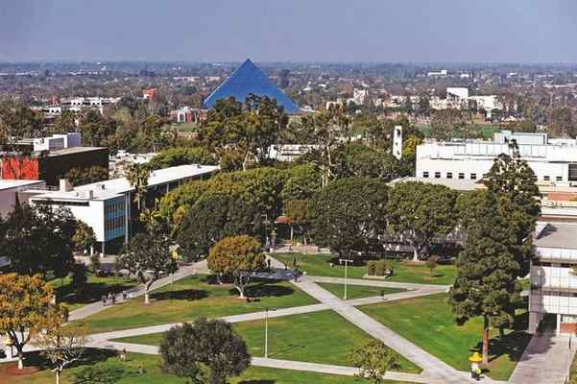
Physics at CSU Long Beach
CSULB
CSULB (1949) is a comprehensive urban
university with nearly 38,000 students
(56% women, 44% men).
We are a Hispanic Serving Institution (39%).
CSULB had 42% Under Represented Minorities (URM) in 2016.
Physics & Astronomy
Part of the College of Natural Sciences & Mathematics:
Biology, Chemistry, Geology, Mathematics,
Physics & Astronomy, Science Education.
Composition of faculty in Physics & Astronomy:
12 TT-T faculty, 6 full and part time lecturers,
Notes:
The city of Long Beach is one of the most diverse cities in the US.

Slide 4
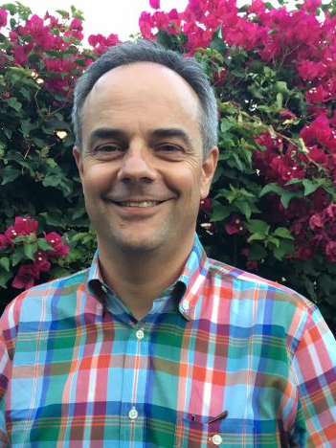
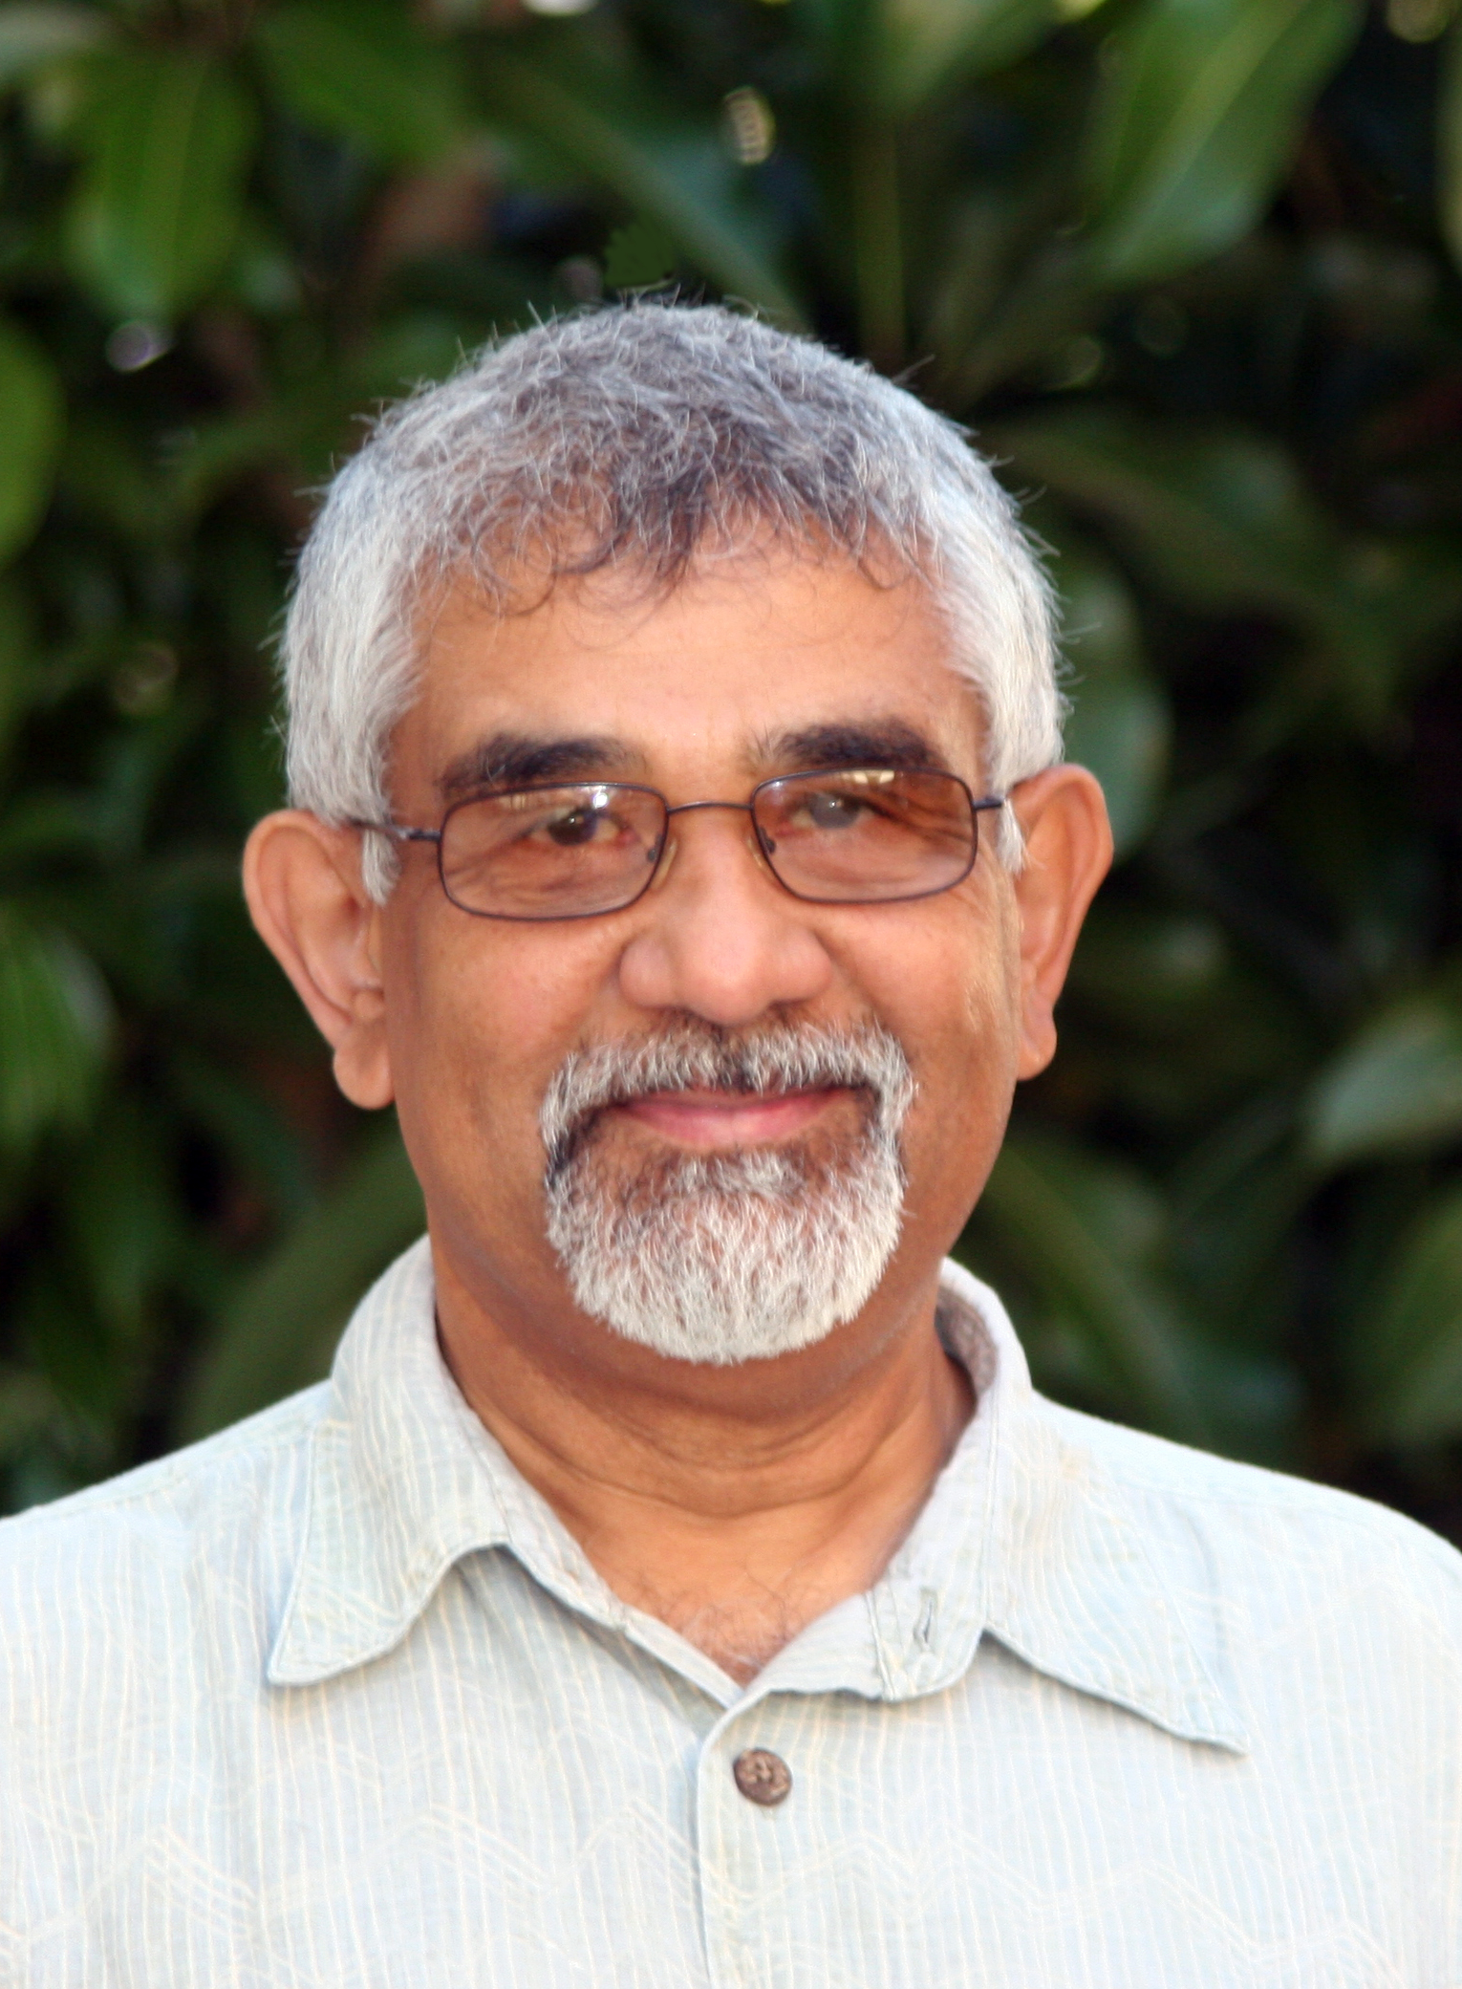
Department of Physics & Astronomy
Research emphasis & funding
Condensed Matter Physics (Exp. & Computational; predominance),
Few body systems and nuclear physics,
Astrophysics,
High-Energy Physics,
Astronomy is focused on General Education courses.

Slide 5
Undergrad Detail (physics)
BS, BA – 10-fold increase in 10 years,

Slide 6
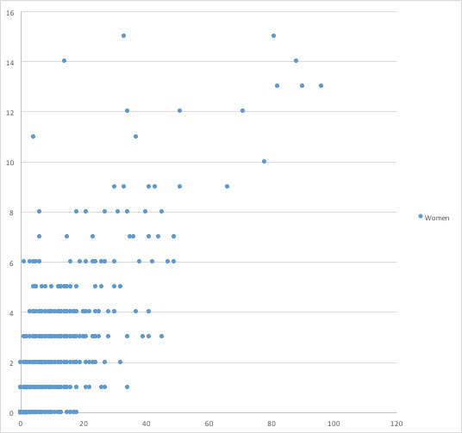
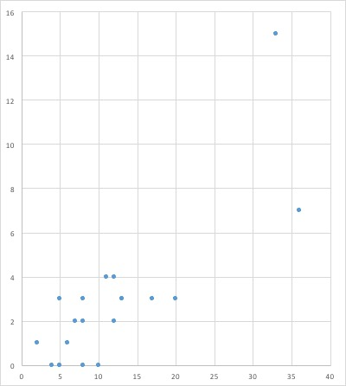
National Physics student body – Gender
CSULB
MIT
CSULB
2015
23 campuses
BS awarded to women
BS awarded to women
San Luis Obispo
2015
763 institutions
Total UG degrees
Total UG degrees
2016 graduation
Both in BS/BA and MS about:
40% URMs and 24% women.
Notes:
Mount Holyoke, UC Berkeley just below CSULB and MIT. I increase the % of women.

Slide 7
National Physics student body – URM (2015 IPEDS)
University of Washington
CSULB
BS awarded to URM
BS awarded to URM
CSULB
Total UG degrees
Total UG degrees

Slide 8
Gender / Ethnicity Achievement Gap
No ethnicity achievement gap.

Slide 9
How we did it: UG Reform Timeline
2008: Reform curriculum, Matter and Interactions
2010: I>Clicker (campus)
2010: PhysTEC
2011: Learning Assistant program
2011: PHYS 390, PHYS 491
2011: PHYS BA curriculum
2012: SCALE-UP classrooms
2012: Teamwork
2014: CRT Projects / Online courses
2015: Streamline Lower Division

Slide 10
PhysTEC Project
2010-12: Supported Site
2013-: Legacy Site
Student-centered advising (teaching explicit)
Teaching induction: Curriculum, PHYS390 (Colorado)
Pedagogical Content Knowledge: PHYS 491
Teaching induction: Co-curriculum, Learning Assistant
Social: Lower-division, upper-division, graduate mixer
Social: Open House (annual) for High School Faculty / students
Social: Monthly demo-sharing

Slide 11
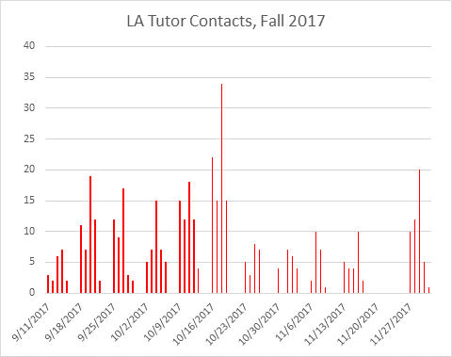
Learning Assistant Program
PHYS 390: semester course in pedagogy
Tutoring services / class embeds (15-20 LA’s)
9 distinct courses (UD math, UD physics)

Slide 12
PHYS 390 Pedagogy Course

Slide 13
Conclusion
Growth in program spurred by PhysTEC
Increase in diversity (gender, ethnicity)
Focus on student development (teaching, Ph.D., R&D, other fields?)
Scale of potential impact:
2015 Latino physics UG degrees: 524
Capacity of CSU: 23 campuses, 10/year= 230, or 30% increase.
Just MS-level: 62 departments, 10/year = 620, over 50% increase.

Slide 14
Enrollment (undegrad & MS)
AY | Active Undergraduates |  | BS+BA degrees |  | Active Graduate |  | MS degrees
 | ALL | URM | ALL | URM | ALL | URM | ALL | URM
15/16 | 130 | 54 | 41 | 18 | 62 | 22 | 19 | 8
14/15 | 88 | 44 | 21 | 10 | 58 | 20 | 9 | 1
13/14 | 68 | 34 | 17 | 5 | 47 | 11 | 9 | 3
12/13 | 75 | 36 | 19 | 5 | 40 | 4 | 11 | 1
11/12 | 61 | 24 | 10 | 2 | 32 | 1 | 13 | 2
10/11 | 48 | 16 | 6 | 1 | 35 | 1 | 6 | 1
09/10 | 38 | 9 | 7 | 3 | 35 | 4 | 16 | 5
08/09 | 44 | 14 | 11 | 2 | 44 | 8 | 12 | 5
07/08 | 41 | 10 | 3 | 1 | 37 | 5 | 6 | 0
URM = Under Represented Minorities in physics
URM = Under Represented Minorities in physics
BS, BA – 3-fold increase in 10 years,
MS program: nearly doubled in 10 years,
Yet, the number of faculty decreased by 25%...

Slide 15
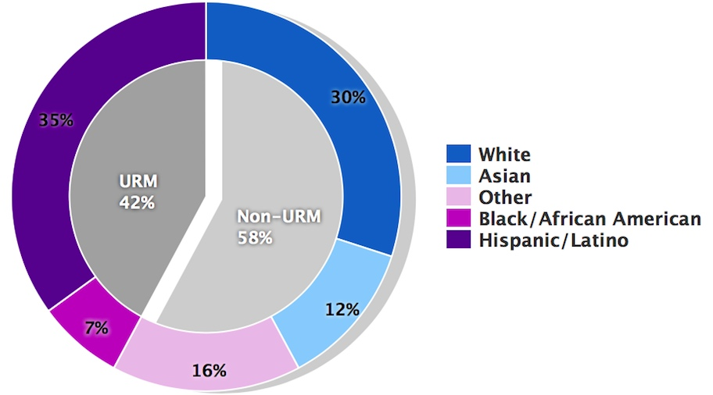
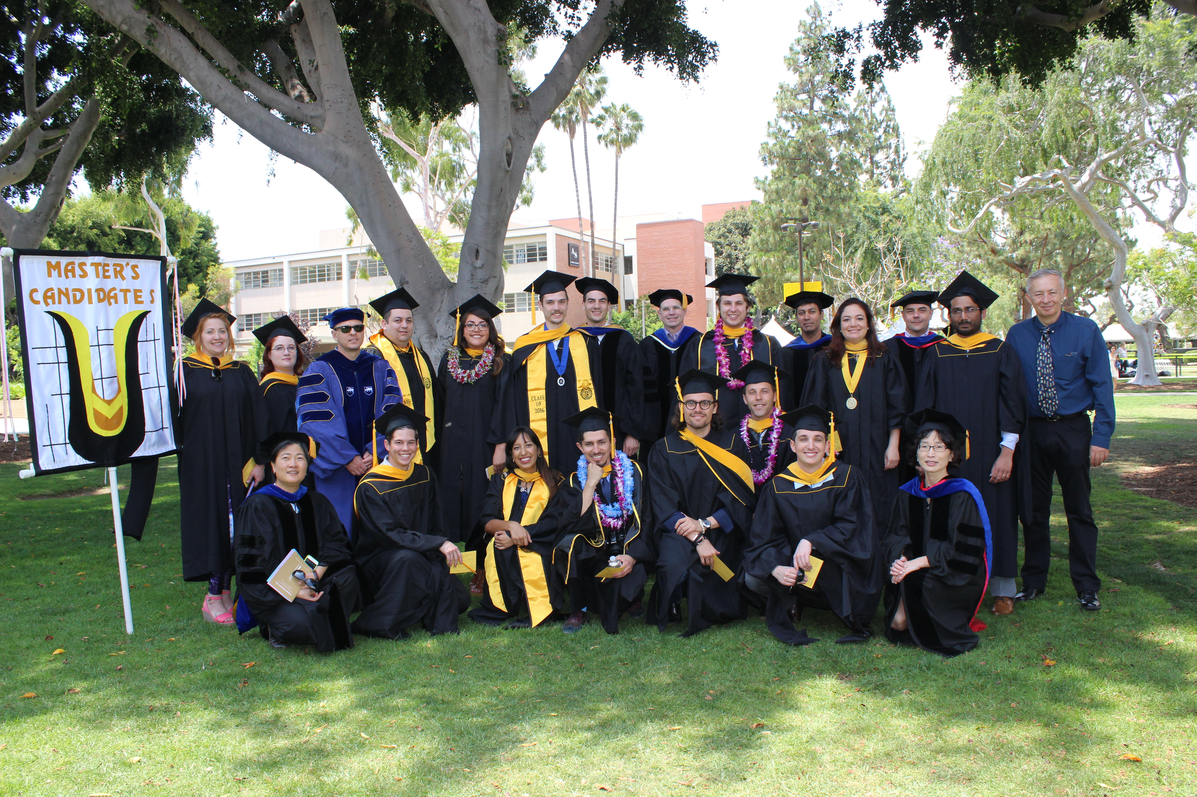
Physics student body – Ethnicity & gender
2016 graduation
Both in BS/BA and MS about:
40% URMs and 24% women.

Slide 16
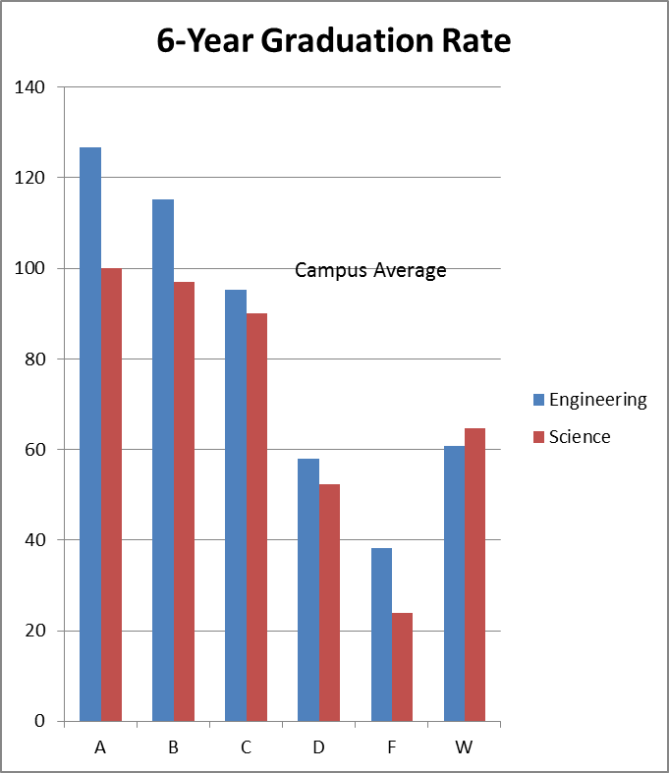
Curricular Reform, 100-level
Matter and Interactions, PHYS 151/2

Slide 17
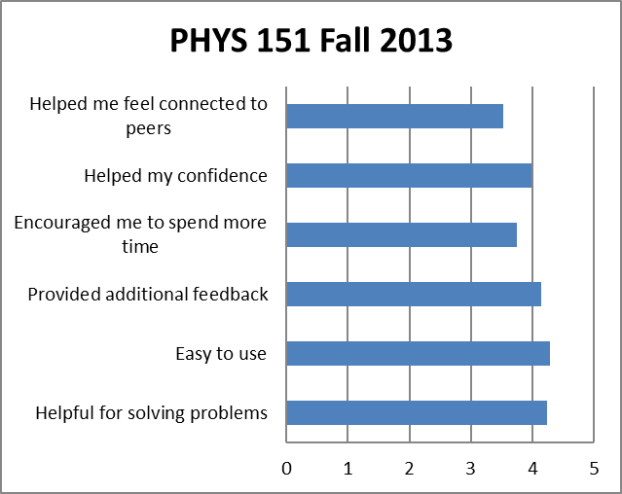
Teamwork in UG
Koondis (Estonian for “Select Team”) (Kisiel NARST ‘14)
Recruiting
Retention
Morale
Homework assistance, normalizing, growth.

Slide 18
Lessons Learned
Curriculum reform
Content of lower division (physics as culture)
Sequencing, bottlenecks
“Easy-entry” recruiting from on-campus students
Co-curriculum
Social teamwork
Teaching as “induction”
Student autonomy / spaces

