Slide 1
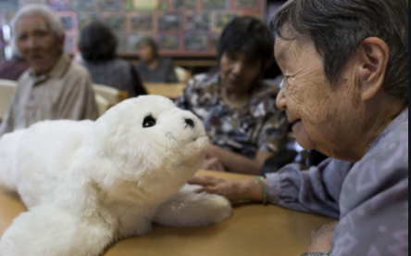
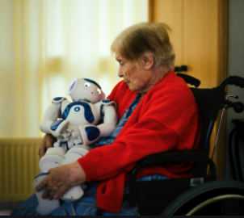
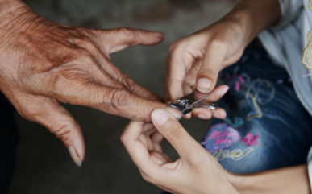
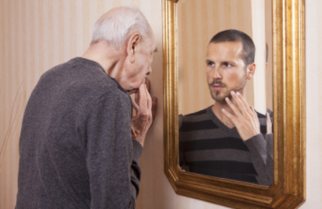
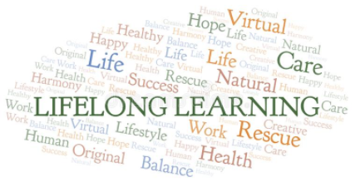
The Influence of Filial Values on Intergenerational Relationships and Perceptions of Caregiving
Rose Tran
Department of Family & Consumer Science
College of Health & Human Service, California State University Long Beach
Introduction
Results
Discussion
It is expected that the elderly population aged 65 and older in the U.S. increase by 67% by 2020. This progressive growth will have many implications for individuals, families, and the government, with one major concern being whether adequate informal caregiving will be available in the future. Although most older adults in the U.S. live independently, when needed, the majority of informal support is provided by family members.
Derived from the Confucian philosophy, filial piety is a virtue of benevolence and righteousness which children are to demonstrate to elders, particularly to their parents and grandparents. Although filial piety is the standard for intergenerational relationships in Eastern cultures, the misconception of it being the practice of severe obedience has garnered much criticism in Western society. Nevertheless, it can be argued that filial piety exists in Western culture as well. The Bible exemplifies filial piety in the fifth commandment: “honor thy father and mother.” Although the notion of showing reverence towards one’s parents appears universally basic and easily accepted in most cultures, the ambiguity of filial norms among Western society and the younger generation have yet to be clearly defined.
Today’s modern nuclear family puts emphasis on independence and self-reliance and less on interdependence, resulting in the diminishing of multigenerational relationships and family ties. The individualistic ideology is common in developed countries, but, interestingly, when compared to other developed countries such as Spain, Norway, Germany, England, and Israel, the U.S. was characterized as disharmonious in older parent-child relationships and as having the weakest public service sectors for elderly care.
Studies infer that intergenerational relationships are more likely to occur when childrens’ engagement is voluntary and free from demands for filial duties. Reasons to provide care differ based on the circumstances of individual families and include financial necessity, cultural expectations about family caregiving, and filial piety. The weakening of family cohesion and the decline of intergenerational relationships have negatively affected the younger generation’s perception of older adults, adding to the decline in adult children’s willingness to provide for their aging parents. The demographic shift toward longevity, family relationships regain importance as Baby Boomers enter late life.
Thus, the transformation of family ethics and moral values in modern society has raised concerns about filial relationships between parents and their adult children. The future of long-term care relies on understanding potential caregivers’ decisions to provide care and the perspective of those who admittedly do not intend to do so. This study aims to investigate the degree of personal responsibility adult children have regarding informal caregiving and what factors are influenced by it.
Under the category of caregiving, the two themes that emerged were (a) an innate sense of responsibility and (b) influences and role models that alter attitudes of caregiving
Mother on her reflection of a time she had taken the caregiving role for her mother: “As the eldest, I felt the responsibility. Somebody had to do it. In my 60s, I never imagine myself having to do it. My mom was very difficult, but my husband was gracious and willing to take her in. My mom was the oldest of three, I’m the oldest of three so I don’t know if it’s our pecking order or your place in life that make us become caregivers. I don’t think anybody knows for sure, but yeah… somebody had to do it.”
Influences and role models: “I saw how my grandmother (maternal side) was treated. My uncle just sold the house and put my grandmother into a care home. That was it, just put her in a home. So then, when my grandmother on my dad’s side got sick, all the siblings, aunts, uncles, and cousins took turns staying at the house to take care of her. With the help of a nurse that came a few hours a week, but it was mainly the family that cared for her like changing diapers and doing all that type of stuff. It was nice.”
Regarding parents’ preferred forms of support, as to why they do not anticipate receiving support from children, four themes emerged: (a) to release burden on children, (c) to prevent getting rejected, (d) desired for empathy, and (e) to maintain independent and self-reliance.
Spare children from burden: “If the time come where I need assistance, I would move into an assisted living and pay some guy to change my diaper. I’d chose a facility before moving in with my daughter. I wouldn’t do that to her, nor would I want it done to me.”
Fear of rejection: “My difficulty with asking is, I have a very hard time hearing “no” so rather than risk rejection, I don’t ask. The chances of getting rejected is not likely, but I’d rather not ask at all and take what they want to give even if it’s not enough. It’s better than getting rejected.”
A desire for empathy: “It's hard when you have to ask someone to ‘say, again, say again?’ With my sons it started out that way. You can hear their frustration with having to repeat themselves because I simply cannot hear. That has been a real burden. For the most part, the people I'm close to, the people that work in the profession with old people, they can understand the physical limitations with aging. So, we can feel safe and be ok with having to repeat ourselves.”
Independent and self-reliance: “The two of them (children) were trying to decide which was going to take me in because I couldn’t take care of myself. I made the decision to check myself into this facility. I went from a nine-bedroom house to living in a single room. It was tough, but it was the best decision. Neither of them had to take me, I took control of the situation myself. Now, I am relying on the staff here to cook, clean, do my laundry so yes, I am receiving care, but I pay for it every month and the decision was my own. I worked hard to be able to pay for the care I am receiving now.”
Majority of the parents’ self-perception of aging were positive!
Negative perceptions were related to physical limitations, feeling “handicapped,” and ”having no goals.”
Caregiving remains a sensitive topic for parents and children, as evident in the few son/daughter participants in this study and the parents’ reluctancy to label their children as not being a caregiver
This study adds to an existing body of knowledge on family dynamics in Western cultures and the association between perception of aging and quality of life. It also contributes to the gap in the literature that seldom addresses individuals who self-identify as non-caregivers.
Parents were more inclined to adapt their caregiving expectations as a precautionary means by not imposing burden on children and to protect themselves from any chance of rejection
The empathy factor
It is easier to seek assistance from personnel in the geriatric field due to the empathy factor, defined as “the ability to understand and share the feelings of another.”
Filial ethics and education for empathy deserve further attention in today’s modern culture. Doing so may work as a model for future generations who may learn acceptance, strengthen intergenerational relationships, and ease the presumption that caregiving must be associated with “burden.”
The future of caregiving?
Technological assistance through robotic aids could help the aging population maintain independence, especially those with disability, but higher life satisfaction was reported among individuals who disclosed having people in their lives whom they can count on if needed. Therefore, the underlying question remains, will anything adequately replace the human element when it comes to caregiving?
Limitations
The participants were representative of an individualistic culture and may have had a biased perspective of filial piety prior to the interview.
Due to the small sample size, this is particularly true of the son/daughter participants failing to answer follow-up questions or providing single word/short answers. Therefore, this sample is not representative of the population and cannot be generalized for the United States as a whole.
Due to the difference between the researcher’s Vietnamese ethnicity and research participants’ Caucasian ethnicity, interracial/interethnic issues may have hindered the researcher’s efforts to gain participants’ engagement. In other words, predetermined notions about family values and traditions that differ between Eastern and Western cultures may have inhibited participants from candidly sharing their individual assessments of family caregiving with the researcher. As a result, key findings/themes determined by the researcher may be partially subjective.
Methods
Conventional content analysis
Semi-structured interview consisting of six open-ended questions
Convenience sampling employed under the following criteria: Parent 65+, single/widowed, and living independently; son/daughter 18+, self-identify as non-caregivers
Total sample size: Five parent-adult child dyads and five parents (only)
For more information
Please contact rose_tran@student.csulb.edu or rose_tran@yahoo.com for more information

