Slide 1
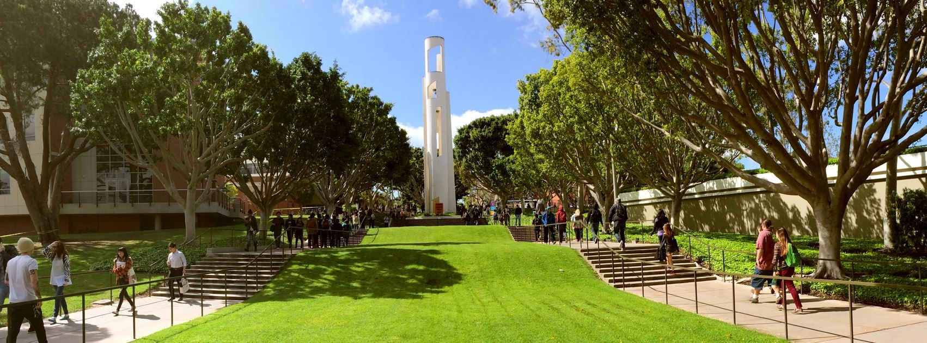
BIG / 49er SMIF Fund: Portfolio Administrative Changes?
Peter A. Ammermann, Ph.D.
Director, Beach Investment Group
14 May 2021

Slide 2
Two Proposed Changes:
Adjustment of portfolio asset allocation guidelines to reduce allowable target allocation to fixed income and increase allowable target allocation to equity and tighten bands around these categories
Movement of account from TSG Wealth Management, with clearing through Wells Fargo, to Pacific Coast Capital Partners, with clearing through LPL

Slide 3
Proposal 1: Adjustment of asset allocation guidelines
Current allowed allocation ranges are as specified below, although the current stated guidelines are specified more generally to cover both portfolios:
Current Allowable Ranges | 49er SMIF Fund | Seegers Fund | Stated in Guidelines
Equity | 25% - 75% | 100% | 25% - 100%
Fixed Income | 25% - 75% | 0% | 0% - 75%
Cash and Equivalents | N.A. | N.A. | N.A.
Proposal: to break out the requirements in the guidelines by portfolio and to adjust the allowable target asset allocation ranges for the 49er SMIF Fund as follows:
49er SMIF Fund | Current Ranges | Proposed Ranges
Equity | 25% - 75% | 50% - 85%
Fixed Income | 25% - 75% | 15% - 50%
Cash and Equivalents | N.A. | 0% - 20%

Slide 4
Proposal 1: Adjustment of asset allocation guidelines
Justifications:
More consistent with the long-term total return / capital appreciation objectives of the portfolio (as described at board of directors’ retreat)
More consistent with current thought and practice in the institutional investment world
Provides greater clarity to the students in making their portfolio decisions
Maintains full and complete educational experience for the students
(Even at the very minimum 15% allocation, the size of the fixed income portion of the portfolio would be approximately $100,000 (or more), which, by itself, is larger than the entire CFAOC SMIF Portfolio, so it should be adequately large enough for the students to be able to receive a good learning experience in fixed income investing!)

Slide 5
Proposal 2: Movement of portfolio to PCCP
At the beginning of this year, our long-time brokers, Rocky Suarez, Diana Wolf, and Michael Mais left Wells Fargo and TSG Wealth Management to start their own firm, Pacific Coast Capital Partners
The 49er SMIF Fund is still housed at Wells Fargo through TSG Wealth Management
Our request is to move the BIG-managed portfolios, including the 49er SMIF Fund, from TSG to Pacific Coast Capital Partners

Slide 6
Proposal 2: Movement of portfolio to PCCP
Justifications:
There has been a long-term relationship of all three principals of PCCP with the BIG program (with Rocky having been an advisor to the program since its very start)
The principals have a strong understanding of our clients’, students’, and portfolios’ needs (and have committed to maintaining the portfolios’ fee structure at the current level)
They have demonstrated strong and continuing support for our students, including through speaking to the students in class, inviting them for firm visits and discussions, hosting dinners for the students, etc.
Their new trading platform through LPL provides greater flexibility to purchase the specific securities the students have actually analyzed and want to put into the portfolio, such as CBON, HYEM, and BSDE, that Wells Fargo’s platform has not allowed; in addition, for example, a wider array of products for ESG investing can be traded through LPL’s platform, allowing for more precisely targeted investments and a richer learning experience for the students in analyzing them

Slide 7
Appendix – PCCP’s Formation Announcement
We are pleased to announce the formation of:
PACIFIC COAST CAPITAL MANAGEMENT
a wealth services firm providing comprehensive planning and investment solutions
Rocky Suares, cfp® MANAGING PARTNER
rockysuares@pacificcoastcm.com
Diana Wolf MANAGING PARTNER
Dianawolf@pacificcoastcm.com
Michael Mais, CFA® Investment Strategist
562-378-0150 main Michaelmais@pacificcoastcm.com
Rocky Suares, Diana Wolf, and Michael Mais are registered with and offer securities and advisory services offered through LPL Financial, member FINRA/SIPC, a registered investment advisor.
PACIFIC COAST CAPITAL MANAGEMENT

Slide 8
Appendix – Account transfer process
According to Diana Wolf:
As far as the account opening, PCCP would need the 49 Shops tax ID and the information including SSN for the person who is currently in control of the account (presumably Robert would still be the signatory). They would also need a copy of the latest statement. They use DocuSign for the account opening and transfer so should make it easy to complete. The other documentation that would be required for entity verification, which can be scanned over, would be Articles of Incorporation/Organization or form 990. They would set up a profile under my name as well for online access so that I can view the account and download information as needed for the BIG students.
Account Opening/Transfer Process:
Obtain information on the entity, controlling party and current account
Open account – DocuSign is sent via email to signatory
Transfer Account – DocuSign is sent via email to signatory
Online Access – Emails sent with online access activation
Transfer process estimated timeframe: 5 business days

