Slide 1
Small Area Demographics
Using Census 2010 TIGER Geographies
With SF1 and American Community Survey (ACS) Data
Frank Gossette
November 16, 2013

Slide 2
Merging Georeferenced Data from Three (3) Sources
FEATURES: Bordering Arcs and Census Enumeration Polygons (TIGER)
ATTRIBUTES: Census Summary Files ( SF1) -- the 100% Data
RELATED DEMOGRAPHICS: Sample Data Estimates ( SF3 vs ACS)

Slide 3
Census Geographies
Data are collected by individual address – Households and Families
Each street, lane, road or path which references an address is a part of the TIGER line files.
Privacy Issues prohibit publication of data for individuals, households and families.

Slide 4
Census Demographics are Aggregated into Enumeration Areas
SummaryTabulations are made of individual records by area
Census Geography is a Hierarchy of Nested Enumeration Areas.

Slide 5
Census Geographic Areas
Legal Areas:
States
Counties
Minor civil divisions
Incorporated places
Congressional districts
Legislative areas
School districts
Urban growth areas
Statistical Areas:
Census county divisions
Census designated places
Census tracts
Census blocks
Metro and micropolitan statistical areas
Urban areas
Public use microdata areas
Traffic analysis zones
Notes:
Census geographic areas can be divided into two types: legal/administrative and statistical. Legal/administrative areas have legally described boundaries; they may provide governmental services or may be used to administer programs.
Statistical geographic areas are defined primarily for data tabulation and presentation purposes. They may relate to other kinds of geographic concepts. For instance, census tracts can be thought of as roughly similar to neighborhoods (at least in urban and suburban areas– the analogy breaks down in rural areas). Census designated places (CDPs) represent unincorporated places that are known locally and may be identified by name in the landscape (through street signs, business names, and so forth), but do not have legally prescribed boundaries. Statistical areas may be defined to represent geographic concepts, such as urbanization or metropolitanization. Urban areas and metropolitan and micropolitan statistical areas, respectively, are representations of discernible patterns on the landscape (urbanization) and less visible processes of social and economic interaction between and urban center and a surrounding region.

Slide 6
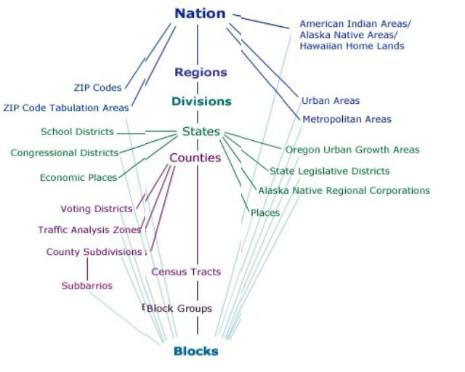
Data is collected from individuals; aggregate data is released by geographic entity

Slide 7
Places
Census Designated Places (CDPs)
Statistical entity
Created to present census data for an area having a concentration of population, housing, and commercial structures
Boundaries delineated by the Census Bureau, with assistance from planning organizations
Locally identifiable name
Not inside an existing incorporated place
Notes:
Boundaries of incorporated places and CDPs do NOT necessarily correspond to census tracts, block groups or MCDs.
For Census 2000, for the first time, CDPs did not need to meet a minimum population threshold to qualify for tabulation of census data.
CDP boundaries, which usually coincide with visible features or the boundary of an adjacent incorporated place or other legal entity boundary, have no legal status, nor do these places have officials elected to serve traditional municipal functions. CDPs usually are delineated in cooperation with county, state, and tribal officials based on Census Bureau guidelines.
Hawaii has only CDPs and no incorporated places.
Three states (Connecticut, New Jersey, and Pennsylvania) also contain Boroughs.

Slide 8
Census Designated Places (CDPs)
Paradise, NV is an example of a CDP. This area of Las Vegas, which includes the strip, is actually outside the city of Las Vegas in an unincorporated area.
Source: http://www.public-domain-photos.com/
Notes:
Paradise, NV is an example of a CDP. This well known area of Las Vegas, which includes the strip, is actually outside the city of Las Vegas in an unincorporated part of Nevada.

Slide 9
Small Geographic Areas
Blocks:
Smallest units for decennial Census data tabulation
Cover entire nation
Nest within all other types of geographic areas
Generally bounded by visible features or boundaries
Block Groups:
Groups of blocks sharing first digit of block number
Smallest units for tabulation of American Community Survey (ACS) data
Population ranges from 1,000 to 3,000
Nest within census tracts

Slide 10
Census Tracts
Small, relatively permanent statistical subdivisions of a county
Relatively consistent boundaries over time
Size: optimally 4,000 people; range between 1,200 and 8,000
Approximately 74,000 census tracts in U.S.
Defined nationwide for the first time in Census 2000; however Block Numbering Areas (BNAs) and tracts covered the entirety of the nation in 1990
Notes:
The primary goal of census tracts is data comparability between censuses. E.g., census tracts support a multi-temporal statistical understanding of an area.
Beginning with the first census tract delineation in 1910, tracts have been delineated with the intention of being stable over many decades, so they generally follow permanent visible features. However, they may follow governmental unit boundaries and other non-visible features in some instances; the boundary of a state or county is always a census tract boundary.
In 1990 and previous censuses, the Census Bureau created tract-like geographic units, called Block Numbering Areas or BNAs, outside of metropolitan areas. BNAs were discontinued for Census 2000; instead, one or more census tracts were identified for every county and statistically equivalent entity.
Tribal tracts can cross state and/or county boundaries and are held to lower population size thresholds. Group quarters/special place tracts are also held to lower population size thresholds.
Low population counties often only contain one BG which is coextensive with one census tract.
Again, in most cases the lowest level of geography that should be used when working with sample data is census tracts, as tracts are relatively consistent over time and used by many programs.
Census tracts and BGs are usually reviewed for data presentation purposes by a local group of census data users and/or governments through the PSAP (Participant Statistical Areas Program), or the geographic staff of a regional census center in accordance with Census Bureau guidelines. Currently this is done before the decennial census to support the decennial census, but with the advent of the ACS, the Census Bureau is considering the review of these boundaries more often.

Slide 11
Definition
Census tracts are small, relatively permanent statistical subdivisions of a county.
Uniquely numbered in each county with a numeric code
Census tracts average about 4,000 inhabitants
Minimum Population – 1,200
Maximum Population – 8,000
Notes:
Census tracts are small, relatively permanent statistical subdivisions of a county. Census tracts nest within the county and are given a numeric code that is unique within the county. The minimum population for a census tract is 1,200 and the maximum is 8,000. Most census tracts average about 4,000 people.

Slide 12
Map of census tracts
This figure displays an example of what census tracts look like. The black outlines represent the county boundaries in Alabama. The different colored polygons within each county represent the census tracts. The census tracts shown are from TIGER 2000.
Notes:
This figure displays an example of what census tracts look like. The black outline represent the county boundaries in Alabama. The different colored polygons represent the census tracts. The census tracts shown above are from 2000.

Slide 13
History of the Census Tract
1790
First census
1890
First delineation of small geographic areas called sanitary districts
1906
Dr. Walter Laidlaw suggested the delineation of permanent, small geographic areas that would retain their boundary census to census
1910
Dr. Laidlaw divided NYC into “districts” and asked Census to do the same for seven other cities
1920
Dr. Laidlaw published data by district for NYC
1930
Howard Wipple became chairman of the Committee on Census Enumeration Areas and promoted the use of census tracts
Notes:
Here is some history of the census tract:
1790: The first recorded Census occurred in 1790.
1890: The first recorded instance of the delineation of small geographic entities, called sanitary districts. 1890 also marks the first time the U.S. Census Bureau worked with local officials to delineate geography.
1906: Dr. Walter Laidlaw, director of the Population Research Bureau of the New York Federation of Churches, suggested the U.S. Census Bureau delineate permanent, small geographic areas that would retain their boundary census to census. He had tried to perform research in New York, but was having trouble because the boundaries he was using were not consistent from census to census.
1910: Dr. Laidlaw divided New York City into 40-acre tracts called “districts.” He also persuaded Census to do the same for seven other cities that had a population over 500,000.
1920: Dr. Laidlaw published data by district for New York City.
1930: Howard Whipple Green, a statistical consultant, helped promote the idea of census tracts. He was having some of the same data problems as Dr. Laidlaw. Many cities decided to define their own census tracts. Mr. Green became chairman of the newly formed Committee on Census Enumeration Areas, promoting census tracts. When he retired, the Census Bureau took on the responsibility of getting the word out about census tracts.

Slide 14
History of the Census Tract
1940
The census tract became an official geographic entity for which the Census Bureau would publish data. Census tracts covered major cities and block number areas (BNAs) covered many other cities
1970
The number of BNAs increased and the criteria of the BNA matched the census tract
1980
1990
Census tracts and BNAs covered the entire nation
2000
The BNA concept was retired and census tracts were defined nationwide.
2010
100th anniversary of the census tract
Notes:
1940: The census tract became an official geographic entity to be included in the data tables of standard publications. Census tracts were now in major cities and block numbering areas (BNAs) were delineated for cities where tracts did not exist.
1970-1980: The number of BNAs increased and the criteria of BNAs changed to match the criteria for census tracts.
1990: Census tracts and BNAs now covered the entire nation.
2000: The BNA concept was retired and census tracts were defined nationwide.
2010: 2010 marks the 100th anniversary of the census tract. Census tracts continue to be an important geographic entity for data tabulation.

Slide 15
Updating Census Tracts
Census tracts are designed to be relatively permanent over time.
Social Scientists use them as surrogates for Neighborhoods.
Any changes are documented so data can be compared from decade to decade.
Census tracts with more than 8,000 people are split into 2 or more tracts and are given an extension to their existing numeric code
Census tracts with less than 1,200 people are merged with a neighboring tract and are given a new numeric code
Small boundary corrections are sometimes allowed as well.
Notes:
Census tracts are designed to be relatively permanent over time, so that data can be compared from decade to decade. Therefore, changes to census tracts are documented and the outline of the original tract is usually maintained.
In areas where population has increased, if the census tract now has more than 8,000 people, the census tract is split into two or more tracts so that the population requirements are met.
In areas where population has decreased, if the census tract now has less than 1,200 people, the census tract is merged with a neighboring tract so that the population requirements are met.
In other areas, small revisions to the census tract boundary are allowed, but the boundary change cannot affect a large amount of the population in the tracts affected. Sometimes small boundary changes have occurred so that the census tract boundary can follow a visible feature such as a road or river.

Slide 16
Updating Census Tracts Community Involvement
Participant Statistical Areas Program (PSAP)
Program offered once every 10 years
Local involvement in delineating statistical areas
Census tracts are split or merged, depending on population change
The new 2010 census tracts were released as part of the 2010 TIGER/Line Shapefiles beginning in December 2010.
Notes:
Census tracts are updated, along with other statistical areas such as census block groups and census designated places, through the Participant Statistical Areas Program (PSAP). The program is currently only offered once a decade, so census tracts are only updated once a decade. The U.S. Census Bureau partners with local governments, usually council of governments or associations of governments. PSAP asks participants to splits tracts that now have more than 8,000 people, or merge tracts that no longer meet the minimum population requirement of 1,200 people. The participants will usually meet with different parties, such as city governments, researchers, and others that uses the data, to have input on the census tract plan.
The new 2010 census tracts became available to the public beginning in December 2010, when the 2010 TIGER/Line Shapefiles were released.

Slide 17
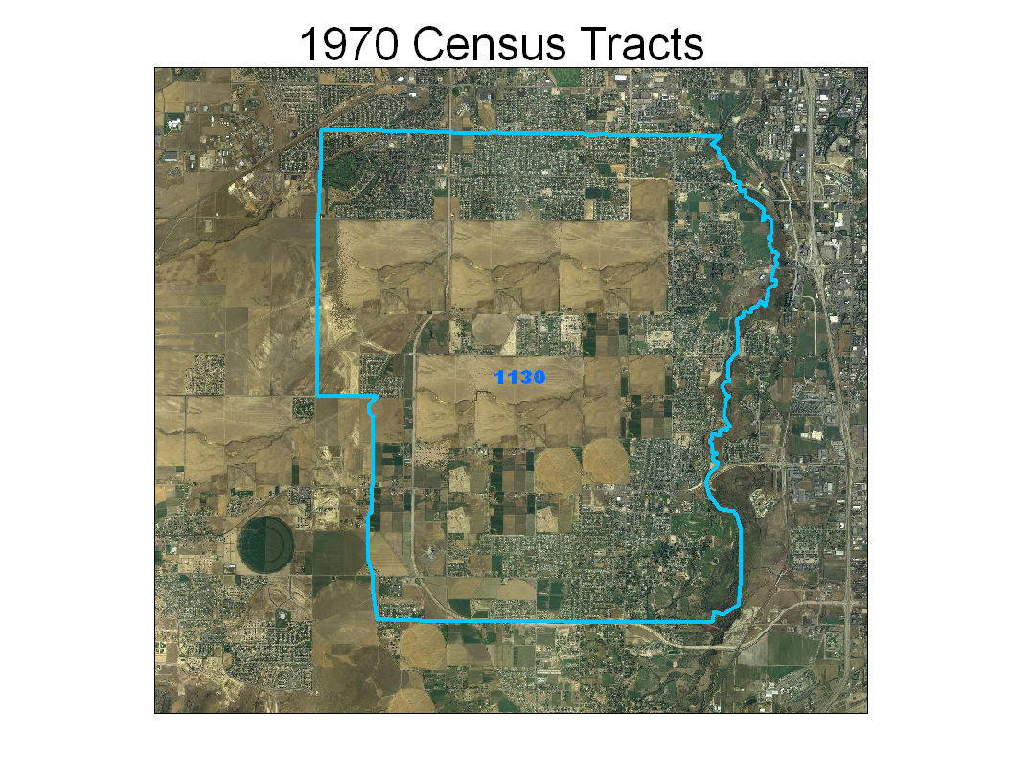
Notes:
The next few slides show an example of an area where population continues to grow and therefore the census tract is split over the decades.
This is the original tract 1130 in South Jordan City, Utah during the 1970 Census

Slide 18
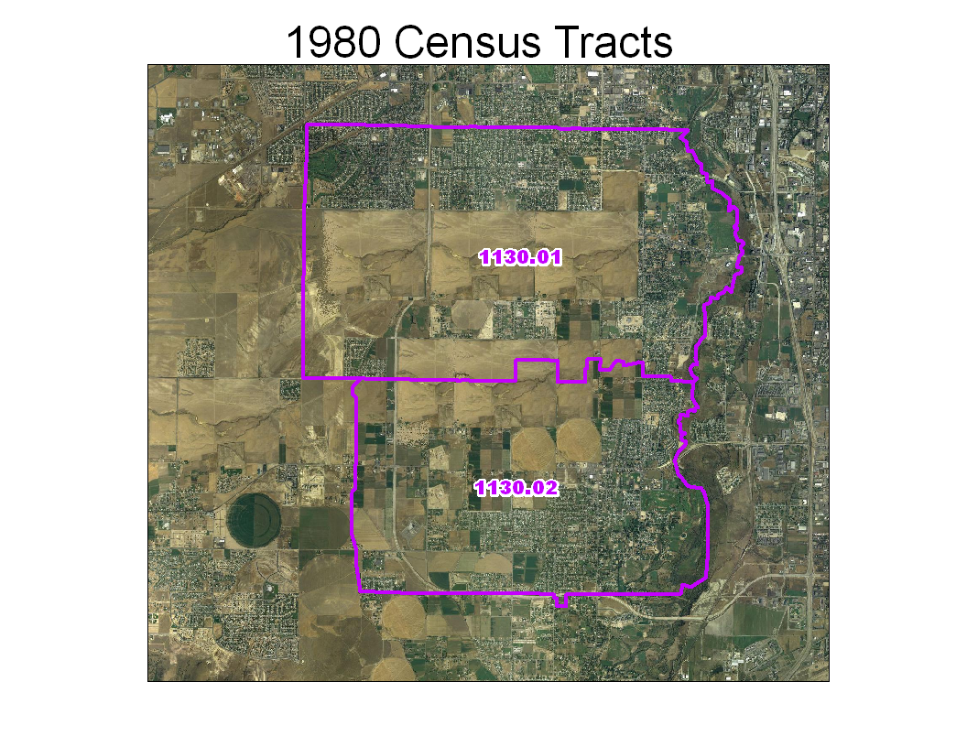
Notes:
For the 1980 Census, enough growth occurred to split the original tract 1130 into two new pieces. Note the tract suffixes .01 and .02.

Slide 19
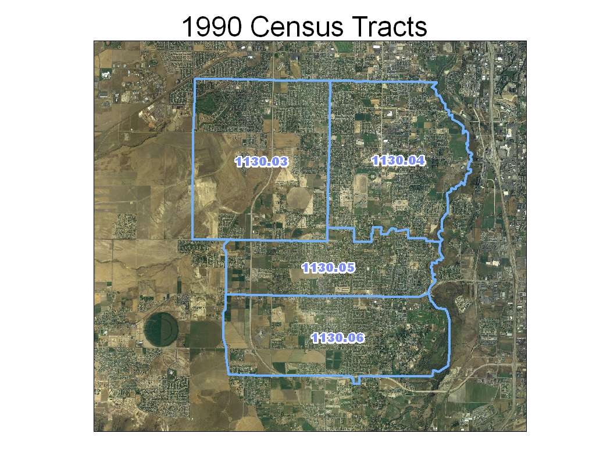
Notes:
For the 1990 Census, growth has again continued at an accelerated pace requiring the two tracts from 1980 to be split further. Notice the original suffixes are no longer used and new ones are provided.

Slide 20
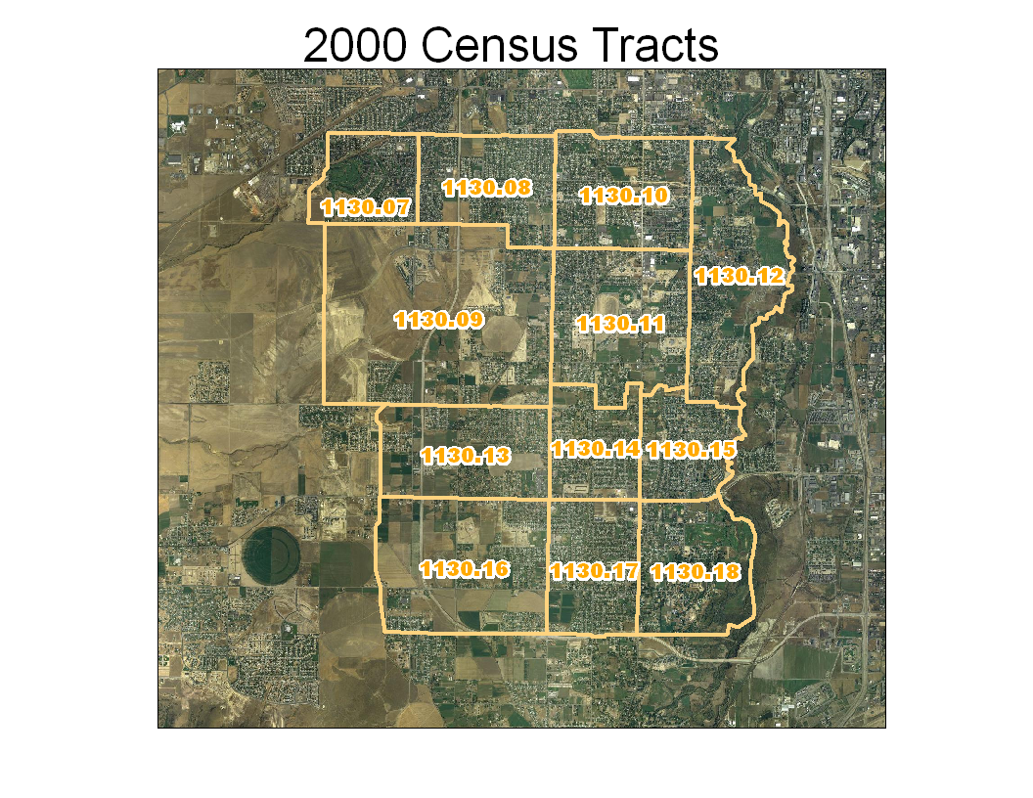
Notes:
Finally in the 2000 Census, the four tracts from 1990 had to be further sub-divided. Once again, the tract suffixes from 1990 are no longer used and new ones are given. You can see that the original outline of tract 1130 still exists, so you can compare the data from 2000 to the same geographic area in 1970.

Slide 21
Longitudinal Studies
Comparing Demographic Changes over Time .. Also involves comparing Geographic Feature changes from Census to Census.
While there are some tools to aid in the identification and nature of changes, there remains a great deal of data “massaging” to make real comparisons.

Slide 22
Census Tract Relationship Files
Files that show how 2000 census tracts relate to 2010 census tracts
One record per each 2000 census tract/2010 census tract spatial set
The area that is uniquely shared between a 2000 census tract and a 2010 census tract
Three sets of files
Census Tract Relationship File with population and housing unit information and area measurement (both national and state-based files)
Substantially Changed 2000 Census Tract Files (both national and state-based files
Substantially Changed Census 2010 Census Tract Files (both national and state-based files)
Notes:
Another way to see the changes made to census tracts over the decade is through the census tract relationship files. These files show how the 2000 census tracts relate to the 2010 census tracts. There is one record per each 2000 census tract/2010 census tract spatial set showing the area that is uniquely shared between a 2000 census tract and a 2010 census tract.
There are three sets of relationship files available for download from our website. The first set of files include population and housing unit information as well as area measurement. The second and third set of files represent the census tracts that exhibit a 2010 population change of 2.5% or greater – where no single part has at least 97.5% of the total respective tract, and also those tracts where the unique identifiers between 2000 and 2010 are different regardless of population change.

Slide 23
No Change
Notes:
In the following examples, we have overlaid the 2000 census tracts (in blue) with the 2010 census tracts (in orange) using the 2010 TIGER/Line shapefiles.
In this example, the census tract from 2000 is exactly the same as the 2010 census tract. The unique identifier and boundary are the same.
There is one corresponding record in the tract relationship file:
STATE00: 08
COUNTY00: 029
TRACT00: 965000
GEOID00: 08029965000
POP00: 5017
HU00: 2465
PART00: W
AREA00: 827553078
AREALAND00: 824172988
STATE10: 08
COUNTY10: 029
TRACT10: 965000
GEOID10: 08029965000
POP10: 5017
HU10: 2465
PART10: W
AREA10: 827553078
AREALAND10: 824172988
AREAPT: 827553078
AREALANDPT: 824172988
AREAPCT00PT: 100.00
AREALANDPCT00PT: 100.00
AREAPCT10PT: 100.00
AREALANDPCT10PT: 100.00
POP10PT: 5017
POPPCT00: 100.00
POPPCT10: 100.00 HU10PT: 2465
HUPCT00: 100.00
HUPCT10: 100.00

Slide 24
Revision
Notes:
In this example, the census tract from 2000 has been slightly revised for 2010. Small boundary corrections were allowed, as long as they did not affect a large amount of the population. Since the 2000 census tract now crosses over into two 2010 census tracts, there are two records in the tract relationship file. You can see in the records below that this boundary change only affected 4.05% of the 2010 population, moving 95 people from 2000 census tract 9960 to 2010 census tract 9659.
Record 1 Record 2
STATE00: 08 STATE00: 08
COUNTY00: 075 COUNTY00: 075
TRACT00: 996000 TRACT00: 996000
GEOID00: 08075996000 GEOID00: 08075996000
POP00: 2343 POP00: 2343
HU00: 1063 HU00: 1063
PART00: P PART00: P
AREA00: 1412988519 AREA00: 1412988519
AREALAND00: 1399653228 AREALAND00: 1399653228
STATE10: 08 STATE10: 08
COUNTY10: 075 COUNTY10: 075
TRACT10: 965900 TRACT10: 966000
GEOID10: 08075965900 GEOID10: 08075966000
POP10: 1090 POP10: 2248
HU10: 562 HU10: 1020
PART10: P PART10: W
AREA10: 1428587152 AREA10: 1364022078
AREALAND10: 1425550434 AREALAND10: 1350695753
AREAPT: 48964867 AREAPT: 1364022078
AREALANDPT: 48955901 AREALANDPT: 1350695753
AREAPCT00PT: 3.47 AREAPCT00PT: 96.53
AREALANDPCT00PT: 3.50 AREALANDPCT00PT: 96.53
AREAPCT10PT: 3.43 AREAPCT10PT: 100.00
AREALANDPCT10PT: 3.43 AREALANDPCT10PT: 100.00
POP10PT: 95 POP10PT: 2248
POPPCT00: 4.05 POPPCT00: 95.95
POPPCT10: 8.72 POPPCT10: 100.00 HU10PT: 43 HU10PT: 1020
HUPCT00: 4.05 HUPCT00: 95.95
HUPCT10: 7.65 HUPCT10: 100.00

Slide 25
Merged
Notes:
In this example, 2000 census tracts 1 and 2 merged together to form 2010 census tract 6. In 2010, each census tract did not meet the population criteria since census tract 1 had a population of 857 and census tract 2 had a population of 751. So, the two census tracts merged and census tract 6 now has a population of 1608, which meets the minimum population threshold.
Record 1 Record 2
STATE00: 08 STATE00: 08
COUNTY00: 081 COUNTY00: 081
TRACT00: 000100 TRACT00: 000200
GEOID00: 08081000100 GEOID00: 08081000200
POP00: 857 POP00: 751
HU00: 532 HU00: 483
PART00: W PART00: P
AREA00: 8956127151 AREA00: 2928158060
AREALAND00: 8942176703 AREALAND00: 2924140283
STATE10: 08 STATE10: 08
COUNTY10: 081 COUNTY10: 081
TRACT10: 000600 TRACT10: 000600
GEOID10: 08081000600 GEOID10: 08081000600
POP10: 1608 POP10: 1608
HU10: 1015 HU10: 1015
PART10: P PART10: P
AREA10: 11884327258 AREA10: 11884327258
AREALAND10: 11866359033 AREALAND10: 11866359033
AREAPT: 8956127151 AREAPT: 2928144943
AREALANDPT: 8942176703 AREALANDPT: 2924127166
AREAPCT00PT: 100.00 AREAPCT00PT: 100.00
AREALANDPCT00PT: 100.00 AREALANDPCT00PT: 100.00
AREAPCT10PT: 75.36 AREAPCT10PT: 24.64
AREALANDPCT10PT: 75.36 AREALANDPCT10PT: 24.61
POP10PT: 857 POP10PT: 751
POPPCT00: 100.00 POPPCT00: 100.00
POPPCT10: 53.30 POPPCT10: 46.70 HU10PT: 532 HU10PT: 483
HUPCT00: 100.00 HUPCT00: 100.00
HUPCT10: 52.41 HUPCT10: 47.59

Slide 26
Split
Notes:
In this example, 2000 census tract 9662 has been split into two 2010 census tracts: 9662.01 and 9662.02. In 2010, the population of 2000 census tract 9662 was 7332, so that is enough to make two census tracts. Therefore, now we have two census tracts in the same area. 9662.01 has a population of 2906 and 9662.02 has a population of 4426.
Record 1 Record 2
STATE00: 08 STATE00: 08
COUNTY00: 085 COUNTY00: 085
TRACT00: 966200 TRACT00: 966200
GEOID00: 08085966200 GEOID00: 08085966200
POP00: 7332 POP00: 7332
HU00: 2876 HU00: 2876
PART00: P PART00: P
AREA00: 1627788676 AREA00: 1627788676
AREALAND00: 1624886476 AREALAND00: 1624886476
STATE10: 08 STATE10: 08
COUNTY10: 085 COUNTY10: 085
TRACT10: 966201 TRACT10: 966202
GEOID10: 08085966201 GEOID10: 08085966202
POP10: 2906 POP10: 4426
HU10: 1190 HU10: 1686
PART10: P PART10: W
AREA10: 972474984 AREA10: 655320683
AREALAND10: 972024739 AREALAND10: 652868728
AREAPT: 972467993 AREAPT: 655320683
AREALANDPT: 972017748 AREALANDPT: 652868728
AREAPCT00PT: 59.74 AREAPCT00PT: 40.26
AREALANDPCT00PT: 59.82 AREALANDPCT00PT: 40.18
AREAPCT10PT: 100.00 AREAPCT10PT: 100.00
AREALANDPCT10PT: 100.00 AREALANDPCT10PT: 100.00
POP10PT: 2906 POP10PT: 4426
POPPCT00: 39.63 POPPCT00: 60.37
POPPCT10: 100.00 POPPCT10: 100.00 HU10PT: 1190 HU10PT: 1686
HUPCT00: 41.38 HUPCT00: 58.62
HUPCT10: 100.00 HUPCT10: 100.00

Slide 27
Thematic Mapping or Analysis is a 4-Step Process
1. Download appropriate TIGER/Line (Shapefiles. )
2. Extract Data from American Fact-Finder OR American Community Survey(s).
3. Manipulate/recalculate tabular data as needed to get the variables you need AND a GEOID field that will match the Shapefiles.
4. Join/Link the TIGER Shapefiles to the tabular data using a Common Field matching GEOID, and symbolize/use as appropriate.

Slide 28
FEATURES
STEP 1: Download appropriate TIGER Shapefiles.
Available as ESRI Shapefiles
Do NOT Contain useful Demographic Attributes
Census Tracts Most Commonly Used for Meso-Scale Mapping and Analysis

Slide 29
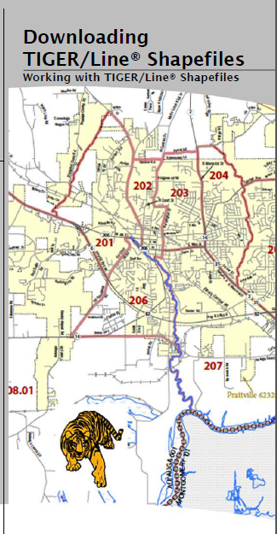
Topologically Integrated Geographic Encoding and Referencing

Slide 30
TIGER/Line Shapefiles
Public product created from the MAF/TIGER database
Digital files containing geographic features (roads, rivers, legal & statistical boundaries, address ranges, etc.), including information about the features and their location
Covers United States, Puerto Rico, and Island Areas
Updated data is released yearly
www.census.gov/geo/www/tiger/index.html

Slide 31
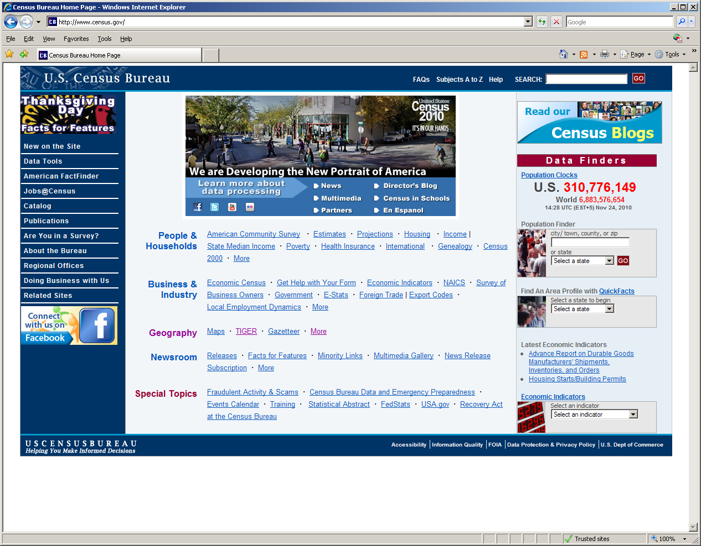
To get TIGER/Line shapefiles, go to www.census.gov, then click on TIGER

Slide 32
Overview Documentation available online at: http://www.census.gov/geo/www/tiger/wwtl/wwtl.html
*** This is where to start for using Census data in GIS.

Slide 33
ATTRIBUTES
STEP 2. Extract Data from American Fact-Finder OR American Community Survey(s).
Demographic Characteristics for Individuals and Households Aggregated by Geography (most are “Counts.”)
Generally Not Useful in “Raw Form.”
Need to “Normalized” – Percentages, Ratios and Densities.

Slide 34
100% Census Data
There was only ONE Census Form in 2010
All responses are tabulated for all Geographies
Summary File 1 contains Tables which summarize responses in (nearly) All Possible Ways
You access these data with American Fact Finder

Slide 35
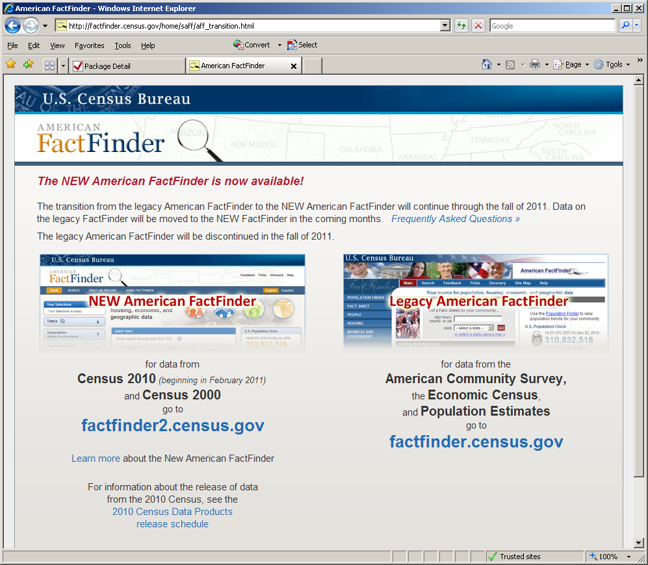
American Fact Finder (AFF). All 2010 Census Data and all future data releases will be in AFF.

Slide 36
Census 2000
In Census 2000, the census used 2 forms
Short Form– asked for basic demographic and housing information, such as age, sex, race, how many people lived in the housing unit, and if the housing unit was owned or rented by the resident
“Long Form– collected the same information as the short form but also collected more in-depth information such as income, education, and language spoken at home
Only a small portion of the population, called a sample, received the long form.
Notes:
36
Two forms were used during Census 2000. The “short form” asked several questions on the most basic demographic and housing topics. These questions asked about age, sex, race, Hispanic origin, the number of people living in the housing unit, and if the housing unit was owned or rented by the resident.
The “long form” collected the same information as the “short form,” but it also asked questions on additional topics. Thirty-two questions were asked of each resident of the housing unit on such topics as marital status, education, language spoken at home, employment, occupation, and others. Twenty-one questions were asked about the housing unit itself, so only one resident of that housing unit was asked to provide information on such topics as plumbing and kitchen facilities, type and cost of utilities, value of the property, and others.
Only a sample of the total U.S. population received the long form. The data from the long form are called “sample data.” The basic data collected on both the short and the long forms are called “100 percent data” since these questions were asked for 100 percent of the U.S. population.

Slide 37
2010 Census and ACS
2010 Census focused on counting the U.S. population
2010 Census had ONLY “short form” questions
The “long” form data are now collected by the ACS
Notes:
37
The 2010 Census included only one form sent to the entire U.S. population. That form asked only questions similar to those contained in previous census short forms. The 2010 Census provides a basic count of the U.S. population, collecting only the most basic demographic and housing information. Detailed demographic, social, economic, and housing data are no longer collected as part of the decennial census.
The data that were collected from the long form sample are now produced from the American Community Survey.
The American Community Survey collects data from the 50 states, the District of Columbia, and Puerto Rico, where it is called the Puerto Rico Community Survey. The American Community Survey does not collect data from the other U.S. territories, such as Guam and the U.S. Virgin Islands. The 2010 decennial census collected long form type data for these areas.
The questions that were asked on the 2010 Census are also asked on the American Community Survey questionnaire.

Slide 38
ACS Estimates Are NOT the 2010 Census Population Counts
The 2010 Census counts the population to support apportionment and redistricting
The ACS supplements this information with annually updated estimates on the nation’s population and housing characteristics
The purpose of the ACS is not to count every person in a community or town but rather, to provide a portrait of the community’s characteristics
38
Notes:
In the wake of the 2010 Census, we want to emphasize that estimates produced by the American Community Survey are not the same as the 2010 Census population counts.
Again, the purpose of the decennial census is counting the population to support apportionment and redistricting. Use numbers from the 2010 Census to obtain counts of the population and their basic characteristics, such as sex, age, race, Hispanic origin, and homeowner status.
The American Community Survey shows how people live by providing a portrait of the community’s characteristics. Use estimates from the ACS to obtain detailed demographic, social, economic, and housing characteristics. You will learn more about these characteristics in upcoming slides.

Slide 39
ACS Content: Population
SOCIAL
Ancestry
Citizenship & Year of Entry
Disability Status
Educational Attainment
Field of Degree
Health Insurance
Grandparents
Fertility
Language
Marital Status & History
Place of Birth
Migration
Relationship
School Enrollment
Veteran Status
ECONOMIC
Employment & Work Status
Income & Earnings
Industry & Occupation
Class of Worker
Commuting
Poverty Status
SNAP Receipt
DEMOGRAPHIC
Age & Sex
Race & Hispanic Origin
39
Notes:
The content collected by the American Community Survey can be grouped into four main types of characteristics – social, economic, demographic, and housing. Let’s take a closer look at the type of information each of these categories contain.
Social characteristics include topics such as education, marital status and history, fertility, grandparent caregivers, veterans, disability status, place of birth, citizenship status, year of entry, language spoken at home, ancestry and tribal affiliation.
Economic characteristics include such topics as health insurance coverage, income, benefits, employment status, occupation, industry, commuting to work, and place of work. Data on the economic characteristics of the population are collected to assess the material well-being of individuals and households.
The American Community Survey also collects the basic demographic characteristics such as sex, age, race and Hispanic origin. This is the same information that was collected by the 2010 Census.

Slide 40
ACS Content: Housing
Age of Householder
House Heating Fuel
Household Size
Kitchen Facilities
Occupancy and Vacancy
Owner Statistics
Plumbing Facilities
Race of Householder
Renter Statistics
Rooms and Bedrooms
Telephone Service
Tenure
Units in Structure
Value of Home
Vehicles Available
Year Householder Moved Into Unit
Year Structure Built
40
Notes:
Housing characteristics include topics such as tenure, occupancy and structure, housing value, taxes and insurance, utilities, and mortgage or monthly rent. This housing data gives us a measure of the housing stock of the country.

Slide 41
Data Product Release Schedule
The ACS annually releases:
1-year estimates (2010)
Areas with populations of 65,000+
The Nation
Every state, the District of Columbia, and Puerto Rico
Every Congressional District
About 25 percent of all counties
3-year estimates (2008-2010)
Areas with populations of 20,000+
5-year estimates (2006-2010)
All areas
Notes:
41
All American Community Survey data are published based on population thresholds. One-year estimates from the American Community Survey are published for geographic areas with a population of 65,000 or more, including counties or county equivalents, all Congressional Districts, metropolitan and micropolitan statistical areas, all 50 states, the District of Columbia, and Puerto Rico. The 2010 American Community Survey 1-year estimates were released in September 2011.
Three-year estimates from the American Community Survey are published for geographic areas with a population of 20,000 or more. The 2008-2010 American Community Survey 3-year estimates were released in October 2011. These 3-year estimates were produced with data collected from the 2008, 2009 and 2010 American Community Surveys.
The Census Bureau released data for all areas, including those with estimated populations of less than 20,000, for the first time in December 2010 with the 2005-2009 American Community Survey 5-year estimates. For small areas with populations less than 20,000, it takes 5 years to accumulate a large enough sample to provide estimates with accuracy similar to the decennial census long form. The 2006-2010 5-year estimates were released in December 2010. These 5-year estimates were produced from the data collected from the 2006, 2007, 2008, 2009, and 2010 American Community Surveys.
All American Community Survey data products are refreshed annually.

Slide 42
Data Products
ACS 1-Year
Data Profile
Comparison Profile
ACS 3-Year
ACS 5-Year
Data Profile
Selected Population Profile
Ranking Tables
Subject Tables
Detailed Tables
Geographic Comparison Tables
Public Use Microdata Sample File
Data Profile
Selected Population Profile
Subject Tables
Detailed Tables
Geographic Comparison Tables
Public Use Microdata Sample File
Subject Tables
Detailed Tables
Geographic Comparison Tables
Public Use Microdata Sample File
Narrative Profile
Narrative Profile
Notes:
The American Community Survey data products are similar to those produced from the decennial census long form. Like the decennial sample data products, the American Community Survey products show the characteristics of the country’s population and housing. These products include 3 broad types of products – profiles, tables, and Public Use Microdata Sample, or PUMS, files. There are multiple types of profiles and tables – data profiles, narrative profiles, comparison profiles, selected population profiles, ranking tables, subject tables, detailed tables, and geographic comparison tables. Not all products are available for each data release. For example, ranking tables are only available in the 1-year estimates, not the 3-year or 5-year estimates.
All of the data products are available on the Census Bureau’s American FactFinder. The data products are explored in depth in the presentation titled “Data Products from the American Community Survey.”

Slide 43
ACS Data Release Schedule
Data products are released in the year following the single year or multiyear period in which data are collected. ACS data includes median home value, median income, percent foreign-born, percent without health insurance, etc. This type of demographic data for small areas (down to tract and block group for the 5yr data) has not been released from Census since the 2000 long form data releases. This data replaces the data formerly collected via the Census long form.

Slide 44
“Census Data” vs ACS
1. 2010 Census shows numbers and basic characteristics (sex, age, race, hispanic origin, and homeowner status).
2. All ACS data are estimates derived from a sample of the United States rather than the whole population. Margin of Error (MOE) is published for each ACS estimate. 250K households in sample each month, 3 million sampled per year.
3. ACS estimates can be joined to a Shapefile or other Attributes.
4. More information/guidance can be found at:
http://www.census.gov/acs/www/

Slide 45
Step 3: Manipulate/recalculate tabular data as needed to get the variables desired AND a GEOID field that will match the Shapefiles.
Tables generally contain raw counts – Number of Males and Females in a Tract
Such numbers are not suitable for most mapping and analysis applications
Appropriate values might be Percent Female (a proportion) or Sex Ratio (males per 100 females)
The Geographic Feature Identifiers in the Shapefile and the Attribute file OFTEN Do Not Match
Identical GEO_IDs are needed to JOIN the table to the map

Slide 46
You usually need to calculate a new values for your map. In this example, we are dividing the estimated number of persons living in poverty by the total estimated persons, and multiplying by 100 to get the “ Percent Living in Poverty.” It is often easier to calculate values for new values outside of ArcGIS software.

Slide 47
STEP 4. Join/Link the TIGER Shapefiles to the tabular data using a Common Field matching GEO_ID
This Is NOT straightforward.
No matter how easy it seems, there are always glitches.
Most commonly, the data types (numbers vs text) do not match.
Some rudimentary “programming” is often necessary.

Slide 48
Requires careful examination of the so-called GEO_ID Fields in both the attribute- and shape-files.
Often a “new data column” must be created to satisfy this simple requirement.
Learn to recognize “TEXT” from “Numbers.”

Slide 49
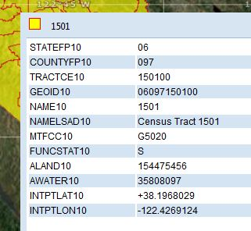
GEO_IDs in the Shapefiles are FIPS Codes

Slide 50
For Example: In the tract shapefile – CTIDFP00 in the ACS data table – GEO_ID2
To join your tabular data to the shapefile you need to have compatible GEO_ID fields

Slide 51
When we return ..
Sonoma County, California 2010
Percent Hispanic by Census Tract

