Slide 1

American Community Survey
Data Products
Updated February 2013
Notes:
1
The American Community Survey, also called the ACS, collects accurate, timely information needed for critical government functions. This approach provides accurate, up-to-date profiles of America's communities every year. The American Community Survey provides annual estimates of demographic, housing, social, and economic characteristics for numerous geographies every year. The ACS provides 1-year estimates for all states as well as for cities, counties, and metropolitan areas with a total population of 65,000 or more. The ACS also provides 3-year estimates for geographies with a total population of 20,000 or more and 5-year estimates for all geographies down to the block group level, even those with very small populations.

Slide 2
Overview
What do I need to know before using ACS estimates and data products?
What data products are available?
How do I access ACS data products?
Notes:
This presentation will address three commonly asked questions about the American Community Survey data products—what do I need to know before using ACS estimates and data products, what data products are available, and how do I access ACS data products?
First, the presentation addresses the question “What do I need to know before using ACS estimates and data products.” There are several key differences between the estimates produced from the American Community Survey and the data produced from the decennial census. These differences include the concept of period estimates and the publication of sampling error measures in many of the ACS data products. We’ll briefly look at these two issues before getting into the availability of data products.

Slide 3
Estimates
ACS produces estimates
ACS estimates are not counts of the population or housing
Population counts are produced from the decennial census
  Population Estimates Program (PEP) updates counts throughout the decade.
Notes:
The main function of the decennial census is to provide counts of every person residing in the United States for the purposes of Congressional apportionment and legislative redistricting. The primary purpose of the American Community Survey is to provide a portrait of the social, housing, economic, and demographic characteristics of the U.S. population. As a result, the American Community Survey does not provide official counts of the population or housing. In between censuses the Census Bureau’s Population Estimates Program is the official source for annual housing unit totals and for annual population totals by age, sex, race, and Hispanic origin.
The basic rule is that if you need a population count, use counts from the decennial census or counts from the Population Estimates Program. If you need to describe the characteristics of the population, use estimates from the American Community Survey.

Slide 4
Period Estimates
ACS estimates are period estimates
Period estimates describe the average characteristics over a specific time period
Contrast with point-in-time estimates that describe characteristics as of a specific date
Notes:
4
The American Community Survey produces period estimates of socioeconomic and housing characteristics. It is designed to provide estimates that describe the average characteristics of an area over a specific time period. In the case of American Community Survey 1-year estimates, the period is the calendar year. For example, the 2011 American Community Survey data describe the population and housing characteristics of an area from January 1, 2011 through December 31, 2011, not for any specific day within the year.
A period estimate is different from a point-in-time estimate. A point-in-time estimate is designed to measure characteristics as of a certain date or narrow time period. For example, the purpose of the decennial census is to count the population living in the United States on a specific date, which is traditionally April 1. Although decennial census data are actually collected over several months, they are designed to provide a snapshot of the U.S. population as of April 1.

Slide 5
Sampling Error
The uncertainty associated with an estimate that is based on data gathered from a sample of the population rather than the full population
Margin of error (MOE) measures the precision of an estimate at a given level of confidence
MOEs at the 90% confidence level for all published ACS estimates
5
Notes:
Sampling error is the uncertainty associated with an estimate that is based on data gathered from a sample of the population rather than the full population.
So, why do sample estimates have uncertainty associated with them? There are two reasons:
Estimates of characteristics from the sample data can differ from those that would be obtained if the entire population were surveyed.
Estimates from one subset or sample of the population can differ from those based on a different sample from that same population.
A key measure of sampling error is the margin of error. It is defined as a measure of the precision of an estimate at a given level of confidence. The most commonly used confidence levels are 90%, 95% and 99%. So what does the confidence level of a margin of error mean? The confidence level of a margin of error indicates the likelihood that the difference between the population value and the sample estimate is less than or equal to the margin of error.
American Community Survey estimates are published with their margins of error at the 90 percent confidence level. However, it is possible to construct margins of error with higher levels of confidence, such as 95 percent or 99 percent. This is done by adjusting the published margin of error. Instructions for these adjustments can be found in the technical appendices in the Compass Handbooks available on the Census Bureau’s web site.
It is important to note that the long form data from Census 2000 are also sample data. Therefore estimates produced from the long form also had sampling error associated with them, but the Census Bureau did not publish these data within the data products.

Slide 6
Overview
What do I need to know before using ACS estimates and data products?
What data products are available?
How do I access ACS data products?
Notes:
Next, let’s look at what data products are available from the American Community Survey.

Slide 7
ACS Data Products
Profiles
  Data Profiles
  Narrative Profiles
  Comparison Profiles
  Selected Population Profiles
Tables
  Detailed Tables and Collapsed Tables
  Subject Tables
  Ranking Tables
  Geographic Comparison Tables
Public Use Microdata Sample (PUMS) Files
Summary Files
Notes:
The American Community Survey data products are similar to those produced from the decennial census long form. Like the decennial sample data products, the American Community Survey products show the characteristics of the country’s population and housing.
These products include four broad types of products – profiles, tables, Public Use Microdata Sample, or PUMS, files and summary files. There are multiple types of profiles and tables – data profiles, narrative profiles, comparison profiles, selected population profiles, detailed tables, subject tables, ranking tables, and geographic comparison tables.
The upcoming slides will go over each of these products in detail. These slides will show static images of the data products as of March 2012. Later in this presentation we will go through an example of how to access the American Community Survey data products via American FactFinder.

Slide 8
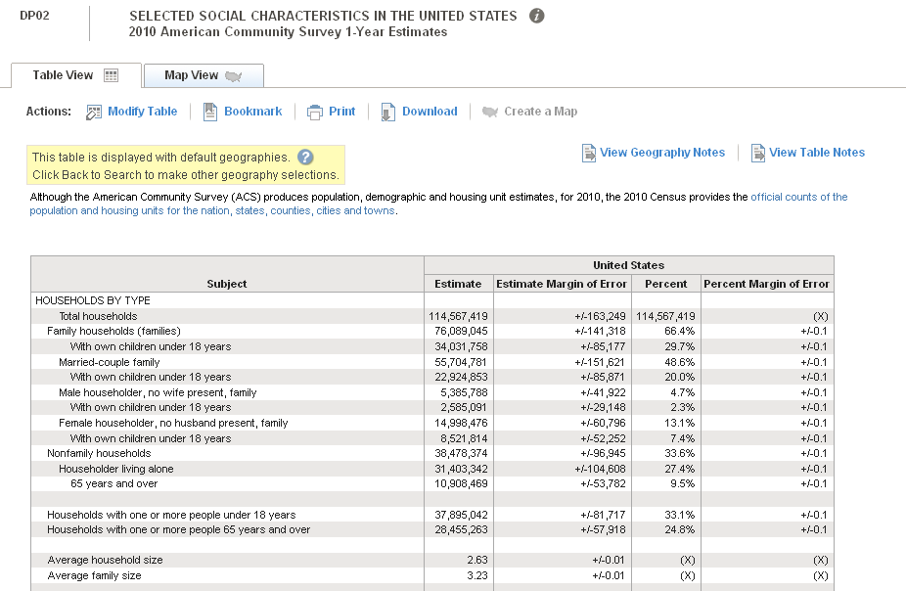
Data Profiles
Notes:
Data Profiles are a good place for data users new to the ACS to start. They provide separate fact sheets on the social, economic, housing, and demographic characteristics for different geographic areas. These fact sheets are listed separately in the search results page. The four profiles include a total of about 450 different characteristics. Data Profiles can be displayed in either a tabular or narrative format.
This slide shows an image of a social data profile. The tabular version is a five column table. A given set of selected summary characteristics and other derived measures for each geographic area is displayed in the first column on the left. The second and third columns include the estimate and its associated margin of error, respectively. The fourth and fifth columns display the estimates in percentage form and the margins of error associated with those percentages, respectively.
As with all American Community Survey data products, the margins of error are presented at the 90-percent confidence level.

Slide 9
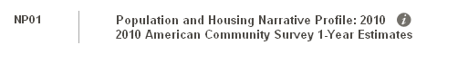
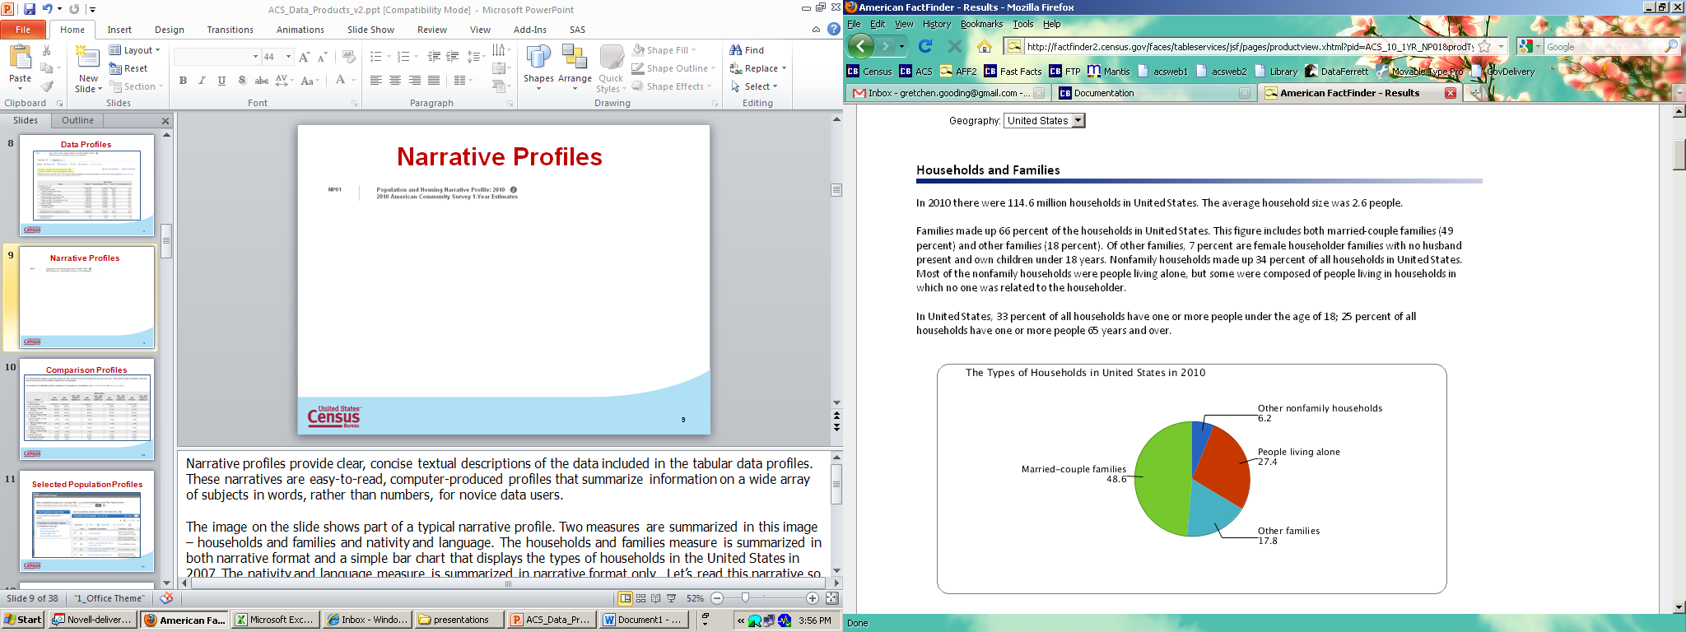
Narrative Profiles
Notes:
9
Narrative profiles provide clear, concise textual descriptions of the data included in the tabular data profiles. These narratives are easy-to-read, computer-produced profiles that summarize information on a wide array of subjects in words, rather than numbers, for novice data users.
The image on the slide shows part of a typical narrative profile. One measure is summarized in this image – households and families. The households and families measure is summarized in both narrative format and a simple pie chart that displays the types of households in the United States in 2010. Let’s read this narrative so we can see how the narrative data profiles summarize information:
In 2010 there were 114.6 million households in United States. The average household size was 2.6 people.
Families made up 66 percent of the households in United States. This figure includes both married-couple families (49 percent) and other families (18 percent). Of other families, 7 percent are female householder families with no husband present and own children under 18 years. Nonfamily households made up 34 percent of all households in United States. Most of the nonfamily households were people living alone, but some were composed of people living in households in which no one was related to the householder.
In United States, 33 percent of all households have one or more people under the age of 18; 25 percent of all households have one or more people 65 years and over.

Slide 10
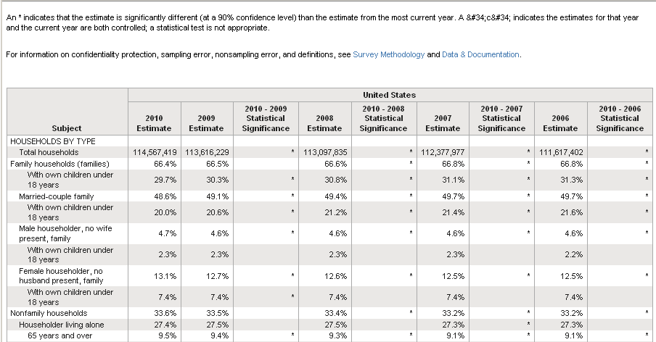
Comparison Profiles
Notes:
Comparison Profiles show data side-by-side from the 5 most recent years of the American Community Survey, indicating where there is a statistically significant difference between these two sets of estimates. An asterisk (*) in the statistical significance column of the comparison profile indicates that the estimate is significantly different . A “c” indicates both estimates are controlled and thus a test of statistical significance is not appropriate. The comparison profiles are only available for 1-year estimates. There are four types of comparison profiles – social, economic, housing, and demographic and they display the same characteristics as the data profiles.
The slide displays an image of a portion of the social comparison profile. The first of this ten column table contains the measures for which data are presented. The second column displays estimates from the 2010 American Community Survey and the third column displays estimates from the 2009 American Community Survey. The fourth column displays the result of the statistical significance test. For example, the 5th row shows information on households which are married couple families. In 2009, this group made up an estimated 49.1 percent of all households in the United States. In 2010, households which are married couple families made up an estimated 48.6 percent of all households in the United States. There is an * in the statistical significance column, indicating that these estimates are statistically different from one another. These estimates show that there was a statistically significant change at the 90 percent confidence level between the 2009 and 2010 American Community Survey.
10

Slide 11
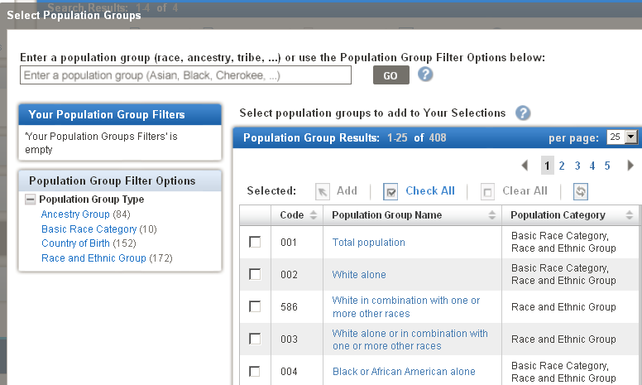
Selected Population Profiles
Notes:
The most detailed race and ethnic data are available through the Selected Population Profiles which provide summary tables separately for over 100 detailed race, ethnic, ancestry, and tribal groups. Starting with the 2007 American Community Survey, the selected population profiles are also available for approximately 100 countries and region of birth groups. The slide displays an image from the American FactFinder population group selection page. The left side of the image displays the four selection tabs that are available: Ancestry Groups, Basic Race Category, Country of Birth, and Race and Ethnic Group.
There are two thresholds used for Selected Population Profiles or SPPs. First, we look at the total population size of the geographic area. Beginning with the 2007 ACS, SPPs are released for geographic areas with a total population of at least 500,000. Prior to the 2007 ACS, SPPs were produced for geographic areas with a total population of at least 1 million.
Then we look at the size of the population group of interest. The 1-year SPPs are released for population groups with an estimated population of 65,000 or more. The 3-year SPPs are released for population groups with an estimated population of 20,000 or more. 5-year Selected Population Profiles are not available.
For example, suppose we’re interested in the Chinese alone population in San Francisco County, California. In 2010, San Francisco County had a total population of 805,463 people and there were an estimated 167,064 people who reported their race as Chinese alone. Because this situation meets both the minimum size of geography, geographic area population threshold and the population group of interest population threshold, a Selected Population Profile was produced.
11

Slide 12
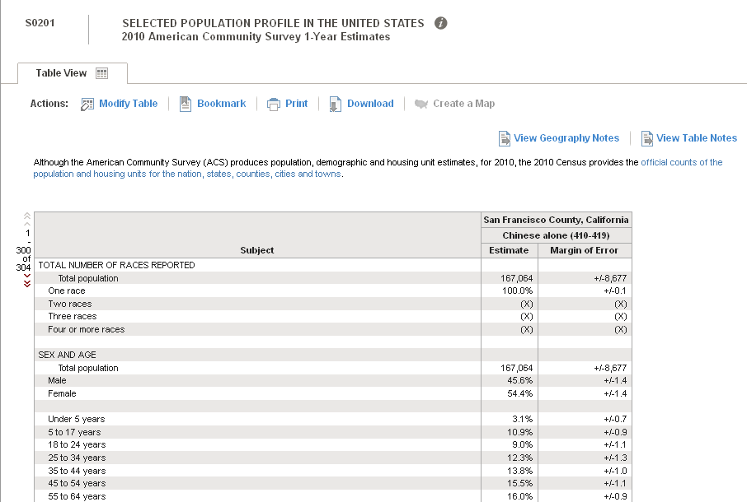
Selected Population Profiles
12
Notes:
12
Selected population profiles provide the user with a ready-made report on a population group and includes the 90 percent margin of error. The idea is to quickly produce a report on a population group of interest, for example: Native Hawaiians and Other Pacific Islanders, people of Bulgarian ancestry, or the foreign-born population born in Brazil.
This slide displays a portion of the selected population profile for the Chinese alone population in San Francisco County, California. The first column of the three column table displays selected characteristics for which data are displayed. The second and third columns show the estimates and margins of error for the selected population group, respectively, in this instance all people in San Francisco County, California who reported their race as Chinese alone.

Slide 13
Detailed Tables
Examples
B01001A-I: Sex by Age by Race and Hispanic Origin
B08134: Means of Transportation to Work by Travel Time to Work
B25018: Median Number of Rooms
B14001: School Enrollment by Level of School for the Population 3 Years and Over
B17001: Poverty Status in the Past 12 Months by Sex and Age
Notes:
13
The detailed tables provide the most detailed data on all topics and geographic areas and are the foundation upon which other data products are built.
Detailed Tables are basic distributions of characteristics that show estimates and their associated margins of error. There are more than 1,200 Detailed Tables and many of the tables are repeated for 11 race and Hispanic origin groups. Detailed tables include distributions for more than 500 characteristics, over 300 race and Hispanic Origin iterations, and 81 imputation tables. Also, Detailed Tables are the only products which are produced for block groups and this geographic level is only available in the Summary File.
A few examples of the types of topics covered by our detailed tables…
Sex by Age by Race and Hispanic Origin
Means of Transportation to Work by Travel Time to Work
Median Number of Rooms
School Enrollment by Level of School for the Population 3 Years and Over
Poverty Status in the past 12 Months by Sex and Age

Slide 14
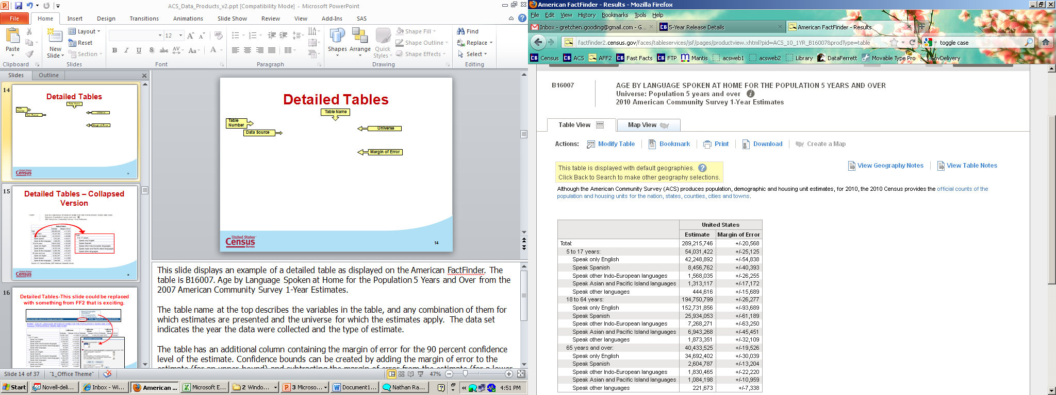
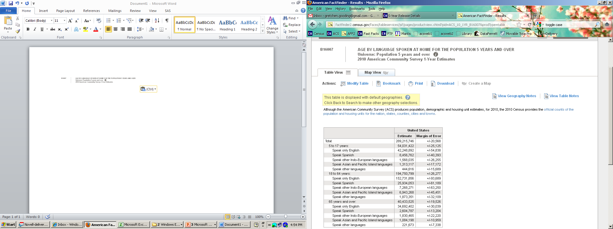
Detailed Tables
Table Name
Table Number
Data Source
Universe
Margin of Error
Notes:
This slide displays an example from the 2010 American Community Survey 1-Year Estimates of a detailed table as displayed on the American FactFinder. The table is B16007. Age by Language Spoken at Home for the Population 5 Years and Over.
The table name at the top describes the variables in the table, and any combination of them for which estimates are presented and the universe for which the estimates apply. The data source indicates the year the data were collected and the type of estimate.
The table has an additional column containing the margin of error for the 90 percent confidence level of the estimate. Confidence bounds can be created by adding the margin of error to the estimate (for an upper bound) and subtracting the margin of error from the estimate (for a lower bound). All published margins of error for the American Community Survey are based on a 90 percent confidence level.
Due to the level of specificity of the detailed tables, many tables have a “collapsed” version. 5-Year estimates have either “basic” or “collapsed” tables, but not both.

Slide 15
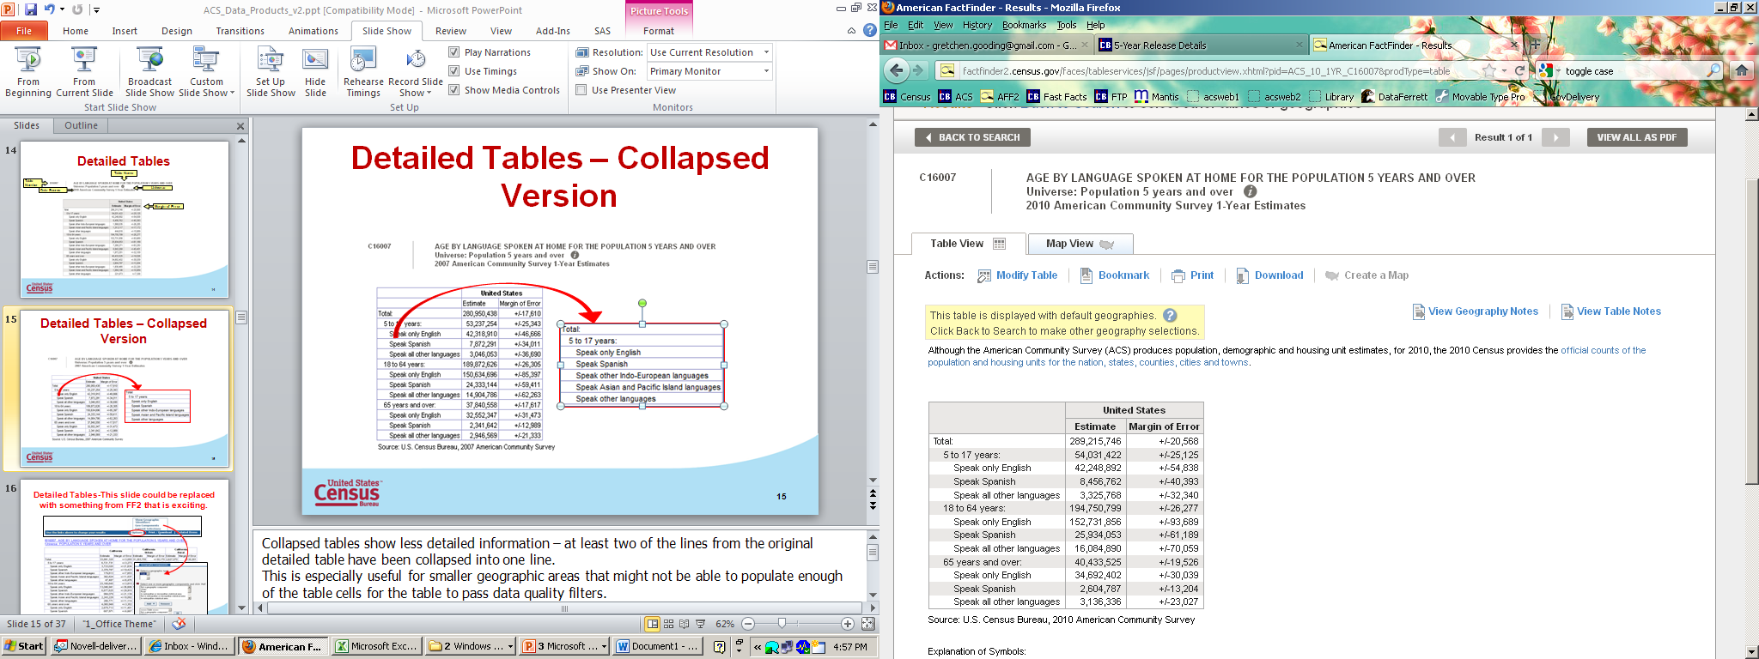
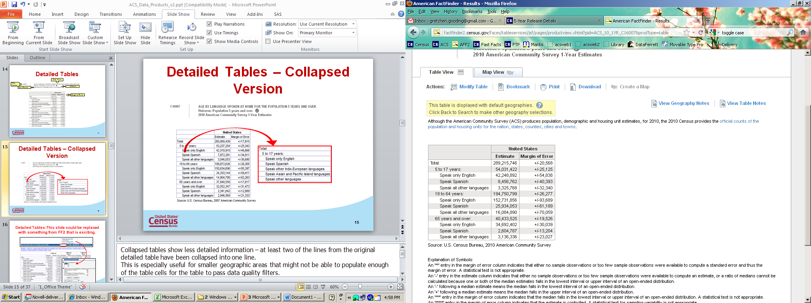
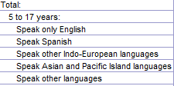
Detailed Tables – Collapsed Version
Notes:
Collapsed tables show less detailed information – at least two of the lines from the original detailed table have been collapsed into one line.
This is especially useful for smaller geographic areas that might not be able to populate enough of the table cells for the table to pass data quality filters.
For example, this table is C16007 which is the collapsed version of table B16007, which we looked at on the previous slide. The detail in the red box shows the original categories. “Speak other Indo-European languages” and “Speak Asian and Pacific Island languages” have been combined with “Speak other languages” to form a single category.
Collapsed tables are noted by the letter “C” as the first character in the table number.
15

Slide 16
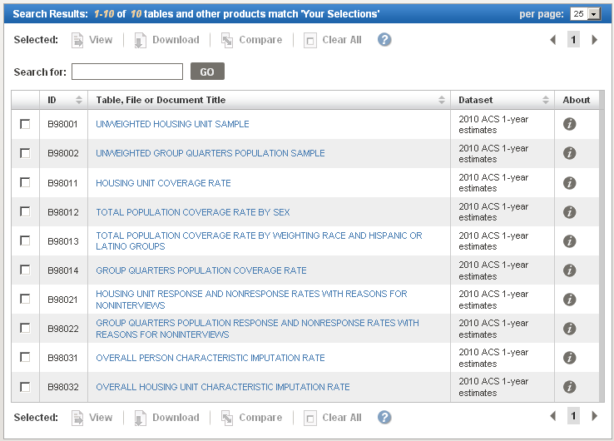
Detailed Tables for
Quality Measures
Notes:
Quality measures illustrate the steps the Census Bureau takes to ensure that American Community Survey data are accurate and reliable. The quality measures are available through American FactFinder in the B98 series of Detailed Tables. There are ten tables that describe the quality of the American Community Survey sample and the data it collects, including sample sizes, coverage rates, and response rates.

Slide 17
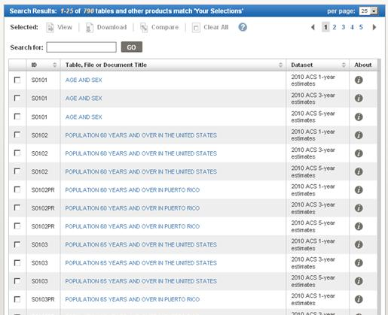
Subject Table List
Notes:
17
For information about a particular topic, such as employment, education, and origins and language, users should start with the Subject Tables. Subject Tables provide pretabulated numbers and percentages for a wide variety of topics, often available separately by age, sex, race or ethnicity.
The image on the slide displays a partial list of the available Subject Tables in the American FactFinder. Subject Tables are largely derived from the detailed tables and are similar to the Census 2000 Quick Tables.

Slide 18
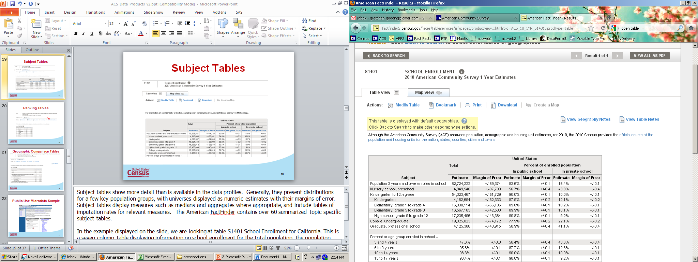
Subject Tables
Notes:
18
Subject tables show more detail than is available in the data profiles. Generally, they present distributions for a few key population groups, with universes displayed as numeric estimates with their margins of error. Subject tables display measures such as medians and aggregates where appropriate, and include tables of imputation rates for relevant measures. The American FactFinder contains over 60 summarized topic-specific subject tables.
In the example displayed on the slide, we are looking at table S1401 School Enrollment for the United States. This is a seven column table displaying information on school enrollment for the total population, the population enrolled in public school and the population enrolled in private school.

Slide 19
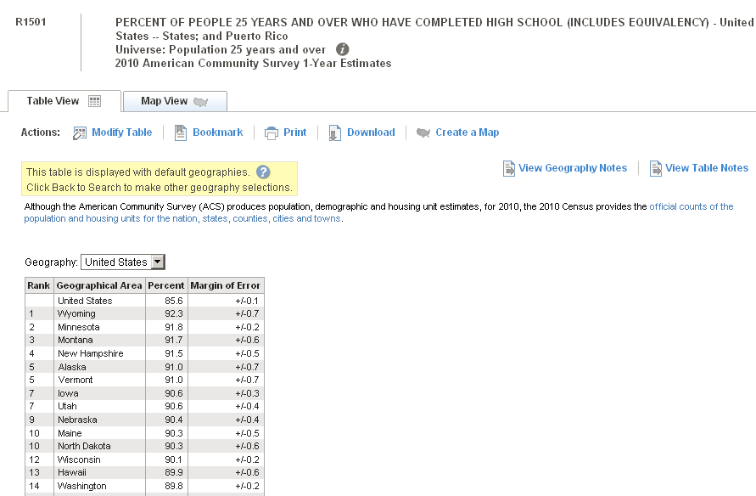
Ranking Tables
Notes:
19
Ranking Tables provide state-level rankings of key ACS variables. There are more than 80 ranking tables available on various topics. The image on the slide shows ranking table R1501. Percentage of People 25 Years and Over Who Have Completed High School (Includes Equivalency). This is a four column table, showing the rank in the first column, the state in the second, and the estimate and margin of error in the third and fourth columns, respectively. Each table displays a single characteristic and the states are “ranked” from highest to lowest. This enables users to compare the different states.

Slide 20
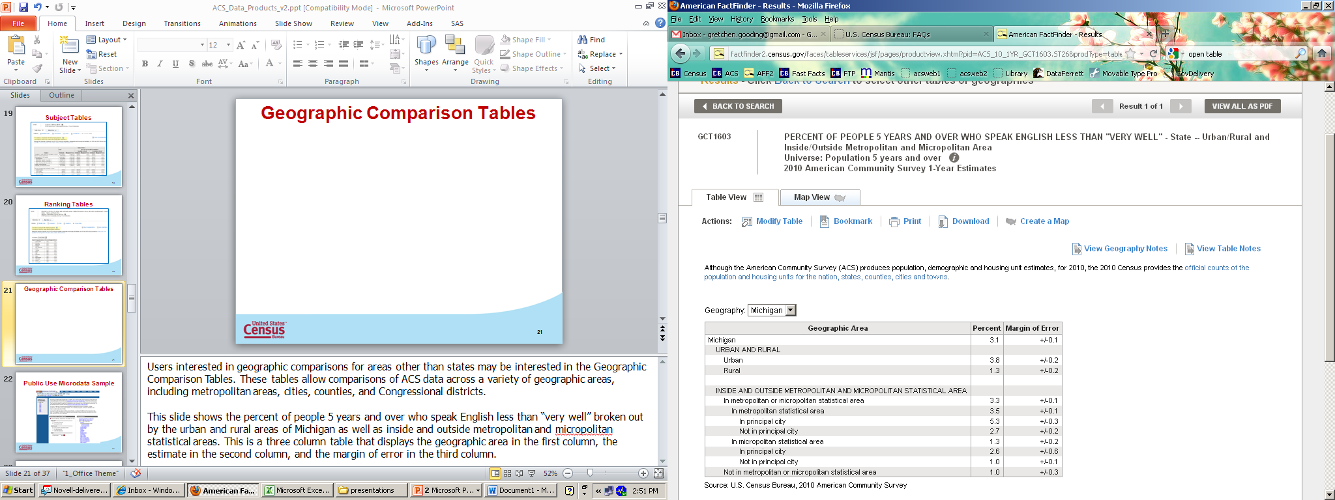
Geographic Comparison Tables
Notes:
20
Users interested in geographic comparisons for areas other than states may be interested in the Geographic Comparison Tables. These tables allow comparisons of ACS data across a variety of geographic areas, including metropolitan areas, cities, counties, and Congressional districts.
This slide shows the percent of people 5 years and over who speak English less than “very well” broken out by the urban and rural areas of Michigan as well as inside and outside metropolitan and micropolitan statistical areas. This is a three column table that displays the geographic area in the first column, the estimate in the second column, and the margin of error in the third column.

Slide 21
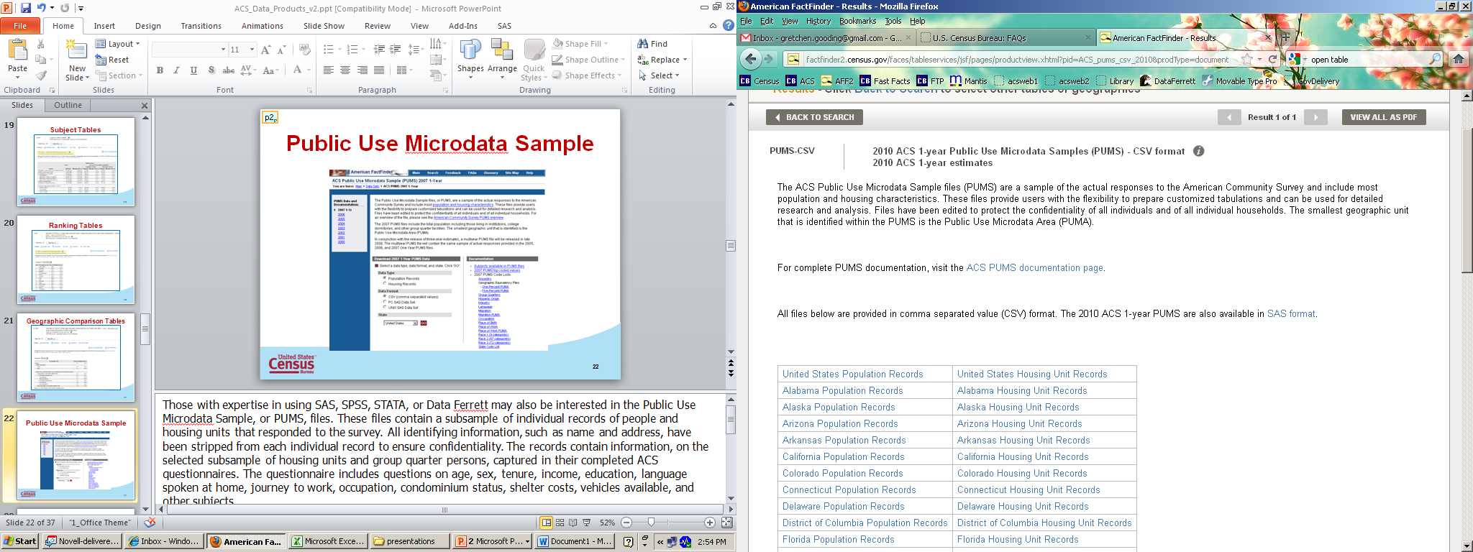
Public Use Microdata Sample
Notes:
Those with expertise in using SAS, SPSS, STATA, or Data Ferrett may also be interested in the Public Use Microdata Sample, or PUMS, files. These files contain a subsample of individual records of people and housing units that responded to the survey. All identifying information, such as name and address, have been stripped from each individual record to ensure confidentiality. The records contain information on the selected subsample of housing units and group quarter persons that was captured in their completed ACS questionnaires. The questionnaire includes questions on age, sex, tenure, income, education, language spoken at home, journey to work, occupation, condominium status, shelter costs, vehicles available, and other subjects.
For many data users, the summary tables and tabular profile reports will suffice. Microdata are for those users who want to create do-it-yourself tabulations, to be able to further draw on the richness of detail recorded in the ACS survey. The PUMS files permit analysis of specific population groups and custom variables that are not available through the American FactFinder.
Microdata users frequently want to look at relationships among variables not shown in the standard products offered by the Census Bureau. For example, what are the characteristics of unemployed homeowners? What characteristics do families with four or more children have in common? What kinds of Hispanic families in a state own their own homes?
The advantage of PUMS is that data users can tabulate data according to the characteristics they need to know about. The disadvantage of PUMS is that data are only available for states and large geographies called Public Use Microdata Areas or PUMAs. When using the PUMS files, users are sacrificing geographic detail for subject detail.
Learn more about PUMS in the “Introduction to the Public Use Microdata Sample (PUMS) File from the American Community Survey” training presentation.

Slide 22
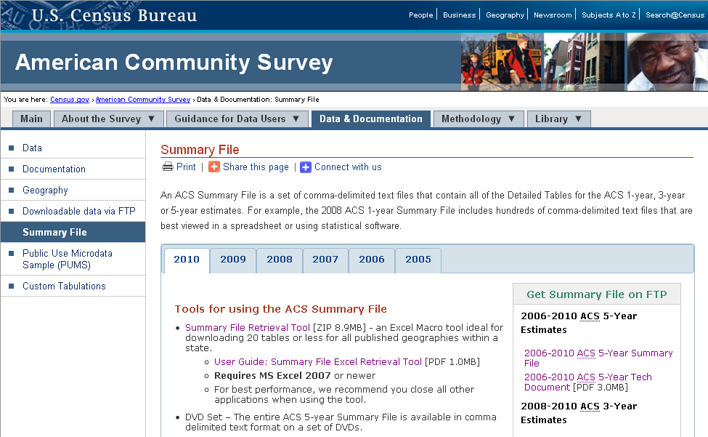
ACS Summary File
http://www.census.gov/acs/www/data_documentation/summary_file/
Notes:
The ACS Summary File is a set of comma-delimited text files that contain all of the Detailed Tables for the ACS 1-year, 3-year, and 5-year estimates. The Summary File is best viewed in a spreadsheet or using statistical software, such as SAS or STATA. Block group level estimates are available only in the Summary File; they are not available in American FactFinder.
You can learn more about the ACS Summary File on our website, census.gov/acs. From the ACS homepage, select the “Data & Documentation” tab, then select “Summary File.” The Summary File page contains links to different tools for using this product, as well as links to the FTP site and technical document. New users should make sure to read the technical documentation before accessing the Summary File via the FTP site.

Slide 23
Overview
What do I need to know before using ACS estimates and data products?
What data products are available?
How do I access ACS data products?
Notes:
Finally, let’s discuss how you can access data products from the American Community Survey.

Slide 24
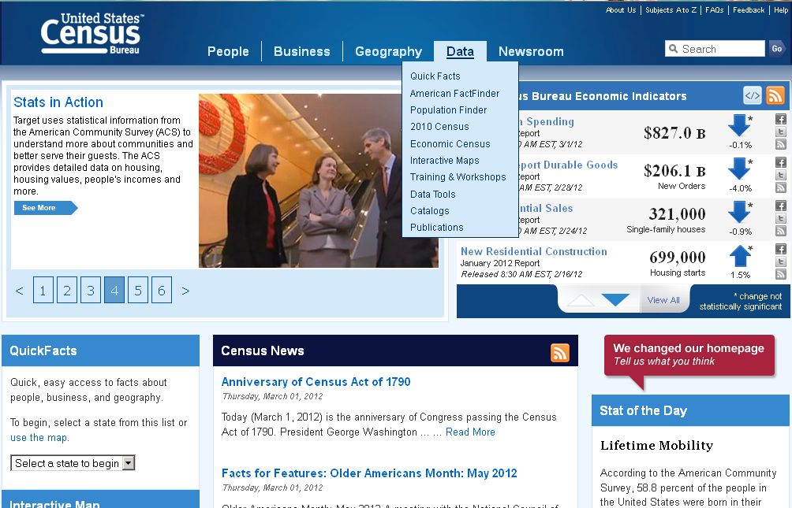
U.S. Census Bureau Home Page
http://www.census.gov
Notes:
24
All ACS data products are available on American FactFinder and via the Census Bureau’s FTP site. You can also access the PUMS files and the 5-Year Summary File through the DataFerrett. Let’s look at each method in a bit more detail.
To access ACS data products through American FactFinder, begin by visiting the main Census website: www.census.gov
From the top navigation bar, select “Data.” The second link from the top is a link to American FactFinder, the main vehicle for accessing data products.

Slide 25
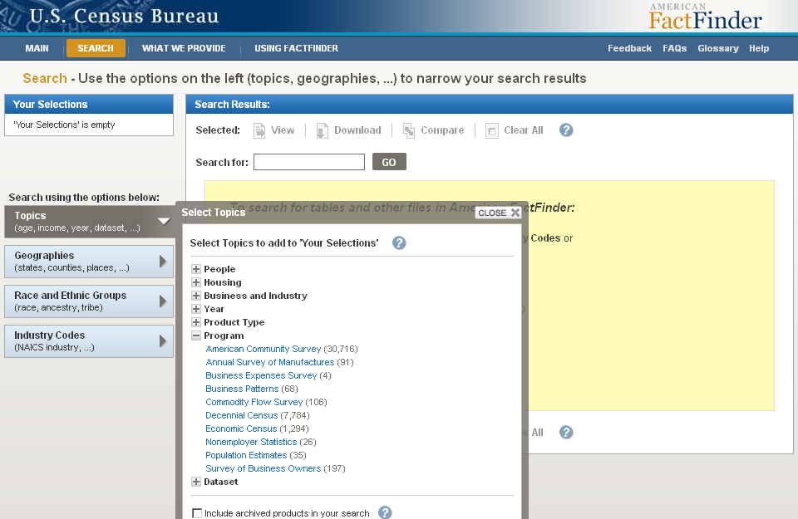
American FactFinder
Notes:
25
American FactFinder houses other programs besides the American Community Survey. Let’s talk about how to limit our search results to just the ACS.
On the left side of the page, click on “Topics.” The “Select Topics” overlay opens. Select the box next to “Programs” and click on “American Community Survey.” This will narrow the search results down to ACS products only.

Slide 26
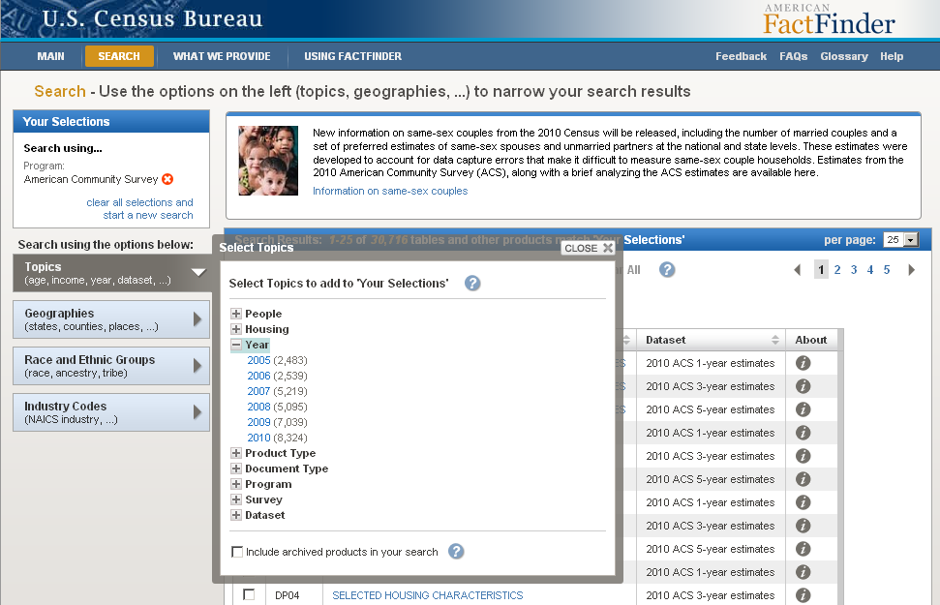
ACS Data Products
Notes:
26
Once you have clicked on “American Community Survey,” your choice will be added to the “Your Selections” box in the upper left corner of the screen. This box displays filters that you have added. Any filter can be removed by choosing the red “X” next to the choice. We can also choose to implement other filters, such as “Year,” “Product Type,” or “Dataset.” In this case, we will choose the year, “2010”.
Once again, on the left side of the page, click on “Topics.” The “Select Topics” overlay opens. Select the box next to “Year” and click on “2010.” This will narrow the search results down to 2010 American Community Survey products only.
Once you have selected your topics of interest, close the “Select Topics” overlay. The “Search Results” shown in AFF should be limited to the 2010 American Community Survey tables.

Slide 27
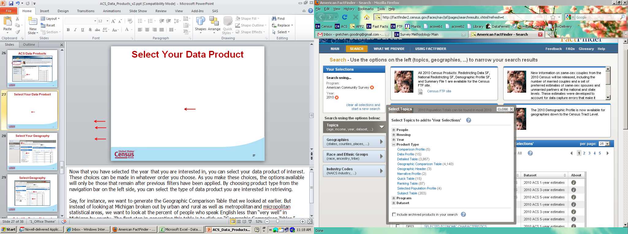
Select Your Data Product
Notes:
27
Now that you have selected the year that you are interested in, you can select your data product of interest. These choices can be made in whatever order you choose. As you make these choices, the options available will only be those that remain after previous filters have been applied. By choosing product type from the navigation bar on the left side, you can select the type of data product you are interested in retrieving.
Say, for instance, we want to generate the Detailed Table that we looked at earlier, B16007 Age by Language Spoken at Home for the Population 5 Years and Over. But instead of looking at the nation, we want to look at the state of California. The first step in generating this table is to again within “Topics,” click on “Product Type,” then “Detailed Tables.”

Slide 28
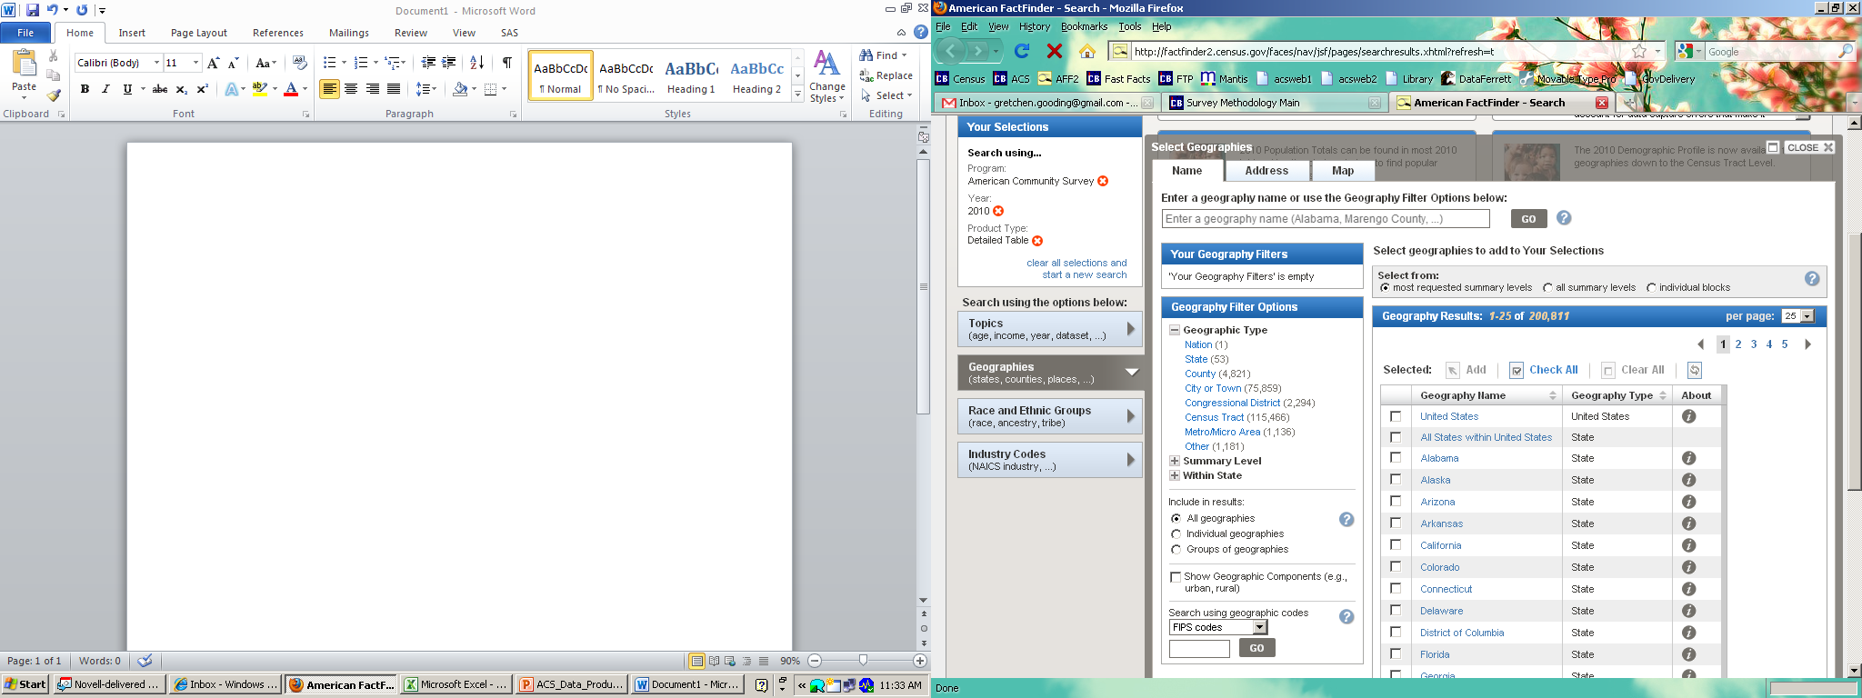
Select Your Geography
Notes:
To create a Detailed Table, we need to select the geography of interest. To do this we must first select the “Geographies” tab on the left side of the page, then select the “Name” tab.
For our example, we will select “State” which brings us to the next geographic selection where we select “California.”
From here, you can also choose to display information by different geographic components for the detailed and collapsed tables. Check the box next to “Show Geographic Components” for this option. It is circled in red in this slide. Geographic components are available for the nation, region, divisions, and states. Geographic components available from the American Community Survey include urban, rural, in metropolitan or micropolitan statistical area, not in metropolitan or micropolitan statistical area, and several others.

Slide 29
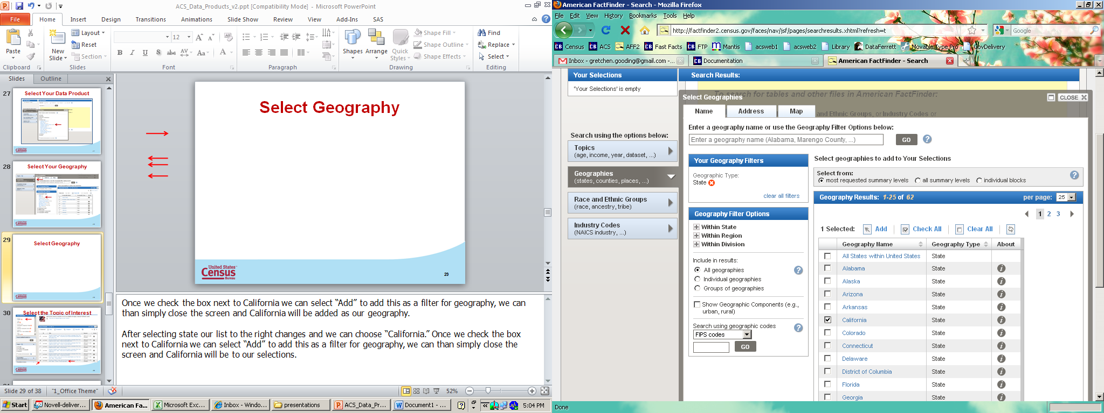
Selecting a State
Notes:
Once we check the box next to California we can select “Add” to add this as a filter for geography, we can than simply close the screen and California will be added as our geography to the “Your Selections” box.

Slide 30
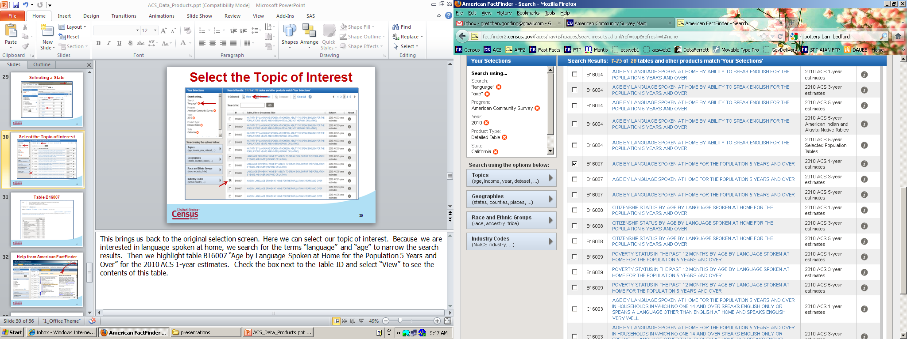
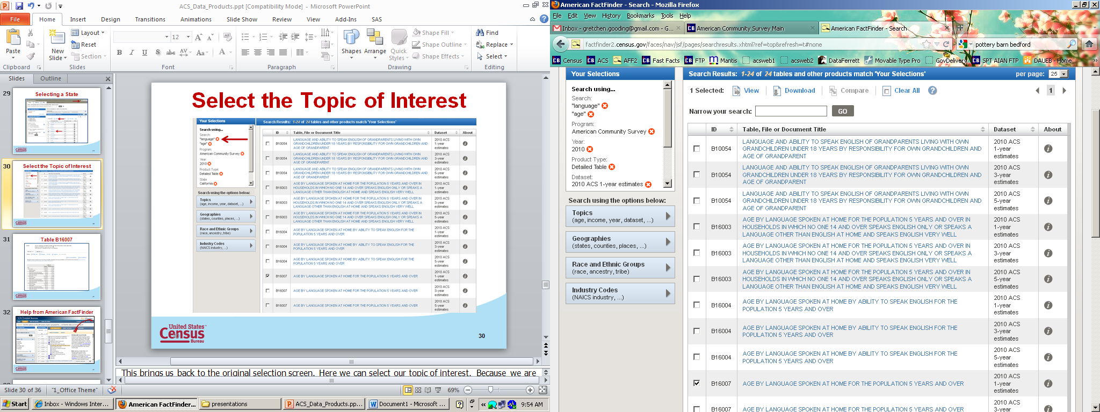
Select the Topic of Interest
30
Notes:
30
This brings us back to the original selection screen. Here we can select our topic of interest. Because we are interested in language spoken at home, we type the terms “language” and “age” in the “Narrow your search” box circled above. Then we select table B16007 “Age by Language Spoken at Home for the Population 5 Years and Over” for the 2010 ACS 1-year estimates. Check the box next to the Table ID and select “View” to see the contents of this table.

Slide 31
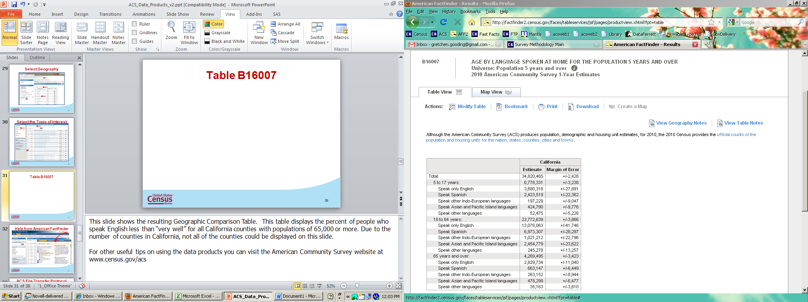
Table B16007
Notes:
31
This slide shows the resulting Detailed Table. This table displays age by language spoken at home for the population 5 years and over for the state of California.
For other useful tips on using the data products you can visit the American Community Survey website at www.census.gov/acs

Slide 32
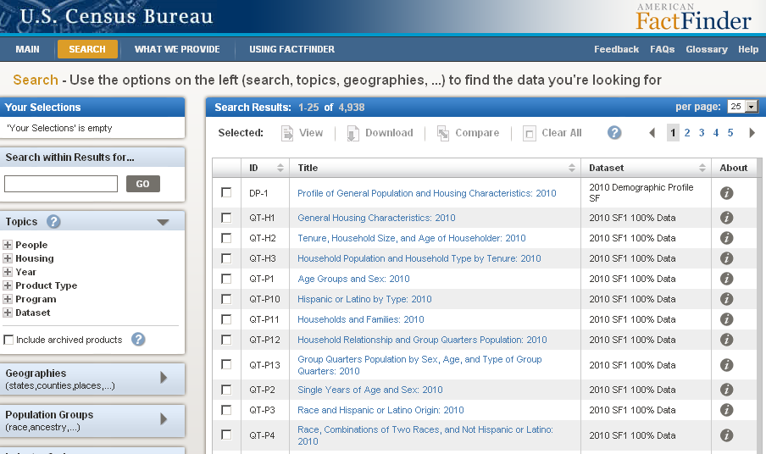
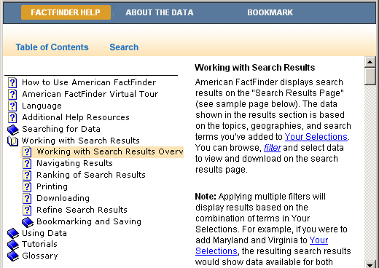
Help from American FactFinder
Notes:
Additional user assistance can be found at the main page of American FactFinder. Clicking on the “Help” tab at the top of the page will open a window that will point you to a set of tutorials on how to use American FactFinder.
32

Slide 33
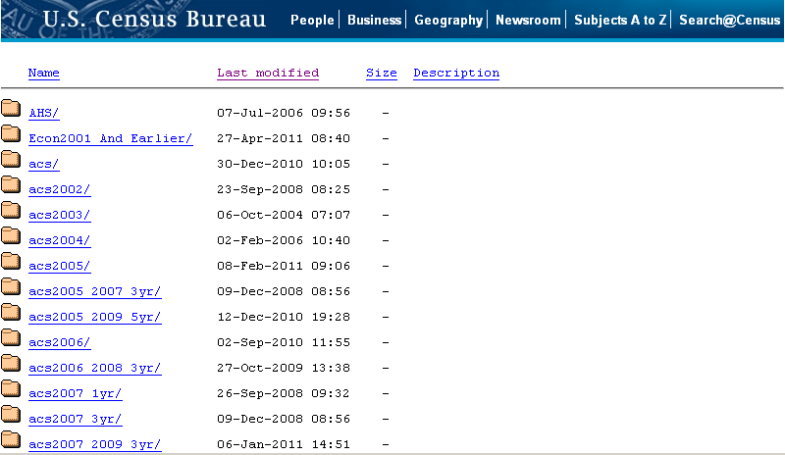
ACS FTP Site
http://www2.census.gov/
Notes:
You can also access ACS data through the Census Bureau’s file transfer protocol site. The FTP site can be accessed at www2 dot census dot gov or through the ACS website. The FTP site contains ACS data as they are released. On the FTP site, users can find current and historical ACS data. The FTP site is particularly useful for users who want to download the ACS Summary File or PUMS file.

Slide 34
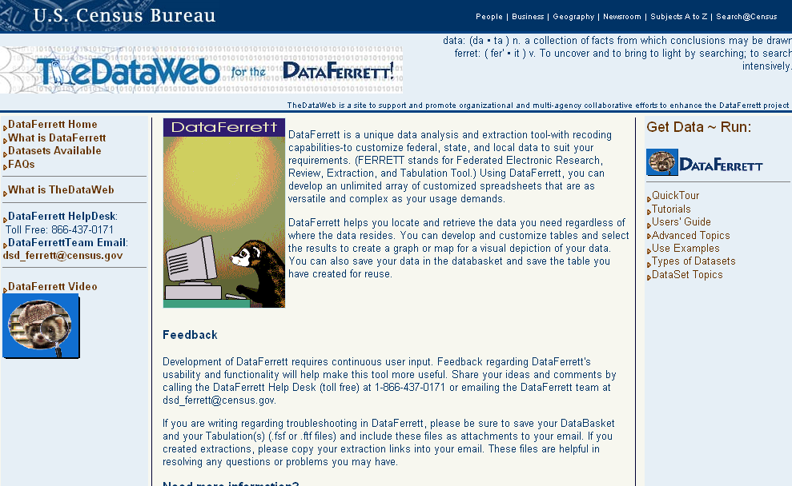
DataFerrett
http://dataferrett.census.gov
Notes:
The PUMS files and 5-year Summary File can also be accessed through a data access tool called the DataFerrett. DataFerrett is available at dataferrett.census.gov. DataFerrett is a data analysis tool with the ability to access many federal, state, local, and private datasets via an Internet connection. For people who do not have access to data analysis tools such as SAS, SPSS, or STATA, DataFerrett is an easy way to access the PUMS files and create the tables you are interested in or access the ACS 5-year Summary File.

Slide 35
DataFerrett Tutorials
Notes:
DataFerrett allows you to recode variables and create tabulations from survey microdata. Tutorials on using DataFerrett are available within the application. You can access them from the right side of the main DataFerrett web page. It is highly recommended that you review these before using DataFerrett, as there are many types of analyses that DataFerrett is capable of computing.

Slide 36
Additional ACS Resources
ACS website (census.gov/acs)
American FactFinder (factfinder2.census.gov)
QuickFacts (quickfacts.census.gov)
DataFerrett (dataferrett.census.gov)
FAQs (https://ask.census.gov/faq.php?id=5000&rtopic=1805)
Notes:
In addition to the ACS website at census.gov/acs, here are some other American Community Survey resources.
American Community Survey data products are available through American FactFinder at factfinder2.census.gov.
Quick, easy access to facts about people, business, and geography are available through QuickFacts at quickfacts.census.gov.
DataFerrett, the Census Bureau’s free online tool that can analyze and extract data from the American Community Survey, is available at dataferrett.census.gov.
Finally, frequently asked questions specific to the American Community Survey are available at ask.census.gov by selecting “American Community Survey” in the left navigation bar.

Slide 37
Final Thoughts
The U.S. Census Bureau measures the nation’s People, Places and Economy
Census Bureau statistics are how America knows what America needs
The Census Bureau is the leading source of quality, timely and relevant information about our nation’s people and economy
Notes:
-The U.S. Census Bureau measures the nation’s People, Places and Economy
The Census Bureau is the leading source of statistical information about the nation’s people, providing not only snapshots of the nation’s population size and growth, but also detailed portraits of the changing characteristics of our communities. The Census Bureau is often the only source of statistics at the local level every year, giving even the smallest communities accurate, timely information that is essential for decision-making. The Census Bureau provides critical, timely information on the health of the U.S. and local economy.
-Census Bureau statistics are how America knows what America needs
More than $400 billion in federal funds are distributed every year to states and communities based in part on demographic, socioeconomic and geographic information generated by the Census Bureau. Census Bureau statistics provide a clear and detailed picture of the entire population. For example, census and American Community Survey (ACS) estimates reflect the growth of the population as well as the changing socioeconomic and demographic characteristics of the American people. State and local governments use census and ACS statistics to plan new roads, new schools and new emergency services. Businesses use the statistics to develop new economic opportunities. Congress has also passed many laws that depend on census and ACS statistics. These include the Voting Rights Act, the Age Discrimination and Employment Act, the National Affordable Housing Act, and the Veterans' Benefit Program. Each of these laws needs comparable measures of relevant attributes to implement the laws.
-The Census Bureau is the leading source of quality, timely and relevant information about our nation’s people and economy
With the innovation of the American Community Survey, every community, every year receives detailed statistics about their social, economic and housing characteristics. We listen to Congress, federal programs and other data users to make sure we’re measuring information that’s relevant for decision-making.

Slide 38
Contact Information
Subscribe to “Email Updates”
http://www.census.gov/acs
Visit the ACS/PRCS website:
http://www.census.gov/acs
Contact by Telephone:
1-800-923-8282
Submit a Question:
https://ask.census.gov
Notes:
38
This presentation gave you an overview of the American Community Survey program and products.
Stay updated on ACS-related news by subscribing to our email updates. Select “Get Email Updates” from the ACS homepage at census dot gov forward slash acs. While you are at our website, check it out for the latest updates on the survey.
Please feel free to contact the Census Bureau if you have questions or need further information. If you have questions that are not answered by the Web site, please call 1-800-923-8282 or submit a question at https://ask.census.gov.

