Slide 1
CARTOGRAPHY
ΣCIΕΝCΕ, ART & TECHNOLOGY
Dr. Frank Gossette Adjunct Professor University of California, Riverside - Extension

Slide 2
Cartography is the discipline dealing with the conception, production, dissemination and study of maps (I.C.A. in Anonymous 1992).

Slide 3
Cartography is considered as the science of preparing all types of maps and charts and includes every operation from original survey to final printing of maps (United Nations 1949, cited in Freitag 1993).

Slide 4
Cartography is the art, science and technology of making maps, together with their study as scientific documents and works of art (I.C.A in Meynen 1973).

Slide 5
THAT SEEMS LIKE A LOT!! HOW MUCH TIME DO WE HAVE??
What can we LEARN TODAY?

Slide 6
The SCIENCE of Map Making
Issues of Abstraction, Simplification and Generalization
Strategies of Symbolization
Methods of Statistical Generalization

Slide 7
ART: Visual Communication
Best Practices
Composition: Parts of the Map
Layout: Arranging Information on the Map
Typography: Lettering and Symbols
Esthetics?

Slide 8
Map Making Technologies
Publication and Presentation – Design Considerations
Selecting an Appropriate Map Projection
Media and Hardware Special Adaptations
Integrating Geospatial Technologies

Slide 9
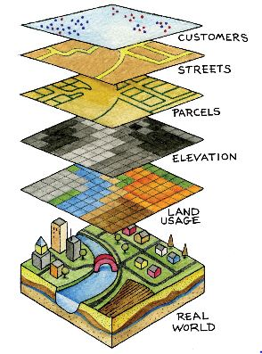

The Science of Map Making: Abstraction, Simplification and Generalization
The Layer Model

Slide 10
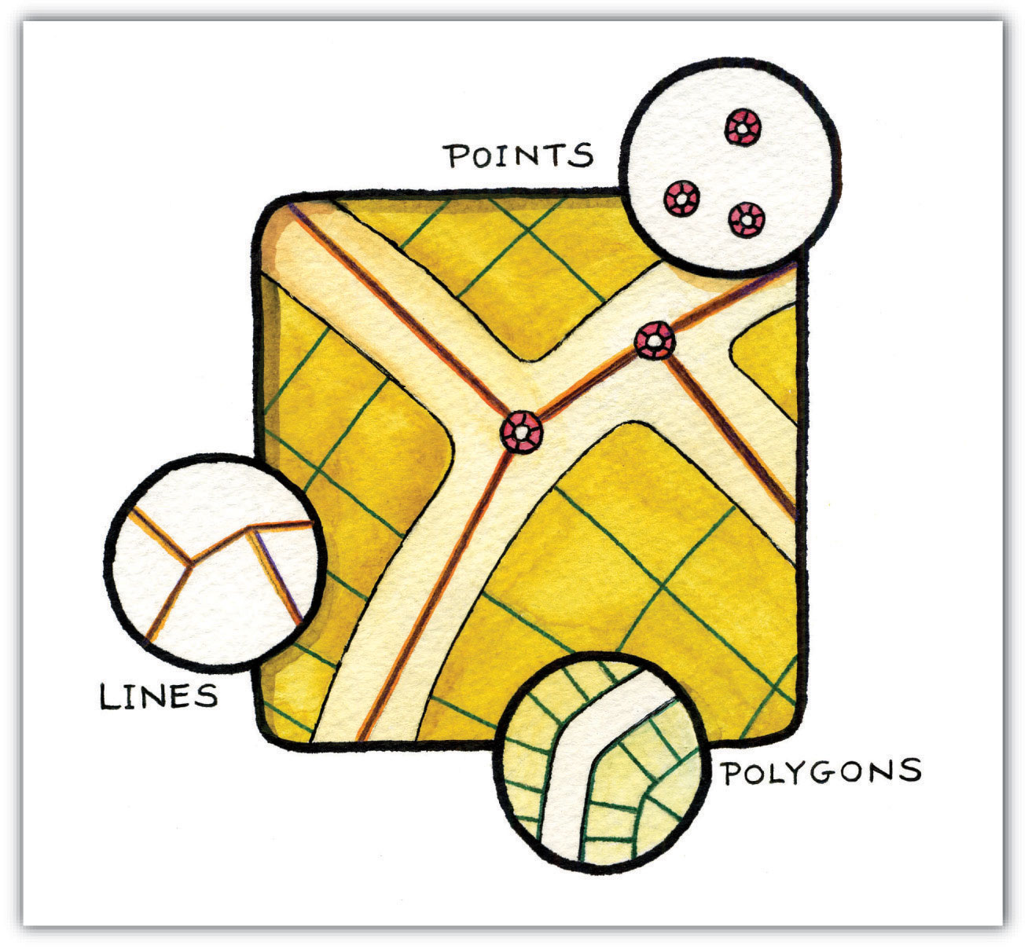
The Science of Map Making: Abstraction, Simplification and Generalization
The Vector GIS Data Model
Map
Features

Slide 11
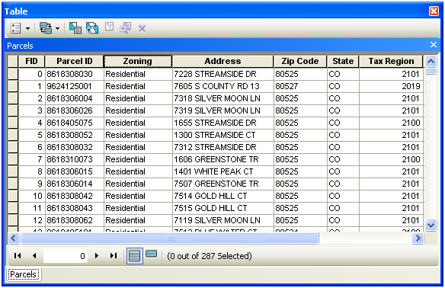

The Science of Map Making: Abstraction, Simplification and Generalization
FEATURE ATTRIBUTES
DATA
TABLE

Slide 12
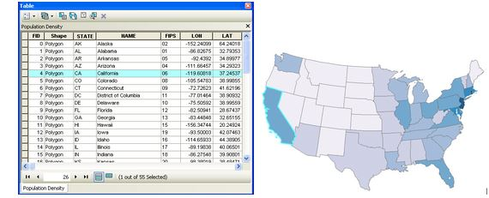
The Science of Map Making: Abstraction, Simplification and Generalization
Features and Attributes Linked in a Thematic Map

Slide 13
The Science of Map Making: Strategies of Symbolization
IT ALL DEPENDS ON THE DATA!
Feature Type?
  Points
  Lines
  Polygons
Attribute Type?
  Nominal
  Ordinal
  Interval
  Ratio

Slide 14
The Science of Map Making: Strategies of Symbolization
Attribute Data TYPES
CATEGORICAL
Quantitative
NOMINAL | ORDINAL | INTERVAL | RATIO
Qualitative
NUMERIC

Slide 15
MAP SYMBOLS
FEATURE TYPE | CATEGORICAL | NUMERIC
POINTS | MARKERS | GRADUATED SYMBOLS
LINES | LINE STYLES/COLORS | LINE THICKNESS
AREAS | PATTERNS/COLORS FILL | PATTERN/COLOR RAMP

Slide 16
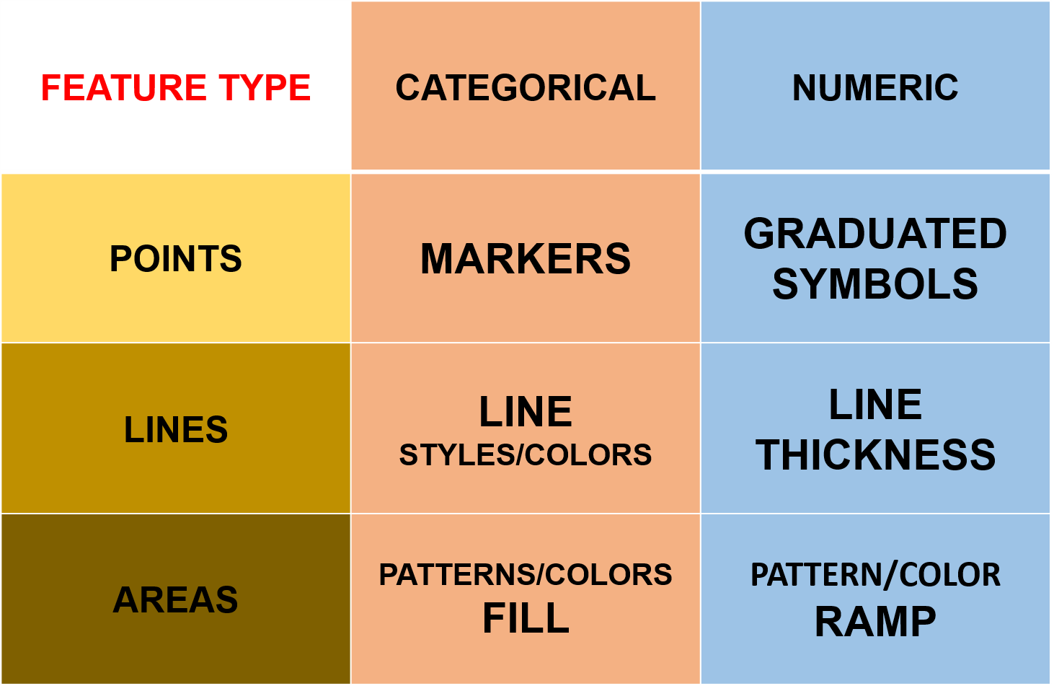
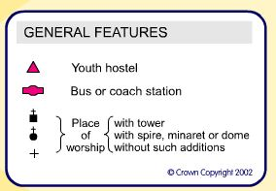


The Science of Map Making: Strategies of Symbolization

Slide 17
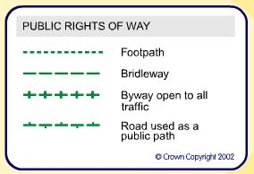

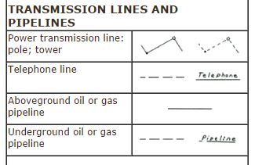
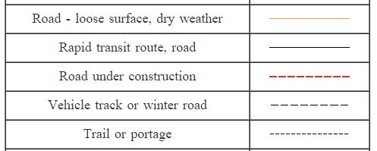
The Science of Map Making: Strategies of Symbolization

Slide 18
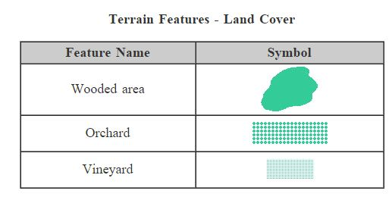
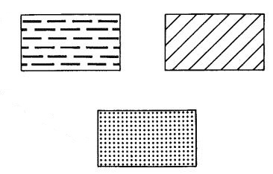
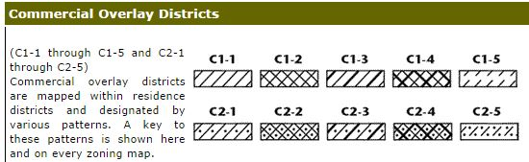
The Science of Map Making: Strategies of Symbolization

Slide 19
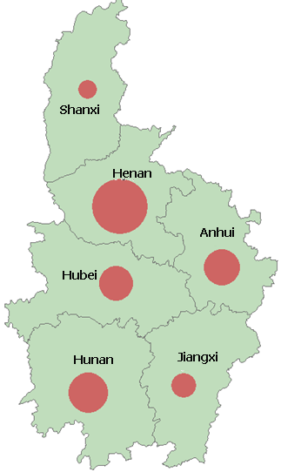
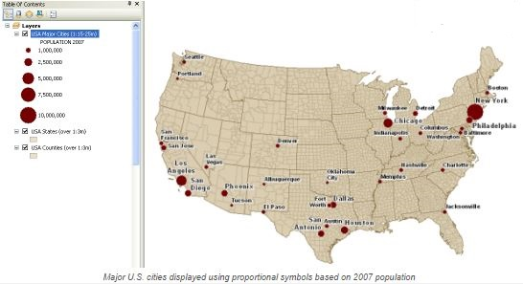
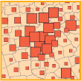
The Science of Map Making: Strategies of Symbolization

Slide 20
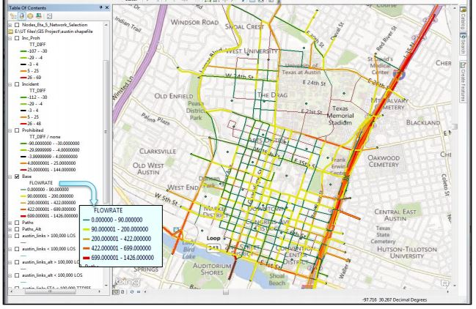
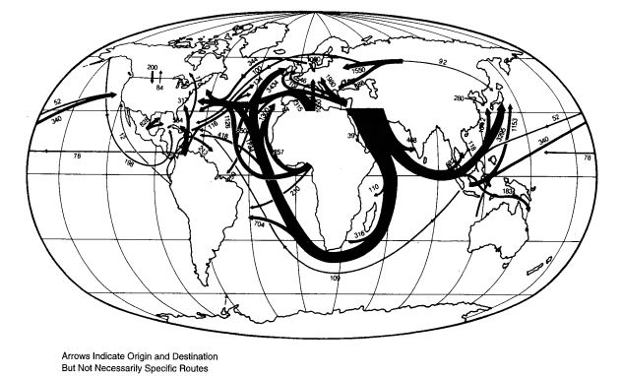
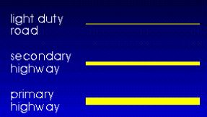
The Science of Map Making: Strategies of Symbolization

Slide 21
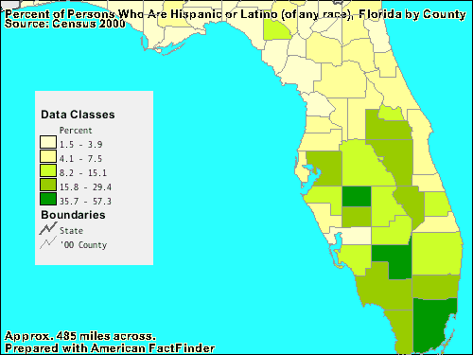
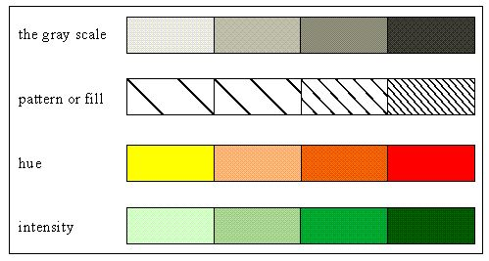
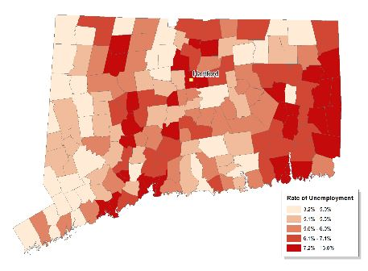
The Science of Map Making: Strategies of Symbolization

Slide 22
The Symbol Matrix
FEATURES | CATEGORICAL Attribute | NUMERIC Attribute
POINTS | MARKERS | GRADUATED SYMBOLS
LINES | LINE STYLES/COLORS | LINE THICKNESS
AREAS | PATTERNS/COLORS FILL | PATTERN/COLOR RAMP

Slide 23
Next:
The Science of Map Making:
Methods of Statistical Generalization

Slide 24
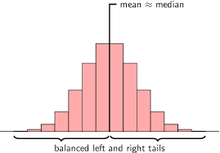
The Science of Map Making: Methods of Statistical Generalization
Get to Know your Data
Explore your data and its "shape"– know the shape of any statistical distribution you plan to map.
Plot a histogram of the data and employ basic descriptive statistics to explore its distribution

Slide 25
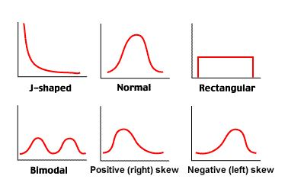
The Science of Map Making: Methods of Statistical Generalization
Common Distributions

Slide 26
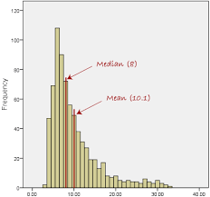
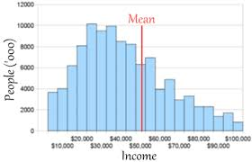
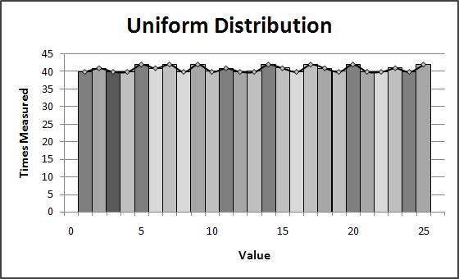
The Science of Map Making: Methods of Statistical Generalization

Slide 27
The Science of Map Making: Methods of Statistical Generalization
In mapping statistical data, the cartographer is always trying to strike a balance between remaining true to the underlying data distribution and generalizing the data sufficiently to reveal intrinsic spatial patterns.
The issues of statistical generalization can be applied to data for points, lines or areas.
This discussion will focus on the mapping of areas in choropleth maps.

Slide 28
The Science of Map Making: Methods of Statistical Generalization
Data Classification
Categories, Classes, Class Intervals, Data Ranges
  All refer to the same process of dividing the individual data values into discrete groups.
Number of Classes – How many distinct groups?
Several Common Classification Methods Exist
Ideally, The Classification Scheme should match the Data Distribution.
The choice of Classification can ALTER the appearance and interpretation of the map.

Slide 29
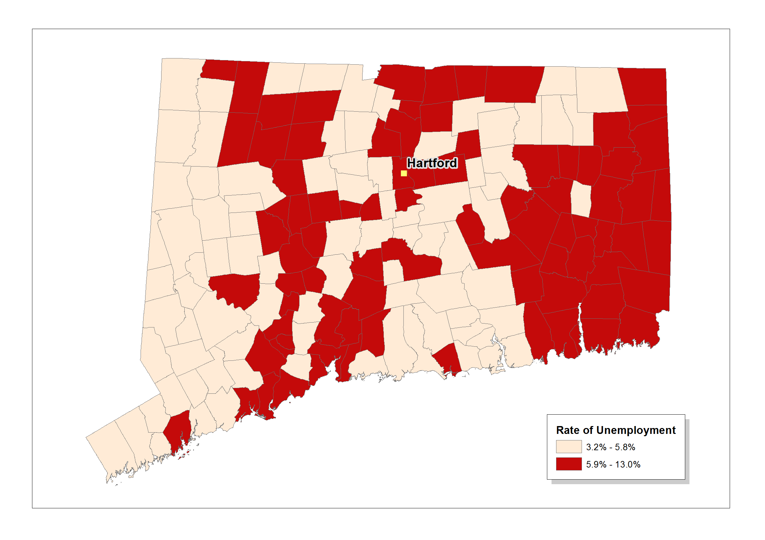
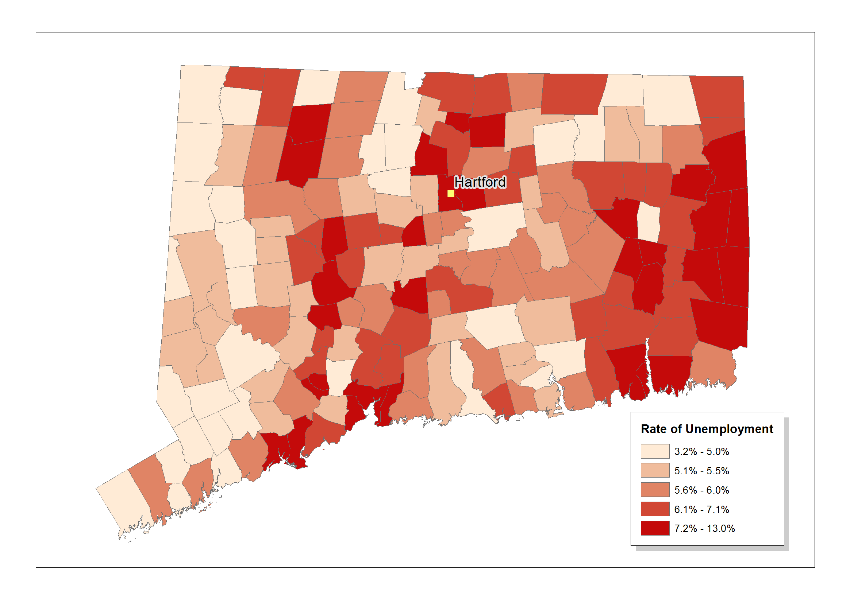
The Science of Map Making: Methods of Statistical Generalization
Comparison of maps using different numbers of categories
2 Classes
5 Classes

Slide 30
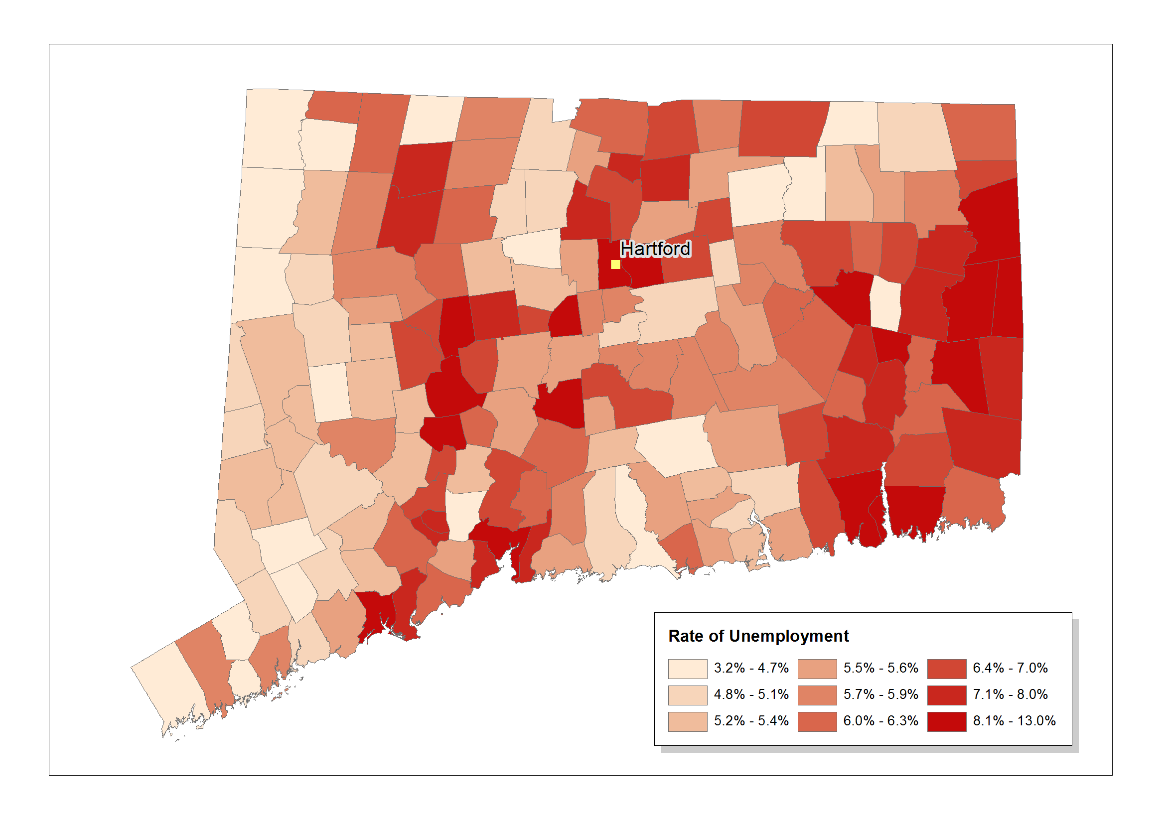
The Science of Map Making: Methods of Statistical Generalization
Comparison of maps using different numbers of categories (continued)
Nine (9)
Classes

Slide 31
The Science of Map Making: Methods of Statistical Generalization
How many Classes should a map have?
Depends on the sophistication of the Map User.
Is limited by people’s ability to distinguish differences.
Generally, maps have no more than seven (7) categories.
Too few and the map hides the underlying patterns.
Too many and the map is too complex to comprehend.

Slide 32
The Science of Map Making: Methods of Statistical Generalization
Common Classification Methods
Equal Intervals: The range (min..max) of data values are divided into classes of equal widths.
Quantiles: The data values are sorted into groups with the same number of cases. Ex: “Quartiles,” “Quintiles,” “Percentiles.”
Standard Deviations: Statistical divisions based on the mean and variance.
Natural Breaks: Manual or Algorithmic identifications of groupings inherent in the data distribution. Ex: “Jenks Method”
User-Defined: Classification based on pre-conceived or external factors.

Slide 33
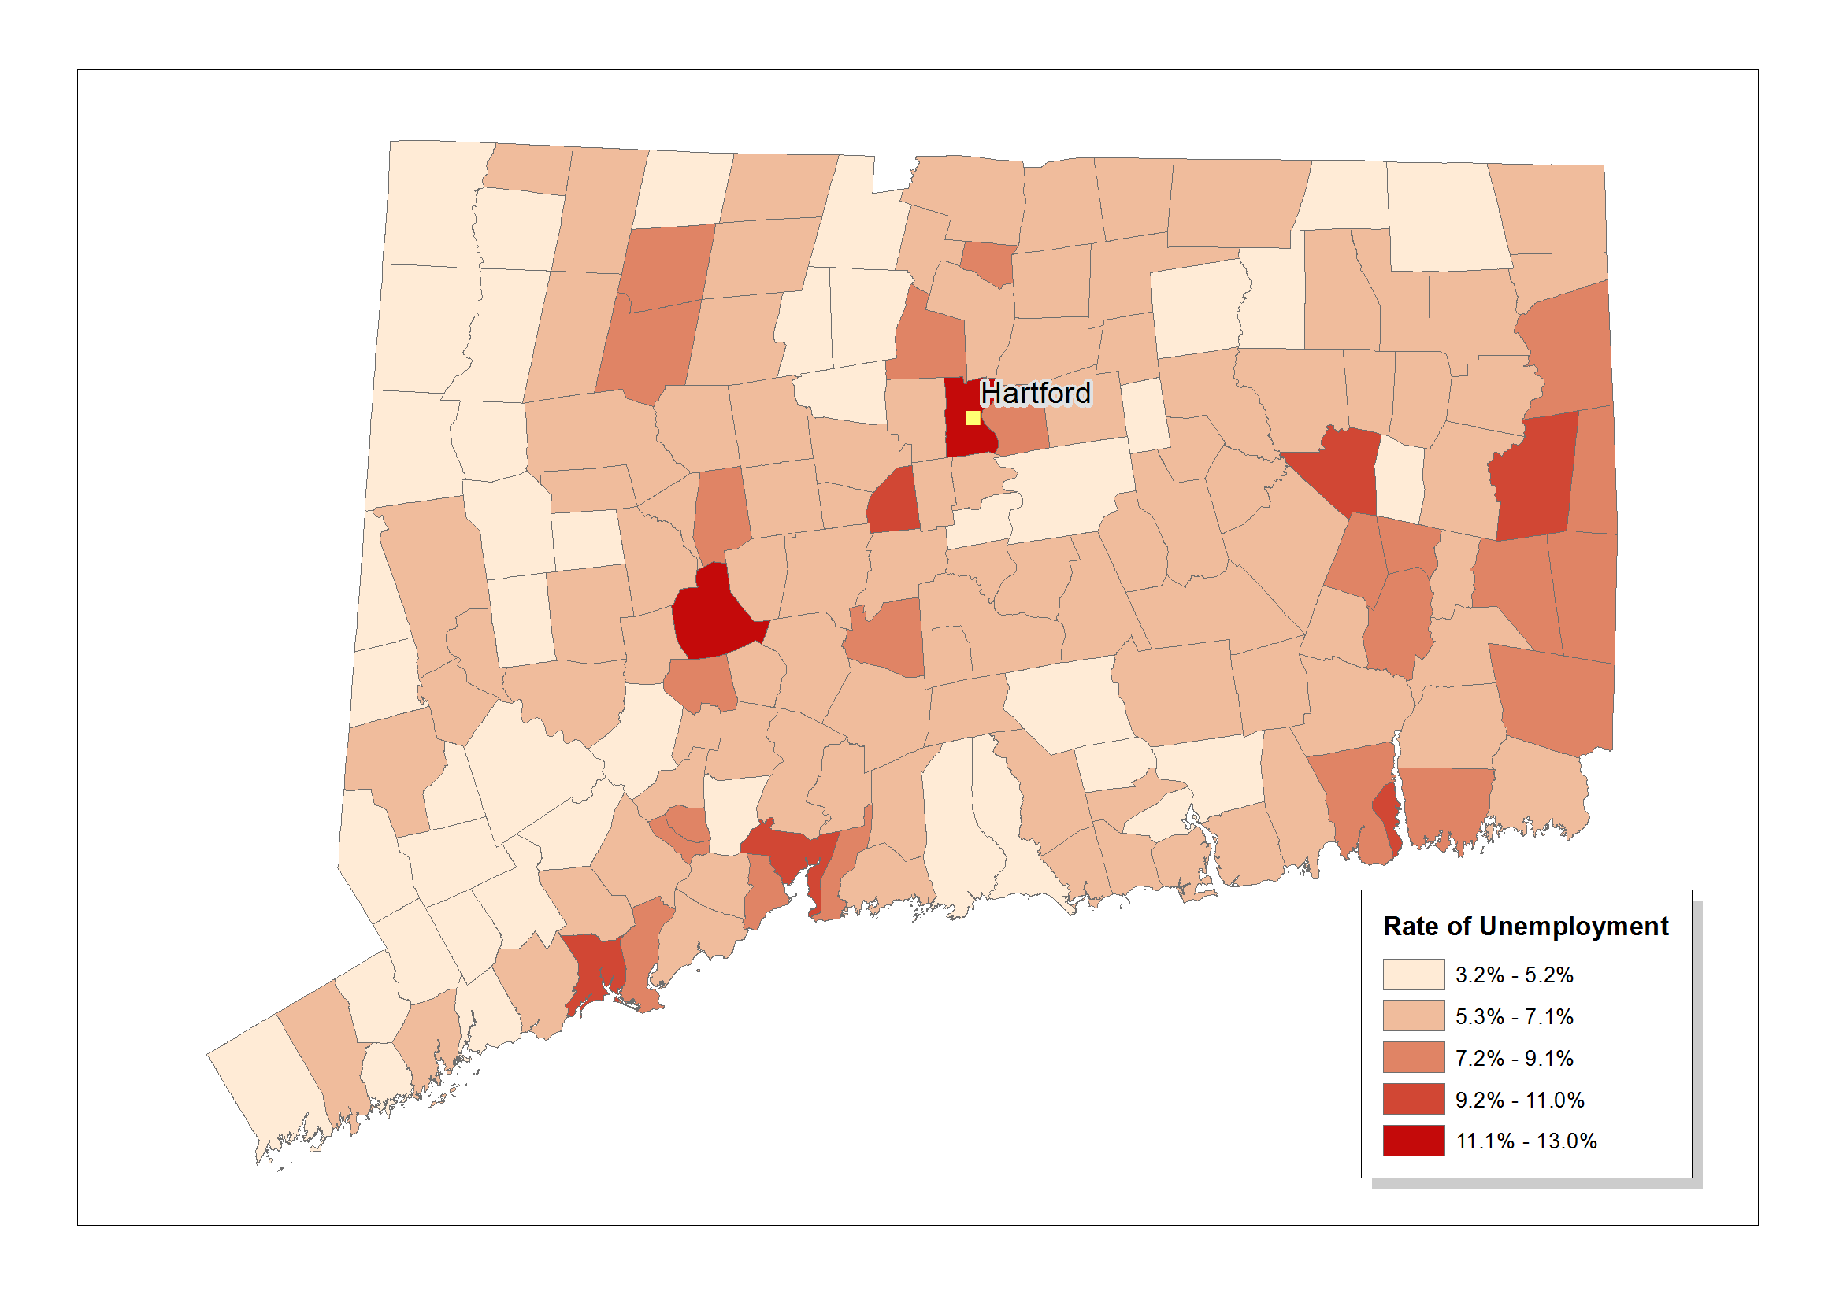
The Science of Map Making: Methods of Statistical Generalization
Common Classification Methods
Equal Intervals: The range (min/max) of data values are divided into classes of equal widths.
Quantiles: The data values are sorted into groups with the same number of cases.

Slide 34
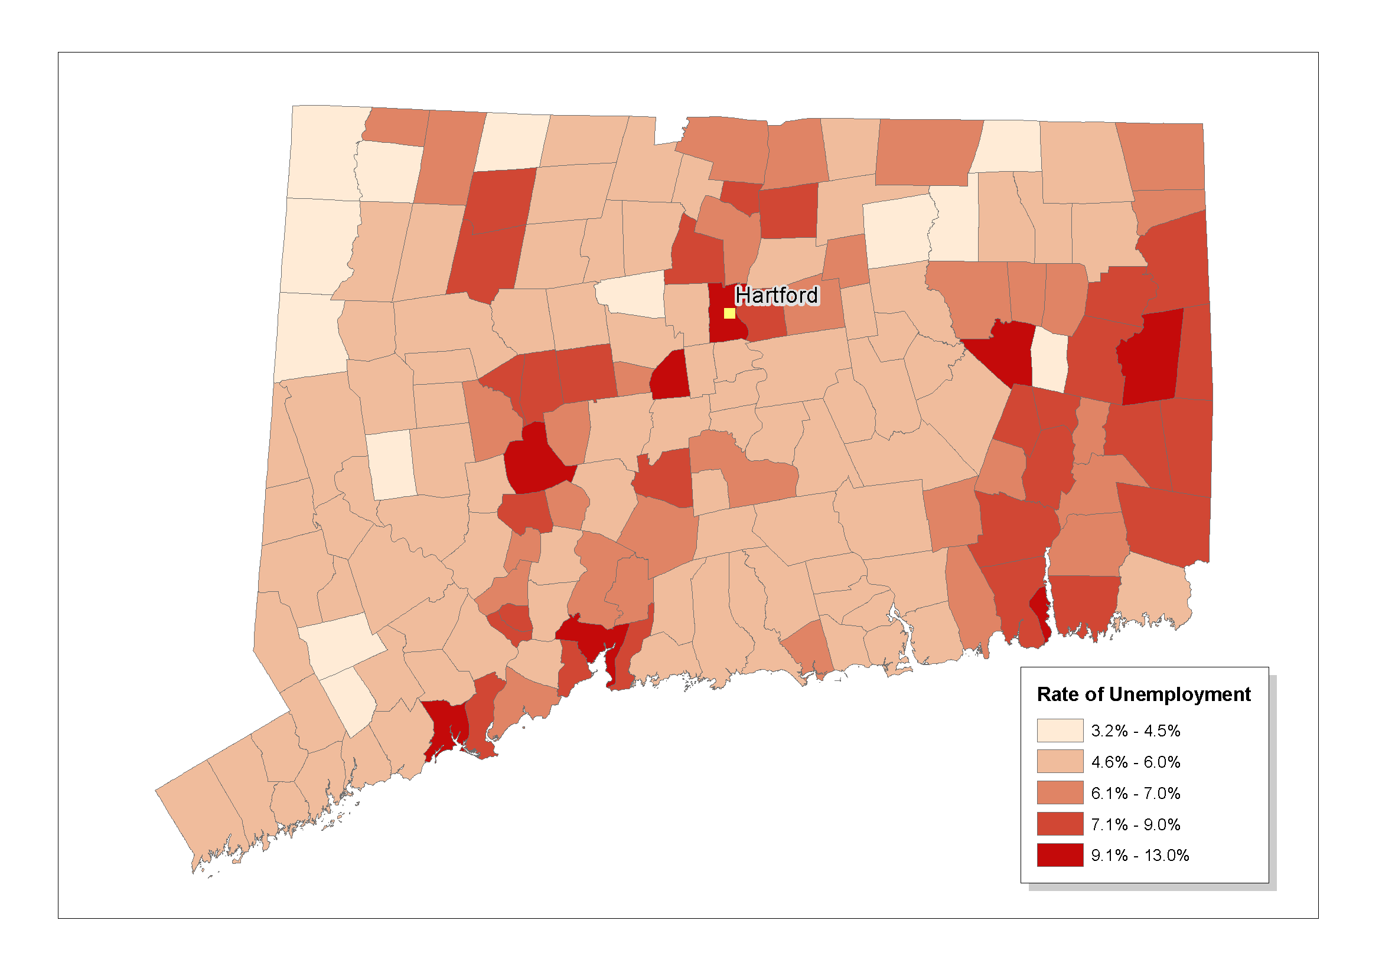
The Science of Map Making: Methods of Statistical Generalization
Common Classification Methods
User-Defined:
Classification based on pre-conceived or external factors.

Slide 35
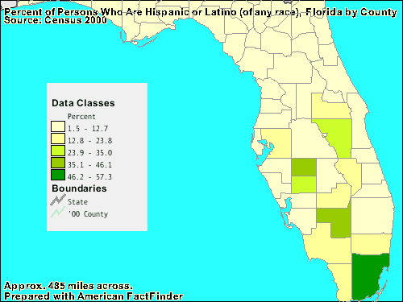
The Science of Map Making: Methods of Statistical Generalization
More on Visual-Interpretive Effects of Classification
Equal Intervals
Natural Breaks (Jenks Method)

Slide 36
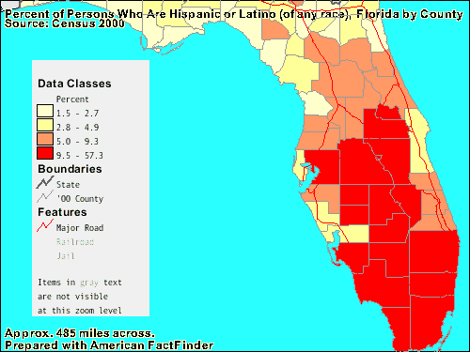
The Science of Map Making: Methods of Statistical Generalization
More on Visual-Interpretive Effects of Classification
Quartiles

Slide 37
NEXT:
ART: Visual Communication
and
Map Design

Slide 38


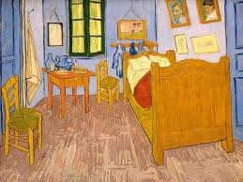
Art and Map Making

Slide 39




Art and Map Making

Slide 40
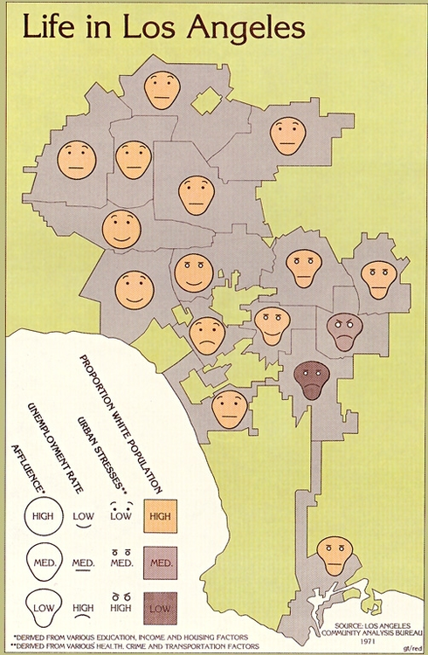
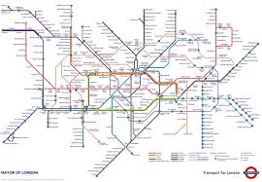
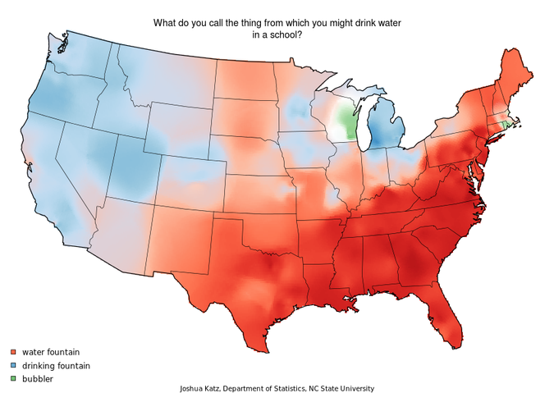
Art and Map Making

Slide 41
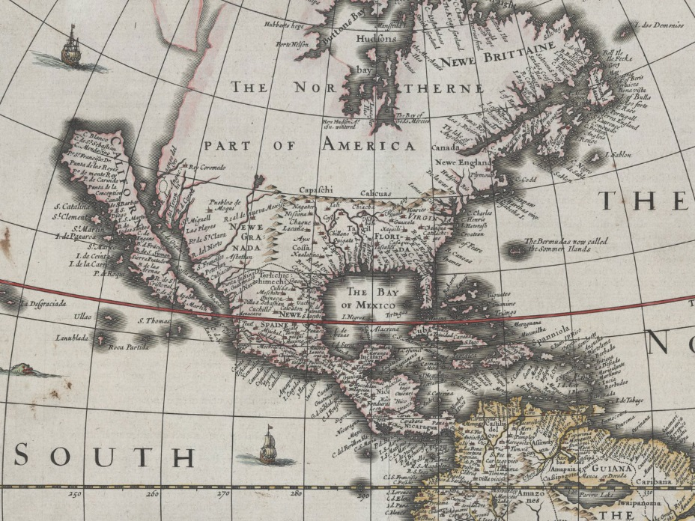
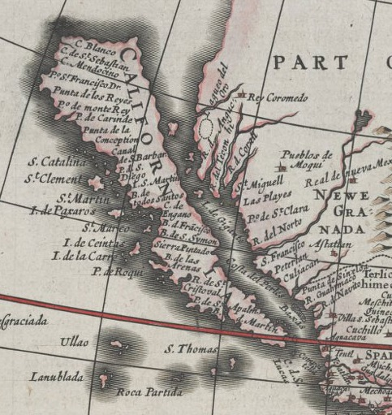
Art and Map Making

Slide 42
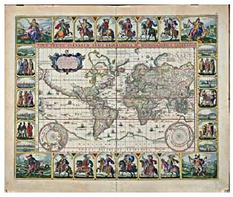
ART

Slide 43


Slide 44
ART: Best Practices
While we may not all be talented enough to produce stunning, creative map designs, we can all learn to follow established guide-lines and general “rules.”
When it comes to the composition and layout of a map, Science can inform Art. What works best – regardless of esthetics – can be established so that even the least “artistic” among us can make a useful and pleasant map.

Slide 45
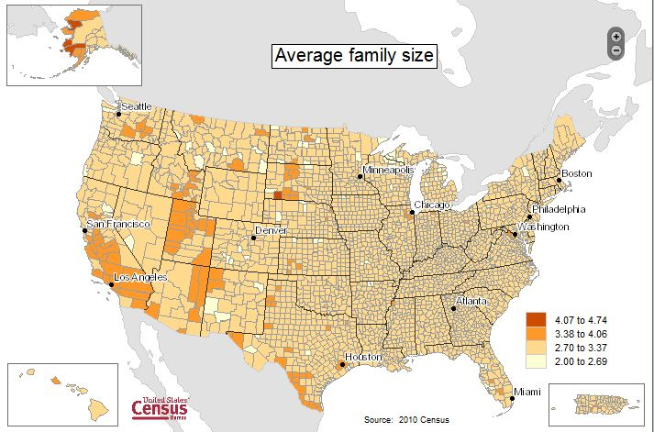
Map Making as Craft

Slide 46
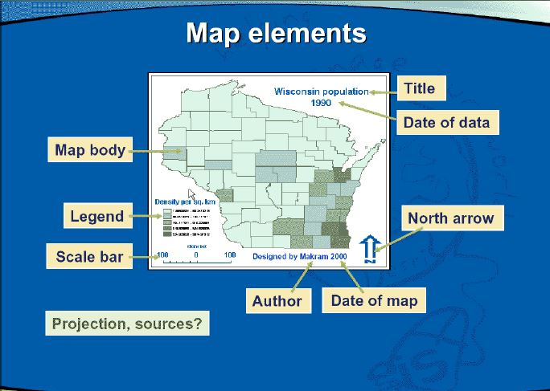
Map Composition and Design: Parts of the Map

Slide 47
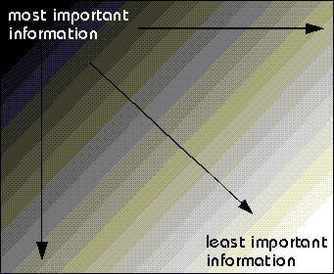
Map Composition and Design: Creating a Visual Hierarchy
Visual hierarchy is content organized in a manner that visually communicates order and importance.
Visual cues, such as size, position, arrangement and color, can be used to create visual hierarchy in a map.
Visual hierarchy creates a sense of depth on a flat map and enables quicker reading of the map for meaning and importance.

Slide 48
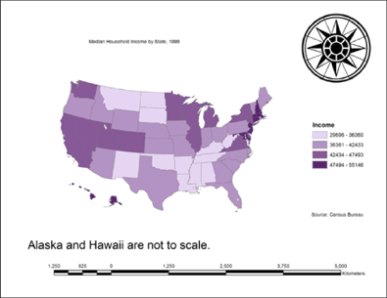
Map Composition and Design: Poor Visual Hierarchy

Slide 49
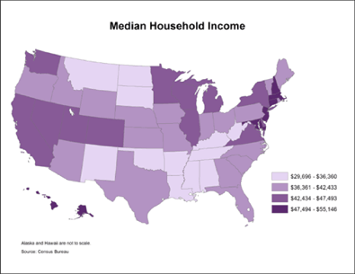
Map Composition and Design: Better Visual Hierarchy

Slide 50
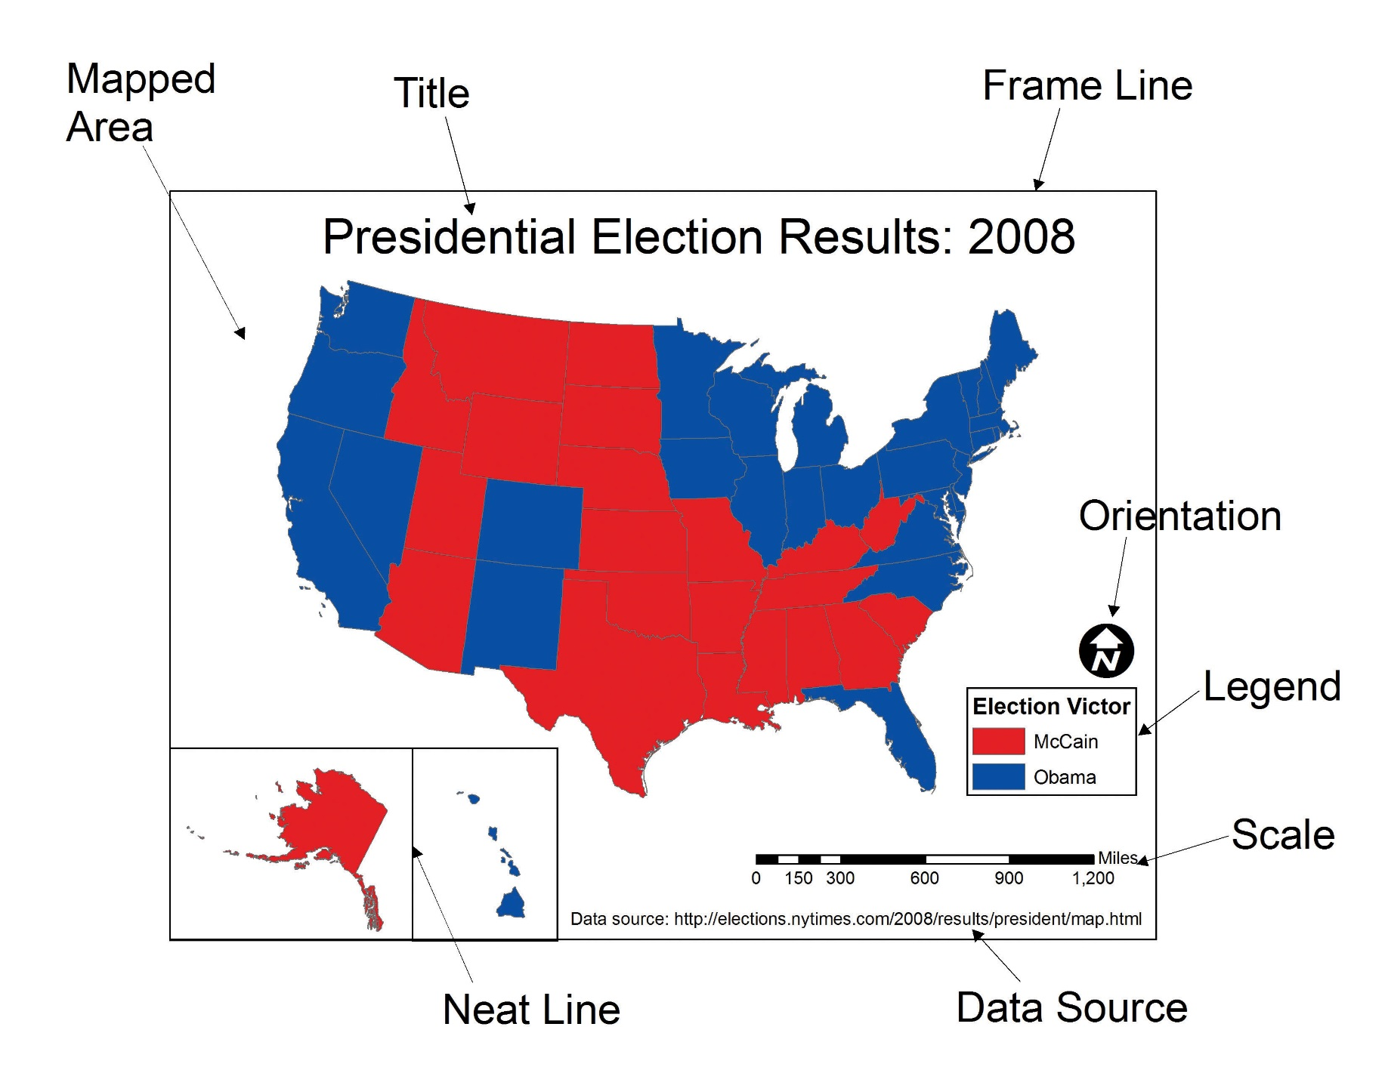
Map Composition and Design: Parts of the Map

Slide 51
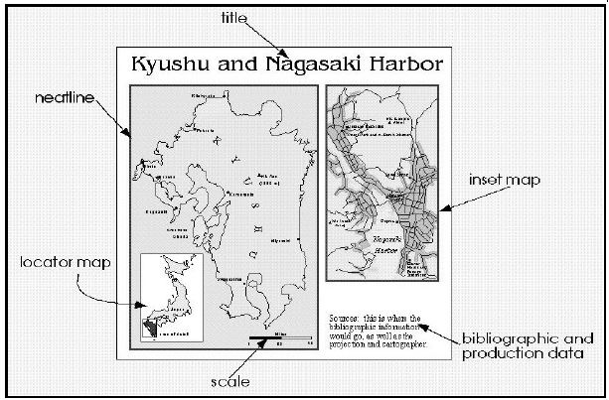
Map Composition and Design: Additional Parts of the Map

Slide 52
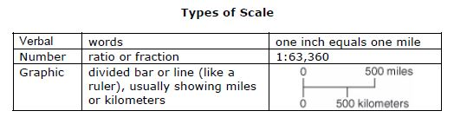
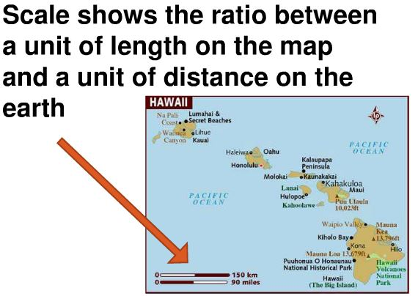
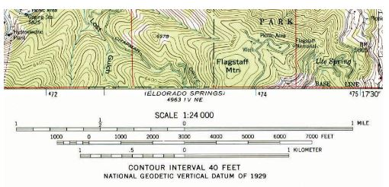
Map Composition and Design: SCALE

Slide 53
Map Composition and Design: Legend Size and Placement
It lists the symbols used on a map and what they depict.
It should fully and clearly identify symbols that require information.
Placement depends mostly on the shape of the mapped area.
It should not overwhelm the Map, but is high in the visual hierarchy.
Removing information related to base map features (state boundaries on a US map) or readily identifiable features (highway symbols) is one effective way to minimize legend size.

Slide 54




Map Composition and Design: LEGENDS

Slide 55



Map Composition and Design: Not so Good .. LEGENDS

Slide 56

Map Composition and Design: My Favorite LEGEND

Slide 57
Map Composition and Design: OTHER Map Components
Do I need a North Arrow?
    Most maps don’t require it.
    IF you need or use one, don’t get crazy!
Do I need to cite the source of the base map and data?
    In most cases, YES. Give credit where it’s due.
Do I have to specify the Projection?
    Depends. Sometimes you don’t know for sure.
    IF you choose a projection for a specific reason, then make a note it.
    [More on Map Projections and choosing one that is appropriate .. Later]
Do I need a Locator map or Inset Map?
    Only if the mapped area is not obvious, or if a certain part of the map needs “zooming in” to show detail.

Slide 58
Map Composition and Design: TITLE
  Most ALL Maps require a Title.
  It should clearly state the Theme of the map,
  The location of the mapped area (unless it is obvious or is part of a series of maps of the same place,)
  The Date of source information,
  Should convey the purpose of the map, and
  Should be tailored to the intended audience.

Slide 59


Slide 60
Map Composition and Design: TITLE and Text
The Position of the title on the page will vary according the size and shape of the mapped area, but in every case should be the most prominent text and with the largest lettering.
Other Text should be lower in the Visual Hierarchy in terms of placement and text size.
LABELS. Place names, Rivers, Roads, and other labels associated with features on the map should VARY according to their importance and within their own hierarchy. (Big cities get bigger type fonts, etc.)
Different Feature Classes may be distinguished by different fonts.

Slide 61
Good Visual Hierarchy

Slide 62


Different Features, Different Fonts
A B C -XYZ
A B C -XYZ

Slide 63

NEXT:
Technologies
Publication and Presentation – Design Considerations
Selecting an Appropriate Map Projection

Slide 64

Matching Purpose and Audience: Choosing a Projection
Imagine that we place a light bulb in the center of a translucent globe. On the globe are outlines of the continents and the lines of longitude and latitude called the graticule. When we turn the light bulb on, the outline of the continents and the graticule will be “projected” as shadows on the wall, ceiling, or any other nearby surface. This is what is meant by map “projection.”

Slide 65

Matching Purpose and Audience: Classes of Projections

Slide 66
Matching Purpose and Audience: Choosing a Projection
When moving from the three-dimensional surface of the earth to a two-dimensional plane, distortions are inevitable.
Map projections introduce distortions in distance, angles, shapes, and surface areas.
Depending on the purpose of the map, a series of trade-offs will need to be made with respect to such distortions.

Slide 67
Matching Purpose and Audience: Choosing a Projection
Projections that accurately represent distances are referred to as equidistant projections.
Note that distances are only correct in one direction, usually running north–south, and are not correct everywhere across the map.
Equidistant maps are frequently used for small-scale maps that cover large areas because they do a good job of preserving the shape of geographic features such as continents.

Slide 68


Platte Carree
Miller’s Cylindrical
Equidistant Projections

Slide 69
Matching Purpose and Audience: Choosing a Projection
Maps that represent angles between locations, also referred to as bearings, are called conformal.
Conformal map projections are used for navigational purposes due to the importance of maintaining a bearing or heading when traveling great distances.
The cost of preserving bearings is that areas tend to be quite distorted in conformal map projections. The Mercator projection is an example of a conformal projection and is famous for distorting Greenland.

Slide 70

Matching Purpose and Audience: Choosing a Projection
Mercator Projection
Shapes are preserved over the map, but sizes are distorted.
To Preserve Shape, you need a conformal projection.

Slide 71

Matching Purpose and Audience: Choosing a Projection
Equal area or equivalent projections preserve the quality of area.
Such projections are of particular use when accurate measures or comparisons of geographical distributions are necessary.
In order to maintain true proportions in the surface of the earth, features sometimes become compressed or stretched depending on the orientation of the projection. Moreover, such projections distort distances as well as angular relationships.

Slide 72

Matching Purpose and Audience: Choosing a Projection

Slide 73

Matching Purpose and Audience: Choosing a Projection
Alber’s Polyconic Equal Area Projection

Slide 74
Matching Purpose and Audience: Choosing a Projection
What is the size of the AREA to be mapped?
  World
  Continent
  Country
  Local Area
What is the THEME to be mapped?
  Is presenting comparable Areas important?
  Are distance measurements from the map necessary?
  Do you want to show Great Circle paths?
  Is N-S-E-W directions meaningful?
  Does showing the actual Shape of an area make a difference?
What unique views or perspectives would enhance understanding?

Slide 75


Slide 76






Publication and Presentation – Design Considerations
Media and Hardware Special Adaptations
Size and Resolution – TV, Web, Print media
Color Capabilities – Pen Plotter, Matrix Printer, CRT, Laser Printer

Slide 77
Map Making Technologies
Integration of other Geospatial Technologies
  GPS
  Satellite Imagery
  LIDAR and other Hi-Res Platforms
  Digital Map Products and Orthophotos

Slide 78







Geospatial Technologies

Slide 79

Good Mapping!

Slide 80
Extra Maps

Slide 81

What can we learn from Bad Maps?

Slide 82

What can we learn from Bad Maps?

Slide 83

What can we learn from Bad Maps?

Slide 84

What can we learn from Bad Maps?

